Slide 1
Chapter 9 Relations 关系

Slide 2
Chapter Summary
Relations and Their Properties
Representing Relations
Equivalence Relations
Partial Orderings

Slide 3
Relations and Their Properties 【关系及其性质】
Section 9.1

Slide 4
Section Summary
Relations and Functions
Properties of Relations
Reflexive Relations
Symmetric and Antisymmetric Relations
Transitive Relations
Combining Relations

Slide 5
What are relations?
Relations are a formal means to specify which elements from two or more sets are related to each other
Examples
{students} who take {courses}
{businesses} and their {telephone numbers}
{integers} and their {divisors}
{program variables} and the {subroutines} they are used in.

Slide 6
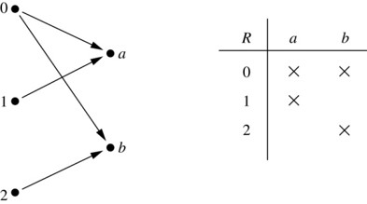
Binary Relations 二元关系
Definition: A binary relation R from a set A to a set B is a subset
Example:
Let A = {0,1,2} and B = {a,b}
{(0, a), (0, b), (1,a) , (2, b)} is a relation from A to B.
We can represent relations from a set A to a set B graphically or using a table:
Relations are more general than functions. A function is a relation where exactly one element of B is related to each element of A.

Slide 7
Binary Relations on a Set 集合上的二元关系
Definition: A binary relation R on a set A is a subset of A × A or a relation from A to A.
Example:
Suppose that A = {a,b,c}. Then R = {(a,a),(a,b),(a,c)} is a relation on A.
Let A = {1, 2, 3, 4}. The ordered pairs in the relation R = {(a,b) | a divides b} are (1,1), (1, 2), (1,3), (1, 4), (2, 2), (2, 4), (3, 3) and (4, 4).

Slide 8
Binary Relations on a Set 集合上的二元关系
题目： A ={1,2}上的所有二元关系有哪些？一共有多少？
解：| A |=2， A × A = {<1,1>,<1,2>,<2,1>,<2,2>}, A 上的二元关系有 |P(AxA)|=2^{2*2}=16种：
∅ , {<1,1>}，{<1,2>}, {<2,1>}, {<2,2>}, {<1,1>,<1,2>}, {<1,1>,<2,1>}, {<1,1>,<2,2>}, {<1,2>,<2,1>}, {<1,2>,<2,2>}, {<2,1>,<2,2>},
{<1,1>,<1,2>,<2,1>},{<1,1>,<1,2>,<2,2>}, {<1,1>,<2,1>,<2,2>}, {<1,2>,<2,1>,<2,2>},
{<1,1>,<1,2>,<2,1>,<2,2>}.

Slide 9
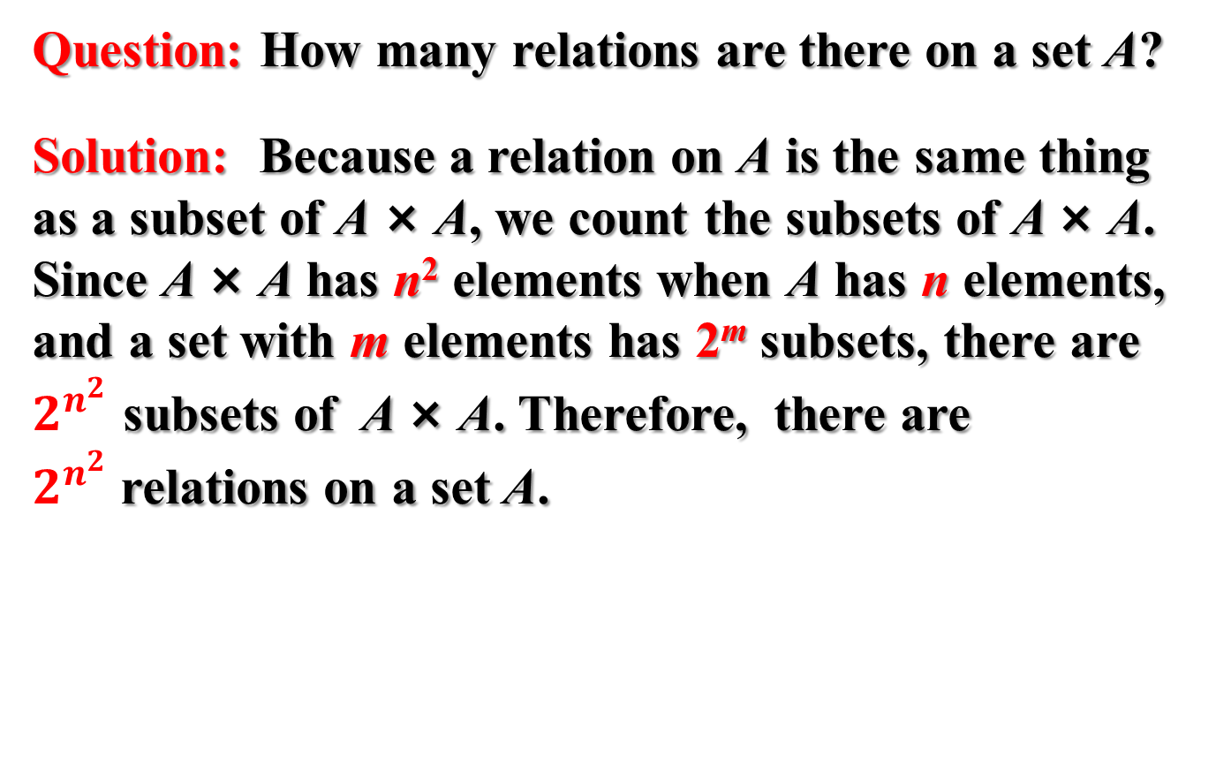
Binary Relations on a Set 集合上的二元关系
Question: How many relations are there on a set A?
Solution: Because a relation on A is the same thing as a subset of A × A, we count the subsets of A × A. Since A × A has n² elements when A has n elements, and a set with m elements has 2^{m} subsets, there are $2^{n^{2}}$ subsets of A × A. Therefore, there are $2^{n^{2}}$relations on a set A.

Slide 10
Binary Relations on a Set 集合上的二元关系
Example: Consider these relations on the set of integers:
Which of these relations contain each of the pairs
(1,1), (1, 2), (2, 1), (1, −1), and (2, 2)?
Solution: Checking the conditions that define each relation, we see that the pair (1,1) is in R₁, R₃, R₄ , and R₆; (1,2) is in R₁ and R₆; (2,1) is in R₂, R₅, and R₆; (1, −1) is in R₂, R₃, and R₆ ; (2,2) is in R₁, R₃, and R₄.

Slide 11

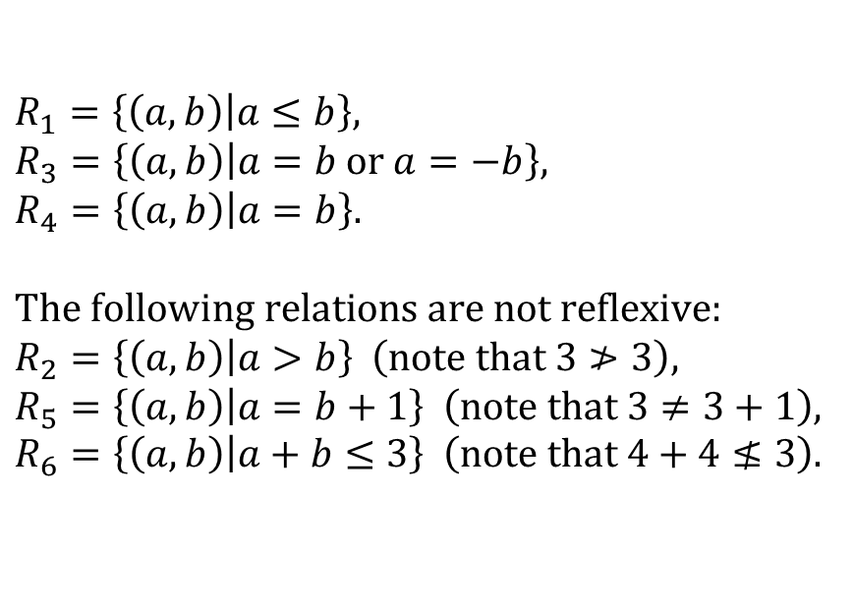
Reflexive Relations 自反性
Definition: R is reflexive (自反的) iff (a,a) ∊ R for every element a ∊ A. Written symbolically, R is reflexive if and only if
$$∀x\left[x∈A→\left(x,x\right)∈R\right]$$
Example: The following relations on the integers are reflexive:
$$R_{1}=\left\{\left.\left(a,b\right)\right|a≤b\right\}, \\ R_{3}=\left\{\left.\left(a,b\right)\right|a=b \text{or} a=−b\right\}, \\ R_{4}=\left\{\left.\left(a,b\right)\right|a=b\right\}.$$
$$\text{The} \text{following} \text{relations} \text{are} \text{not} \text{reflexive}\text{:} \\ R_{2}=\left\{\left.\left(a,b\right)\right|a>b\right\} \left(\text{note} \text{that} 3≯3\right), \\ R_{5}=\left\{\left.\left(a,b\right)\right|a=b+1\right\} \left(\text{note} \text{that} 3≠3+1\right), \\ R_{6}=\left\{\left.\left(a,b\right)\right|a+b≤3\right\} \left(\text{note} \text{that} 4+4≰3\right).$$
If A = ∅ then the empty relation is reflexive vacuously. That is the empty relation on an empty set is reflexive! 【空集】

Slide 12
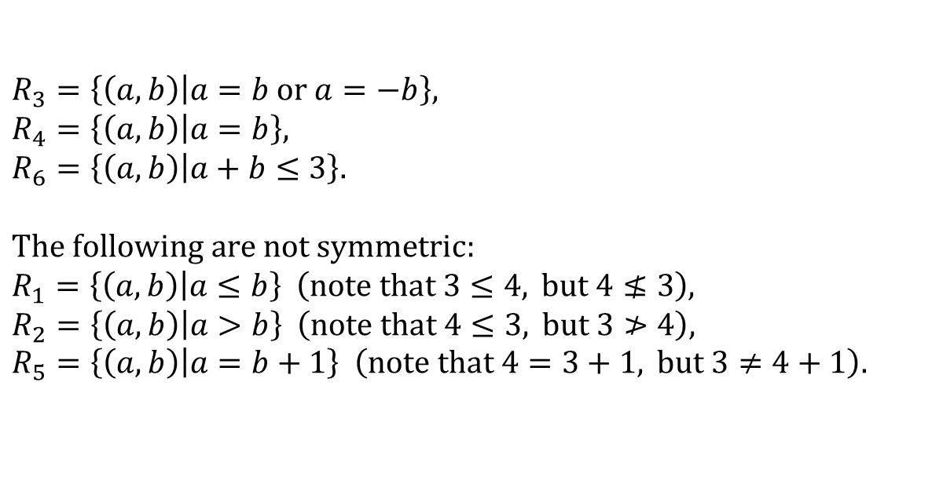
Symmetric Relations 对称性
Definition: R is symmetric (对称的) iff (b,a) ∊ R whenever (a,b) ∊ R for all a,b ∊ A. Written symbolically, R is symmetric if and only if
Example: The following relations on the integers are symmetric:
$$R_{3}=\left\{\left.\left(a,b\right)\right|a=b \text{or} a=−b\right\}, \\ R_{4}=\left\{\left.\left(a,b\right)\right|a=b\right\}, \\ R_{6}=\left\{\left.\left(a,b\right)\right|a+b≤3\right\}.$$
$$\text{The} \text{following} \text{are} \text{not} \text{symmetric}\text{:} \\ R_{1}=\left\{\left.\left(a,b\right)\right|a≤b\right\} \left(\text{note} \text{that} 3≤4, \text{but} 4≰3\right), \\ R_{2}=\left\{\left.\left(a,b\right)\right|a>b\right\} \left(\text{note} \text{that} 4≤3, \text{but} 3≯4\right), \\ R_{5}=\left\{\left.\left(a,b\right)\right|a=b+1\right\} \left(\text{note} \text{that} 4=3+1, \text{but} 3≠4+1\right).$$

Slide 13
Antisymmetric Relations 反对称性
Definition: A relation R on a set A such that for all a,b ∊ A if (a,b) ∊ R and (b,a) ∊ R, then a = b is called antisymmetric (反对称的). Written symbolically, R is antisymmetric if and only if
Example: The following relations on the integers are antisymmetric:
For any integer, if a a ≤ b and b ≤ a, then a = b.

Slide 14

Transitive Relations 传递性
Definition: A relation R on a set A is called transitive (传递的) if whenever (a, b) ∊ R and (b, c) ∊ R, then (a, c) ∊ R, for all a,b,c ∊ A. Written symbolically, R is transitive if and only if
$$∀x∀y∀z\left[\left(x,y\right)∈R∧\left(y,z\right)∈R→\left(x,z\right)∈R\right]$$
Example: The following relations on the integers are transitive:
$$R_{1}=\left\{\left.\left(a,b\right)\right|a≤b\right\}, \\ R_{2}=\left\{\left.\left(a,b\right)\right|a>b\right\}, \\ R_{3}=\left\{\left.\left(a,b\right)\right|a=b \text{or} a=−b\right\}, \\ R_{4}=\left\{\left.\left(a,b\right)\right|a=b\right\}. \\ \text{The} \text{following} \text{are} \text{not} \text{transitive}\text{:} \\ R_{5}=\left\{\left.\left(a,b\right)\right|a=b+1\right\} \left(\text{note} \text{that} \text{both} \left(4,3\right) \text{and} \left(3,2\right) \text{belongs} \text{to} R_{5}, \text{but} \text{not}\left(4,2\right)\right), \\ R_{6}=\left\{\left.\left(a,b\right)\right|a+b≤3\right\} \left(\text{note} \text{that} \text{both} \left(2,1\right) \text{and} \left(1,2\right) \text{belongs} \text{to} R_{6}, \text{but} \text{not} \left(2,2\right)\right).$$
For every integer, a ≤ b and b ≤ c, then b ≤ c.

Slide 15
Combining Relations 关系的组合
Given two relations R₁ and R₂, we can combine them using basic set operations to form new relations such as R₁ ∪ R₂, R₁ ∩ R₂, R₁ − R₂, and R₂ − R₁.
Example: Let A = {1,2,3} and B = {1,2,3,4}. The relations R₁ = {(1,1),(2,2),(3,3)} and R₂ = {(1,1),(1,2),(1,3),(1,4)} can be combined using basic set operations to form new relations:

Slide 16
Composition 合成
Definition: Suppose
R₁ is a relation from a set A to a set B.
R₂ is a relation from B to a set C.
Then the composition (or composite) of R₂ with R₁, is a relation from A to C where
if (x, y) is a member of R₁ and (y, z) is a member of R₂, then (x, z) is a member of R₂∘ R₁.

Slide 17
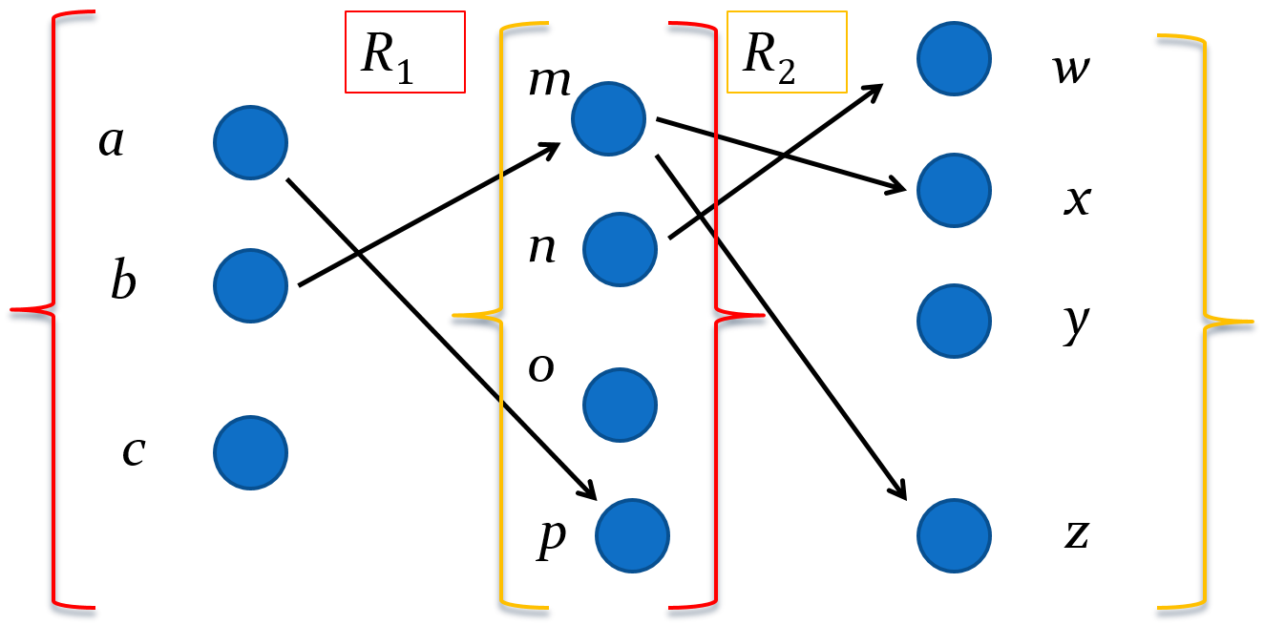
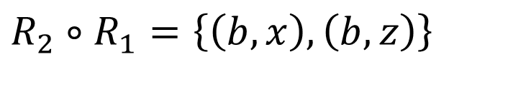
Representing the Composition of Relations 关系的合成
$$R_{2}∘R_{1}=\left\{\left(b,x\right),\left(b,z\right)\right\}$$

Slide 18
Powers of a Relation 关系的幂
Definition: Let R be a binary relation on A. Then the powers R^{n} of the relation R can be defined inductively by:
Basis Step: R¹ = R
Inductive Step: R^{n+1} = R^{n} ∘ R
The powers of a transitive relation are subsets of the relation. This is established by the following theorem:
Theorem 1: The relation R on a set A is transitive iff R^{n} ⊆ R for n = 1,2,3 ….
18

Slide 19
Representing Relations 【关系的表示】
Section 9.3

Slide 20
Section Summary
Representing Relations using Matrices
Representing Relations using Digraphs

Slide 21

Representing Relations Using Matrices 关系的矩阵表示
A relation between finite sets can be represented using a zero-one matrix (0-1矩阵). Suppose R is a relation from A = {a₁, a₂, …, a_{m}} to B = {b₁, b₂, …, b_{n}}.The relation R is represented by the matrix M_{R} = [m_{ij}], where
$$m_{ij}=\left\{\begin{matrix}1 \text{if} \left(a_{i}, b_{j}\right)∈R, \\ 0 \text{if} \left(a_{i}, b_{j}\right)∉R.\end{matrix}\right.$$

Slide 22
Examples of Representing Relations Using Matrices
Example 1: Suppose that A = {1,2,3} and B = {1,2}. Let R be the relation from A to B containing (a,b) if a ∈ A, b ∈ B, and a > b. What is the matrix representing R (assuming the ordering of elements is the same as the increasing numerical order)?
Solution: Because R = {(2,1), (3,1),(3,2)}, the matrix is

Slide 23
Examples of Representing Relations Using Matrices
Example 2: Let A = {a₁,a₂, a₃} and B = {b₁,b₂, b₃,b₄, b₅}. Which ordered pairs are in the relation R represented by the matrix
Solution: Because R consists of those ordered pairs (a_{i},b_{j}) with m_{ij} = 1, it follows that:

Slide 24
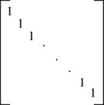
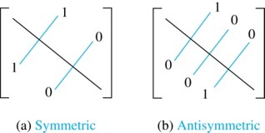
Matrices of Relations on Sets
If R is a reflexive relation (自反关系) , all the elements on the main diagonal of M_{R} are equal to 1.
R is a symmetric relation (对称关系), if and only if m_{ij} = 1 whenever m_{ji} = 1. R is an antisymmetric relation (反对称关系), if and only if m_{ij} = 0 or m_{ji} = 0 when i≠ j.

Slide 25
Example of a Relation on a Set
Example 3: Suppose that the relation R on a set is represented by the matrix
Is R reflexive, symmetric, and/or antisymmetric?

Slide 26
Section Summary
Representing Relations using Matrices
Representing Relations using Digraphs

Slide 27
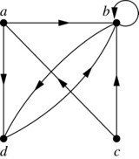
Representing Relations Using Digraphs 关系的图表示
Definition: A directed graph (有向图), or digraph, consists of a set V of vertices (or nodes, 顶点) together with a set E of ordered pairs of elements of V called edges (or arcs, 边). The vertex a is called the initial vertex (起点) of the edge (a,b), and the vertex b is called the terminal vertex (终点) of this edge.
An edge of the form (a,a) is called a loop (环).
Example 7: A drawing of the directed graph with vertices a, b, c, and d, and edges (a, b), (a, d), (b, b), (b, d), (c, a), (c, b), and (d, b) is shown here.

Slide 28
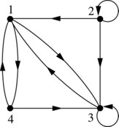
Examples of Digraphs Representing Relations
Definition: The relation R on a set A is represented by the directed graph that has the elements of A as its vertices and the ordered pairs (a, b), where (a, b) ∈ R, as edges.
Example 8: What are the ordered pairs in the relation represented by this directed graph?
Solution: The ordered pairs in the relation are (1, 3), (1, 4), (2, 1), (2, 2), (2, 3), (3, 1), (3, 3), (4, 1), and (4, 3)

Slide 29
Determining which Properties a Relation has from its Digraph
Reflexivity: A loop must be present at all vertices in the graph.
Symmetry: If (x,y) is an edge, then so is (y,x).
Antisymmetry: If (x,y) with x ≠ y is an edge, then (y,x) is not an edge.
Transitivity: If (x,y) and (y,z) are edges, then so is (x,z).

Slide 30
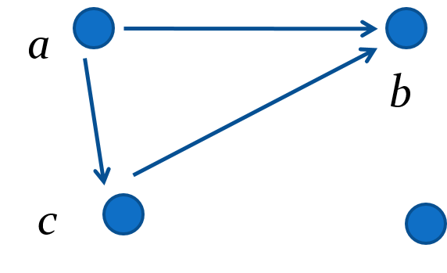
Determining which Properties a Relation has from its Digraph – Example 1
Reflexive? No, there are no loops
Symmetric? No, for example, there is no edge from c to a
Antisymmetric? Yes, whenever there is an edge from one vertex to another, there is not one going back
Transitive? Yes.

Slide 31
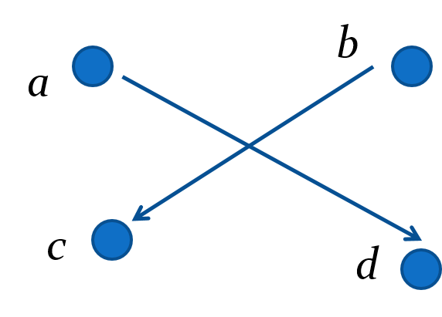
Determining which Properties a Relation has from its Digraph – Example 2
Reflexive? No, there are no loops
Symmetric? No, for example, there is no edge from d to a
Antisymmetric? Yes, whenever there is an edge from one vertex to another, there is not one going back
Transitive? Yes (trivially), there are no two edges where the first edge ends at the vertex where the second edge begins

Slide 32
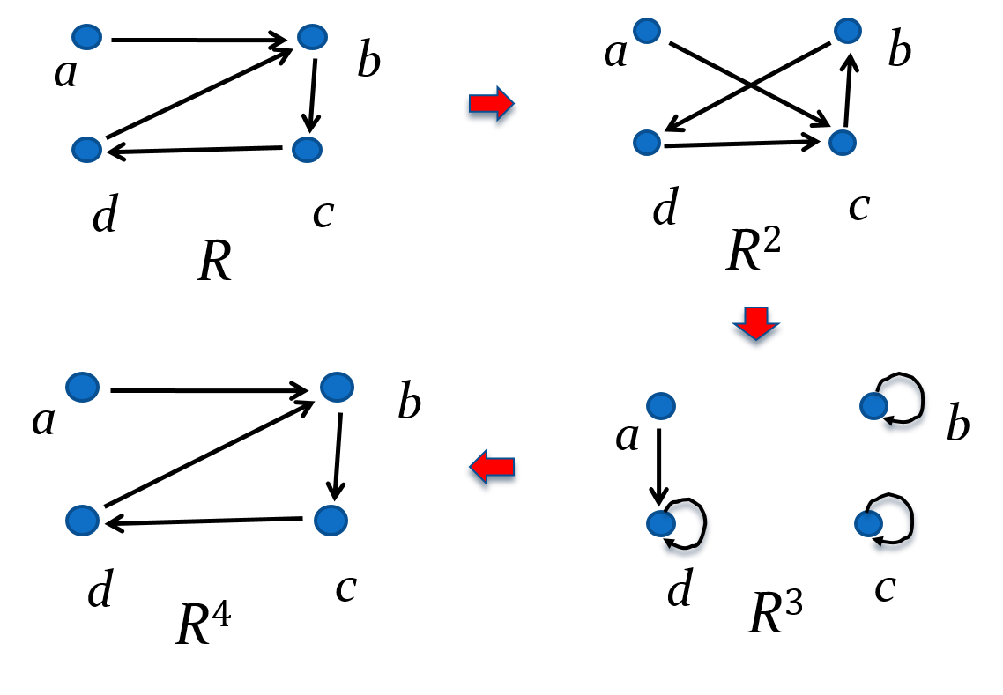
Example of the Powers of a Relation
The pair (x,y) is in R^{n} if there is a path of length n from x to y in R (following the direction of the arrows).

Slide 33
Example of the Powers of a Relation
a
b
c
d
a
b
c
d
R⁰
R=R¹
a
b
c
d
a
b
c
d
R²=R⁴
R³=R⁵

Slide 34
Example of the Powers of a Relation
a
b
c
d
a
b
c
d
R⁰
R=R¹
a
b
c
d
a
b
c
d
R²=R⁴
R³=R⁵

Slide 35
Closures of Relations 【关系的闭包】
Section 9.4

Slide 36
Closures of Relations
定义
设 R 为非空集合 A 上的关系, R 的自反 （对称或传递）闭包是 A 上的关系 R′, 使得 R′ 满足以下条件：
1) R′是自反的（对称的或传递的）; 2) R ⊆ R′; 3) 对 A 上任何包含 R 的自反（对称或传递）关系
R′′ 有 R′ ⊆ R′′.
一般将 R 的自反闭包记作 r(R), 对称闭包记作 s(R), 传递闭包记作 t(R).

Slide 37
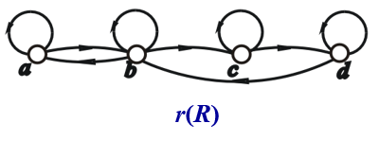
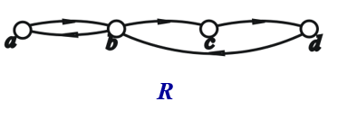
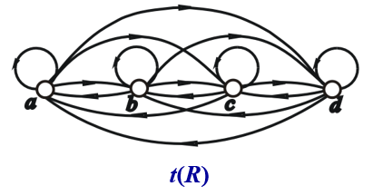
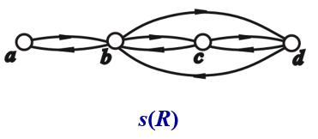
Closures of Relations
例如: 设A = {a, b, c, d}, R = {<a, b>, <b, a>, <b, c>, <c, d>, <d,b>}, R 和 r(R), s(R), t(R)的关系图如下图所示.

Slide 38
Closures of Relations
定义
设 R 为非空集合 A 上的关系, 则有
r(R) = R∪R⁰;
s(R) = R∪R⁻¹;
t(R) = R∪R²∪R³∪….
说明
对于有穷集合A (|A| = n), 3)中的并最多不超过 R^{n}.
若R是自反的, 则 r(R)=R; 若R是对称的, 则s(R)=R;
若R是传递的, 则 t(R)=R.

Slide 39
Closures of Relations
关系矩阵
关系R, r(R), s(R), t(R)分别对应M, M_{r}, M_{s} 和 M_{t} , 则
1) M_{r} = M + E
2) M_{s} = M + M^{T}
3) M_{t} = M + M² + M³ + …
上式中：
E 是和 M 同阶的单位矩阵;
M^{T}是 M 的转置矩阵;
矩阵的元素相加时使用逻辑加.
传递闭包：Warshall算法

Slide 40
Closures of Relations
关系图
关系 R, r(R), s(R), t(R)的关系图记为G, G_{r}, G_{s}, G_{t} , 则 G_{r} ,
G_{s}, G_{t} 的顶点集与 G 的顶点集相等. 除了G 的边以外：
1) 考察 G 的每个顶点, 如果没有环就加上一个环，最终
得到 G_{r} .
2) 考察G的每条边, 如果有一条 x_{i} 到 x_{j} 的单向边, 且i ≠ j,
则在 G 中加一条 x_{j} 到 x_{i} 的反方向边，最终得到G_{s}.
3)考察G的每个顶点 x_{i}, 找从 x_{i} 出发的每一条路径, 如果
从 x_{i} 到路径中任何结点 x_{j} 没有边，就加上这条边.当
检查完所有的顶点后就得到图G_{t} .

Slide 41
Equivalence Relations 【等价关系】
Section 9.5

Slide 42
Section Summary
Equivalence Relations
Equivalence Classes
Equivalence Classes and Partitions

Slide 43
Equivalence Relations 【等价关系】
Definition 1: A relation on a set A is called an equivalence relation 【等价关系】if it is reflexive【自反】, symmetric【对称】, and transitive【传递】.
Definition 2: Two elements a, and b that are related by an equivalence relation are called equivalent. The notation a ∼ b is often used to denote that a and b are equivalent elements with respect to a particular equivalence relation.

Slide 44
Strings
Example: Suppose that R is the relation on the set of strings of English letters such that aRb if and only if l(a) = l(b), where l(x) is the length of the string x. Is R an equivalence relation?
Solution: Show that all of the properties of an equivalence relation hold.
Reflexivity: Because l(a) = l(a), it follows that aRa for all strings a.
Symmetry: Suppose that aRb. Since l(a) = l(b), l(b) = l(a) also holds and bRa.
Transitivity: Suppose that aRb and bRc. Since l(a) = l(b),and l(b) = l(c), l(a) = l(c) also holds and aRc.

Slide 45
Divides
Example: Show that the “divides” relation on the set of positive integers is not an equivalence relation.
Solution: The properties of reflexivity, and transitivity do hold, but there relation is not transitive. Hence, “divides” is not an equivalence relation.
Reflexivity: a ∣ a for all a.
Not Symmetric: For example, 2 ∣ 4, but 4 ∤ 2. Hence, the relation is not symmetric.
Transitivity: Suppose that a divides b and b divides c. Then there are positive integers k and l such that b = ak and c = bl. Hence, c = a(kl), so a divides c. Therefore, the relation is transitive.

Slide 46
Congruence Modulo m 模m同余
Example: Let m be an integer with m > 1. Show that the relation R = {(a,b) | a ≡ b (mod m)} is an equivalence relation on the set of integers.
Solution: Recall that a ≡ b (mod m) if and only if m divides a − b.
Reflexivity: a ≡ a (mod m) since a − a = 0 is divisible by m since 0 = 0 ∙ m.
Symmetry: Suppose that a ≡ b (mod m). Then a − b is divisible by m, and so a − b = km, where k is an integer. It follows that b − a = (− k) m, so b ≡ a (mod m).
Transitivity: Suppose that a ≡ b (mod m) and b ≡ c (mod m). Then m divides both a − b and b − c. Hence, there are integers k and l with a − b = km and b − c = lm. We obtain by adding the equations: a − c = (a − b) + (b − c) = km + lm = (k + l) m.
Therefore, a ≡ c (mod m).

Slide 47
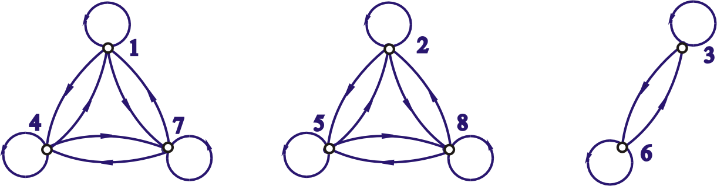
Congruence Modulo m 模m同余
Example: Let m be an integer with m > 1. Let A = {1, 2, ... , 8 }, show that the relation R = {(x, y) | x, y∈A ∧ x ≡ y (mod 3)} is an equivalence relation on the set of integers.

Slide 48
Equivalence Classes 等价类
Definition 3: Let R be an equivalence relation on a set A. The set of all elements that are related to an element a of A is called the equivalence class of a. The equivalence class of a with respect to R is denoted by [a]_{R}.
When only one relation is under consideration, we can write [a], without the subscript R, for this equivalence class.
Note that
The equivalence classes of the relation congruence modulo m are called the congruence classes modulo m. The congruence class of an integer a modulo m is denoted by
$${\left[a\right]}_{m}, \text{so} {\left[a\right]}_{m}=\left\{…, a−2m, a−m,a, a+m, a+2m, …\right\}.$$
For example,

Slide 49
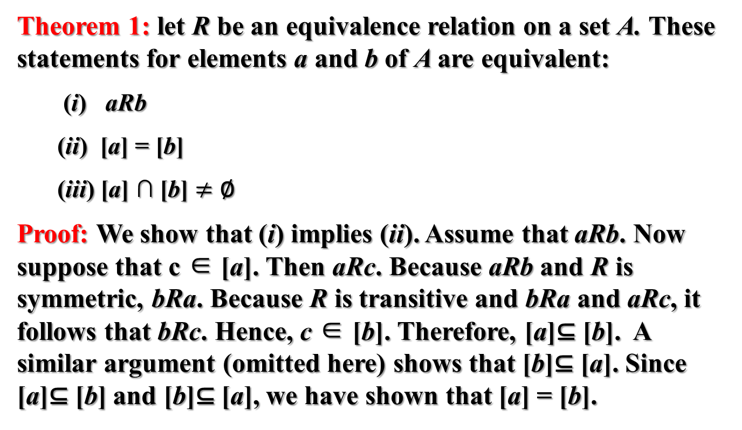
Equivalence Classes and Partitions 等价类和划分
Theorem 1: let R be an equivalence relation on a set A. These statements for elements a and b of A are equivalent:
(i) aRb
(ii) [a] = [b]
(iii) [a] ∩ [b] $≠$ ∅
Proof: We show that (i) implies (ii). Assume that aRb. Now suppose that c ∈ [a]. Then aRc. Because aRb and R is symmetric, bRa. Because R is transitive and bRa and aRc, it follows that bRc. Hence, c ∈ [b]. Therefore, [a]⊆ [b]. A similar argument (omitted here) shows that [b]⊆ [a]. Since [a]⊆ [b] and [b]⊆ [a], we have shown that [a] = [b].
(see text for proof that (ii) implies (iii) and (iii) implies (i))

Slide 50
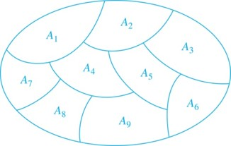
Partition of a Set 集合的划分
Definition: A partition 【划分】of a set S is a collection of disjoint nonempty subsets of S that have S as their union. In other words, the collection of subsets A_{i}, where i ∈ I (where I is an index set), forms a partition of S if and only if
A_{i} ≠ ∅ for i ∈ I,
A_{i} ∩ A_{j} = ∅ when i ≠ j,
and
A Partition of a Set

Slide 51
An Equivalence Relation Partitions a Set 1个等价关系划分1个集合
Let R be an equivalence relation on a set A. The union of all the equivalence classes of R is all of A, since an element a of A is in its own equivalence class [a]_{R}. In other words,
From Theorem 1, it follows that these equivalence classes are either equal or disjoint, so
when

Slide 52
An Equivalence Relation Partitions a Set 1个等价关系划分1个集合
Theorem 2: Let R be an equivalence relation on a set S. Then the equivalence classes of R form a partition of S. Conversely, given a partition {A_{i} | i ∈ I} of the set S, there is an equivalence relation R that has the sets A_{i}, i ∈ I, as its equivalence classes.
【1个等价关系划分1个集合，相反，1个划分可以找到1个等价关系】

Slide 53
Partial Orderings 【偏序关系】
Section 9.6

Slide 54
Section Summary
Partial Orderings and Partially-ordered Sets
Hasse Diagrams

Slide 55
Partial Orderings 偏序
Definition 1: A relation R on a set S is called a partial ordering, or partial order, if it is reflexive (自反), antisymmetric (反对称), and transitive (传递).
A set together with a partial ordering R is called a partially ordered set, or poset, and is denoted by (S, R). Members of S are called elements of the poset.

Slide 56
Partial Orderings 偏序
Example 1: Show that the “greater than or equal” relation (≥) is a partial ordering on the set of integers.
Reflexivity: a ≥ a for every integer a.
Antisymmetry: If a ≥ b and b ≥ a , then a = b.
Transitivity: If a ≥ b and b ≥ c , then a ≥ c.

Slide 57
Partial Orderings 偏序
Example 2: Show that the divisibility relation (∣) is a partial ordering on the set of integers.
Reflexivity: a ∣ a for all integers a.
Antisymmetry: If a and b are positive integers with a | b and b | a, then a = b.
Transitivity: Suppose that a divides b and b divides c. Then there are positive integers k and l such that b = ak and c = bl. Hence, c = a(kl), so a divides c. Therefore, the relation is transitive.

Slide 58
Partial Orderings 偏序
Example 3: Show that the inclusion relation (⊆) is a partial ordering on the power set of a set S.
Reflexivity: A ⊆ A whenever A is a subset of S.
Antisymmetry: If A and B are positive integers with A ⊆ B and B ⊆ A, then A = B.
Transitivity: If A ⊆ B and B ⊆ C, then A ⊆ C.

Slide 59
Comparability 可比
Customarily, the notation a ≼ b is used to denote that (a, b)∈ R in an arbitrary poset (S, R).
Definition 2: The elements a and b of a poset (S,≼ ) are comparable (可比) if either a ≼ b or b ≼ a. When a and b are elements of S so that neither a ≼ b nor b ≼ a, then a and b are called incomparable (不可比).
Definition 3: If (S,≼ ) is a poset and every two elements of S are comparable, S is called a totally ordered set (全序集) or linearly ordered set (线序集) , and ≼ is called a total order (全序) or a linear order (线序).
Definition 4: (S,≼ ) is a well-ordered set (良序集) if it is a poset such that ≼ is a total ordering and every nonempty subset of S has a least element (最小元).

Slide 60
可比,盖住
1. 定义：设（A, ≼）为偏序集（poset）,对于任意的x,y∈A,如果x ≼ y或者y ≼ x成立,则称x与y是可比的.
2. 定义：如果x ≺ y(即x ≼ y∧x≠y), 且不存在z∈A使得x ≺ z ≺ y,则称y盖住x.
(A, ≼)是A = {1,2,3,4,5}上的整除关系,1和任意元素有整除关系,所以1和1,2,3,4,5是可比的.
但2不能整除3,所以2和3是不可比的. 1 ≼ 2并且不存在一个z使得1 ≼ z ≼ 2,所以2盖住1. 同样4盖住2,但4不盖住1.

Slide 61
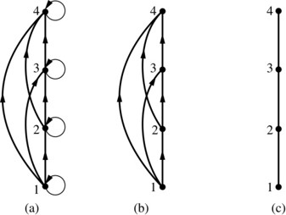
Hasse Diagrams 哈斯图
Definition: A Hasse diagram is a visual representation of a partial ordering that leaves out edges that must be present because of the reflexive and transitive properties.
A partial ordering is shown in (a) of the figure above. The loops due to the reflexive property are deleted in (b). The edges that must be present due to the transitive property are deleted in (c). The Hasse diagram for the partial ordering (a), is depicted in (c).

Slide 62
Procedure for Constructing a Hasse Diagram
To represent a finite poset (S,≼) using a Hasse diagram, start with the directed graph of the relation:
Remove the loops (a, a) present at every vertex due to the reflexive property.
Remove all edges (x, y) for which there is an element z ∈ S such that x ≺ z and z ≺ y. These are the edges that must be present due to the transitive property.
Arrange each edge so that its initial vertex is below the terminal vertex. Remove all the arrows, because all edges point upwards toward their terminal vertex.

Slide 63
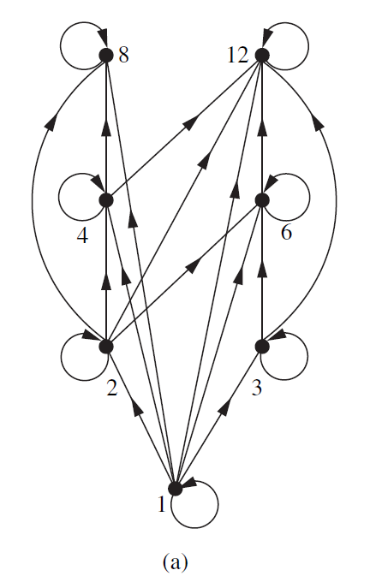
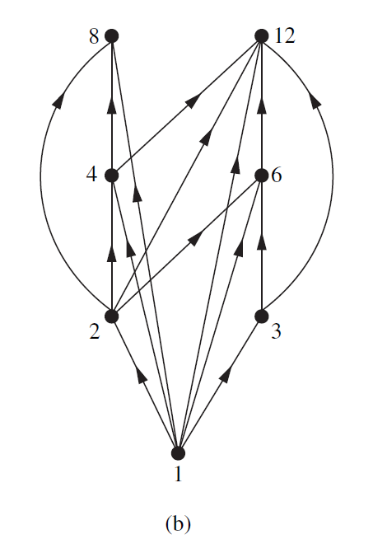
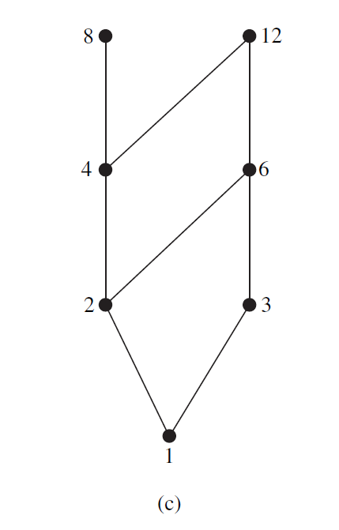
Hasse Diagrams 哈斯图
Example: Draw the Hasse diagram representing the partial ordering {(a, b) ∣a divides b} on {1, 2, 3, 4, 6, 8, 12}.

Slide 64
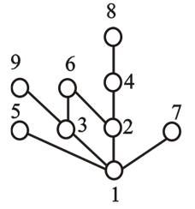
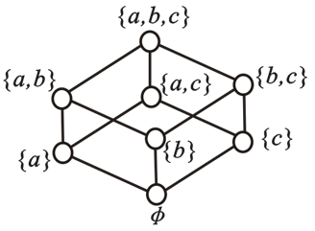
Hasse Diagrams 哈斯图
Example: Draw the Hasse Diagrams the following two posets.
（ {1, 2, 3, 4, 5, 6, 7, 8, 9 }, | ）
（ P({a,b,c}), ⊆ ）

Slide 65
Homework
§9.1 7 b) c) d), 32, 58 a) b) §9.3 14, 22, 24,
§9.5 15, 24
§9.6 7, 23 c), 26
Due date : 2024.5.21

