Slide 1
ELECTA01
Computer architecture
ELECTA01
Hogeschool Rotterdam
Opleiding Elektrotechniek
Minor Embedded Systems
J.W. Peltenburg / J.Z.M. Broeders (brojz@hr.nl)

Slide 2
Organization: Lectures & Homework
Lectures
  8 lectures
Homework
  Read the book
  Do exercises from the book.
I talk about the theory.
We do some exercises.
Repeat.
Interrupt based
If questions arise: ask.

Slide 3
Organization: examination
Homework Lab (Group of maximal 2 students. 25% of final grade)
  Writing assembly for the ARMv8 processor
    You get some C code or description of an algorithm
    “Compile” manually into assembly
    Run in a simulator
Written exam (75% of final grade)
  135 minutes in week 9 (T1). Resit at end of quarter 2 (HT1).
    60 minutes formative exam in week 4.
See “Curushandleiding” for details.

Slide 4
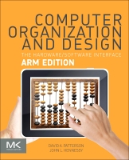
Organization: Book
Book
  Computer Organization and Design
    The Hardware / Software Interface
      ARM Edition
      David A. Patterson, John L. Hennessy
      ISBN: 9780128017333
    Standard textbook on the subject
    Good availability
    Lots of exercises
    Mandatory for this course (must be used during the exam)

Slide 5
Planning CTA01
Week 1: Introduction, Performance & Parallelism
Week 2: Instructions for arithmetic and memory
Week 3: Instructions for decisions and procedures
Week 4: Computer arithmetic
Week 5: Single cycle LEGv8, intro pipelining
Week 6: Pipelined LEGv8, hazards and forwarding
Week 7: Memory architecture
Week 8: Guest lecture (multicore and parallelism)

Slide 6
Preliminary Knowledge
Required to have knowledge of:
  Elementary Digital Circuits
  C programming

Slide 7
Why Computer Architecture?
Exploit your knowledge about the hardware when writing software
  Make code run faster and more efficient
  Writing inline assembly is sometimes necessary (but rarely)
  Can my μC run my code fast enough? Why (not)?
Connect superfast hardware peripheral to a processor
More and more custom So(P)C designs
  Also small design companies
It’s everywhere!
  New automobile: 150+ microprocessors
  Average household: 50+ microprocessors
  Supercomputer: 25000+ processors
  Your gaming GPU: 500+ cores

Slide 8
And what is more…
After completing HWP01 and CTA01 you should be able to, with some effort, write your own simple ARM-like processor in VHDL (although this is outside the scope of this course).

Slide 9
Agenda
Introduction
History
Layers and abstraction
Components of a computer
Performance analysis

Slide 10
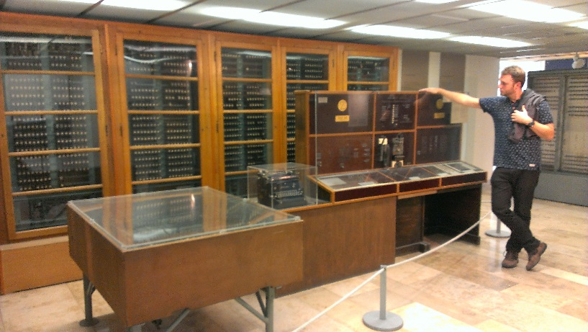
Computing technology history
1947: First electrical and digital computer: ENIAC (von Neumann)
  Around that time the transistor was invented at Bell Labs: components became faster and faster and cheaper and cheaper.
1972: First commercially available microprocessor in one chip by Intel (Faggin, Hoff, Mazer, Shima)
  Around this time Texas Instruments and Pico/General Instruments were also building single chip processors.
  Single chip designs made everything much faster.
The Zuse Z4 was the first commercial digital computer.

Slide 11
Computer science & scientists
Computer science: the formalisms and mathematics behind solving problems by computing
George Boole:
Boolean algebra
Ada Lovelace:
Algorithms for machines
Alan Turing:
Formal mathematical framework of computation
Claude Shannon:
Information theory, Boolean description of digital circuits
John von Neumann:
Stored-program concept

Slide 12
Chapter 1
Computer Abstractions and Technology

Slide 13
The Computer Revolution
§1.1 Introduction
Progress in computer technology
  Underpinned by Moore’s Law
Makes novel applications feasible
  Computers in automobiles
  Smartphones
  Human genome project
  World Wide Web
  Search Engines
Computers are pervasive

Slide 14
Classes of Computers
Personal computers
  General purpose, variety of software
  Subject to cost/performance tradeoff
Server computers
  Network based
  High capacity, performance, reliability
  Range from small servers to building sized

Slide 15
Classes of Computers
Supercomputers
  High-end scientific and engineering calculations
  Highest capability but represent a small fraction of the overall computer market
Embedded computers
  Hidden as components of systems
  Stringent power/performance/cost constraints

Slide 16
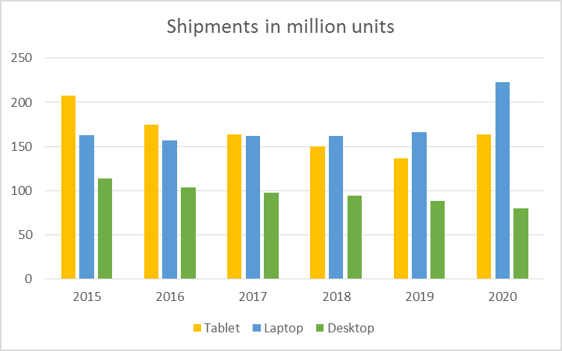
The PostPC Era
Bron: https://www.statista.com/statistics/272595/global-shipments-forecast-for-tablets-laptops-and-desktop-pcs/

Slide 17
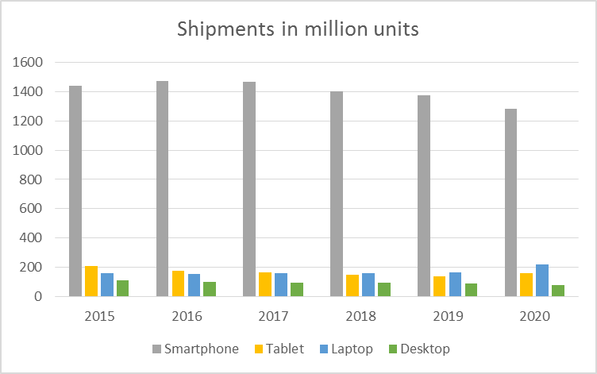
The PostPC Era
Bron: https://www.statista.com/statistics/263441/global-smartphone-shipments-forecast/

Slide 18
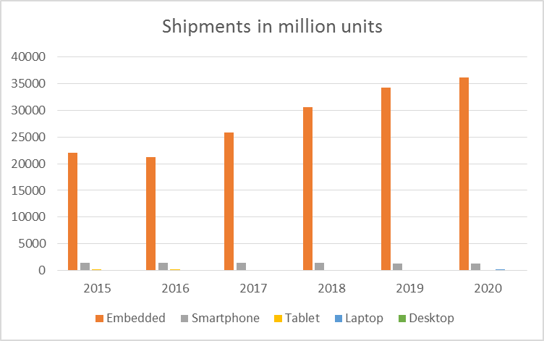
The PostPC Era
Bron: https://www.icinsights.com/news/bulletins/MCUs-Sales-To-Reach-RecordHigh-Annual-Revenues-Through-2022/

Slide 19
The PostPC Era
Personal Mobile Device (PMD)
  Battery operated
  Connects to the Internet
  Hundreds of dollars
  Smart phones, tablets, smart watches
Cloud computing
  Warehouse Scale Computers (WSC)
  Software as a Service (SaaS)
  Portion of software run on a PMD and a portion run in the Cloud
  Amazon and Google

Slide 20
What You Will Learn
How programs are translated into the machine language
  And how the hardware executes them
The hardware/software interface
What determines program performance
  And how it can be improved
How hardware designers improve performance
What is parallel processing

Slide 21
Understanding Performance
Algorithm
  Determines number of operations executed
Programming language, compiler, architecture
  Determine number of machine instructions executed per operation
Processor and memory system
  Determine how fast instructions are executed
I/O system (including OS)
  Determines how fast I/O operations are executed

Slide 22








Eight Great Ideas
Design for Moore’s Law
Use abstraction to simplify design
Make the common case fast
Performance via parallelism
Performance via pipelining
Performance via prediction
Hierarchy of memories
Dependability via redundancy
§1.2 Eight Great Ideas in Computer Architecture

Slide 23
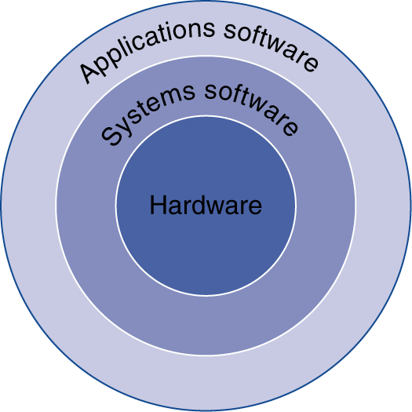
Below Your Program
Application software
  Written in high-level language
System software
  Compiler: translates HLL code to machine code
  Operating System: service code
    Handling input/output
    Managing memory and storage
    Scheduling tasks & sharing resources
Hardware
  Processor, memory, I/O controllers
§1.3 Below Your Program

Slide 24
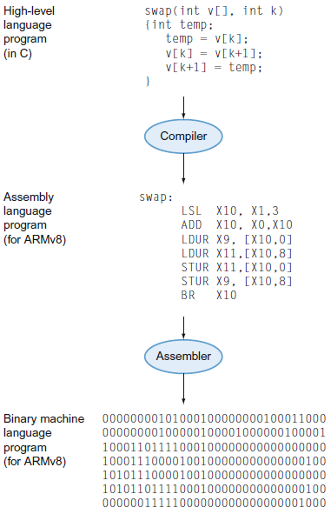
Levels of Program Code
High-level language
  Level of abstraction closer to problem domain
  Provides for productivity and portability
Assembly language
  Textual representation of instructions
Hardware representation
  Binary digits (bits)
  Encoded instructions and data

Slide 25
Components of a Computer
I skip this part of the lecture.
You have to study paragraph 1.4 yourself!

Slide 26
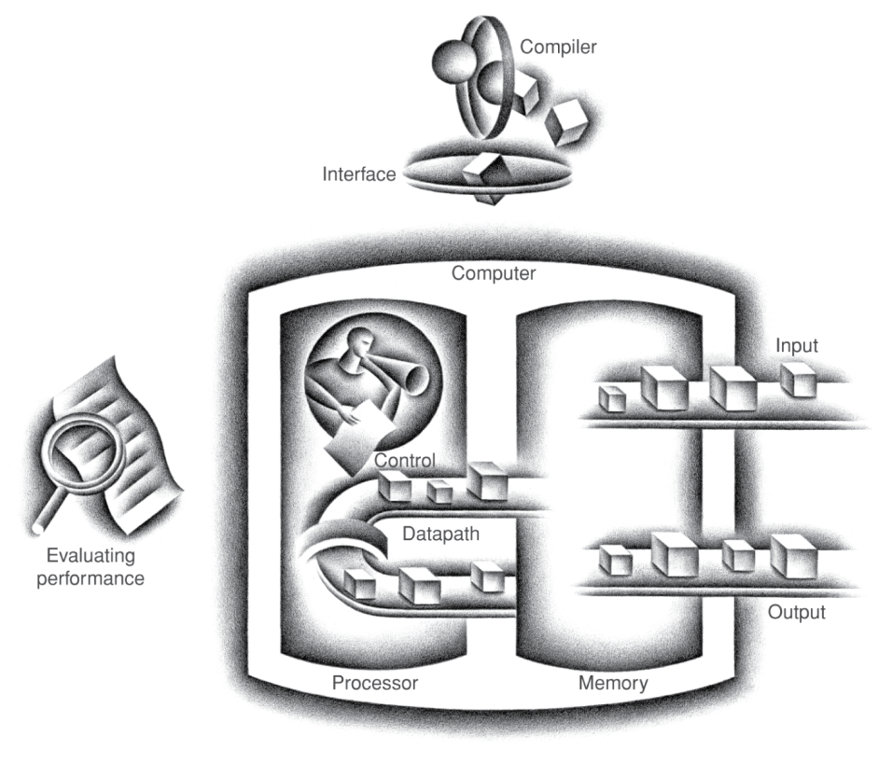
Components of a Computer
Same components for
all kinds of computer
  Desktop, server,
  embedded
Input/output includes
  User-interface devices
    Display, keyboard, mouse
  Storage devices
    Hard disk, CD/DVD, flash
  Network adapters
    For communicating with other computers
§1.4 Under the Covers
The BIG Picture
>>

Slide 27
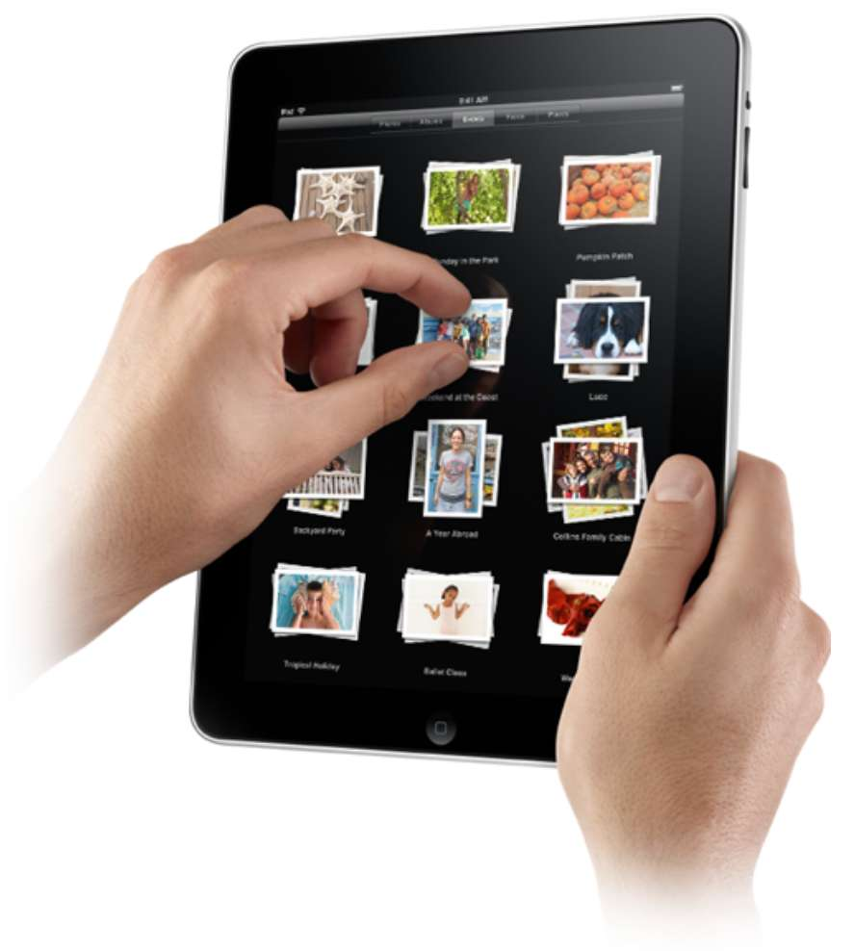
Touchscreen
>>
PostPC device
Supersedes keyboard and mouse
Resistive and Capacitive types
  Most tablets, smart phones use capacitive
  Capacitive allows multiple touches simultaneously

Slide 28
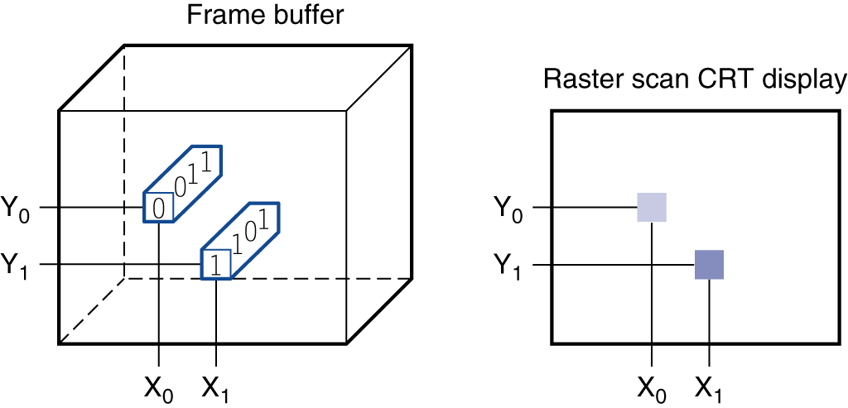
Through the Looking Glass
LCD screen: picture elements (pixels)
  Mirrors content of frame buffer memory
>>

Slide 29
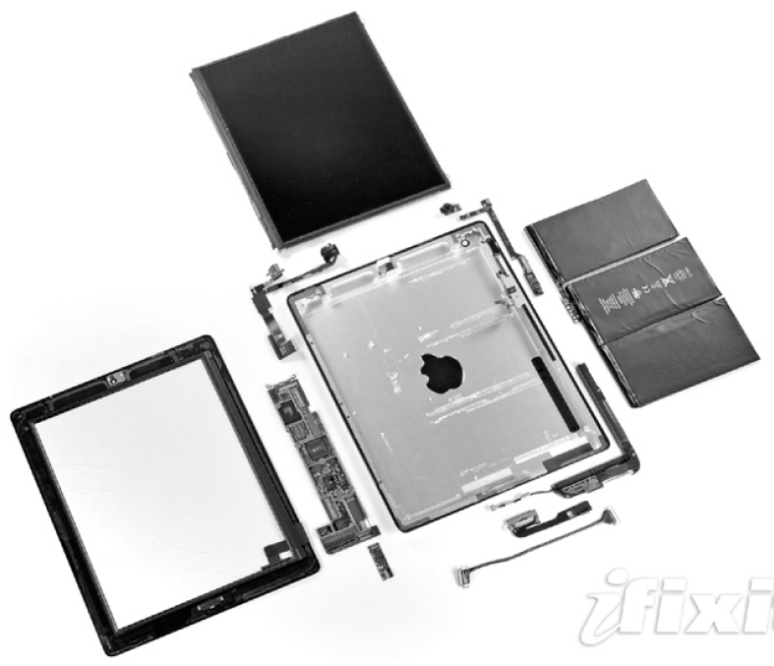
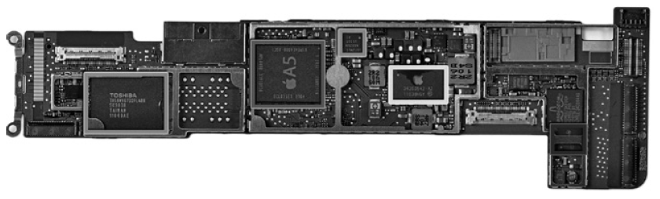
Opening the Box
>>
Capacitive multitouch LCD screen
3.8 V, 25 Watt-hour battery
Computer board

Slide 30
Inside the Processor (CPU)
Datapath: performs operations on data
Control: sequences datapath, memory, ...
Cache memory
  Small fast SRAM memory for immediate access to data
>>

Slide 31
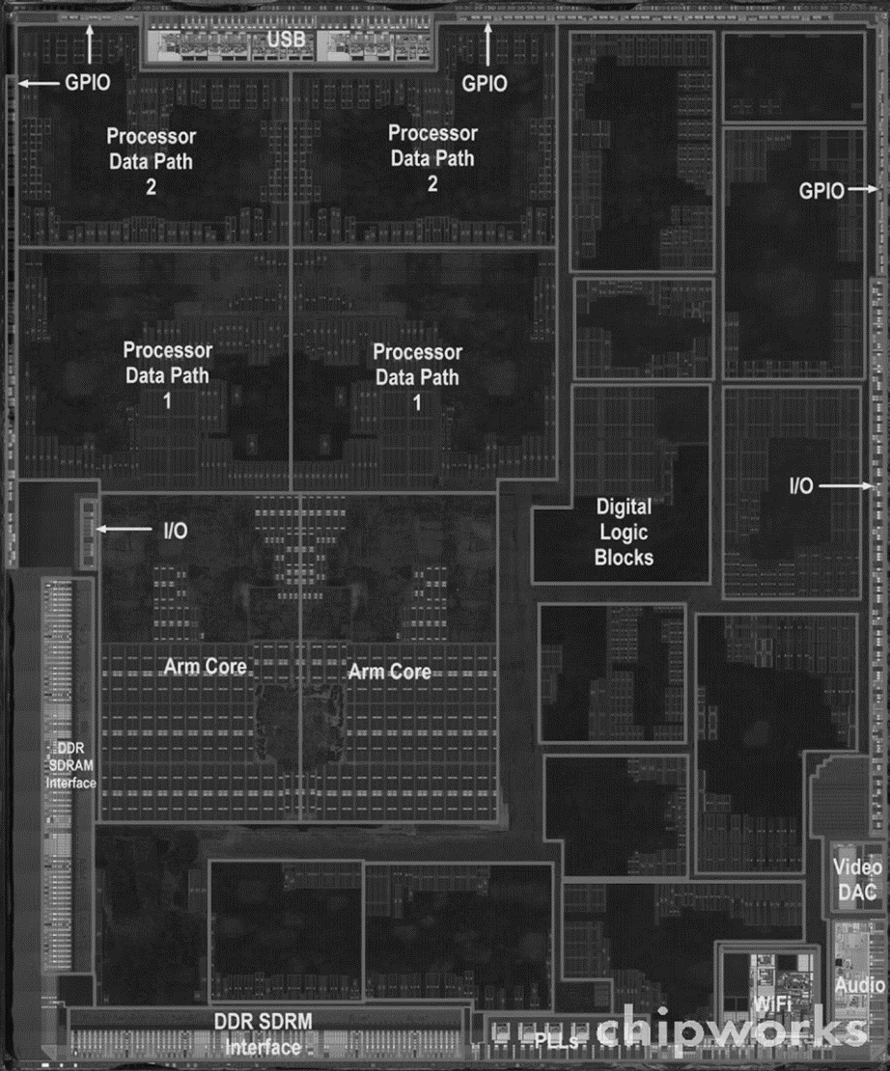
Inside the Processor
>>
Apple A5

Slide 32
Abstractions
>>
The BIG Picture
Abstraction helps us deal with complexity
  Hide lower-level detail
Instruction set architecture (ISA)
  The hardware/software interface
Application binary interface
  The ISA plus system software interface
Implementation
  The details underlying and interface

Slide 33

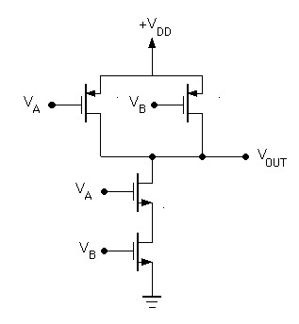
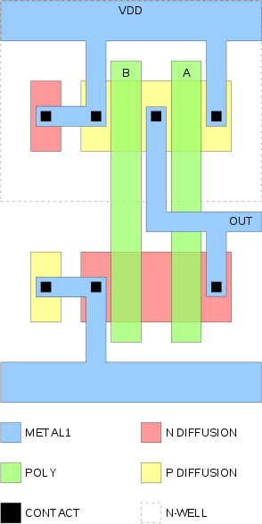
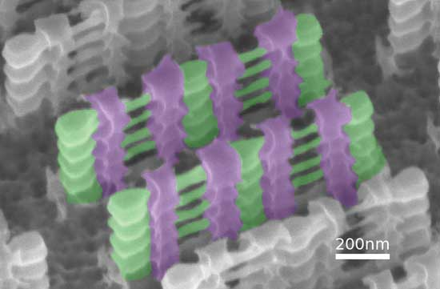
Abstraction example AND gate
>>
Image Sources: http://people.seas.harvard.edu/~jones/es154/lectures/lecture_7/MOS/mos_logic.html
http://www.creativecommons.org
http://www.electroiq.com/articles/sst/print/vol-55/issue-8/features/cover-articles/a-review-of-recent-advances-in-electronic.html

Slide 34
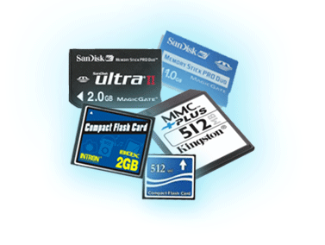
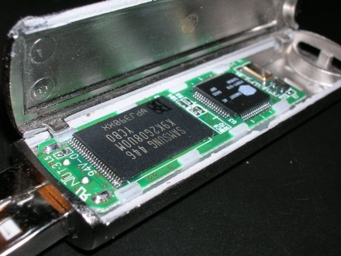
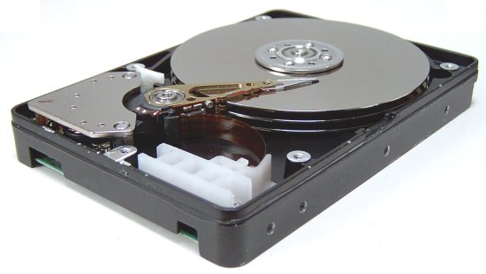
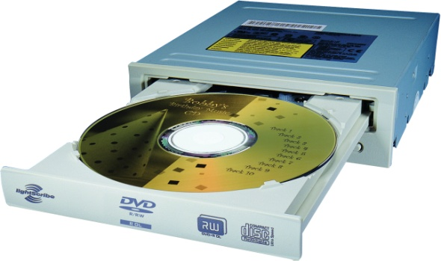
A Safe Place for Data
>>
Volatile main memory
  Loses instructions and data when power off
Non-volatile secondary memory
  Magnetic disk
  Flash memory
  Optical disk (CDROM, DVD)

Slide 35
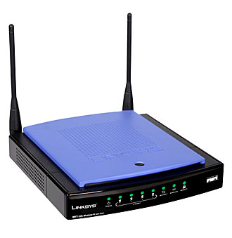
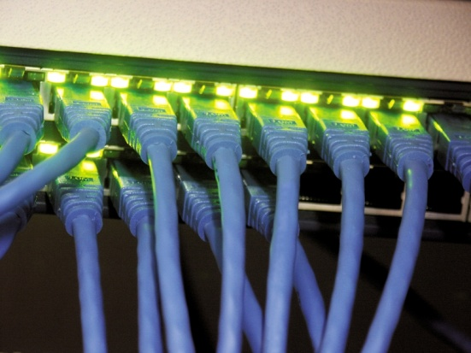
Networks
>>
Communication, resource sharing, nonlocal access
Local area network (LAN): Ethernet
Wide area network (WAN): the Internet
Wireless network: WiFi, Bluetooth

Slide 36
Semiconductor Technology
I skip this part of the lecture.
You have to study paragraph 1.5 yourself!

Slide 37
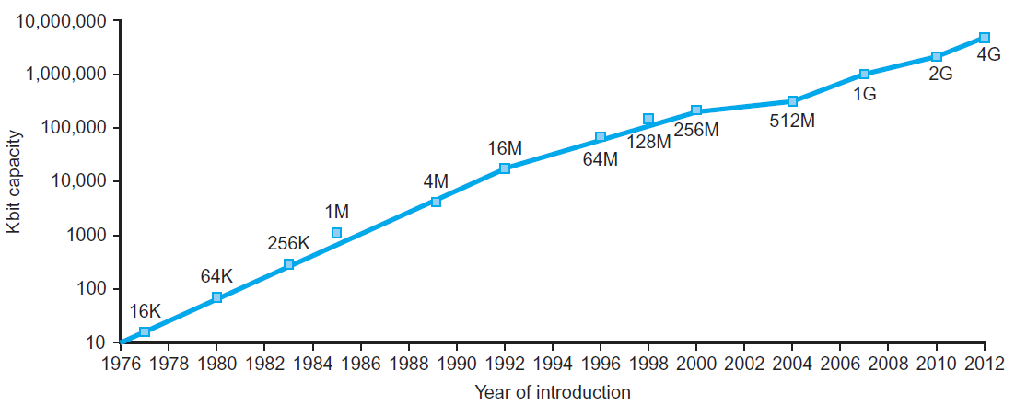
Technology Trends
>>
Electronics technology continues to evolve
  Increased capacity and performance
  Reduced cost
§1.5 Technologies for Building Processors and Memory
DRAM capacity
Year | Technology | Relative performance/cost
1951 | Vacuum tube | 1
1965 | Transistor | 35
1975 | Integrated circuit (IC) | 900
1995 | Very large scale IC (VLSI) | 2,400,000
2013 | Ultra large scale IC | 250,000,000,000

Slide 38
Semiconductor Technology
Silicon: semiconductor
Add materials to transform properties:
  Conductors
  Insulators
  Switch
>>

Slide 39
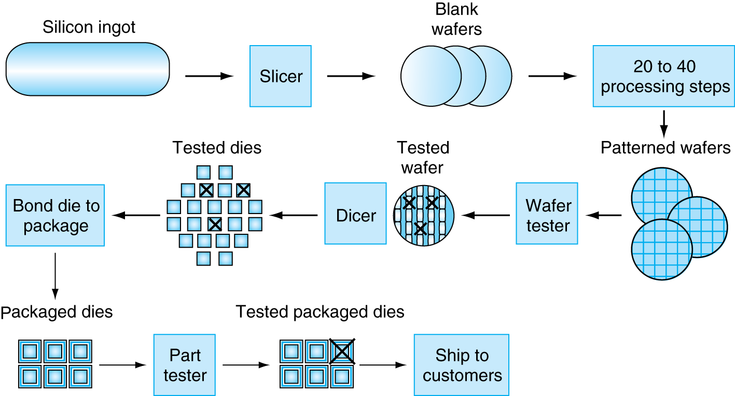
Manufacturing ICs
>>
Yield: proportion of working dies per wafer

Slide 40
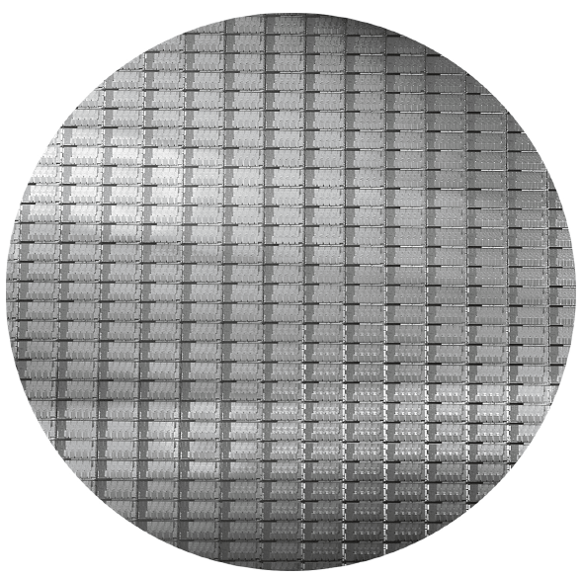
Intel Core i7 Wafer
>>
300mm wafer, 280 chips, 32nm technology
Each chip is 20.7 x 10.5 mm

Slide 41

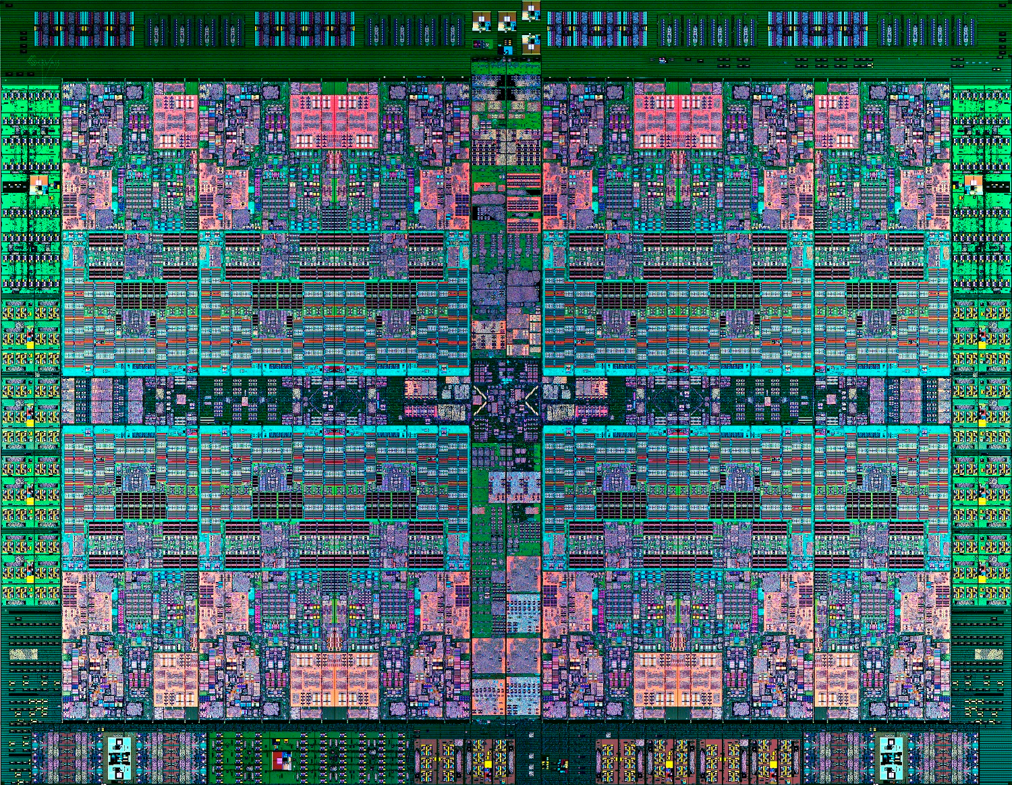
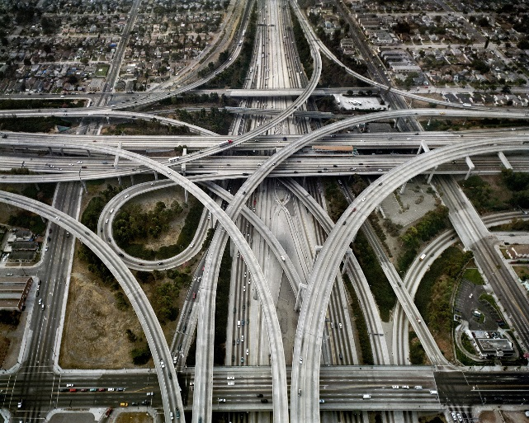
Semiconductor fabrication technology (1)
Compare IBM’s 12-core POWER8 chip (2013) to a map of The Netherlands
Process used: 22nm
Chip area: approx. 6.5 cm²
Netherlands area: approx. 40,000 km²
Scale:
2.6 cm / 200 km → 1:7,700,000 (approx.)
Compares to the Netherlands filled with roads
0.17 meters wide
0.17 meters apart
15 layers
>>
Inspiration for this slide is taken with permission from the digital IC design course of Nick van der Meijs at: http://cas.et.tudelft.nl/~nick/courses/digic/

Slide 42
Semiconductor fabrication technology (2)
>>
Wafer diameter: 300 mm
Netherlands area: approx. 40,000 km²
Equivalent diameter: approx. 225 km
300 mm : 225 km
1 : 750000
22 nm : ~1.7 cm
A special wafer stepper could print The Netherlands with a resolution of 1.7 cm in 20 seconds!
Inspiration for this slide is taken with permission from the digital IC design course of Nick van der Meijs at: http://cas.et.tudelft.nl/~nick/courses/digic/

Slide 43
Integrated Circuit Cost
>>
Nonlinear relation to area and defect rate
  Wafer cost and area are fixed
  Defect rate determined by manufacturing process
  Die area determined by architecture and circuit design

Slide 44
Defining Performance
§1.6 Performance
Which airplane has the best performance?

Slide 45
Response Time and Throughput
Response time
  How long it takes to do a task
Throughput
  Total work done per unit time
    e.g., tasks/transactions/… per hour
How are response time and throughput affected by
  Replacing the processor with a faster version?
  Adding more processors?
We’ll focus on response time for now…

Slide 46
Relative Performance
Define Performance = 1/Execution Time
“X is n time faster than Y”
Example: time taken to run a program
  10s on A, 15s on B
  Execution Time_{B} / Execution Time_{A}
  = 15s / 10s = 1.5
  So A is 1.5 times faster than B

Slide 47
Measuring Execution Time
Elapsed time
  Total response time, including all aspects
    Processing, I/O, OS overhead, idle time
  Determines system performance
CPU time
  Time spent processing a given job
    Discounts I/O time, other jobs’ shares
  Comprises user CPU time and system CPU time
  Different programs are affected differently by CPU and system performance

Slide 48
CPU Clocking
Operation of digital hardware governed by a constant-rate clock
Clock period
Clock (cycles)
Data transfer
and computation
Update state
Clock period: duration of a clock cycle
  e.g., 250ps = 0.25ns = 250×10^{–12}s
Clock frequency (rate): cycles per second
  e.g., 4.0GHz = 4000MHz = 4.0×10⁹Hz

Slide 49
CPU Time
Performance improved by
  Reducing number of clock cycles
  Increasing clock rate
  Hardware designer must often trade off clock rate against cycle count

Slide 50
CPU Time Example
Computer A: 2GHz clock, 10s CPU time
Designing Computer B
  Aim for 6s CPU time
  Can do faster clock, but causes 1.2 × clock cycles
How fast must Computer B clock be?

Slide 51
Instruction Count and CPI
Instruction Count for a program
  Determined by program, ISA and compiler
Average cycles per instruction
  Determined by CPU hardware
  If different instructions have different CPI
    Average CPI affected by instruction mix

Slide 52
CPI Example
Computer A: Cycle Time = 250ps, CPI = 2.0
Computer B: Cycle Time = 500ps, CPI = 1.2
Same ISA
Which is faster, and by how much?
A is faster…
…by this much

Slide 53
CPI in More Detail
If different instruction classes take different numbers of cycles
Weighted average CPI
Relative frequency

Slide 54
CPI Example
Calculate Average CPI
Alternative compiled code sequences using instructions in classes A, B, C
Class | A | B | C
CPI for class | 1 | 2 | 3
IC in sequence 1 | 2 | 1 | 2
IC in sequence 2 | 4 | 1 | 1
Sequence 1: IC = 5
  Clock Cycles
  = 2×1 + 1×2 + 2×3
  = 10
  Avg. CPI = 10/5 = 2.0
Sequence 2: IC = 6
  Clock Cycles
  = 4×1 + 1×2 + 1×3
  = 9
  Avg. CPI = 9/6 = 1.5

Slide 55
Performance Summary
The BIG Picture
Performance depends on
  Algorithm: affects IC, possibly CPI
  Programming language: affects IC, CPI
  Compiler: affects IC, CPI
  Instruction set architecture: affects IC, CPI, T_{c}

Slide 56
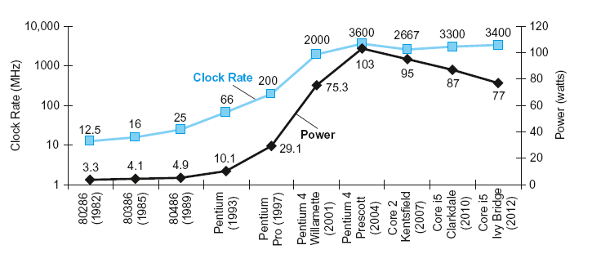
Power Trends
§1.7 The Power Wall
In CMOS IC technology
×30
Proportional to
5V → 1V
×1000

Slide 57
Reducing Power
Calculate P_{new}/P_{old}
Suppose a new CPU has
  85% of capacitive load of old CPU
  15% voltage and 15% frequency reduction
The power wall
  We can’t reduce voltage further
  We can’t remove more heat
How else can we improve performance?

Slide 58
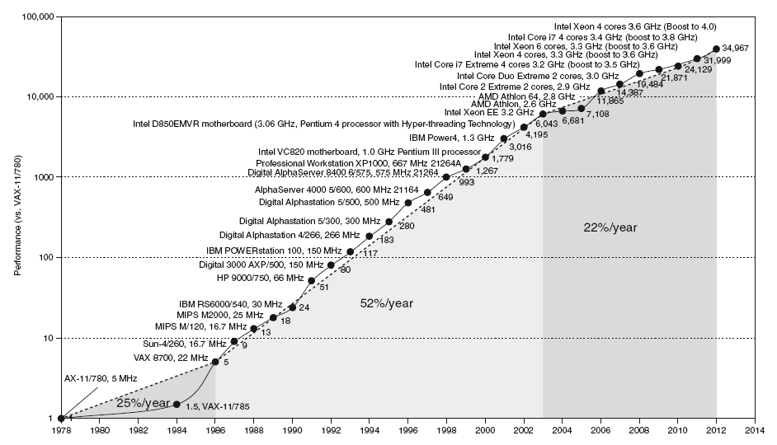
Uniprocessor Performance
§1.8 The Sea Change: The Switch to Multiprocessors
Constrained by power, instruction-level parallelism, memory latency

Slide 59
Multiprocessors
Multicore microprocessors
  More than one processor per chip
Requires explicitly parallel programming
  Compare with instruction level parallelism
    Hardware executes multiple instructions at once
    Hidden from the programmer
  Hard to do
    Programming for performance
    Load balancing
    Optimizing communication and synchronization

Slide 60
Pitfall: Amdahl’s Law
Improving an aspect of a computer and expecting a proportional improvement in overall performance
§1.10 Fallacies and Pitfalls
Example: multiply accounts for 80s/100s
  How much improvement in multiply performance to get 5× overall?
  Can’t be done!
Corollary: make the common case fast

Slide 61
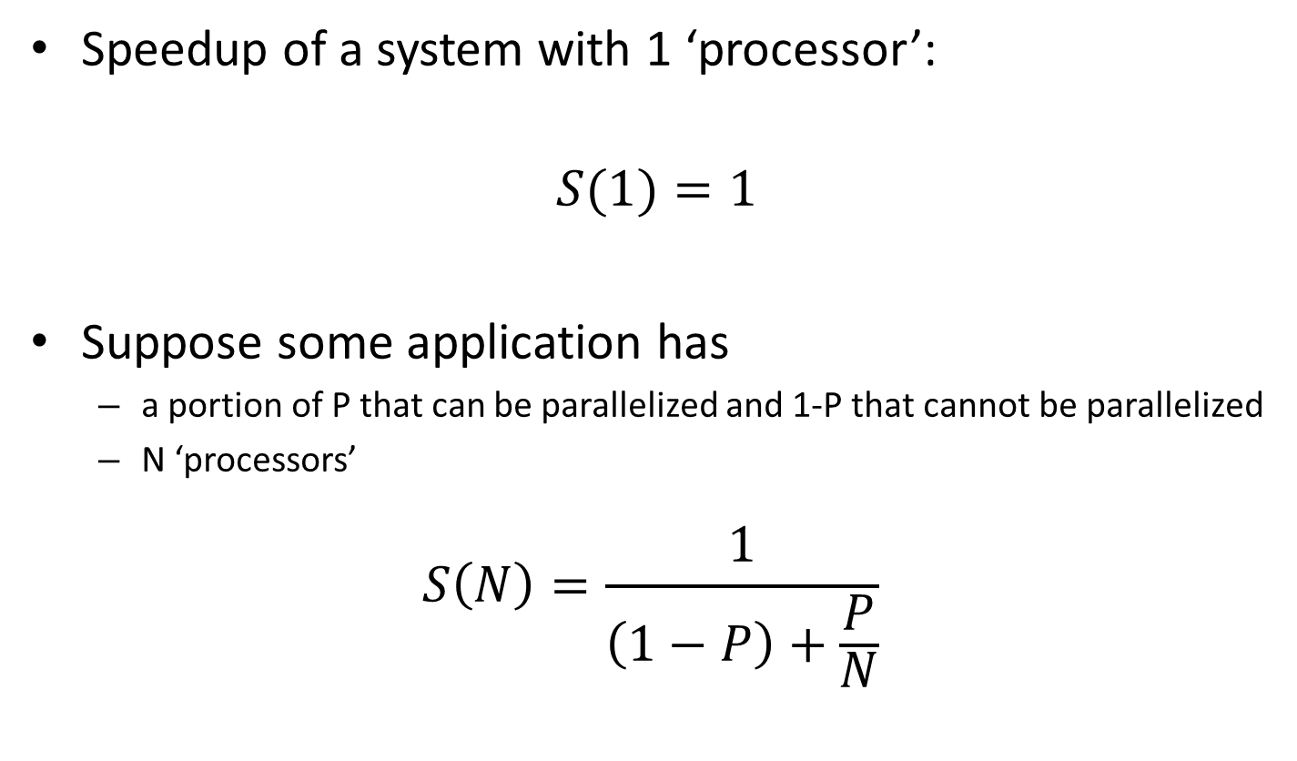
Amdahl’s Law (1/2)
Speedup of a system with 1 ‘processor’:
$$S(1)=1$$
Suppose some application has
  a portion of P that can be parallelized and 1-P that cannot be parallelized
  N ‘processors’
$$S\left(N\right)=\frac{1}{\left(1−P\right)+\frac{P}{N}}$$

Slide 62
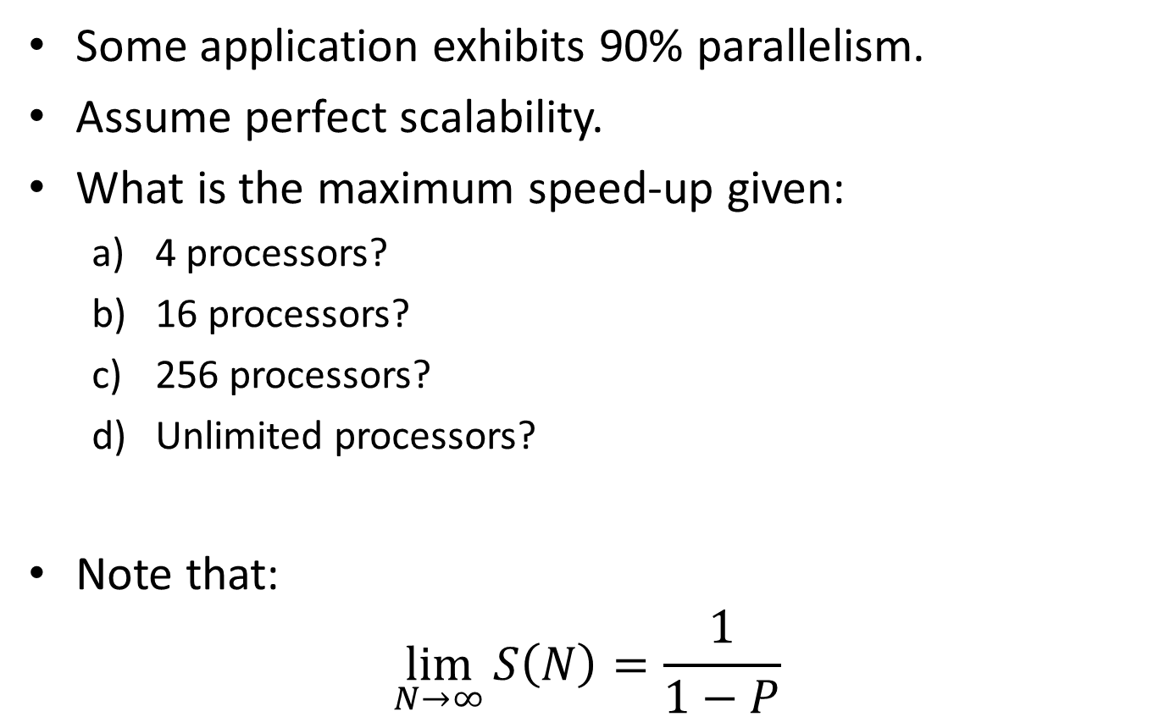

Exercise
Some application exhibits 90% parallelism.
Assume perfect scalability.
What is the maximum speed-up given:
  4 processors?
  16 processors?
  256 processors?
  Unlimited processors?
Note that:
$\lim_{N→∞}{S\left(N\right)=\frac{1}{1−P}}$
$$S\left(N\right)=\frac{1}{\left(1−P\right)+\frac{P}{N}}$$

Slide 63
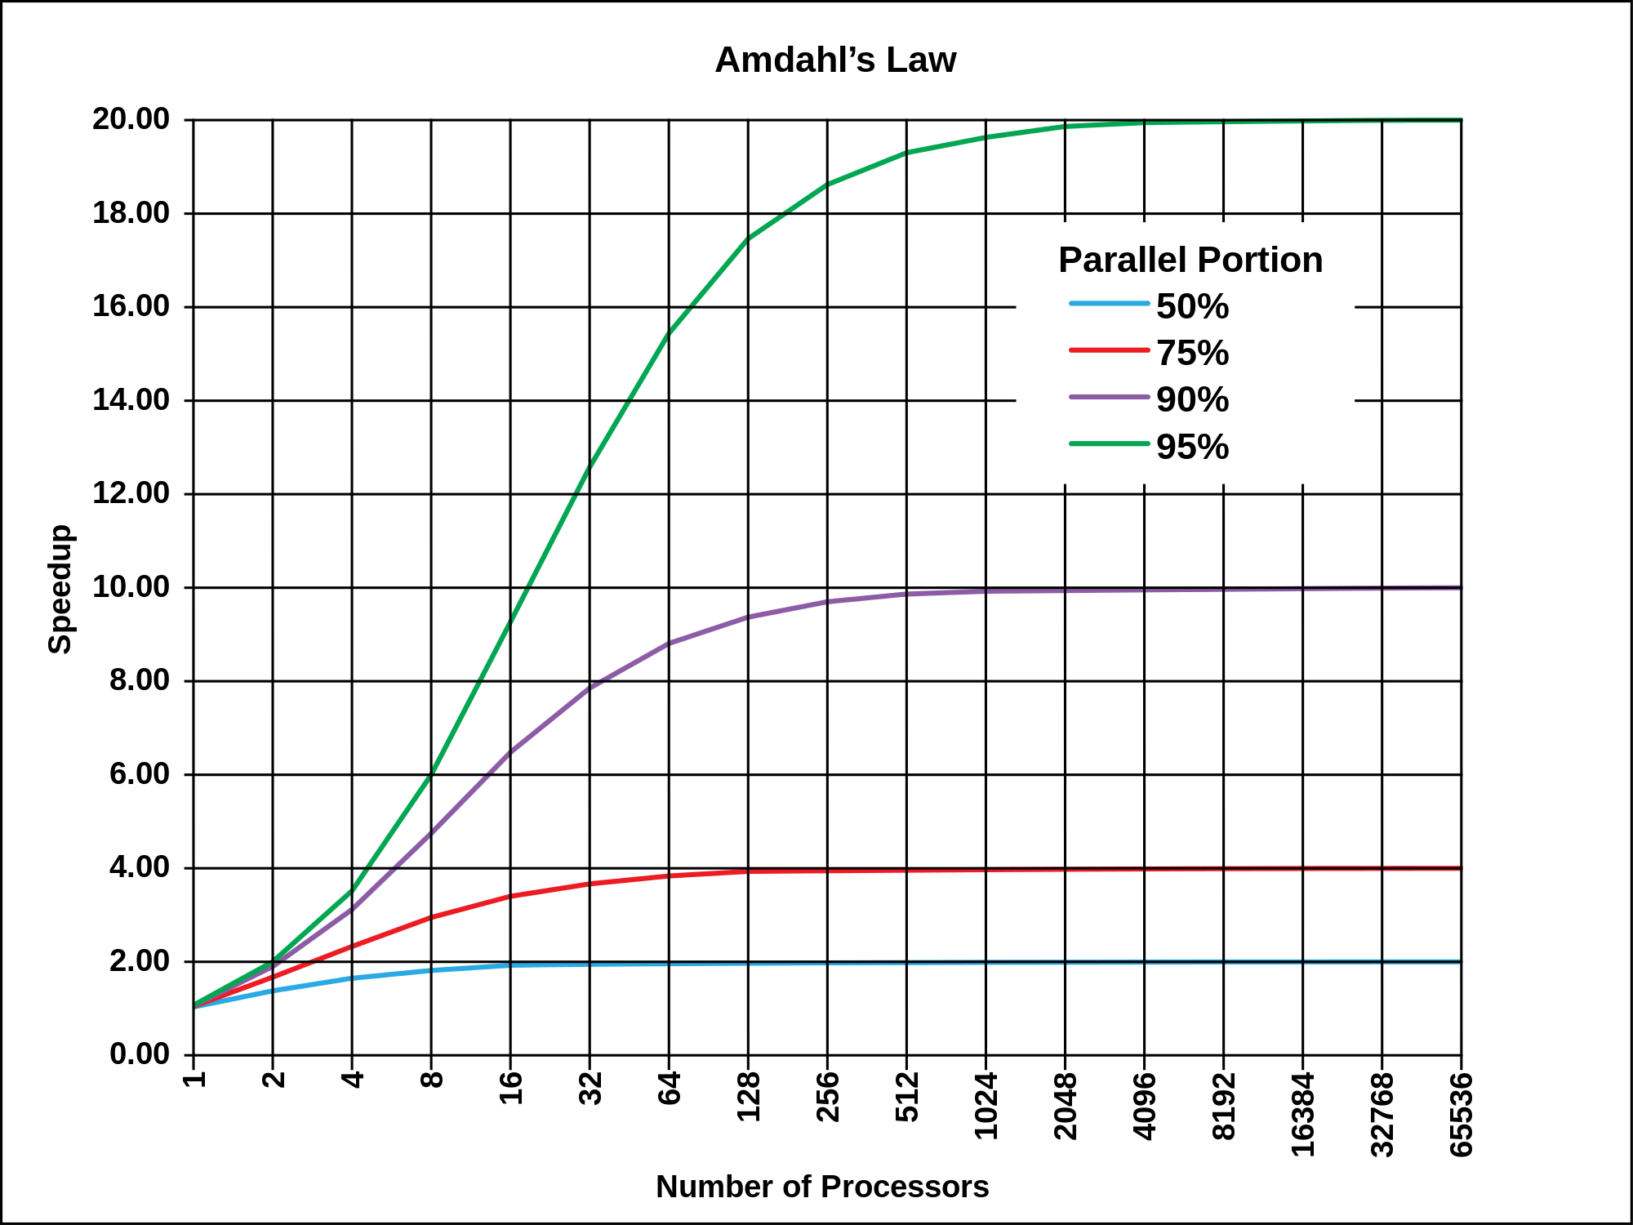
Amdahl’s Law (2/2)
Source: http://commons.wikimedia.org/wiki/File:AmdahlsLaw.svg

Slide 64
Fallacy: Low Power at Idle
Look back at i7 power benchmark
  At 100% load: 258W
  At 50% load: 170W (66%)
  At 10% load: 121W (47%)
Google data center
  Mostly operates at 10% – 50% load
  At 100% load less than 1% of the time
Consider designing processors to make power proportional to load

Slide 65
Pitfall: MIPS as a Performance Metric
MIPS: Millions of Instructions Per Second
  Doesn’t account for
    Differences in ISAs between computers
    Differences in complexity between instructions
  CPI varies between programs on a given CPU

Slide 66
Concluding Remarks
Cost/performance is improving
  Due to underlying technology development
Hierarchical layers of abstraction
  In both hardware and software
Instruction set architecture
  The hardware/software interface
Execution time: the best performance measure
Power is a limiting factor
  Use parallelism to improve performance
§1.9 Concluding Remarks

