Slide 1
H2
Instructions
ELECTA01
Computer architecture
ELECTA01
Hogeschool Rotterdam
Opleiding Elektrotechniek
Minor Embedded Systems
J.W. Peltenburg / J.Z.M. Broeders (brojz@hr.nl)

Slide 2
Instructions: The language of the computer
Hoofdstuk 2

Slide 3
Agenda
Instruction Set
Operations and Operands
Representing Instructions in the Computer
Logical Operations
Instructions for Making Decisions
Supporting Procedures in Computer Hardware
LEGv8 Addressing for Wide Immediates and Addresses
A C Sort Example to Put It All Together
Arrays versus Pointers

Slide 4
Agenda
Instruction Set
Operations and Operands
Representing Instructions in the Computer
Logical Operations
Instructions for Making Decisions
Supporting Procedures in Computer Hardware
LEGv8 Addressing for Wide Immediates and Addresses
A C Sort Example to Put It All Together
Arrays versus Pointers

Slide 5
Instruction Set
How to tell a computer what to do?
Bits are the letters of the computer
Instructions are the words of the computer
  An instruction is a collection of bits
The instruction set is the vocabulary of the computer
  An instruction set is a collection of instructions

Slide 6
Instruction Set
§2.1 Introduction
The repertoire of instructions of a computer
Different computers have different instruction sets
  But with many aspects in common
Early computers had very simple instruction sets
  Simplified implementation
Many modern computers also have simple instruction sets

Slide 7
The ARMv8 Instruction Set
A subset, called LEGv8, used as the example throughout the book
Commercialized by ARM Holdings (www.arm.com)
Large share of embedded core market
  Applications in consumer electronics, network/storage equipment, cameras, printers, …
Typical of many modern ISAs
  See ARM Reference Data tear-out card

Slide 8
Agenda
Instruction Set
Operations and Operands
Representing Instructions in the Computer
Logical Operations
Instructions for Making Decisions
Supporting Procedures in Computer Hardware
LEGv8 Addressing for Wide Immediates and Addresses
A C Sort Example to Put It All Together
Arrays versus Pointers

Slide 9
Design Principles applied to the ARMv8 ISA
Design principles
  1. Simplicity favors regularity
  2. Smaller is faster
  3. Make the common case fast
  4. Good design demands good compromises
We will regularly see these principles when exploring the ISA

Slide 10
Arithmetic Operations
Add and subtract, three operands
  Two sources and one destination
ADD a, b, c // a gets b + c
All arithmetic operations have this form
Design Principle 1: Simplicity favors regularity
  Regularity makes implementation simpler
  Simplicity enables higher performance at lower cost
§2.2 Operations of the Computer Hardware

Slide 11
Arithmetic Example
C code:
f = (g + h) - (i + j);
Compiled LEGv8 code:
ADD t0, g, h // temp t0 = g + h
ADD t1, i, j // temp t1 = i + j
SUB f, t0, t1 // f = t0 - t1
Processor does not work with variables but with registers

Slide 12


Memory Hierarchy
The ALU can only operate on values that are inside the register
Not directly from the main memory!
Need to LOAD stuff from main memory
Memory Hierarchy
  Will be discussed later
<KBs
cpu registers
$$1/f_{c}$$
KBs$\sim$MBs
cache
0.5-2.5 ns
complexity
size
cost
speed
GBs
main memory
50-70 ns
70-150 ns
5-20 ms
TBs
storage

Slide 13
Register Operands
Arithmetic instructions use register
operands
LEGv8 has a 32 × 64-bit register file
  Use for frequently accessed data
  64-bit data is called a “doubleword”
    31 x 64-bit general purpose registers X0 to X30
  32-bit data called a “word”
    31 x 32-bit general purpose sub-registers W0 to W30
Design Principle 2: Smaller is faster
  Compare to main memory: millions of locations
§2.3 Operands of the Computer Hardware

Slide 14
LEGv8 Registers
X0 – X7: procedure arguments/results
X8: indirect result location register
X9 – X15: temporaries
X16 – X17 (IP0 – IP1): may be used by linker as a scratch register, other times as temporary register
X18: platform register for platform independent code; otherwise a temporary register
X19 – X27: saved
X28 (SP): stack pointer
X29 (FP): frame pointer
X30 (LR): link register (return address)
XZR (register 31): the constant value 0
X0 – X8, X16 – X18, X28 – X30 will be explained later

Slide 15
Register Operand Example
C code:
f = (g + h) - (i + j);
  f, …, j in X19, X20, …, X23
Compiled LEGv8 code:
ADD X9, X20, X21
ADD X10, X22, X23
SUB X19, X9, X10

Slide 16
Memory Operands
Main memory used for composite data
  Arrays, structures, dynamic data
To apply arithmetic operations
  Load values from memory into registers
  Store result from register to memory
Memory is byte addressed
  Each address identifies an 8-bit byte
LEGv8 does not require words to be aligned in memory, except for instructions and the stack

Slide 17
Memory Operand Example
C code:
A[12] = h + A[8];
  h in X21, base address of A in X22
Compiled LEGv8 code:
  Index 8 requires offset of 64
LDUR X9,[X22,#64] // U for “unscaled”
ADD X9,X21,X9
STUR X9,[X22,#96]
?

Slide 18
Registers vs. Memory
Registers are faster to access than memory
Operating on memory data requires loads and stores
  More instructions to be executed
Compiler must use registers for variables as much as possible
  Only spill to memory for less frequently used variables
  Register optimization is important!

Slide 19
Immediate Operands
Constant data specified in an instruction
ADDI X22, X22, #4
Design Principle 3: Make the common case fast
  Small constants are common
  Immediate operand avoids a load instruction

Slide 20
Signed and Unsigned Numbers
I skip this part of the lecture because you already now this stuff.
You maybe have to study paragraph 2.4 yourself!

Slide 21
Unsigned Binary Integers
>>
Given an n-bit number
§2.4 Signed and Unsigned Numbers
Range: 0 to +2^{n} – 1
Example
  0000 0000 0000 0000 0000 0000 0000 1011₂
  = 0 + … + 1×2³ + 0×2² +1×2¹ +1×2⁰
  = 0 + … + 8 + 0 + 2 + 1 = 11₁₀
Using 32 bits
  0 to +4,294,967,295

Slide 22
2s-Complement Signed Integers
>>
Given an n-bit number
Range: –2^{n – 1} to +2^{n – 1} – 1
Example
  1111 1111 1111 1111 1111 1111 1111 1100₂
  = –1×2³¹ + 1×2³⁰ + … + 1×2² +0×2¹ +0×2⁰
  = –2,147,483,648 + 2,147,483,644 = –4₁₀
Using 32 bits
  –2,147,483,648 to +2,147,483,647

Slide 23
2s-Complement Signed Integers
>>
Bit 31 is sign bit
  1 for negative numbers
  0 for non-negative numbers
–(–2^{n – 1}) can’t be represented
Non-negative numbers have the same unsigned and 2s-complement representation
Some specific numbers
  0: 0000 0000 … 0000
  –1: 1111 1111 … 1111
  Most-negative: 1000 0000 … 0000
  Most-positive: 0111 1111 … 1111

Slide 24
Signed Negation
>>
Complement and add 1
  Complement means 1 → 0, 0 → 1
Example: negate +2
  +2 = 0000 0000 … 0010_{two}
  –2 = 1111 1111 … 1101_{two} + 1
  = 1111 1111 … 1110_{two}

Slide 25
Sign Extension
>>
Representing a number using more bits
  Preserve the numeric value
Replicate the sign bit to the left
  c.f. unsigned values: extend with 0s
Examples: 8-bit to 16-bit
  +2: 0000 0010 => 0000 0000 0000 0010
  –2: 1111 1110 => 1111 1111 1111 1110
In LEGv8 instruction set
  LDURSB: sign-extend loaded byte
  LDURB: zero-extend loaded byte

Slide 26
Agenda
Instruction Set
Operations and Operands
Representing Instructions in the Computer
Logical Operations
Instructions for Making Decisions
Supporting Procedures in Computer Hardware
LEGv8 Addressing for Wide Immediates and Addresses
A C Sort Example to Put It All Together
Arrays versus Pointers

Slide 27
Representing Instructions
Instructions are encoded in binary
  Called machine code
LEGv8 instructions
  Encoded as 32-bit instruction words
  Small number of formats encoding operation code (opcode), register numbers, …
  Regularity!
§2.5 Representing Instructions in the Computer

Slide 28
Hexadecimal
>>
Base 16
  Compact representation of bit strings
  4 bits per hex digit
0 | 0000 | 4 | 0100 | 8 | 1000 | c | 1100
1 | 0001 | 5 | 0101 | 9 | 1001 | d | 1101
2 | 0010 | 6 | 0110 | a | 1010 | e | 1110
3 | 0011 | 7 | 0111 | b | 1011 | f | 1111
Example: ECA8 6420
  1110 1100 1010 1000 0110 0100 0010 0000

Slide 29
LEGv8 R-format Instructions
opcode
Rm
shamt
Rn
Rd
11 bits
5 bits
6 bits
5 bits
5 bits
Instruction fields
  opcode: operation code
  Rm: the second register source operand
  shamt: shift amount (000000 for now)
  Rn: the first register source operand
  Rd: the register destination

Slide 30
R-format Example
opcode
Rm
shamt
Rn
Rd
11 bits
5 bits
6 bits
5 bits
5 bits
ADD X9,X20,X21
458_{hex}
21_{ten}
0_{ten}
20_{ten}
9_{ten}
10001011000_{two}
10101_{two}
000000_{two}
10100_{two}
01001_{two}
1000 1011 0001 0101 0000 0010 1000 1001_{two} =
8B150289₁₆

Slide 31
LEGv8 D-format Instructions
opcode
address
op2
Rn
Rt
11 bits
9 bits
2 bits
5 bits
5 bits
Load/store instructions
  Rn: base register
  address: constant offset from contents of base register (+/- 32 doublewords)
  Rt: destination (load) or source (store) register number
Design Principle 3: Good design demands good compromises
  Different formats complicate decoding, but allow 32-bit instructions uniformly
  Keep formats as similar as possible

Slide 32
LEGv8 I-format Instructions
opcode
immediate
Rn
Rd
10 bits
12 bits
5 bits
5 bits
Immediate instructions
  Rn: source register
  Rd: destination register
Immediate field is zero-extended

Slide 33
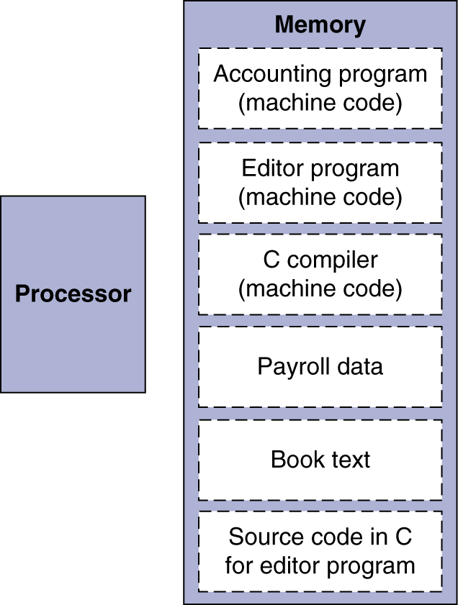
Stored Program Computers
The BIG Picture
Instructions represented in binary, just like data
Instructions and data stored in memory
Programs can operate on programs
  e.g., compilers, linkers, …
Binary compatibility allows compiled programs to work on different computers
  Standardized ISAs

Slide 34
Agenda
Instruction Set
Operations and Operands
Representing Instructions in the Computer
Logical Operations
Instructions for Making Decisions
Supporting Procedures in Computer Hardware
LEGv8 Addressing for Wide Immediates and Addresses
A C Sort Example to Put It All Together
Arrays versus Pointers

Slide 35
Logical Operations
Instructions for bitwise manipulation
§2.6 Logical Operations
Operation | C | Java | LEGv8
Shift left | << | << | LSL
Shift right | >> | >>> | LSR
Bit-by-bit AND | & | & | AND, ANDI
Bit-by-bit OR | | | | | ORR, ORRI
Bit-by-bit NOT | ^ | ^ | EOR, EORI
Useful for extracting and inserting groups of bits in a word

Slide 36
Shift Operations
opcode
Rm
shamt
Rn
Rd
11 bits
5 bits
6 bits
5 bits
5 bits
shamt: how many positions to shift
Shift left logical
  Shift left and fill with 0 bits
  LSL by i bits multiplies by 2^{i}
Shift right logical
  Shift right and fill with 0 bits
  LSR by i bits divides by 2^{i} (unsigned only)

Slide 37
AND Operations
>>
Useful to mask bits in a word
  Set some bits to 0, leave others unchanged
AND X9,X10,X11
X10
00000000 00000000 00000000 00000000 00000000 00000000 00001101 11000000
X11
00000000 00000000 00000000 00000000 00000000 00000000 00111100 00000000
X9
00000000 00000000 00000000 00000000 00000000 00000000 00001100 00000000

Slide 38
OR Operations
>>
Useful to include bits in a word
  Set some bits to 1, leave others unchanged
ORR X9,X10,X11
X10
00000000 00000000 00000000 00000000 00000000 00000000 00001101 11000000
X11
00000000 00000000 00000000 00000000 00000000 00000000 00111100 00000000
X9
00000000 00000000 00000000 00000000 00000000 00000000 00111101 11000000

Slide 39
EOR Operations
>>
Differencing operation
  Invert (flip) some bits, leave others unchanged
EOR X9,X10,X12 // NOT operation
X10
00000000 00000000 00000000 00000000 00000000 00000000 00001101 11000000
X12
11111111 11111111 11111111 11111111 11111111 11111111 11111111 11111111
X9
11111111 11111111 11111111 11111111 11111111 11111111 11110010 00111111

Slide 40
Agenda
Instruction Set
Operations and Operands
Representing Instructions in the Computer
Logical Operations
Instructions for Making Decisions
Supporting Procedures in Computer Hardware
LEGv8 Addressing for Wide Immediates and Addresses
A C Sort Example to Put It All Together
Arrays versus Pointers

Slide 41
Conditional Operations
Branch to a labeled instruction if a condition is true
  Otherwise, continue sequentially
CBZ register, L1
  if (register == 0) branch to instruction labeled L1;
CBNZ register, L1
  if (register != 0) branch to instruction labeled L1;
B L1
  branch unconditionally to instruction labeled L1;
§2.7 Instructions for Making Decisions
CBZ = Compare and Branch if Zero

Slide 42
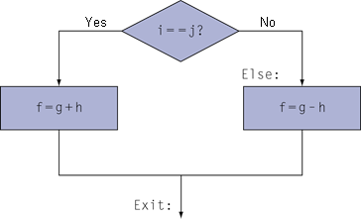
Compiling If Statements
C code:
if (i == j) f = g + h;
else f = g - h;
  f, …, j in X19, …, X23
Compiled LEGv8 code:
SUB X9, X22, X23
CBNZ X9, Else
ADD X19, X20, X21
B Exit
Else: SUB X19, X20, X21
Exit: …
Assembler calculates offset

Slide 43
Compiling Loop Statements
C code:
while (save[i] == k) i += 1;
  i in X22, k in X24, address of save in X25
Compiled LEGv8 code:
Loop: LSL X9, X22, #3
ADD X10, X25, X9
LDUR X11, [X10, #0]
SUB X12, X11, X24
CBNZ X12, Exit
ADDI X22, X22, #1
B Loop
Exit: …

Slide 44
Basic Blocks
A basic block is a sequence of instructions with
  No embedded branches (except at end)
  No branch targets (except at beginning)
A compiler identifies basic blocks for optimization
An advanced processor can accelerate execution of basic blocks

Slide 45
More Conditional Operations
Condition codes, set from arithmetic instruction with S-suffix (ADDS, ADDIS, ANDS, ANDIS, SUBS, SUBIS)
  negative (N): result had 1 in MSB
  zero (Z): result was 0
  overflow (V): result sign overflowed
  carry (C): result had carryout from MSB
Use subtract and set flags, then conditionally branch:
  B.EQ (equal)
  B.NE (not equal)
  B.LT (less than, < signed), B.LO (lower, < unsigned)
  B.LE (less than or equal, ≤ signed), B.LS (lower or same, ≤ unsigned)
  B.GT (greater than, > signed), B.HI (higher, > unsigned)
  B.GE (greater than or equal, ≥ signed),
  B.HS (higher or same, ≥ unsigned)
S = Set flags

Slide 46
Signed vs. Unsigned
Signed comparison ≠ Unsigned comparison
Example
  W22 = 1111 1111 1111 1111 1111 1111 1111 1111
  W23 = 0000 0000 0000 0000 0000 0000 0000 0001
  W22 ? W23 # signed
    –1 < +1
  W22 ? W23 # unsigned
    +4,294,967,295 > +1
<
>

Slide 47
Conditional Example
if (a > b) a += 1;
  a in X22, b in X23
  a and b are signed numbers
  SUBS XZR, X22, X23
  B.LE Exit
  ADDI X22, X22, #1
  Exit:
Note: condition in B is complement of condition in if

Slide 48
Conditional Example
if (a > b) a += 1;
  a in X22, b in X23
  a and b are unsigned numbers
  SUBS XZR, X22, X23
  B.LS Exit
  ADDI X22, X22, #1
  Exit:

Slide 49
Pseudo instructions
A pseudo instruction in assembler language is translated into an other instruction.
Meant to make your live a little easier.
See book page 129.
CMP Xa, Xb ➔ SUBS XZR, Xa, Xb
CMPI Xa,#c ➔ SUBIS XZR, Xa, #c
MOV Xa, Xb ➔ ORR Xa, XZR, Xb

Slide 50
Agenda
Instruction Set
Operations and Operands
Representing Instructions in the Computer
Logical Operations
Instructions for Making Decisions
Supporting Procedures in Computer Hardware
LEGv8 Addressing for Wide Immediates and Addresses
A C Sort Example to Put It All Together
Arrays versus Pointers

Slide 51
Procedure Calling
Steps required
  Place parameters in registers X0 to X7
  Transfer control to procedure
  Acquire storage for procedure
  Perform procedure’s operations
  Place result in register for caller
  Return to place of call (address in X30)
§2.8 Supporting Procedures in Computer Hardware
When the book writes “procedure” you may read “function”

Slide 52
Procedure Call Instructions
Procedure call: branch with link
BL ProcedureLabel
  Address of following instruction put in X30 = LR (Link Register)
  Jumps to target address
Procedure return: branch to register
BR LR
  Copies LR to program counter
  Can also be used for computed jumps
    e.g., for case/switch statements
Can also be used for jump to function pointers

Slide 53
Register Usage
X9 to X17: temporary registers
  Not preserved by the callee
X19 to X28: saved registers
  If used, the callee saves and restores them
Callee = function which is called
ARM Call Convention
Should we follow this convention?

Slide 54
Leaf Procedure Example
C code:
long long int leaf_example(
long long int g, long long int h,
long long int i, long long int j)
{
long long int f;
f = (g + h) - (i + j);
return f;
}
  Arguments g, …, j in X0, …, X3
  Return value in X0

Slide 55
Leaf Procedure Example
LEGv8 code:
leaf_example:
ADD X9, X0, X1
ADD X10, X2, X3
SUB X0, X9, X10
BR LR

Slide 56
Leaf Procedure Example
C code:
long long int leaf_example(
long long int g, long long int h,
long long int i, long long int j)
{
long long int f;
f = (g + h) - (i + j);
return f;
}
  Arguments g, …, j in X0, …, X3
  Return value in X0
  f in X19 (hence, need to save X19 on stack)
Strange requirement! Let’s just do it as an exercise

Slide 57
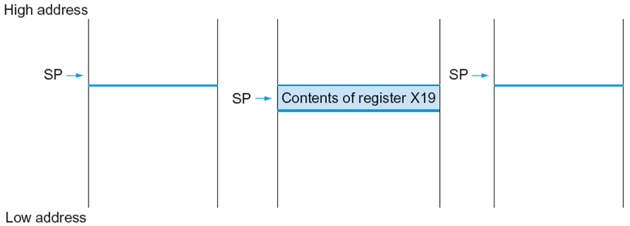
Local Data on the Stack
During procedure call
Before procedure call
After procedure call

Slide 58
Leaf Procedure Example
LEGv8 code:
leaf_example:
SUBI SP, SP, #8
STUR X19, [SP, #0]
ADD X9, X0, X1
ADD X10, X2, X3
SUB X19, X9, X10
ADD X0, X19, XZR
LDUR X19, [SP, #0]
ADDI SP, SP, #8
BR LR

Slide 59
Non-Leaf Procedures
Procedures that call other procedures
For nested call, caller needs to save on the stack:
  Its return address
  Any arguments and temporaries needed after the call
Restore from the stack after the call

Slide 60
Non-Leaf Procedure Example
C code:
long long int fact(long long int n)
{
if (n <= 1) return n;
else return n * fact(n - 1);
}
  Argument n in X0
  Result in X0
Strange implementation of factorial! Let’s just do it as an exercise
Use MUL instruction for multiplication (see Chapter 3)
Assume result fits in long long int

Slide 61
Leaf Procedure Example
LEGv8 code:
fact:
SUBIS XZR, X0, #1
B.GT else
BR LR
else:
SUBI SP, SP, #16
STUR LR, [SP, #8]
STUR X0, [SP, #0]
SUBI X0, X0, #1
BL fact
LDUR X9, [SP, #0]
LDUR LR, [SP, #8]
ADDI SP, SP, #16
MUL X0, X9, X0
BR LR

Slide 62
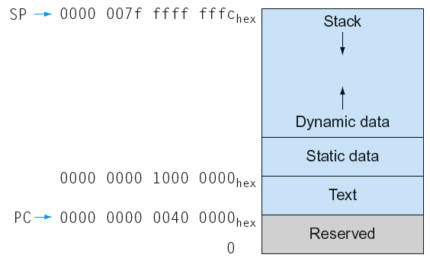
Memory Layout
Text: program code
Static data: global variables
  e.g., static variables in C, constant arrays and strings
Dynamic data: heap
  E.g., malloc in C, new in Java
Stack: local (automatic) variables (spilled registers)

Slide 63
Agenda
Instruction Set
Operations and Operands
Representing Instructions in the Computer
Logical Operations
Instructions for Making Decisions
Supporting Procedures in Computer Hardware
LEGv8 Addressing for Wide Immediates and Addresses
A C Sort Example to Put It All Together
Arrays versus Pointers

Slide 64
64-bit Constants
Most constants are small
  12-bit immediate is sufficient
For the occasional 64-bit constant
MOVZ: move 16-bit wide with zeros
MOVK: move 16-bit wide with keep
Use with second operand (LSL 0, 16, 32 or 48)
§2.10 LEGv8 Addressing for 32-Bit Immediates and Addresses
MOVZ X9,255,LSL 16
0000 0000 0000 0000
0000 0000 0000 0000
0000 0000 1111 1111
0000 0000 0000 0000
MOVK X9,255,LSL 0
0000 0000 0000 0000
0000 0000 0000 0000
0000 0000 1111 1111
0000 0000 1111 1111

Slide 65
Pseudo instructions
A pseudo instruction in assembler language is translated into an other instruction.
Meant to make your live a little easier.
LDA Xa, Label ➔ proper set of MOVZ
and MOVK instructions
(max 4)

Slide 66
Branch Addressing
B-type
  B Label // go to location Label:
CB-type
  CBNZ X19, Exit // go to Exit if X19 != 0
Both addresses are PC-relative
  Address = PC + offset (from instruction) x 4
5
Instruction offset to Label:
6 bits
26 bits
181
Instruction offset to Exit:
19
8 bits
19 bits
5 bits

Slide 67
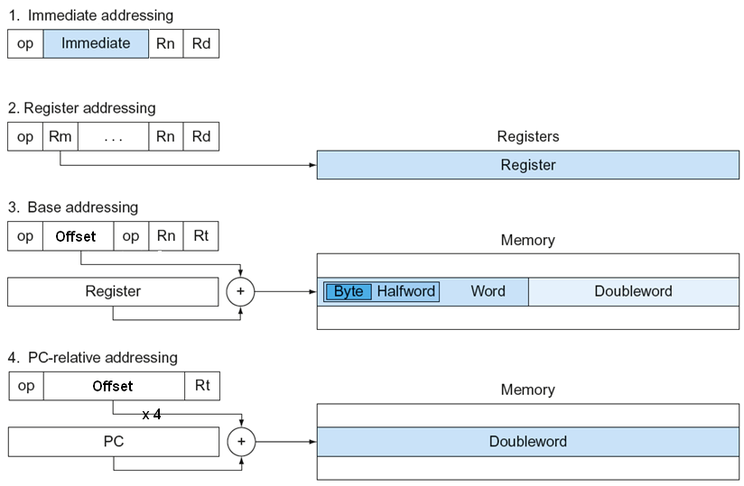
LEGv8 Addressing Summary
Figure 2.19 in your book is incorrect!
unsigned
signed
signed

Slide 68
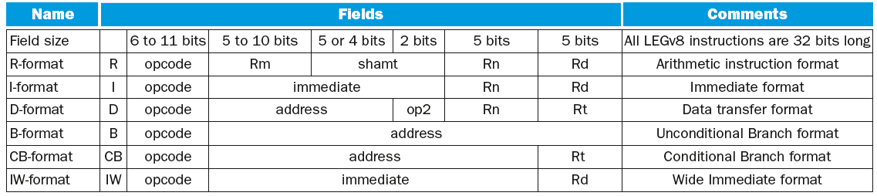
LEGv8 Encoding Summary
Address field actually contains an offset

Slide 69
Agenda
Instruction Set
Operations and Operands
Representing Instructions in the Computer
Logical Operations
Instructions for Making Decisions
Supporting Procedures in Computer Hardware
LEGv8 Addressing for Wide Immediates and Addresses
A C Sort Example to Put It All Together
Arrays versus Pointers

Slide 70
C Sort Example
Illustrates use of assembly instructions for a C bubble sort function
Swap procedure (leaf)
  void swap(long long int v[],
  size_t k)
  {
  long long int temp;
  temp = v[k];
  v[k] = v[k+1];
  v[k+1] = temp;
  }
  v in X0, k in X1, temp in X9
§2.13 A C Sort Example to Put It All Together
Why do we use X9?

Slide 71
The Procedure Swap
swap: LSL X10, X1, #3 // X10 = k * 8
ADD X10, X0, X10 // X10 = address of v[k]
LDUR X9, [X10, #0] // X9 = v[k]
LDUR X11, [X10, #8] // X11 = v[k+1]
STUR X11, [X10, #0] // v[k] = X11 (v[k+1])
STUR X9, [X10, #8] // v[k+1] = X9 (v[k])
BR LR // return to calling
// routine

Slide 72
The Sort Procedure in C
Non-leaf (calls swap)
  void sort (long long int v[], size_t n)
  {
  size_t i, j;
  for (i = 0; i < n; i += 1) {
  for (j = i – 1;
  j >= 0 && v[j] > v[j + 1];
  j -= 1)
  {
  swap(v, j);
  }
  }
  }
  v in X0, n in X1, i in X19, j in X20
Why do we use X19 and X20?

Slide 73
The Outer Loop
Skeleton of outer loop:
  for (i = 0; i <n; i += 1) {
MOV X19,XZR // i = 0
for1tst:
CMP X19, X1 // compare X19 to X1 (i to n)
B.GE exit1 // go to exit1 if X19 ≥ X1 (i≥n)
(body of outer for-loop)
ADDI X19,X19,#1 // i += 1
B for1tst // branch to test of outer loop
exit1:

Slide 74
The Inner Loop
Skeleton of inner loop:
  for (j = i − 1; j >= 0 && v[j] > v[j + 1]; j − = 1) {
SUBI X20, X19, #1 // j = i - 1
for2tst: CMP X20,XZR // compare X20 to 0 (j to 0)
B.LT exit2 // go to exit2 if X20 < 0 (j < 0)
LSL X10, X20, #3 // reg X10 = j * 8
ADD X11, X0, X10 // reg X11 = v + (j * 8)
LDUR X12, [X11,#0] // reg X12 = v[j]
LDUR X13, [X11,#8] // reg X13 = v[j + 1]
CMP X12, X13 // compare X12 to X13
B.LE exit2 // go to exit2 if X12 ≤ X13
MOV X0, X21 // first swap parameter is v
MOV X1, X20 // second swap parameter is j
BL swap // call swap
SUBI X20, X20, #1 // j –= 1
B for2tst // branch to test of inner loop
exit2:

Slide 75
Preserving Registers
Preserve saved registers:
SUBI SP,SP,#40 // make room on stack for 5 regs
STUR LR,[SP,#32] // save LR on stack
STUR X22,[SP,#24] // save X22 on stack
STUR X21,[SP,#16] // save X21 on stack
STUR X20,[SP,#8] // save X20 on stack
STUR X19,[SP,#0] // save X19 on stack
MOV X21, X0 // copy parameter X0 into X21
MOV X22, X1 // copy parameter X1 into X22
Restore saved registers:
exit1: LDUR X19, [SP,#0] // restore X19 from stack
LDUR X20, [SP,#8] // restore X20 from stack
LDUR X21,[SP,#16] // restore X21 from stack
LDUR X22,[SP,#24] // restore X22 from stack
LDUR X30,[SP,#32] // restore LR from stack
ADDI SP,SP,#40 // restore stack pointer
The code in your book is incorrect!

Slide 76
Effect of Compiler Optimization
Compiled with gcc for Pentium 4 under Linux

Slide 77
Effect of Language and Algorithm

Slide 78
Lessons Learnt
Instruction count and CPI are not good performance indicators in isolation
Compiler optimizations are sensitive to the algorithm
Java/JIT compiled code is significantly faster than JVM interpreted
  Comparable to optimized C in some cases
Nothing can fix a dumb algorithm!

Slide 79
Agenda
Instruction Set
Operations and Operands
Representing Instructions in the Computer
Logical Operations
Instructions for Making Decisions
Supporting Procedures in Computer Hardware
LEGv8 Addressing for Wide Immediates and Addresses
A C Sort Example to Put It All Together
Arrays versus Pointers

Slide 80
Arrays vs. Pointers
Array indexing involves
  Multiplying index by element size
  Adding to array base address
Pointers correspond directly to memory addresses
  Can avoid indexing complexity
§2.14 Arrays versus Pointers

Slide 81
Example: Clearing an Array
clear1(long long array[], size_t size) { size_t i; for (i = 0; i < size; i++) array[i] = 0; } | clear2(long long *array, size_t size) { long long *p; for (p = &array[0]; p < &array[size]; p++) *p = 0; }
MOV X9,XZR // i = 0 loop1: LSL X10,X9,#3 // X10 = i * 8 ADD X11,X0,X10 // X11 = address // of array[i] STUR XZR,[X11,#0] // array[i] = 0 ADDI X9,X9,#1 // i = i + 1 CMP X9,X1 // compare i to // size B.LT loop1 // if (i < size) // go to loop1 | MOV X9,X0 // p = address of // array[0] LSL X10,X1,#3 // X10 = size * 8 ADD X11,X0,X10 // X11 = address // of array[size] loop2: STUR XZR,[X9,#0] // Memory[p] = 0 ADDI X9,X9,#8 // p = p + 8 CMP X9,X11 // compare p to < // &array[size] B.LT loop2 // if (p < // &array[size]) // go to loop2

Slide 82
Comparison of Array vs. Ptr
Multiply “strength reduced” to shift
Array version requires shift to be inside loop
  Part of index calculation for incremented i
  c.f. incrementing pointer
Compiler can achieve same effect as manual use of pointers
  Induction variable elimination
  Better to make program clearer and safer

Slide 83
NIET VERGETEN
Mail sturen over met wie je practicum wilt doen.

