Slide 1
H 3
Computer Arithmetic
ELECTA01
Computer architecture
ELECTA01
Hogeschool Rotterdam
Opleiding Elektrotechniek
Minor Embedded Systems
J.W. Peltenburg / J.Z.M. Broeders (brojz@hr.nl)

Slide 2
ARITHMETIC FOR COMPUTERS
Hoofdstuk 3

Slide 3
Arithmetic for Computers
§3.1 Introduction
Operations on integers
  Addition and subtraction
  Multiplication and division
  Dealing with overflow
Floating-point real numbers
  Representation and operations

Slide 4
Addition and Subtraction
>>
Right to left addition, bit by bit.
Carries passed to the next digit to the left.
Behavior as expected, because we humans do the same.
Subtraction is the same as addition: the appropriate operand is simply negated before being added.

Slide 5
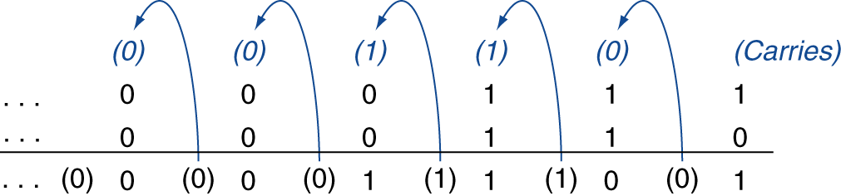
Integer Addition
>>
Example: 7 + 6
§3.2 Addition and Subtraction
Overflow if result out of range
  Adding +ve and –ve operands, no overflow
  Adding two +ve operands
    Overflow if result sign is 1
  Adding two –ve operands
    Overflow if result sign is 0

Slide 6
Integer Subtraction
>>
Add negation of second operand
Example: 7 – 6 = 7 + (–6)
  +7: 0000 0000 … 0000 0111
  –6: 1111 1111 … 1111 1010
  +1: 0000 0000 … 0000 0001
Overflow if result out of range
  Subtracting two +ve or two –ve operands, no overflow
  Subtracting +ve from –ve operand
    Overflow if result sign is 0
  Subtracting –ve from +ve operand
    Overflow if result sign is 1

Slide 7
Overflows
>>
Can we have an overflow by adding if both the operands have different signs?
Operation | Operand A | Operand B | Result indicating overflow
A + B | ≥ 0 | ≥ 0 | < 0
A + B | < 0 | < 0 | ≥ 0
A – B | ≥ 0 | < 0 | < 0
A – B | < 0 | ≥ 0 | ≥ 0

Slide 8
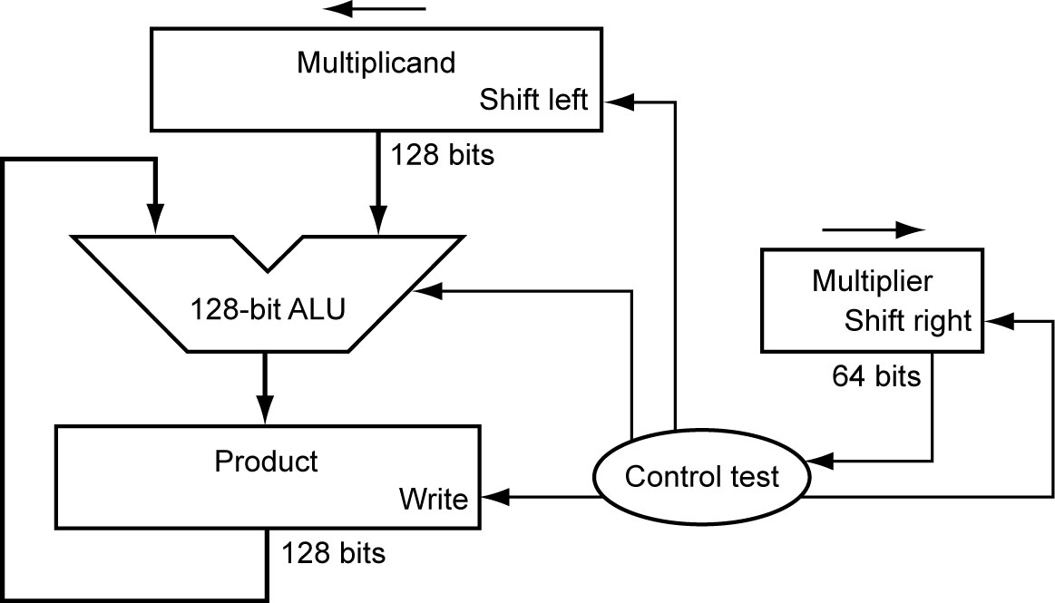
Multiplication
§3.3 Multiplication
Start with long-multiplication approach
multiplicand
1000
× 1001
1000
0000
0000
1000
1001000
multiplier
product
Length of product is the sum of operand lengths

Slide 9
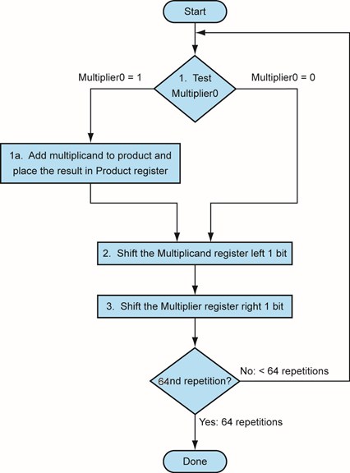
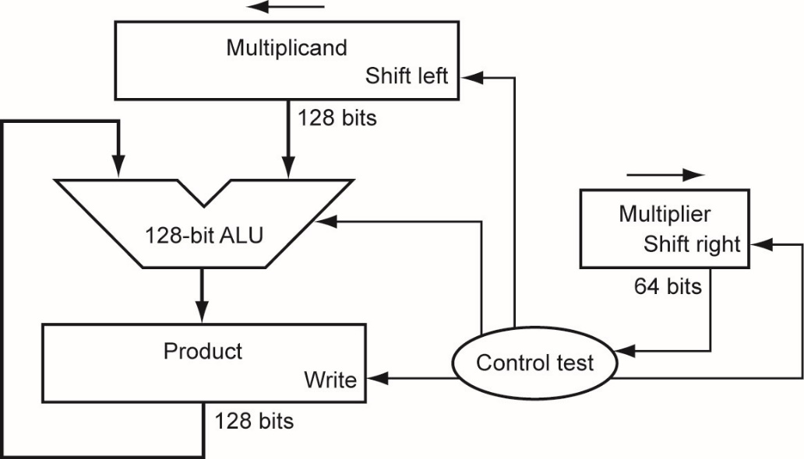
Multiplication Hardware
Initially 0
Corrected version of Figure 3.4 page 194.

Slide 10
Exercise
Multiply 10 by 9
Use 4 bits multiplicand and 4 bits multiplier (8 bits product).

Slide 11
Exercise solution
Iteration | Step | Multiplier | Multiplicand | Product
0 | Initial values | 1001 | 0000 1010 | 0000 0000
1 | multiplier(0)=1; add multiplicand sll multiplicand slr multiplier | 1001 1001 0100 | 0000 1010 0001 0100 0001 0100 | 0000 1010 0000 1010 0000 1010
2 | multiplier(0)=0; no add multiplicand sll multiplicand slr multiplier | 0100 0100 0010 | 0001 0100 0010 1000 0010 1000 | 0000 1010 0000 1010 0000 1010
3 | multiplier(0)=0; no add multiplicand sll multiplicand slr multiplier | 0010 0010 0001 | 0010 1000 0101 0000 0101 0000 | 0000 1010 0000 1010 0000 1010
4 | multiplier(0)=1; add multiplicand sll multiplicand slr multiplier | 0001 0001 0000 | 0101 0000 1010 0000 1010 0000 | 0101 1010 0101 1010 0101 1010

Slide 12
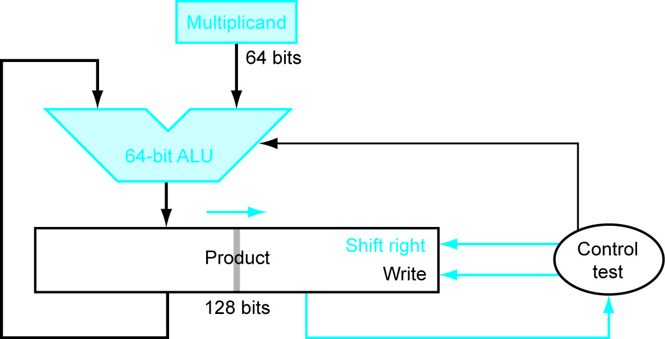
Optimized Multiplier
Perform steps in parallel: add/shift
One cycle per partial-product addition
  That’s ok, if frequency of multiplications is low

Slide 13
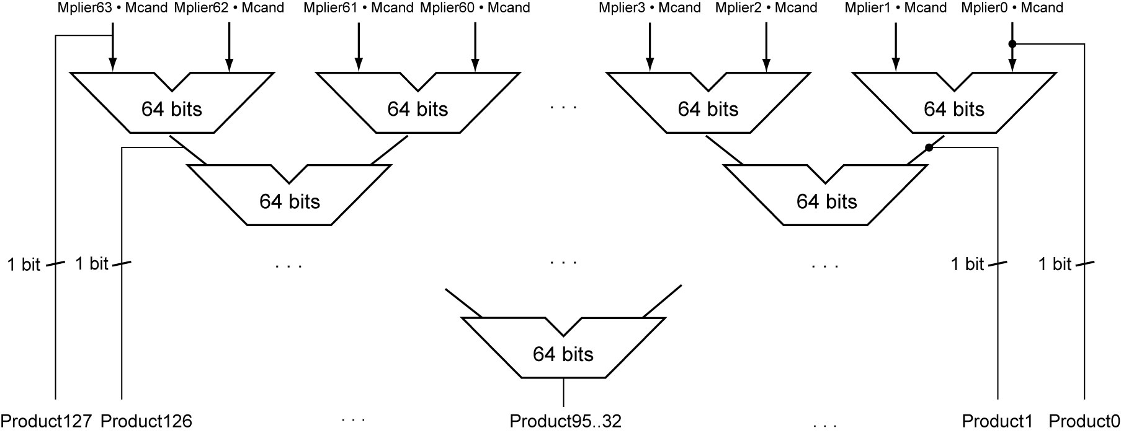
Faster Multiplier
Uses multiple adders
  Cost/performance tradeoff
Can be pipelined
  Several multiplication performed in parallel

Slide 14
LEGv8 Multiplication
Three multiply instructions:
  MUL: multiply
    Gives the lower 64 bits of the product
  SMULH: signed multiply high
    Gives the upper 64 bits of the product, assuming the operands are signed
  UMULH: unsigned multiply high
    Gives the upper 64 bits of the product, assuming the operands are unsigned

Slide 15
Floating Point
§3.5 Floating Point
Representation for non-integral numbers
  Including very small and very large numbers
Like scientific notation
  –2.34 × 10⁵⁶
  +0.002 × 10^{–4}
  +987.02 × 10⁹
In binary
  ±1.xxxxxxx₂ × 2^{yyyy}
Types float and double in C
normalized
not normalized

Slide 16
Floating Point Standard
Defined by IEEE Std 754-1985
  latest version IEEE 754-2008
Developed in response to divergence of representations
  Portability issues for scientific code
Now almost universally adopted
Several representations, most importantly:
  Single precision (32-bit)
  Double precision (64-bit)

Slide 17
IEEE Floating-Point Format
single: 8 bits
double: 11 bits
single: 23 bits
double: 52 bits
S
Exponent
Fraction
S: sign bit (0 ⇒ non-negative, 1 ⇒ negative)
Normalize significand: 1.0 ≤ |significand| < 2.0
  Always has a leading pre-binary-point 1 bit, so no need to represent it explicitly (hidden bit)
  Significand is Fraction with the “1.” restored
Exponent: excess representation: actual exponent + Bias
  Ensures exponent is unsigned
  Single: Bias = 127; Double: Bias = 1023

Slide 18
Single-Precision Range
Exponents 00000000 and 11111111 reserved
Smallest value
  Exponent: 00000001
  ⇒ actual exponent = 1 – 127 = –126
  Fraction: 000…00 ⇒ significand = 1.0
  ±1.0 × 2^{–126} ≈ ±1.2 × 10^{–38}
Largest value
  exponent: 11111110
  ⇒ actual exponent = 254 – 127 = +127
  Fraction: 111…11 ⇒ significand ≈ 2.0
  ±2.0 × 2⁺¹²⁷ ≈ ±3.4 × 10⁺³⁸

Slide 19
Double-Precision Range
Exponents 0000…00 and 1111…11 reserved
Smallest value
  Exponent: 00000000001
  ⇒ actual exponent = 1 – 1023 = –1022
  Fraction: 000…00 ⇒ significand = 1.0
  ±1.0 × 2^{–1022} ≈ ±2.2 × 10^{–308}
Largest value
  Exponent: 11111111110
  ⇒ actual exponent = 2046 – 1023 = +1023
  Fraction: 111…11 ⇒ significand ≈ 2.0
  ±2.0 × 2⁺¹⁰²³ ≈ ±1.8 × 10⁺³⁰⁸

Slide 20
Floating-Point Precision
Relative precision
  all fraction bits are significant
  Implicit 1 is significant
  Single: approx 2^{–24}
    Equivalent to 24 × log₁₀2 ≈ 24 × 0.3 ≈ 7 decimal digits of precision
  Double: approx 2^{–53}
    Equivalent to 53 × log₁₀2 ≈ 53 × 0.3 ≈ 16 decimal digits of precision

Slide 21
Floating-Point Example
Represent –0.75 in IEEE 754 single and double precision
  –0.75 = (–1)¹ × 1.1₂ × 2^{–1}
  S = 1
  Fraction = 1000…00₂
  Exponent = –1 + Bias
    Single: –1 + 127 = 126 = 01111110₂
    Double: –1 + 1023 = 1022 = 01111111110₂
Single: 1011111101000…00 0xBF400000
Double: 1011111111101000…00
    0xBFE8000000000000

Slide 22
Floating-Point Example
What number is represented by the single precision float (IEEE 754) 0xC0A00000
11000000101000…00
  S = 1
  Fraction = 01000…00₂
  Exponent = 10000001₂ = 129
x = (–1)¹ × (1.01₂) × 2^{(129 – 127)}
  = (–1) × 1.25 × 2²
  = –5.0

Slide 23
Denormal Numbers
Exponent = 000...0 ⇒ hidden bit is 0
Smaller than normal numbers
  allow for gradual underflow, with diminishing precision
Denormal with fraction = 000...0
Two representations of 0.0!

Slide 24
Infinities and NaNs
Exponent = 111...1, Fraction = 000...0
  ±Infinity
  Can be used in subsequent calculations, avoiding need for overflow check
Exponent = 111...1, Fraction ≠ 000...0
  Not-a-Number (NaN)
  Indicates illegal or undefined result
    e.g., 0.0 / 0.0
  Can be used in subsequent calculations

Slide 25
FP Instructions in LEGv8
Separate FP registers
  32 x 32-bits single-precision: S0, …, S31
  32 x 64-bits double-precision: D0, …, D31
  Sn stored in the lower 32 bits of Dn
FP instructions operate only on FP registers
  Programs generally don’t do integer ops on FP data, or vice versa
  More registers with minimal code-size impact
FP load and store instructions
  LDURS, LDURD
  STURS, STURD

Slide 26
FP Instructions in LEGv8
Single-precision arithmetic
  FADDS, FSUBS, FMULS, FDIVS
    e.g., FADDS S2, S4, S6
Double-precision arithmetic
  FADDD, FSUBD, FMULD, FDIVD
    e.g., FADDD D2, D4, D6
Single- and double-precision comparison
  FCMPS, FCMPD
  Sets or clears FP condition-code bits
Branch on FP condition code true or false
  B.cond

Slide 27
FP Example: °F to °C
C code:
float f2c (float fahr) {
return ((5.0/9.0)*(fahr - 32.0));
}
  fahr in S0, result in S0, literals in global memory space with offset from X27 (const5, const9, const32).
Compiled LEGv8 code:
f2c:
LDURS S16, [X27, const5]
LDURS S17, [X27, const9]
FDIVS S18, S16, S17
LDURS S19, [X27, const32]
FSUBS S20, S0, S19
FMULS S0, S18, S20
BR LR
ARM Call Convention:
D0-D7: Arguments / Results
D8-D15: Saved by callee
D16-D31: Temporaries

Slide 28
FP Example: Matrix Multiplication
X = X + Y × Z
  All 32 × 32 matrices, 64-bit double-precision elements
C code:
void mm(double x[][],
double y[][], double z[][]) {
int i, j, k;
for (i = 0; i! = 32; i = i + 1)
for (j = 0; j! = 32; j = j + 1)
for (k = 0; k! = 32; k = k + 1)
x[i][j] = x[i][j]
+ y[i][k] * z[k][j];
}
  Addresses of x, y, z in X0, X1, X2, and
  i, j, k in X9, X10, X11

Slide 29
FP Example: Matrix Multiplication
LEGv8 code:
mm: ADDI X12, XZR, #32
MOV X9, XZR
L1: MOV X10, XZR
L2: MOV X11, XZR
LSL X13, X9, #5
ADD X14, X13, X10
LSL X15, X14, #3
ADD X16, X0, X15
LDURD D8, [X16, #0]
L3: LSL X13, X9, #5
ADD X14, X13, X11
LSL X15, X14, #3
ADD X17, X1, X15
LDURD D9, [X17, #0]
LSL X13, X11, #5
ADD X14, X13, X11
LSL X15, X14, #3
ADD X17, X2, X15
LDURD D10, [X17, #0]
FMULD D11, D9, D10
FADDD D8, D8, D11
ADDI X11, X11, #1
CMP X11, X12
B.LT L3
STURD D8, [X16, #0]
ADDI X10, X10, #1
CMP X10, X12
B.LT L2
ADDI X9, X9, #1
CMP X9, X12
B.LT L1
BR LR

Slide 30
Concluding Remarks
Bits have no inherent meaning
  Interpretation depends on the instructions applied
Computer representations of numbers
  Finite range and precision
  Need to account for this in programs
§3.9 Concluding Remarks

Slide 31
Concluding Remarks
ISAs support arithmetic
  Signed and unsigned integers
  Floating-point approximation to reals
Bounded range and precision
  Operations can overflow and underflow

