Slide 1
H4
The processor
ELECTA01
Computer architecture
ELECTA01
Hogeschool Rotterdam
Opleiding Elektrotechniek
Minor Embedded Systems
J.W. Peltenburg / J.Z.M. Broeders (brojz@hr.nl)

Slide 2
Planning CTA01
Week 1: Introduction, Performance & Parallelism
Week 2: Instructions for arithmetic and memory
Week 3: Instructions for decisions and procedures
Week 4: Computer arithmetic
Week 5: Single cycle LEGv8, intro pipelining
Week 6: Pipelined LEGv8, hazards and forwarding
Week 7: Memory architecture
Week 8: Guest lecture (multicore and parallelism)

Slide 3
Chapter 4
The Processor

Slide 4
Introduction
§4.1 Introduction
CPU performance factors
  Instruction count
    Determined by ISA and compiler
  CPI and Cycle time
    Determined by CPU hardware
We will examine two LEGv8 implementations
  A simplified version
  A more realistic pipelined version
Simple subset, shows most aspects
  Memory reference: LDUR, STUR
  Arithmetic/logical: ADD, SUB, AND, ORR
  Control transfer: CBZ

Slide 5
Instruction Execution
PC → instruction memory, fetch instruction
Register numbers → register file, read registers
Depending on instruction type
  Use ALU to calculate
    Arithmetic or logic result for R-type (ADD, SUB, AND, ORR)
    Memory address for D-type instructions (LDUR, STUR)
    Register equals zero for CB-type (CBZ)
  For CB-type (CBZ) calculate branch target address
  Access data memory for D-type (LDUR, STUR)
  Write to register file for R-type (ADD, SUB, AND, ORR) and load (LDUR)
PC ← PC + 4 or PC ← Branch target address
In parallel
In parallel

Slide 6
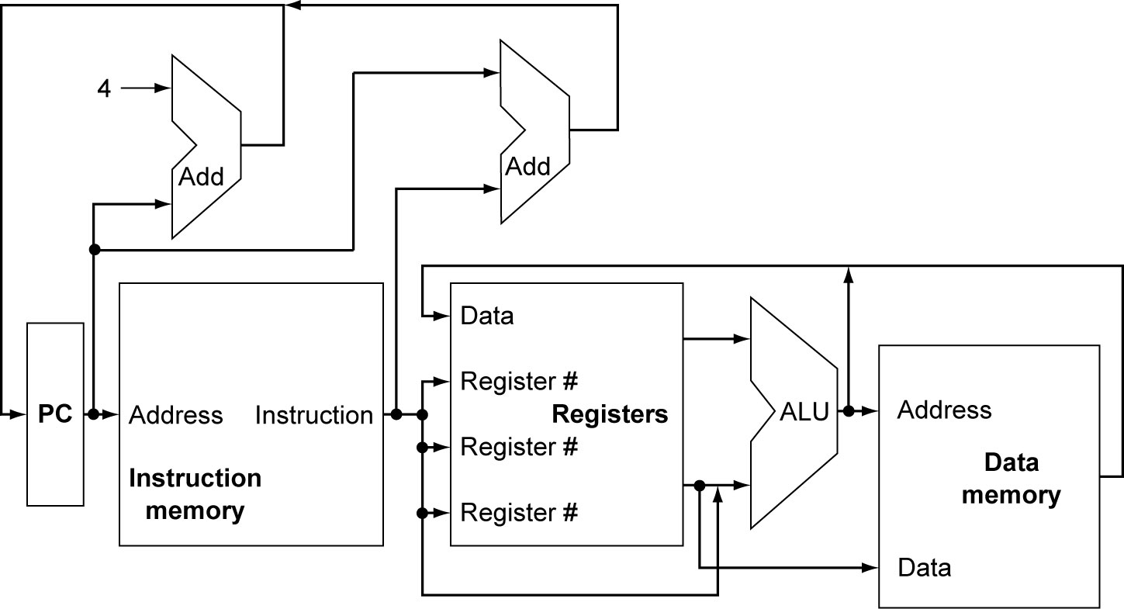
CPU Overview

Slide 7
Multiplexers
Can’t just join wires together
  Use multiplexers

Slide 8
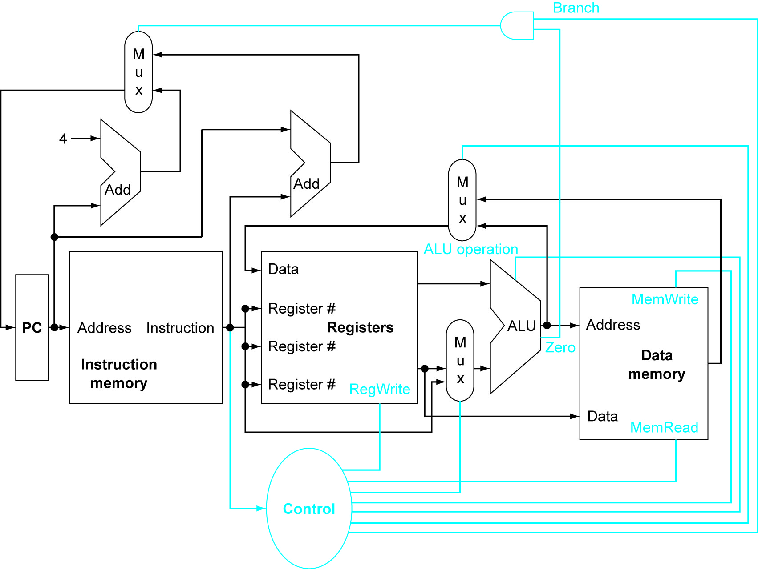
Control

Slide 9
Logic Design Basics
>>
Information encoded in binary
  Low voltage = 0, High voltage = 1
  One wire per bit
  Multi-bit data encoded on multi-wire buses
Combinational element
  Operate on data
  Output is a function of input
State (sequential) elements
  Store information
§4.2 Logic Design Conventions

Slide 10
Combinational Elements
>>
AND-gate
  Y = A & B
Adder
  Y = A + B
A
+
Y
B
A
Y
B
Arithmetic/Logic Unit
  Y = F(A, B)
Multiplexer
  Y = S ? I1 : I0
A
I0
M
u
x
Y
Y
ALU
I1
B
S
F

Slide 11
Sequential Elements
>>
Register: stores data in a circuit
  Uses a clock signal to determine when to update the stored value
  Edge-triggered: update when Clk changes from 0 to 1
Clk
D
Q
D
Clk
Q

Slide 12
Sequential Elements
>>
Register with write control
  Only updates on clock edge when write control input is 1
  Used when stored value is required later
Clk
D
Q
Write
Write
D
Clk
Q

Slide 13
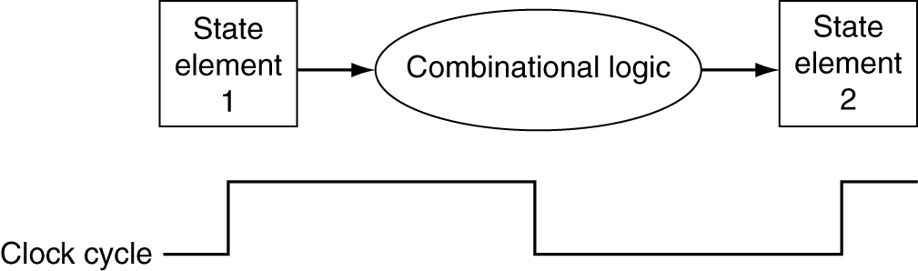
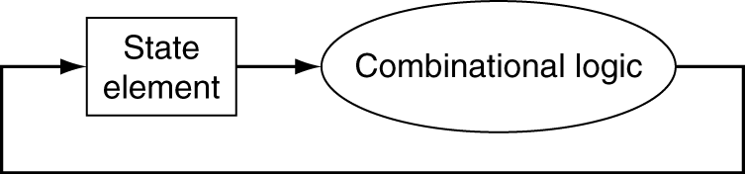
Clocking Methodology
>>
Combinational logic transforms data during clock cycles
  Between clock edges
  Input from state elements, output to state element
  Longest delay determines clock period

Slide 14
Building a Datapath
Datapath
  Elements that process data and addresses
  in the CPU
    Registers, ALUs, mux’s, memories, …
We will build a LEGv8 datapath incrementally
  Refining the overview design
§4.3 Building a Datapath

Slide 15
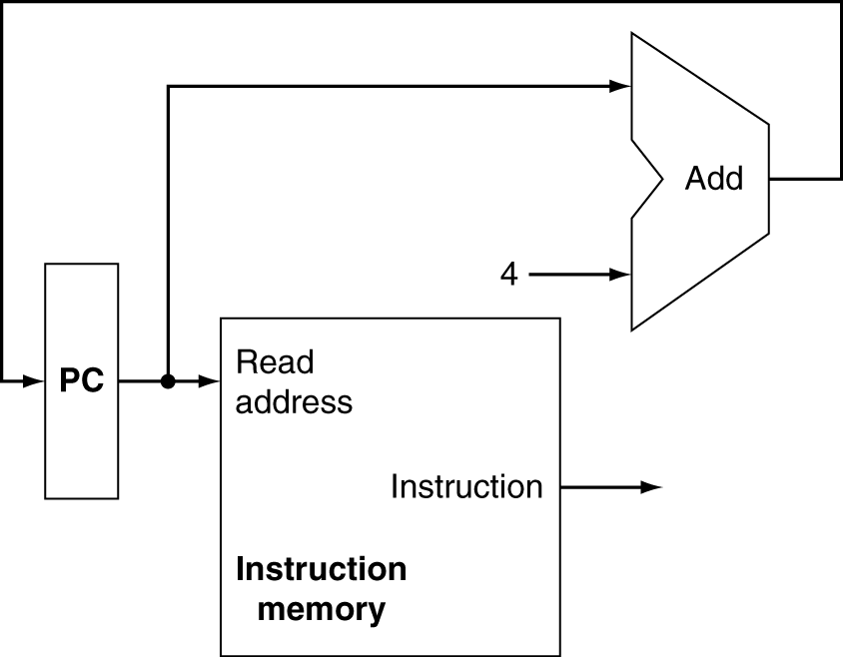
Instruction Fetch
Increment by 4 for next instruction
64-bit register

Slide 16
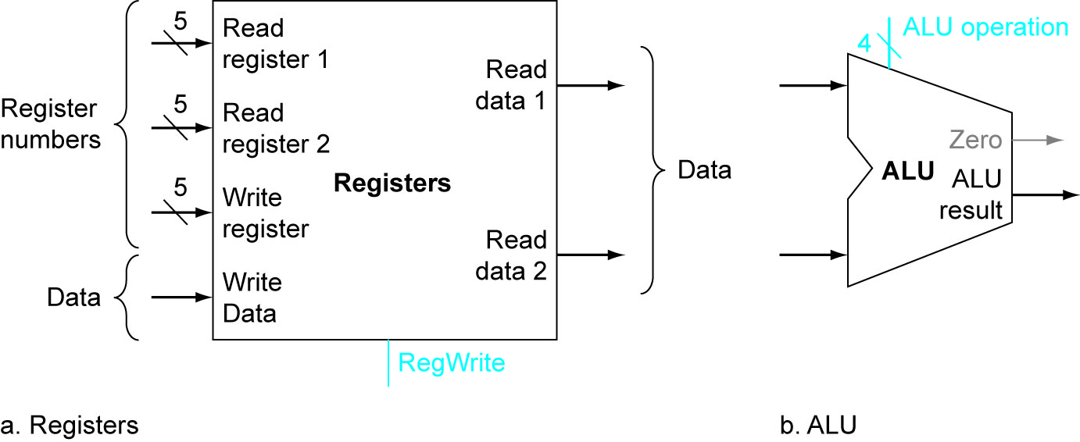
R-type Instructions ADD, SUB, AND, ORR
Read two register operands
Perform arithmetic/logical operation
Write register result
Multiport register file:
2 read ports, 1 write port

Slide 17
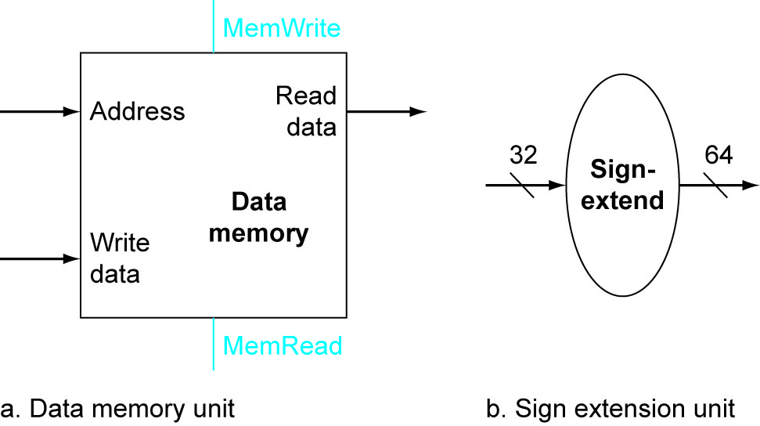
D-type Instructions LDUR, STUR
Read register operands
Calculate address using 9-bit offset
  Use ALU, but sign-extend offset
LDUR: Read memory and update register
STUR: Write register value to memory

Slide 18
CB-type Instruction CBZ
Read register operand
Compare operand to zero
  Use ALU pass input and check Zero output
Calculate target address
  Sign-extend 19-bit displacement field
  Shift left 2 places (word displacement)
  Add to PC

Slide 19
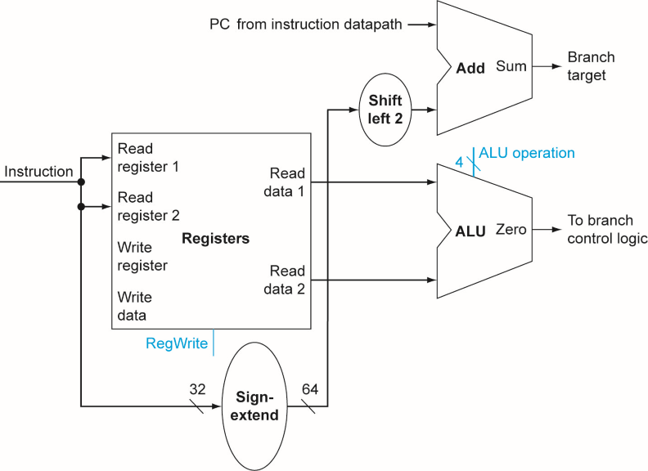
Branch Instructions
Corrected version of Figure 4.9 page 268.
Just
re-routes wires

Slide 20
Composing the Elements
First-cut data path does an instruction in one clock cycle
  Each datapath element can only do one function at a time
  Hence, we need separate instruction and data memories
Use multiplexers where alternate data sources are used for different instructions

Slide 21
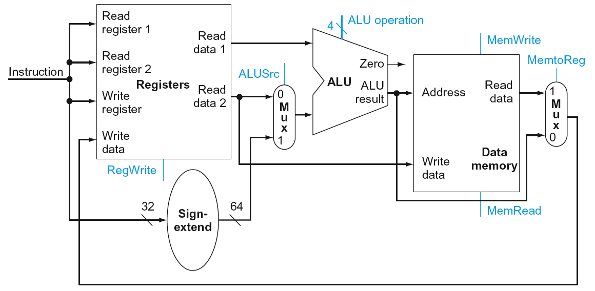
R-Type/D-Type Datapath
ADD, SUB, AND, ORR, LDUR, STUR

Slide 22
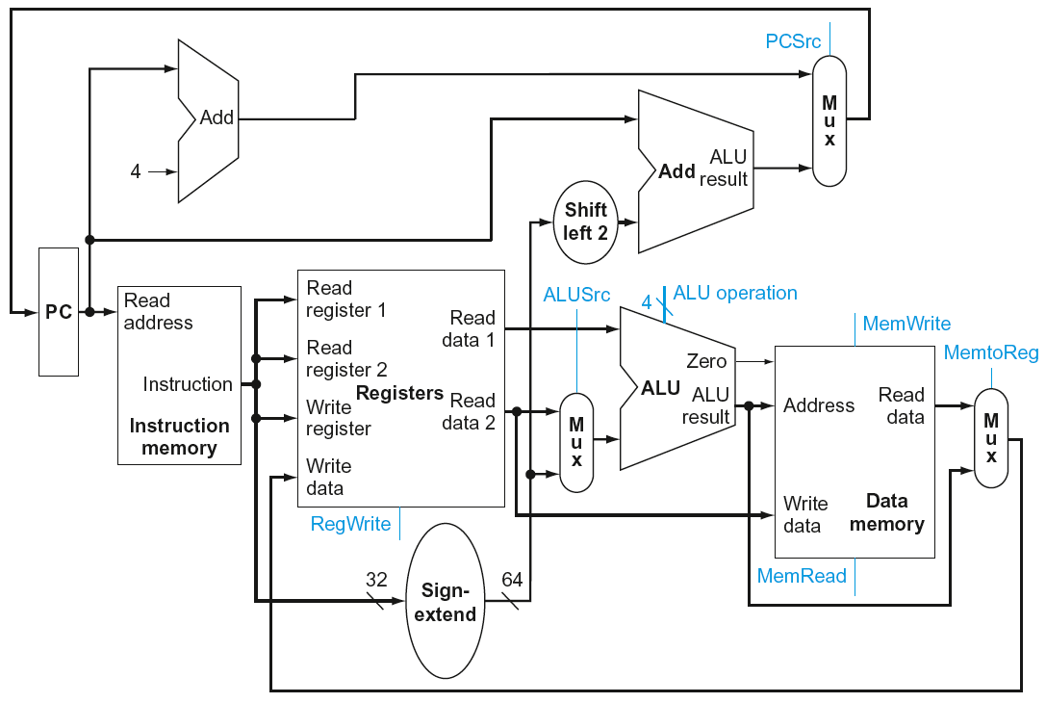
Full Datapath
ADD, SUB, AND, ORR, LDUR, STUR, CBZ

Slide 23
ALU Control
See ALU design Figure A.5.12 page A-35
ALU used for
  D-type LDUR, STUR: Function = add
  CB-type CBZ: Function = pass
  R-type ADD, SUB, AND, ORR: Function depends on opcode
§4.4 A Simple Implementation Scheme
ALU control | F = Function
0000 | AND
0001 | OR
0010 | add
0110 | subtract
XX11 | pass input b

Slide 24
ALU Control
Assume 2-bit ALUOp derived from opcode
  Combinational logic derives ALU control
opcode | ALUOp | Operation | Opcode field | ALU function | ALU control
LDUR | 00 | load register | XXXXXXXXXXX | add | 0010
STUR | 00 | store register | XXXXXXXXXXX | add | 0010
CBZ | 01 | compare and branch on zero | XXXXXXXXXXX | pass input b | XX11
R-type ADD, SUB, AND, ORR | 10 | add | 10001011000 | add | 0010
 |  | subtract | 11001011000 | subtract | 0110
 |  | AND | 10001010000 | AND | 0000
 |  | OR | 10101010000 | OR | 0001

Slide 25
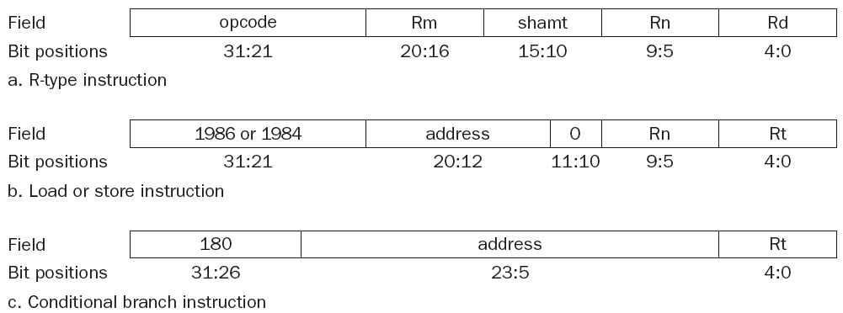
The Main Control Unit
Control signals derived from instruction

Slide 26
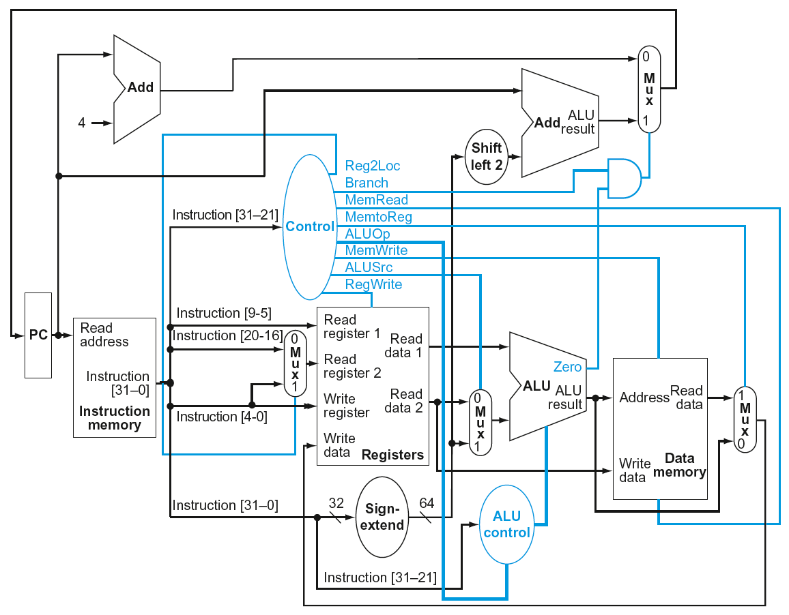
Datapath With Control

Slide 27
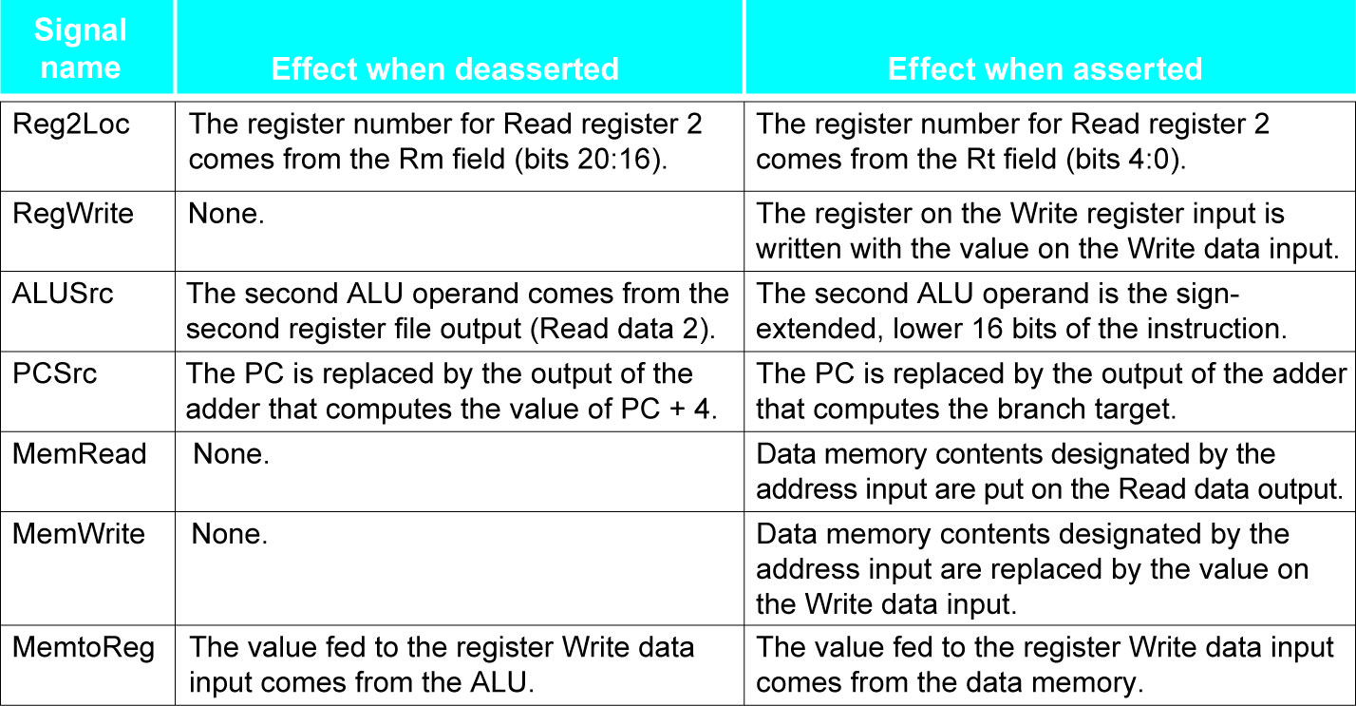
Control signals

Slide 28
Implementing B-type (B)
B
000101
offset
31:26
25:0
Branch uses word offset
PC ⬅ PC + (sign extended offset) x 4
Need an extra control signal decoded from opcode

Slide 29
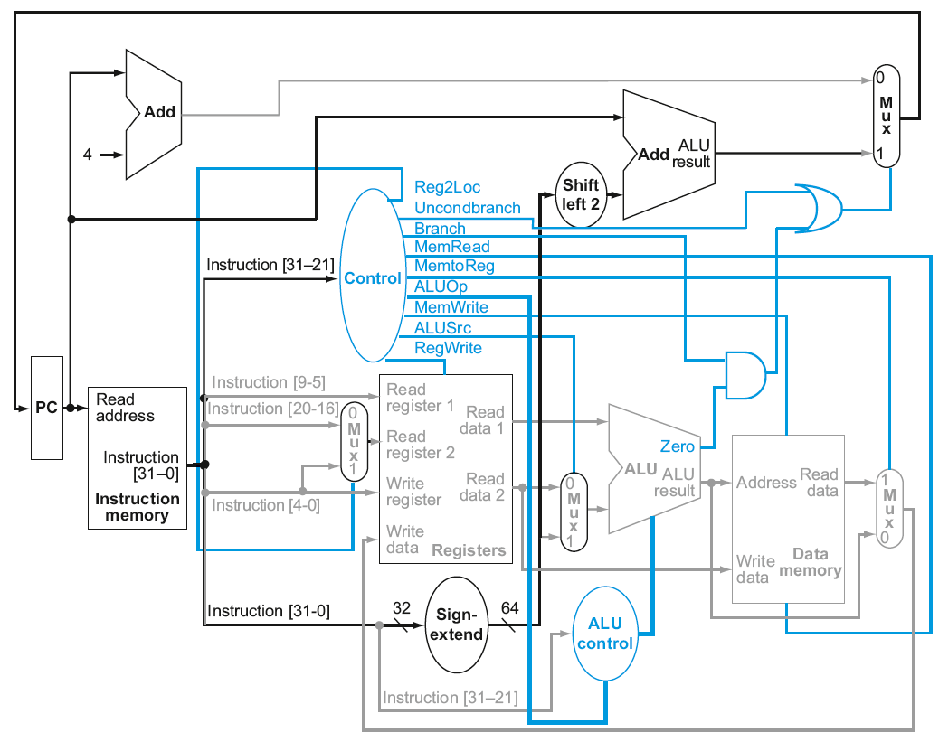
Datapath With B Added

Slide 30
Performance Issues
Longest delay determines clock period
  Critical path: load instruction
  Instruction memory → register file → ALU → data memory → register file
Not feasible to vary period for different instructions
Violates design principle
  Making the common case fast
We will improve performance by pipelining

Slide 31
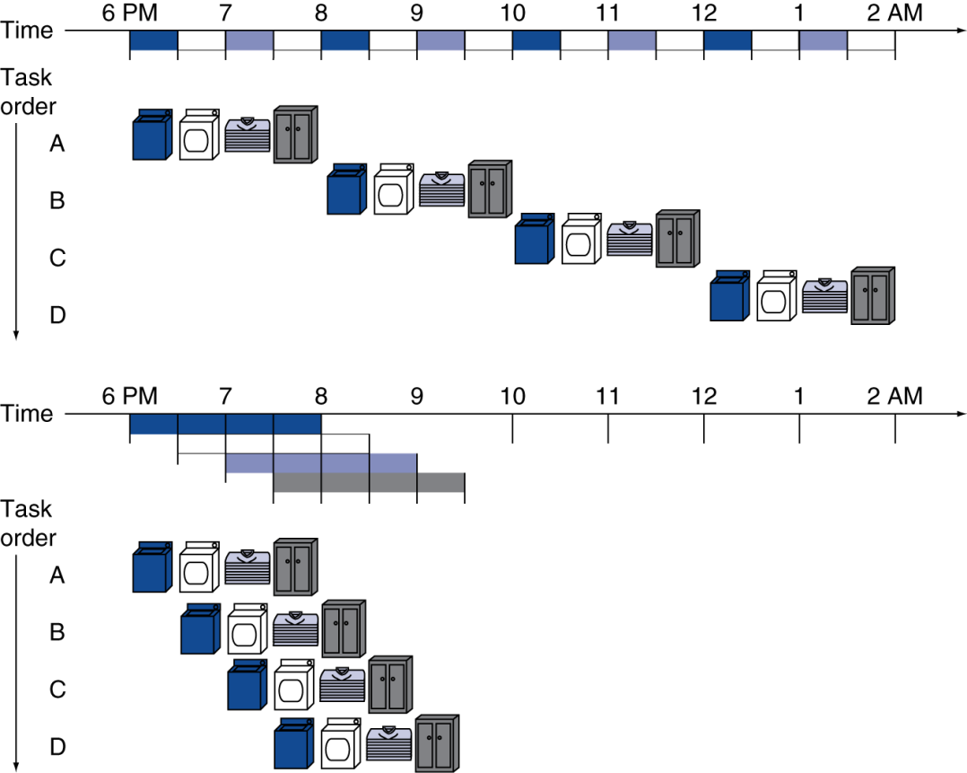
Pipelining Analogy
Pipelined laundry: overlapping execution
  Parallelism improves performance
§4.5 An Overview of Pipelining
Speedup?
Four loads:
  Speedup
  = 8/3.5 = 2.3
Non-stop:
  Speedup
  = 2n/0.5n + 1.5 ≈ 4
  = number of stages

Slide 32
LEGv8 Pipeline
Five stages, one step per stage
  IF: Instruction fetch from memory
  ID: Instruction decode & register read
  EX: Execute operation or calculate address
  MEM: Access memory operand
  WB: Write result back to register

Slide 33
Pipeline Performance
Assume time for stages is
  100 ps for register read or write
  200 ps for other stages
Compare pipelined datapath with single-cycle datapath
Instr | Instr fetch | Register read | ALU op | Memory access | Register write | Total time
LDUR | 200ps | 100 ps | 200ps | 200ps | 100 ps | 800ps
STUR | 200ps | 100 ps | 200ps | 200ps |  | 700ps
R-format | 200ps | 100 ps | 200ps |  | 100 ps | 600ps
CBZ | 200ps | 100 ps | 200ps |  |  | 500ps

Slide 34
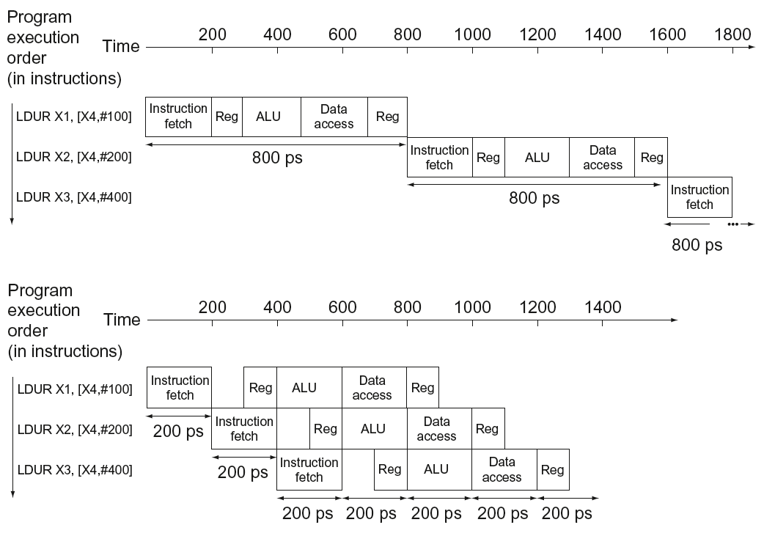
Pipeline Performance
Single-cycle (T_{c}= 800ps)
Pipelined (T_{c}= 200ps)

Slide 35
Pipeline Speedup
If all stages are balanced
  i.e., all take the same time
  Time between instructions_{pipelined}
  = Time between instructions_{nonpipelined}
  Number of stages
If not balanced, speedup is less
Speedup due to increased throughput
  Latency (time for each instruction) does not decrease

Slide 36
Pipelining and ISA Design
LEGv8 ISA designed for pipelining
  All instructions are 32-bits
    Easier to fetch and decode in one cycle
    c.f. x86: 1- to 17-byte instructions
  Few and regular instruction formats
    Can decode and read registers in one step
  Load/store addressing
    Can calculate address in 3rd stage, access memory in 4th stage
  Alignment of memory operands
    64-bit Memory access takes only one cycle

Slide 37
Hazards
Situations that prevent starting the next instruction in the next cycle
Structure hazards
  A required resource is busy
Data hazard
  Need to wait for previous instruction to complete its data read/write
Control hazard
  Deciding on control action depends on previous instruction

Slide 38
Structure Hazards
Conflict for use of a resource
In LEGv8 pipeline with a single memory
  Load/store requires data access
  Instruction fetch would have to stall for that cycle
    Would cause a pipeline “bubble”
Hence, pipelined datapaths require separate instruction/data memories
  Or separate instruction/data caches

Slide 39
Structure Hazards
Conflict for use of a resource
In LEGv8 the registers are used in stages ID (read) and WB (write)
Assumed time for stages is
  100 ps for register read or write
  200 ps for other stages
Hence, write and read can be combined in one pipeline slot
  write in first 100 ps, read in last 100 ps

Slide 40
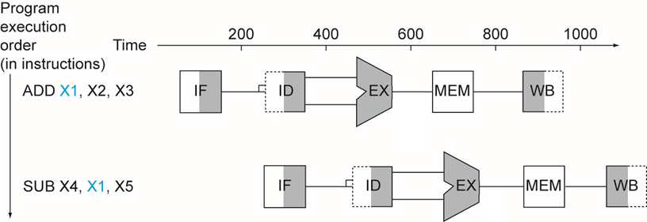
Data Hazards
An instruction depends on completion of data access by a previous instruction
  ADD X1, X2, X3
  SUB X4, X1, X5
Data can not move backward in time!

Slide 41
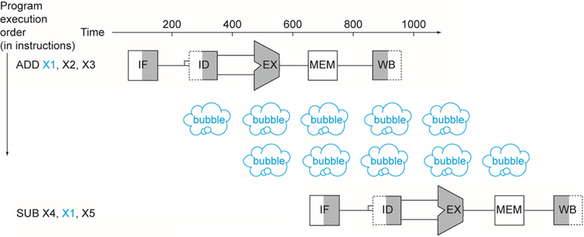
Stalling (aka insert bubbles)
wait for the data to be stored in a register
  Requires extra control logic
Data now moves forward in time!

Slide 42
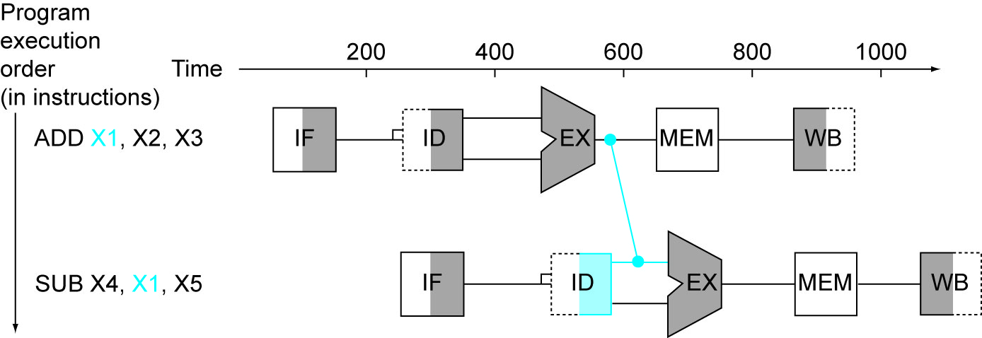
Forwarding (aka Bypassing)
Use result when it is computed
  Don’t wait for it to be stored in a register
  Requires extra connections in the datapath and extra control logic

Slide 43
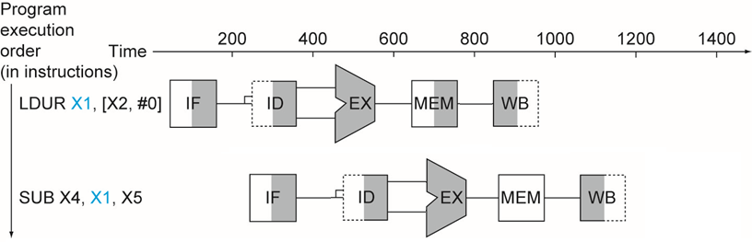
Load-Use Data Hazard
Can’t always avoid stalls by forwarding
  If value not computed when needed
  Can’t forward backward in time!

Slide 44
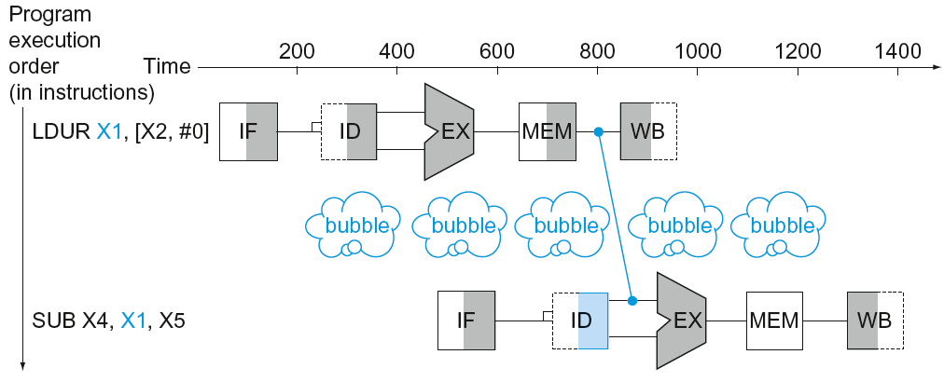
Load-Use Data Hazard
Can’t avoid stalls by forwarding
  Stall can be limited to one cycle by using forwarding.

Slide 45
Code Scheduling to Avoid Stalls
Reorder code to avoid use of load result in the next instruction
C code for A[3]=A[0]+A[1]; A[4]=A[0]+A[2];
LDUR X1, [X0,#0]
LDUR X2, [X0,#8]
ADD X3, X1, X2
STUR X3, [X0,#24]
LDUR X4, [X0,#16]
ADD X5, X1, X4
STUR X5, [X0,#32]
LDUR X1, [X0,#0]
LDUR X2, [X0,#8]
LDUR X4, [X0,#16]
ADD X3, X1, X2
STUR X3, [X0,#24]
ADD X5, X1, X4
STUR X5, [X0,#32]
stall
stall
13 cycles
11 cycles

Slide 46
Control Hazards
Branch determines flow of control
  Fetching next instruction depends on branch outcome
  Pipeline can’t always fetch correct instruction
    Still working on ID stage of branch
In LEGv8 pipeline
  Need to compare registers and compute target early in the pipeline
  Add hardware to do it in ID stage

Slide 47
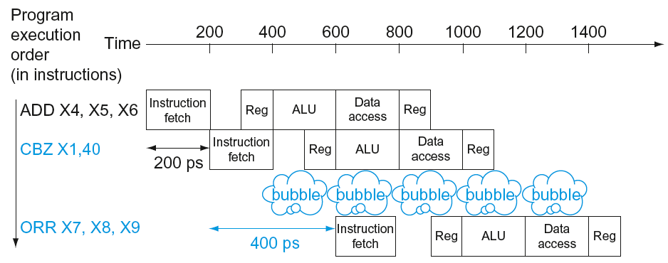
Stall on Branch
Wait until branch outcome determined before fetching next instruction

Slide 48
Branch Prediction
Longer pipelines can’t readily determine branch outcome early
  Stall penalty becomes unacceptable
Predict outcome of branch
  Only stall if prediction is wrong
In LEGv8 pipeline
  Can predict branches not taken
  Fetch instruction after branch, with no delay

Slide 49
More-Realistic Branch Prediction
Static branch prediction
  Based on typical branch behavior
  Example: loop and if-statement branches
    Predict backward branches taken
    Predict forward branches not taken
Dynamic branch prediction
  Hardware measures actual branch behavior
    e.g., record recent history of each branch
  Assume future behavior will continue the trend
    When wrong, stall while re-fetching, and update history

Slide 50
Pipeline Summary
The BIG Picture
Pipelining improves performance by increasing instruction throughput
  Executes multiple instructions in parallel
  Each instruction has the same latency
Subject to hazards
  Structure, data, control
Instruction set design affects complexity of pipeline implementation

Slide 51
Planning CTA01
Week 1: Introduction, Performance & Parallelism
Week 2: Instructions for arithmetic and memory
Week 3: Instructions for decisions and procedures
Week 4: Computer arithmetic
Week 5: Single cycle LEGv8, intro pipelining
Week 6: Pipelined LEGv8, hazards and forwarding
Week 7: Memory architecture
Week 8: Guest lecture (multicore and parallelism)

Slide 52
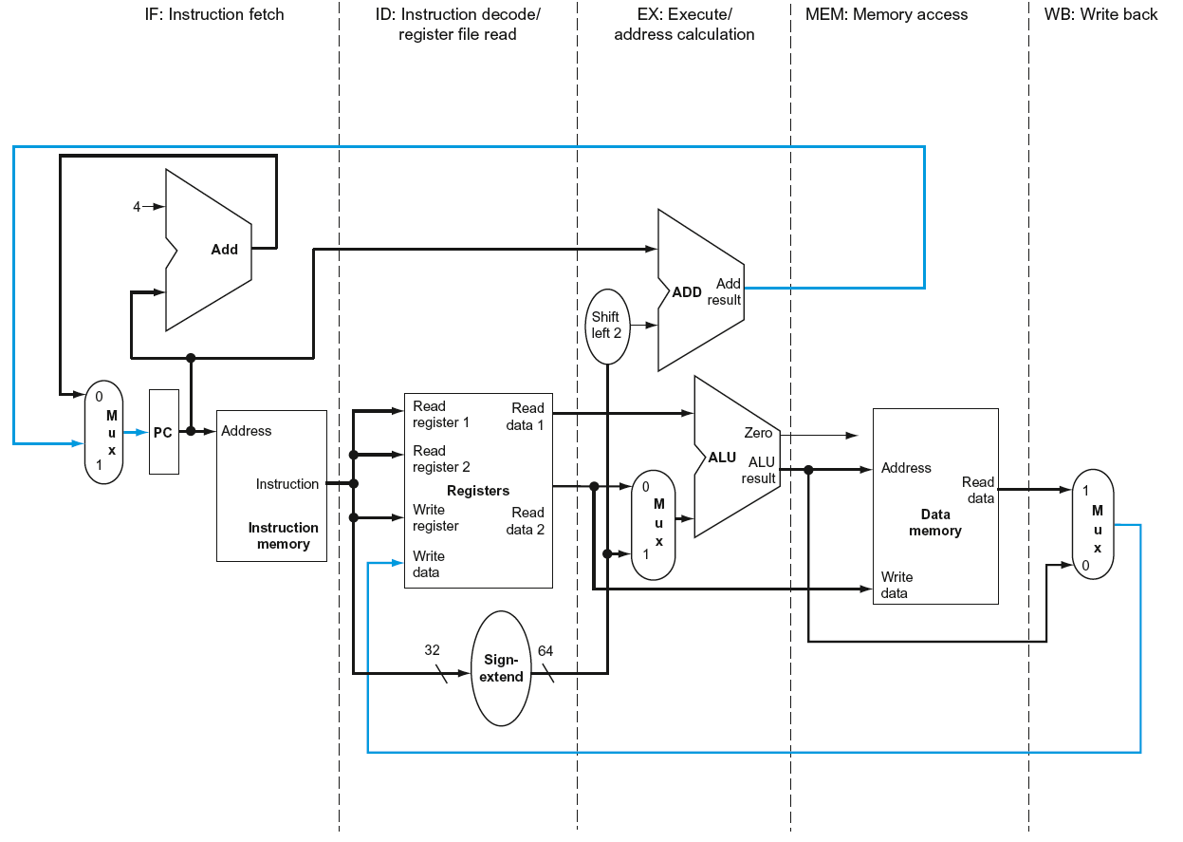
LEGv8 Pipelined Datapath
§4.6 Pipelined Datapath and Control
MEM
Right-to-left flow leads to hazards
WB

Slide 53
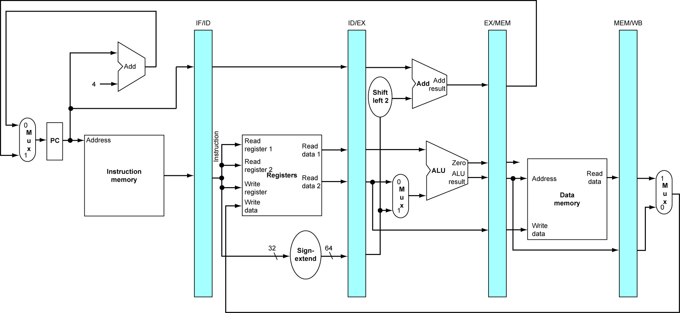
Pipeline registers
Need registers between stages
  To hold information produced in previous cycle

Slide 54
Pipeline Operation
Cycle-by-cycle flow of instructions through the pipelined datapath
  “Single-clock-cycle” pipeline diagram
    Shows pipeline usage in a single cycle
    Highlight resources used
  “Multi-clock-cycle” diagram
    Graph of operation over time
We’ll look at “single-clock-cycle” diagrams for load & store

Slide 55
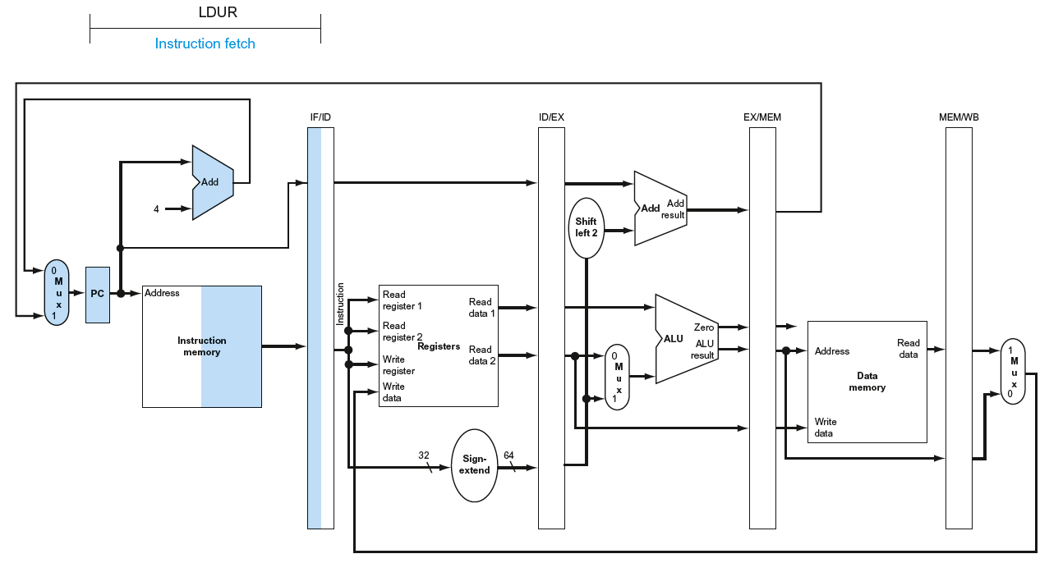
IF for Load, Store, …

Slide 56
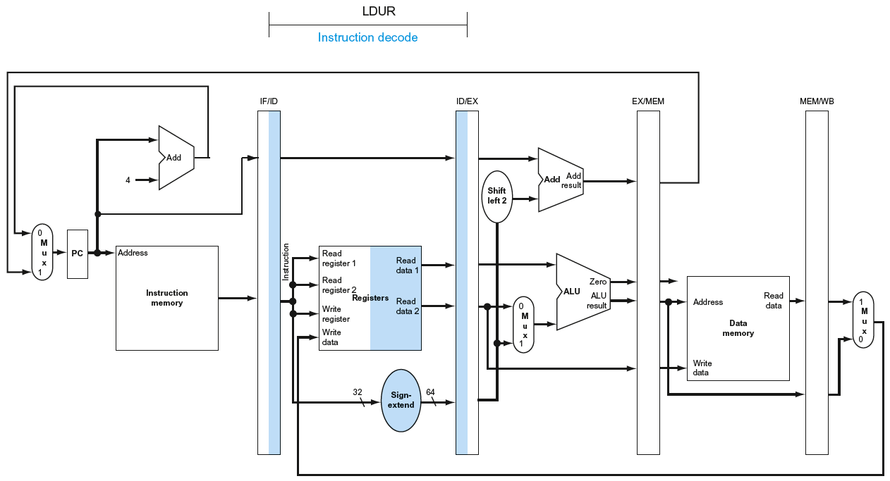
ID for Load, Store, …

Slide 57
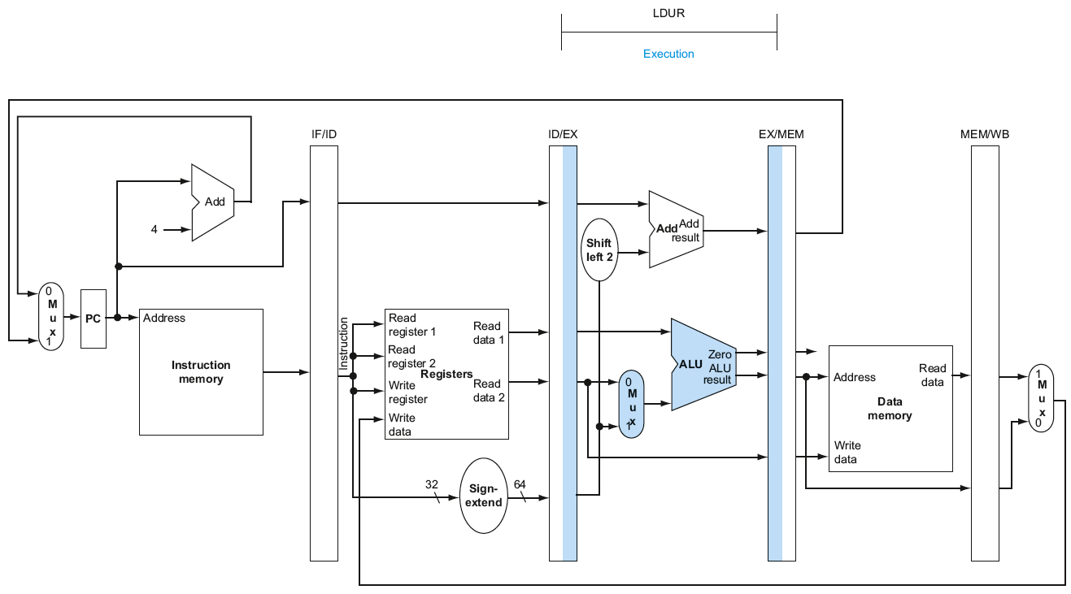
EX for Load

Slide 58
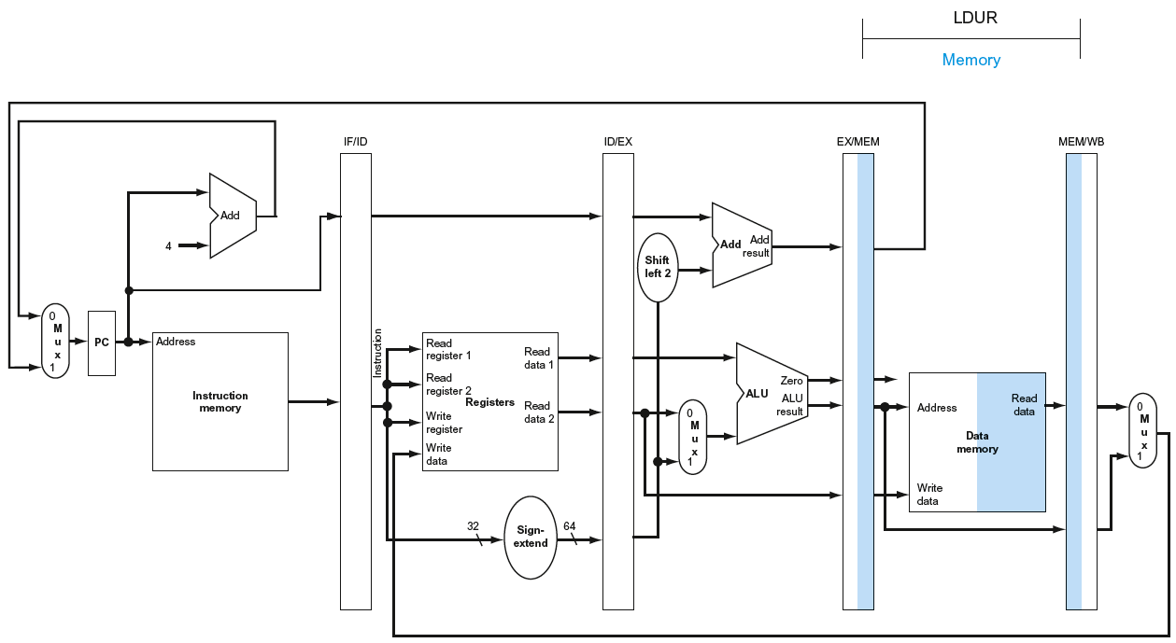
MEM for Load

Slide 59
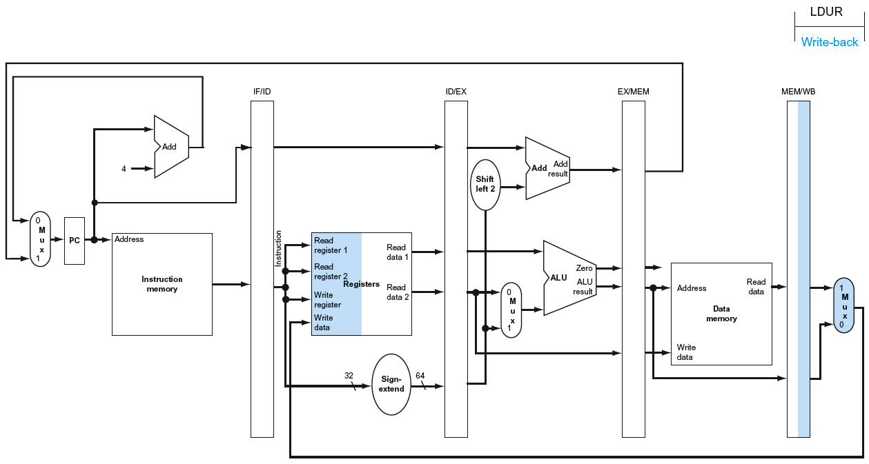
WB for Load
Wrong
register
number

Slide 60
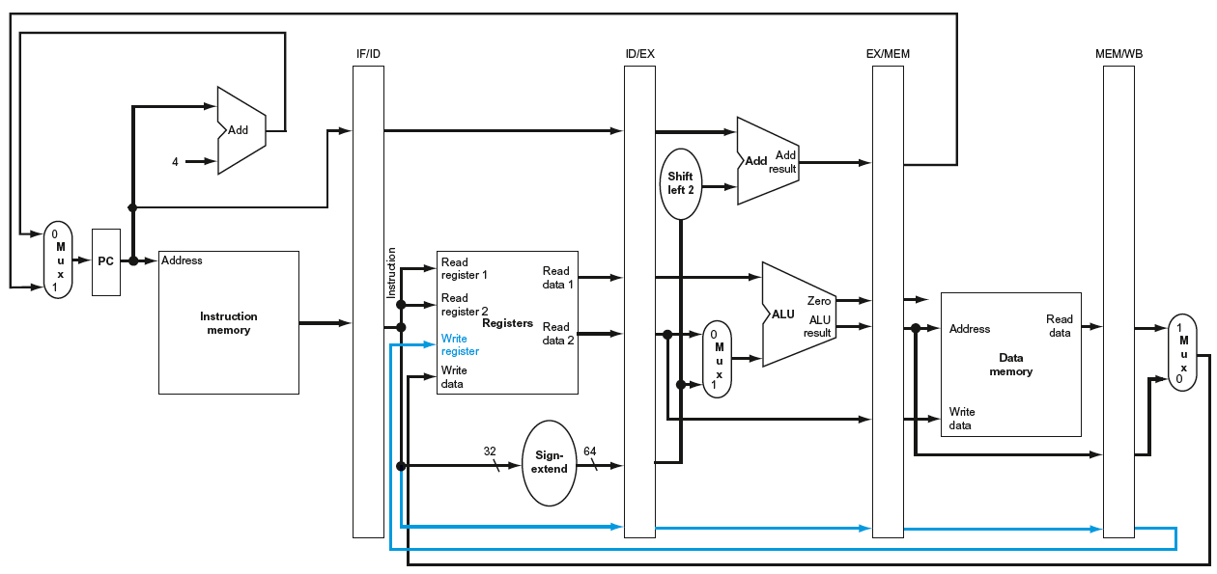
Corrected Datapath for Load

Slide 61
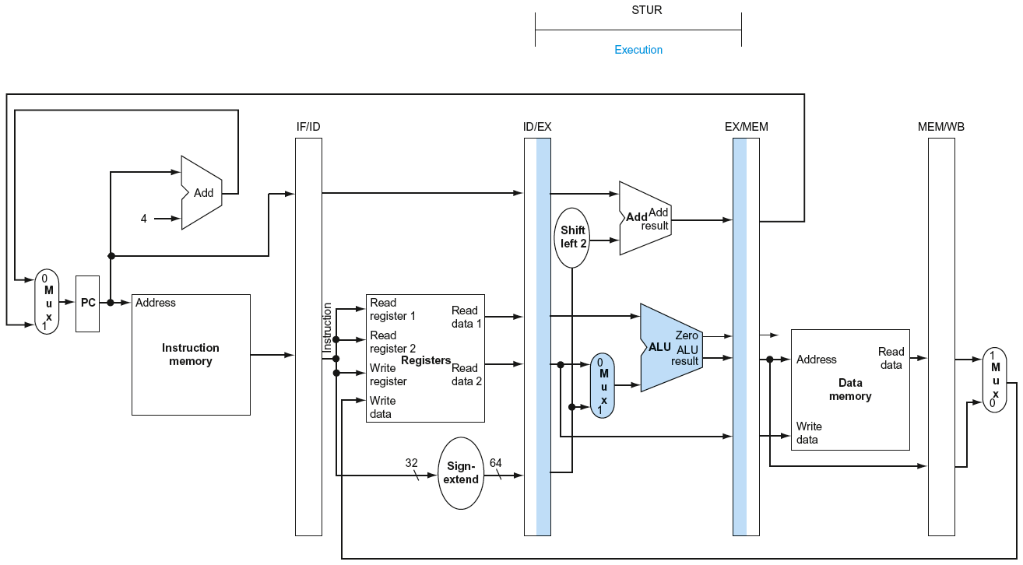
EX for Store

Slide 62
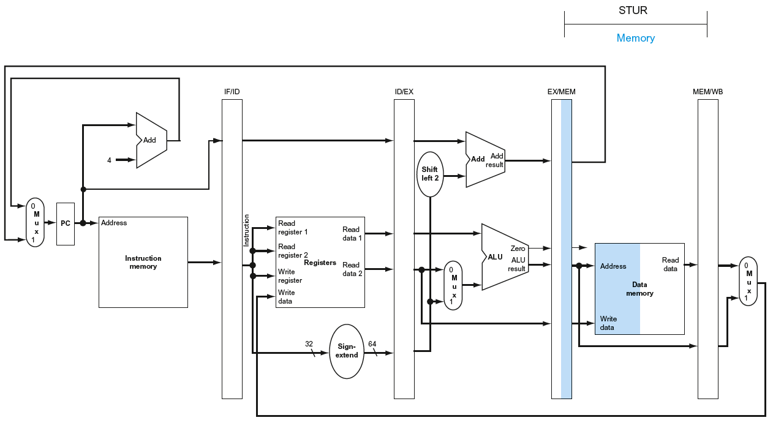
MEM for Store

Slide 63
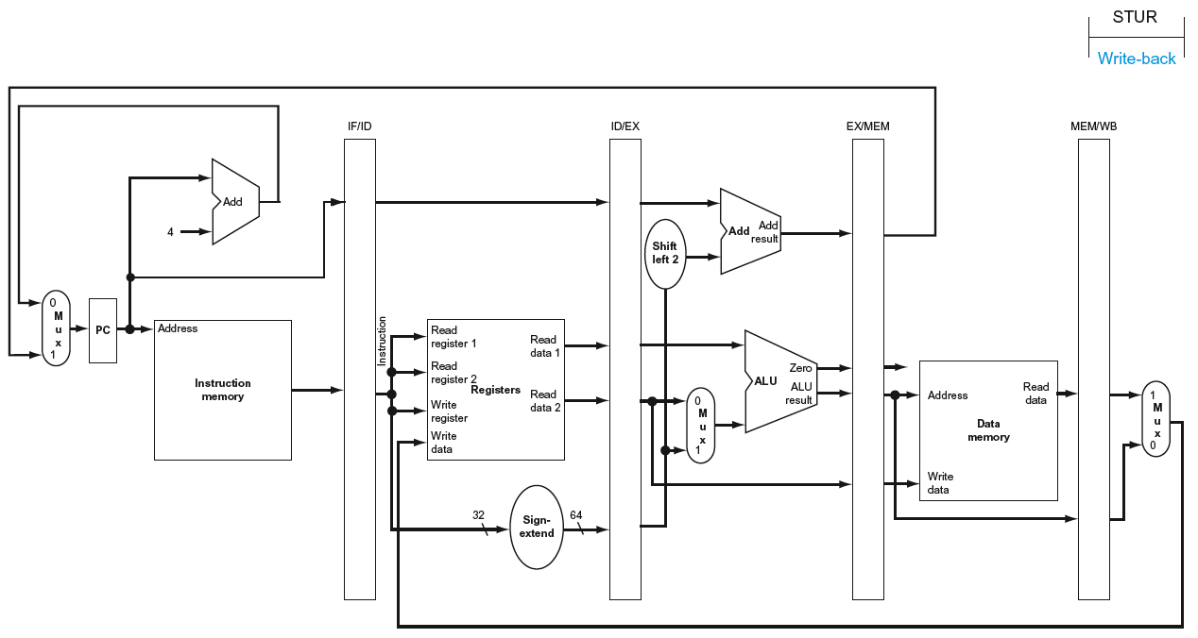
WB for Store

Slide 64
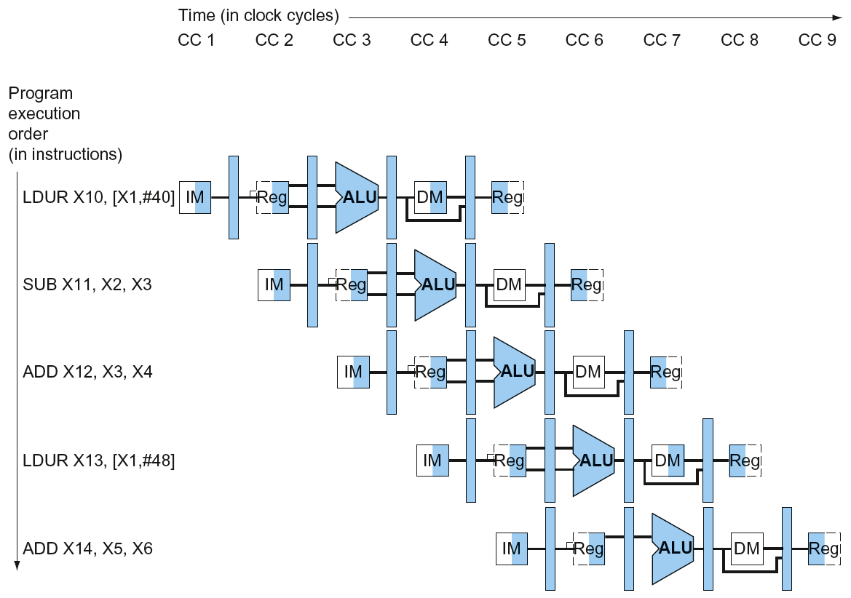
Multi-Cycle Pipeline Diagram
Form showing resource usage

Slide 65
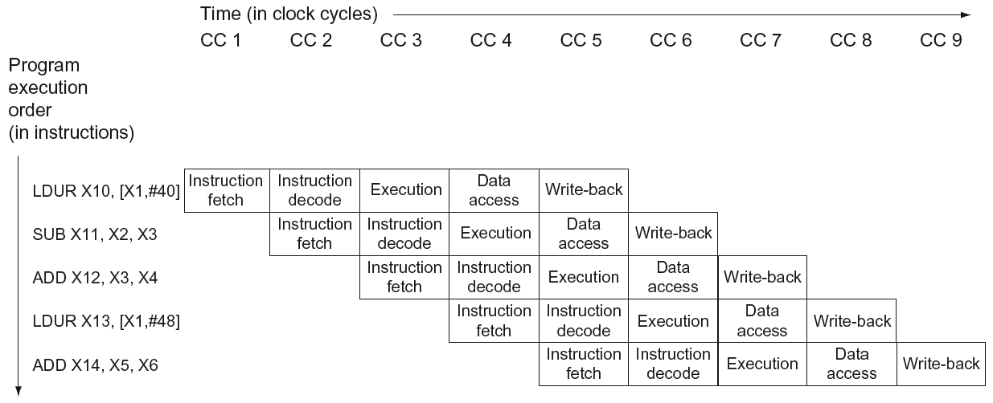
Multi-Cycle Pipeline Diagram
Traditional form

Slide 66
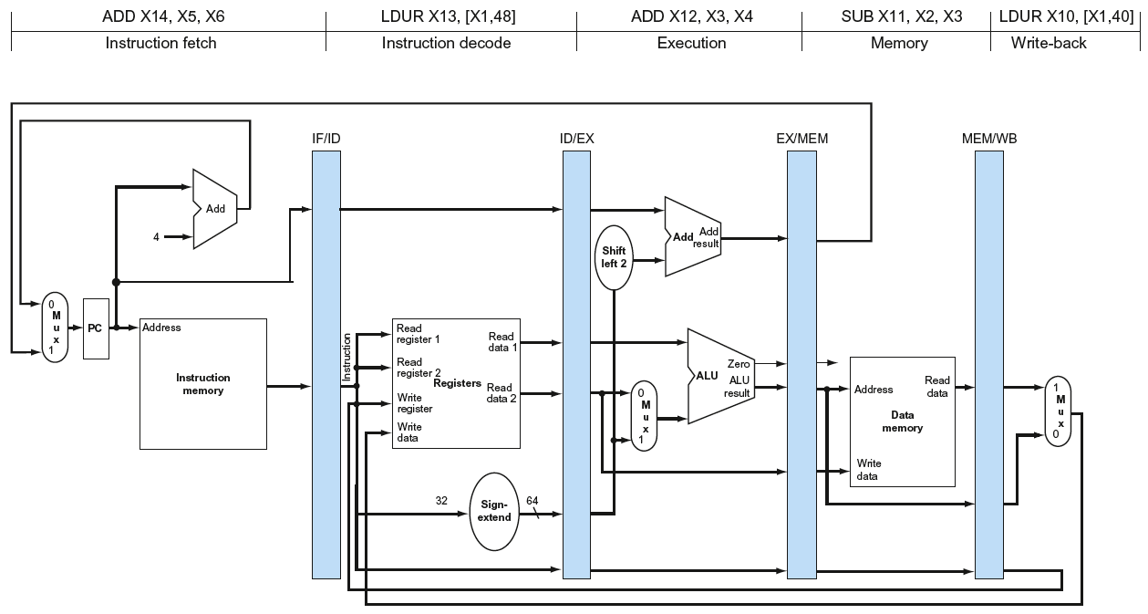
Single-Cycle Pipeline Diagram
State of pipeline in a given cycle, e.g. CC 5

Slide 67
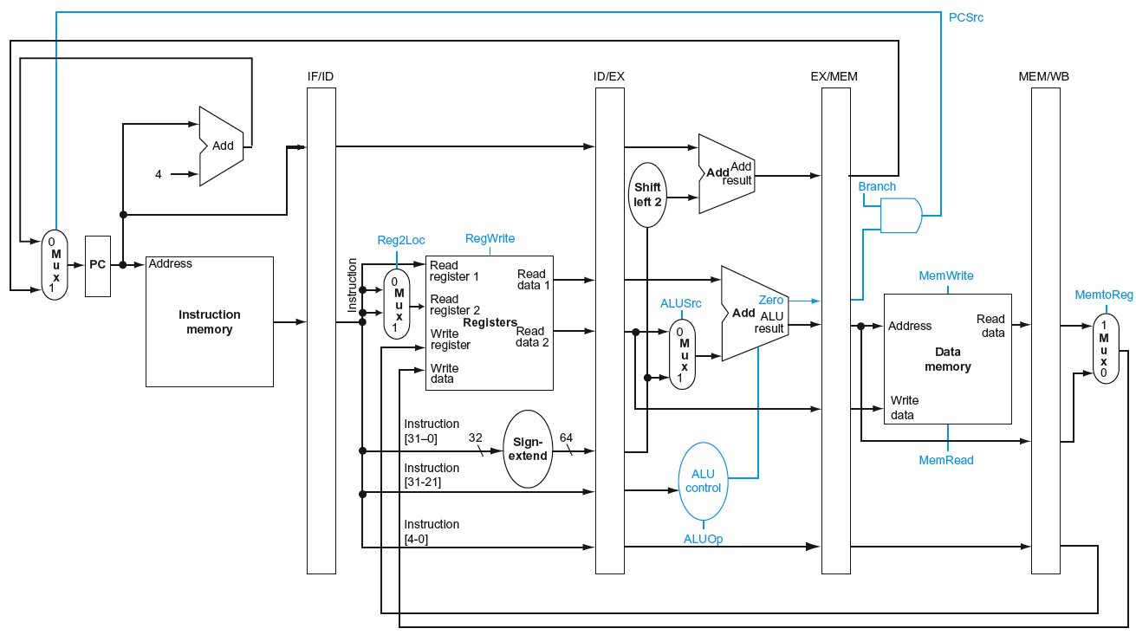
Pipelined Control (Simplified)

Slide 68
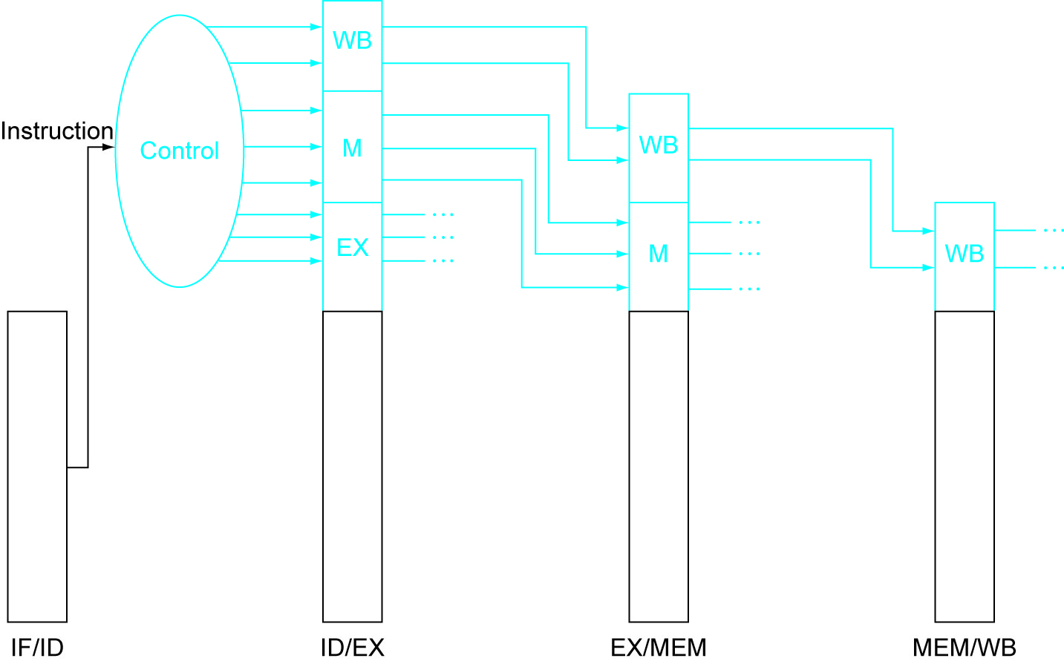
Pipelined Control
Control signals derived from instruction
  As in single-cycle implementation

Slide 69
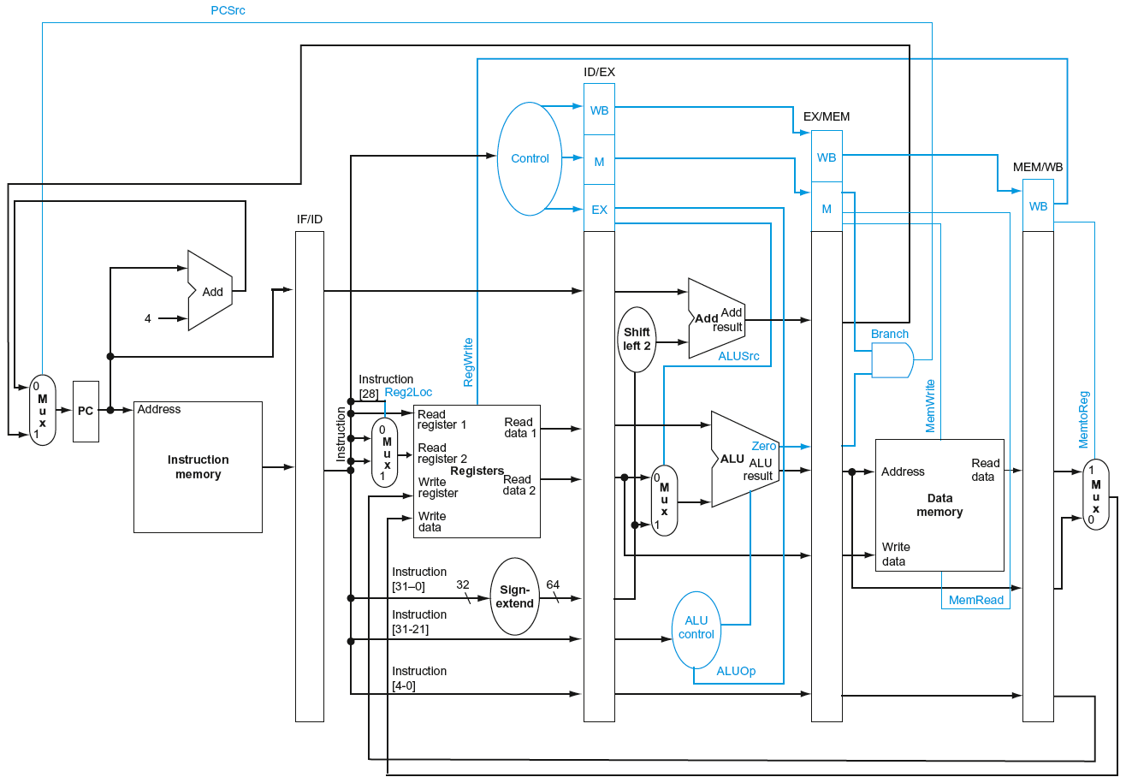
Pipelined Control

Slide 70
Data Hazards in ALU Instructions
Consider this sequence:
  SUB X2,X1,X3
  AND X12,X2,X5
  OR X13,X6,X2
  ADD X14,X2,X2
  STUR X15,[X2,#100]
We can resolve hazards with forwarding
  How do we detect when to forward?
§4.7 Data Hazards: Forwarding vs. Stalling

Slide 71
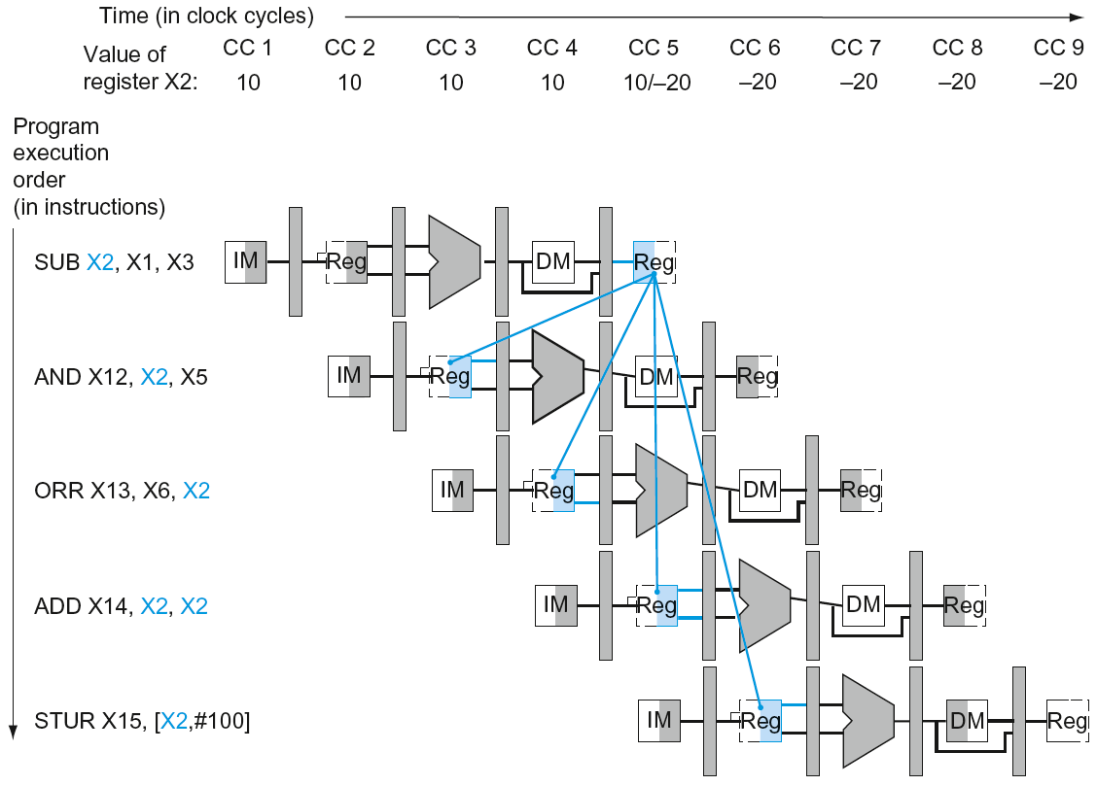
Dependencies & Forwarding

Slide 72
Detecting the Need to Forward
Pass register numbers along pipeline
  e.g., ID/EX.RegisterRs = register number for Rs sitting in ID/EX pipeline register
ALU operand register numbers in EX stage are given by
  ID/EX.RegisterRn1, ID/EX.RegisterRm2
Data hazards when
  1a. EX/MEM.RegisterRd = ID/EX.RegisterRn1
  1b. EX/MEM.RegisterRd = ID/EX.RegisterRm2
  2a. MEM/WB.RegisterRd = ID/EX.RegisterRn1
  2b. MEM/WB.RegisterRd = ID/EX.RegisterRm2
Fwd from
EX/MEM
pipeline reg
Fwd from
MEM/WB
pipeline reg

Slide 73
Detecting the Need to Forward
But only if forwarding instruction will write to a register!
  EX/MEM.RegWrite, MEM/WB.RegWrite
And only if Rd for that instruction is not XZR
  EX/MEM.RegisterRd ≠ 31,
  MEM/WB.RegisterRd ≠ 31

Slide 74
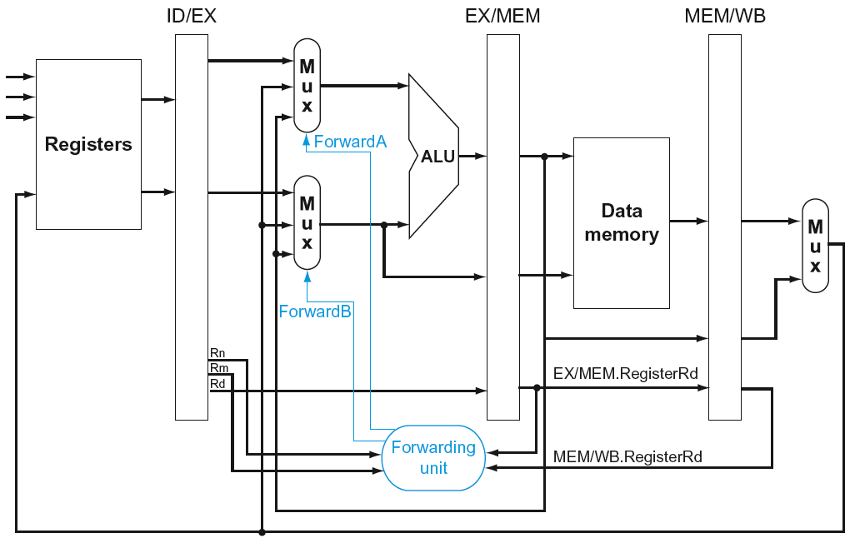
Forwarding Paths

Slide 75
Forwarding Conditions
Mux control | Source | Explanation
ForwardA = 00 | ID/EX | The first ALU operand comes from the register file.
ForwardA = 10 | EX/MEM | The first ALU operand is forwarded from the prior ALU result.
ForwardA = 01 | MEM/WB | The first ALU operand is forwarded from data memory or an earlier ALU result.
ForwardB = 00 | ID/EX | The second ALU operand comes from the register file.
ForwardB = 10 | EX/MEM | The second ALU operand is forwarded from the prior ALU result.
ForwardB = 01 | MEM/WB | The second ALU operand is forwarded from data memory or an earlier ALU result.

Slide 76
Forwarding Condition EX hazard
EX hazard
  if (EX/MEM.RegWrite
  and (EX/MEM.RegisterRd ≠ 31)
  and (EX/MEM.RegisterRd = ID/EX.RegisterRn1)) ForwardA = 10
  if (EX/MEM.RegWrite
  and (EX/MEM.RegisterRd ≠ 31)
  and (EX/MEM.RegisterRd = ID/EX.RegisterRm2)) ForwardB = 10

Slide 77
Forwarding Condition MEM hazard
MEM hazard
  if (MEM/WB.RegWrite
  and (MEM/WB.RegisterRd ≠ 31)
  and (MEM/WB.RegisterRd = ID/EX.RegisterRn1)) ForwardA = 01
  if (MEM/WB.RegWrite
  and (MEM/WB.RegisterRd ≠ 31)
  and (MEM/WB.RegisterRd = ID/EX.RegisterRm2)) ForwardB = 01
Dit is nog niet helemaal correct! Zie volgende slide.

Slide 78
Double Data Hazard
Consider the sequence:
  add X1,X1,X2
  add X1,X1,X3
  add X1,X1,X4
Both hazards occur
  Want to use the most recent
Revise MEM hazard condition
  Only fwd if EX hazard condition isn’t true

Slide 79
Revised Forwarding Condition
MEM hazard
  if (MEM/WB.RegWrite
  and (MEM/WB.RegisterRd ≠ 31)
  and not(EX/MEM.RegWrite and (EX/MEM.RegisterRd ≠ 31)
  and (EX/MEM.RegisterRd = ID/EX.RegisterRn1))
  and (MEM/WB.RegisterRd = ID/EX.RegisterRn1)) ForwardA = 01
  if (MEM/WB.RegWrite
  and (MEM/WB.RegisterRd ≠ 31)
  and not(EX/MEM.RegWrite and (EX/MEM.RegisterRd ≠ 31)
  and (EX/MEM.RegisterRd = ID/EX.RegisterRm2))
  and (MEM/WB.RegisterRd = ID/EX.RegisterRm2)) ForwardB = 01

Slide 80
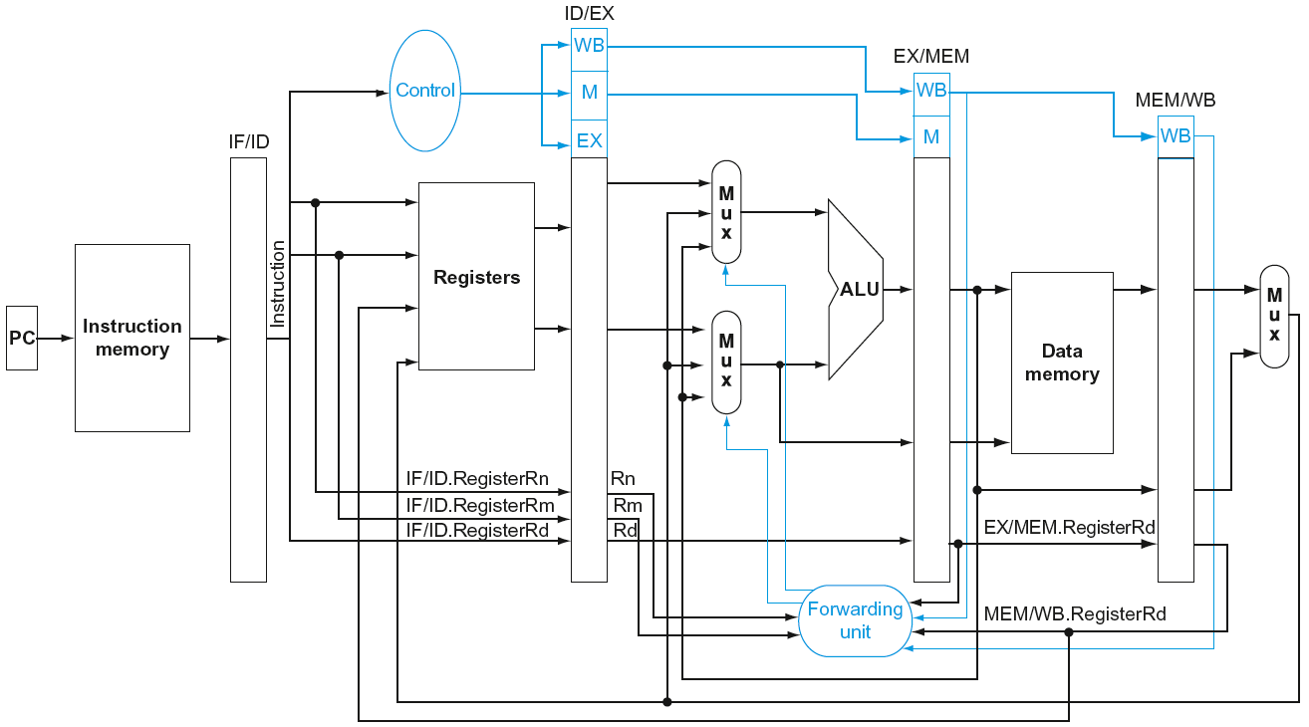
Datapath with Forwarding

Slide 81
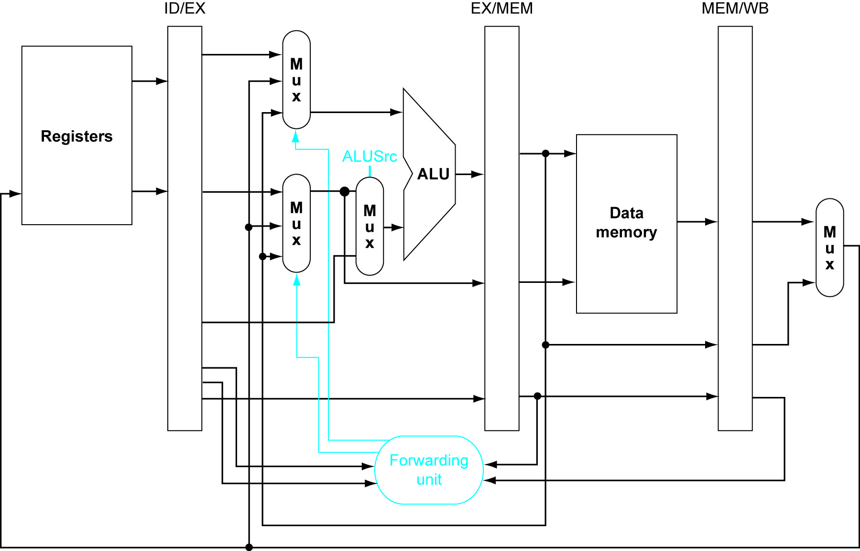
Datapath Detail

Slide 82
Load-Use Hazard Detection
Check when using instruction is decoded in ID stage
ALU operand register numbers in ID stage are given by
  IF/ID.RegisterRn1, IF/ID.RegisterRm2
Load-use hazard when
  ID/EX.MemRead and
  ((ID/EX.RegisterRd = IF/ID.RegisterRn1) or
  (ID/EX.RegisterRd = IF/ID.RegisterRm2))
If detected, stall and insert bubble

Slide 83
How to Stall the Pipeline
Force control values in ID/EX register
to 0
  EX, MEM and WB do nop (no-operation)
Prevent update of PC and IF/ID register
  Using instruction is decoded again
  Following instruction is fetched again
  1-cycle stall allows MEM to read data for LDUR
    Can subsequently forward to EX stage

Slide 84
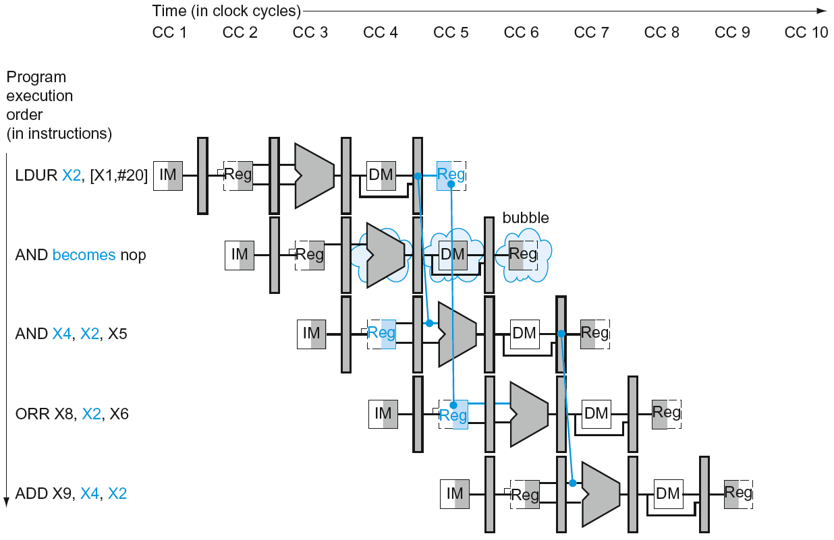
Load-Use Data Hazard
Stall inserted here

Slide 85
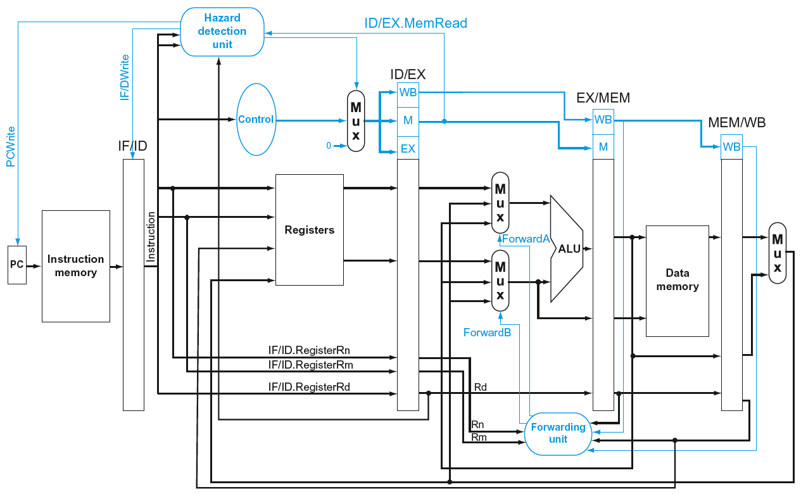
Datapath with Hazard Detection

Slide 86
Stalls and Performance
The BIG Picture
Stalls reduce performance
  But are required to get correct results
Compiler can arrange code to avoid hazards and stalls
  Requires knowledge of the pipeline structure

Slide 87
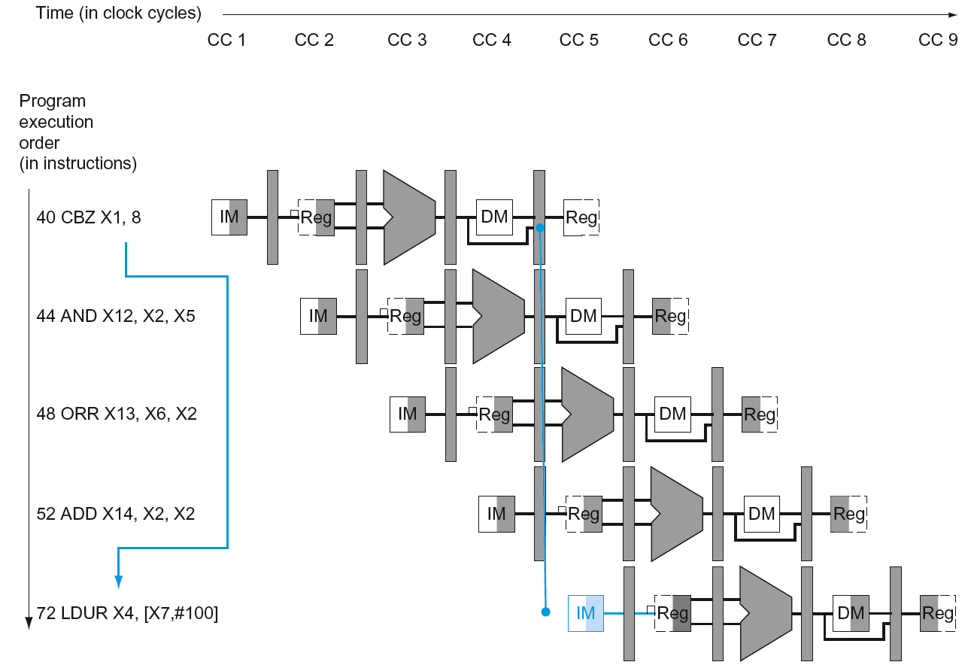
Branch Hazards
§4.8 Control Hazards
If branch outcome determined in MEM
Flush these
instructions
(Set control
values to 0)
PC

Slide 88
Reducing Branch Delay
Move hardware to determine outcome to ID stage
  Target address adder
  Register comparator
Example: branch taken
  36: SUB X10, X4, X8
  40: CBZ X1, X3, 8
  44: AND X12, X2, X5
  48: ORR X13, X2, X6
  52: ADD X14, X4, X2
  56: SUB X15, X6, X7
  ...
  72: LDUR X4, [X7,#50]

Slide 89
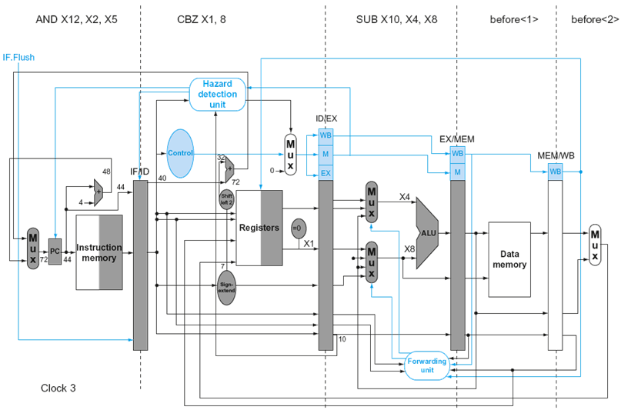
Example: Branch Taken

Slide 90
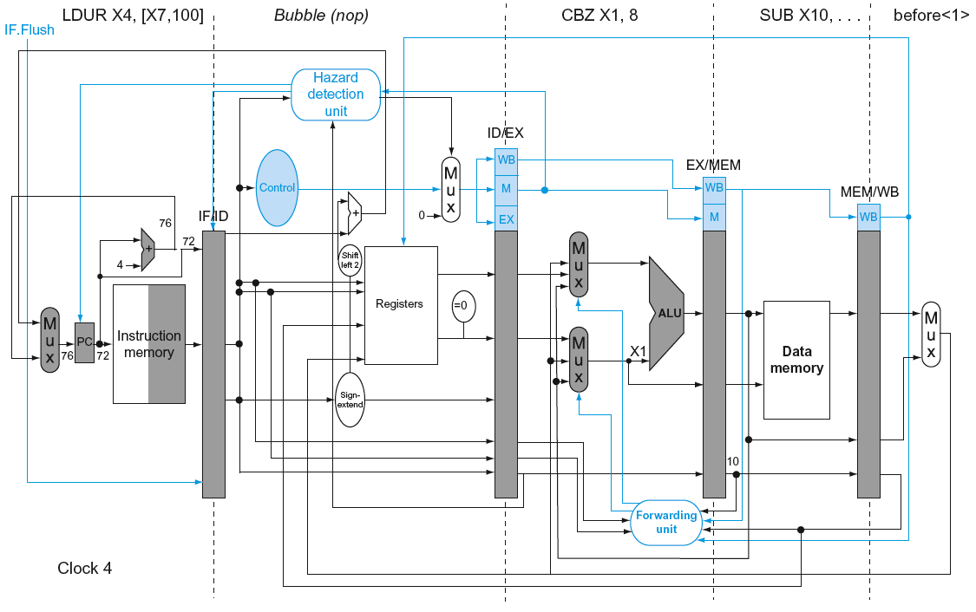
Example: Branch Taken

Slide 91
Dynamic Branch Prediction
In deeper and superscalar pipelines, branch penalty is more significant
Use dynamic prediction
  Branch prediction buffer (aka branch history table)
  Indexed by recent branch instruction addresses
  Stores outcome (taken/not taken)
  To execute a branch
    Check table, expect the same outcome
    Start fetching from fall-through or target
    If wrong, flush pipeline and flip prediction

Slide 92
1-Bit Predictor: Shortcoming
Inner loop branches mispredicted twice!
outer: …
…
inner: …
…
CBZ …, …, inner
…
CBZ …, …, outer
  Mispredict as taken on last iteration of inner loop
  Then mispredict as not taken on first iteration of inner loop next time around

Slide 93
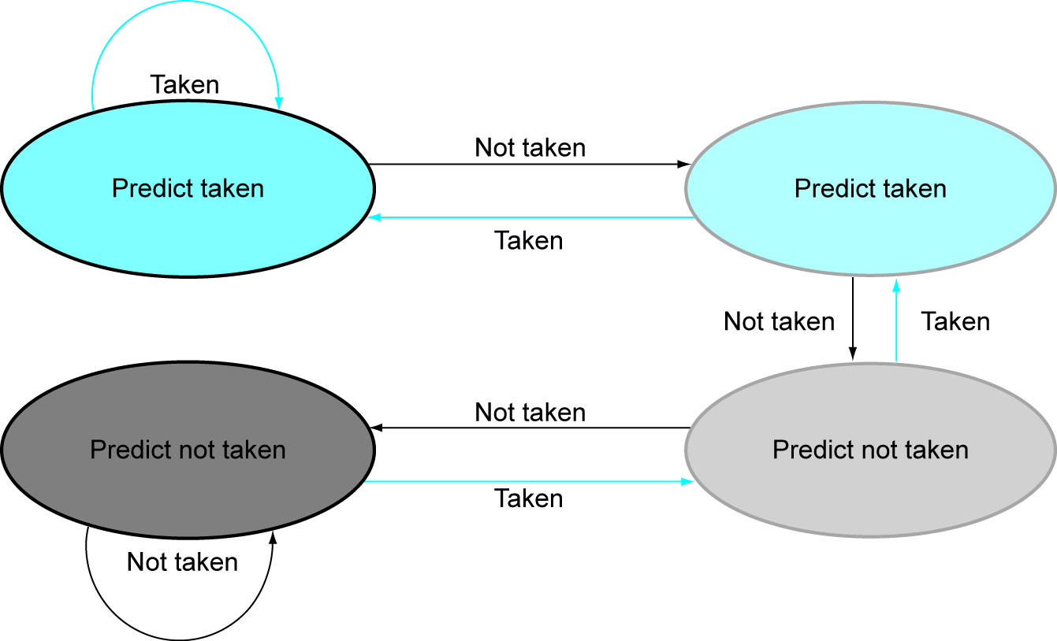
2-Bit Predictor
Only change prediction on two successive mispredictions

Slide 94
Calculating the Branch Target
Even with predictor, still need to calculate the target address
  1-cycle penalty for a taken branch
Branch target buffer
  Cache of target addresses
  Indexed by PC when instruction fetched
    If hit and instruction is branch predicted taken, can fetch target immediately

Slide 95
Fallacies
Pipelining is easy (!)
  The basic idea is easy
  The devil is in the details
    e.g., detecting data hazards
Pipelining is independent of technology
  So why haven’t we always done pipelining?
  More transistors make more advanced techniques feasible
  Pipeline-related ISA design needs to take account of technology trends
    e.g., predicated instructions
§4.14 Fallacies and Pitfalls

Slide 96
Concluding Remarks
ISA influences design of datapath and control
Datapath and control influence design of ISA
Pipelining improves instruction throughput
using parallelism
  More instructions completed per second
  Latency for each instruction not reduced
Hazards: structural, data, control
§4.14 Concluding Remarks

