Slide 1
H5
Memory Architecture
ELECTA01
Computer architecture
ELECTA01
Hogeschool Rotterdam
Opleiding Elektrotechniek
Minor Embedded Systems
J.W. Peltenburg / J.Z.M. Broeders (brojz@hr.nl)

Slide 2
Planning CTA01
Week 1: Introduction, Performance & Parallelism
Week 2: Instructions for arithmetic and memory
Week 3: Instructions for decisions and procedures
Week 4: Computer arithmetic
Week 5: Single cycle LEGv8, intro pipelining
Week 6: Pipelined LEGv8, hazards and forwarding
Week 7: Memory architecture
Week 8: Guest lecture (multicore and parallelism)

Slide 3
Chapter 5
Large and Fast: Exploiting Memory Hierarchy

Slide 4
Principle of Locality
§5.1 Introduction
Programs access a small proportion of their address space at any time
Temporal locality
  Items accessed recently are likely to be accessed again soon
  e.g., instructions in a loop, induction variables
Spatial locality
  Items near those accessed recently are likely to be accessed soon
  E.g., sequential instruction access, array data
https://en.wikipedia.org/wiki/Induction_variable

Slide 5
Example
int A[1024];
int B[1024];
int C[1024];
for (int i = 0; i < 1024; i++) {
A[i] = B[i] + C[i];
}
Where is the temporal locality (if any)?
Where is the spatial locality (if any)?

Slide 6
Taking Advantage of Locality
Memory hierarchy
Store everything on disk
Copy recently accessed (and nearby) items from disk to smaller DRAM memory
  Main memory
Copy more recently accessed (and nearby) items from DRAM to smaller SRAM memory
  Cache memory attached to CPU

Slide 7
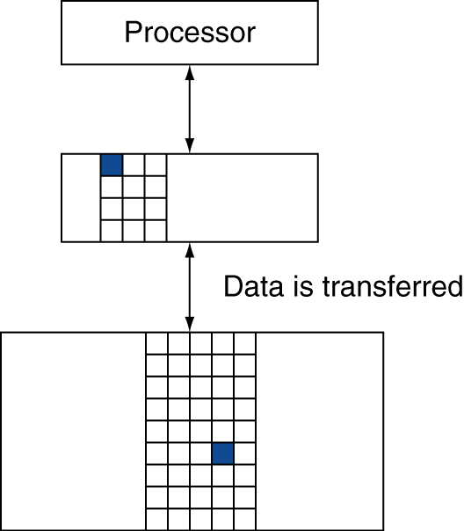
Memory Hierarchy Levels
Block (aka line): unit of copying
  May be multiple words
If accessed data is present in upper level
  Hit: access satisfied by upper level
    Hit ratio: hits/accesses
If accessed data is absent
  Miss: block copied from lower level
    Extra time taken: miss penalty
    Miss ratio: misses/accesses
    = 1 – hit ratio
  Then accessed data supplied from upper level
Why?
cache
main

Slide 8
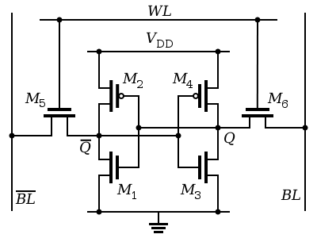
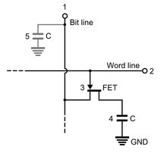
Memory Technology
Static RAM (SRAM)
  0.5ns – 2.5ns, $500 – $1000 per GB
Dynamic RAM (DRAM)
  50ns – 70ns, $10 – $20 per GB
Flash
  5µs – 50µs, $0.75 – $1 per GB
Magnetic disk
  5ms – 20ms, $0.05 – $0.10 per GB
Ideal memory
  Access time of SRAM
  Capacity and cost/GB of disk
§5.2 Memory Technologies
×100
SRAM
×100
×1000
DRAM
Illusion is created by cache memory and virtual memory

Slide 9
Cache Memory
Cache memory
  The level of the memory hierarchy closest to the CPU
How do we know if the data is present?
Where do we look?
§5.3 The Basics of Caches

Slide 10
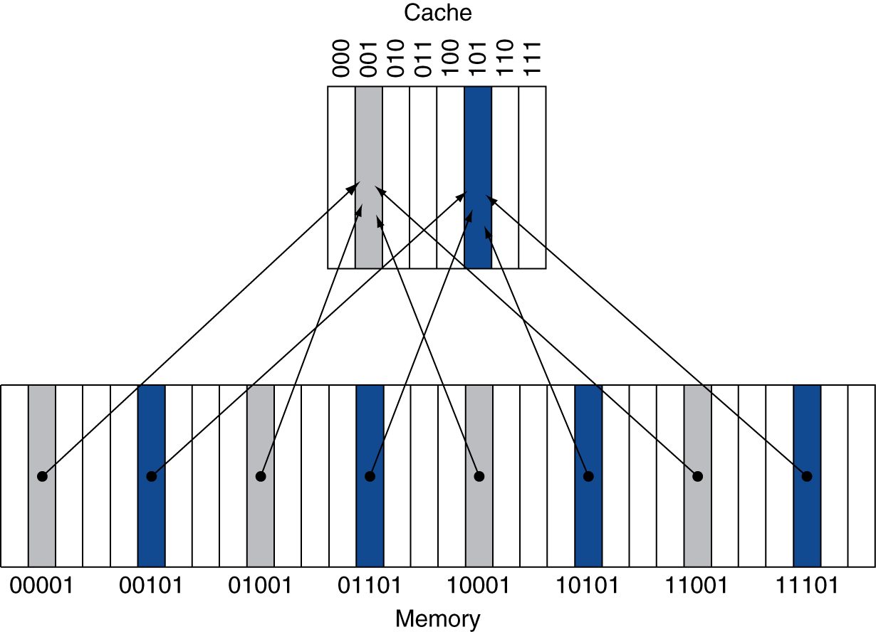
Direct Mapped Cache
Location determined by address
Direct mapped: only one choice
  (Block address) modulo (#Blocks in cache)
#Blocks is a power of 2
Use low-order address bits

Slide 11
Tags and Valid Bits
How do we know which particular block is stored in a cache location?
  Store block address as well as the data
  Actually, only need the high-order bits
  Called the tag
What if there is no data in a location?
  Valid bit: 1 = present, 0 = not present
  Initially 0

Slide 12
Cache Example
Main memory 32 words
Cache 8-blocks, 1 word/block, direct mapped
Initial state:
Index | V | Tag | Data
000 | 0
001 | 0
010 | 0
011 | 0
100 | 0
101 | 0
110 | 0
111 | 0

Slide 13
Cache Example
Word addr | Binary addr | Hit/miss | Cache block
22 | 10 110 | Miss | 110
Index | V | Tag | Data
000 | 0
001 | 0
010 | 0
011 | 0
100 | 0
101 | 0
110 | 1 | 10 | Mem[10110]
111 | 0
0

Slide 14
Cache Example
Word addr | Binary addr | Hit/miss | Cache block
26 | 11 010 | Miss | 010
Index | V | Tag | Data
000 | 0
001 | 0
010 | 1 | 11 | Mem[11010]
011 | 0
100 | 0
101 | 0
110 | 1 | 10 | Mem[10110]
111 | 0
0

Slide 15
Cache Example
Word addr | Binary addr | Hit/miss | Cache block
22 | 10 110 | Hit | 110
26 | 11 010 | Hit | 010
Index | V | Tag | Data
000 | 0
001 | 0
010 | 1 | 11 | Mem[11010]
011 | 0
100 | 0
101 | 0
110 | 1 | 10 | Mem[10110]
111 | 0

Slide 16
Cache Example
Word addr | Binary addr | Hit/miss | Cache block
16 | 10 000 | Miss | 000
3 | 00 011 | Miss | 011
16 | 10 000 | Hit | 000
Index | V | Tag | Data
000 | 1 | 10 | Mem[10000]
001 | 0
010 | 1 | 11 | Mem[11010]
011 | 1 | 00 | Mem[00011]
100 | 0
101 | 0
110 | 1 | 10 | Mem[10110]
111 | 0

Slide 17
Cache Example
Word addr | Binary addr | Hit/miss | Cache block
18 | 10 010 | Miss | 010
Index | V | Tag | Data
000 | 1 | 10 | Mem[10000]
001 | 0
010 | 1 | 11 | Mem[11010]
011 | 1 | 00 | Mem[00011]
100 | 0
101 | 0
110 | 1 | 10 | Mem[10110]
111 | 0

Slide 18
Cache Example
Word addr | Binary addr | Hit/miss | Cache block
18 | 10 010 | Miss | 010
Index | V | Tag | Data
000 | 1 | 10 | Mem[10000]
001 | 0
010 | 1 | 10 | Mem[10010]
011 | 1 | 00 | Mem[00011]
100 | 0
101 | 0
110 | 1 | 10 | Mem[10110]
111 | 0

Slide 19
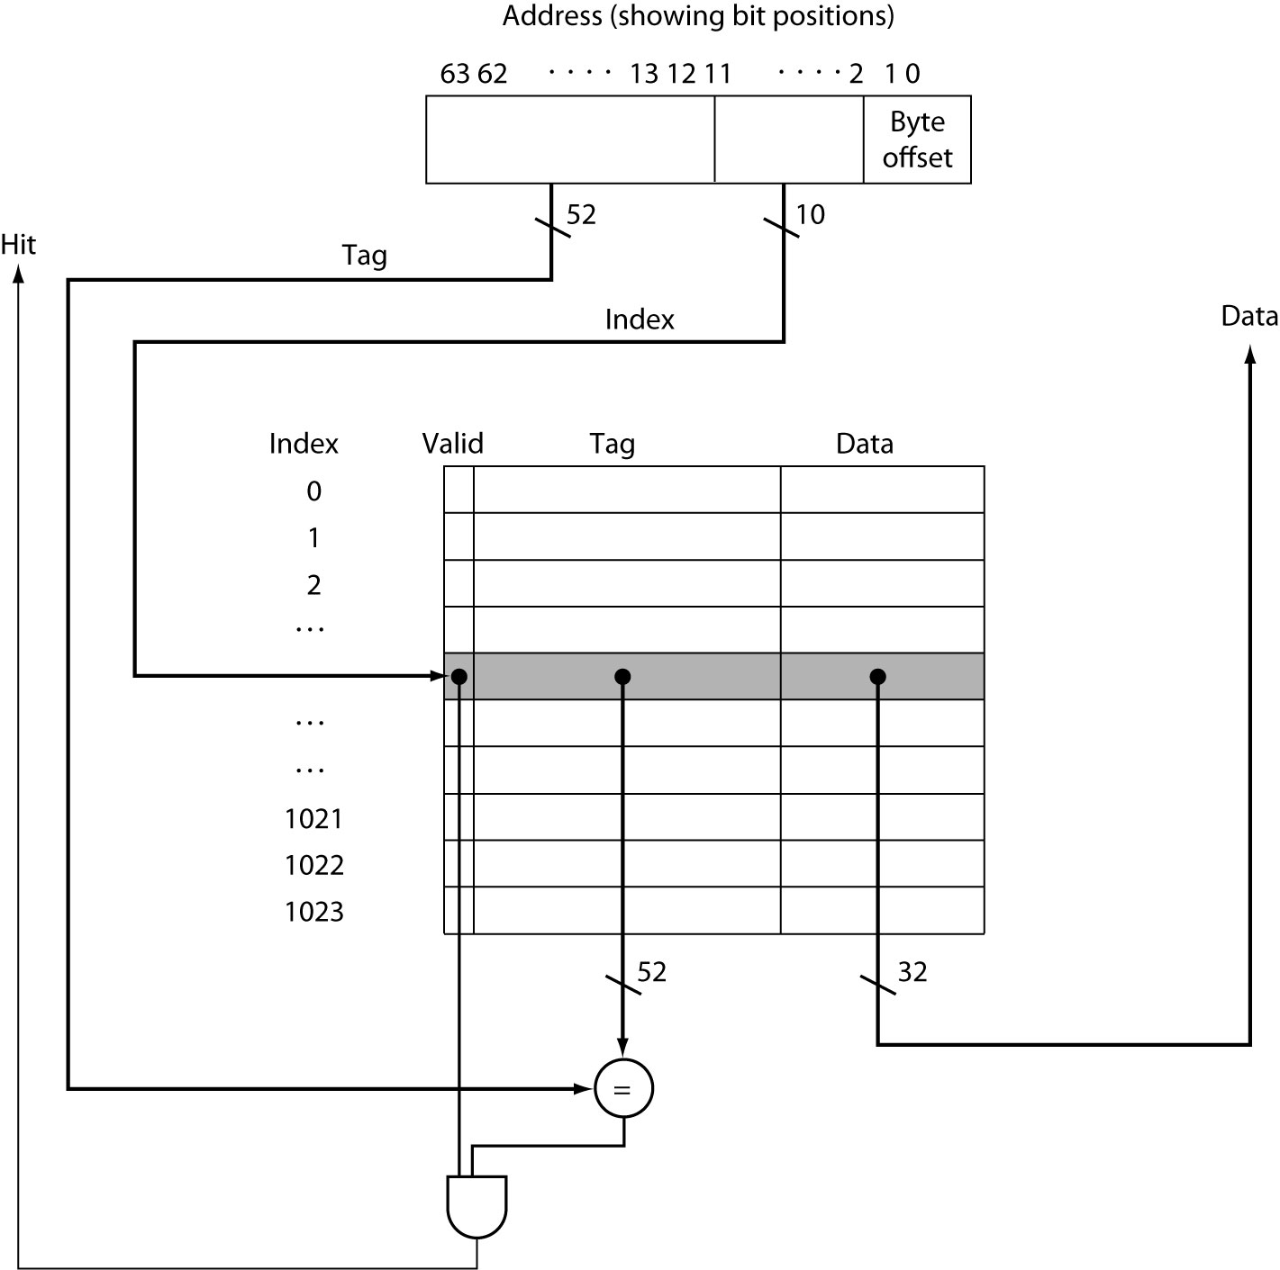
Address Subdivision

Slide 20
Example: Larger Block Size
Why?
64 blocks, 16 bytes/block
  To what block number (index) does address 1200 map?
Block address = ⎣1200/16⎦ = 75
Block number = 75 modulo 64 = 11
63
10
9
4
3
0
Tag
Index
Offset
54 bits
6 bits
4 bits
Alternative 1200 = 0..0100 1011 0000
Tag = 1
Index = 11
Offset = 0

Slide 21
Block Size Considerations
Larger blocks should reduce miss rate
  Due to spatial locality
But in a fixed-sized cache
  Larger blocks ⇒ fewer of them
    More competition ⇒ increased miss rate
  Larger blocks ⇒ pollution
Larger miss penalty
  Can override benefit of reduced miss rate
  Early restart and critical-word-first can help (see page 406)

Slide 22
Cache Misses
On cache hit, CPU proceeds normally
On cache miss
  Stall the CPU pipeline
  Fetch block from next level of hierarchy
  Instruction cache miss
    Restart instruction fetch
  Data cache miss
    Complete data access

Slide 23
Write-Through
On data-write hit, could just update the block in cache
  But then cache and memory would be inconsistent
Write through: also update memory
But makes writes take longer
  e.g., if base CPI = 1, 10% of instructions are stores, write to memory takes 100 cycles
    Effective CPI = 1 + 0.1×100 = 11
Solution: write buffer
  Holds data waiting to be written to memory
  CPU continues immediately
    Only stalls on write if write buffer is already full

Slide 24
Write-Back
Alternative: On data-write hit, just update the block in cache
  Keep track of whether each block is dirty
When a dirty block is replaced
  Write it back to memory
  Can use a write buffer to allow replacing block to be read first

Slide 25
Write Allocation
What should happen on a write miss?
Alternatives for write-through
  Allocate on miss: fetch the block
  Write around: don’t fetch the block
    Since programs often write a large block before reading it (e.g., initialization)
For write-back
  Usually fetch the block

Slide 26
Measuring Cache Performance
Components of CPU time
  Program execution cycles
    Includes cache hit time
  Memory stall cycles
    Mainly from cache misses
With simplifying assumptions:
§5.4 Measuring and Improving Cache Performance

Slide 27
Cache Performance Example
Given
  I-cache miss rate = 2%
  D-cache miss rate = 4%
  Miss penalty = 100 cycles
  Base CPI (ideal cache) = 2
  Load & stores are 36% of instructions
Calculate speedup due to addition of cache
Calculate maximum speedup (if main memory would be as fast as cache)
Realistic value, see sheet 8

Slide 28
Cache Performance Example
CPI without cache
  = 2 + 100 + 0.36 × 100 = 138
CPI with cache
  = 2 + 0.02 × 100 + 0.36 × 0.04 × 100 = 5.44
Speedup
  = 138 / 5.44 = 25.4
Maximum speedup
  = 138 / 2 = 69
  = 69 / 25.4 = 2.7 faster than with cache

Slide 29
Average Access Time
Hit time is also important for performance
Average memory access time (AMAT)
  AMAT = Hit time × Hit rate
  + (Hit time + Miss penalty) × Miss rate
  AMAT = Hit time × (1 – Miss rate)
  + (Hit time + Miss penalty) × Miss rate
  AMAT = Hit time – Hit time × Miss rate
  + Hit time × Miss rate + Miss penalty × Miss rate
  AMAT = Hit time + Miss rate × Miss penalty
See book page 416

Slide 30
Performance Summary
When CPU performance increased
  Miss penalty becomes more significant
Decreasing base CPI
  Greater proportion of time spent on memory stalls
Increasing clock rate
  Memory stalls account for more CPU cycles
Can’t neglect cache behavior when evaluating system performance

Slide 31
Associative Caches
Fully associative
  Allow a given block to go in any cache entry
  Requires all entries to be searched at once
  Comparator per entry (expensive)
n-way set associative
  Each set contains n entries
  Block number determines which set
    (Block number) modulo (#Sets in cache)
  Search all entries in a given set at once
  n comparators (less expensive)

Slide 32
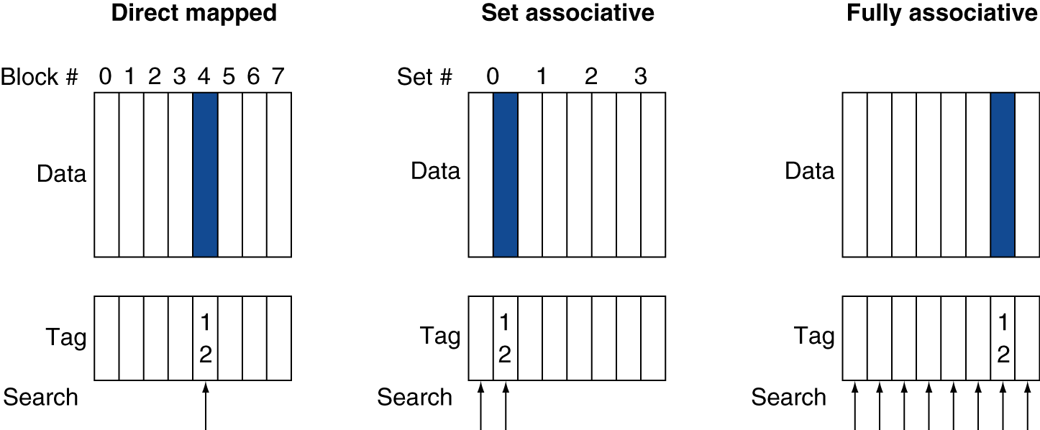
Associative Cache Example
Two-way
12 mod 8 = 4
12 mod 4 = 0

Slide 33
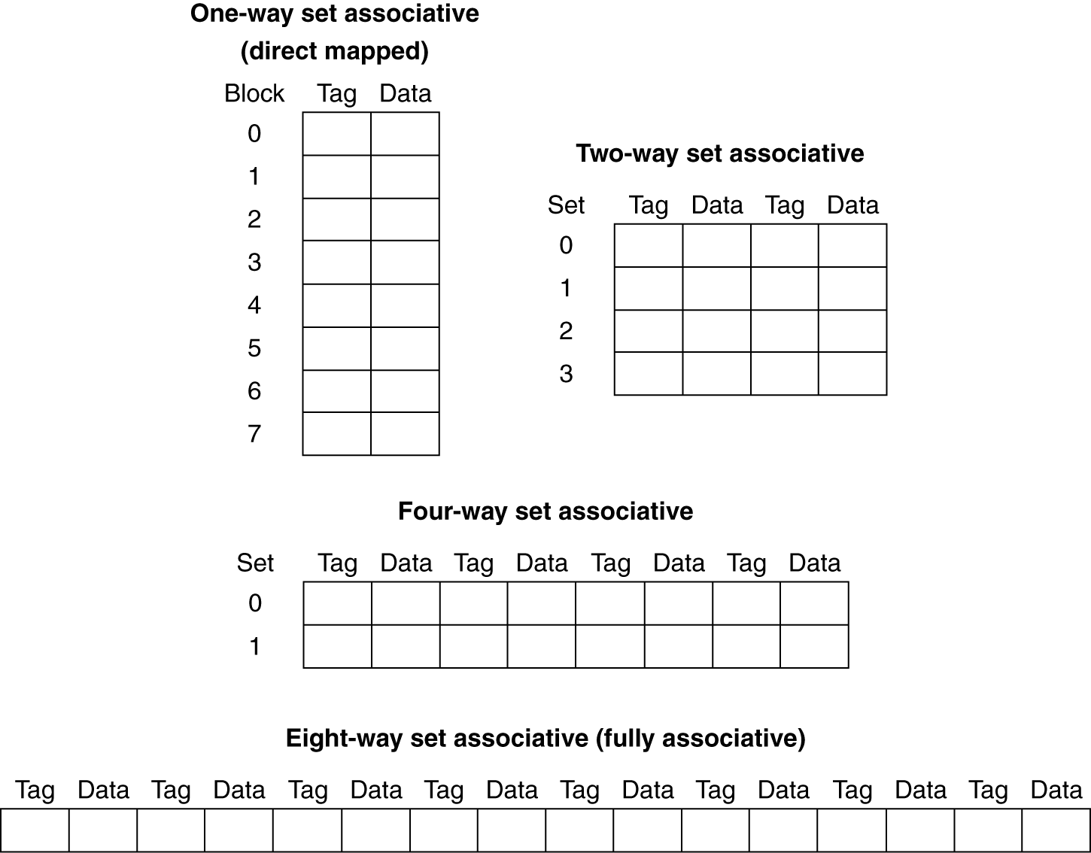
Spectrum of Associativity
For a cache with 8 entries

Slide 34
Associativity Example
Compare 4-block caches
  Direct mapped, 2-way set associative,
  fully associative
  Block access sequence: 0, 8, 0, 6, 8
Direct mapped
Block address | Cache index | Hit/miss | Cache content after access
 |  |  | 0 | 1 | 2 | 3
0 | 0 | miss | Mem[0]
8 | 0 | miss | Mem[8]
0 | 0 | miss | Mem[0]
6 | 2 | miss | Mem[0] |  | Mem[6]
8 | 0 | miss | Mem[8] |  | Mem[6]

Slide 35
Associativity Example
2-way set associative
Block address | Cache index | Hit/miss | Cache content after access
 |  |  | Set 0 |  | Set 1
0 | 0 | miss | Mem[0]
8 | 0 | miss | Mem[0] | Mem[8]
0 | 0 | hit | Mem[0] | Mem[8]
6 | 0 | miss | Mem[0] | Mem[6]
8 | 0 | miss | Mem[8] | Mem[6]
Fully associative
Block address |  | Hit/miss | Cache content after access
0 |  | miss | Mem[0]
8 |  | miss | Mem[0] | Mem[8]
0 |  | hit | Mem[0] | Mem[8]
6 |  | miss | Mem[0] | Mem[8] | Mem[6]
8 |  | hit | Mem[0] | Mem[8] | Mem[6]

Slide 36
How Much Associativity
Increased associativity decreases miss rate
  But with diminishing returns
Simulation of a system with 64KB
D-cache, 16-word blocks, SPEC2000
  1-way: 10.3%
  2-way: 8.6%
  4-way: 8.3%
  8-way: 8.1%

Slide 37
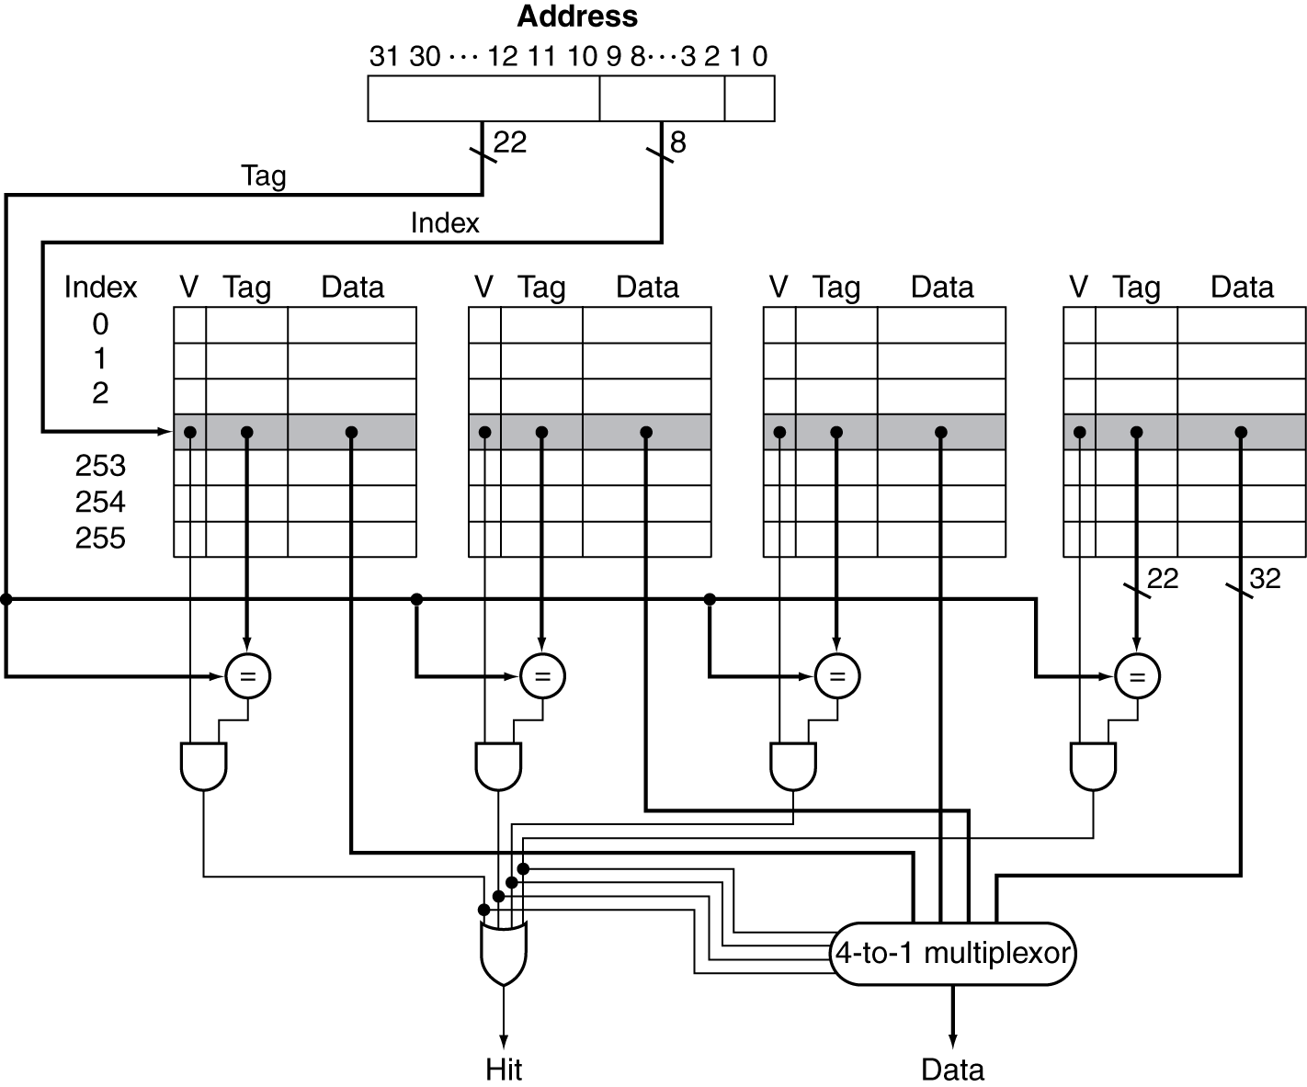
Set Associative Cache Organization

Slide 38
Replacement Policy
Direct mapped: no choice
Set associative
  Prefer non-valid entry, if there is one
  Otherwise, choose among entries in the set
Least-recently used (LRU)
  Choose the one unused for the longest time
    Simple for 2-way, manageable for 4-way, too hard beyond that
Random
  Gives approximately the same performance as LRU for high associativity

Slide 39
Multilevel Caches
Primary cache attached to CPU
  Small, but fast
Level-2 cache services misses from primary cache
  Larger, slower, but still faster than main memory
Main memory services L-2 cache misses
Some high-end systems include L-3 cache

Slide 40
Multilevel Cache Example
Given
  CPU base CPI = 1, clock rate = 4GHz
  Miss rate/instruction = 2%
  Main memory access time = 100ns
With just primary cache
  Miss penalty = 100ns/0.25ns = 400 cycles
  Effective CPI = 1 + 0.02 × 400 = 9

Slide 41
Example (cont.)
Now add L-2 cache
  Access time = 5ns
  Global miss rate to main memory = 0.5%
Calculate speedup
Primary miss with L-2 hit
  Penalty = 5ns/0.25ns = 20 cycles
Primary miss with L-2 miss
  Extra penalty = 400 cycles
CPI = 1 + 0.02 × 20 + 0.005 × 400 = 3.4
Speedup = 9/3.4 = 2.6

Slide 42
Multilevel Cache Considerations
Primary cache
  Focus on minimal hit time
L-2 cache
  Focus on low miss rate to avoid main memory access
  Hit time has less overall impact
Results
  L-1 cache usually smaller than a single cache
  L-1 block size smaller than L-2 block size

Slide 43
Interactions with Advanced CPUs
Out-of-order CPUs can execute instructions during cache miss
  Pending store stays in load/store unit
  Dependent instructions wait in reservation stations
    Independent instructions continue
Effect of miss depends on program data flow
  Much harder to analyse
  Use system simulation

Slide 44
Software Optimization via Blocking
Goal: maximize accesses to data before it is replaced
See book page 427

Slide 45
Concluding Remarks
Fast memories are expensive and therefore small, cheap memories are slow but can be large
  We really want fast, large memories ☹
  Caching gives this illusion ☺
Principle of locality
  Programs use a small part of their memory space frequently
Memory hierarchy
  L1 cache ↔ L2 cache ↔ … ↔ DRAM memory
  ↔ disk
§5.16 Concluding Remarks

Slide 46
Planning CTA01
Week 1: Introduction, Performance & Parallelism
Week 2: Instructions for arithmetic and memory
Week 3: Instructions for decisions and procedures
Week 4: Computer arithmetic
Week 5: Single cycle LEGv8, intro pipelining
Week 6: Pipelined LEGv8, hazards and forwarding
Week 7: Memory architecture
Week 8: Guest lecture (multicore and parallelism)
  Aanwezigheid verplicht!
  Zo niet → vervangende opdracht

