Slide 1
EMS20 Week 4 Lab 2

Slide 2
Leerdoelen Week 4 Lab 2
Leerdoelen week 4 lab 2. Je leert:
hoe pthreads met elkaar kunnen communiceren met behulp van een message queue (mqueue).

Slide 3
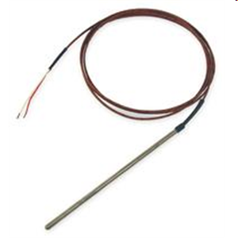
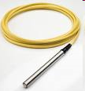

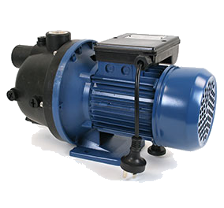
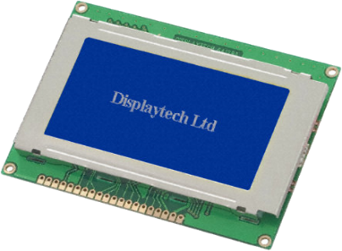
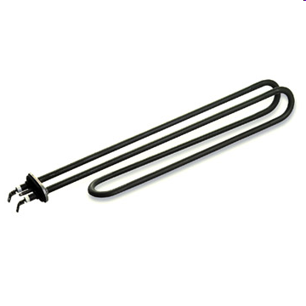
Communicatie tussen taken
thermocouple
pressure transducer
ADC
ADC
T
P
S
DAC
Switch
Screen
pump/valve
heater

Slide 4
Communicatie via mqueue (1 van 2)
int main(void) {
Board_init();
mqd_t mqdes;
struct mq_attr mqAttrs;
mqAttrs.mq_maxmsg = 3;
mqAttrs.mq_msgsize = sizeof(int);
mqAttrs.mq_flags = 0;
mqdes = mq_open("ints", O_RDWR | O_CREAT, 0666, &mqAttrs);
pthread_t tp, tc;
pthread_attr_t attr;
pthread_attr_init(&attr);
pthread_attr_setstacksize(&attr, 1024);
pthread_create(&tp, &attr, &producer, &mqdes);
pthread_create(&tc, &attr, &consumer, &mqdes);
Maximale aantal berichten.
Maximale aantal bytes per bericht.
Grotere stack zodat printf gebruikt kan worden.

Slide 5
Communicatie via mqueue (1 van 2)
void *producer(void *pp) {
mqd_t mq = *(mqd_t *)pp;
for (int i = 0; i < 10; i++) {
mq_send(mq , (char *)&i, sizeof(i), 0);
}
return NULL;
}
void *consumer(void *pp) {
mqd_t mq = *(mqd_t *)pp;
while (1) {
int msg;
mq_receive(mq, (char *)&msg, sizeof(msg), NULL);
printf("%d\n", msg);
}
}
source

Slide 6
Uitvoer
[Cortex_M4_0] Ready... Go!
0
1
2
3
4
5
6
7
8
9

Slide 7
Extra producer
pthread_t tp1, tp2, tc;
pthread_attr_t attr;
pthread_attr_init(&attr);
pthread_attr_setstacksize(&attr, 1024);
pthread_create(&tp1, &attr, &producer, &mqdes);
pthread_create(&tp2, &attr, &producer, &mqdes);
pthread_create(&tc, &attr, &consumer, &mqdes);
source

Slide 8
Uitvoer
[Cortex_M4_0] Ready... Go!
0
1
2
3
4
0
5
6
1
7
8
2
9
3
4
5
6
7
8
9

Slide 9
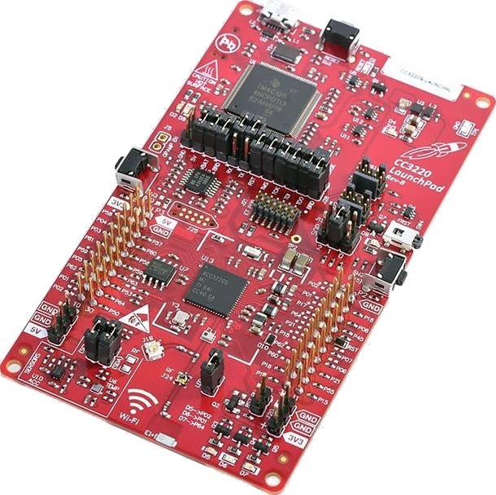

Aan de slag!
Aan de slag met Opdrachten_Week_4_Lab_2.pdf

