Slide 1
Real-Time Operating Systems
ROS01
Minor Embedded Systems
Week 1
Introduction
versd@hr.nl
brojz@hr.nl

Slide 2
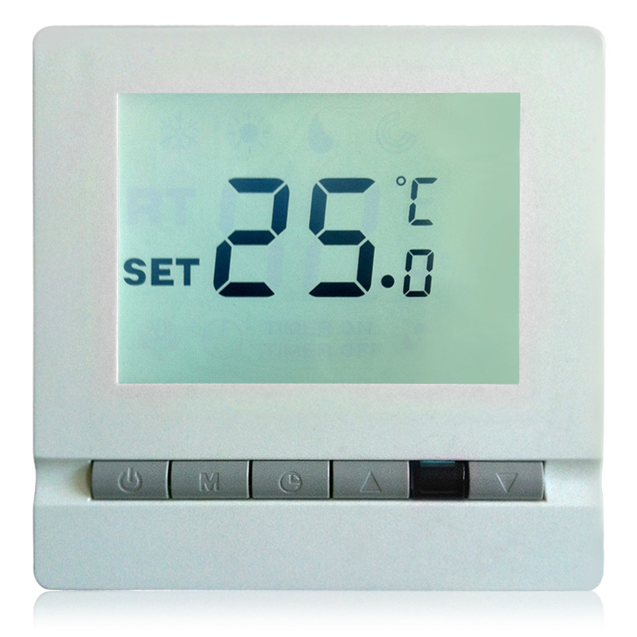
What is an embedded system?
Traditional
  Specific purpose
  Very limited resources
  Very limited interface

Slide 3
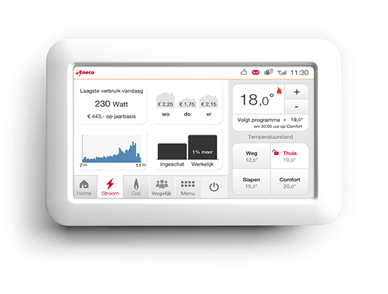
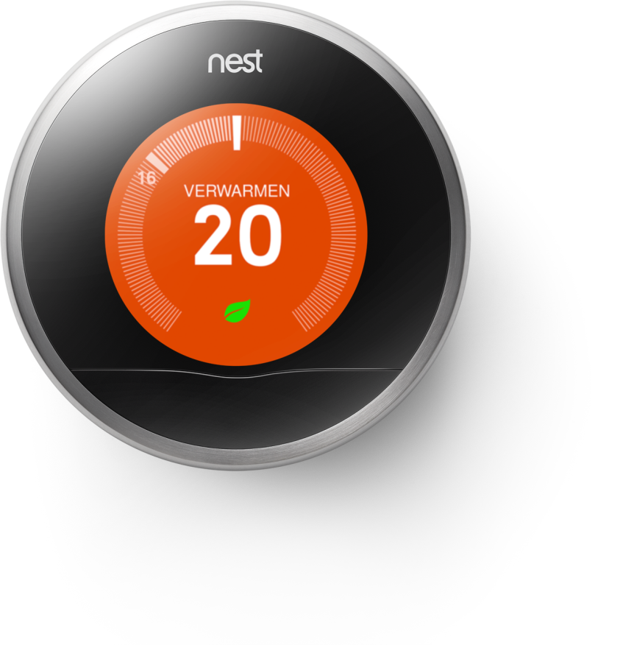
What is an embedded system?
Modern
  Limited set of purposes
  Bigger but still limited resources
  Intuitive interface
  Connected to the IoT

Slide 4
Problem with modern applications
Reading out multiple sensors to drive multiple actuators while performing multiple algorithms while responding within a set period of time
One CPU / Microcontroller
Limited I/O
Limited processing power
Limited time
Creating suitable software that is independent of the type and amount of sensors and actuators allowing precise control over the use of time

Slide 5

What is a real-time system?
System for which the response times for unpredictable inputs must be predictable.
System for which the output must not only be correct but also on the right time.

Slide 6
ROS01
What will be taught?
  Working with an advanced microcontroller platform
  Different types of architectures to deal with the problem
  Using a real-time operating system to promise:
    Response times
    Tested and reliable code
    Expandable code
  Schedulability and response time analysis

Slide 7
How to pass this course
50% of your grade is based on the weekly assignments up to and including week 4
  Concluded by a report
The other 50% consists of a two-part final assignment
  Implementing the assignment using TI-RTOS
  Calculation the feasability of the requirements

Slide 8
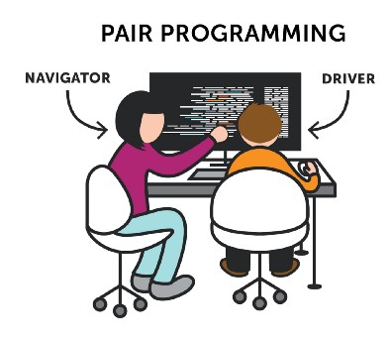

Pair programming
You work, and are graded, in pairs (pairing is done by the instructors).
https://medium.com/@tomspencer_uk/pair-programming-and-problem-solving-4531ef3bf171

Slide 9
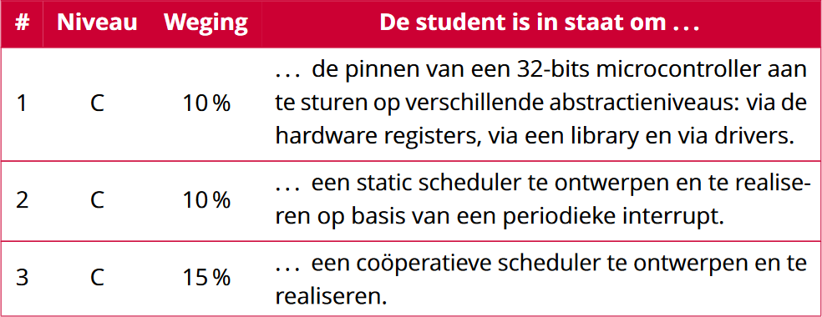
Leerdoelen (1 van 2)

Slide 10
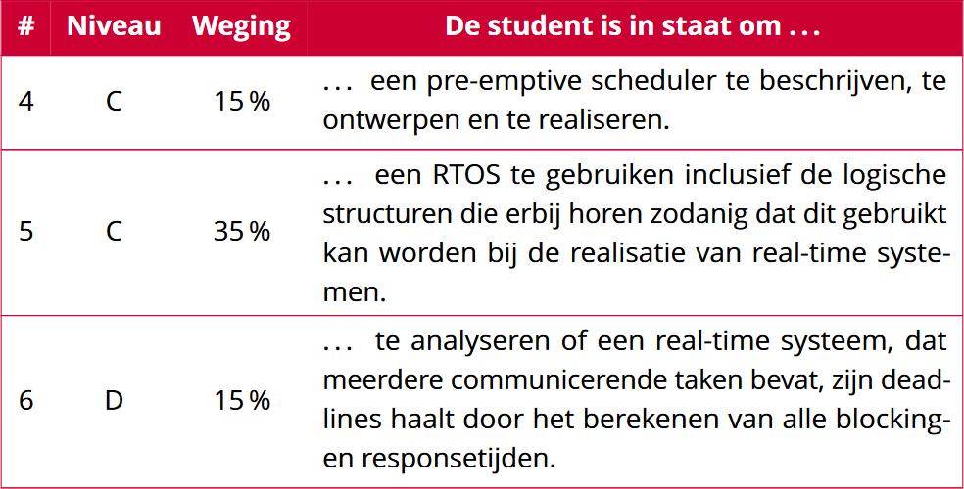
Leerdoelen (2 van 2)

Slide 11
Planning ROS01
Week 1: Introduction – Blinking leds
Week 2: Super loop construct with an ISR
Week 3: Cooperative Scheduling
Week 4: Pre-emptive Scheduling
Week 5: TI-RTOS
Week 6: Schedulability Analyses, Priority Assignment
Week 7: Response Time Analyses
Week 8: Finalizing Final Assigment

Slide 12
Learning Goals Week 1
You will learn:
  the architecture of the CC3220S;
  how to write software to control the leds on different abstraction levels.

Slide 13
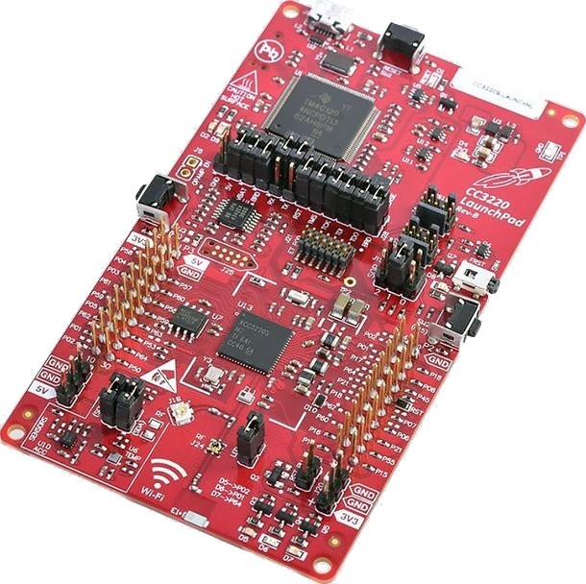
Development Platform
SimpleLink™ Wi-Fi® CC3220S LaunchPad™
CC3220S SoC:
  32-bit ARM® Cortex®-M4
  Wifi processor
  Wifi radio

Slide 14
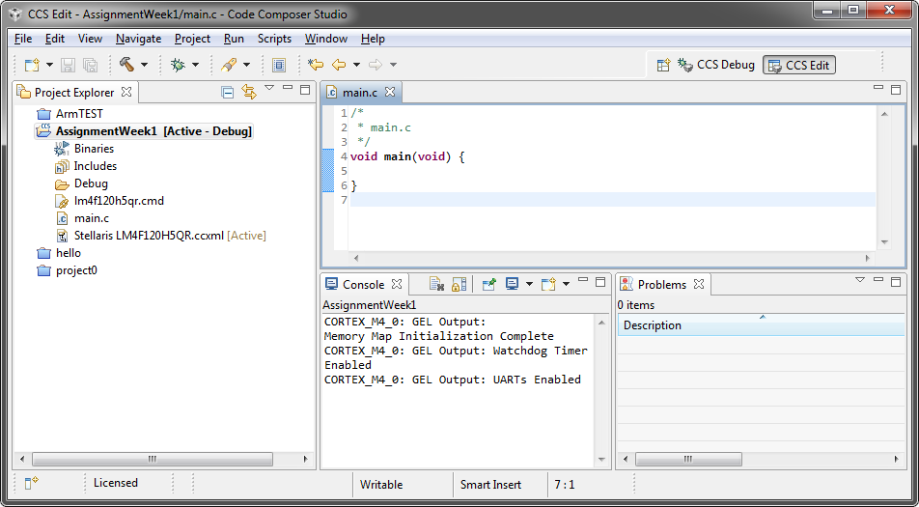
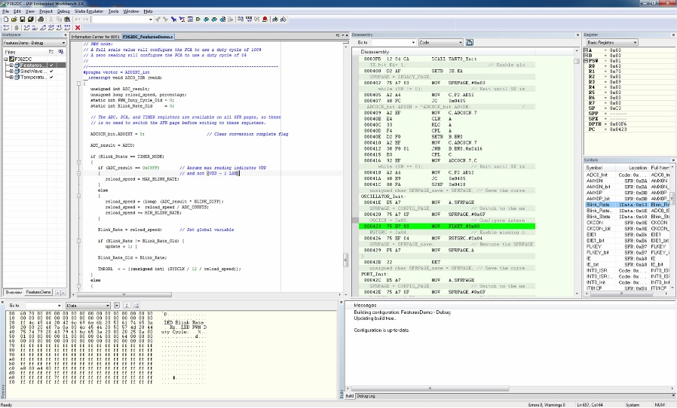
Software
Development Environment Options
  TI Code Composer Studio
    Based on Eclipse
    Optimized compiler
    Fully functional
  IAR Embedded Workbench
    Professional and well supported
    Free version is size limited
  DIY (e.g. Eclipse, arm-gcc, gdb ...)
    Hassle setting up

Slide 15
CC3220 SimpleLink™ Wi-Fi® LaunchPad™

Slide 16
CC3220S

Slide 17
Abstraction layers

Slide 18
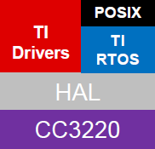
Abstraction Layers
Application
This week
Week 5
This week

Slide 19
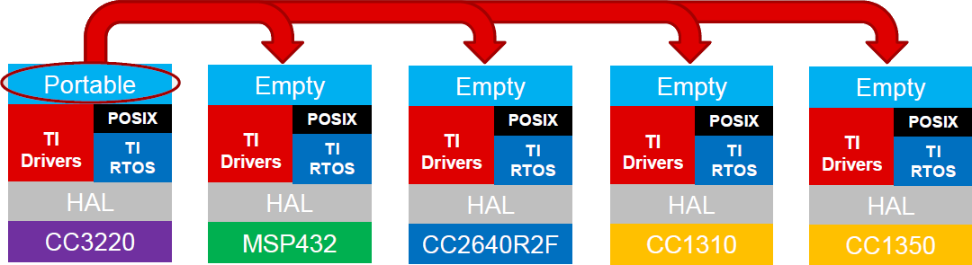
TI SimpleLink™
wifi
BLE
Bluetooth low energy
Sub-1 GHz RF
Sub-1 GHz.
2.4 GHz

Slide 20
DIY
Start working on assignment week 1

