Slide 1
Real-Time Operating Systems
ROS01
Minor Embedded Systems
Week 2
Super loop construct with an ISR
versd@hr.nl
brojz@hr.nl

Slide 2
Planning ROS01
Week 1: Introduction – Hello World
Week 2: Super loop construct with an ISR
Week 3: Cooperative Scheduling
Week 4: Pre-emptive Scheduling
Week 5: Using TI-RTOS
Week 6: Schedulability Analyses, Priority Assignment
Week 7: Response Time Analyses
Week 8: Finalizing Final Assigment

Slide 3
Overview
The microcontroller
  History
  Properties of the Cortex M4 CPU
  Interrupt system
  Timers
  Direct Memory Access system
Superloop ‘scheduler’

Slide 4
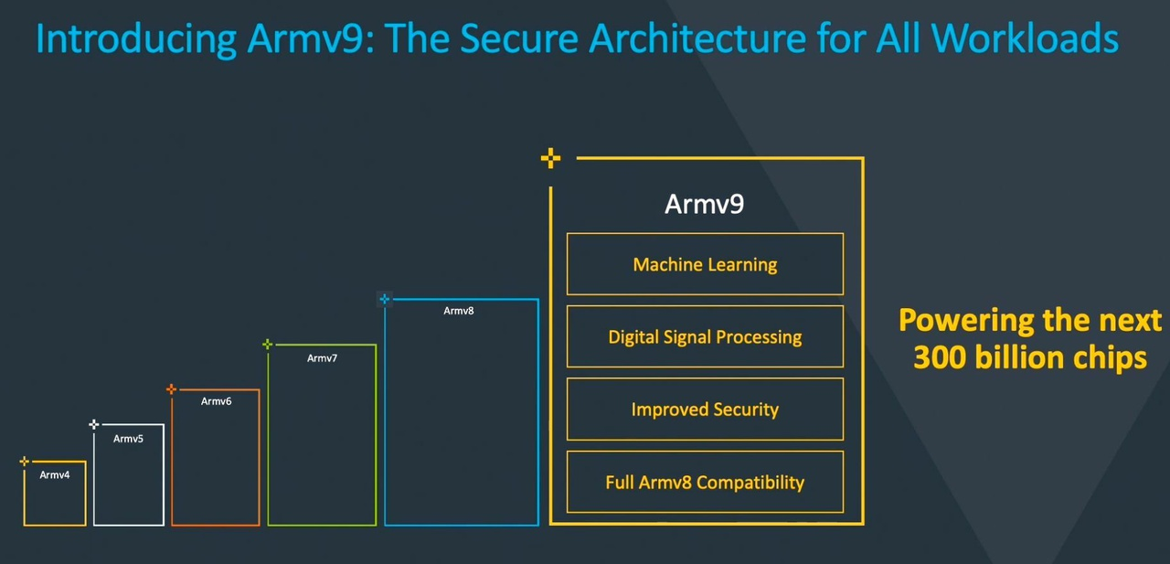
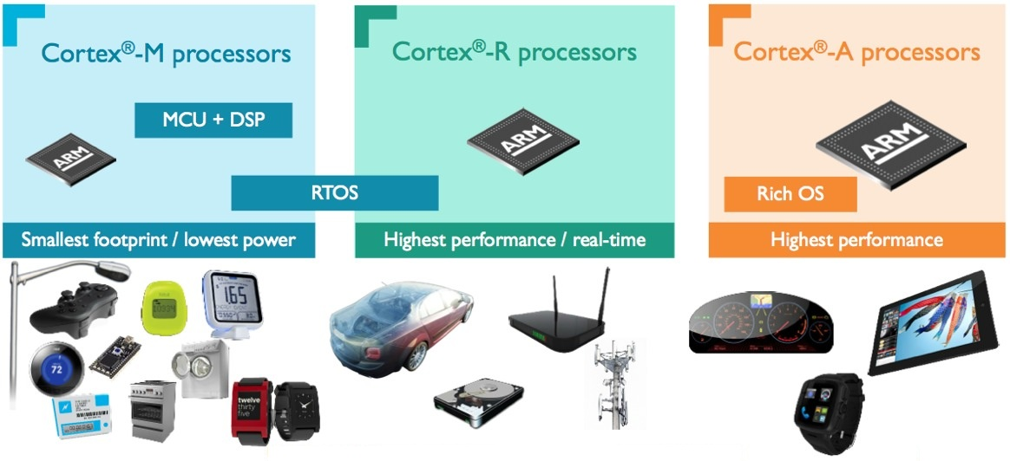
ARM History
Started in 1980 as a co-processor
  ARM1 architecture
Latest:
  ARMv9-A architecture (zie bijv. Cortex-A710)
Difference to x86?

Slide 5
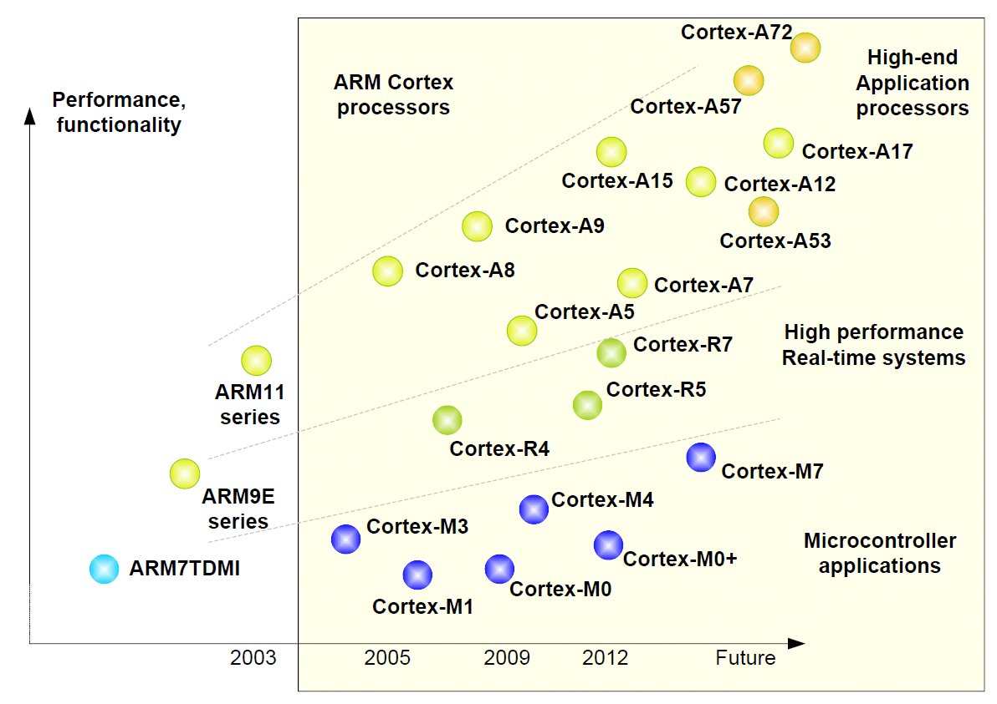
ARM family

Slide 6
CC3220S

Slide 7
Cortex M4
ARMv7E-M architecture
  Two modes of operation: Thread (application code) and Handler (exceptions and OS).
    Main SP(MSP) / Process SP (PSP)
  Two privilege levels: Unprivileged and privileged.
  Thumb 2 instructions
    Single cycle integer division/multiply
  Ultra-low power sleep modes
  Atomic bit manipulation (Bit-banding)
  System timer (SysTick)
  Nested Vector Interrupt Controller (NVIC)

Slide 8
Exceptions – NVIC
Nested Vectored Interrupt Controller
  75 exception sources
  Priority level between -3 to 7 (low number is high priority)
    Priority groups
      group priority (determines preemption)
      sub priority fields (determines order when multiple interrupts are pending)
  Tail-chaining of Exception Handlers
  External Non Maskable Interrupt

Slide 9
Exception types

Slide 11

Timers
4 GPTM (16/32)
  two 16 bit counters per module
  OR one 32 bit counter per module
    How long does an overflow take?
  $2^{32}$ ≈ 4.3e9 ≈ 53.7 s @ 80MHz

Slide 12
Timers

Slide 13
Bit-Banding

Slide 14
Bit-Banding
You should use bit0 in the alias region to change a bit in the bit-band region.

Slide 15
µDMA
(Bulk) data-transfers without CPU (32 channels)
  Memory <-> Memory
  Memory <-> Peripheral
Several transfer modes
  Basic
  Ping-pong (two alternating buffers to support continuous data flow)
  Scatter-gather
Configuration
  Channel control structures

Slide 16
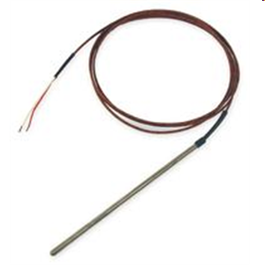
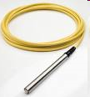
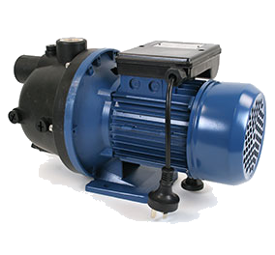
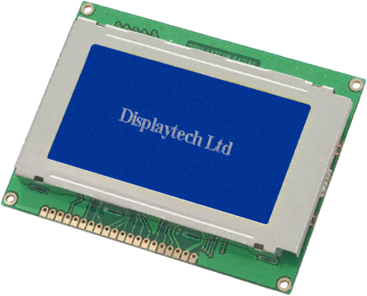
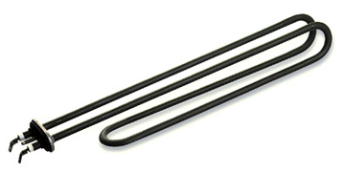
Voorbeeld embedded system
thermocouple
pressure transducer
ADC
ADC
T
P
S
DAC
Switch
Screen
pump/valve
heater

Slide 17
Software Architecture
What is the biggest flaw with this architecture?
  NO control over time
    Not deterministic
      e.g. sample time of T and P depends on execution times
    No response time promises
    Wasting CPU cycles
T = temperature control
P = pressure control
S = screen update
T
P
S
T
P
S
T
P
S
time

Slide 18

Superloop Construct
Simple, deterministic
Fixed time scheduling using SysTick
Sleep until next SysTick (save energy)
Is it necessary to run all tasks every tick?
T
P
S
T
P
S
time
SysTick
SysTick

Slide 19
Opdrachten / Verslag
Opdrachten worden niet afgetekend
  Komen wel in het verslag
Je mag om feedback vragen
Verslag
  Bevat code opdrachten
  Uitleg interessante delen
    Bijv. Het adres-masker bij week 1

