Slide 1
Real-Time Operating Systems
ROS01
Minor Embedded Systems
Week 3
Cooperative Scheduling

Slide 2
Planning ROS01
Week 1: Introduction – Blinking leds
Week 2: Super loop construct with an ISR
Week 3: Cooperative Scheduling
Week 4: Pre-emptive Scheduling
Week 5: Using TI-RTOS
Week 6: Schedulability Analyses, Priority Assignment
Week 7: Response Time Analyses
Week 8: Finalizing Final Assigment

Slide 3
Overview
Scheduling
  Problem
  Goal
  Possible solution

Slide 4
Scheduling
Problem
  Multiple processes require CPU time
    Some processes need it ASAP
    Some processes just need to happen at some point in time
  Multiple processes require bandwidth
    USB, Serial, SPI ....
    Prioritization?
Goal
  Create a framework that’ll ease (CPU) time management
  Easy to add new processes and to share resources

Slide 5
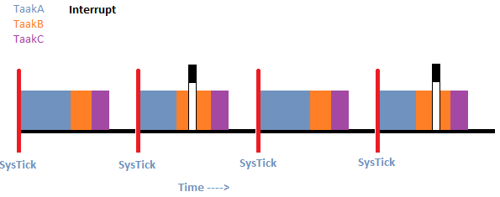
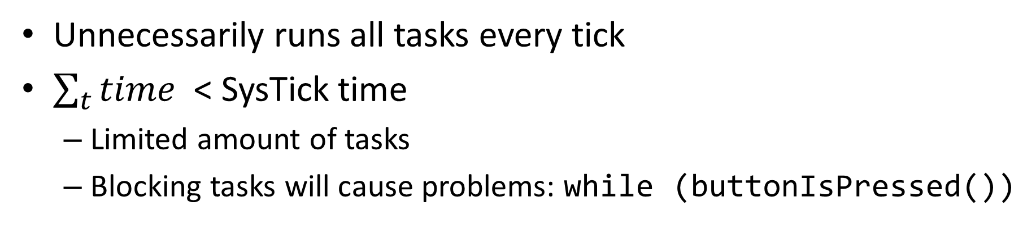
Superloop Construct
Unnecessarily runs all tasks every tick
$\sum_{t}{time}$ < SysTick time
  Limited amount of tasks
  Blocking tasks will cause problems: while (buttonIsPressed())

Slide 6
‘Complex’ Cooperative Scheduler
Cooperative:
  Task finishes
  then transfers control back to the scheduler
No fights over concurrent use of hardware
Perfect for small amount of tasks
Easy to maintain
Adaption to simple version:
  Each task gets its own period (e.g. 400 SysTicks)
  Each task could have a priority, state, etc

Slide 7
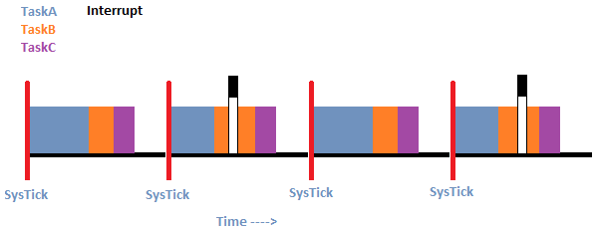
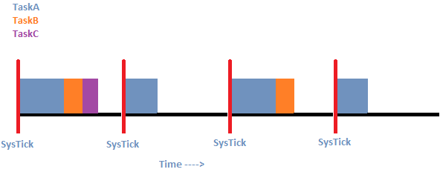
Difference

Slide 8
Overview
Tasklist
  Structure (struct) for each task
  Ordered by priority
  Only execute task when ready
Use SysTick to determine which task is READY
Use main loop to execute all ready tasks.
Sleep until next SysTick

Slide 9
Interim : Function pointer
Syntax
  void func(int);
  void (*pointerNaarFunc)(int);
To run
  pointerNaarFunc = &func;
  (*pointerNaarFunc)(42);
To run (alternative)
  pointerNaarFunc = func;
  pointerNaarFunc(42);

Slide 10
Suspending a task
Implementing a delay using SysTick
  Change state to WAITING
  Initialize a counter, or add to the existing period
  Decrement the counter each tick
  When reached zero, put into ready mode

Slide 11
Scheduling
The process of selecting the task to execute next
  What if 3 tasks are READY at the same time?
  Which one will be selected first?
Scheduling algorithms
  FIFO
  Priority based
  Shortest Job First

Slide 12

FIFO – Scheduling Algorithm
Tasks are run in order of task-creation
  Add most important tasks first
  Add less important tasks later
Pro
  Easy!
  No overhead in selecting
Con
  Fixed solution, pre-determined at compile time
  Tasks created run-time are always last

Slide 13
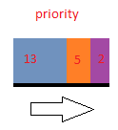
Priority based – Scheduling Algorithm
Use ‘priority’ number over position in task list
  Highest priority task goes first of all READY tasks
Pro
  Ability to work with more tasks
  Possible to change priority real time
  Most demanding tasks run first
Cons
  Means either sorting a list or traversing it
    Increases scheduling time

Slide 14

Shortest Job First – Scheduling Algorithm
First execute the task with shortest estimated run-time
  First used in database applications, keep customers happy!
Pro
  Shortest average waiting time
Con
  Estimating (dynamic) task time
  Longest tasks have worst reaction time

Slide 15
Next Week
Pre-Emptive scheduling
(pre-emptive) Scheduling algorithms

