Slide 1
Real-Time Operating Systems
ROS01
Minor Embedded Systems
Week 4
Pre-emptive Scheduling

Slide 2
Planning ROS01
Week 1: Introduction – Blinking leds
Week 2: Super loop construct with an ISR
Week 3: Cooperative Scheduling
Week 4: Pre-emptive Scheduling
Week 5: Using TI-RTOS
Week 6: Schedulability Analyses, Priority Assignment
Week 7: Response Time Analyses
Week 8: Finalizing Final Assigment

Slide 3
Overview
Scheduling
  Problem
  Goal
  Possible solution

Slide 4
Scheduling
Problem
  Multiple processes require CPU time
    Some processes need it asap
    Some processes just need to happen at some point in time
  Multiple processes require bandwidth
    USB, Serial, SPI ....
    Prioritization?
Goal
  Create a framework that’ll ease (CPU) time management
  Easy to add new processes and to share resources

Slide 5
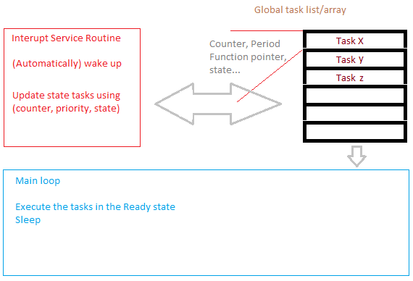
Review Cooperative Scheduler

Slide 6
Demo
Demonstration of pre-emptive project

Slide 7
Cooperative versus Pre-emptive scheduling
Cooperative
  Tasks run sequentially
  High priority tasks have to wait till last task finishes
  Easy to set up
  Low overhead scheduler
Pre-emptive (Multi-tasking)
  Important tasks always finish first
  Danger of starvation and using hardware concurrently
  More overhead on resources(RAM) and CPU time

Slide 8
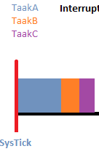
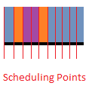
Pre-emption
Interrupting a task to execute a different task
Scheduler decides next task
Context switch switches the tasks
  How does it work?

Slide 9
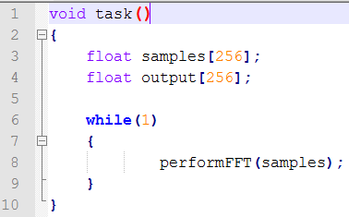
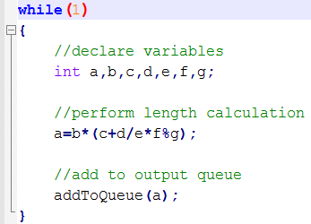
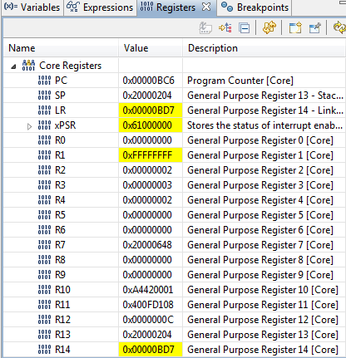
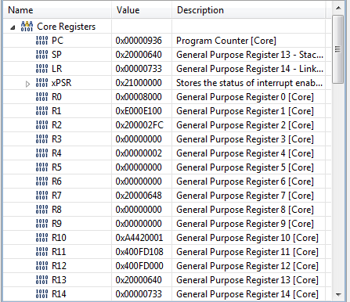
Switching context
Enter exception (PendSV)
Save context (CPU registers) to stack
Switch stack to new task
Load context from stack to CPU
Leave exception using new stack
save context ->

Slide 10
Pre-emptive scheduling
Priority based
  Scheduler decides and update states of tasks
  When high priority task comes alive, it interrupts lower priority tasks
  When all tasks are suspended, the idle task can run
Round robin
  Every task gets equal CPU time
  When all tasks are suspended, the idle task can run
Demo
  Instructor demonstrates algorithms

Slide 11
Problems with pre-emptive scheduling
Starvation
  Low priority tasks don’t get cpu time
    Possible solution: Aging
Sharing resources
  Tasks can’t use hardware ‘simultaneously’
  Waiting for hardware to come available can cause deadlock or priority inversion
    Next week

Slide 12
Assignment week 4/5
Done with assignment 1-3?
  Acquire VersdOS
    https://bitbucket.org/HR_ELEKTRO/ros01_ccs_projecten
    Import the project into the workspace
    Possibly select the right compiler version under project settings
Assignment 4
  Modify scheduler from round-robin to priority based
  Modify and optimize code as well as possible
  Write report chapter about choices and modifications
    Sunday week 6 23:59- Modulewijzer

Slide 13
Next Week
TI-RTOS
  What is it
  Problems and challenges with
  Threads and IPC (Inter Process Synchronization)
  POSIX API overview
  Read assignment 5 before next week’s lesson!

