Slide 1
Real-Time Operating Systems
ROS01
Minor Embedded Systems
Week 5
Using TI-RTOS
versd@hr.nl
brojz@hr.nl

Slide 2
Planning ROS01
Week 1: Introduction – Blinking leds
Week 2: Super loop construct with an ISR
Week 3: Cooperative Scheduling
Week 4: Pre-emptive Scheduling
Week 5: Using TI-RTOS
Week 6: Schedulability Analyses, Priority Assignment
Week 7: Response Time Analyses
Week 8: Finalizing Final Assigment

Slide 3
Overview
  Tasks
    Creation / Deletion
    Parameter passing
  Multitasking problems
    Situation / Problem
    Goal
    Solution

Slide 4
Multitasking
“An environment where program execution can be interrupted and continued at any time in any location”
Questions
  How to design such a system and promise timing?
  How to prevent data corruption?
  How to communicate between tasks?

Slide 5


POSIX
POSIX
Portable Operating System Interface (POSIX) is a standard API for Operating Systems.
  Many OS partially comply with this standard. For example: Linux, Android, OSX, VxWorks, QNX Neutrino, TI-RTOS etc.
Tasks (threads) are dynamically created by using API calls.
Semaphores and mutexes can be used to synchronize tasks.
Message Queues can be used to communicate between tasks.

Slide 6
Pthread Example (1 of 2)
void *print1(void *par) {
for (int i = 0; i < 10; i++) {
usleep(100000);
printf("print1\n");
}
return NULL;
}
void *print2(void *par) {
for (int i = 0; i < 10; i++) {
usleep(200000);
printf("print2\n");
}
return NULL;
}

Slide 7
Pthread Example (2 of 2)
Uitvoer:
print1
print2
print1
print1
print2
print1
print1
print2
print1
print1
print2
print1
print1
print2
print1
print2
print2
print2
print2
print2
void *main_thread(void *arg) {
pthread_attr_t pta;
pthread_attr_init(&pta);
pthread_attr_setstacksize(&pta, 1024);
pthread_t t1, t2;
pthread_create(&t1, &pta, &print1, NULL);
pthread_create(&t2, &pta, &print2, NULL);
pthread_join(t1, NULL);
pthread_join(t2, NULL);
check( pthread_attr_destroy(&pta) );
return NULL;
}
Source: pthread.c

Slide 8
Pthread with Parameter Example (1 of 2)
typedef struct {
char *msg;
useconds_t us;
} par_t;
void *print(void *par) {
par_t* p = par;
for (int i = 0; i < 10; i++) {
usleep(p->us);
printf(p->msg);
}
return NULL;
}

Slide 9
Pthread with Parameter Example (2 of 2)
Uitvoer:
print1
print2
print1
print1
print2
print1
print1
print2
print1
print1
print2
print1
print1
print2
print1
print2
print2
print2
print2
print2
void *main_thread(void *arg) {
pthread_attr_t pta;
pthread_attr_init(&pta);
pthread_attr_setstacksize(&pta, 1024);
pthread_t t1, t2;
par_t p1 = {"print1\n", 100000};
par_t p2 = {"print2\n", 200000};
pthread_create(&t1, &pta, &print, &p1);
pthread_create(&t2, &pta, &print, &p2);
pthread_join(t1, NULL);
pthread_join(t2, NULL);
check( pthread_attr_destroy(&pta) );
return NULL;
}
Source: pthread_par.c

Slide 10
Problem with Shared Memory
volatile int aantal = 0;
void *teller(void *par) {
for (int i = 0; i < 10000000; i++) {
aantal++;
}
return NULL;
}
//…
pthread_create(&t1, &pta, &teller, NULL);
pthread_create(&t2, &pta, &teller, NULL);
pthread_create(&t3, &pta, &teller, NULL);
Source: pthread_shared.c
What is the final value of aantal?

Slide 11
Problem with Shared Memory
The operation aantal++ is not atomic (in machine code).
  For example, X10 contains the address of aantal:
  LDUR X9, [X10, #0]
  ADDI X9, X9, #1
  STUR X9, [X10, #0]
What is the minimal and the maximal final value of aantal?
  Minimum = 10000000
  Maximum = 30000000
What happens when a task switch occurs at this moment?

Slide 12
Data Corruption
Situations: Task A and B use a shared global variable
(just demonstrated)
Task C and D are both using the same peripheral
(e.g., UART port)
Goal: Preventing concurrent use of a resource by multiple tasks
Solution: Using tokens to represent resources. Allow a limited number
of tasks to get the same token at the same time.

Slide 13
Solution?
There are solutions which use shared variables
(2 flags and 1 turn variable) and busy waiting.
  Dekker’s algorithm: http://en.wikipedia.org/wiki/Dekker's_algorithm
  Peterson’s algorithm: http://en.wikipedia.org/wiki/Peterson's_algorithm
Busy waiting costs clock cycles!
OSes offer solutions without busy waiting.

Slide 14
IPC Inter Process (Task) Communication
Shared variable based
  Busy waiting
    Inefficient
    Mutual exclusion is hard (Dekker’s or Peterson’s algorithm)
  Spinlock
    Busy waiting
  Mutex
  Semaphore
  Monitor
    Mutex combined with Conditional variables
  Barrier
  Read Write Lock
  Event Groups
Message based
  Message Queue

Slide 15


Mutex
Simple way to create a mutual exclusive so-called critical section.
  Only one task can be in the critical section.
Mutex has a lock (take) and a unlock (give) function.
  OS ensures that these functions are atomic!
  At the start of the critical section the mutex
  must be locked (taken) and at the end of
  the critical section the mutex must be
  unlocked (given).

Slide 16
Task States
Lock mutex m which is unlocked
ready
running
Lock mutex m which is already locked
Unlock mutex m
Blocked on m

Slide 17

Mutex
When a task t tries to lock mutex m which is already locked by an other task, task t is blocked on m.
We also say:
  Task t waits for mutex m.
  Task t sleeps until mutex m is unlocked.
Order of unblocking (waking up):
  general purpose OS: FIFO
  real-time OS: highest priority

Slide 18
Mutex with Shared Memory
int aantal = 0;
pthread_mutex_t m;
void *teller(void *par) {
for (int i = 0; i < 10000000; i++) {
pthread_mutex_lock(&m);
aantal++;
pthread_mutex_unlock(&m);
}
return NULL;
}
Source: mutex.c

Slide 19
Data Corruption
DANGER
  Priority inversion
    Low priority task has mutex locked
    High priority task is blocked due to mutex
    Solution: priority inheritance
  Deadlock
    Task A has resource 1 locked and wants to lock resource 2
    Task B has resource 2 locked and wants to lock resource 1
Will be discussed in week 7!

Slide 20
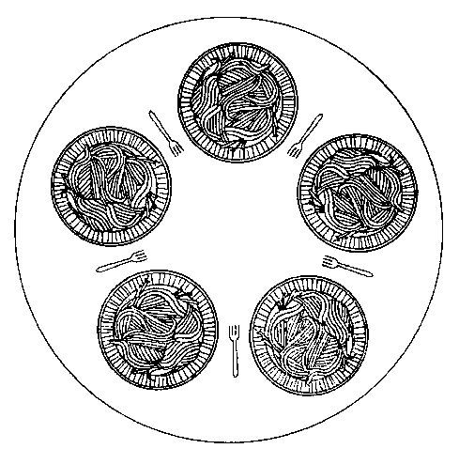
Deadlock (Example)
There are 5 philosophers.
The life of a philosopher consists of:
  Thinking;
  Eating.
Each philosopher has one plate and one fork.
  To eat a philosopher needs two forks.

Slide 21
Dining Philosophers
pthread_mutex_t fork[5];
void *philosopher(void *par) {
int i = *(int*)par;
while (1) {
printf("philosopher %d is sleeping\n", i);
sleep(1);
pthread_mutex_lock(&fork[i]);
pthread_mutex_lock(&fork[(i + 1) % 5]);
printf("philosopher %d is eating\n", i);
pthread_mutex_unlock(&fork[i]);
pthread_mutex_unlock(&fork[(i + 1) % 5]);
}
}

Slide 22
Dining Philosophers
pthread_t t[5];
int tid[5];
for (int i = 0; i < 5; i++)
{
tid[i] = i;
pthread_create(&t[i], &pta, &philosopher, &tid[i]);
}
This program can come to a hold (deadlock)! How?
Solution? See homework assignment hereafter.
Source: pthread_philosophers.c

Slide 23
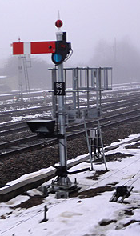
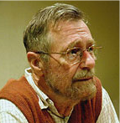
Counting Semaphore
Operations:
  Psem (prolaag (probeer te verlagen), take, wait):
  wait (block, sleep) if count == 0 else decrement count.
  Vsem (verhoog, signal, give, post):
  unblock a waiting task if count == 0 else increment count.
Order of unblocking (wake up):
  general purpose: FIFO
  real-time: highest priority
Edsger Dijkstra

Slide 24
Homework
Solve the problem of the dining philosophers by using a semaphore to ensure that no more than 4 philosophers will be able to sit at the table at the same time.
Solution: Create semaphore with initial count of 4 in main.
Now each philosopher must take a semaphore after sleeping and must give the semaphore before sleeping again.
The semaphore counts the number of available chairs at the table and a philosopher requires a chair to sit at the table.

Slide 25
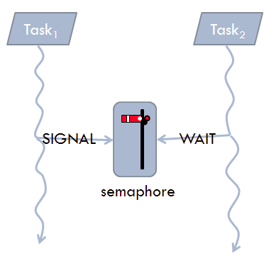
Semaphore versus Mutex
Mutex can only be used for mutual exclusion (task which takes the mutex should also give the mutex (back)).
Semaphore can also be used for other synchronization purposes.
Homework:
  Task a consists of two sequential parts a₁ and a₂.
  Task b consists of two sequential parts b₁ and b₂.
  Task c consists of two sequential parts c₁ and c₂.
  Make sure (using a semaphore) that the parts b₂ and c₂ are always executed after part a₁ has been executed.
post
wait

Slide 26
Inter Task Communication
Situation: Task A reads/debounces buttons
Task B executes functionality based on button pressed
Task C is the gate to the USB port
Other tasks send messages to C
Goal: Create a message queue variable that tasks can add to and receive from.

Slide 27
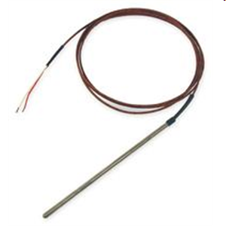
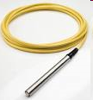

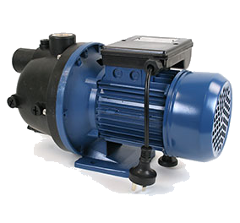
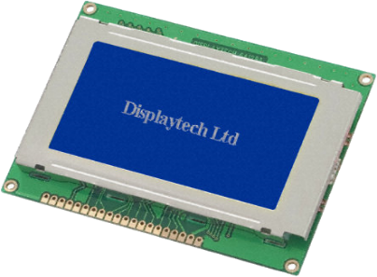

Communication between Threads
thermocouple
pressure transducer
ADC
ADC
T
P
S
DAC
Switch
Screen
pump/valve
heater

Slide 28
Message Queue Example (1 of 2)
void *main_thread(void *arg)
{
mqd_t mqdes;
mq_attr mqAttrs;
mqAttrs.mq_maxmsg = 3;
mqAttrs.mq_msgsize = sizeof(int);
mqAttrs.mq_flags = 0;
mqdes = mq_open("ints", O_RDWR | O_CREAT, 0666, &mqAttrs);
pthread_t tp, tc;
pthread_attr_t attr;
pthread_attr_init(&attr);
pthread_attr_setstacksize(&attr, 1024);
pthread_create(&tp, &attr, &producer, &mqdes);
pthread_create(&tc, &attr, &consumer, &mqdes);

Slide 29
Message Queue Example (2 of 2)
void *producer(void *p) {
mqd_t mq = *(mqd_t *)p;
for (int i = 0; i < 10; i++) {
mq_send(mq, (char *)&i, sizeof(i), 0);
}
return NULL;
}
void *consumer(void *p) {
mqd_t mq = *(mqd_t *)p;
for (int i = 0; i < 10; i++) {
int msg;
mq_receive(mq, (char *)&msg, sizeof(msg), NULL);
printf("%d\n", msg);
}
return NULL;
}
Source: mqueue.c

Slide 30
Next Week
Week 6: Schedulability Analyses, Priority Assignment
Week 7: Response Time Analyses

