Slide 1
Real-Time Operating Systems
ROS01
Minor Embedded Systems
Week 7
RT Analyses (part 2)
versd@hr.nl
brojz@hr.nl

Slide 2
Planning ROS01
Week 1: Introduction – Blinking leds
Week 2: Super loop construct with an ISR
Week 3: Cooperative Scheduling
Week 4: Pre-emptive Scheduling
Week 5: Using TI-RTOS
Week 6: Schedulability Analyses, Priority Assignment,
Response Time Analyses (part 1)
Week 7: Response Time Analyses (part 2)
Week 8: Finalizing Final Assignment

Slide 3
Task states
Lock mutex m which is unlocked
ready
running
Lock mutex m which is already locked
Unlock mutex m
Blocked on m

Slide 4
FPS-DMPO Blocking
When a task with a lower priority has to wait on a task with a higher priority, the task is preempted.
A preempted task is added to the ready queue before tasks with the same priority.
When a task with a high priority has to wait on a task with a lower priority, the task is blocked (priority inversion).
When a task is unblocked, it is added to the ready queue after tasks with the same priority.
To predict the real-time behavior of a task, the maximum time a task can be blocked must be predictable (bound blocking).

Slide 5
Priority inversion example
Four tasks (a, b, c, and d) share two resources (Q and V).
Each resource can only be used mutually exclusive (so each resource is protected with a mutex).
task | prio | execution | release time
d | 4 | EEQVE | 4
c | 3 | EVVE | 2
b | 2 | EE | 2
a | 1 | EQQQQE | 0
E = task only needs the
processor to run
Q = task needs processor
and resource Q to run
V = task needs processor
and resource V to run

Slide 6
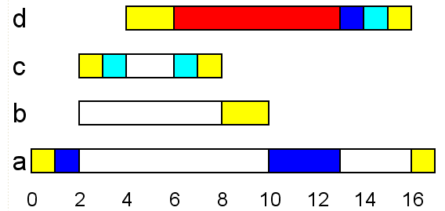
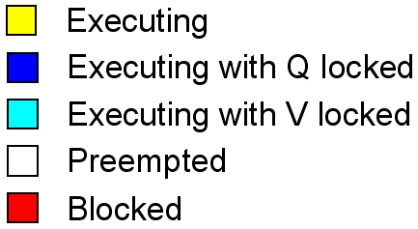
Priority inversion example
Finish this Gantt chart yourself!
t = 1
t = 2
t = 3
t = 4
t = 5
task | prio | execution | release time
d | 4 | EEQVE | 4
c | 3 | EVVE | 2
b | 2 | EE | 2
a | 1 | EQQQQE | 0

Slide 7
FPS-DMPO Priority inversion
Task d is being blocked by task a, b, and c (all tasks with a lower priority)!
Blocking (priority inversion) can not be avoided if we use mutual exclusive recourses.
Blocking can be bounded by using priority inheritance:
  When a task is blocked on a resource, then the task that owns the recourse gets (inherits) the priority of the blocked task.

Slide 8
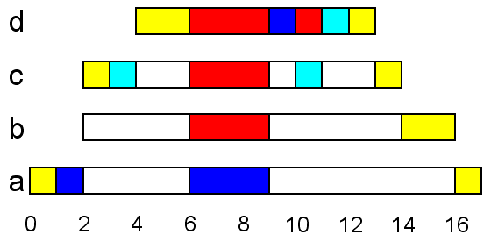
Priority inheritance example
Finish this Gantt chart yourself!
t = 5
task | prio | execution | release time
d | 4 | EEQVE | 4
c | 3 | EVVE | 2
b | 2 | EE | 2
a | 1 | EQQQQE | 0

Slide 9
Blocking Priority inheritance
The blocked time of each task is now bounded.
B_{i} = maximum blocking time for task i
K = total number of resources
usage(k, i) = Boolean function
  1 if there is a task with a priority lower than P_{i} and a task with a priority higher than or equal to P_{i} (this can be task i itself) which share resource k.
  0 otherwise.
C_{k} = maximum time for which resource k is locked.

Slide 10
Blocking Response time analyze

Slide 11
Priority inheritance example
Calculate the maximum blocking time (B_{i}) for all tasks in the previous example
task | prio | execution | release time
d | 4 | EEQVE | 4
c | 3 | EVVE | 2
b | 2 | EE | 2
a | 1 | EQQQQE | 0
E = task only needs the
processor to run
Q = task needs processor
and resource Q to run
V = task needs processor
and resource V to run
usage(k, i) = 1 if there is a task with a priority lower than P_{i} and a task with a priority higher than or equal to P_{i} (this can be task i itself) which share resource k.

Slide 12
Solution
C_{V} = 2, C_{Q} = 4
Table for usage(k, i) and B_{i}
i | k = V | k = Q | B_{i}
d | 1 | 1 | 6
c | 0 | 1 | 4
b | 0 | 1 | 4
a | 0 | 0 | 0

Slide 13
Blocking Priority inheritance
Priority inheritance can not be implemented for semaphores and message queues!
  When using a semaphore it is often not possible to determine which task is causing the blocking (which task will call the post() for which a task blocked on wait() is waiting for)!
  Example: using a semaphore with an initial count value of zero for synchronization purposes.
  When using message passing it is often not possible to determine which task is causing the blocking (which task will perform the send() for which a task blocked on receive() is waiting for)!
Solution: e.g. Priority Ceiling Protocol
Which task will call post()?
Task 1
Task 2
Task 3
Task 4
wait()
OS can not see into the future. Who can?
post()

