Slide 1
Training Digital Signal Processing
ELETDS02
Filters
brojz@hr.nl
muiko@hr.nl
Original author: Johan Peltenburg

Slide 2
Last week
Signals in real life are continuous and analog.
Need to sample and quantify them to be able to process them digitally.
They become discrete-time digital signals.
Signals can be represented as the sum of sines/cosines with certain frequencies and amplitudes.
Many problems are specified or solved in the Fourier frequency domain.
We can switch between time and frequency domain with the Fourier Transform.

Slide 3
Filters
TDS02

Slide 4
Filters (1)
Typical filters remove certain frequencies from a signal.

Slide 5


Filters (2)
Typical filters remove certain frequencies from a signal.
$$X\left(z\right)$$
$$Y\left(z\right)$$

Slide 6
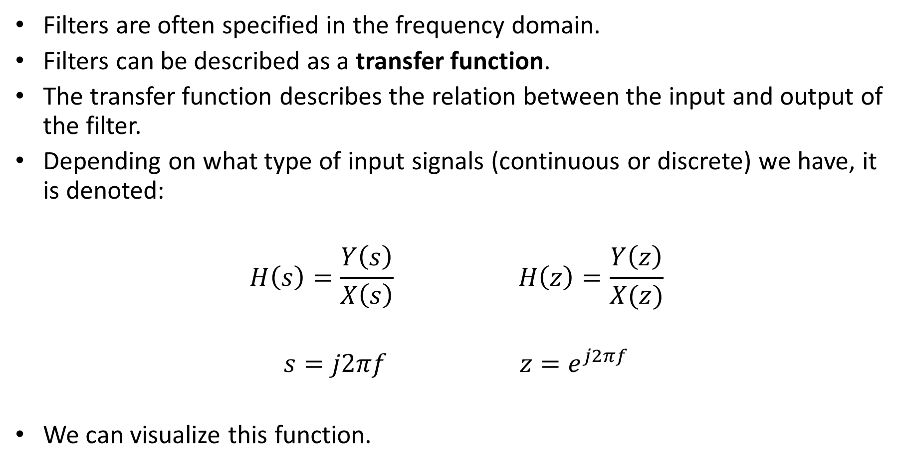
Transfer function (1)
Filters are often specified in the frequency domain.
Filters can be described as a transfer function.
The transfer function describes the relation between the input and output of the filter.
Depending on what type of input signals (continuous or discrete) we have, it is denoted:
$$H\left(s\right)=\frac{Y\left(s\right)}{X\left(s\right)} H\left(z\right)=\frac{Y\left(z\right)}{X(z)}$$
$$s=j2πf z=e^{j2πf}$$
We can visualize this function.

Slide 7


Transfer function (2)
$$X\left(z\right)$$
$$Y\left(z\right)$$

Slide 8
Transfer function (3)
$$X\left(z\right)$$
$$Y\left(z\right)$$

Slide 9

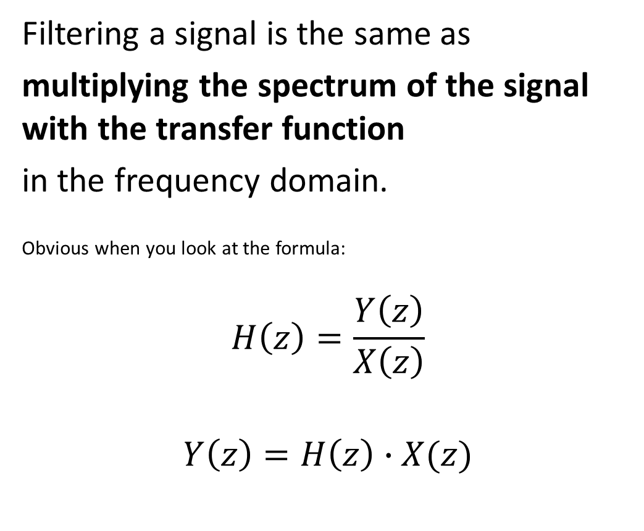

Filters (3)
Filtering a signal is the same as
multiplying the spectrum of the signal with the transfer function
in the frequency domain.
Obvious when you look at the formula:
$$H\left(z\right)=\frac{Y\left(z\right)}{X\left(z\right)}$$
$$Y\left(z\right)=H\left(z\right)∙X(z)$$
$$X\left(z\right)$$
$$Y\left(z\right)$$

Slide 10
Time-domain filter variant
To design a filter, we specify the transfer function in the frequency domain.
We use the IDTFT (Inverse Discrete Time Fourier Transform) to go back to the discrete-time domain.
Technical note: this only works for non-recursive filters.

Slide 11
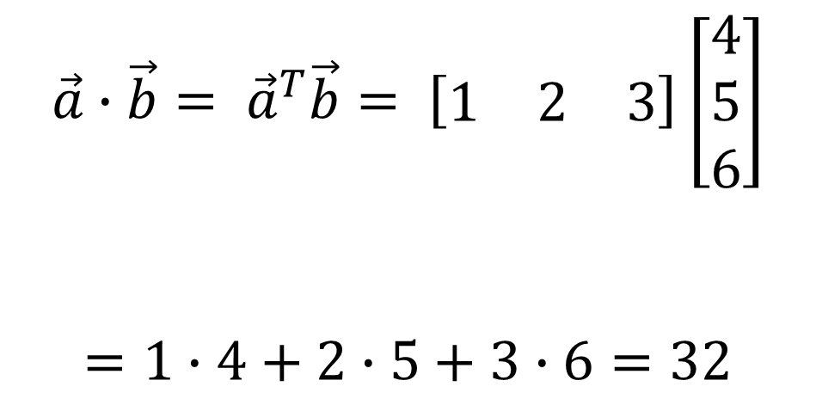
Convolution
Multiplication in the frequency domain is the same as convolution in the time-domain.
Convolution for 1 output sample can be seen as the inner product of two vectors:
Inner product operator
3 × 1
$$\vec{a}∙\vec{b}= {\vec{a}}^{T}\vec{b}= \left[\begin{matrix}1 & 2 & 3\end{matrix}\right]\left[\begin{matrix}4 \\ 5 \\ 6\end{matrix}\right]$$
$$=1∙4+2∙5+3∙6=32$$
1 × 3
1 × 1
Scalar

Slide 12
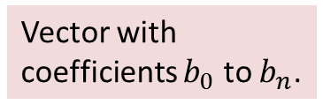
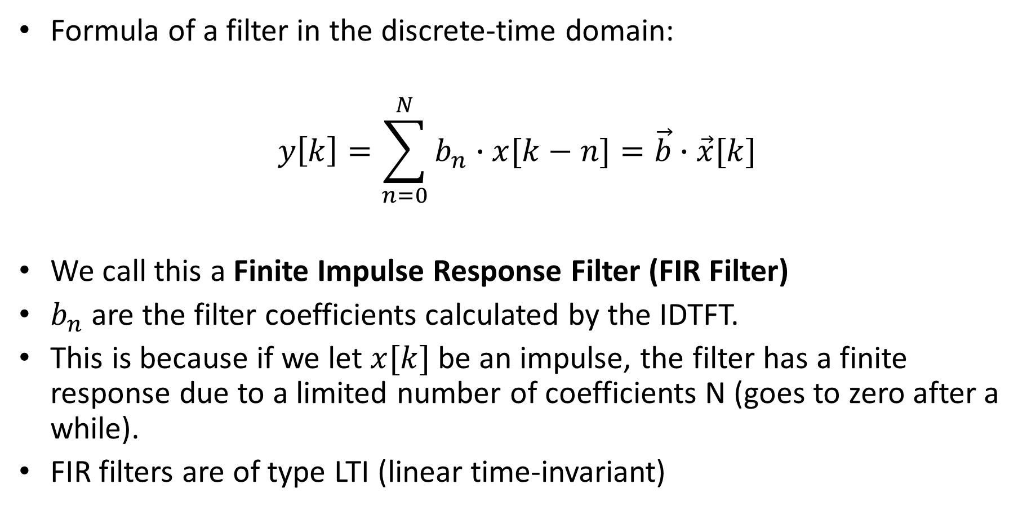
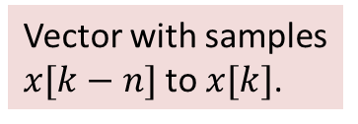
FIR Filter
Convolution.
Formula of a filter in the discrete-time domain:
$$y\left[k\right]=\sum_{n=0}^{N}{b_{n}∙x[k−n]}=\vec{b}∙\vec{x}[k]$$
We call this a Finite Impulse Response Filter (FIR Filter)
$b_{n}$ are the filter coefficients calculated by the IDTFT.
This is because if we let $x[k]$ be an impulse, the filter has a finite response due to a limited number of coefficients N (goes to zero after a while).
FIR filters are of type LTI (linear time-invariant)
Vector with coefficients $b_{0}$ to $b_{N}$.
Vector with samples $x[k−N]$to $x[k]$.

Slide 13


Filters (4)
$$x\left(t\right)$$
$$y(t)$$
Should’ve been drawn with a bit more symmetry

Slide 14
Common transfer functions of filters
Low-pass
High-pass
Band-pass
Band-stop
  Notch filter

Slide 15
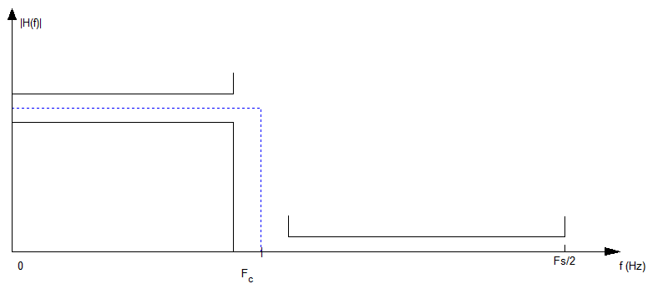
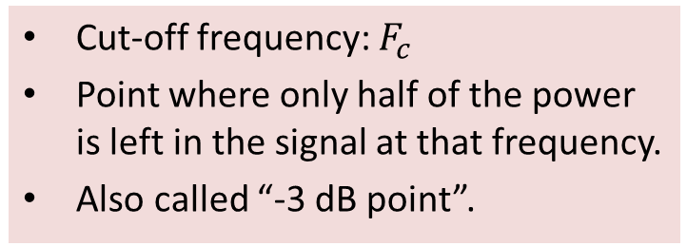
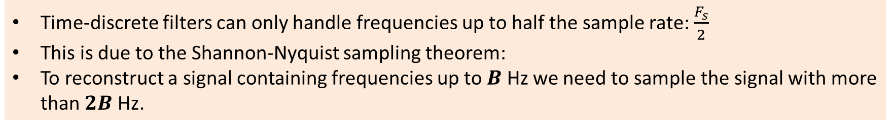
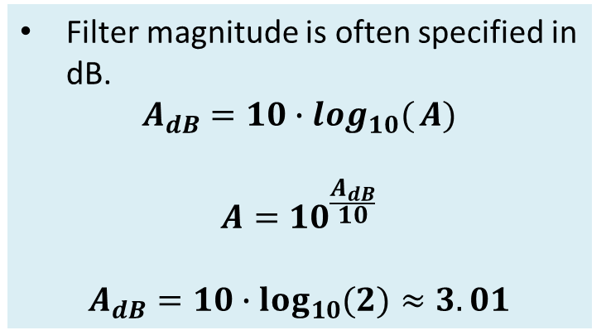
Filter characteristics (1)
Cut-off frequency: $F_{c}$
Point where only half of the power is left in the signal at that frequency.
Also called “-3 dB point”.
Filter magnitude is often specified in dB.
$$A_{dB}=10∙\log_{10}({A)}$$
$$A={10}^{\frac{A_{dB}}{10}}$$
$$A_{dB}=10∙\log_{10}{(2)}≈3.01$$
An ideal low-pass filter.
Time-discrete filters can only handle frequencies up to half the sample rate: $\frac{F_{s}}{2}$
This is due to the Shannon-Nyquist sampling theorem:
To reconstruct a signal containing frequencies up to $B$ Hz we need to sample the signal with more than $2B$ Hz.

Slide 16
Some filter terminology
Pass band: Frequency range in which the filter lets signals pass.
Stop band: Frequency range in which the filter suppresses signals.
Roll-off: Steepness of the filter between the pass band and the stop band.
Bode-plot: A graphical representation of the transfer function, including phase characteristics.

Slide 17
Summary
Filters remove certain frequencies from a signal.
Filters have a transfer function often specified in the frequency domain.
We can implement the filter in the discrete-time domain by using the IDTFT.
(Discrete-time) filters have several characteristic such as response shape (LP, HP, BP, BS ), cut-off frequency and others.

