Slide 1
Training Digital Signal Processing
ELETDS02
Fixed point calculations
brojz@hr.nl
muiko@hr.nl

Slide 2
Last week
The IDTFT gives us an infinite number of coefficients of our FIR filter.
To implement the filter in practice we need to apply windowing.
Rectangular windowing might introduce unwanted effects in the frequency domain.
Different window formulas exist that try to keep certain unwanted effects to a minimum. (Experiment with these!)
IIR filters contain feedback (or are recursive).
With only a few coefficients good results can be achieved .
Might be unstable.

Slide 3
Fixed point calculations
TDS02

Slide 4
Fixed point versus floating point
Floating point numbers:
  Standardized in IEEE Standard for Floating-Point Arithmetic (IEEE 754)
  Supported in almost any programming language
  Big dynamic range, e.g. 32-bit single precision (float in C): 1.2E-38 to 3.4E+38
  Precision varies with value, e.g. float has 23 significant bits, the precision depends on the position of the binary point which varies
  Calculations take more time / chip area / power than integer calculations
Fixed point numbers:
  Not standardized and unsupported in almost any programming language
  Small dynamic range (watch out for overflows)
  Fixed precision
  Calculations are almost the same as integer calculations

Slide 5
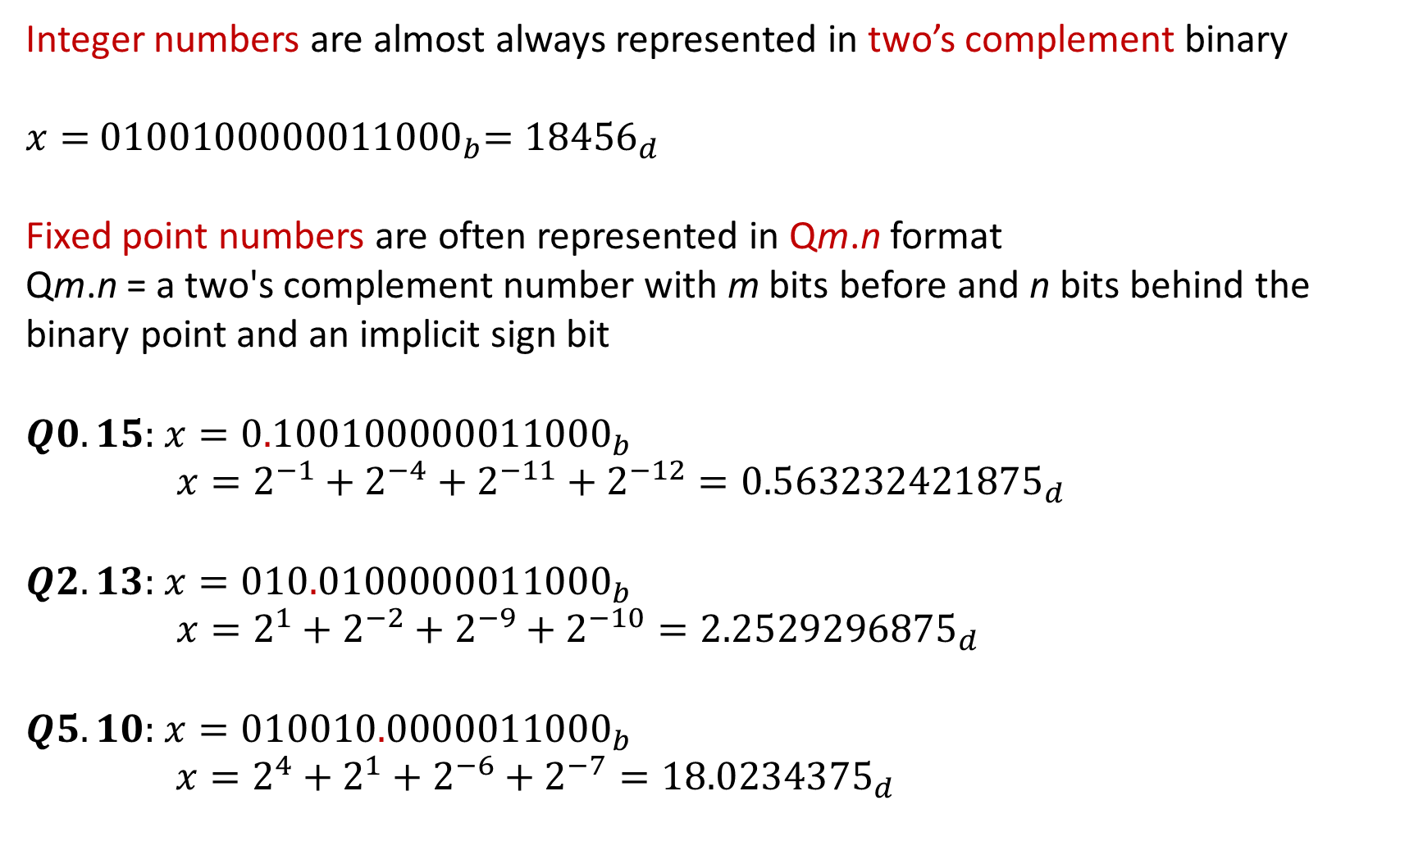
FIXED POINT EXAMPLES 1
Integer numbers are almost always represented in two’s complement binary
$$x={ 0100100000011000}_{b}={18456}_{d}$$
Fixed point numbers are often represented in Qm.n format
Qm.n = a two's complement number with m bits before and n bits behind the binary point and an implicit sign bit
$$Q0.15:{ x=0.100100000011000}_{b}$$
$x=2^{−1}+2^{−4}+2^{−11}+2^{−12}={0.563232421875}_{d}$
$$Q2.13:{ x=010.0100000011000}_{b}$$
$x=2^{1}+2^{−2}+2^{−9}+2^{−10}={2.2529296875}_{d}$
$Q5.10:$ ${x=010010.0000011000}_{b}$
$x=2^{4}+2^{1}+2^{−6}+2^{−7}={18.0234375}_{d}$

Slide 6
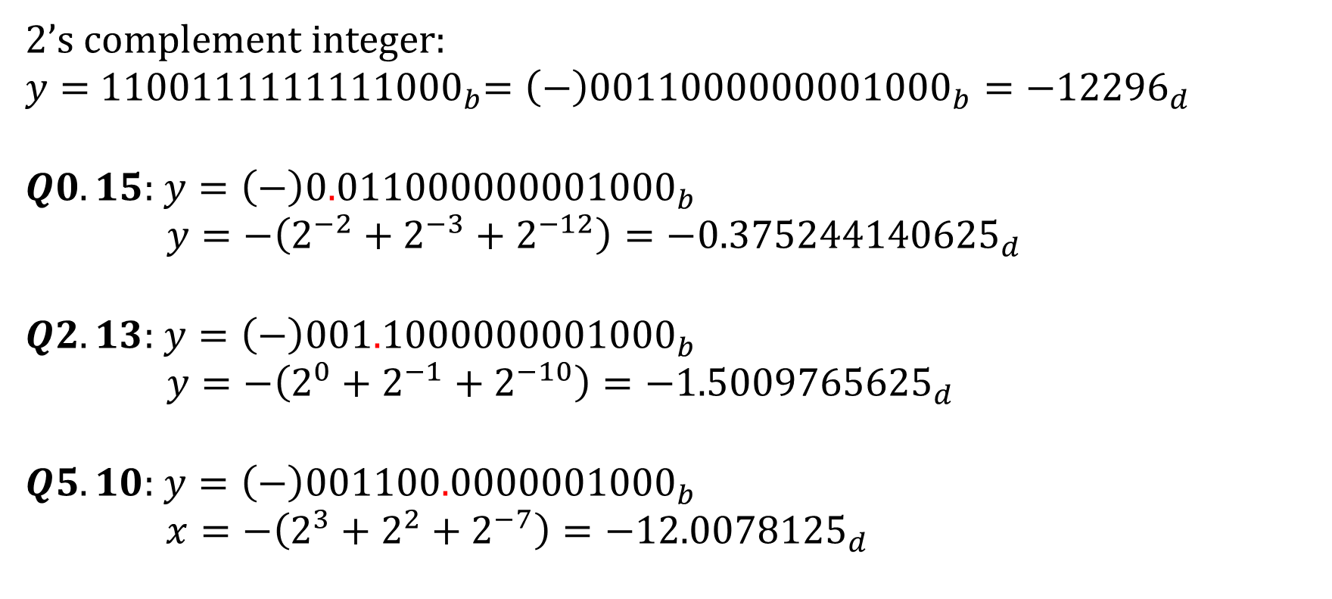
FIXED POINT EXAMPLES 2
2’s complement integer:
$$y={ 1100111111111000}_{b}=\left(−\right){0011000000001000}_{b}={−12296}_{d}$$
$$Q0.15:{ y=\left(−\right)0.011000000001000}_{b}$$
$y=−\left(2^{−2}+2^{−3}+2^{−12}\right)={−0.375244140625}_{d}$
$$Q2.13:{ y=\left(−\right)001.1000000001000}_{b}$$
$y=−\left(2^{0}+2^{−1}+2^{−10}\right)={−1.5009765625}_{d}$
$Q5.10:$ ${y=\left(−\right)001100.0000001000}_{b}$
$x=−\left(2^{3}+2^{2}+2^{−7}\right)={−12.0078125}_{d}$

Slide 7
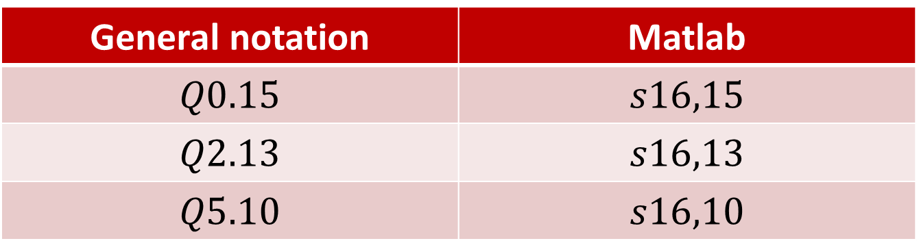
FIXED POINT MATLAB NOTATION
General notation | Matlab
$$Q0.15$$ | $$s16,15$$
$$Q2.13$$ | $$s16,13$$
$$Q5.10$$ | $$s16,10$$
16 bits total of which 10 bits right of the point
So 6 bits left of the point (including signbit)

Slide 8
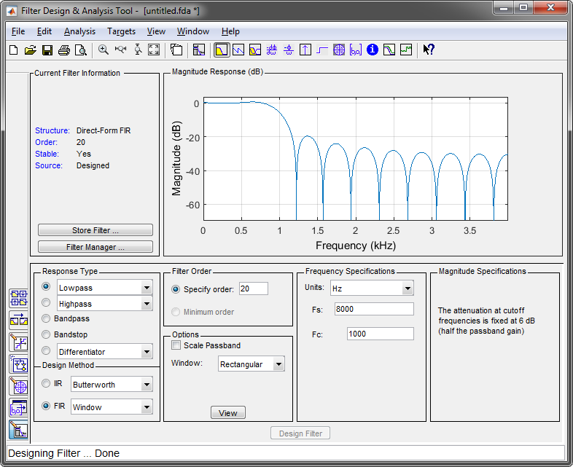
FIR FILTER COËFFICIENTS 1

Slide 9
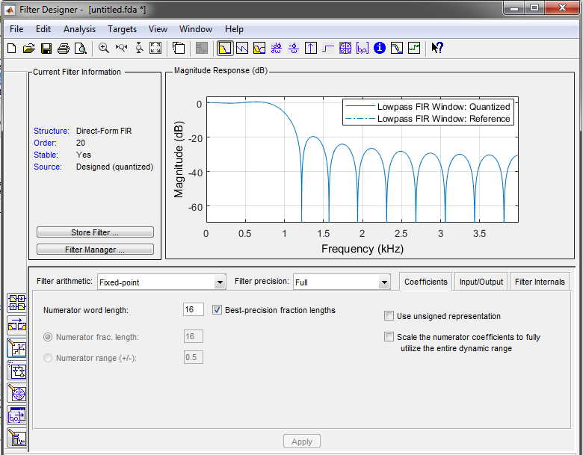
FIR FILTER COËFFICIENTS 2

Slide 10
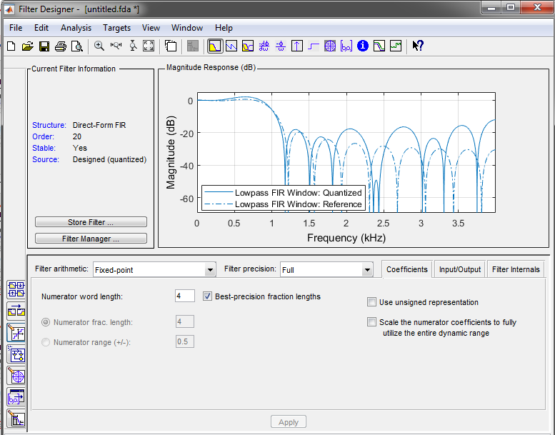
FIR FILTER COËFFICIENTS 3

Slide 11
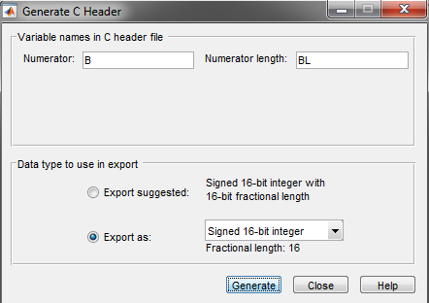
FIR FILTER COËFFICIENTS 4
Targets -> Generate C Header

Slide 12
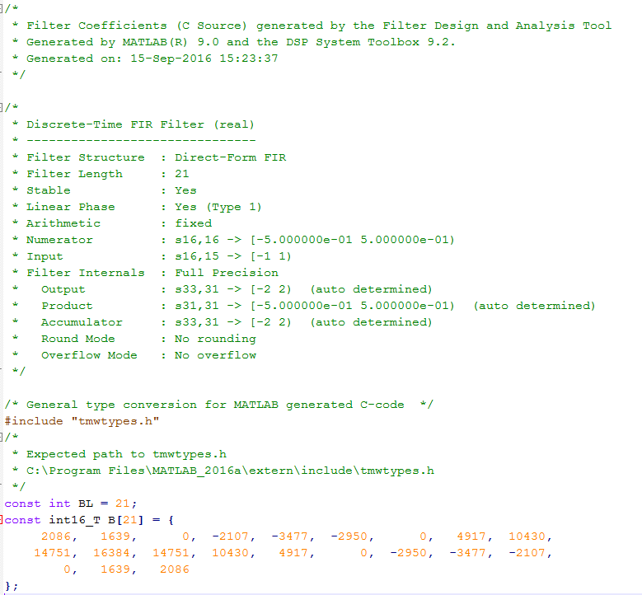
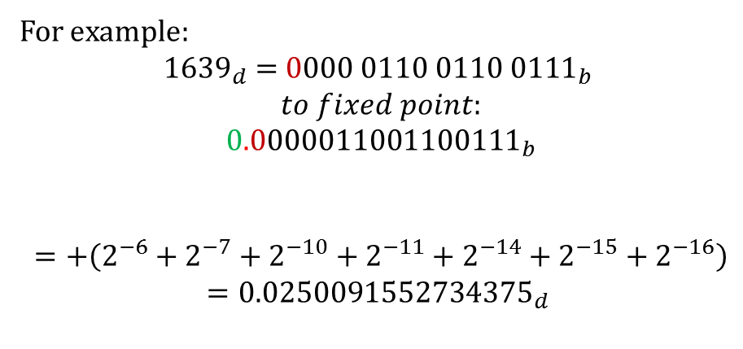
C-HEADER
16 bit fixed point number with 16 bits right of the point. (2’s complement!)
For example:
$${1639}_{d}={ 0000 0110 0110 0111}_{b}$$
$$to fixed point:$$
$${0.0000011001100111}_{b}$$
$$=+\left(2^{−6}+2^{−7}+2^{−10}+2^{−11}+2^{−14}+2^{−15}+2^{−16}\right)$$
$$={0.0250091552734375}_{d}$$

Slide 13
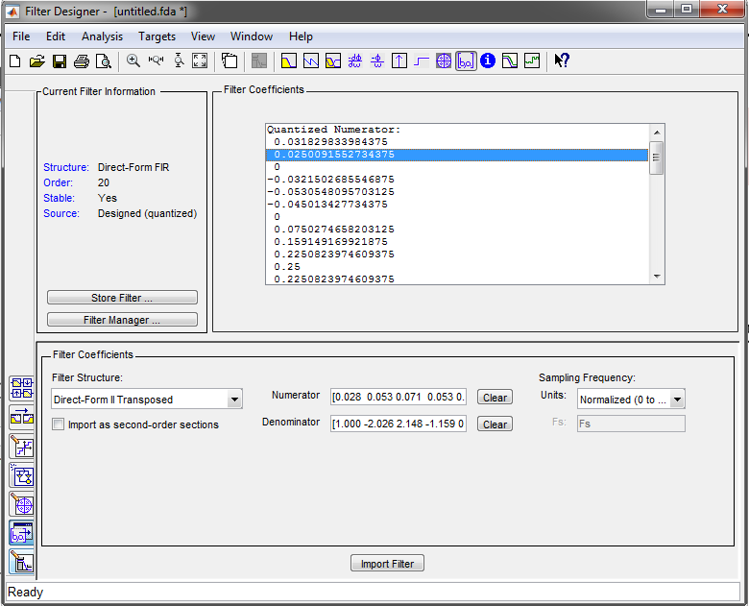
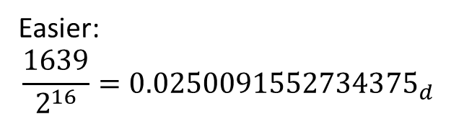
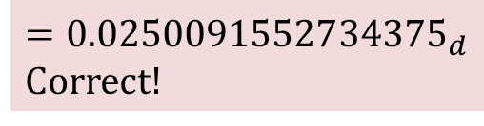
CHECK
$$={0.0250091552734375}_{d}$$
Correct!
Easier:
$$\frac{1639}{2^{16}}={0.0250091552734375}_{d}$$

Slide 14
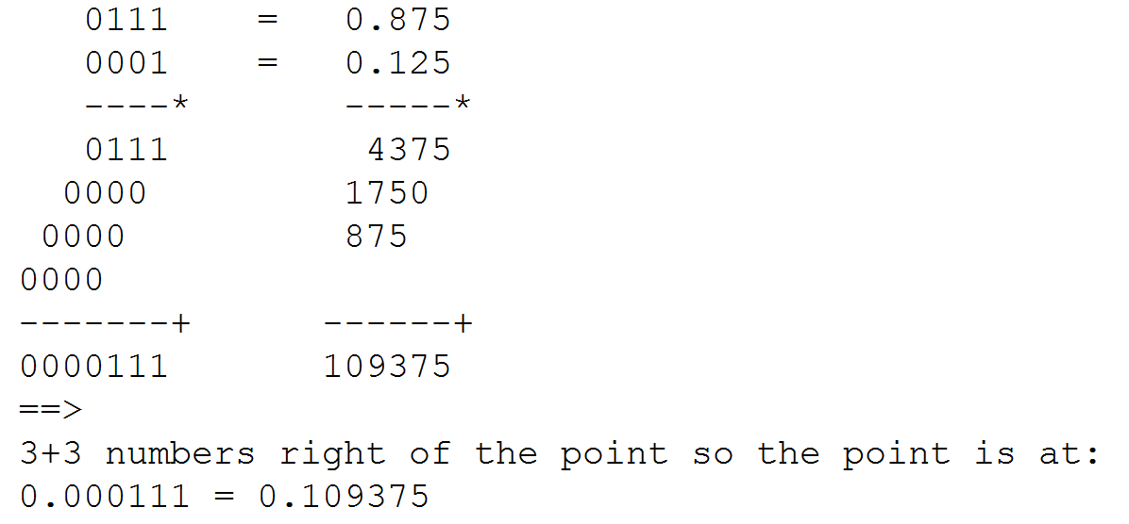

MULTIPLICATION
$$Q0.3 notation$$

Slide 15
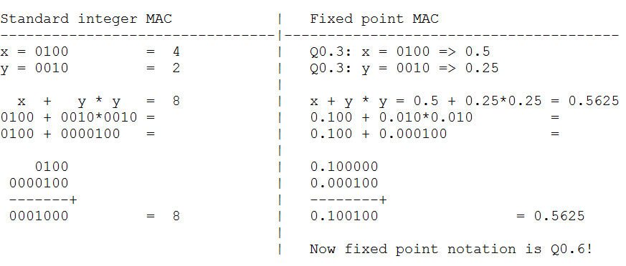
MULTIPLY ACCUMULATE ARITHMETIC
Correct placement of the point
Addition with points aligned
Add zeroes

Slide 16
C-HEADER
Why 31 bit right of the point?
Why 33 bits total?
How to implement this in C?

Slide 17
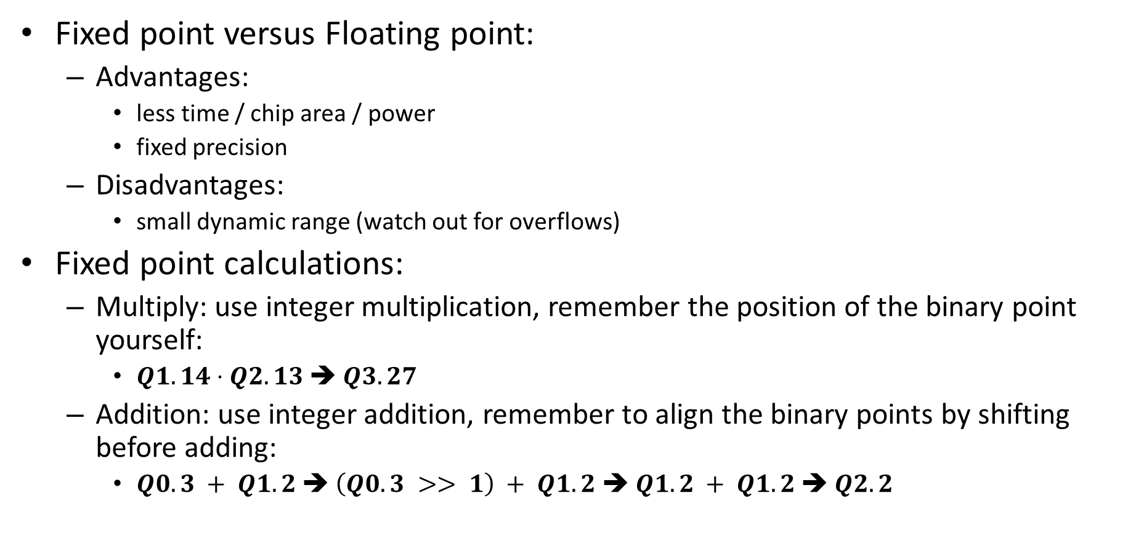
Summary
Fixed point versus Floating point:
  Advantages:
    less time / chip area / power
    fixed precision
  Disadvantages:
    small dynamic range (watch out for overflows)
Fixed point calculations:
  Multiply: use integer multiplication, remember the position of the binary point yourself:
    $Q1.14⋅Q2.13$ ➔ $Q3.27$
  Addition: use integer addition, remember to align the binary points by shifting before adding:
    $Q0.3 + Q1.2$➔ $\left(Q0.3 >> 1\right) + Q1.2$➔ $Q1.2 + Q1.2$➔ $Q2.2$

