Slide 1

CS 513
Knowledge Discovery and Data Mining
PREDICTING ATTRITION IN R

Slide 2



Team: The Ensemble
Homa Deilamy
Tigran Margaryan
Hariom Mehta

Slide 3
Problem Statement
To develop a classification model(s) to predict the potential of employees leaving the company (become terminated).

Slide 4
Understanding
We have started our analysis by understanding what data we have, and we have tried to understand where we have missing values. The only columns that contain missing values are REFERRAL_SOURCE and TERMINATION_YEAR. It’s essential to notice that TERMINATION_YEAR doesn’t really have missing values, because logically active employees do not have TERMINATION_YEAR.
At this point, we have replaced missing values in REFERRAL_SOURCE with “Other” because we already had that category, and since we did not know the source, we decided that it’s the best category to fill in for missing values.
We also encountered a row with a random space “ ” and we have removed the entire row. We decided to do so because our dataset is big enough and that one row does not have a significant impact on the overall results.

Slide 5
Processing
First off, we have dropped EMP_ID, JOBCODE, REFERRAL_SOURCE, TERMINATION_YEAR.
The reason we dropped those columns is that the first two are random numbers, and TERMINATION_YEAR is collected once the employee terminated the contract (retrospective data). If we are to predict the STATUS for current employees, TERMINATION_YEAR should not be included in the model.
Also, we have dropped REFERRAL_SOURCE because as we found out during the analysis, it does not have any significance and there is no need to treat the missing values here.

Slide 6
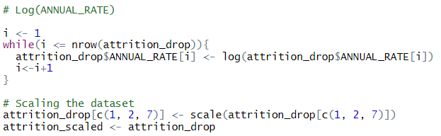
Processing
As we don’t have any missing values anymore, we have done log transformation for ANNUAL_RATE because (1) we now have slightly better residuals after the transformation and (2) as we found out during the analysis it’s the only continual variable that we are going to use in the future. We didn’t transform any other continual variable because we are not going to use them. Next, we have scaled the continual columns.

Slide 7
Processing
Next, we have checked if our target variable (“STATUS”) column is balanced. Since the column is almost perfectly balanced, we won’t do anything with it.
A T
5394 4217

Slide 8
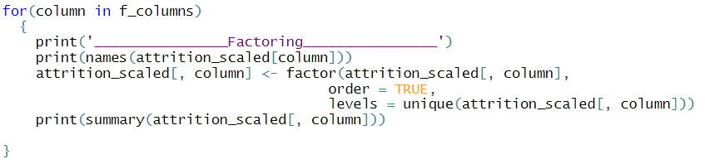
Processing
Here we have factored the categorical columns using the for loop.

Slide 9
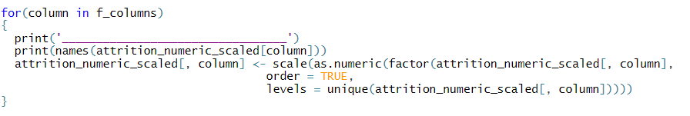
Processing
Here we have processed the data for ANN.

Slide 10
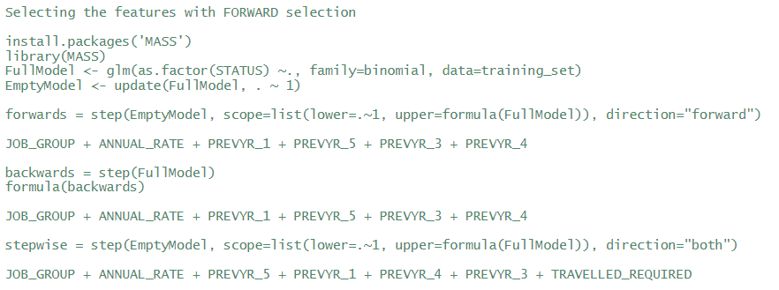
Forward selection
Variable selection
Moving forward, for variable selection, we have performed forward selection and the results are as follows:
Forwards: JOB_GROUP + ANNUAL_RATE + PREVYR_1 + PREVYR_5 + PREVYR_3 + PREVYR_4
We have also performed backward and stepwise selection, and the result was almost the same.
Backwards: JOB_GROUP + ANNUAL_RATE + PREVYR_1 + PREVYR_5 + PREVYR_3 + PREVYR_4
Stepwise: JOB_GROUP + ANNUAL_RATE + PREVYR_5 + PREVYR_1 + PREVYR_4 + PREVYR_3 + TRAVELLED_REQUIRED

Slide 11
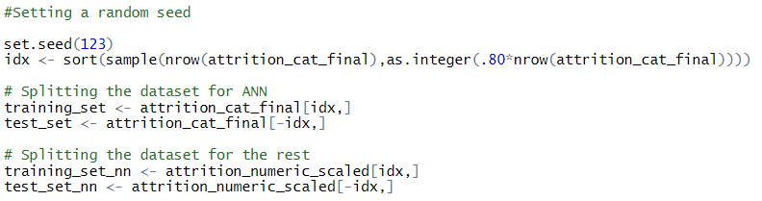
Processing
Finally, we have created testing and training data sets. As Artificial Neural Network requires only numeric datasets, we have created a separate testing and training sets for ANN. As our dataset is big enough, we have done 80/20 split. The training and test sets of ANN include all the preprocessed columns (in hopes of detecting the anomalies in the data), whereas training and test sets of other models include only the significant columns determined by forwards selection.

Slide 12
Classification Algorithms
These are the algorithms that we have used for our predictions:
Multivariate Logistic Regression
Naive Bayes
K-Nearest Neighbor
Decision Tree
Random Forest
Support Vector Machines (SVM) with Linear Kernel
Support Vector Machines (SVM) with Radial Kernel
Artificial Neural Network
C5.0
Ensemble Model

Slide 13

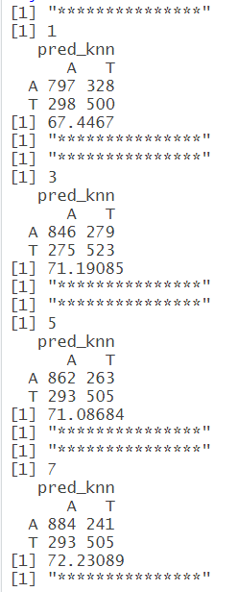
K-Nearest Neighbor

Slide 14
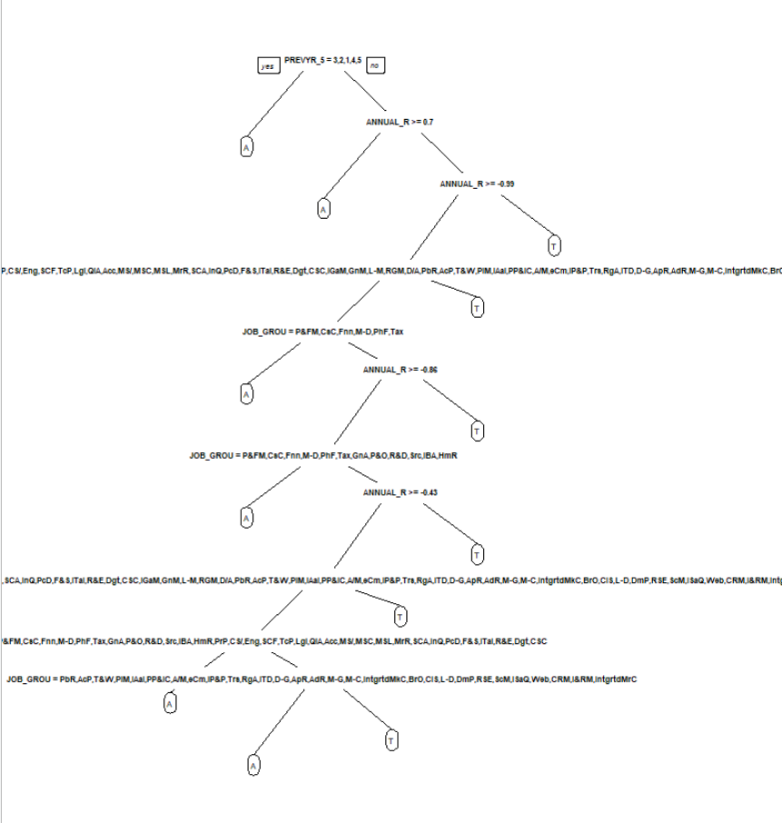
Decision Tree

Slide 15
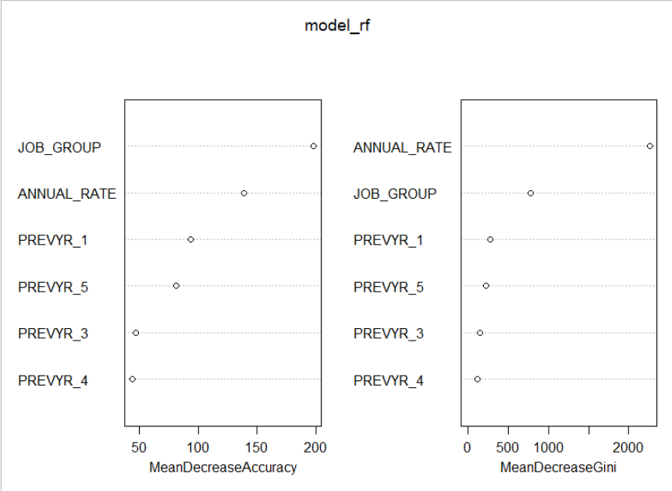
Random Forest

Slide 16
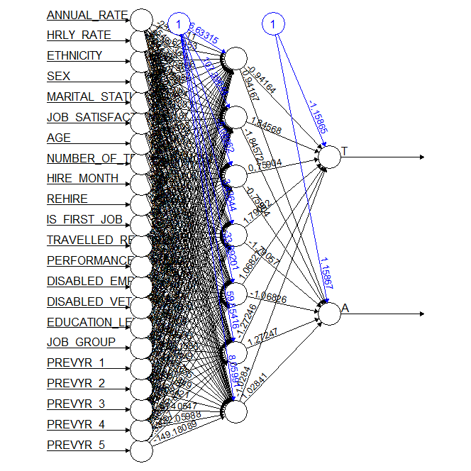
Artificial Neural Network

Slide 17
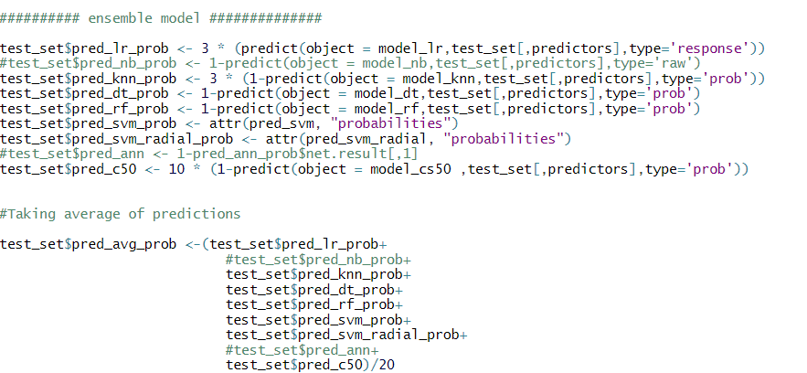
Ensemble Model
In our Ensemble Model, we have calculated the weighted average of the predicted probabilities of the algorithms that we have used during the analysis. We included only the successful ones.

Slide 18
Ensemble Model
 | A | T
A | 954 | 171
T | 307 | 491
Confusion matrix
Accuracy: 75.14301%

Slide 19
Accuracy rates of all the algorithms
Algorithms | Accuracy
Artificial Neural Network | 61.88248
Naive Bayes | 64.01456
Random Forest | 70.25481
Support Vector Machines (SVM) with Radial Kernel | 70.93084
Decision Tree | 71.34685
K-Nearest Neighbor | 72.23089
Multivariate Logistic Regression | 72.38690
Support Vector Machines (SVM) with Linear Kernel | 72.90692
C5.0 | 74.83099
Ensemble Model | 75.14301

Slide 20
Thank you!

