Slide 1
Route Based Cell Communication Analysis_V1

Slide 2
Background
Cell-cell communication is important
The single cell rna-seq gives us a chance to uncover the mask of cell-cell communication.
However,
All the cell communication only focus on the ligand-receptors, they never use route concepts.
The existing method may have a huge amount of False positive since the gene expression of receptors always is commonly high.
Routes within each pathway can have different functions.
rPAC have been applied into bulk cell
This work, we apply pathway route analysis along with third party databases on single cell rna seq data to explore the cell-cell communication.
We aim to achieve:
1. Identify if cell wise communication existed and the communication type (Auto, para)
2. Scoring cell wise communication(with spatial data)
3. Cell communication pattern and try to prove it with literature survey.
4. We apply it on bone data and brain data
5. We try to find the communication pattern to form a squared that cause a specific cell formation/differentiation

Slide 3
Method – Step 1
Build curated Database by combining KEGG(rPAC), Chip-Seq, CellChat, CellTalk.
Cell 2
Cell 2
(C2-R2-RLigand)
(C2-R2-RReceptor)
(C1-R1)(Optional)
rPAC
(C2-R2)
rPAC
(C1-R1-TF) (Optional)
rPAC & Chip-Seq
(C1-R1-TLigand)
CellChat, CellTalk, rPAC

Slide 4
Method – For goal 1
Hierarchical rule of cell communication:
Intuitively, Cell communication can be identified when this pattern shows up. C2-R2-receptor is high, but C2-R2-Ligand is missing or low, C1-R1-Ligand is high. Or C2-R2-receptor is low, but C2-R2-Ligand is high, C1-R1-Ligand is high, C2-R2-Ligand can active C2-R2-receptor and C1-R1-Ligand can inhibit C2-R2-receptor.
We extend to route concepts, instead of C2-R2-receptor we use C2-R2.
So, the table show our basic rule to identify cell cell communication.
Table x
X
X
X
X

Slide 5
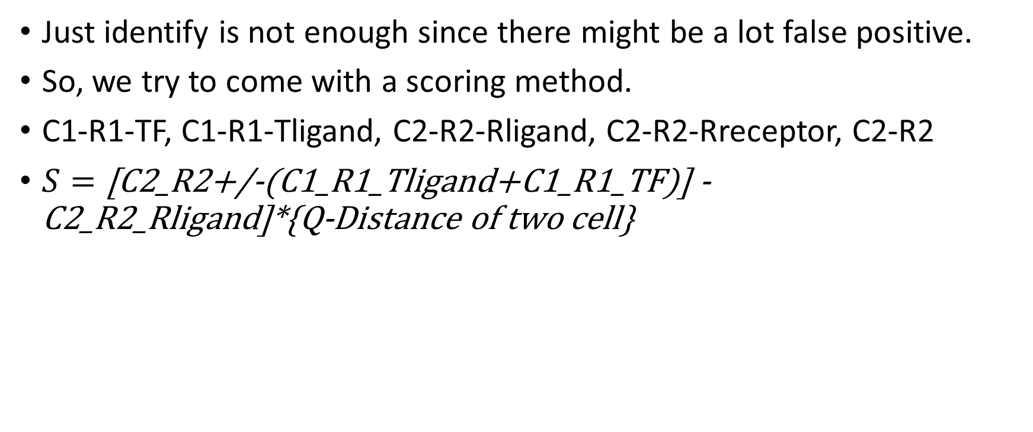
Method – For goal 2
Just identify is not enough since there might be a lot false positive.
So, we try to come with a scoring method.
C1-R1-TF, C1-R1-Tligand, C2-R2-Rligand, C2-R2-Rreceptor, C2-R2
$S=\text{[}\text{C}\text{2_}\text{R}\text{2+/−(}\text{C}\text{1_}\text{R}\text{1_}\text{Tligand}\text{+}\text{C}\text{1_}\text{R}\text{1_}\text{TF}\text{)] − }\text{C}\text{2_}\text{R}\text{2_}\text{Rligand}\text{]∗\{}\text{Q}\text{−}\text{Distance} \text{of} \text{two} \text{cell}\text{\} }$

Slide 6
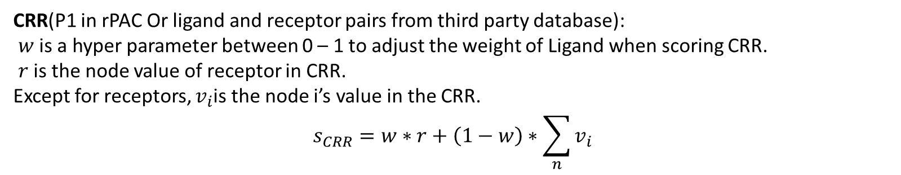
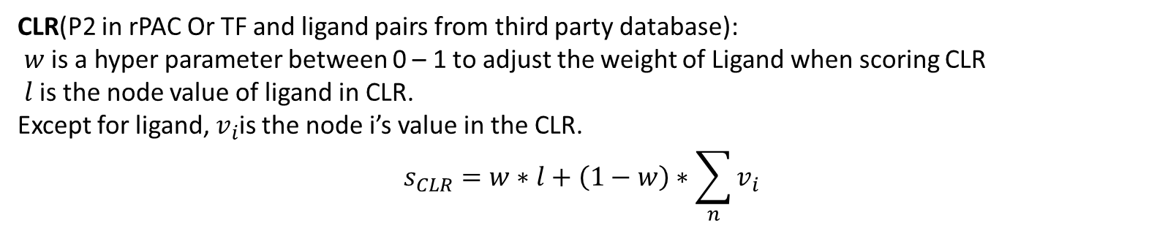
Method– Route Score (Ligand and receptor centric (expectation of ligand and receptor is always 1 ))
CLR(P2 in rPAC Or TF and ligand pairs from third party database):
$w$ is a hyper parameter between 0 – 1 to adjust the weight of Ligand when scoring CLR
$l$ is the node value of ligand in CLR.
Except for ligand, $v_{i}$is the node i’s value in the CLR.
$$s_{CLR}=w∗l+\left(1−w\right)∗\sum_{n}{v_{i}}$$
CRR(P1 in rPAC Or ligand and receptor pairs from third party database):
$w$ is a hyper parameter between 0 – 1 to adjust the weight of Ligand when scoring CRR.
$r$ is the node value of receptor in CRR.
Except for receptors, $v_{i}$is the node i’s value in the CRR.
$$s_{CRR}=w∗r+\left(1−w\right)∗\sum_{n}{v_{i}}$$

Slide 7
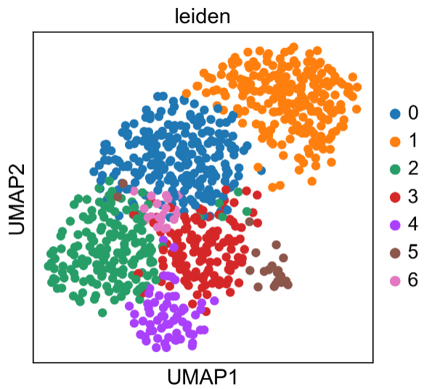
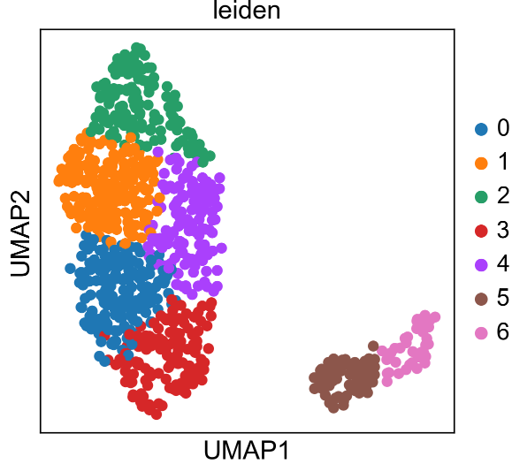
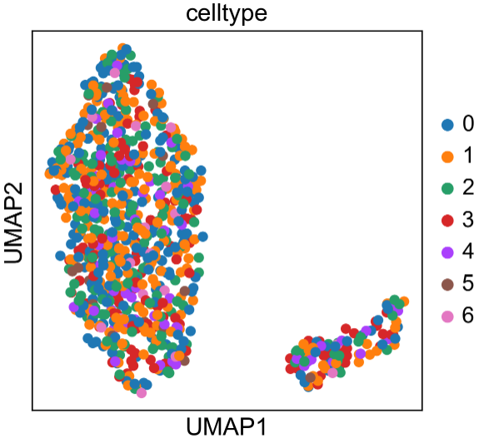
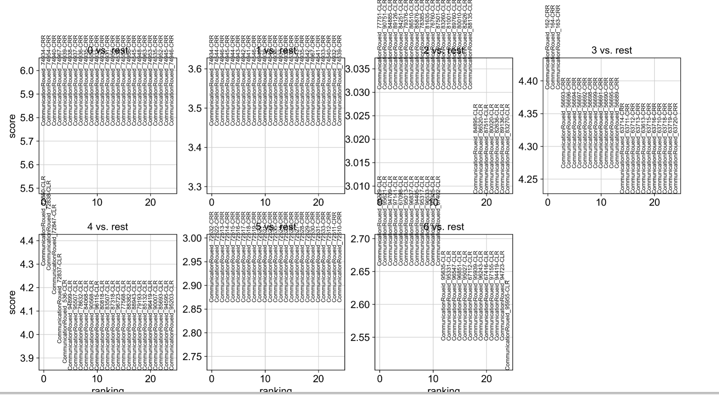
Result update (April- 21)
Dataset (Mouse OB cell only, 853 cells, clustering methods leiden)
Gene expression UMAP and leiden clustering
Cell communication UMAP and leiden clustering
Cell communication UMAP and Cell type labeling (From the first figure clustering )
Communication routes rank in all 7 cell type

Slide 8
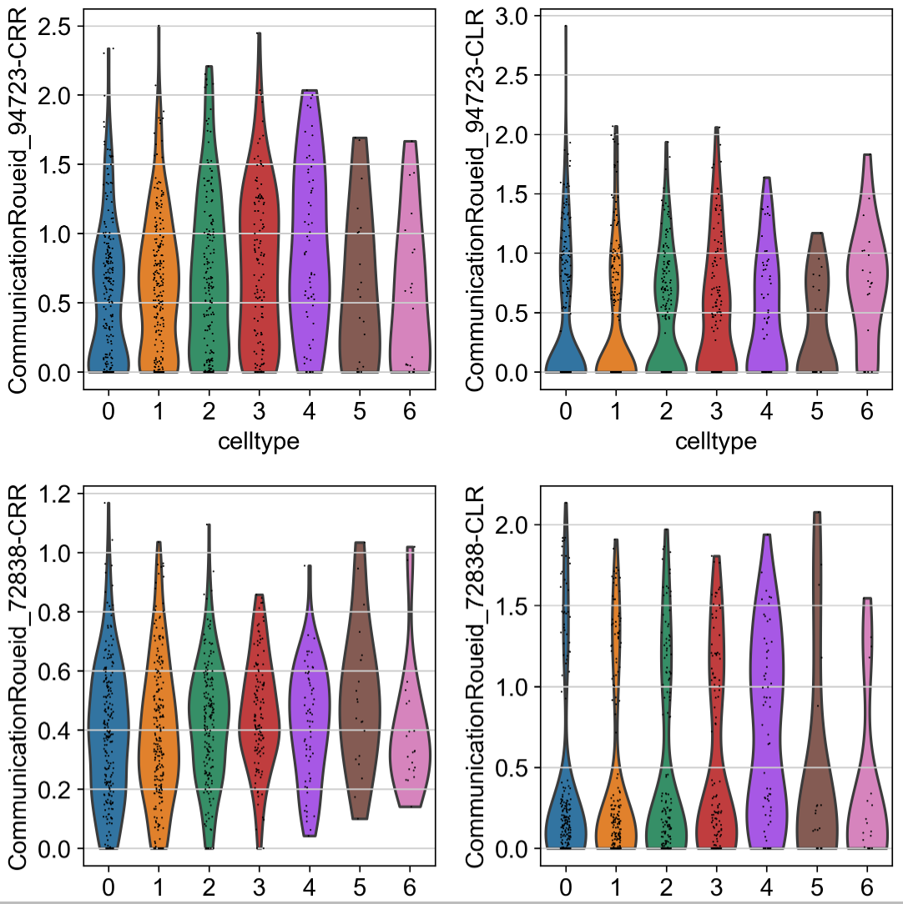
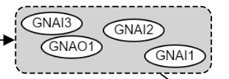


Communication Route 72838
Cell talk db
CNR1,DRD2
KLF4
Chip-seq
TCN2
TF and targets pairs which its target are ligand

Slide 9
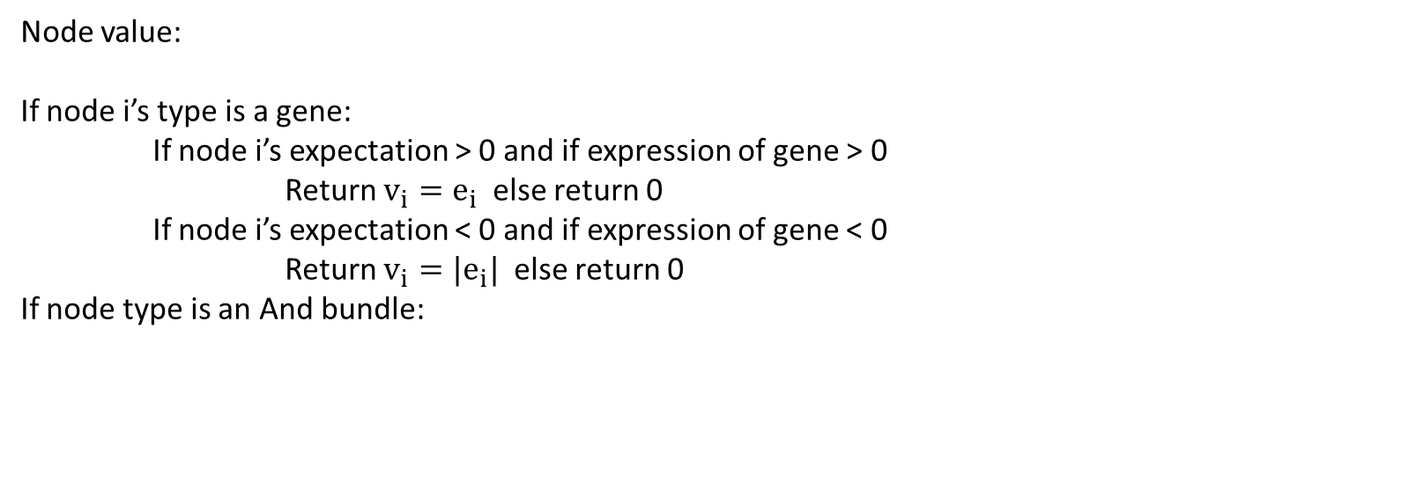
Node value:
If node i’s type is a gene:
If node i’s expectation > 0 and if expression of gene > 0
Return $v_{i}=e_{i}$ else return 0
If node i’s expectation < 0 and if expression of gene < 0
Return $v_{i}={|e}_{i}|$ else return 0
If node type is an And bundle:

Slide 10
Results

Slide 13
Visualization
Pyvis

Slide 21
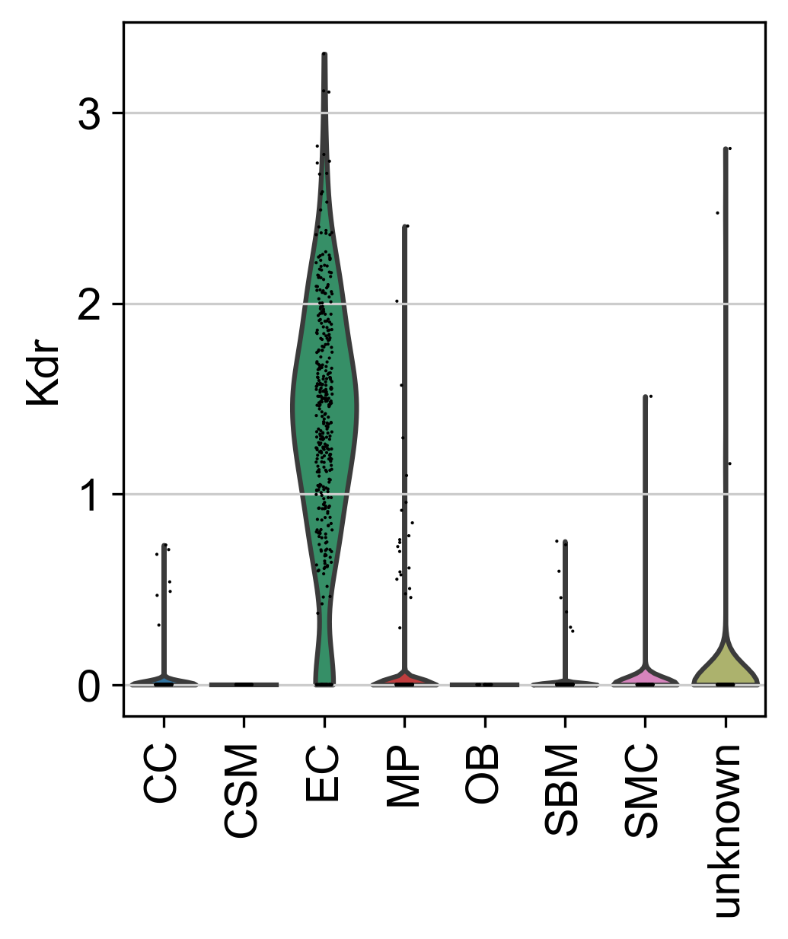
a
Biological knowledge databases
b
Input data
c
Communication score between cell type
Harmonizome
Cell ChatDB
Cell Talk DB
KEGG
Preprocessed Real Single cell RNA-seq gene expression data matrix
Preprocessed Simulated Single cell RNA-seq gene expression data matrix
 | CT1_CT2 | CT2_CT3 | CT3_CT1
R1 | 9.1 | 5.4 | 1.1
R2 | 6.1 | 2.5 | 6.6
R3 | 3.3 | 4.3 | 2.3
Cell group meta data
(Optional)
Routes
TF-target
database
Ligand-receptor pairs database
Gene signaling regulated route database
…
d
Communication Routes
e
f
Secretor
Receiver
Route-wised Communication Score between cell
Post analysis of the inter cell types communication
ULR
DRR
TF
Receptor
rICRN
Summary table
Violin plot
Gene
 | C1 | C2 | C3
R1 | 0.6 | 0.7 | 0.54
R2 | 0.3 | 0.2 | 0.9
R3 | 0.1 | 0.8 | 0.7
S | R | Score | pval
CT1 | CT2 | 9.1 | 0.1
CT3 | CT1 | 6.6 | 0.03
CT2 | CT3 | 4.3 | 0.004
KEGG
Gene
Harmonizome
Gene
Gene
KEGG
Ligand
Gene
TF
CellChat, CellTalkDB, KEGG
…

Slide 22
Secretor
Receiver
ULR
DRR
TF
Receptor
Gene
Gene
KEGG
Harmonizome
Gene
Gene
KEGG
Ligand
Gene
TF
CellChat, CellTalkDB, KEGG

Slide 23
Secretor
Receiver
TF
Receptor
ULR
Gene
Gene
Gene
Gene
DRR
Ligand
Gene
TF

Slide 24
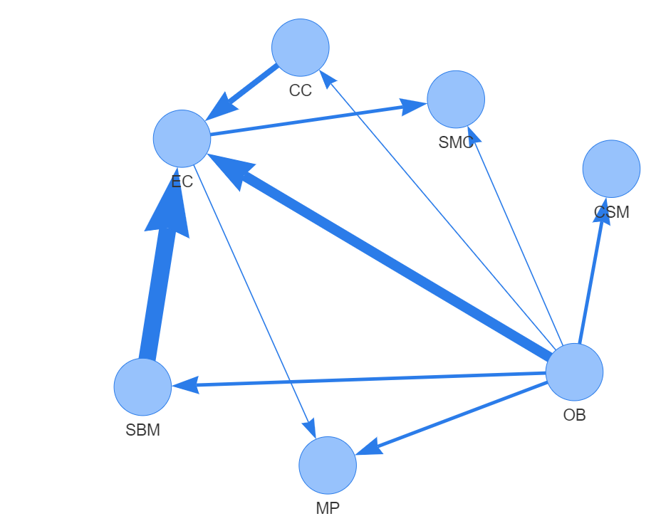

Slide 25
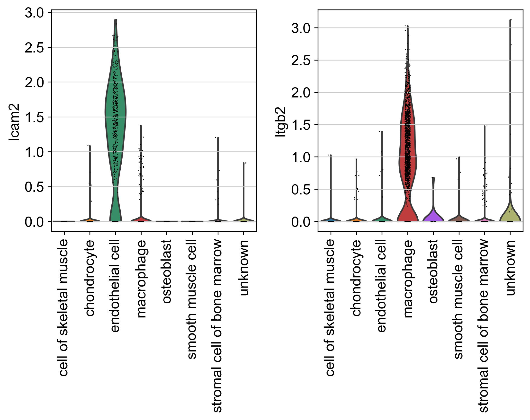

Slide 26
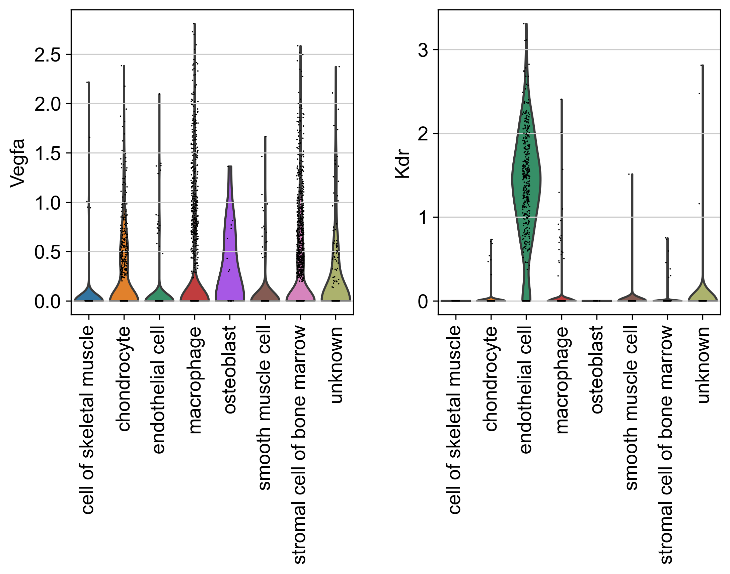

Slide 27
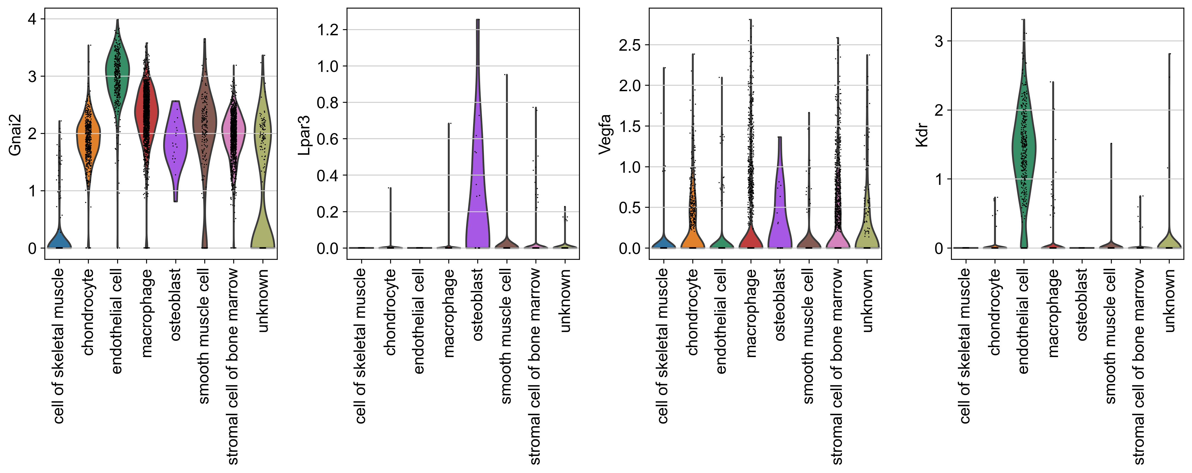

Slide 28
GATA
VAV3
VAV2
VAV1
KDR
RAC1
RAC2
GATA
RAC3
MAP2K1
ICAM2
MAP2K2
MAPK1
MAPK3
RUNX2
VEGFA

Slide 32
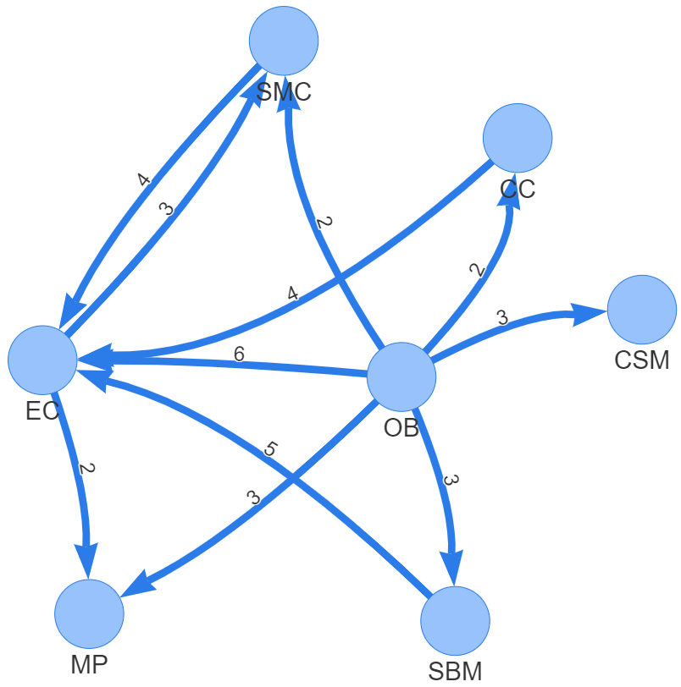
Endothelia Cell
Secretor
Macrophage
Receiver

Slide 33
EC Secretor
MP Receiver
MYC
VAV1
MAP2K1
RAC1
GATA2
MAP2K2
ICAM2
ITGB2
VAV2
RAC2
PAK1
TAL1
MAPK1
VAV3
RAC3
MAPK3
SCLY
Sub part of Natural killer cell mediated cytotoxicity pathway

Slide 34
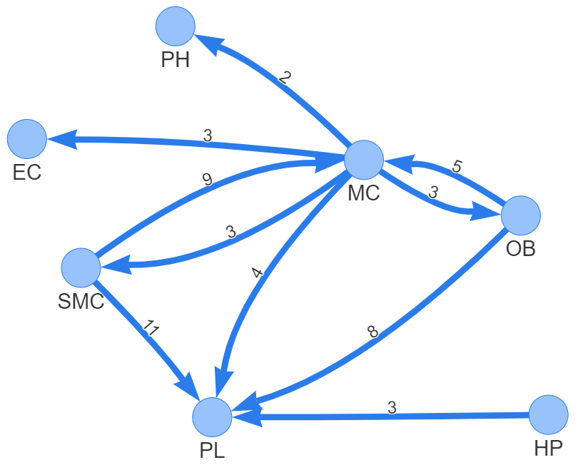
Smooth muscle cell
Secretor
Platelets
Receiver

Slide 35
SMC
Secretor
PL
Receiver
PIK3CA
PIK3CB
TFAP2A
PIK3CD
TBX3
COL18A1
ITGB3
SRC
PIK3R1
SOX11
PIK3R2
RCOR2
PIK3R3
Sub part of Thyroid hormone signaling pathway

Slide 36
Secretor
Receiver
PIK3CA
PIK3CB
TFAP2A
PIK3CD
TBX3
COL18A1
ITGB3
SRC
PIK3R1
SOX11
PIK3R2
RCOR2
PIK3R3
Sub part of Thyroid hormone signaling pathway

Slide 37
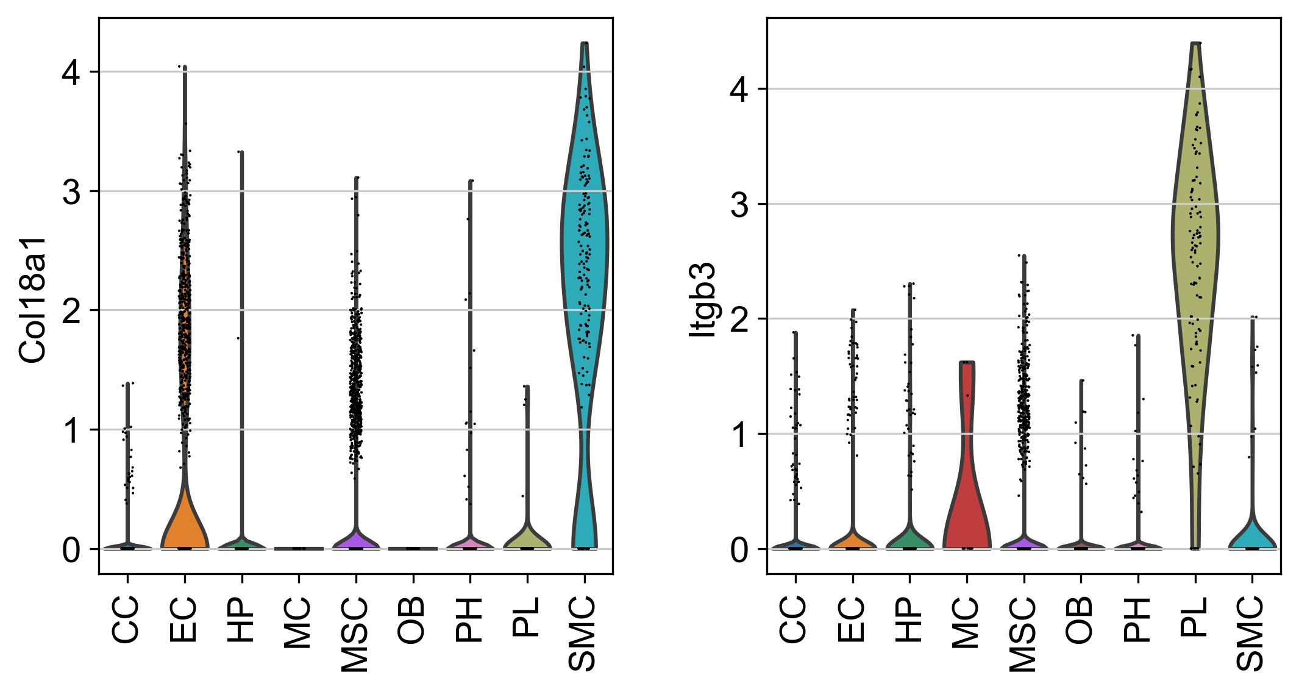
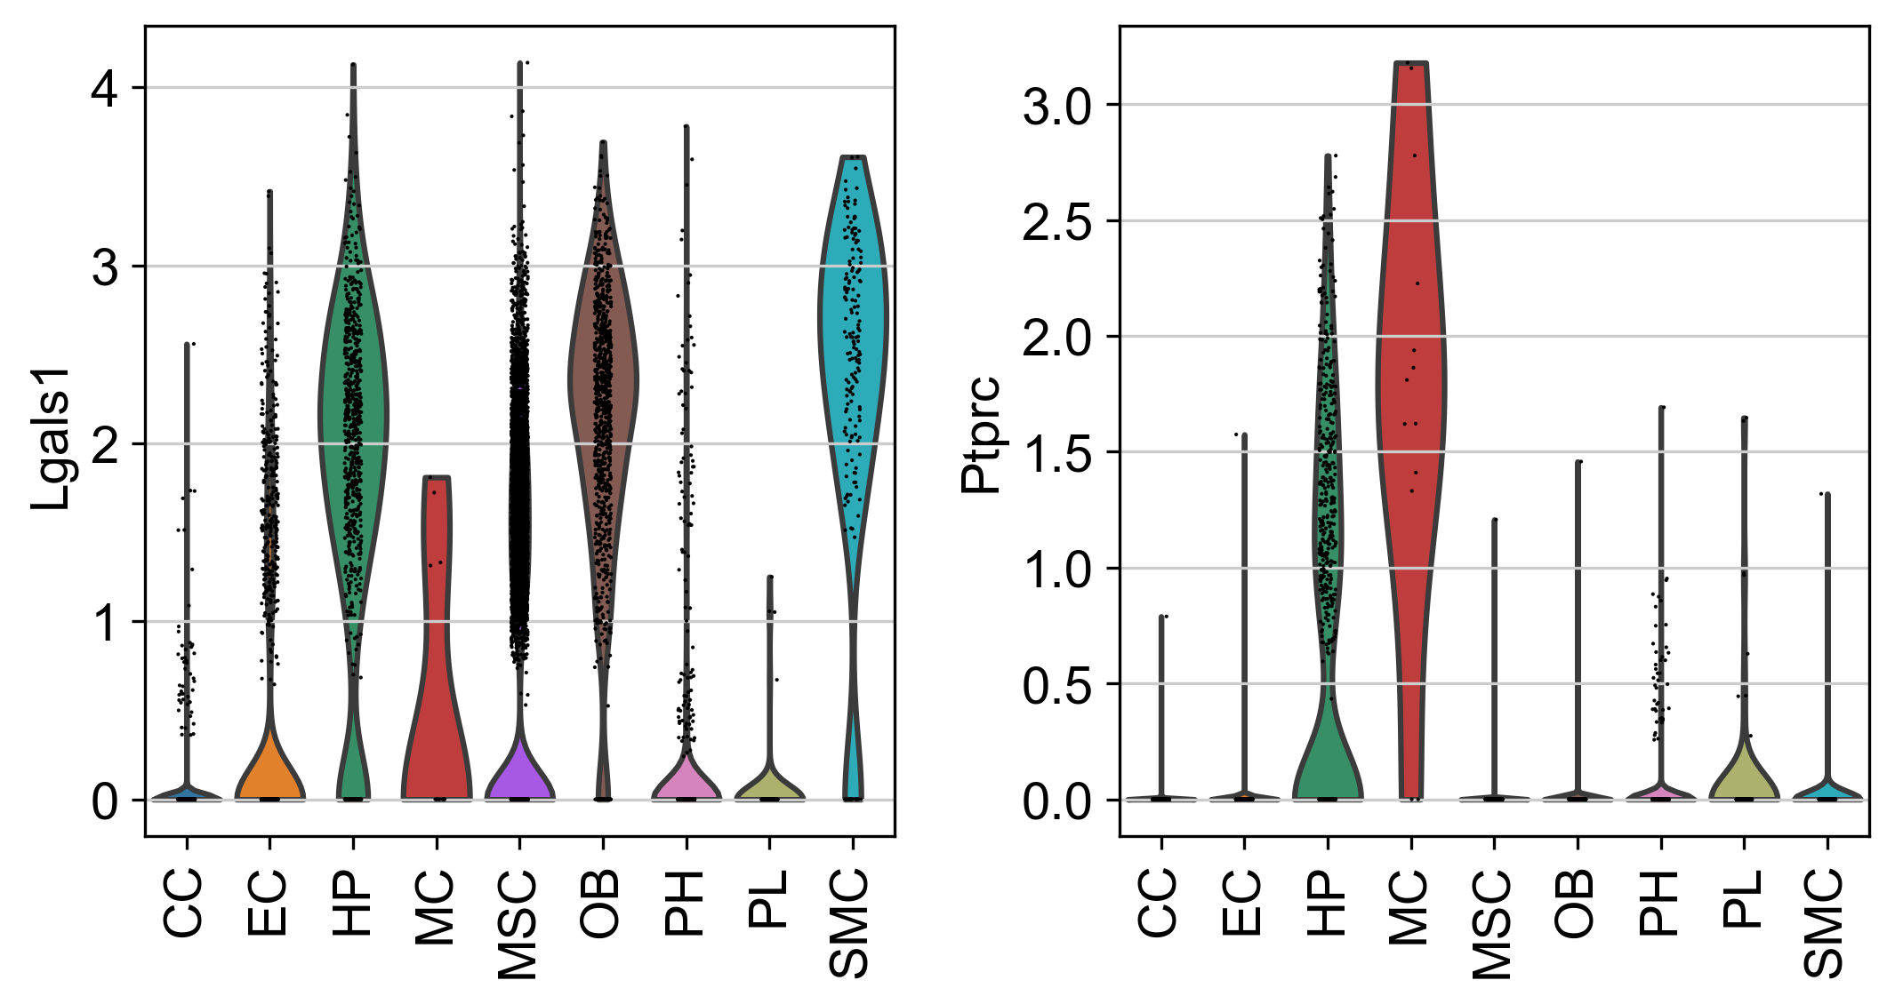

Slide 38
