Slide 1
Difference between NicheNet and rCOM
Features
NicheNet
rCOM
TF centric analysis
No
Yes
Feature1
No
Yes
Feature1
No
Yes
Feature1
No
Yes
Regulatory relationship relationships
No
Yes
Prior Knowledge
Yes
Yes

Slide 2
rCOM computation workflow or algorithm?
Step 1 – Discover ULR xxx for yyy
Using Node expected value
Step 2 – Discover DRR xxx for yyy
Step 3 - DRR
Communication route score
Step 1
For two cells, Ci and Cj, if I = j, then and autocrine
paracrine
Figure xx.

Slide 3
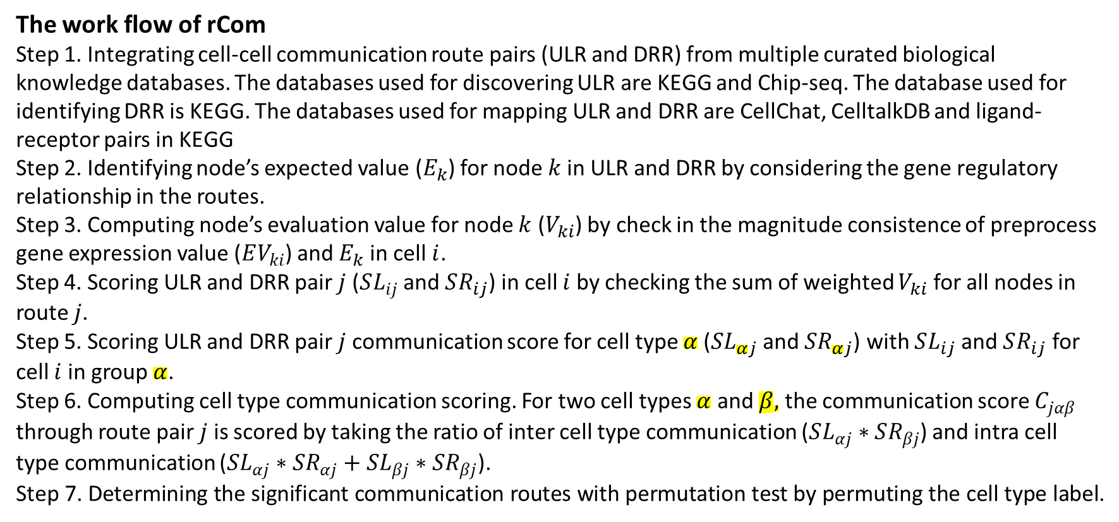
The work flow of rCom
Step 1. Integrating cell-cell communication route pairs (ULR and DRR) from multiple curated biological knowledge databases. The databases used for discovering ULR are KEGG and Chip-seq. The database used for identifying DRR is KEGG. The databases used for mapping ULR and DRR are CellChat, CelltalkDB and ligand-receptor pairs in KEGG
Step 2. Identifying node’s expected value ($E_{k}$) for node $k$in ULR and DRR by considering the gene regulatory relationship in the routes.
Step 3. Computing node’s evaluation value for node $k$ ($V_{ki}$) by check in the magnitude consistence of preprocess gene expression value ($EV_{ki}$) and $E_{k}$ in cell$i$.
Step 4. Scoring ULR and DRR pair $j$ ($SL_{ij}$ and $SR_{ij}$) in cell $i$ by checking the sum of weighted $V_{ki}$ for all nodes in route $j$.
Step 5. Scoring ULR and DRR pair $j$ communication score for cell type $α$($SL_{αj}$ and $SR_{αj}$) with $SL_{ij}$ and $SR_{ij}$ for cell $i$ in group $α$.
Step 6. Computing cell type communication scoring. For two cell types $α$ and $β,$ the communication score $C_{jαβ}$ through route pair $j$ is scored by taking the ratio of inter cell type communication ($SL_{αj}∗SR_{βj}$) and intra cell type communication ($SL_{αj}∗SR_{αj}+SL_{βj}∗SR_{βj}$).
Step 7. Determining the significant communication routes with permutation test by permuting the cell type label.

Slide 4
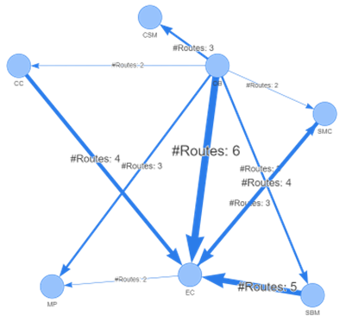
Secretor
Ligand
Receiver
Macrophage
Endothelia Cell
Secretor

Slide 5
