Slide 1
Intro to Reinforcement Learning
August 2017

Slide 2
A brief introduction to reinforcement learning
A brief introduction to reinforcement learning
https://www.youtube.com/watch?v=m2weFARriE8

Slide 3
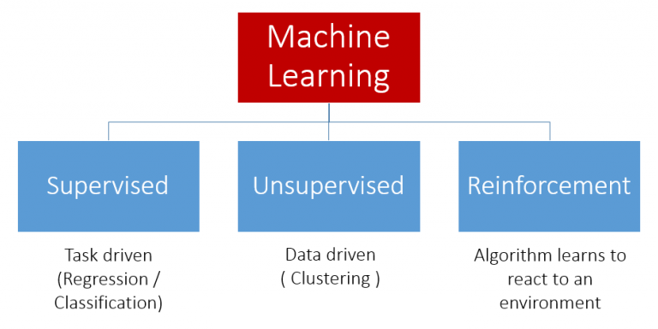
Recap
Type of Machine Learning

Slide 4
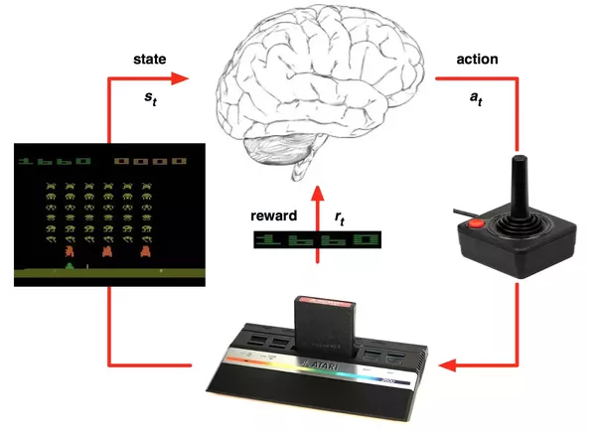
Reinforcement Learning
RL elements
Agent
Action (right, left, fire)
Reward
State
Goal
Maximize long-term reward

Slide 5
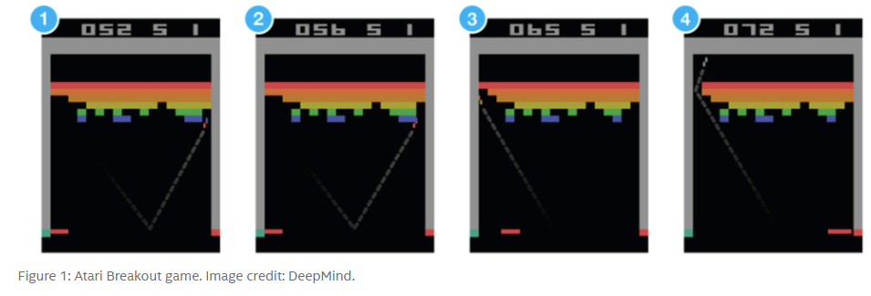
How to maximize reward?
Finding optimal policy
Given current state (s_t) what is the best action to maximize future reward
Why not supervised learning?

Slide 6
RL Challenges
Credit assignment problem
Which action was responsible for the reward
Explore-exploit dilemma
Stick to strategy that gives you reward or explore for higher rewards

Slide 7
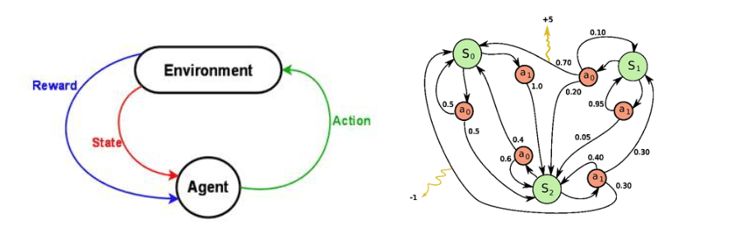

RL Formulation
Markov Decision Process

Slide 8


Q-Learning
Future reward
Declaring Q-function
Policy

