Slide 1
Convolutional gated recurrent architectures for video segmentation
Mennatullah Siam, Sepehr Valipour, Martin Jagersand, Nilanjan Ray

Slide 2
Abstract
Previous work: semantic segmentation on still images
Temporal data in video for semantic segmentation
Fully-CNN and Gated Recurrent Unit (GRU)
Sequence of consecutive frames and outputs segmentation of last frame
GRU to preserve spatial connectivity
Around 5% improvement for Dice respect to F-CNN

Slide 3
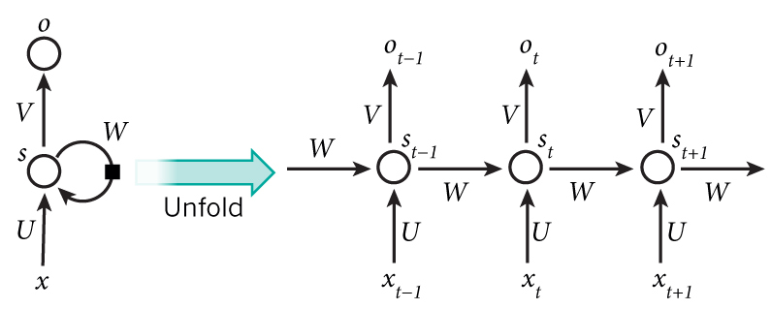
Method
Recurrent neural networks:
Long short term memory (LSTM)
Gated recurrent unit (GRU): reduced number of gates and parameters

Slide 4
Overview

Slide 5
Recurrent Fully Convolution

Slide 6
Qualitative Results

Slide 7
Quantitative Results

Slide 8
Qualitative Results

Slide 9
Summary
Time correlation is effective overall
More effective for smaller objects (car, pedestrian) than large objects(sky, buildings)
Higher complexity

