Slide 1
AIclub Lunch& Learn
Feb. 2017

Slide 2
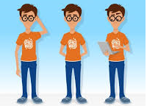
AIclub at Halyard
A group of GEEKS!
Weekly meetings
Discuss new AI related topics
Articles
Talks
Projects

Slide 3

AIclub Outcome
Inspirations for solving challenges
New ideas
A place to think out of the box

Slide 4
New Research Article on Nature
Dermatologist-level classification of skin cancer with deep neural networks
Authors: A. Esteva, B. Kuprel, R. Novoa, J. Ko, S. Sweter, H. Blau, S. Thrun
EE&CS, Stanford University in collaboration with multiple healthcare institutes
Video https://www.youtube.com/watch?v=IvmLEq9piJ4

Slide 5
Motivation
Around 5.4 million new skin cancer cases in the US every year
Over 10,000 deaths annually in the US due to skin cancer
Early detection is critical
Survival rate goes from 14% to 99%
if detect early
Computer-aided dermatology

Slide 6
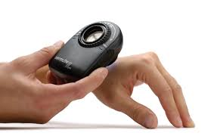
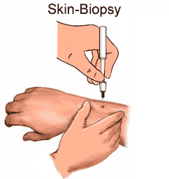
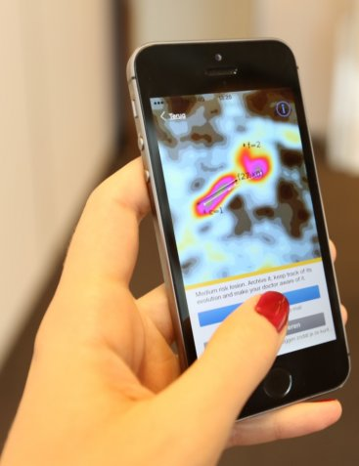
Introduction
Imaging modalities
Dermoscopy images
Histological images
Invasive biopsy and microscopy images
Photographic images (ex. Smartphone images)
Previous work are not competitive
Insufficient data
Focus on standard imaging modalities

Slide 7
Method
AI algorithm: GoogleNet InceptionV3 architecture
Pre-train on 1.28 million images

Slide 8
Dataset
Around 130 k images for train
Dermatologist labeled images
Images come from 18 different
clinician-curated repositories
Organized in three groups
with 2032 diseases

Slide 9
Results
180 images/dermatologist

Slide 10
Video
Skin Cancer Image Classification
https://www.youtube.com/watch?v=toK1OSLep3s

Slide 11
Conclusion
AI has significantly advanced
AI for health care
Identify a problem
Collection of massive data
Annotation with help of doctors
Accessible diagnostic devices powered by AI

