Slide 1
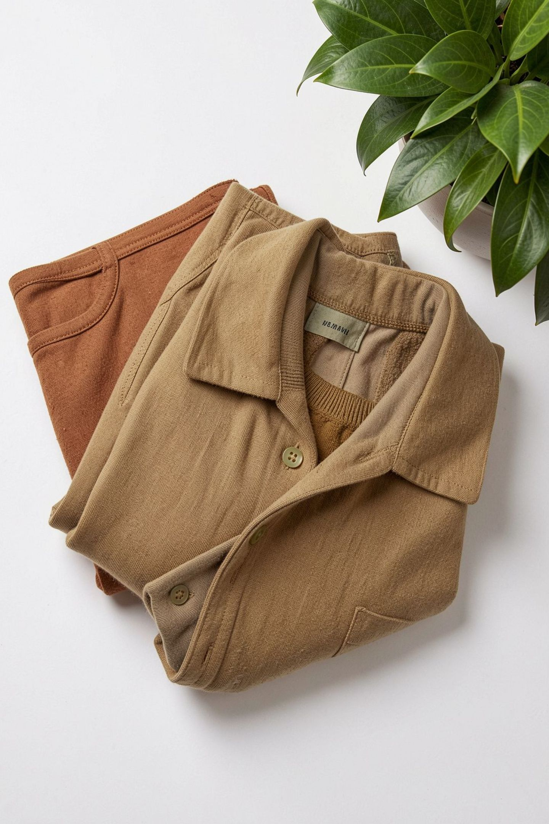

FashionCycle
AI-Powered Circular Fashion & Clothing Lifecycle Platform
SDG 12 – RESPONSIBLE CONSUMPTION AND PRODUCTION

Slide 2
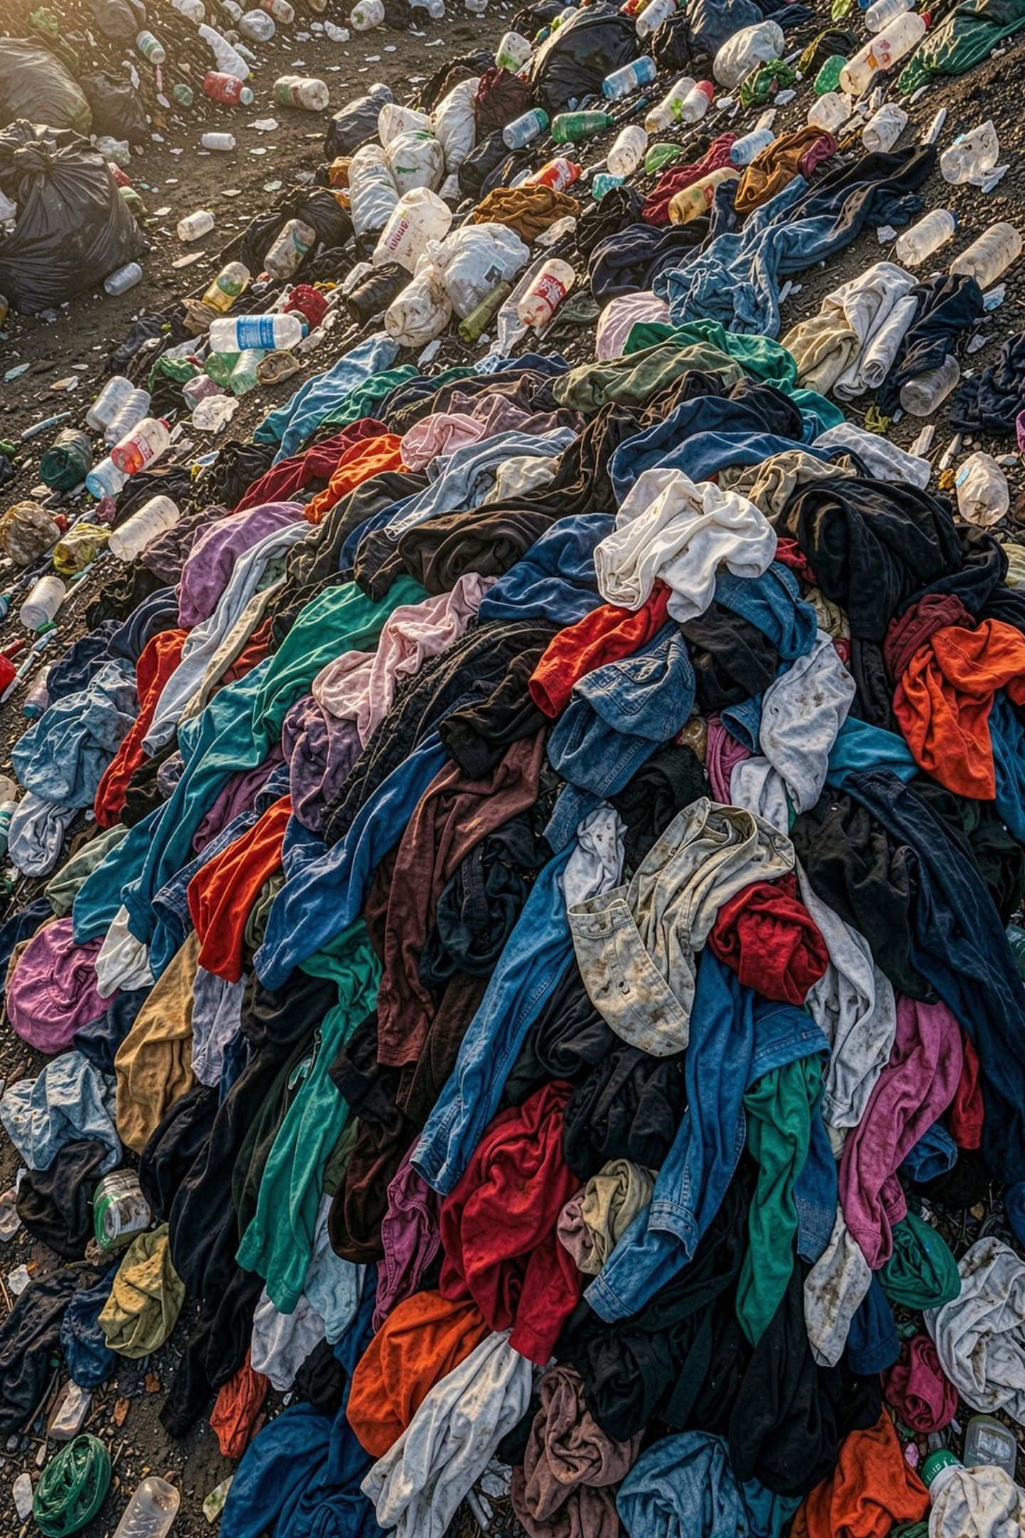
The Problem with Fast Fashion
The dominant Buy → Use → Discard model generates massive textile waste. Users lack tools to choose the best next step for unwanted clothing.
Reusable Clothing Discarded
Most discarded garments could be resold, repaired, or donated.
No Intelligent Guidance
No single platform helps users decide between selling, donating, repairing, exchanging, or recycling.
Fragmented Solutions
Existing platforms address only one lifecycle stage, not the full circular journey.
"How can technology help users choose the most sustainable next step for unwanted clothing?"

Slide 3





Introducing FashionCycle
Users upload a photo or details of an unwanted garment. FashionCycle's Circular Decision Engine analyzes it and recommends the best next action — Sell, Donate, Exchange, Repair, or Recycle.
Upload
Clothing image & details
AI Analysis
Condition, material & value
Circular Decision Engine
Circularity Score & ranking
Best Action
Sell, Donate, Exchange, Repair, or Recycle
Complete & Track
Execute action & log impact

Slide 4
Project Objectives
1
Reduce Textile Waste
Promote reuse and responsible disposal of unwanted garments.
2
AI-Powered Analysis
Analyze clothing characteristics, condition, and estimated value.
3
Smart Action Recommendation
Recommend the most suitable circular action per garment.
4
Integrated Circular Platform
Unified system for selling, donating, exchanging, repairing, and recycling.
5
Lifecycle & Impact Tracking
Track garment journeys and quantify sustainability impact.
6
Encourage Sustainable Behavior
Drive eco-conscious habits through EcoPoints, scores, and analytics.

Slide 5
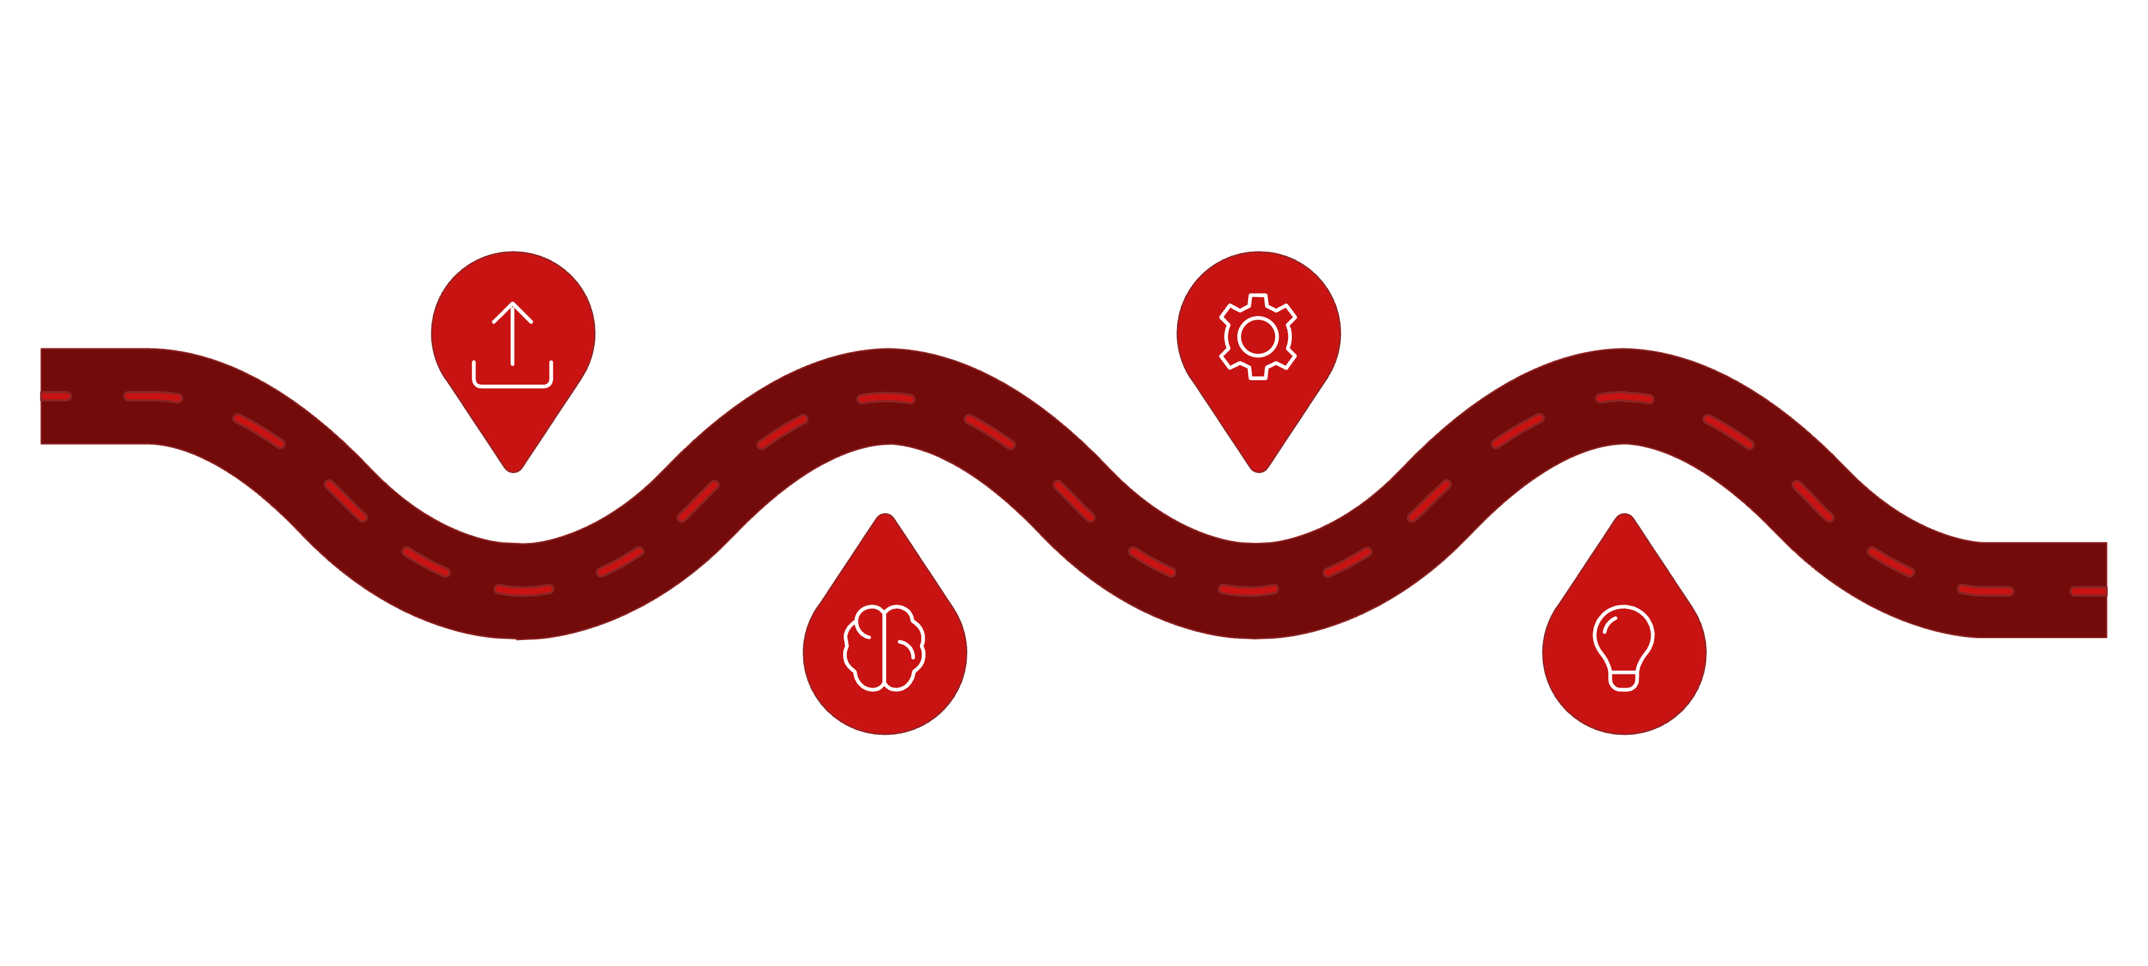
How FashionCycle Works
A seamless end-to-end journey from upload to impact — powered by AI at every stage.
Circular Engine
Upload
User uploads image and item details
Compute Circularity Score for actions
Recommendation
AI Analysis
Assess condition, material, category, value
Suggest Sell, Donate, Repair, Exchange, Recycle
Each stage is designed to minimize user effort while maximizing the sustainability and economic value of every garment decision.

Slide 6
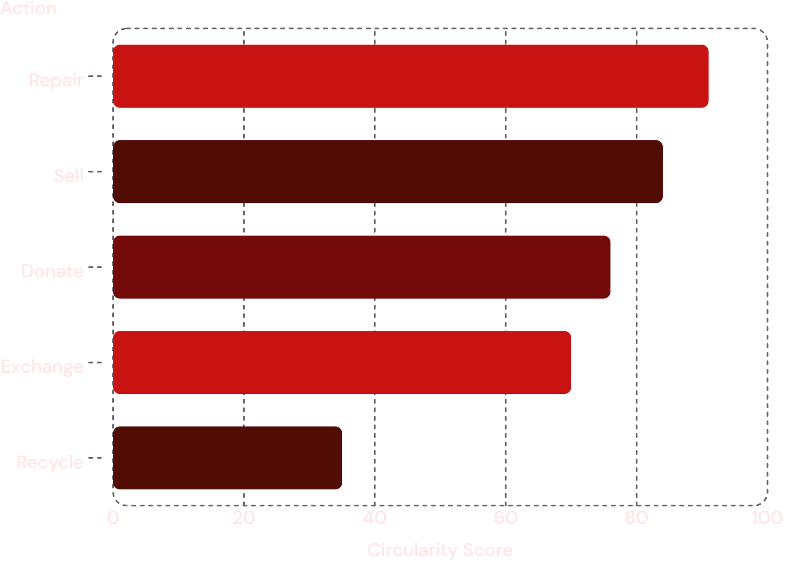

AI & Circular Decision Engine
The engine analyzes each garment across multiple dimensions and computes a Circularity Score for every possible action.
Action Score Comparison (Example Output)
Clothing category, color & brand recognition
Visible condition assessment
Material detection (where visible)
Estimated resale value
Repairability & reuse potential
Example Output — Black Denim Jacket: Condition: Good · Resale: ₹800 · Repairability: High · Reuse: High → Best Action: Repair → Reuse (91/100)
Values shown are example outputs for demonstration purposes.

Slide 7
Key Features
AI Clothing Recognition
Resale Price Estimation
Identifies category, brand, color, and condition from uploaded images.
Predicts market value to guide sell vs. donate decisions.
Circular Action Engine
Integrated Marketplace
Ranks all five actions and recommends the optimal next step.
Sell, donate, or exchange clothing within a single platform.
AI Repair Guidance
Sustainability Dashboard
Recommends repairs and connects users to local repair services.
Tracks garment lifecycle, EcoPoints, and environmental impact.

Slide 8
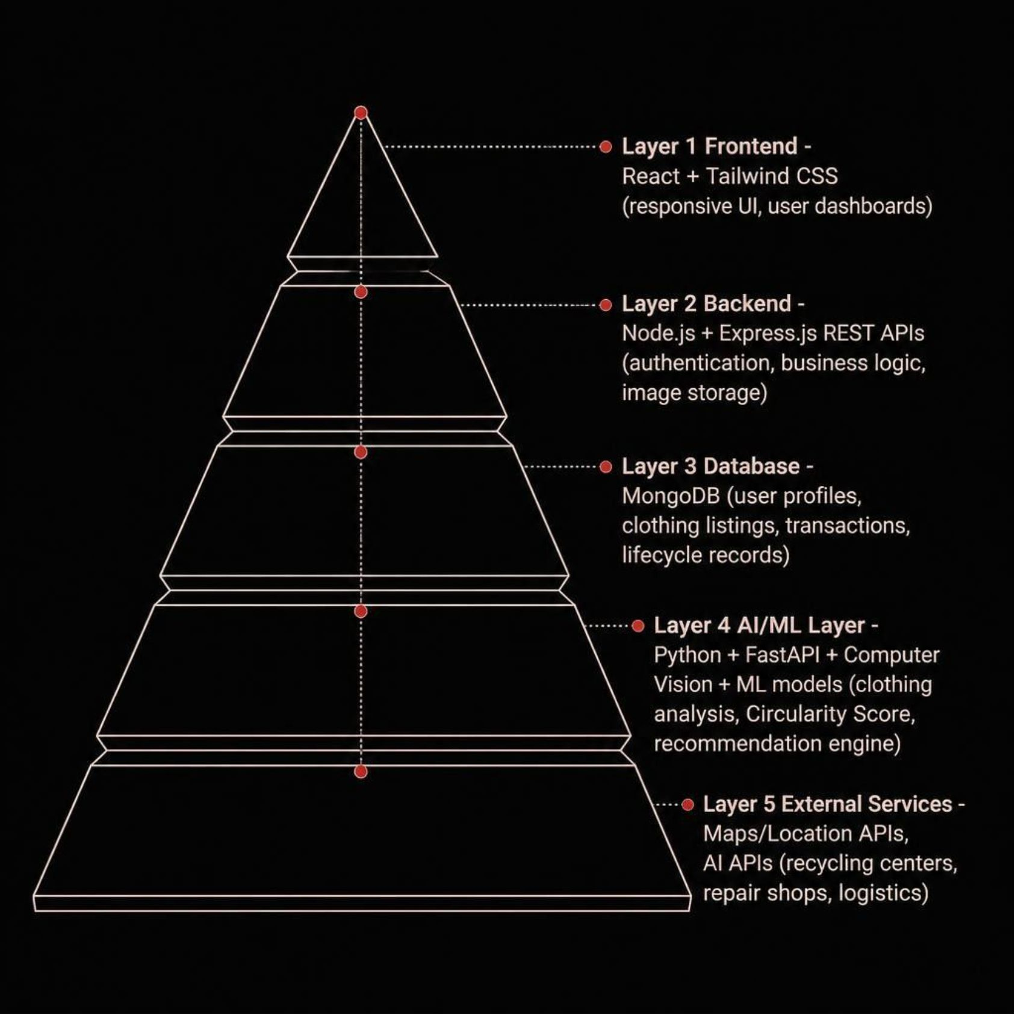
System Architecture & Technology Stack
Architecture Highlights
Frontend: React + Tailwind CSS — responsive, modern UI
Backend: Node.js + Express.js — RESTful APIs
Database: MongoDB — flexible document storage
AI/ML: Python + FastAPI — computer vision & ML models
External: Maps, Location & AI APIs
Core subsystems: Authentication, Image Storage, Recommendation Engine, and Analytics.

Slide 9
User & Admin Modules
User Module
Admin Module
Register, login & profile management
Upload clothing for AI analysis
View recommended circular action
Sell, donate, or exchange clothing
Request repair & find recycling options
Track lifecycle & sustainability score
Earn EcoPoints & rewards
User & account management
Clothing listing moderation
Donation & exchange oversight
Reported content management
Platform analytics dashboard
Sustainability statistics & reports
Category & transaction insights

Slide 10

Example User Journey
A user uploads an old denim jacket. FashionCycle identifies it, assesses condition, and recommends the best circular action.
AI Analysis
Best Action: Repair → Reuse
Denim Jacket · Condition: 7.5/10 · Resale: ₹800–₹1,000 · Repairability: High · Reuse: High
Repair cost: ₹100–₹200 · Extended life: 1–2 years · Circularity Score: 91/100
Impact
Prevents premature disposal and extends the garment's useful life — one decision at a time.
"FashionCycle transforms unwanted clothing from waste into its next useful life."

