Slide 1

AI Introduction Final Project - AI Animals Recognize
A107221096 林承翰
A107221014 曹宏瑋
2021/01/04

Slide 2
Process Chart
宣告使用套件
設定資料位置
定義資料標籤
資料事前處理
建立CNN模型
判斷並儲存結果

Slide 3
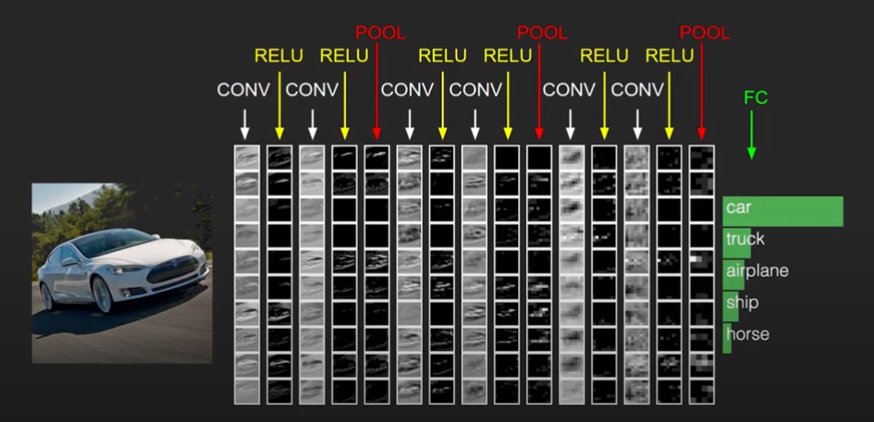
CNN-Convolutional Neural Network

Slide 4
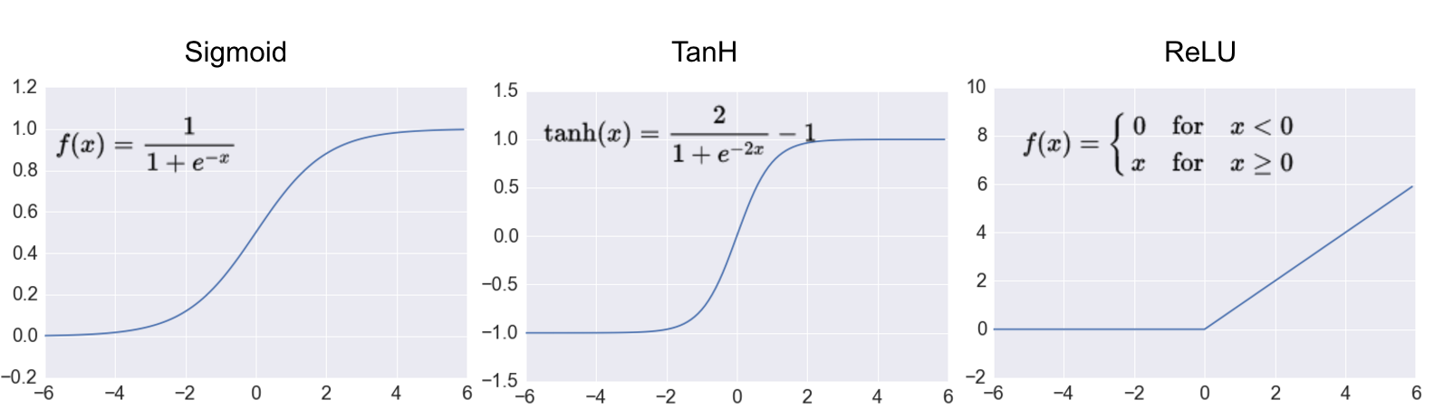
CNN-Convolutional Neural Network

Slide 5
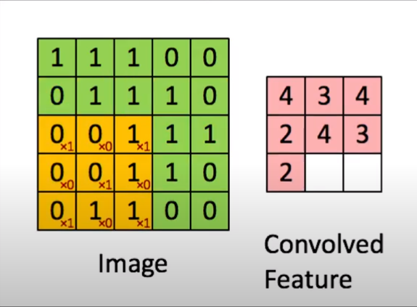
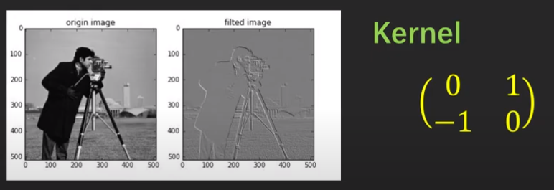
CNN-Convolutional Neural Network

Slide 6
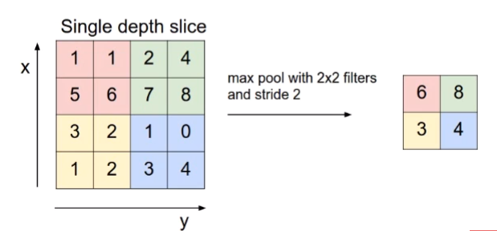
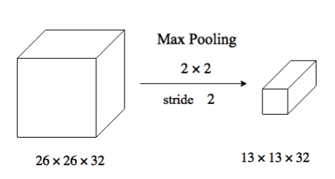
CNN-Convolutional Neural Network

Slide 7
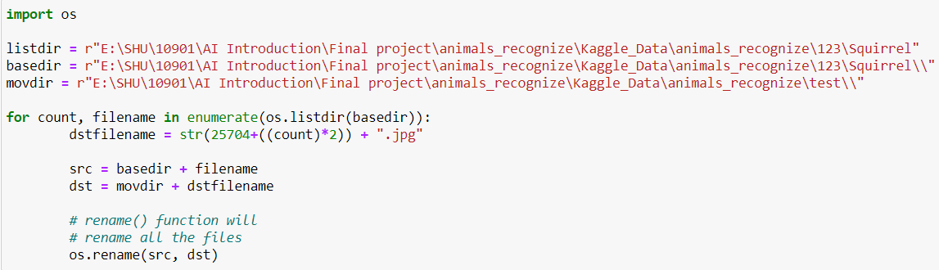
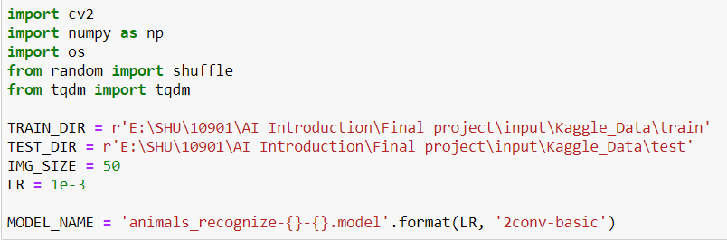
Main Program-Step 1

Slide 8
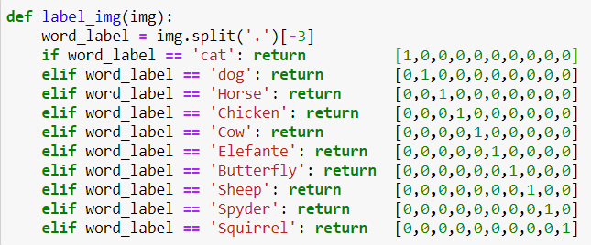
Main Program-Step 2

Slide 9
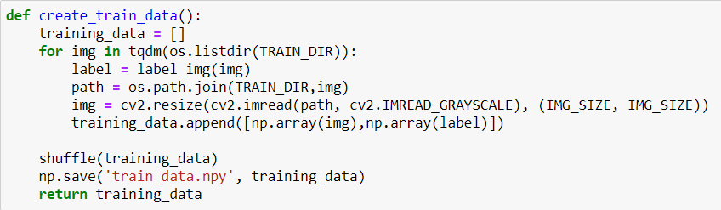
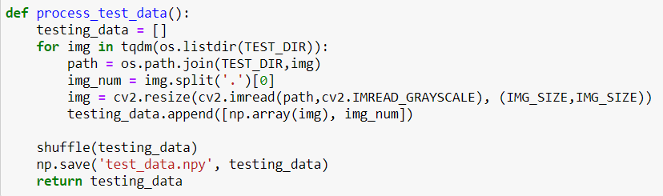
Main Program-Step 3

Slide 10
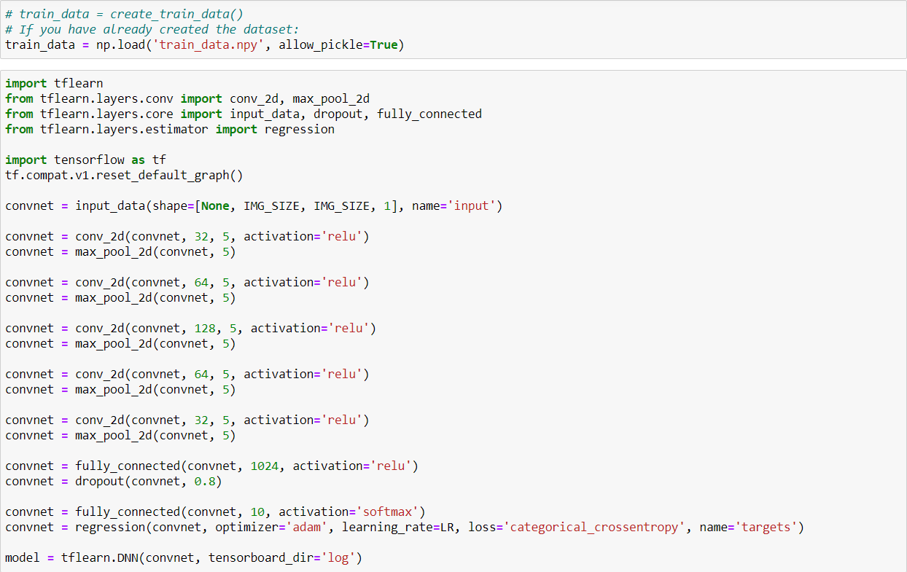
Main Program-Step 4

Slide 11
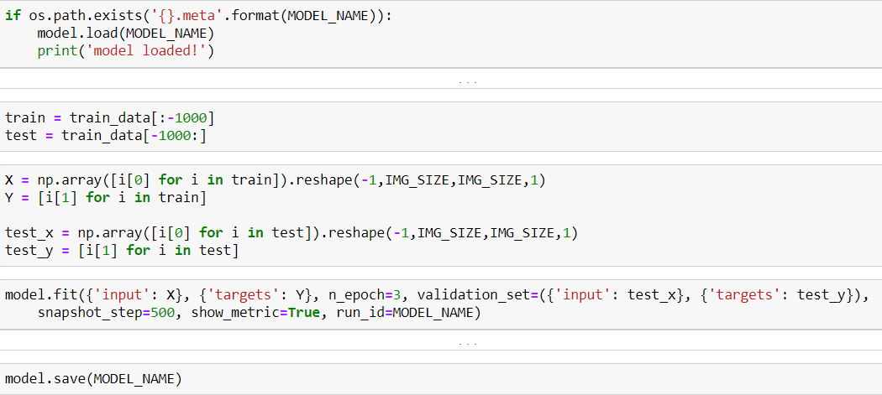
Main Program-Step 5

Slide 12
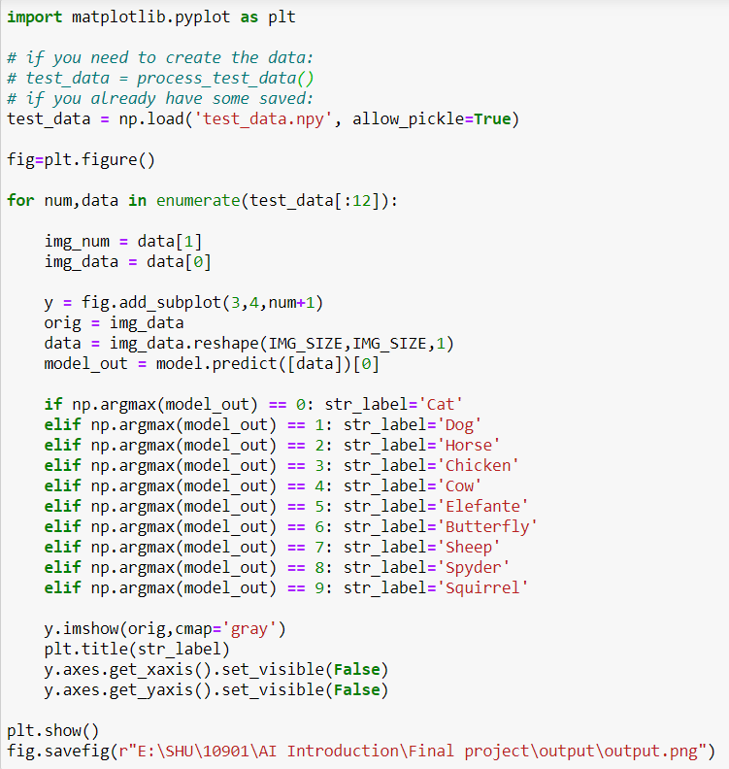
Main Program-Step 6

Slide 13
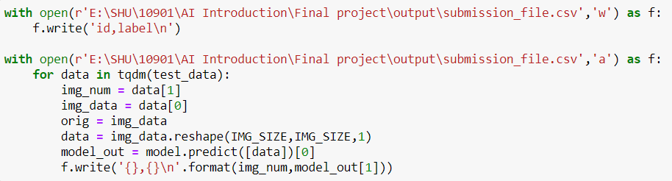
Main Program-Step 7

Slide 14
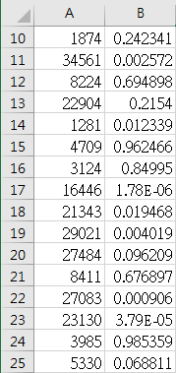
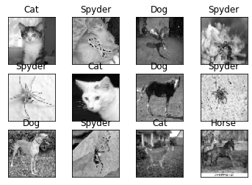
Result

