Slide 1

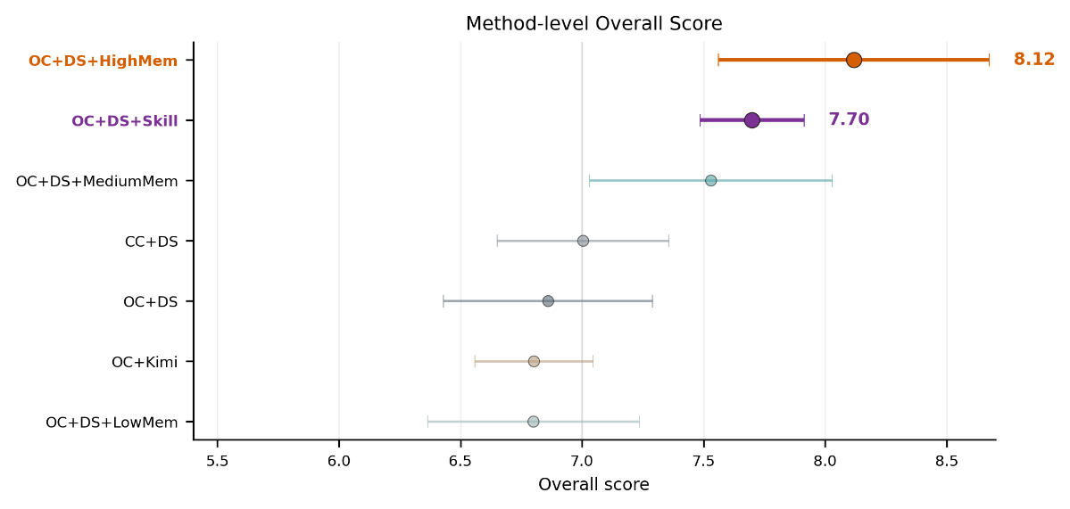
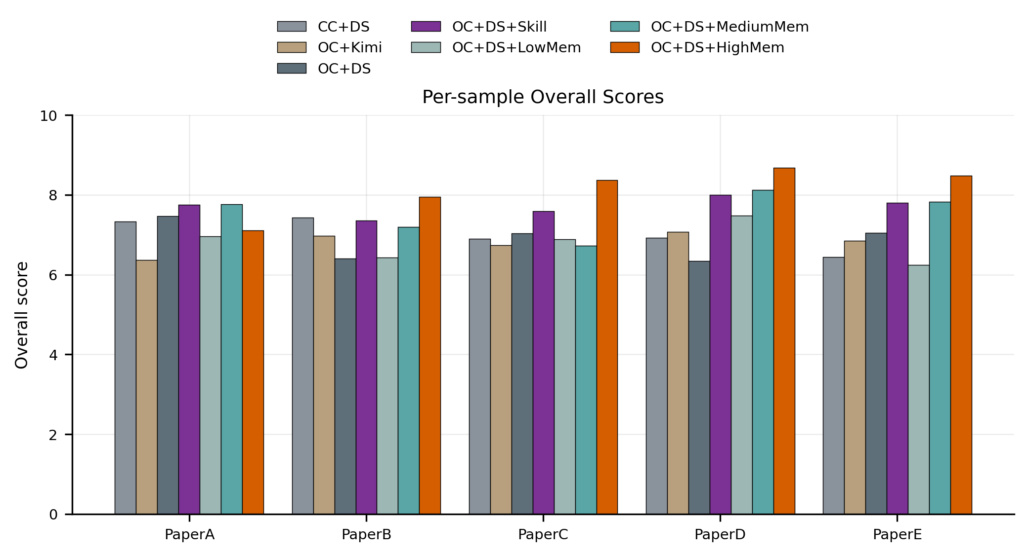
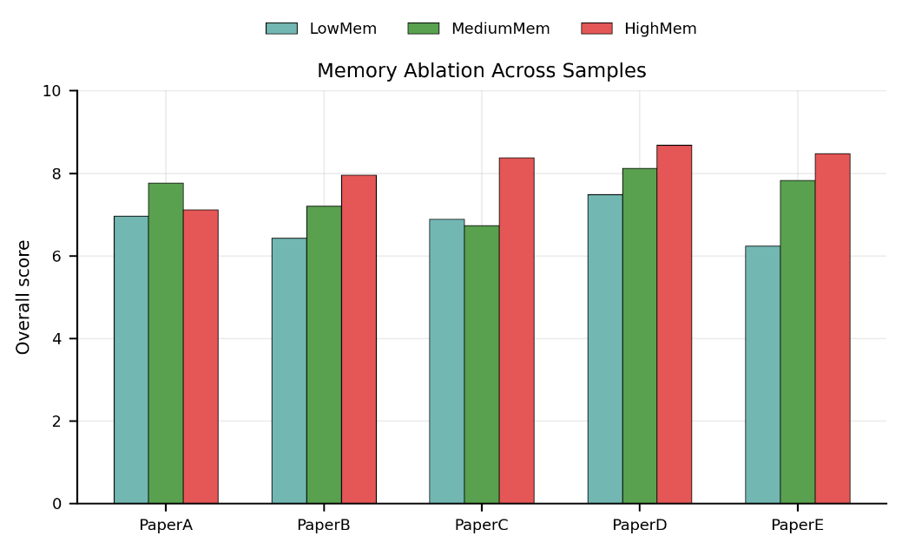
Evaluating Citation-Claim Consistency
in LLM-Generated Related Work
STA324
大语言模型的原理与应用
(2026 spring)
Jintian Guo, Canxiang Jiang, Ying Ling, Jiaqi Ma
Department of Statistics and Data Science, SUSTech
Introduction
Large language model agents can generate fluent academic related work sections, but their citations may be fabricated, weakly related, or unable to support the surrounding claims [1,2]. This creates a risk that generated scientific text appears credible while its evidence structure is unreliable.
This project studies citation-claim inconsistency in LLM-generated related work. We ask OpenClaw to regenerate missing related work sections and bibliographies from real ICLR 2026 papers, then evaluate whether the generated claims are supported by valid and appropriately placed citations.
To support this study, we build a benchmark dataset and an evaluation pipeline for citation-grounded related work generation. We further conduct ablation experiments to analyze how skill, memory, model choice, and agent framework affect citation reliability.
Figure1. Mean overall performance by method group.
We first assessed the average overall performance of each method group. High memory achieved the highest mean overall score (8.12), while skill improved the baseline from 6.86 to 7.70. In contrast, changing only the model or agent produced unstable gains, suggesting that citation-grounded generation needs explicit constraints or reusable failure feedback.
a
b
Method
We construct RWGenBench-ICLR26 from 262 real ICLR 2026 papers. For each paper, we retain the main body while removing the related work section, body citations, references, figures, and tables. The original related work section and its corresponding references are stored separately as gold targets.
We use RWEval to compare candidate related work and candidate references against the gold related work and gold references. The evaluator outputs a structured JSON report, a human-readable Markdown report, and an overall score from 0 to 10. It diagnoses missing key points, hallucinated references, bibliographic errors, unsupported citation-claim pairs, overclaiming, topic-structure issues, and length redundancy.
The overall score is then computed from seven main dimensions: content coverage, citation quality, relevance, thematic structure, synthesis quality, writing quality, and length conciseness. Citation quality is then further decomposed into citation validity, citation appropriate-ness, citation coverage, citation placement, and citation topic consistency.
Figure 2. Per-sample performance and memory ablation. (a) Overall scores of all method groups across five paper-level tasks. (b) Overall scores of low-, medium-, and high-memory settings across five paper-level tasks.
We further examined whether the average gains were consistent across individual papers. In Figure 2(a), method performance varies by task: medium memory performs best on PaperA, while high memory performs best on PaperB-E. This shows that memory is helpful, but its effect is not uniformly optimal across all samples.
Figure 2(b) isolates the memory settings and shows a clearer improvement from low to high memory. The mean overall score increases from 6.80 under low memory to 8.12 under high memory. This suggests that memory helps reuse previous failure experience and recover missing related work themes.
Summary
Overall, our experiments lead to three main findings:
Baseline OpenClaw recognizes paper topics, but still has low content coverage, and overclaiming.
Skill improves citation quality by turning generation into a safer workflow, while memory improves overall score by reusing previous failures.
Changing the model or agent alone is unstable, showing that reliable citation generation requires explicit constraints and memory mechanisms.
Results
We evaluate five papers using four groups of ablation experiments: (1) a baseline OpenClaw setting without skill or memory, (2) a skill-enhanced workflow with candidate paper screening, reference validity checking, and citation-claim pair checking, (3) low-, medium-, and high-memory settings that convert previous failures into reusable experience, and (4) alternative model or agent configurations, including Claude Code(CC) with DeepSeek(DS) and OpenClaw(OC) with Kimi.
Reference
[1] Ji, Ziwei, et al. "Survey of hallucination in natural language generation." ACM computing surveys 55.12 (2023): 1-38.
[2] Mugaanyi, Joseph, et al. "Evaluation of large language model performance and reliability for citations and references in scholarly writing: cross- disciplinary study." Journal of Medical Internet Research 26 (2024): e52935.

