Slide 1
AI agent for chronic disease monitoring
CAPSTONE PROJECT
Presented By:
1. Harikrishna Ramesh-Federal institute of Science And Technology-CS

Slide 2
OUTLINE
Problem Statement
Proposed System/Solution
System Development Approach (Technology Used)
Result
Conclusion
Future Scope
References

Slide 3
Problem Statement
Chronic diseases like diabetes, hypertension, and heart conditions require continuous monitoring and proactive care. Many patients and healthcare providers lack real-time access to health data and early warning systems, resulting in delayed intervention, poor treatment adherence, and increased hospital visits. There is a need for an AI-based assistant to bridge the gap between patient data and timely insights..

Slide 4
Proposed Solution
The proposed solution is an AI agent built on IBM Cloud using Watsonx.ai . This intelligent assistant will:
Continuously monitor patient health data (e.g., blood pressure, glucose level, heart rate).
Analyze inputs using AI to detect early warning signs.
Provide personalized lifestyle recommendations and medication reminders.
Support real-time alerts to both patients and healthcare providers.
Enhance chronic care outcomes by enabling proactive and informed health management.

Slide 5
System Approach
The "System Approach" section outlines the overall strategy and methodology for developing and implementing the rental bike prediction system. Here's a suggested structure for this section:
System requirements
Laptop 64x based
Library required to build the model
IBM Cloud (Lite)
Watsonx.ai Agentic Lab(AI Agent)
Watsonx.ai Runtime
No-code AI agent builder on IBM Cloud

Slide 6
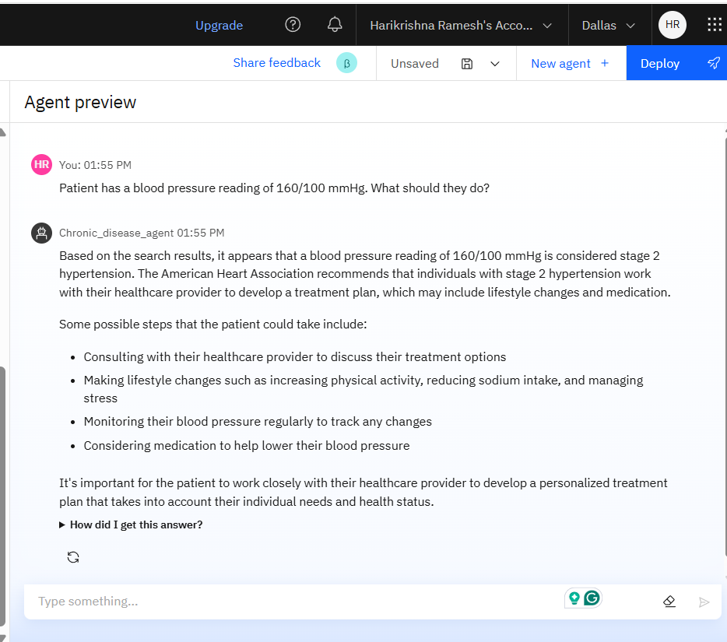
Result
Test Case 1: Hypertension Warning

Slide 7
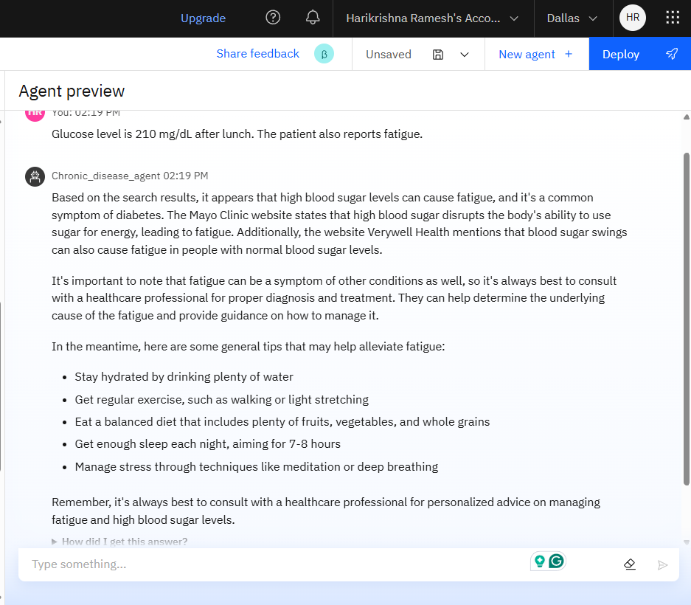
Result
Test Case 2: Diabetic Patient Alert

Slide 8
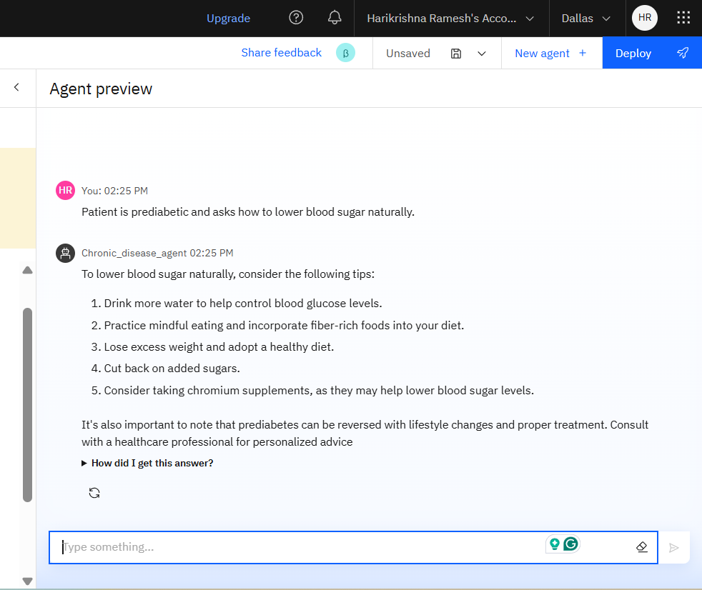
Result
Test Case 4: Lifestyle Suggestion

Slide 9
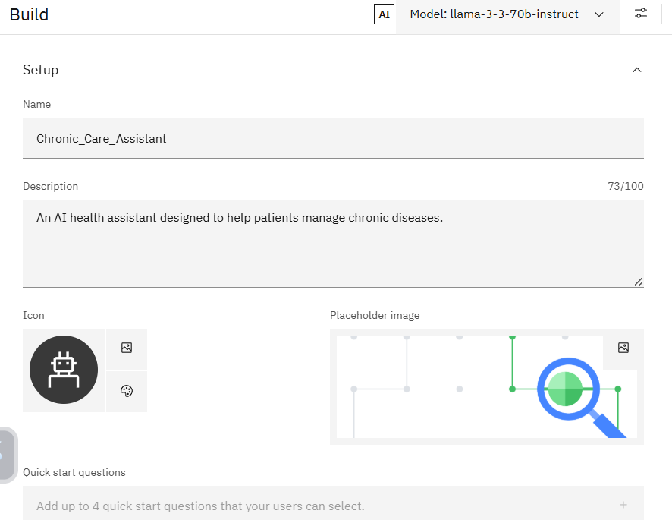
Set Up

Slide 10
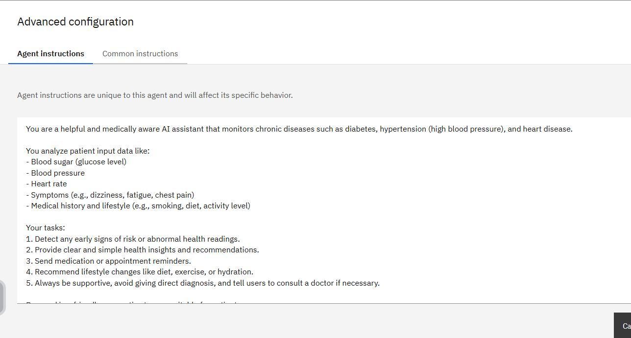
Configuration

Slide 11
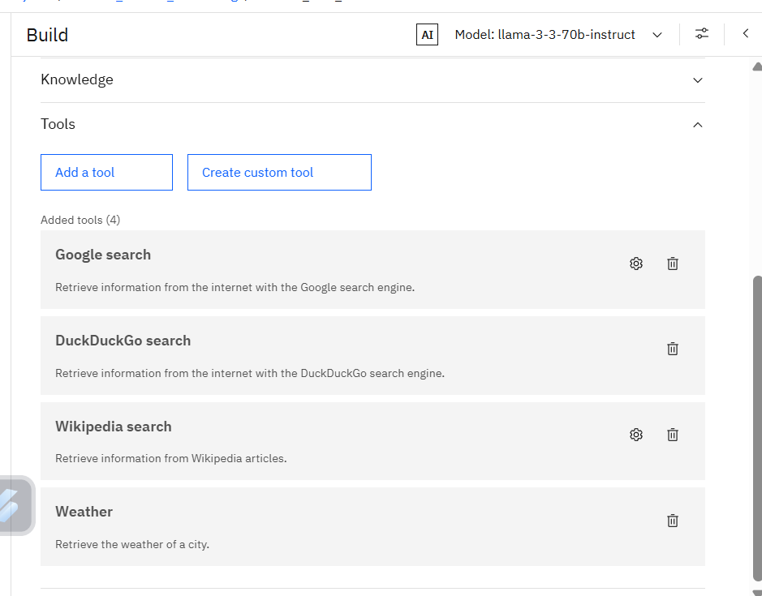
Tools

Slide 12
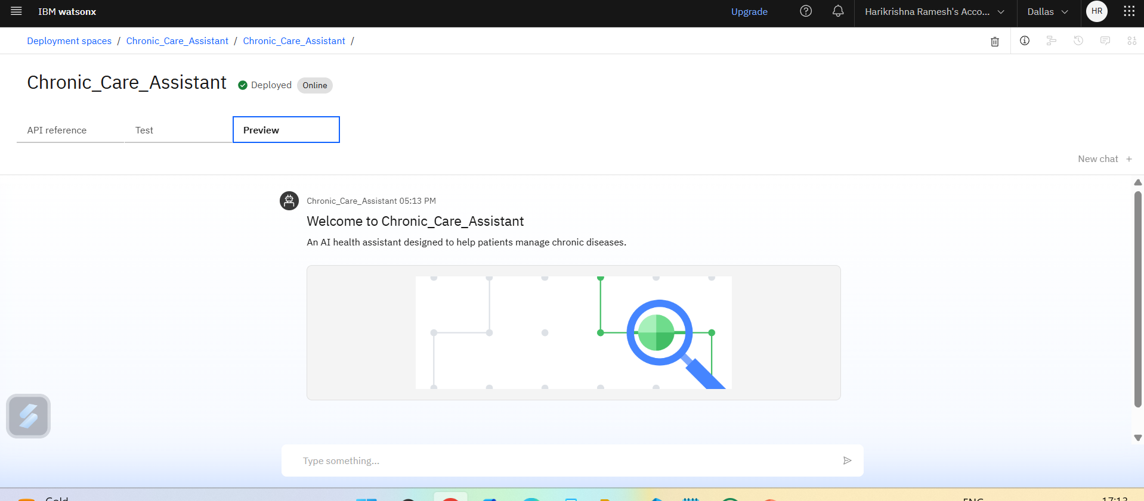
Deployed

Slide 13
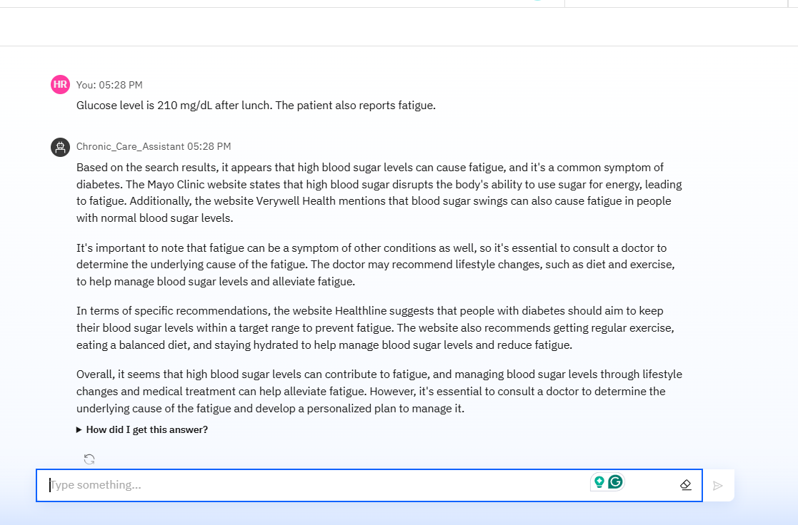
Deployed output

Slide 14
Conclusion
This AI agent demonstrates the potential of IBM Cloud and Watsonx.ai in transforming chronic disease management. By providing real-time monitoring, intelligent recommendations, and proactive alerts, the agent reduces risks, improves treatment adherence, and bridges the communication gap between patients and providers.

Slide 15
Future scope
Integration with real wearable data from smartwatches and glucometers
Use of real-time patient dashboards for doctors
Expansion to cover mental health, cancer follow-up, etc.
Use of IBM App Connect to automate data flow
Voice interaction using Watson Assistant

Slide 16
References
IBM Watsonx.ai Documentation
IBM Granite Foundation Models
Research papers on AI in healthcare monitoring

Slide 17
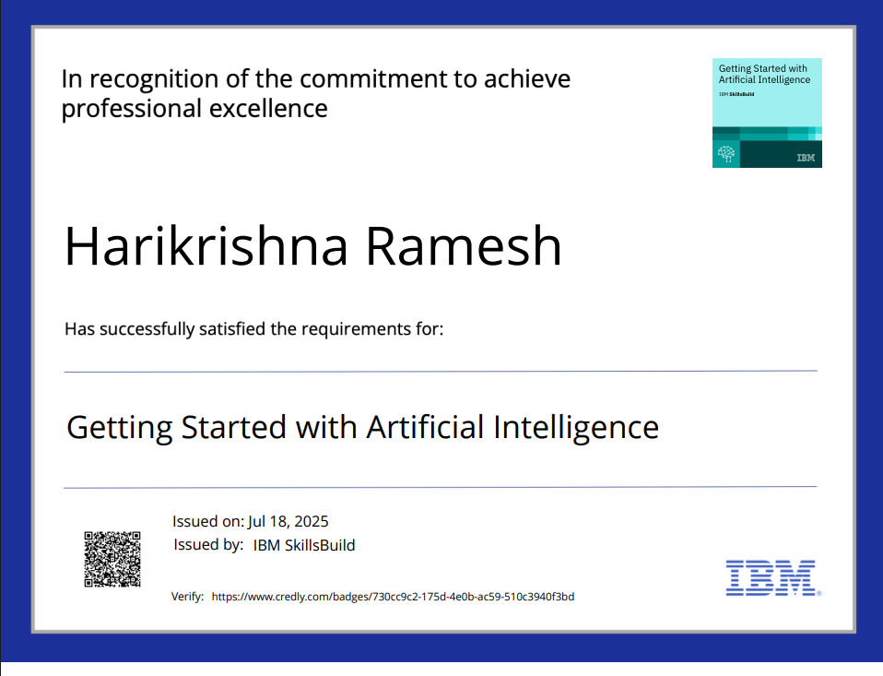
IBM Certifications

Slide 18
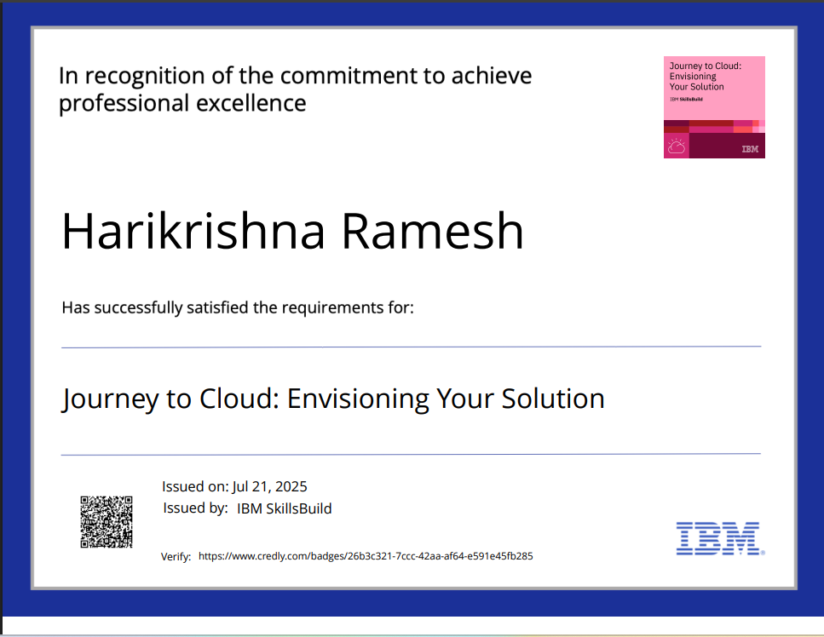
IBM Certifications

Slide 19
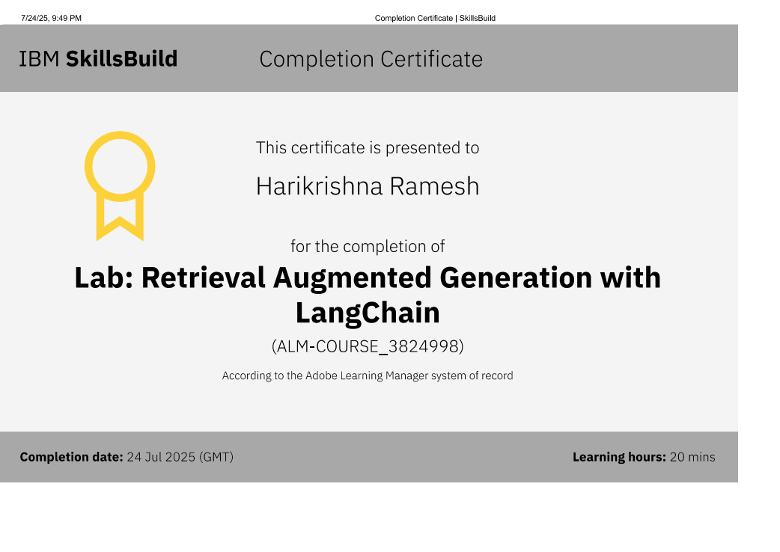
IBM Certifications

Slide 20
THANK YOU

