Slide 1
Project Greed
New AGE INFRASTRUCTURE

Slide 2
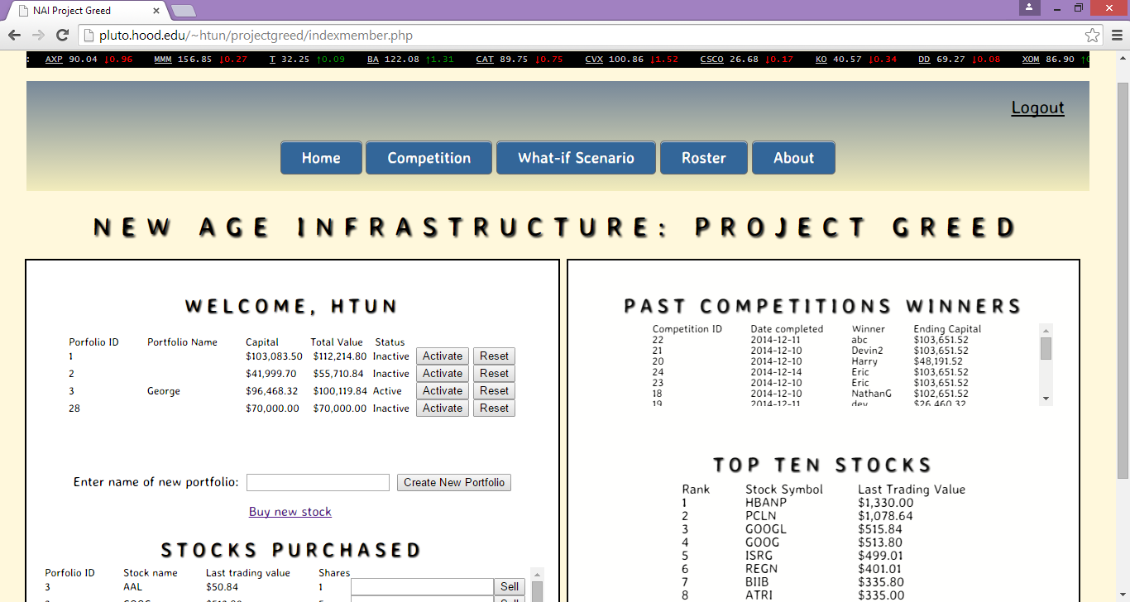

Slide 3
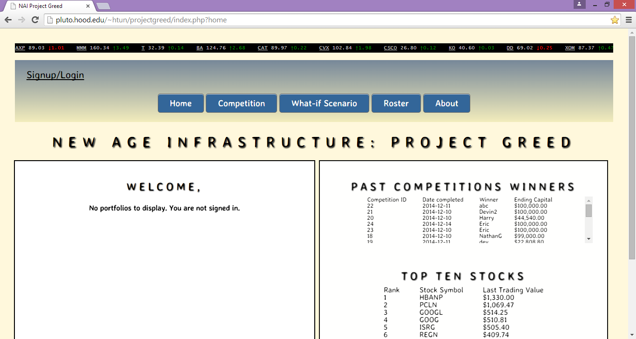

Slide 4
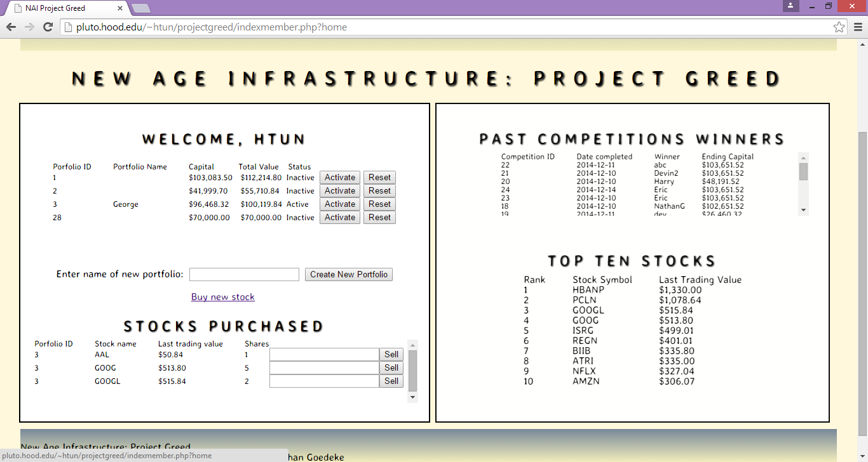

Slide 5
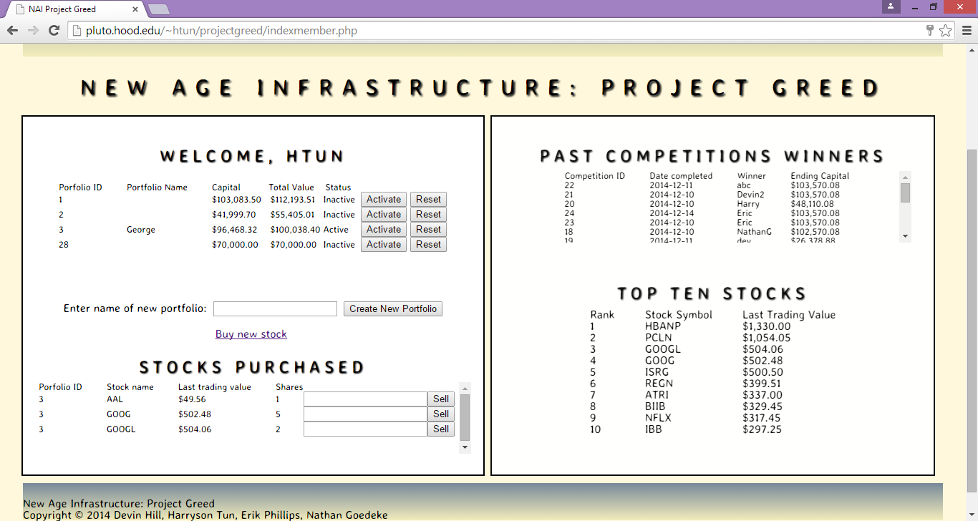

Slide 6
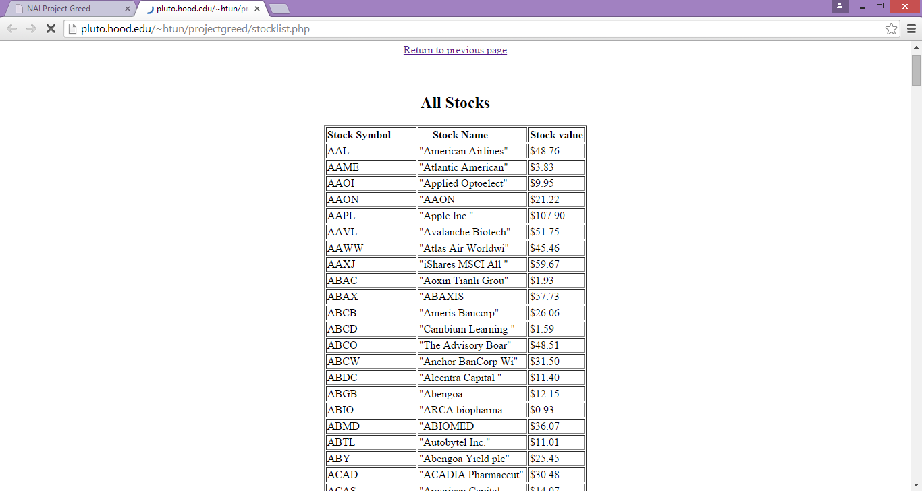
View All Stocks Link

Slide 7
Ideas for Future Development
Line graph for portfolios
More efficient search engine in transaction engine
Alert boxes for reset button
Pop up boxes for Instructions

