Slide 1
Volatility Band Width
Estimating and Backtesting Volatility Bands for the S&P 500
K. Mohamed Harith
Erdős Institute — Quantitative Finance Bootcamp, Fall 2026
github.com/Harry140896/Volatility-band-width
Notes:
Title slide.

Slide 2
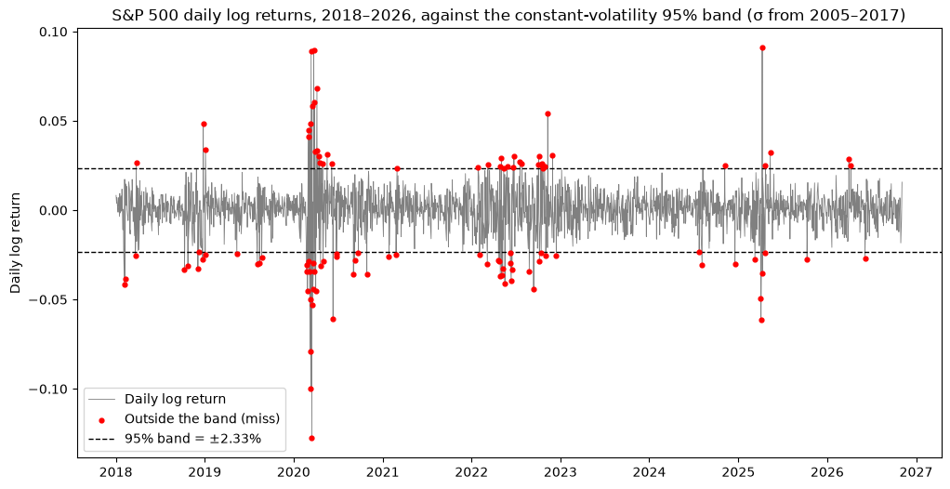
One fixed volatility band misses in bursts
Question Can volatility models give reliable 95% bands for the S&P 500's next-day return? And if so, how should volatility be estimated to make them more reliable?
Constant-volatility GBM: one volatility from 2005–2017 gives a fixed band of ±2.33% every day
But volatility itself changes: from 6.7% (2017) to 41.0% (2008) a year
Result: misses pile up in crises and almost vanish in calm years
Notes:
Motivation: the constant band from Section 1 of the notebook.

Slide 3
Every model is a way to estimate tomorrow's volatility
1 Daily log return
2 95% band
3 A miss
r_{t} = s_{t} z_{t}, z_{t} ~ N(0, 1)
[ −1.96 s_{t} , +1.96 s_{t} ]
the return falls outside the band
Constant GBM
Rolling GBM
EWMA
GARCH(1,1)
One volatility for every day
Equal weights on the last m days
Weights that fade geometrically: recent days count most
Reacts to yesterday's shock, pulled towards a long-run level
s = 0.0119 per day
m = 160 days
λ = 0.94
α = 0.103, β = 0.880
Each model fixes a weakness of the one before →
All parameters fixed on 2005–2017; tested on 2018–2026. Daily drift ≈ 1/50 of daily volatility, so it is neglected.
Notes:
All four models share r_t = s_t z_t (s_t = daily volatility) and the band ±1.96 s_t; they differ only in how s_t is estimated.

Slide 4
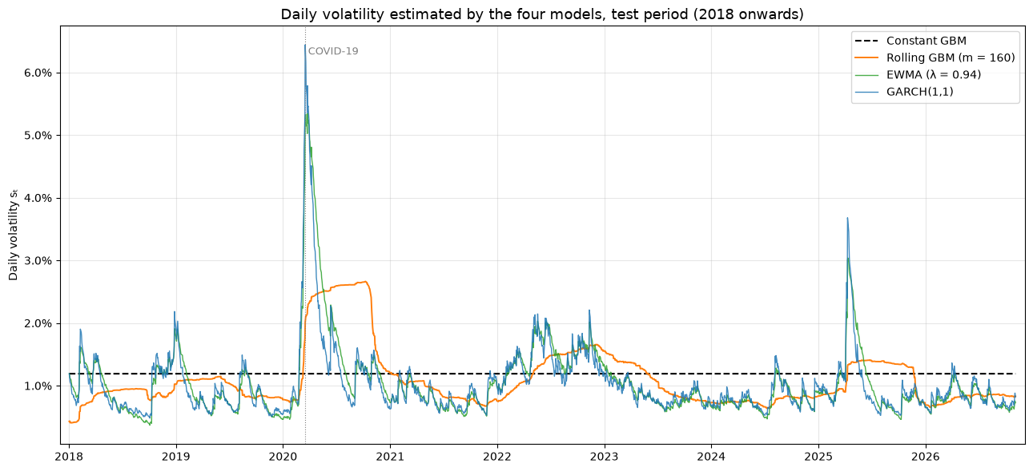
Backtesting
Model | Misses | Rate
● Constant GBM | 109 | 4.9%
● Rolling GBM | 156 | 7.0%
● EWMA | 128 | 5.8%
● GARCH(1,1) | 116 | 5.2%
Expected at 95% | ≈ 111 | 5.0%
Test period: 2,223 trading days (2018–2026)
Constant GBM: right on average (4.9%), but flat through every crisis
Rolling GBM: reacts late and stays high long after the shock, so it misses most (7.0%)
EWMA and GARCH: spike with the shock, then decay back; both stay near 5% (5.8%, 5.2%)
Notes:
Backtest on 2018–2026 with parameters fixed on 2005–2017. A miss rate near 5% is necessary but not sufficient: next slide tests whether misses are the right number AND independent.

Slide 5
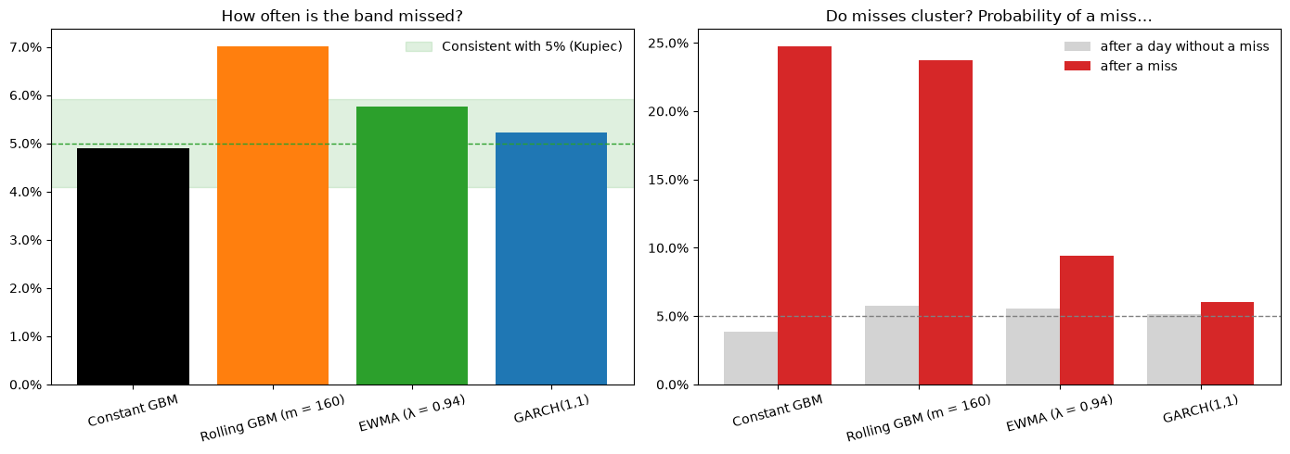
Validation
Kupiec test
Is the number of misses consistent with 5%?
Compares the observed miss rate with 5%; likelihood ratio ~ χ²₁
Christoffersen test
Are the misses independent?
Is a miss more likely the day after a miss? Compares P(miss | miss) with P(miss | no miss); likelihood ratio ~ χ²₁
Model | Miss rate | Kupiec p | P(miss | no miss) | P(miss | miss) | Christoffersen p
● Constant GBM | 4.9% | 0.834 | 3.9% | 24.8% | < 0.001
● Rolling GBM | 7.0% | < 0.001 | 5.8% | 23.7% | < 0.001
● EWMA | 5.8% | 0.109 | 5.5% | 9.4% | 0.089
● GARCH(1,1) | 5.2% | 0.639 | 5.2% | 6.0% | 0.692
Red p-value: test rejected at the 5% level
Only EWMA and GARCH pass both tests. Constant GBM gets the count right, but its misses cluster.
Notes:
Kupiec: unconditional coverage (number of misses). Christoffersen: independence of misses (first-order Markov). Rolling GBM with m = 160.

Slide 6
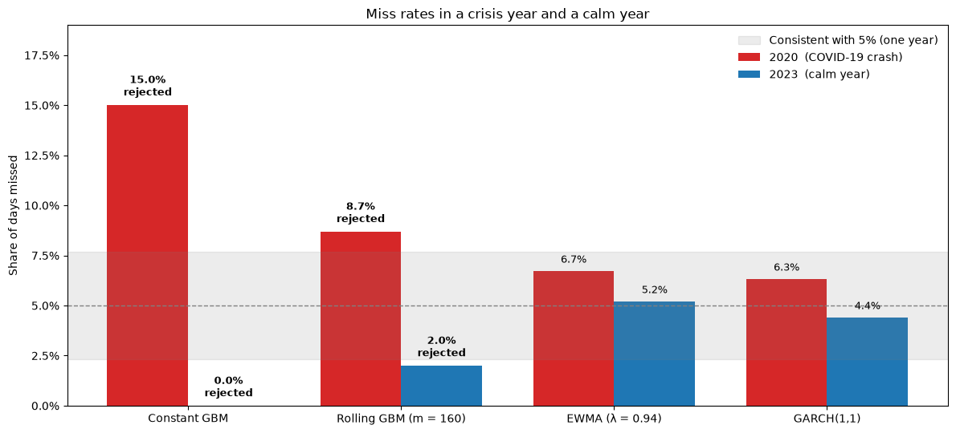
Crisis year vs calm year
Constant GBM
2020: 15.0% 2023: 0.0%
Too narrow in the crisis, too wide in the calm. The two errors cancel to 4.9% overall.
Rolling GBM
2020: 8.7% 2023: 2.0%
Adapts, but too slowly: rejected in both years.
EWMA and GARCH(1,1)
6.7% / 5.2% and 6.3% / 4.4%
Consistent with 5% in both years.
A good miss rate over the whole period can hide failures in both directions.
2020: COVID-19 crash. 2023: calm year. Each year tested separately (Kupiec).
Notes:
Kupiec test applied within each year (about 250 days). Shaded zone in the figure: miss rates consistent with 5% for one year.

Slide 7
Conclusions and limitations
Conclusions
Limitations → next steps
1. A miss rate close to 5% is not enough. Constant GBM: 4.9% overall, but 15.0% in 2020 and 0% in 2023, and its misses cluster.
2. Updating volatility slowly is not enough. Rolling GBM misses too often (7.0%), and its misses cluster.
3. Reacting to yesterday's shock works. EWMA and GARCH pass both tests. They still miss the first days of a crash: they react to news, they do not predict it.
4. GARCH performs best, but EWMA with the fixed λ = 0.94 is close.
Normal shocks; real returns have fat tails
→ Student-t shocks, and a check at 99%
Parameters frozen from 2005–2017
→ re-estimate them periodically
Gains and losses counted together; size of misses ignored
→ GJR-GARCH and Expected Shortfall
One market, one train/test split
→ another market, e.g. the Nifty 50
Notes:
Full list: "Limitations and next steps" at the end of the notebook.

Slide 8
Thank you
Questions welcome
K. Mohamed Harith
Code and notebook: github.com/Harry140896/Volatility-band-width
Notes:
Closing slide.

