Slide 1
Distances in cosmology - what we can learn from them
Bruce Bassett
NASSP Observational Cosmology

Slide 2
Some Online Research Resources
http://arxiv.org - an excellent resource of papers.
ADS -http://adsabs.harvard.edu/ – astro paper database
SPIRES – High energy physics database
www.sdss.org (http://cas.sdss.org/) - the SDSS survey and skyserver
SIMBAD – looking for specific objects?
http://www.cosmocoffee.com - cosmology discussion forum, jobs etc…
http://scholar.google.com - general academic resource

Slide 3
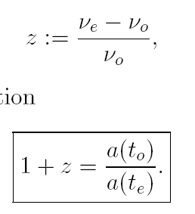
Redshift…
As the universe expands, wavelengths are stretched…it is why the
Early universe was radiation dominated (why?)
1+z is the number of times smaller the cosmos was at that time…

Slide 4
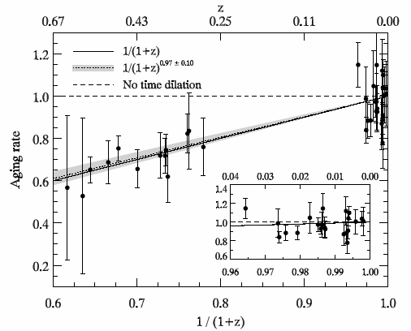
Testing cosmic time-dilation with SNIa
Blondin et al, 2008

Slide 5
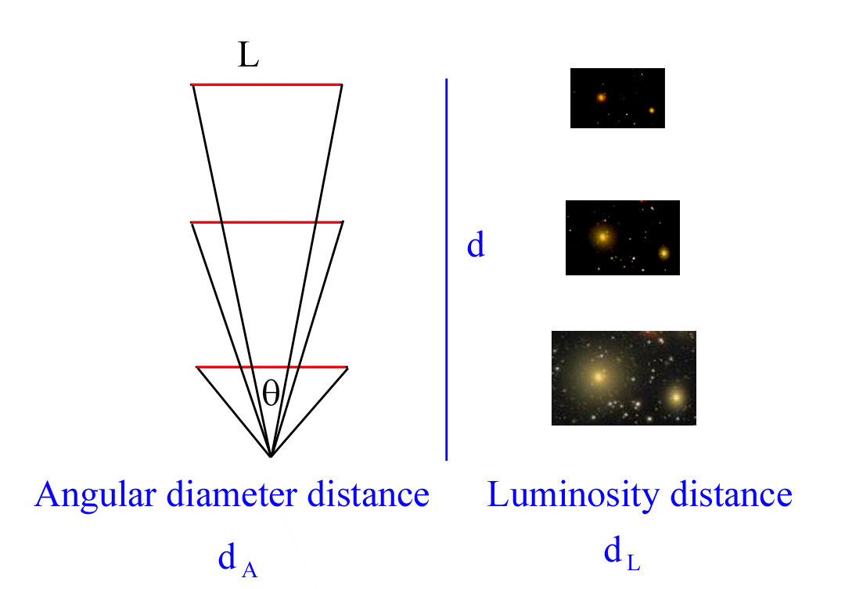
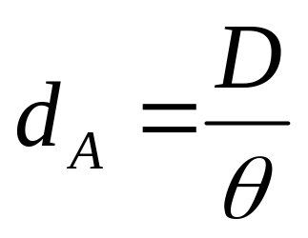
Distances…
D
Angular-diameter
distance (area distance)
It is the way we usually
measure distances on earth!

Slide 6
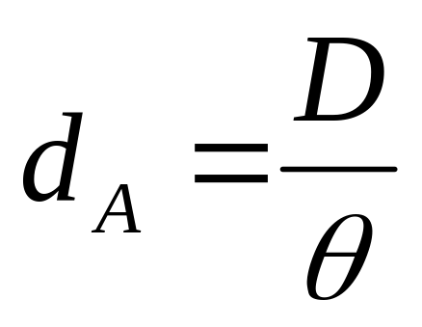
Angular diameter distance
Need “standard rulers” – how can we estimate D?
E.g. Baryon Acoustic Oscillations
    X-ray clusters
radio galaxies
compact radio sources.
All except the first (BAO) rely on complex nonlinear modeling so are not very reliable. We will discuss BAO in detail later in the course.

Slide 7
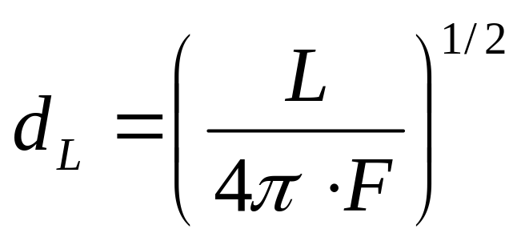
Luminosity distance
L=intrinsic luminosity
F = received flux

Slide 8
How to measure distances…
d_{L} – “standard candles”
The problem – we cant get the distance unless we know the intrinsic luminosity, L.
SNIa – we can estimate L from the decline rate of the lightcurve (brighter SNIa decay faster – See next Lecture).
(Philips, 1993).

Slide 9
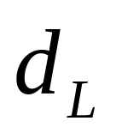
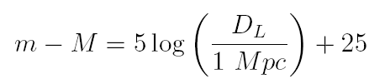
d_{L} in terms of magnitudes…
In terms of absolute (M) and apparent magnitudes (m) we have
The quantity m-M is the distance modulus, usually denoted μ.

Slide 10
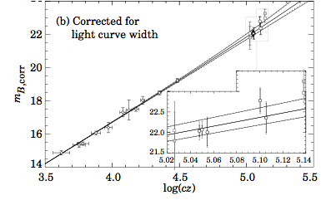
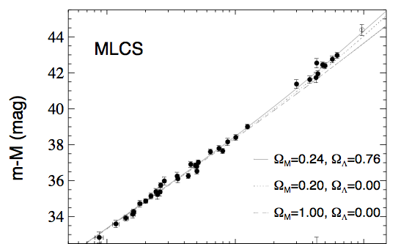
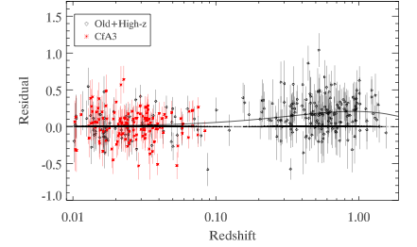
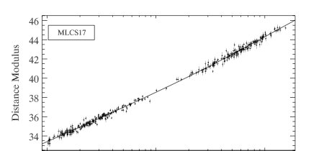
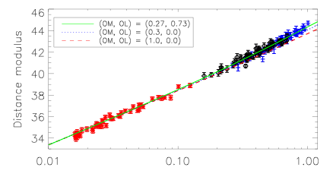
SCP 96
High-z / SCP 98
Ω_{Μ}=0.94±0.31 (flat)
Ω_{M}=0.28±0.10 (flat)
Evolution of the Hubble Diagram 1996-2009
ESSENCE+SNLS 07
Constitution 09
Ω_{M}=0.267±0.023 (flat)
Ω_{M}=0.281±0.026 (+BAO)
Filled by the SDSS
SN survey

Slide 11
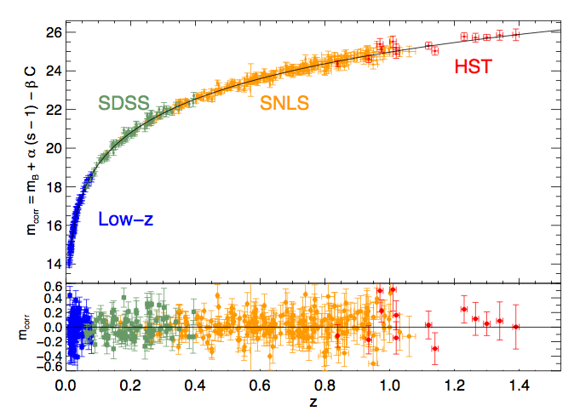
Current state-of-the art
Conley et al, 2011

Slide 12
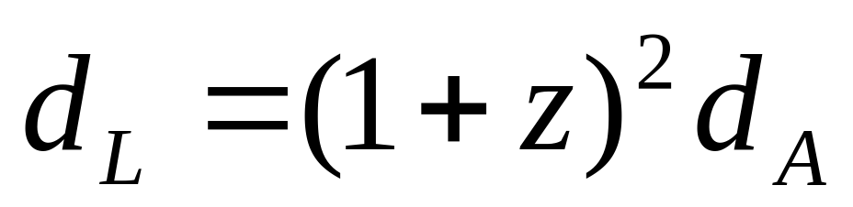
How are these two distances related?
Surely they must give the same result?
Not quite….but almost:
This “distance duality” is
true in any metric theory of gravity (not just
General Relativity) as long as photon number is
Conserved.

Slide 13
How do we use distances to learn about the cosmos?

Slide 14
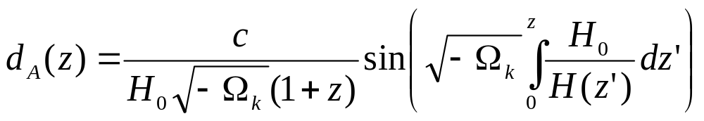
The Angular Diameter Distance
c/H₀ is the overall
Scale (Hubble scale)
Spatial
Curvature
(zero = flat)
Expansion rate of the
Cosmos (energy densities)

Slide 15
The Luminosity Distance

Slide 16
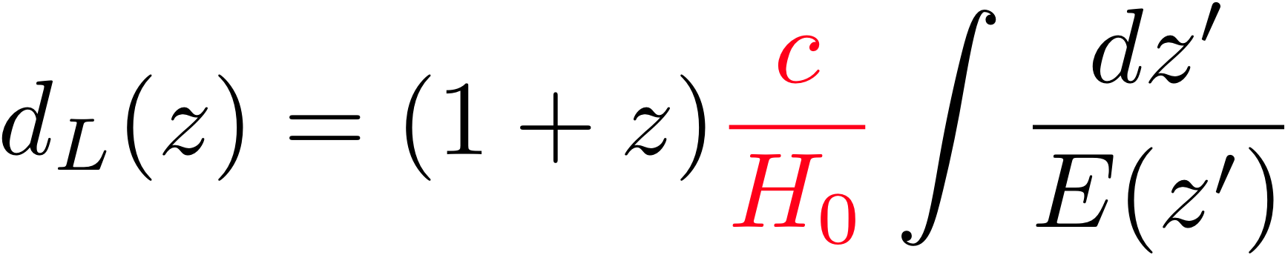
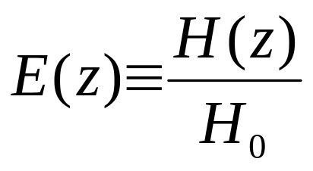
What do distances tell us?
If the Universe is flat (Ω_{k} = 0) then this simplifies to:
Distance we measure What we want

Slide 17
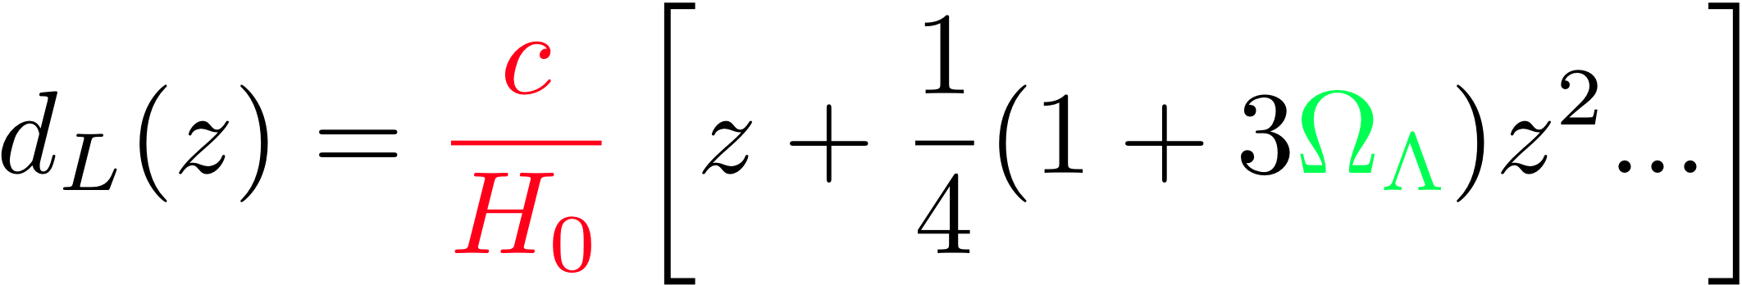
What do distances tell us?
Let’s assume the Universe is flat (Ω_{k} = 0) to start with.
Taylor expanding to second order gives…
The Hubble constant, H₀
Sets the overall scale for all
Distances (Hubble’s law
is true for all models)
The curvature of the Hubble
Diagram depends on the
Amount of dark energy, Ω_{Λ}

Slide 18
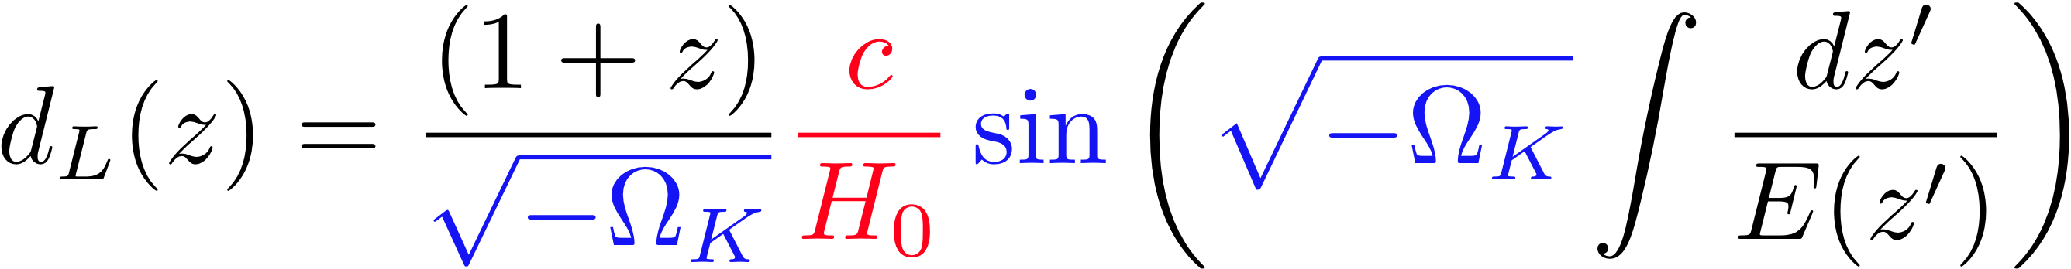
What do distances tell us?
What happens when we don’t assume flatness?
χ
Encodes the effect of the curved null geodesics …

Slide 19
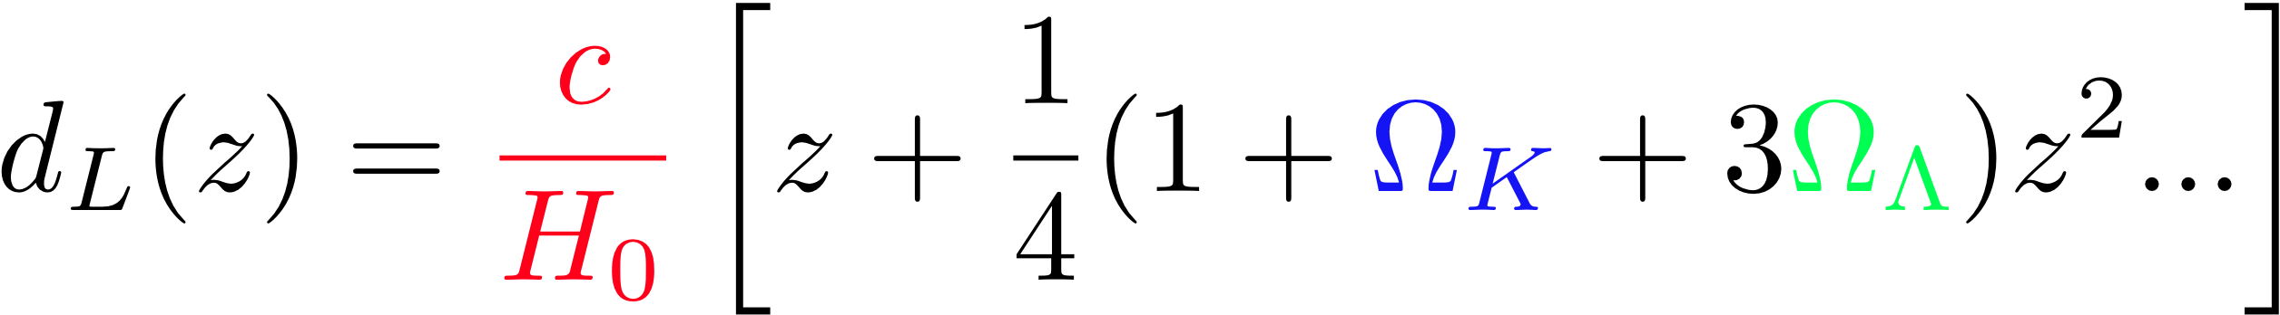
What do distances tell us?
What happens when we don’t assume flatness?
Taylor expanding to second order gives…
2nd order term is degenerate on the line:
Ω_{Λ} = Ω_{M}/2 + const.
The curvature of the Hubble
Diagram now depends on the
Amount of dark energy AND the spatial curvature, Ω_{K}

Slide 20
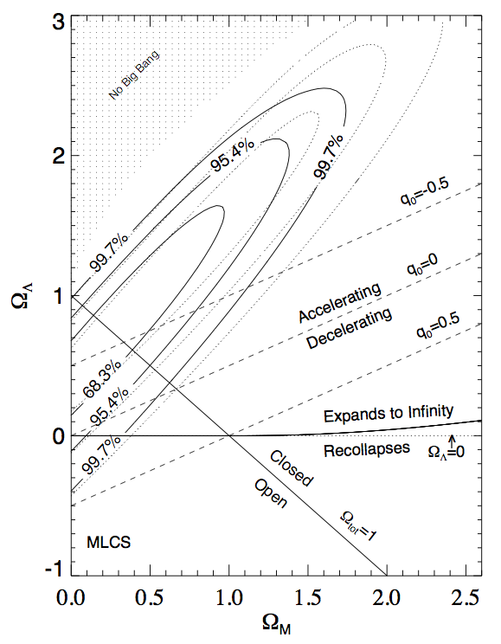

Ω_{Λ} = Ω_{M}/2 + const.
Riess et al, 1998

Slide 21
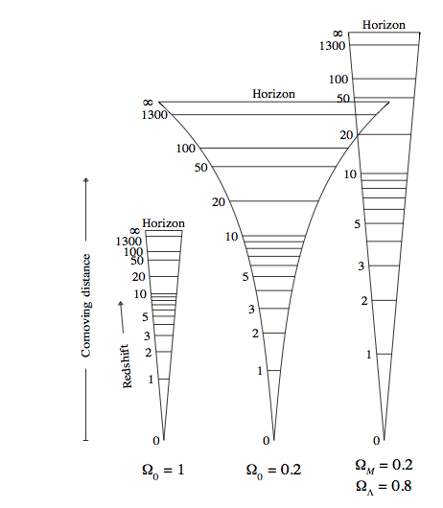
Ω_{K} = 0
Ω_{K} = 0.8
Ω_{K} = 0
The size of an object is not uniquely determined by χ – curvature must also be known
Dynamics
χ =
Hamilton 97

Slide 22
Distances and densities..
We showed that in general:
Where is the dimensionless
Hubble expansion rate, normalised to unity today. This is why distances tell us about Dark Energy…
Exercise: derive the flat-space limit of this (Ω_{k} = 0)

Slide 23
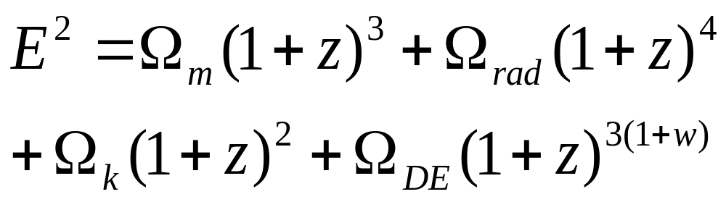
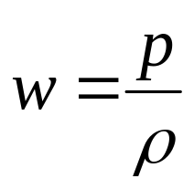
E is for “energy”…
Where….
In the case where of dark energy (DE)
is assumed to be constant in time, and the Ω_{i} are the density parameters for the various components today.

Slide 24
Dynamical Dark Energy
In general, w can be time-dependent: w(z). Then instead we have
Exercise: Compute f(z) for the case w(z) = w₀ + w_{a} z/(1+z)

Slide 25
Geometry – Dynamics Degeneracy
But note, that even with perfect distance measurements there is a perfect degeneracy between the curvature (Ω_{k}) and general H(z) (Weinberg, ‘73)

Slide 26
Distance modulus and magnitudes
Apparent
Magnitude
Distance
Modulus
Absolute
Magnitude
d_{L} converts M → m
Common in Supernova cosmology to plot μ or m_{B} vs redshift

Slide 27
d_{L} Wish list…
We want objects that are:
Very Bright…so we can see them across the observable universe
Known: We know each object’s intrinsic luminosity.
Standard: no environmental dependence of the intrinsic luminosity
Time-invariant: their intrinsic luminosity doesn’t change with redshift
Easy to find…
Emit most of their light in the optical
(counter example: binary black holes as GW sirens)

Slide 28

Problem: if we don’t know M
What can we do?
Constants
Redshift dependent
If we subtract the apparent magnitudes of two objects with the same M at different redshifts, all the unknown constants disappear…

Slide 29
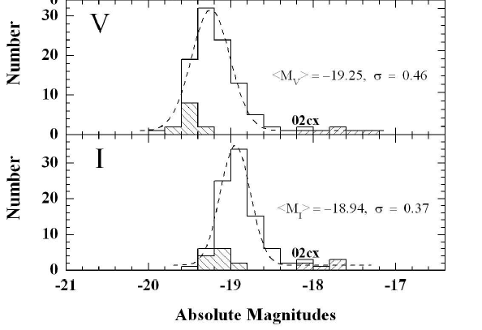
Type Ia Supernovae (SNIa)
Very Bright…at peak they can outshine their host galaxies
Stable: Don’t seem to evolve with redshift
Fairly standard:
σ = 0.4 mag
Easy to find…
~ 1 per century per
galaxy

Slide 30
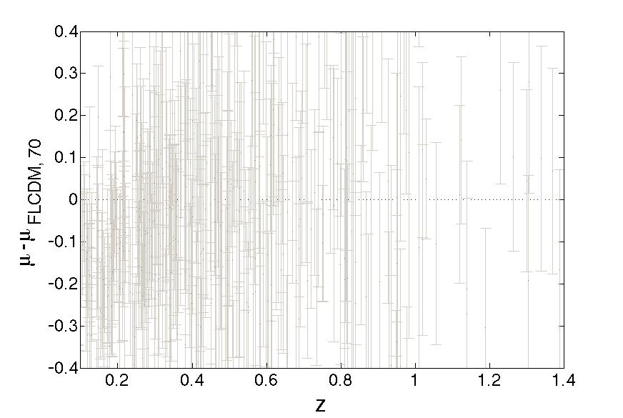
Relative Hubble Diagram
Dimmer and hence further
Ω_{m}=0.3, Ω_{Λ}=0.7, H₀ = 70 km/s/Mpc
Brighter and hence closer

Slide 31
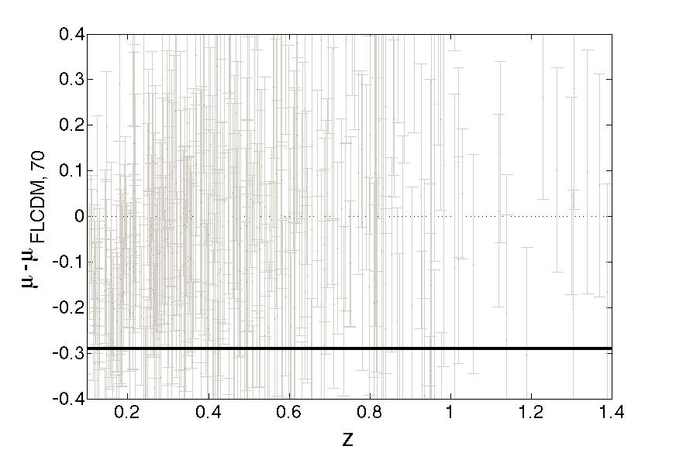
Ω_{m}=0.3, Ω_{Λ}=0.7, H₀ = 70 km/s/Mpc
H₀ = 80 km/s/Mpc

Slide 32
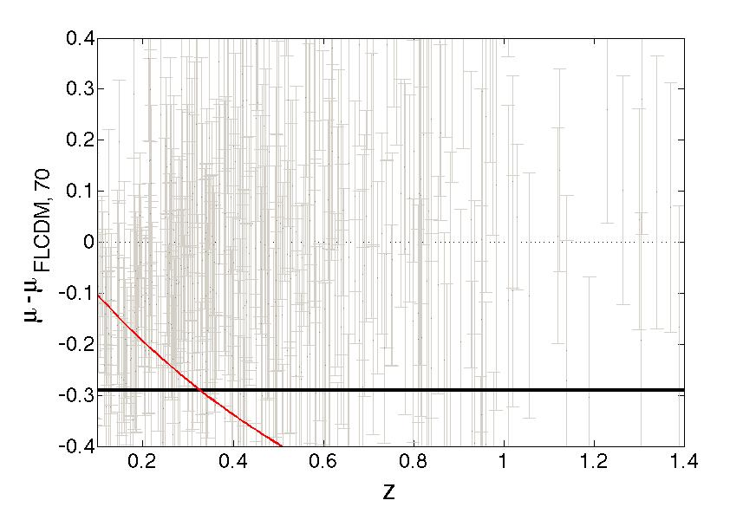
Ω_{m}=0.3, Ω_{Λ}=0.7, H₀ = 70 km/s/Mpc
EdS Model: Ω_{m}=1
H₀ = 80 km/s/Mpc

Slide 33
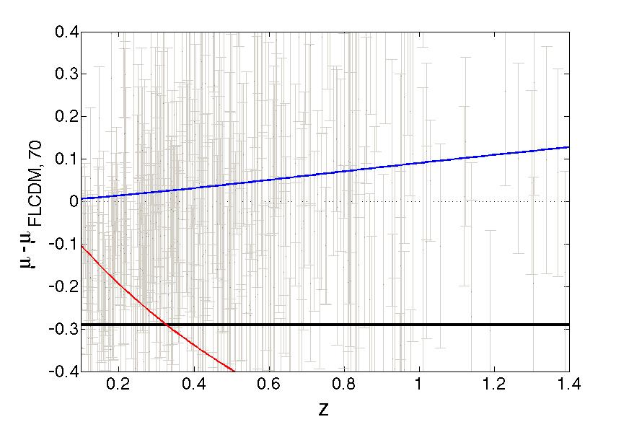
Ω_{m}=0.2, Ω_{Λ}=0.7
Ω_{m}=0.3, Ω_{Λ}=0.7
EdS Model: Ω_{m}=1
H₀ = 80 km/s/Mpc

Slide 34
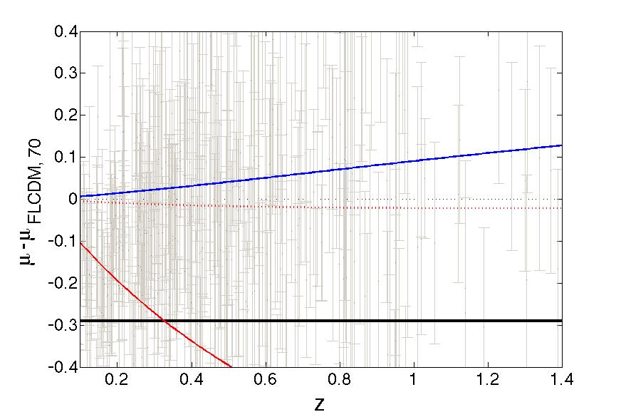
Ω_{m}=0.2, Ω_{Λ}=0.7
w = -0.95
EdS Model: Ω_{m}=1
H₀ = 80 km/s/Mpc

Slide 35
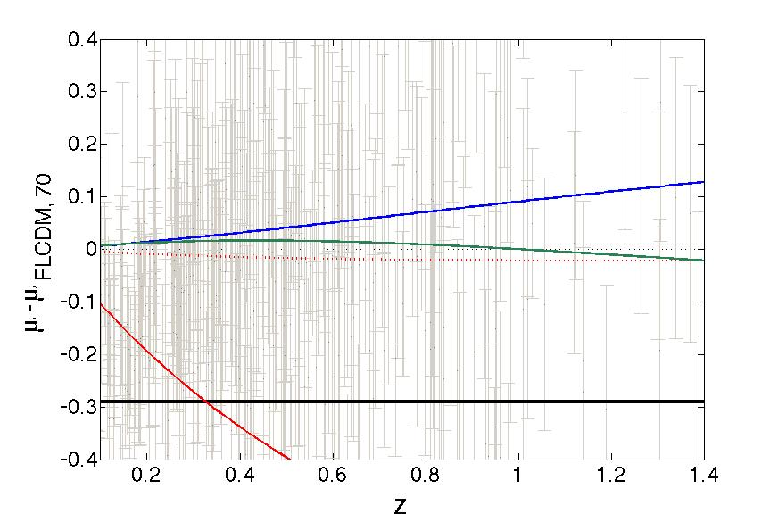
Ω_{m}=0.2, Ω_{Λ}=0.7
Ω_{m}=0.35, Ω_{Λ}=0.8
w = -0.95
EdS Model: Ω_{m}=1
H₀ = 80 km/s/Mpc

