Slide 1
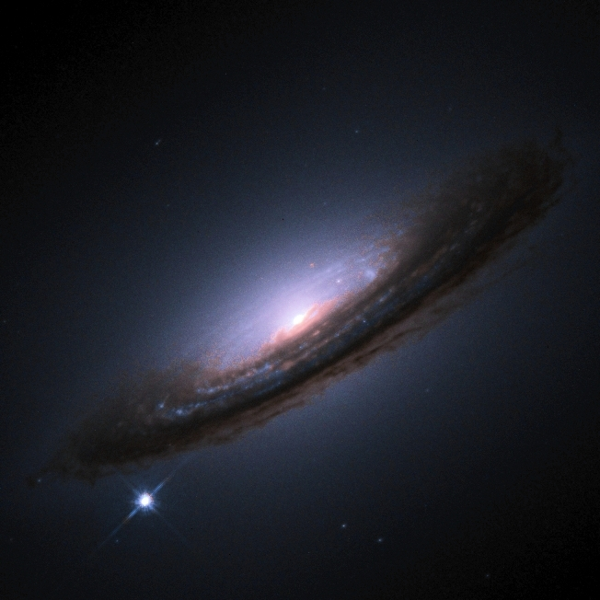
Type Ia SNe
Observational Cosmology
NASSP course
Bruce Bassett

Slide 2
What good are exploding stars for cosmology?
From the previous lecture, we can use “standard candles” to measure luminosity distances in cosmology
Type Ia Supernovae (SNIa, SNeIa) are believed to be nearly perfect standard candles…
They provided the first evidence for dark energy (in 1998) and…
They are very bright, so can be measured to large distances.

Slide 3
SNe Types
There are several different types of SNe, each with a different explosion mechanism
SNe are classified from their spectral features
The classification dates back a long time, and thus is not particularly related to the type of explosion
Only SNIa appear to be homogenous

Slide 4
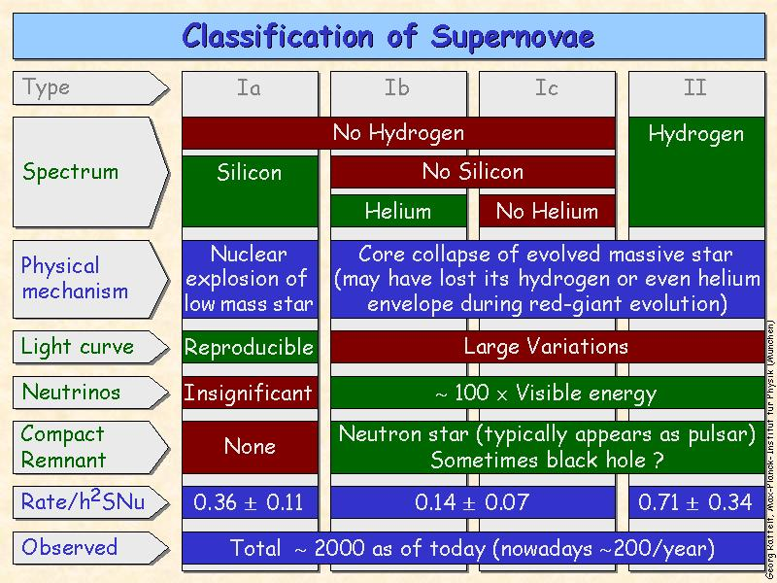

Slide 5
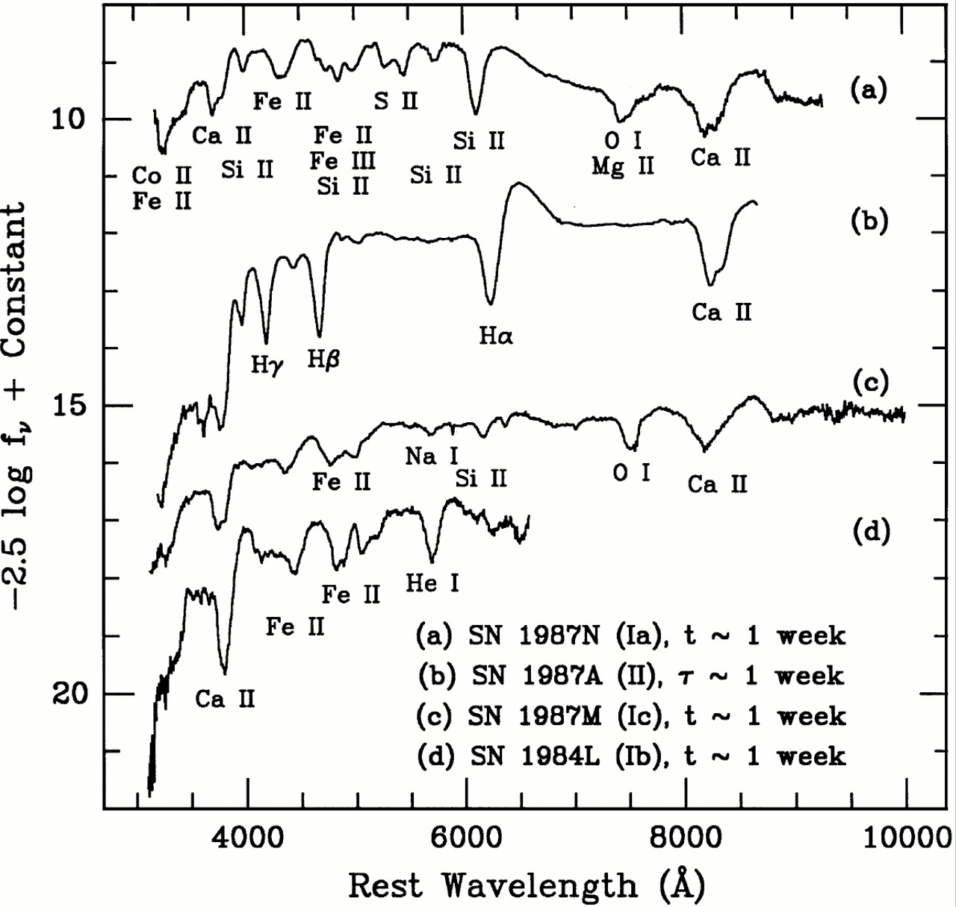
Ia
Early
SN
Spectra
Filippenko 1997
II
Ic
Ib

Slide 6
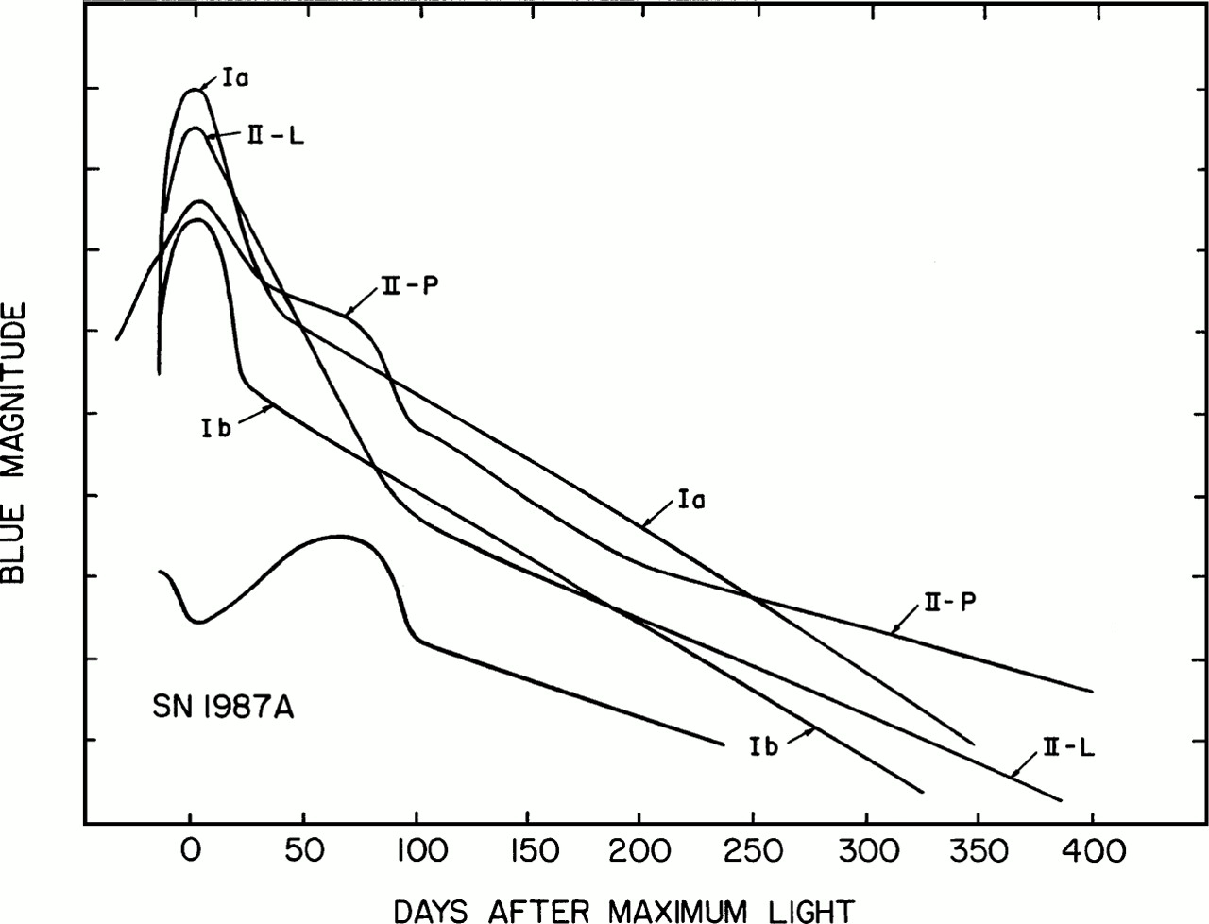

Light-curves of different SNe

Slide 7
Type Ia Supernovae
General properties:
  Homogeneous class* of events, only small (correlated) variations
  Rise time: ~ 15 – 20 days
  Full decay time: many months
  Bright: M_{B} ~ – 19.5 at peak
No hydrogen in the spectra
  Early spectra: Si, Ca, Mg, ...(absorption)
  Late spectra: Fe, Ni,…(emission)
  Very high velocities (~10,000 km/s)
SN Ia found in all types of galaxies, including ellipticals
  Hence progenitor systems must have long lifetimes – WHY?
*luminosity, color,
spectra at max. light

Slide 8
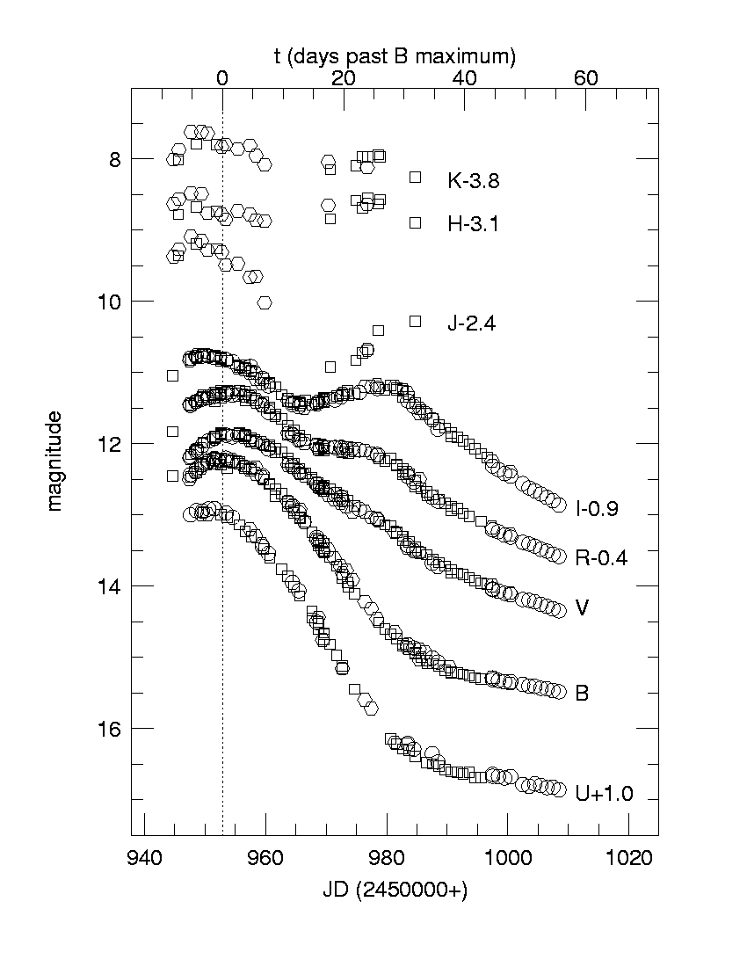
Light curves of a SNIa in different bands
SN1998bu
Light curve
Suntzeff, et al
Jha, et al
Hernandez, et al

Slide 9
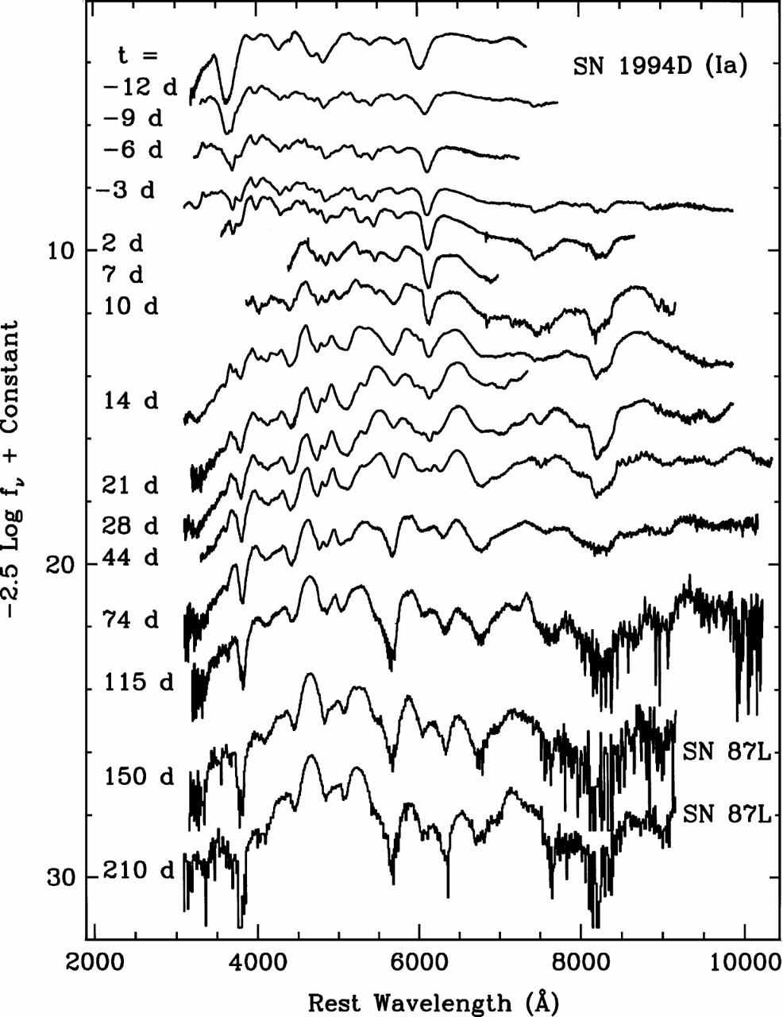
Spectral evolution
The spectrum of a SNIa changes with time reflecting the fact that one is looking at different parts of the explosion…
Days (e.g. –2d, 12d) are quoted relative to date of B-band maximum.

Slide 10
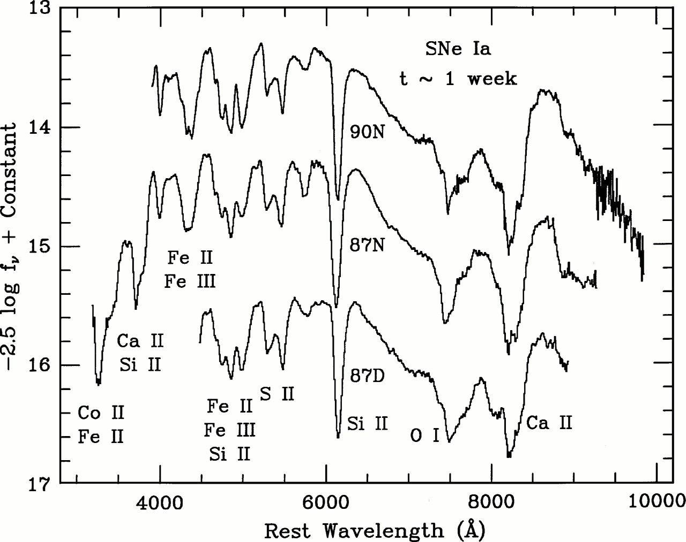
SNIa spectral Homogeneity at fixed epoch

Slide 11
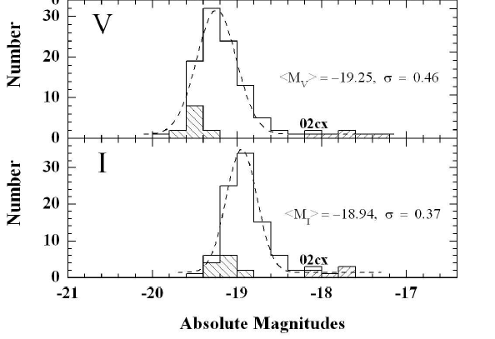
Are SNIa perfect standard candles?
On average there is still some variation in intrinsic luminosity – hence they are not perfect standard candles…

Slide 12
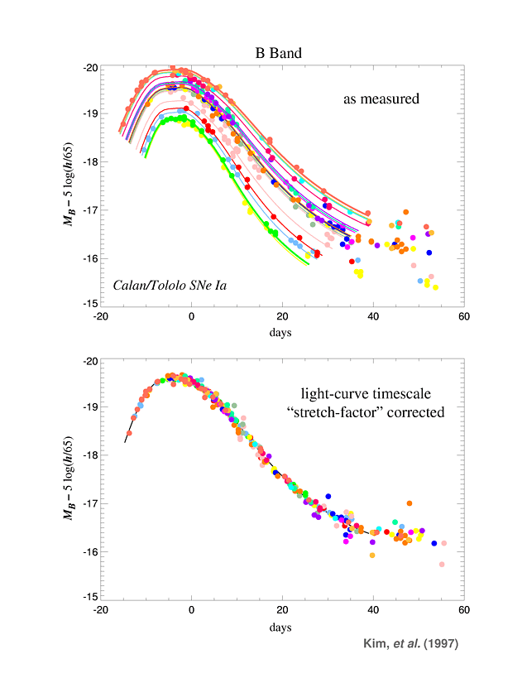
A quick definition: Δm₁₅
The change in m in the 15 days after maximum
Δm₁₅
15 Days

Slide 13
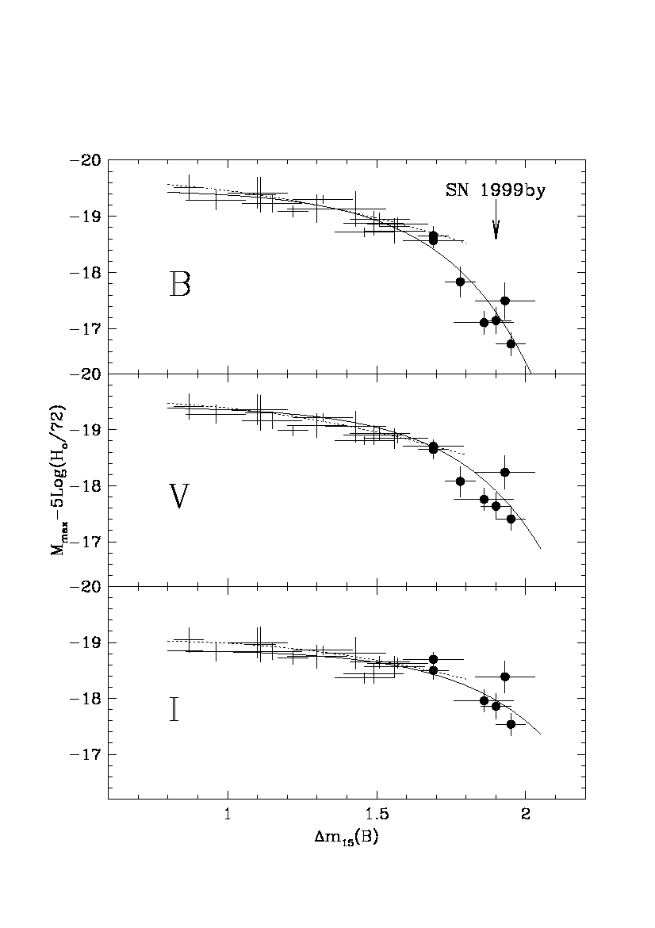
SN Ia Peak Luminosity
Empirically correlated
with Light-Curve
Decline Rate
Brighter ←→
Slower
Use to reduce
Peak
Luminosity
Dispersion
Phillips 1993
Peak Luminosity
Garnavich, etal
Rate of decline

Slide 14
Type Ia SN
Peak Brightness
as calibrated
Standard Candle
Peak brightness
correlates with
decline rate
Luminosity
Time

Slide 15
SNIa as true standard candles
After correction, the dispersion is only about σ~ 0.15 mag!
This corresponds to an uncertainty in the true distance of about ~7% which is very good.
But, there could be problems: the correlation between intrinsic luminosity and decay time is calibrated at low redshift. What if there is evolution with redshift? This would cause problems.
How can we explain the brightness-decay time correlation?

Slide 16
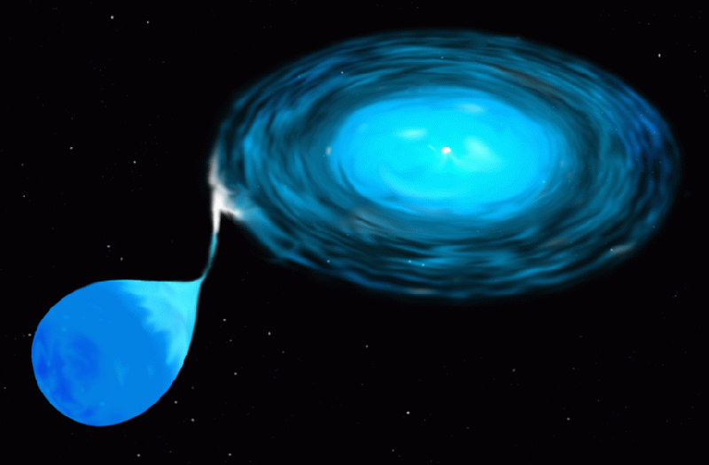
SN Ia Theory:
“Standard model”:
  SNe Ia are thermonuclear
  explosions of C+O white
  dwarf (WD) stars.
Evolution to criticality:
  Accretion from a binary companion leads to growth of the WD to the critical Chandrasekhar mass
  (~ 1.4 solar masses).
After ~1000 years of slow thermonuclear “cooking”, a violent explosion is triggered at or near the center, and the star is completely incinerated within seconds, no compact remnant is left.
In the core of the star, light elements are burned in fusion reactions to form Nickel.
The radioactive decay of Nickel and Cobalt makes it shine for a couple of months

Slide 17
Chandrasekhar Mass Models
The WD accretes H or He from the companion star, burns it
on the surface to C+O
When M = M_{Ch}= 1.4 solar masses (Chandrasekhar mass)
thermonuclear instability: C, O burn explosively to ⁵⁶Ni (n=p)
in the core
→ explosion driven by E_{kin} released from fusion reactions
in a few seconds. Free expansion of ejecta thereafter,
with velocities ~10⁴ km/sec.
Outer regions burn to Si, Ar, Ca,… as seen in early spectra.
Radioactive decays: ⁵⁶Ni → ⁵⁶Co → ⁵⁶Fe + MeV photons (days)
γ’s downscatter, `thermalize’and escape as optical/NIR light: light
curve that we see.

Slide 18
SNIa as standard candles - I
We can explain why SNIa have roughly the same intrinsic luminosity if we assume that all of the Chandrasekhar mass,: M_{Ch} , is fully burned → M_{Ni} ~ 0.6 M_{sun}
→ `fixed’ L_{peak}
Why is there some variation in L_{peak}? Well spread in progenitor Mass (1– 7 M_{sun})
→ spread in C/O ratio
→ spread in M_{Ni} produced & E_{kin}
→ spread in L_{max}
Other diversity factors: varying accretion rates, rotation speeds, magnetic fields, metallicity etc…

Slide 19
SNIa as standard candles - II
How can we explain the crucial brightness-decay time (L_{peak} - Δm₁₅) correlation?
Basic idea: increased mass in nickel affects both peak luminosity and decline rate:
Increase M_{Ni} → increase L_{peak}
Increase M_{Ni} → increase T → increase opacity → increase photon diffusion time → longer decline

Slide 20
There has been recent progress in 3D…
From the FLASH centre – the first
Self-consistent SNIa explosion…via
Compressional heating…

Slide 21
Details…
The bubble, initially measuring approximately 10 miles in diameter, rises more than 1,200 miles to the surface of the star in one second.
In another second, the flame crashes into itself on the opposite end of the star, triggering a detonation.
This process simulates no more than three seconds. The Flash Center team ran its simulation on two supercomputers. Just one of the jobs ran for 75 hours on 768 computer processors, for a total of 58,000 cpu hours.

Slide 22
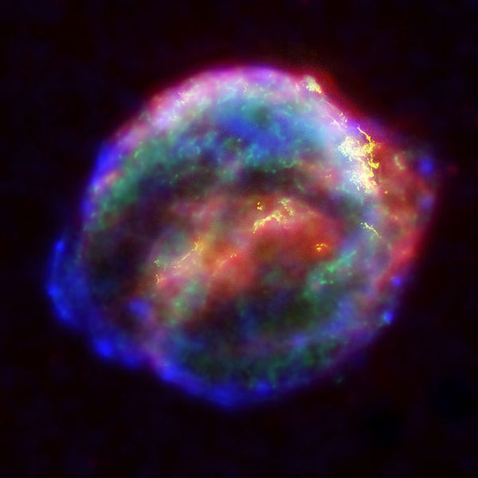
So far so good…but a much better understanding of SNIa are required for the future as we push them to the limit for cosmology…
Kepler’s SNIa remnant
as seen by Chandra

Slide 23
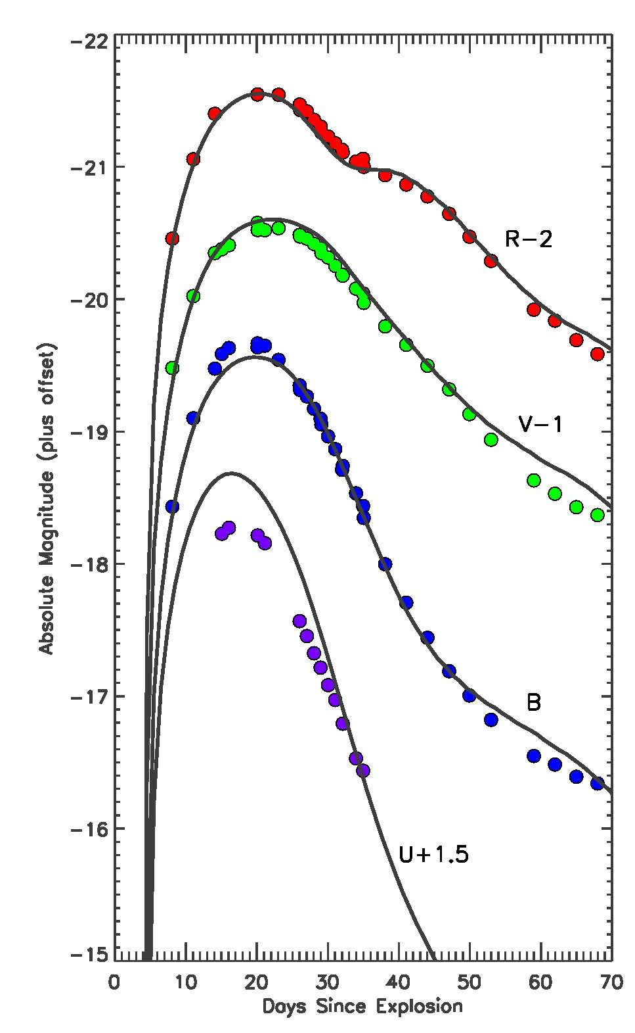
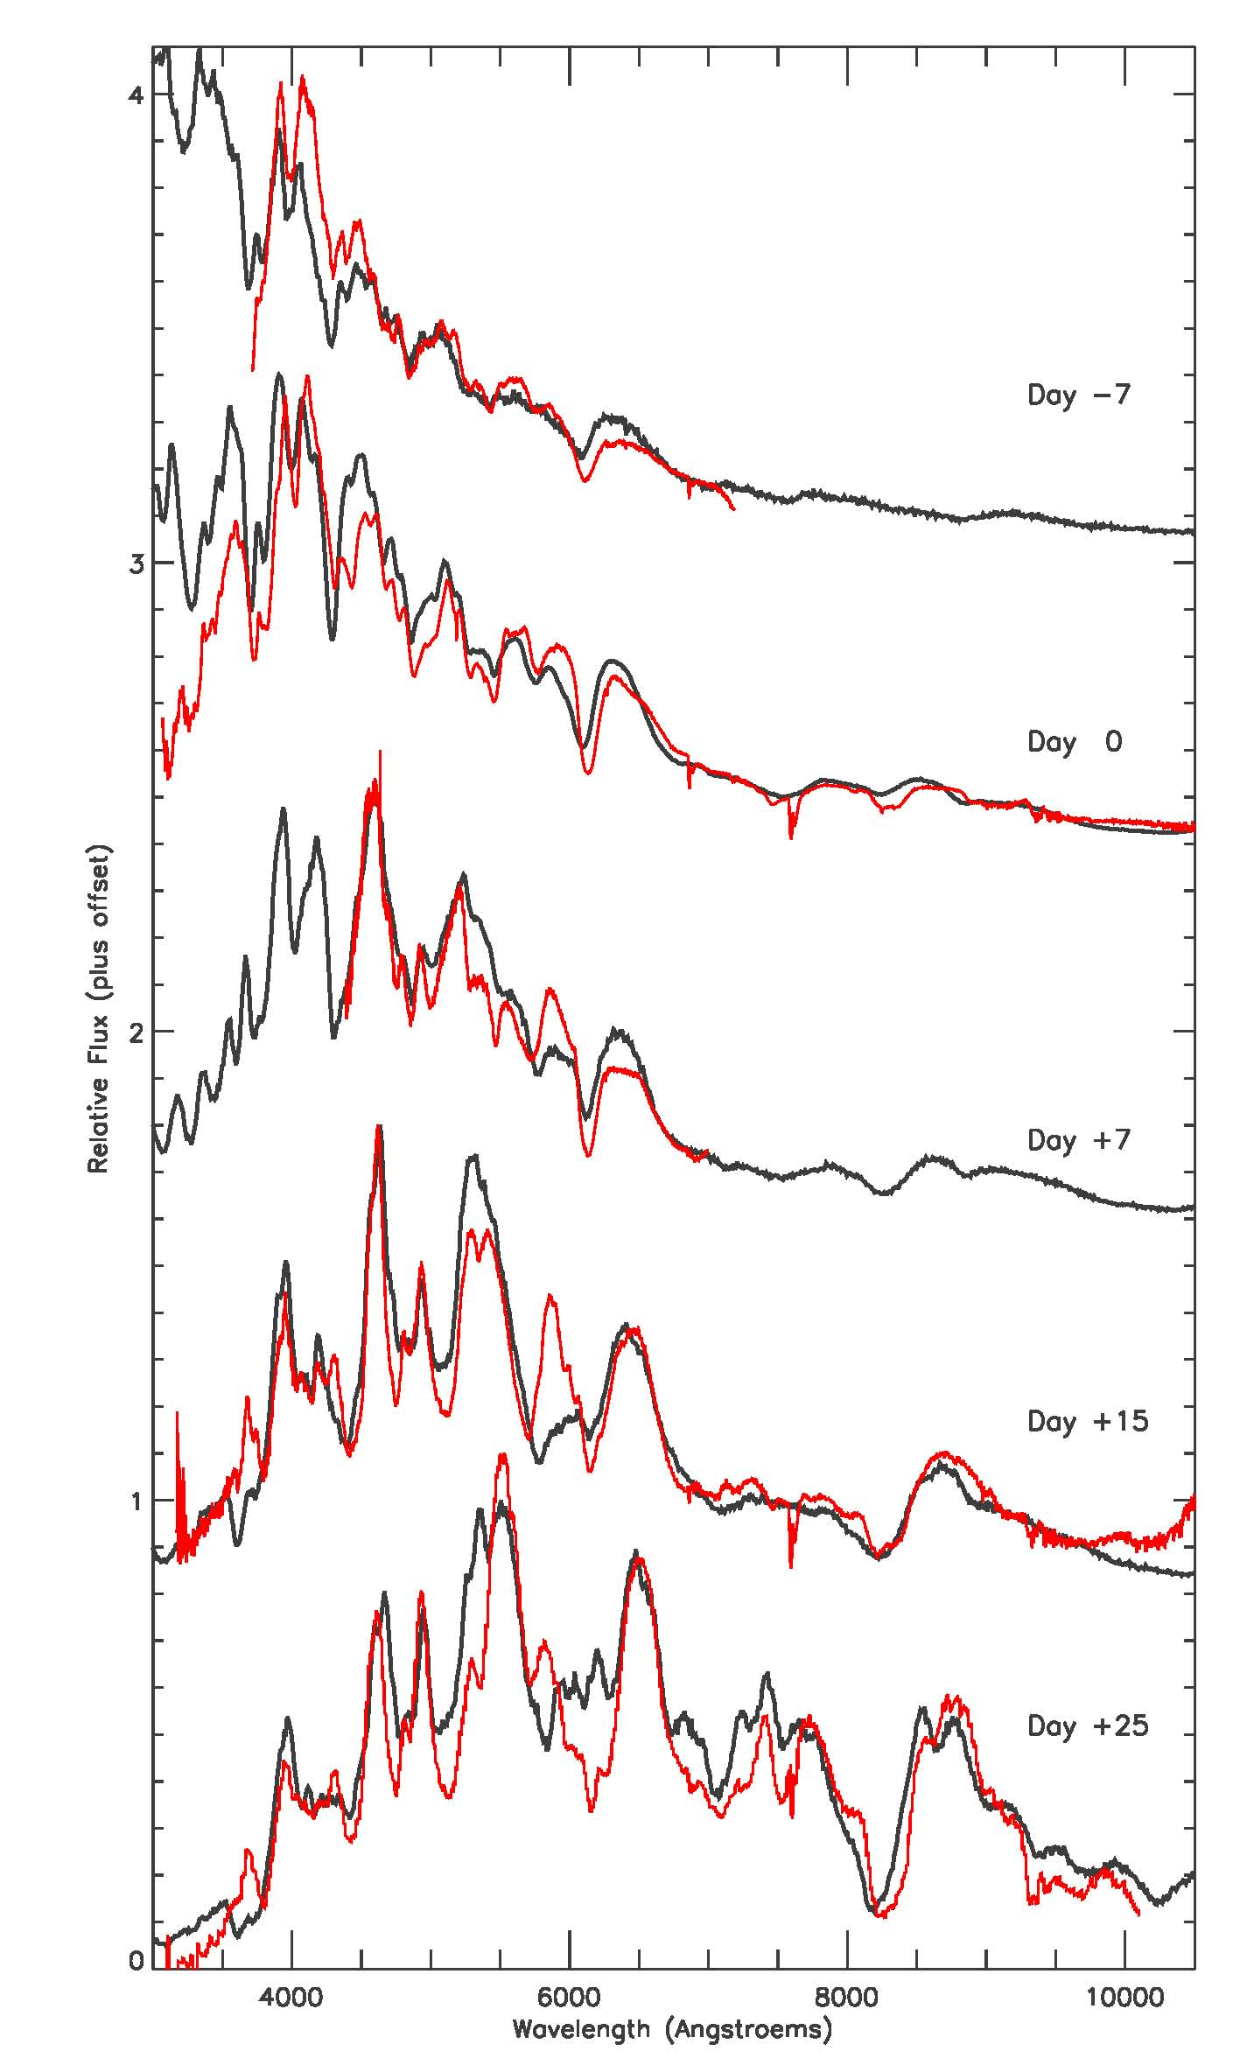
Comparison of Predicted and Observed Light Curves and Spectra
Comparison of U, V, B, R light curves predicted by GCD model and obs. of Type Ia
Supernova SN 2001el
Comparison of spectra predicted by GCD model and obs. of Type Ia supernova SN 1994D
Kasen &
Plewa (2006)
Moving into an era where comparisons of high-fidelity, 3D, whole-star stimulations and high-quality observations will allow us to discriminate among proposed explosion mechanisms

Slide 24
Some problems
Whilst some simulated models of SNIa explosions are now available, reproducing the observed light-curves and spectra is only just beginning
Computationally it is impossible to run enough simulations to consider all possible scenarios
3-D modelling is very much in it’s infancy – off-centre explosions are only just being considered
A few SNe progenitor systems have been found, but they are very difficult to find and study
So we shall have to cope with an empirical relationship for a while longer.

Slide 25
QUESTIONS you should now be able to answer…
Why are SNIa useful for cosmology?
What are the distinctive spectral features of SNIa?
What is the current model for SNIa explosions?
Why are SNIa approximately standard candles?
What correlation do we use to make them more standard?
What are some of the challenges for the future of SNIa science?

