Slide 1
MCMC and the Fisher Matrix
NASSP Observational Cosmology Course
Bruce Bassett

Slide 2
Overview
The Monte Carlo Markov Chain (MCMC) method for parameter estimation
Designed to answer the question:
“How do I estimate 1000 parameters from my dataset?”
The Fisher Matrix
Designed to answer the question:
“How do I estimate the power of a survey or experiment that hasn’t taken any data yet?”

Slide 3
Monte Carlo Markov Chain (MCMC)
If we are searching through a high-dimensional parameter space we cant use the grid approach (why?)
Need a clever way to find the best-fits and to estimate error-bars
MCMC is such a method and is based on jumping around randomly

Slide 4
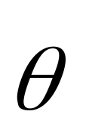
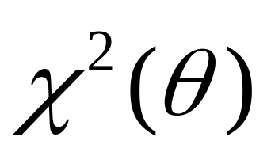
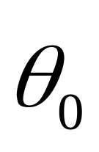
Basic idea
Write the parameters we want to estimate as a vector
We want to find the parameters which minimise
Step 1: choose an initial vector randomly
Subscript is step number not
Which parameter!

Slide 5
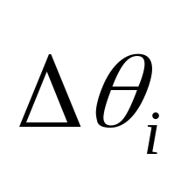
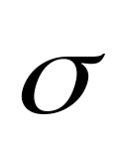
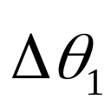
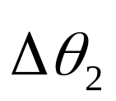
The MCMC Algorithm
Then loop doing the following N times:
Choose a jump from a Gaussian distribution with mean zero and standard deviation vector (controls how big the characteristic jumps are in each parameter)

Slide 6
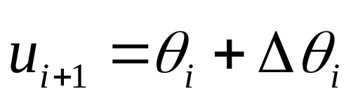
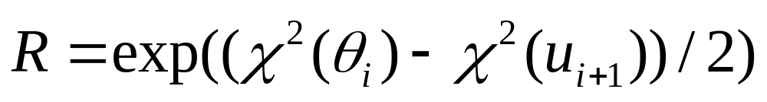
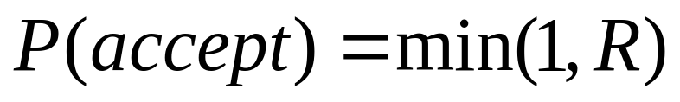
The Metropolis-Hastings Algorithm in MCMC
We construct
And compute
If we have got to a better place, R > 1.
The metropolis-Hastings algorithm then accepts this jump with probability:

Slide 7
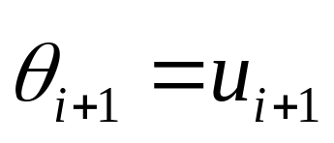
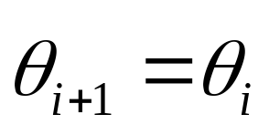
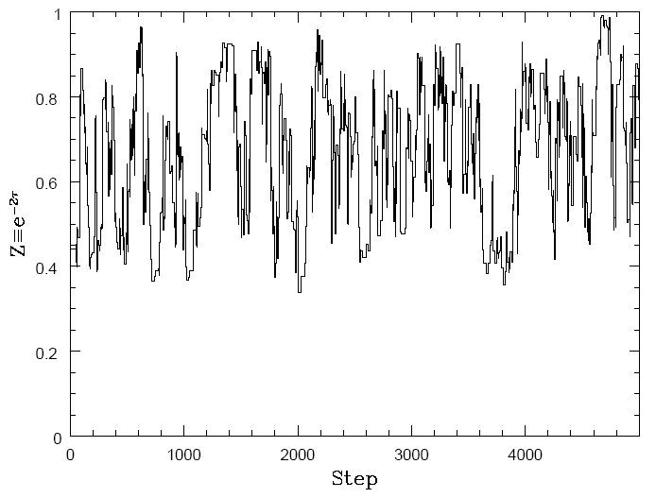
The Metropolis-Hastings Algorithm
If we accept the step, set (move to the new point)
Otherwise set (don’t move!)
Iterate this process (the result is called a chain)
E.g.: a
chain for
reionisation,
τ

Slide 8
Sometimes going the wrong way is good…
While MCMC always accepts a good step it sometimes accepts a bad step (since the probability for acceptance when R < 1 is not zero). This stops it from being trapped in local minima.

Slide 9
Why is MCMC useful?
It is a theorem that eventually MCMC will find the global minimum (usually pretty quick)
The computational power needed to do a good job does not grow exponentially with the number of parameters (unlike other methods) – computationally efficient
We are typically interested in computing not only the best-fit parameters, but also the error bars on those parameters. This means integrating the likelihood over all parameters other than the one we are interested in (a process called marginalisation). With MCMC this is trivial – all we do is histogram the component of the chain corresponding to that parameter.

Slide 10
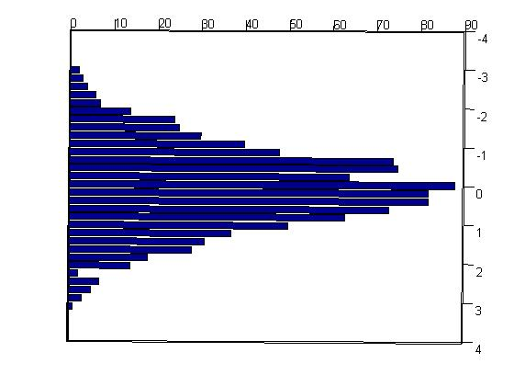
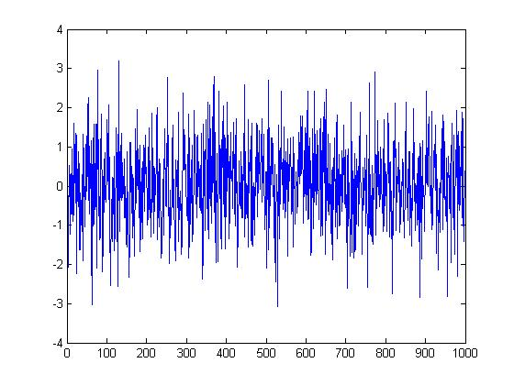
Histograming to find the best-fit and errors
Chain vs step number
mean
(upper/lower) error bars (1, 2 sigma bars containing 68%, 95% of chain)

Slide 11
Burn-in
The first part of the chain is usually not relevant and is removed (burn-in)
There is no precise burn-in criterion. One way is to remove the initial part of the chain before the first time the chain reached 50% of the best likelihood achieved in the full chain

Slide 12
Convergence
MCMC only assures you of the right answers as N → infinity
How big is infinity in practise?
One way to check is to either run a single long chain, divide it into sub-chains and check that they give the same answers…
Or, run multiple chains starting at random points in the parameter space and check that they give the same answers…

Slide 13
Exercise: Code your own MCMC
Write pseudo-code for your own MCMC algorithm

Slide 14
Fisher Matrix

Slide 15
The Fisher Matrix
How do we estimate how well a survey will do before it gets any data? E.g. how well will a future SNIa survey constrain w?
One way is to do a simulation, produce fake data and then run it through MCMC like you would the real data. This is the best, but is time-consuming.
The Fisher matrix provides a quick and easy answer which is often good enough.

Slide 16
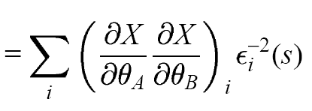
The Fisher Matrix
Assumes the Likelihood (L~ exp(-χ²/2)) is close to a Gaussian function of the parameters…
The Fisher matrix is then:
Where the quantity being measured is X (e.g. d_{L} for a SNIa survey) and ε_{i} is the i-th projected error on X and the sum is over all the measurements which will be made (e.g sum over N SNIa).
F_{AB}

Slide 17
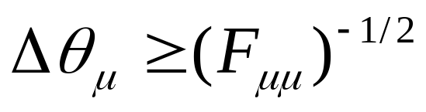
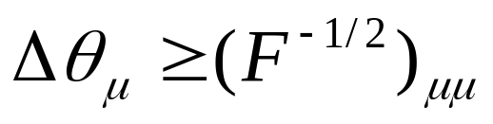
But what does it do?
Well, if we know all the other parameters then the error on the μ−th parameter is:
If we must estimate all parameters simultaneously then the error on the μ-th parameter is:
(i.e. compute the inverse square-root and take the μμ element)
Convince yourself using a 2x2 matrix that the second is always greater than the first…why does this make sense from what you know of likelihoods?

Slide 18
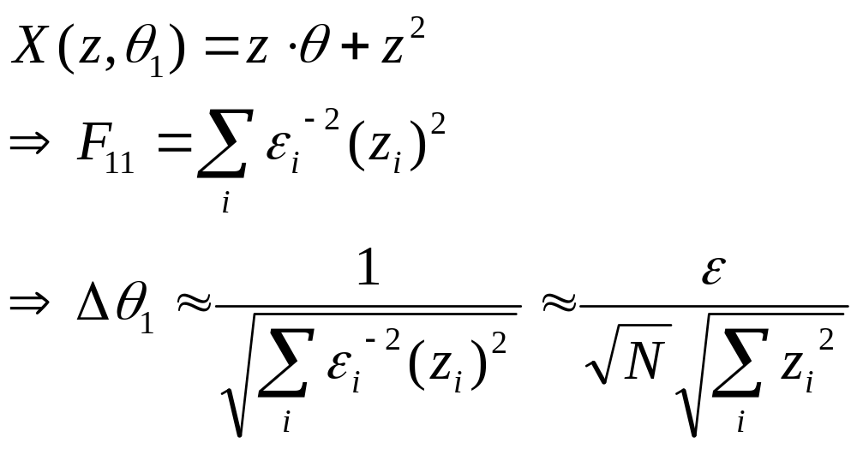
A linear example
A linear parameter dependence (here z is the independent variable, e.g. redshift)
If all the N measurements have the same error, ε

Slide 19
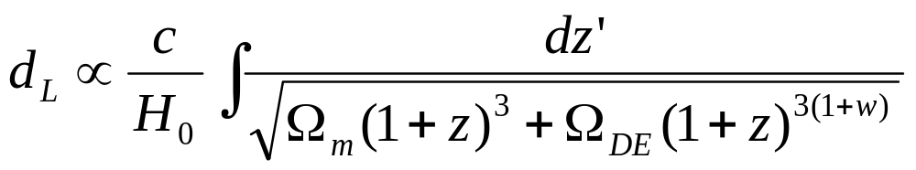
In general…
In general the measurement are nonlinear functions of the parameters…e.g.
If X = d_{L} and the parameters are w, H₀ and Ω_{m.} Then:
Compute the Fisher matrix in this case…

Slide 20
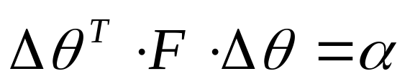
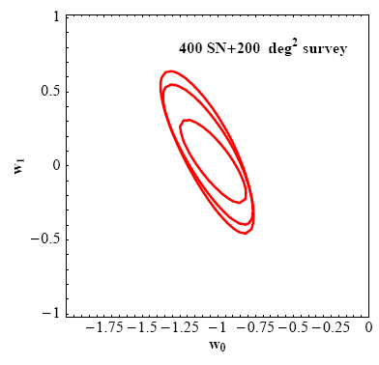
Why bother?
Allows predicted performance estimates, e.g…
It also allows easy detection of degeneracies:
Here F is the Fisher matrix - this
is the equation for an ellipse in matrix form
(the error-ellipse)
Here α = 2.31, 6.2 for 2 parameters at
1 and 2 sigma contours respectively.

Slide 21
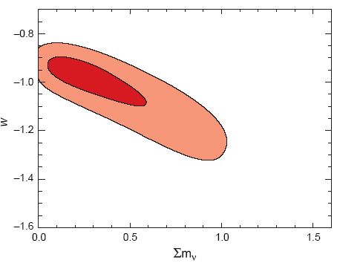
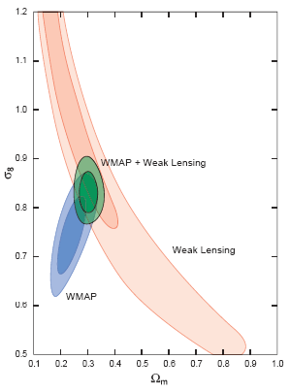
Limitations of the Fisher matrix
It is only accurate if the Likelihood is nearly Gaussian. Put another way…
Error-contours can be very non-Gaussian in general and not shaped like ellipses!
WMAP +
Other data

Slide 22
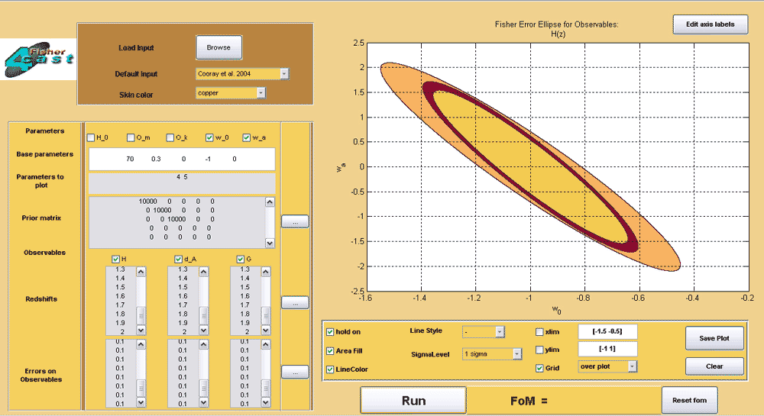
Fisher4Cast
Available at http://www.cosmology.org.za
General GUI-based Fisher matrix analysis
Produced by UCT students
Publicly released code under GNU license

Slide 23
Summary
MCMC provides a toolbox to estimate best-fit parameters and their errors from any data-set even with large numbers of parameters (> 1000)
The Fisher matrix provides an easy way to forecast the power of an experiment or survey to constrain a parameter of interest.
Both of these are very powerful tools one can use anywhere (not just cosmology)

