Slide 1
Statistics and parameter estimation in cosmology
Observational Cosmology
NASSP course
Bruce Bassett

Slide 2
Resources
Wikipeadia.com + lots on the web
D. J. C. MacKay, Information theory, inference, and learning algorithms Cambridge (2003). A good how-to book for MCMC, neural networks, data compression.
Available on the web at: http://www.inference.phy.cam.ac.uk/mackay/itila/book.html

Slide 3
What’s the point?
A crude characterisation of science is that it is the full circle:
This requires
Statistics.
1
Create a (new) theory that fits
the existing data. Make
new predictions.
3
2
Take new data
Test the
Theory predictions
Against the new data

Slide 4
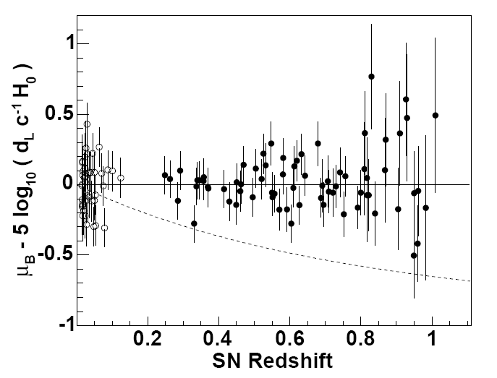
The problem…
The solid line
Is clearly a better fit
To the data…but how do we quantify this belief?

Slide 5
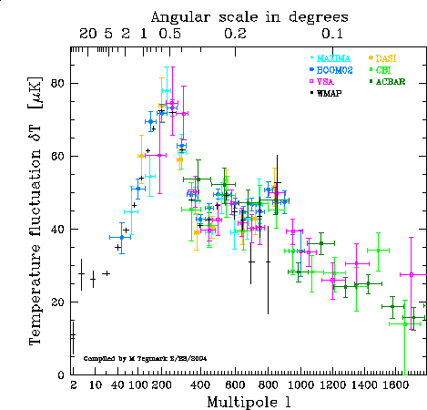
…and how do we combine multiple datasets?

Slide 6
What are error bars?
y
Error on y measurement
Data point (x,y)
Error on x measurement
x

Slide 7
error bar sizes
Here model 2 is
ruled out by the
data at high
confidence.
Here model 2 is
not ruled out by
the data.
Model 1
Model 2

Slide 8
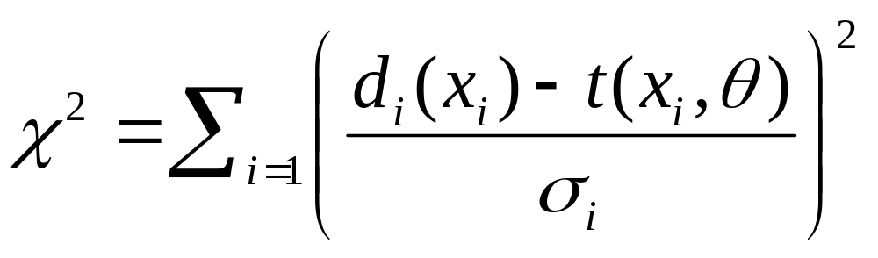
The χ² statistic
A useful measure of how well data is fit by a theoretical curve (which may depend on some parameters, θ_{ι}) is the quantity:
This is the sum of the number of standard deviations (σ_{i}) the data is away from the theoretical curve.
d_{i} is the data
t_{i} is the theoretical
prediction at that point.
The sum is over data
points.

Slide 9
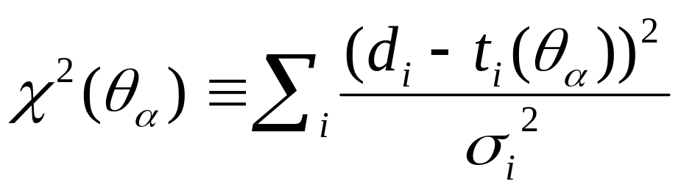
What is the χ²?
This point has χ² ~ 9
d_{i}
σ_{i}
t_{i}

Slide 10
χ² is just the sum over the data points, of the number of standard deviations the data is from the model:
(χ² ~30)
(χ² ~10)

Slide 11
χ² continued...
Exercise 1: assuming a linear model:
t(x,θ_{i}) = θ₁x + θ₂
Analytically compute the best-fit values of the parameters given a set of N data-points with given errors, σ_{i}, using the χ² statistic.

Slide 12
Parameter estimation - I
A very common problem in science is that we want to find the parameter values that best fit given observational data.
For example: what is the period of a binary star, the mass of the electron, the value of the Hubble constant or the size of the cosmological constant?

Slide 13
Parameter estimation - II
How can we estimate the best-fitting parameters?
Since any measurement has finite accuracy, this is always a statistical problem. We want the most-likely values of the parameters.
We can estimate this by minimising χ² while we vary the parameters of the theory. We already did it in the case of a linear model.

Slide 14
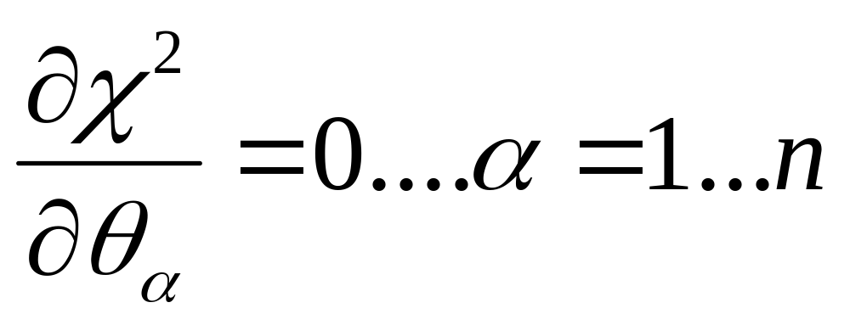
To estimate parameters…

Slide 15
Parameter estimation - III
If the model depends nonlinearly on the parameters we usually cannot solve it analytically and must use numerical methods.
This is a well-studied branch of computational mathematics.
We want to find the global minimum of χ² (there are often lots of local minima which we are not interested in)

Slide 16
Parameter estimation - IV
One of the easiest ways to minimise χ² when there are few parameters (less than 4 or 5) is the grid method.
Consider the case of a single parameter, θ, for simplicity. We split up the allowed range of θ into n equal regions, with grid points labeled θ_{i}.
We then compute χ² at each point in the region and then choose the smallest χ²_{i} . The corresponding θ_{i} is approximately the best-fit parameter value. Obviously the method can be refined by increasing n.
Grid method fails for large number of parameters (why?). Stochastic/Monte Carlo methods are much better in this case (e.g. MCMC, simulated annealing).

