Slide 1
Probabilities and Parameter Estimation
Observational Cosmology
Bruce Bassett (bruce@saao.ac.za)
AIMS, SAAO and UCT
2015

Slide 2
Why focus on statistics and why do it now?
Obs Cos
There is a shortage of modern, applied, statistical skills in many arenas in South African academia and industry
These skills are essential for e-Science and for progress in the modern ‘Moore’s-Law world’ where large data sets are becoming the norm.
This is particularly true in cosmology (e.g. LOFAR will deliver 1 Terabyte/second, KAT will probably deliver 100 MB/s).

Slide 3
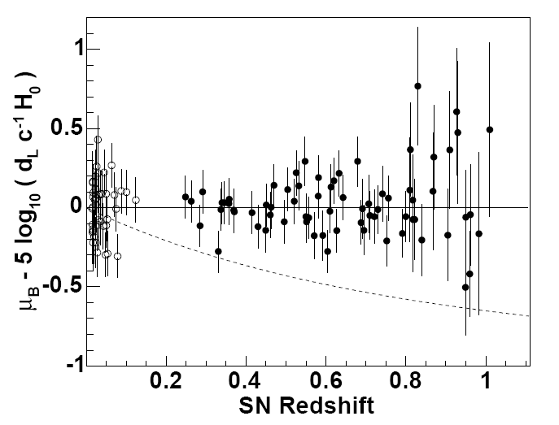
A standard problem – parameter estimation
Obs Cos
How do we find the
Best-fitting curve to the data?

Slide 4
Obs Cos
We have introduced the χ² statistic in the last lecture as a way of estimating parameters.
However, we will need to be more sophisticated in our treatment in general to do a good job of parameter estimation in cosmology…

Slide 5
Some basic theory…
Obs Cos

Slide 6
Random variables
Obs Cos
We start by assuming that X is a random variable taking values denoted x, either continuously or discretely distributed.
The probability distribution function (pdf), f_{X}(x) is the key function containing the information about how likely any given value, x, is.

Slide 7
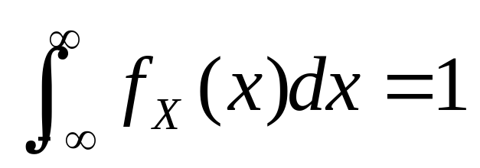
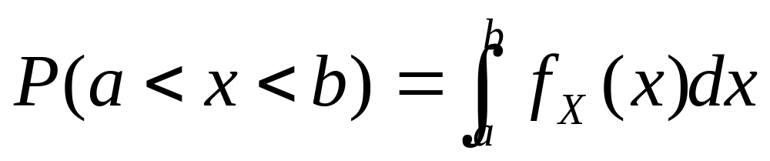
Basic Probability Theory
Obs Cos
The pdf controls the probability of observing a given value x for X
(1)
And the probability that a < x < b is
(2)
Some value must be
found with 100% probability

Slide 8
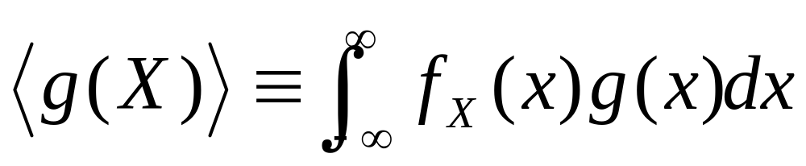
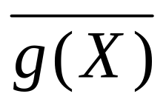
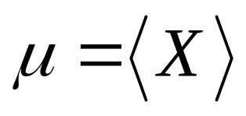
Expectations
Obs Cos
For any function g(X), the expectation value of g(X) is defined to be:
This is also sometimes denoted E(g(X))
or . The mean of X is often denoted μ:

Slide 9
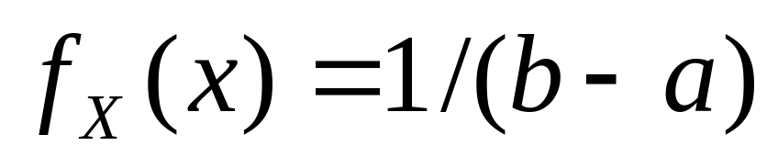
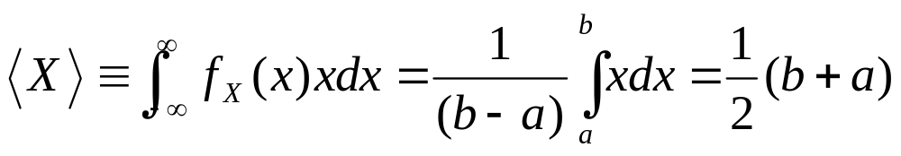
Example: the uniform distribution.
Obs Cos
For the uniform distribution between the limits a and b, the pdf is just (why?):
Hence the expected value (mean) is:

Slide 10
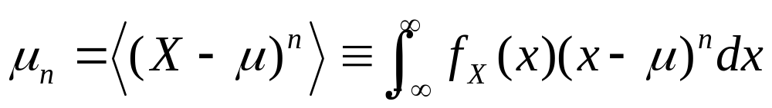
Moments
Obs Cos
It is of interest to look at fluctuations around the mean, μ
n=2 corresponds to the usual variance, σ^{2.}
Exercise: compute the variance for the uniform distribution.

Slide 11
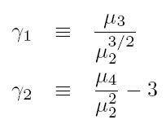
Skewness and Kurtosis
Obs Cos
The skewness (γ₁) and Kurtosis (γ₂) are defined to be:
They vanish for a Gaussian pdf (all odd moments vanish for a Gaussian and all even moments can be written in terms of σ²).

Slide 12
Some standard probability distributions…
Obs Cos

Slide 13
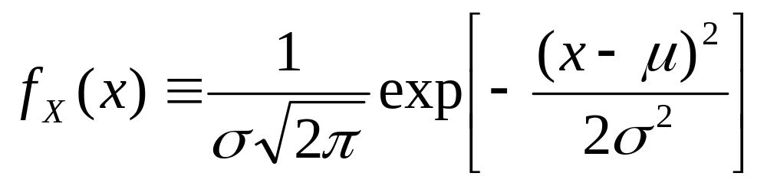
The Gaussian (Normal) distribution
Obs Cos
It has the pdf:
Exercise 2: show that the Gaussian has mean and variance given by μ, σ²
It is often denoted N(μ, σ²)

Slide 14
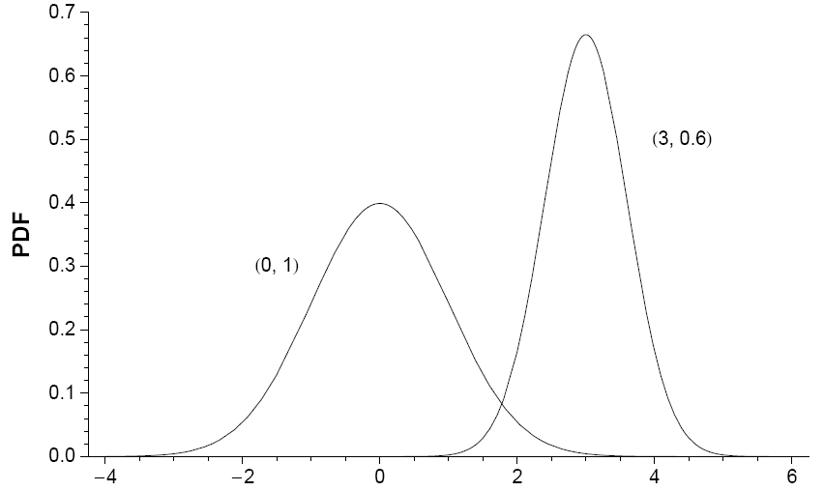
Obs Cos

Slide 15

The Gaussian Central Limit Theorem
Obs Cos
The sum
U₁ + U₂ + … U_{n}
of a large number of independent, identically distributed (iid) variables, U_{i}, is Gaussian distributed in the limit n→ .
(True within reason – must have finite mean and variance)

Slide 16
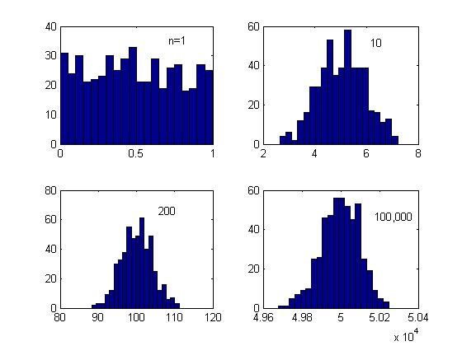
Example: distribution of sums of n uniformly distributed numbers (500)…
Obs Cos

Slide 17
Some notation….
Conditional probability
Obs Cos
P(A|B) should be read: the probability of A assuming (given) that B is true.
This is in contrast to: P(A,B) which is the probability that both A and B are true.
Joint probability

Slide 18
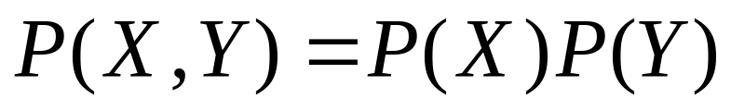
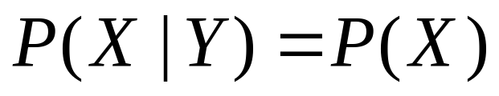
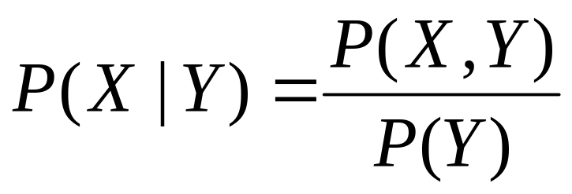
Relating the two..the product rule
Obs Cos
If X and Y are independent then (by definition):
But also
(X doesn’t depend on Y being true at all)
Hence we have:
(NB: this is generaly true)

Slide 19
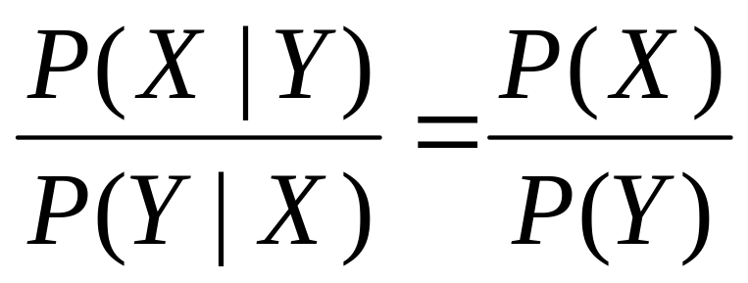
Bayes theorem
Obs Cos
Since P(X,Y) = P(Y,X) Bayes’ theorem follows immediately, which states:
Now on to Bayesian statistics…

Slide 20
Bayesian statistics
Obs Cos
We will use Bayes’ theorem to evaluate the likelihood of a theory/model/parameter given some data (D)
Hence we will talk of
P(D|T) or P(D|θ) or P(T|D)
Data
Theory
Parameters

Slide 21
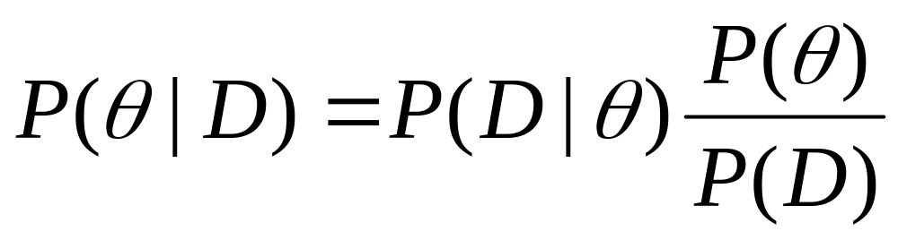
Bayesian statistics II
Obs Cos
If we take X = θ and Y = D then Bayes’ theorem becomes:
This allows us to evaluate the probability of the parameters (θ) given the observed data (D), which is what we want to do in science often.

Slide 22
Notation: Priors, likelihoods and posteriors
Obs Cos
Prior
Probability
distribution
(before)
Likelihood
(Likelihood
Of observing
The data assuming
The theory)
Posterior
Probability
(after)
Bayesian evidence
(Arbitrary
Normalisation most
Of the time)

Slide 23
Priors – P(T)
Obs Cos
Bayesian statistics differs from “old-style” frequentist statistics in its use of prior knowledge:
If you toss a coin 10 times and get 10 heads, what is the probability of getting heads on the 11th toss?
Frequentist answer: 50%
Bayesian answer: >95% because the coin is obviously biased!

Slide 24
Maximum Likelihood (posterior) Parameter estimatation
Obs Cos
Idea is simple: the parameters that are most likely to be correct are the ones that maximise the posterior probability distribution.
I.e., one finds the parameter values that maximises

Slide 25
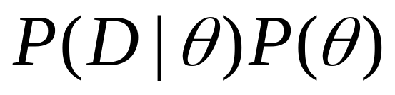
Max L parameter estimation II
Obs Cos
In practice, since P(D) doesn’t depend on the theory, we simply need to maximise:
But how do we compute this in reality?
The prior, P(θ) is chosen by you, so that is easy.
The part that needs some discussion is the likelihood, P(D|θ).

Slide 26
Computing the likelihood
Obs Cos
Let us assume that our data consists of N independent data-points, d_{i}
Their independence implies that:
P(d₁,..d_{N}|θ)=P(d₁|θ) x P(d₂|θ) x … P(d_{N}|θ)
So the problem reduces to finding the likelihood for single points.

Slide 27
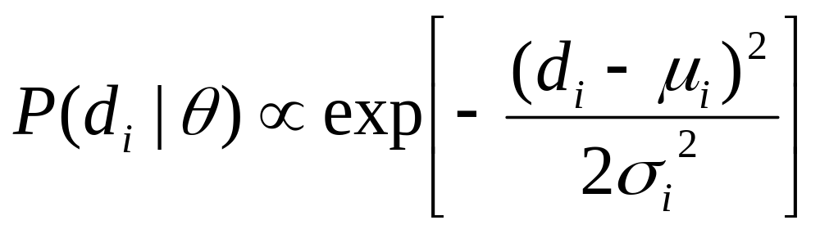
Gaussianity to the rescue…
Obs Cos
Let us assume (often a good approximation) that for each point
d_{i} = μ_{i} + n_{i} : the data (d) is the true value (μ) plus noise (n) which has a Gaussian pdf with mean 0 and variance σ_{ι}²
Then

Slide 28
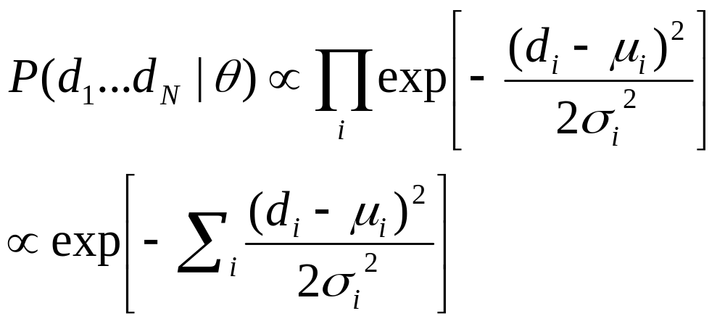
Obs Cos
Hence
P(d₁,..d_{N}|θ)=P(d₁|θ) x P(d₂|θ) x … P(d_{N}|θ)
is simply:

Slide 29
Great, but what now?
Obs Cos
What are the true values μ_{i}?
Well, we are doing parameter estimation so we assume that our theory is the correct description of reality, so the μ_{i} are just the predictions of the theory for the given parameter values.
Let’s denote the theoretical predictions by t_{i} (θ_{α} ) where θ_{α} denote the parameters we are trying to estimate.
Then…

Slide 30
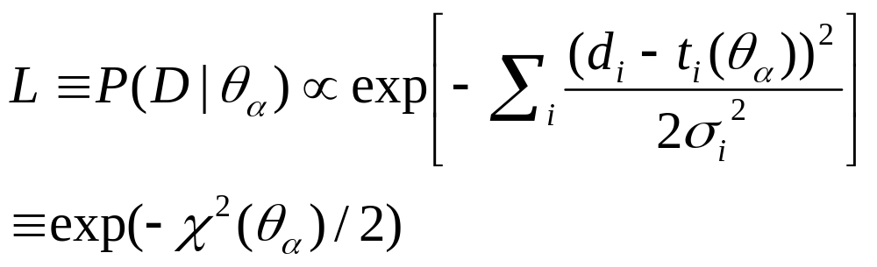
Chi-squared…
Obs Cos
The likelihood then becomes:
Where χ² is the standard chi-squared statistic.

Slide 31
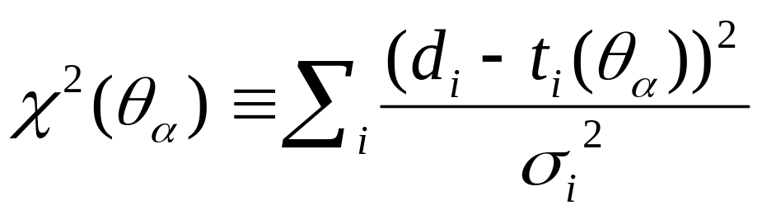
What is the χ²?
Obs Cos
This point has χ² ~ 9
d_{i}
σ_{i}
t_{i}

Slide 32
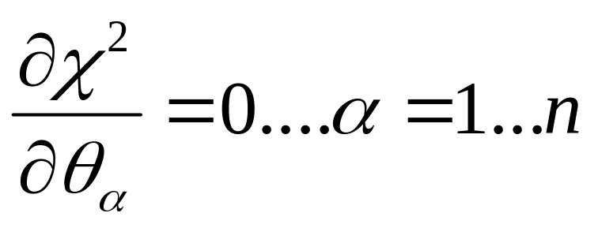
Minimisation
Obs Cos
Maximising the likelihood is equivalent to minimising the χ² statistic (in the case of a trivial prior)
As before, the best parameters therefore solve:
Note that the constants of proportionality (e.g. P(D)) in the posterior don’t matter…

Slide 33
Errors on parameters
Obs Cos
In general we don’t just want the best-fitting parameters (those that maximise the likelihood) we also want to give error bars on the parameters.
For example we want to be able to say: at 95% confidence level a given parameter θ lies between –1.2 and 0.4 with a best fit of –0.7.
How do we do this?

Slide 34
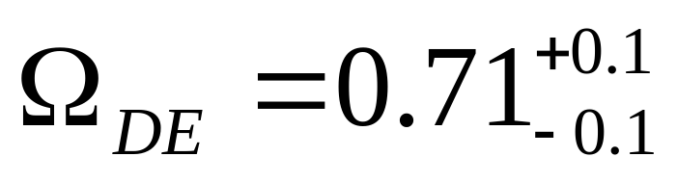
1-sigma, 2-sigma…
Obs Cos
If the random variable, X, is Gaussian distributed with standard deviation, σ, then we can easily calculate probabilities
|x – μ| < σ with about 68% probability
|x – μ| < 2σ with about 95% probability
|x – μ| < 3σ with about 99.7% probability
Typically results are quoted in the format:
1-sigma error
bars

Slide 35
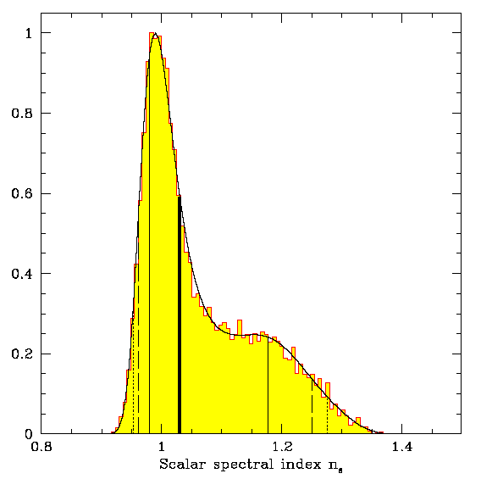
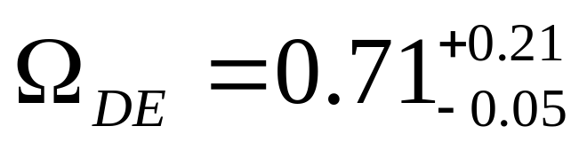
Asymmetric probabilities
Obs Cos
What happens if the distribution is very non-Gaussian?
Then we simply compute confidence limits numerically as percentiles.
In these cases we can end up with asymmetric error bars…e.g.
Tegmark et al 04

Slide 36
Error bar sizes
Obs Cos
Here model 2 is
ruled out by the
data at high
confidence.
Here model 2 is
not ruled out by
the data.
Model 1
Model 2

Slide 37
Some basic points about errors…
Obs Cos
Why do error bars matter at all?
Consider the recent WMAP result that the best-fit curvature is:
Ω_{tot} = 1.02
Is this a “real detection” of spatial curvature?
This depends on the error bar. The full result is approximately: Ω_{tot} = 1.02^{+0.02} _{-0.02}
Hence, only 1σ away from 1 – assuming Gaussianity, this means that with ~16% probability the universe is open and ~84% closed.
This may seem significant but it is actually very weak. Usually we require 3σ (>99%)

Slide 38
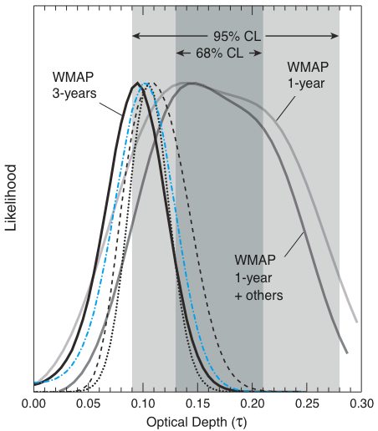
Why even 2-sigma is not enough…
Obs Cos
The improved polarisation measurements in the 3rd year WMAP results have significantly changed the best-fit optical depth (by 2-sigma)
Moral: 2-sigma is usually not statistically significant (systematics!)
Spergel et al 06

Slide 39
Multiple parameters
Obs Cos
If we consider two parameters we don’t have error bars, but error ellipses which give the region within which the parameters lie with a given probability (e.g. 95%, 99% etc…)
Often however the effect of changing one parameter can be exactly offset by changing another one…
This implies a degeneracy – one can only measure accurately a combination of the parameters. E.g. given the equation xy = 1, one cannot measure x or y separately.
As a result, the error on a parameter is always larger (or at best =) if other parameters are simutaneously being estimated from the same data.

Slide 40
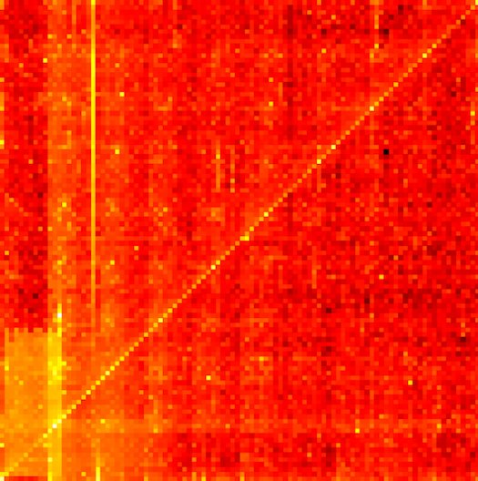

Obs Cos

Slide 41
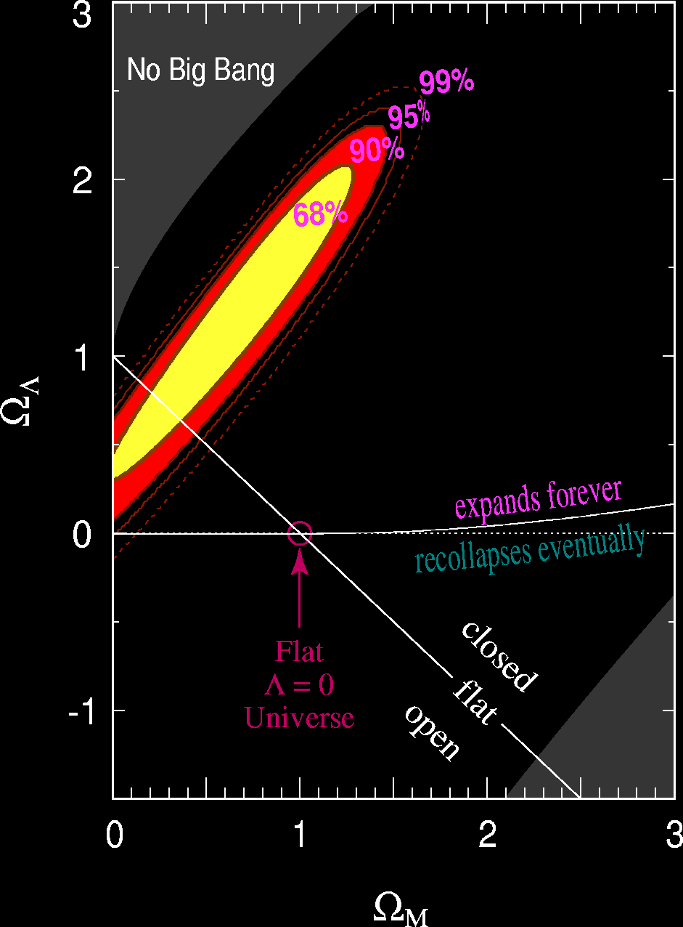
Example of error ellipses – SNIa data
Obs Cos
Amount of
Dark energy
Direction of
SNIa degeneracy
(Amount of ordinary matter)

Slide 42
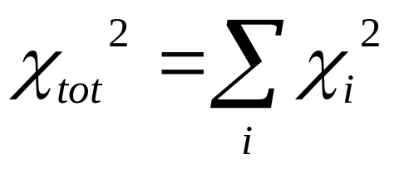
How do we combine data from multiple experiments?
Obs Cos
If datasets are statistically independent simply compute the χ_{i}² for each experiment and then simply sum them to compute a total chi-squared:
Then minimise this total chi-squared to estimate the best-fit parameters…
If the data are correlated, then combining them is non-trivial - one needs to know how they are correlated.

Slide 43
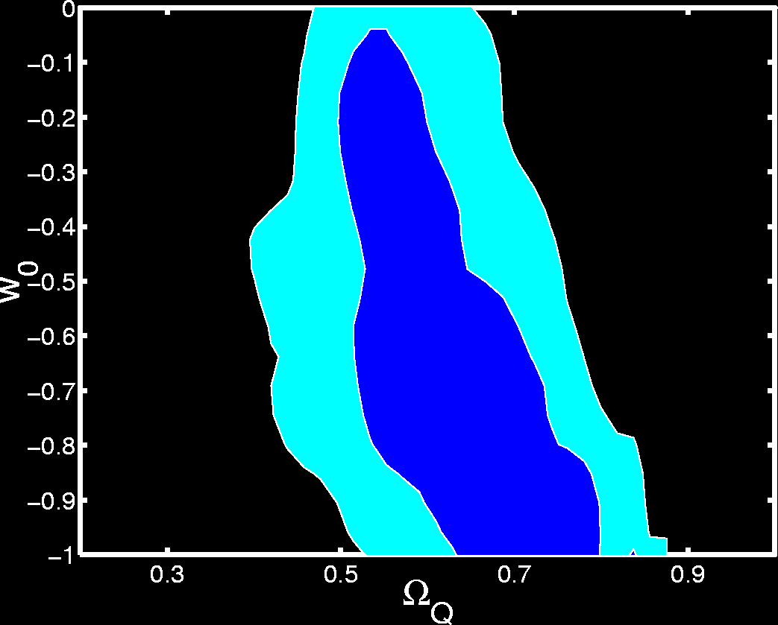
Degeneracies in the CMB
Obs Cos
Corasaniti et al. 2005
We can decrease w₀ = p/ρ
By lowering Ω_{DE} and H₀
without changing the CMB.
➲ degeneracy in the CMB
➲ WMAP alone constrains
dark energy models
badly
WMAP
(Fraction of total energy density in DE)

Slide 44
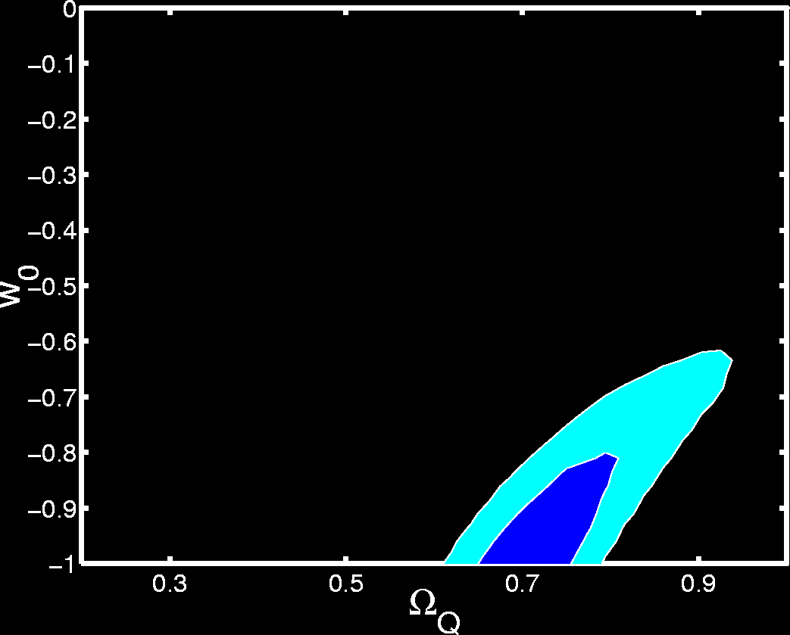
degeneracies in the SNIa
Obs Cos
Kunz
A different degeneracy
exists if we use the
supernova
Data.
But it runs in another
direction
SN-Ia

Slide 45
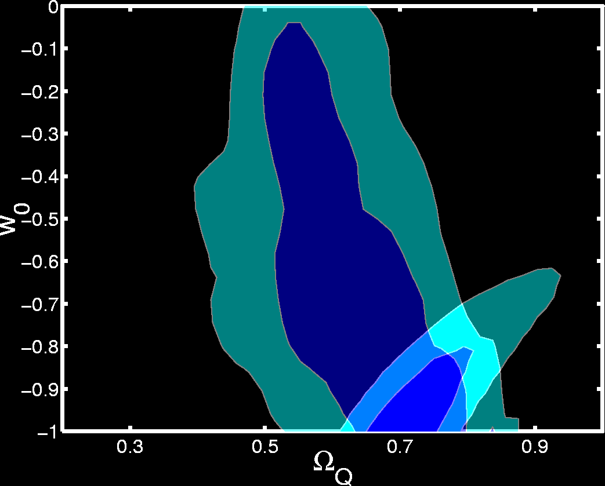
Breaking Degeneracies by combining different data
Obs Cos
Kunz
By combining the two
data sets, we can
constrain the parameters
much more tightly.
WMAP
SN-Ia

Slide 46
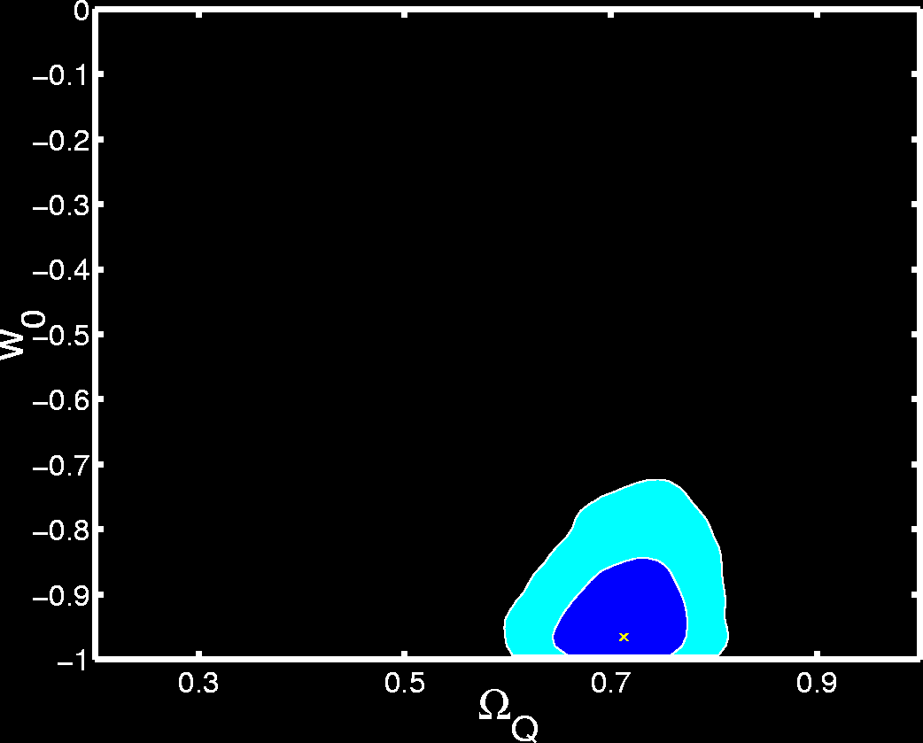
The accelerating cosmos
Obs Cos
Kunz
The combined data gives
good evidence for the
Cosmos being dominated
By energy with significant
negative pressure
(w < -1/3)
Hence good evidence for
Cosmic acceleration

Slide 47
Marginalisation
Obs Cos
If we are estimating 100 parameters we end up with a 100 dimensional posterior distribution.
But if we want to estimate errors we need a one-dimensional likelihood such as:

Slide 48
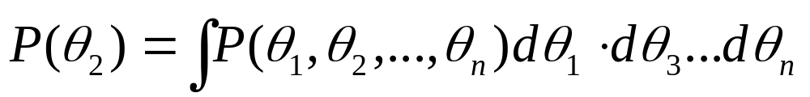
Marginalisation II
Obs Cos
The process of moving from the full posterior to just a one or two dimensional likelihood is called marginalisation and is given by integrating the full posterior over all other parameters. E.g.:

Slide 49
Marginalisation III
Obs Cos
This is actually just the natural generalisation of a standard law of probability:
P(X) = P(X,Y) + P(X,Z) + …
where the sum is over all possible joint probabilities involving X.
E.g. the probability of finding my keys is the sum of the joint probabilities that I find it with my papers, my laptop, my pens etc… (including all possible combinations)

Slide 50
Marginalisation IV
Obs Cos
The problem with marginalisation is that for high-dimensional posteriors, it is computationally very intensive (n-dimensional numerical integration).
Again MCMC is a great way of doing marginalisation as we later discuss…

