Slide 1
A DATA ANALYSIS REPORT ON REFRESHER TRAINING, STUDENTS’ RECORD SECTION, UNIVERSITY OF CAPE COAST
JOSEPH HARRY MENSAH

Slide 2
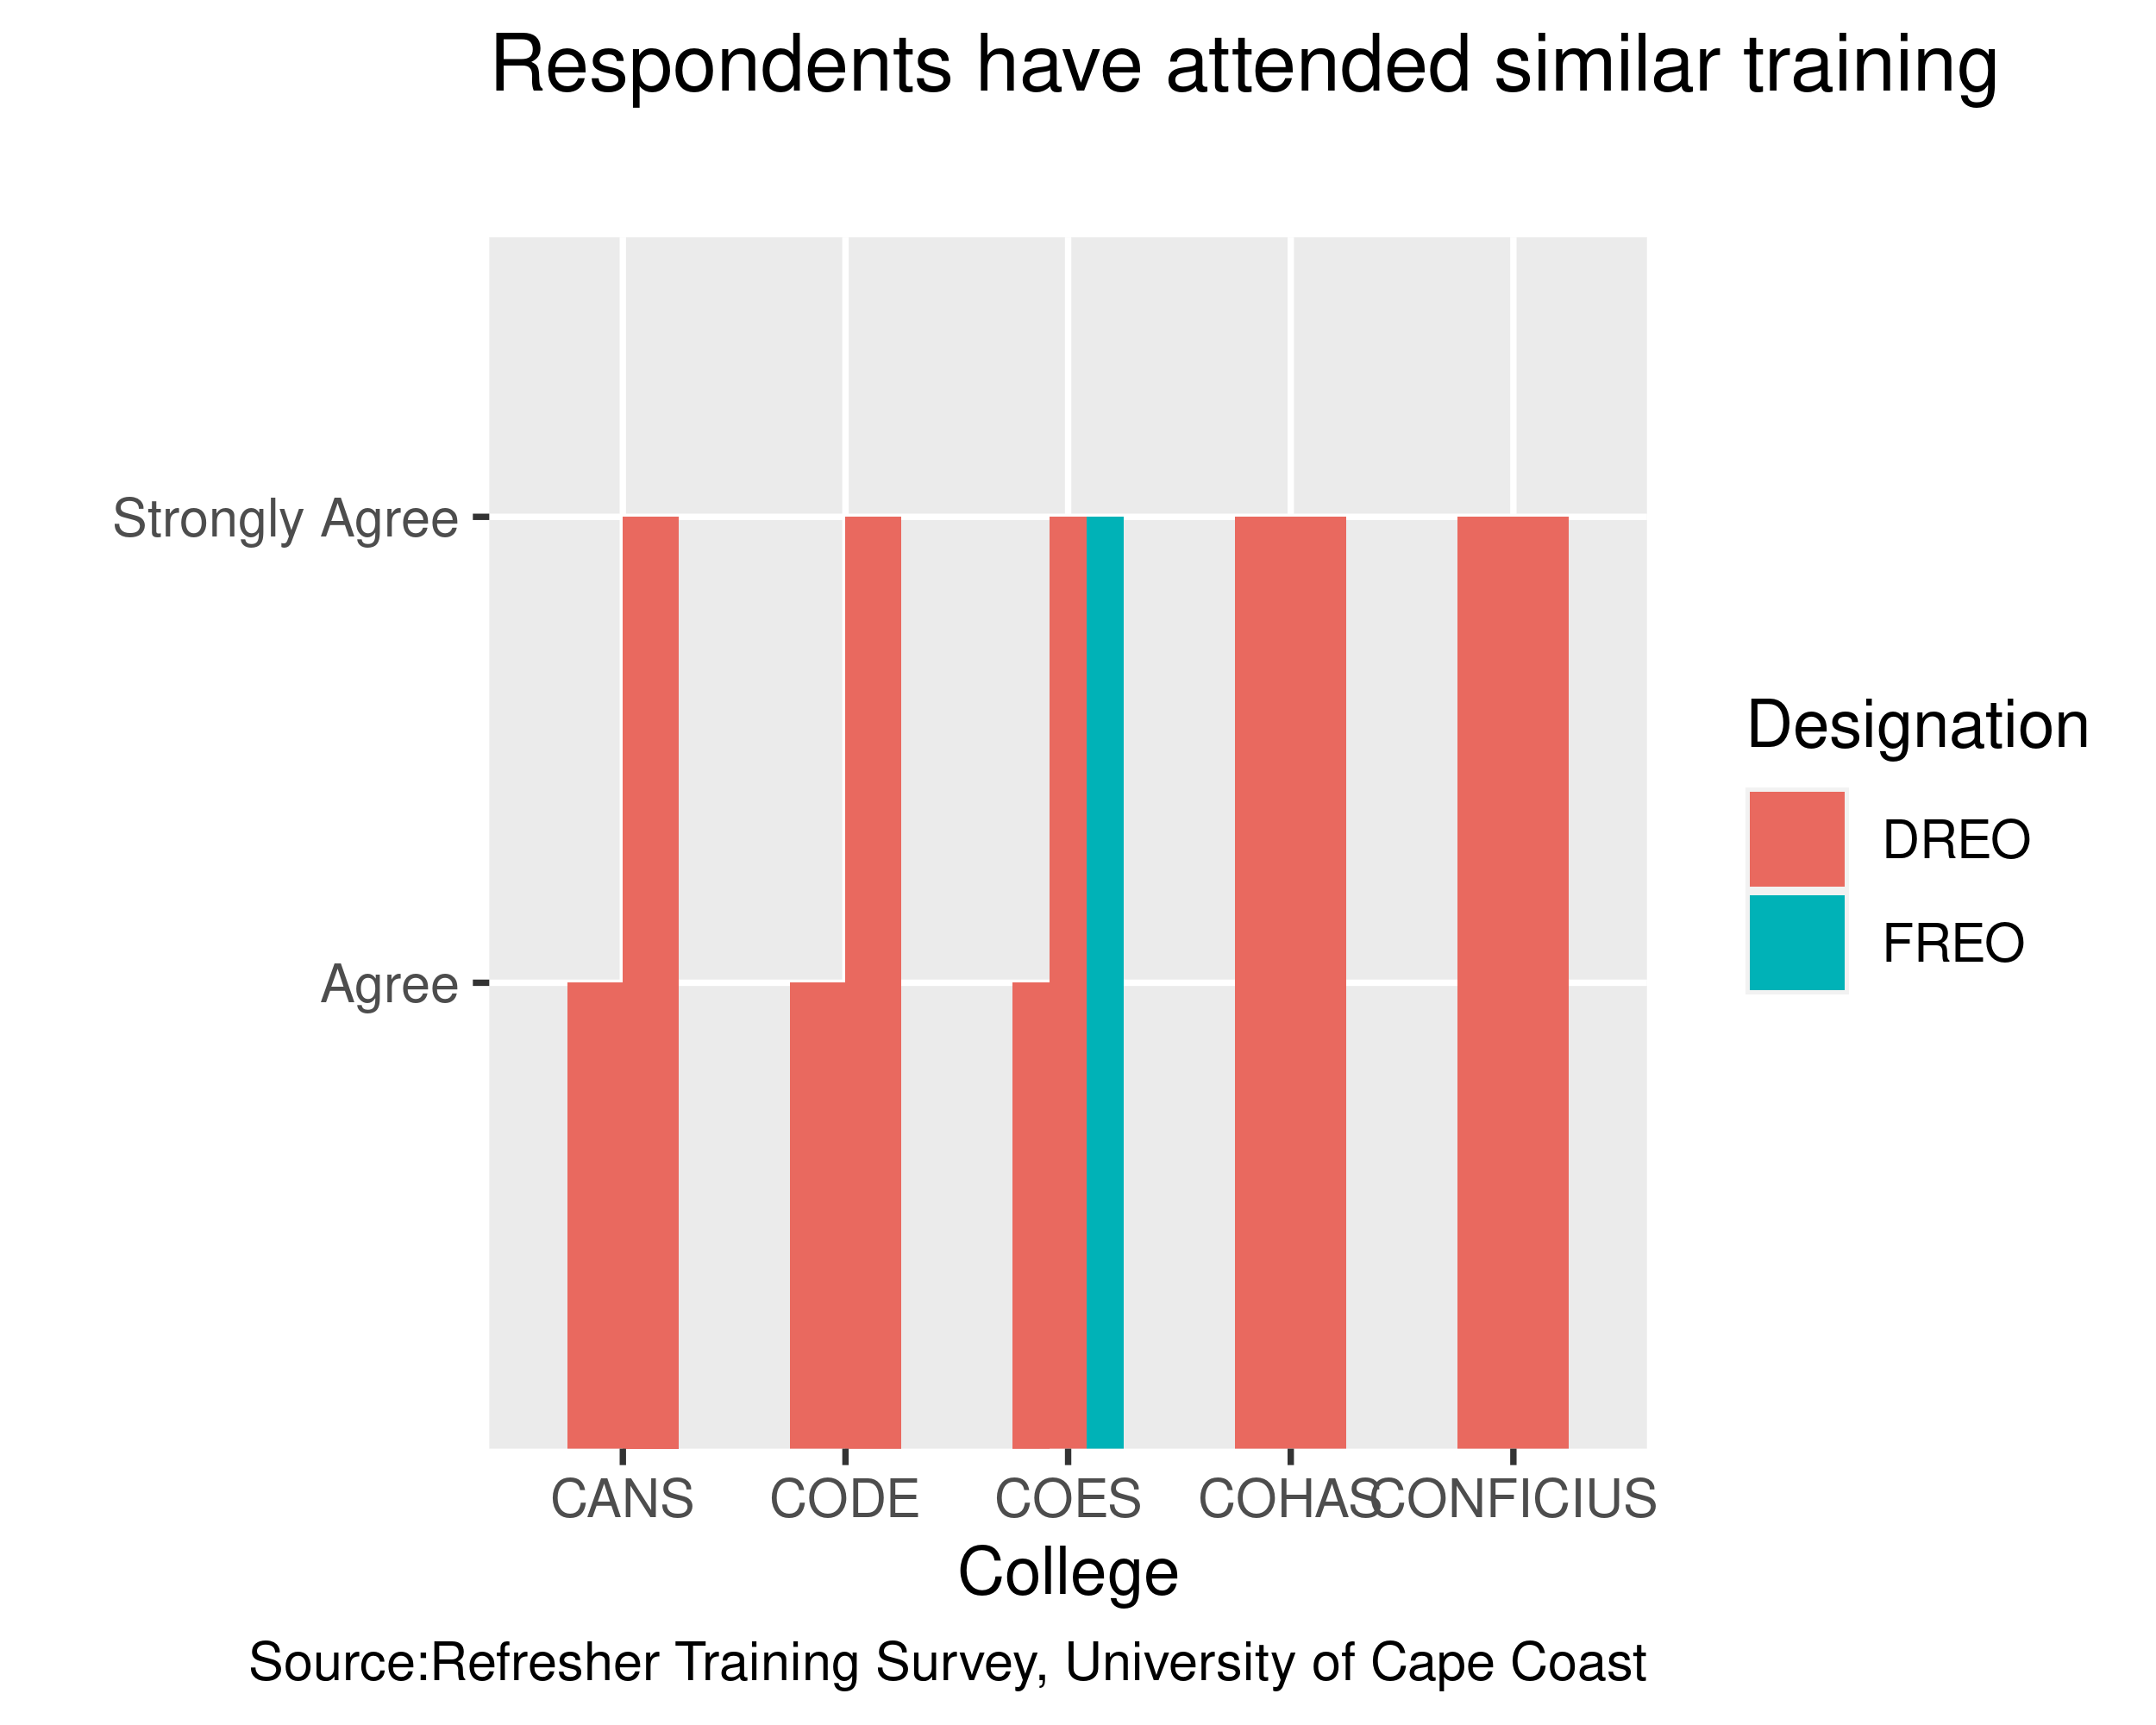
The training session was useful to my work

