Slide 1
A DATA ANALYSIS REPORT ON REFRESHER TRAINING, STUDENTS’ RECORD SECTION, UNIVERSITY OF CAPE COAST
JOSEPH HARRY MENSAH

Slide 2
Table of Contents
Question: The training session was useful to my work
The training session was useful to my work
The training session was useful to my work
Comparison: The training session was useful to my work
Question: The training will impact positively on my work
Positive Impact On Work
Positive Impact On Work
Comparison: The training will impact positively on my work
Question: I need such training regularly
The need for such training regularly
The need for such training regularly
Comaparison: I need such training regularly
Question : I have acquired the basic knowledge necessary to use the UCCOSIS
Acquired basic Knowledge on UCCOSIS usage
Acquired basic Knowledge on UCCOSIS usage
Comparison: I have acquired the basic knowledge necessary to use the UCCOSIS
Question: I need a user manual for the UCCOSIS
The Need For A User Manual
The Need For A User Manual
Comparison: I need a user manual for the UCCOSIS
Respondents on acquiring knowledge and capability of making data entries after training
I have acquired the basic knowledge on UCCOSIS usuage & I can make data entry using the UCCOSIS software
Organisational Analysis And Other Relevant Questions
Was the venue suitable
Presentations
Presenation 1
Presentation 2
Presentation 3
Presentation 4
Overall, how satisfied were you with the presentation/training?
THANK YOU!!

Slide 3
Question: The training session was useful to my work

Slide 4
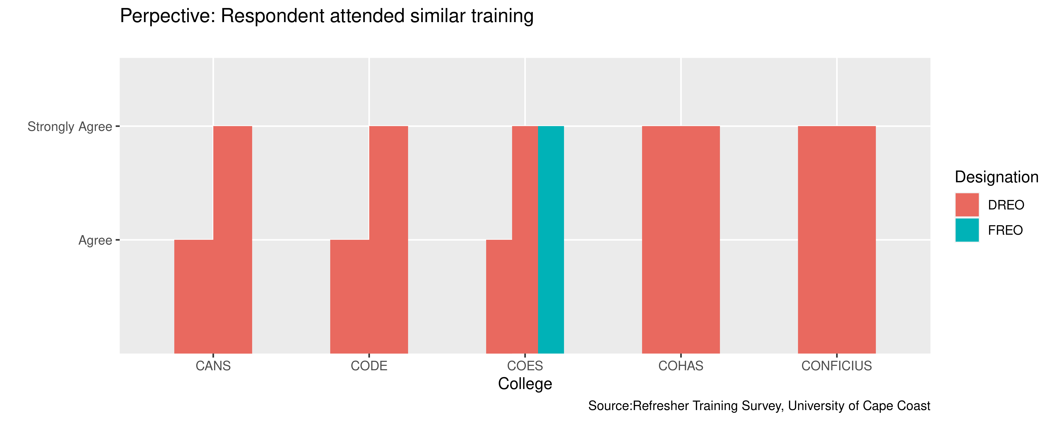
The training session was useful to my work

Slide 5
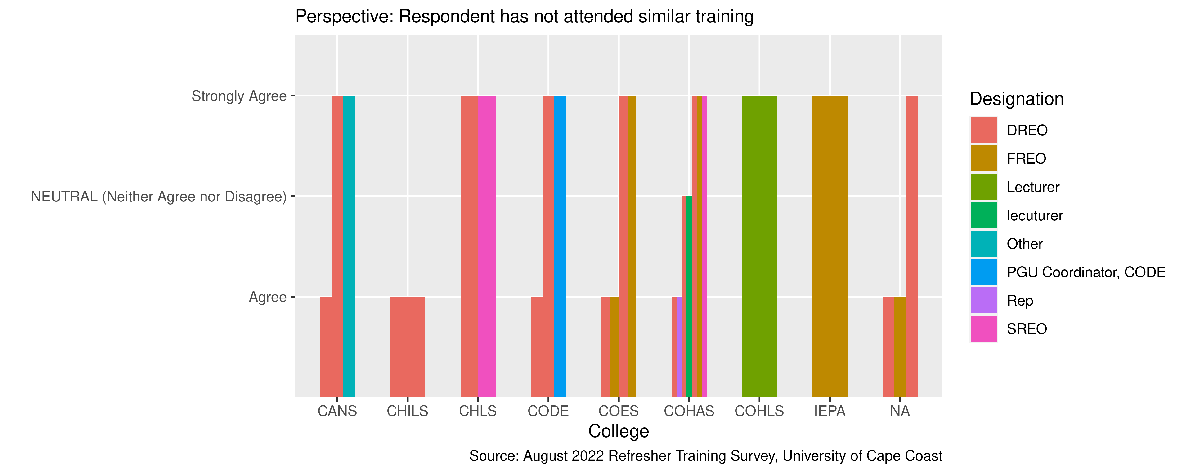
The training session was useful to my work

Slide 6
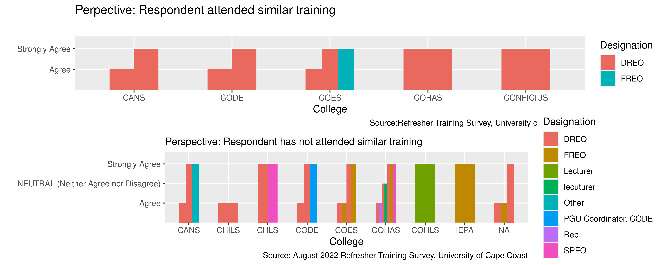
Comparison: The training session was useful to my work

Slide 7
Question: The training will impact positively on my work

Slide 8
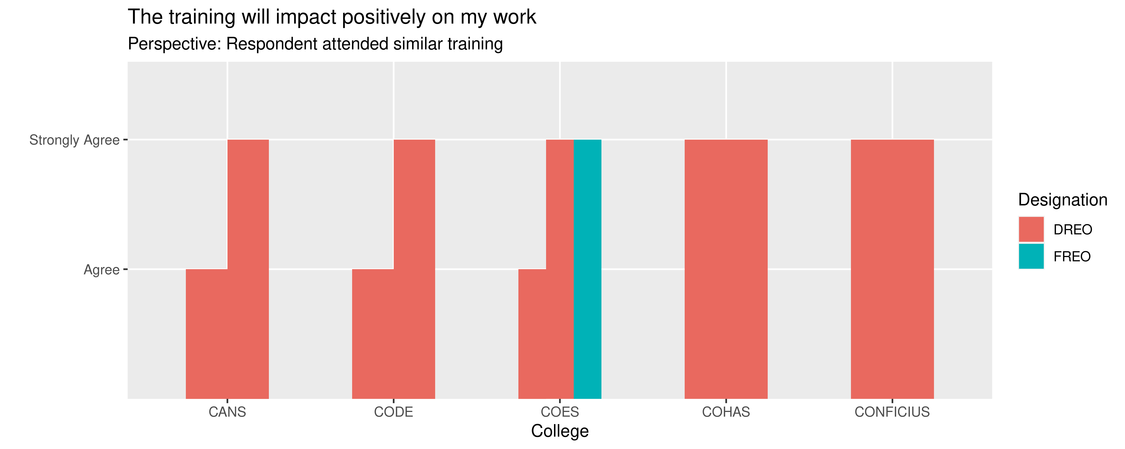
Positive Impact On Work

Slide 9
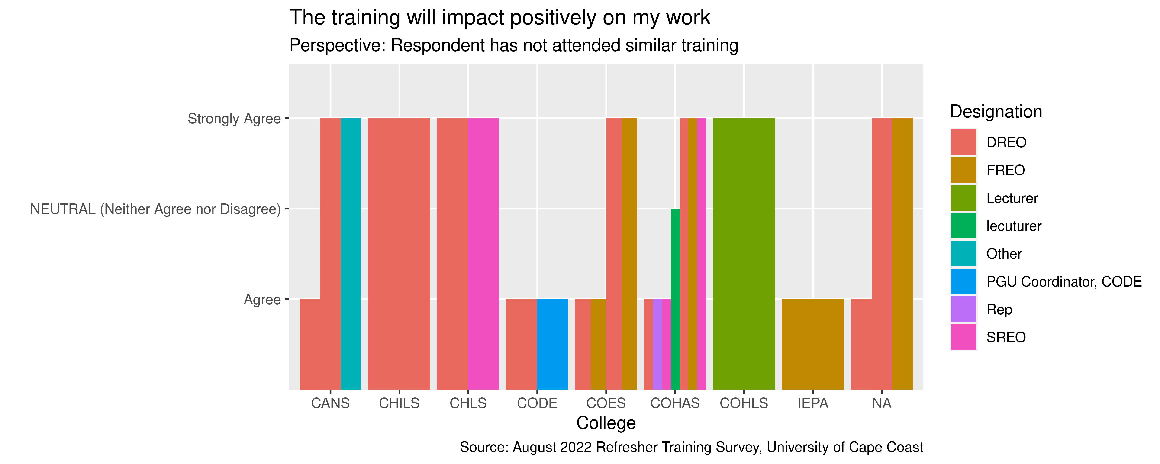
Positive Impact On Work

Slide 10
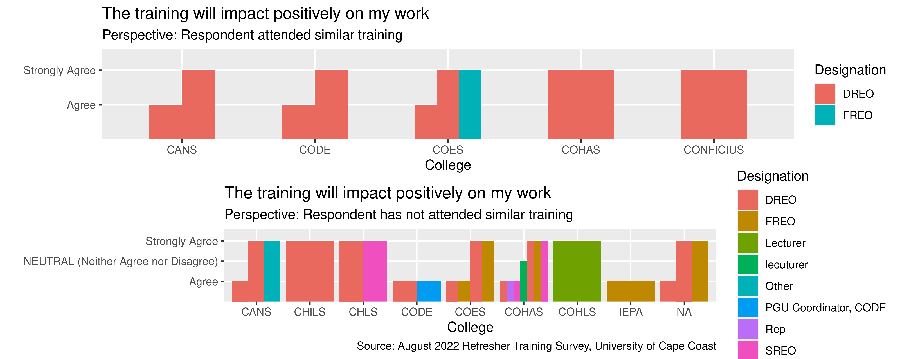
Comparison: The training will impact positively on my work

Slide 11
Question: I need such training regularly

Slide 12
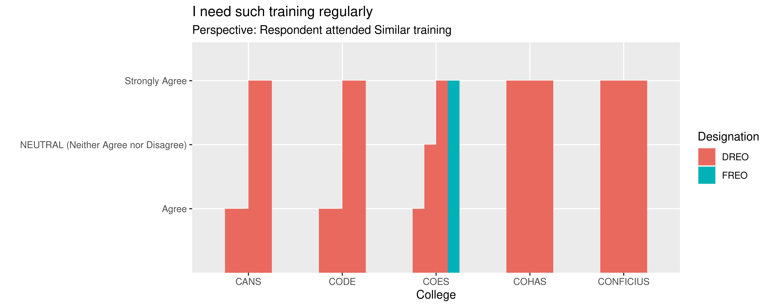
The need for such training regularly

Slide 13
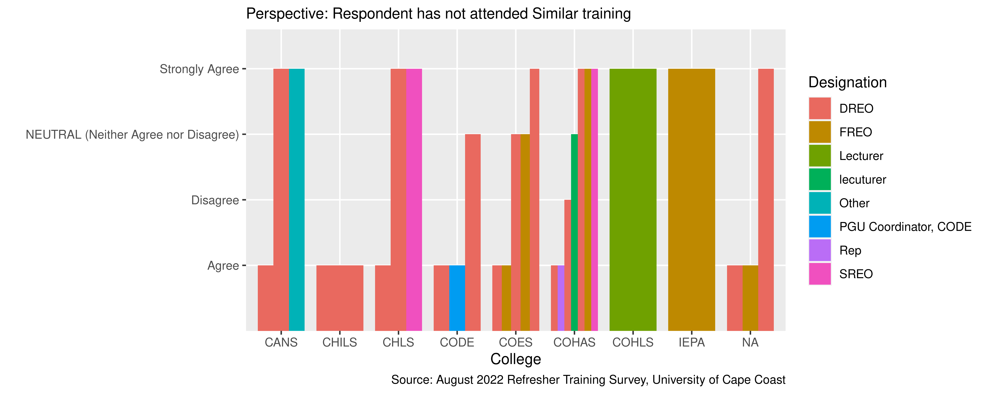
The need for such training regularly

Slide 14
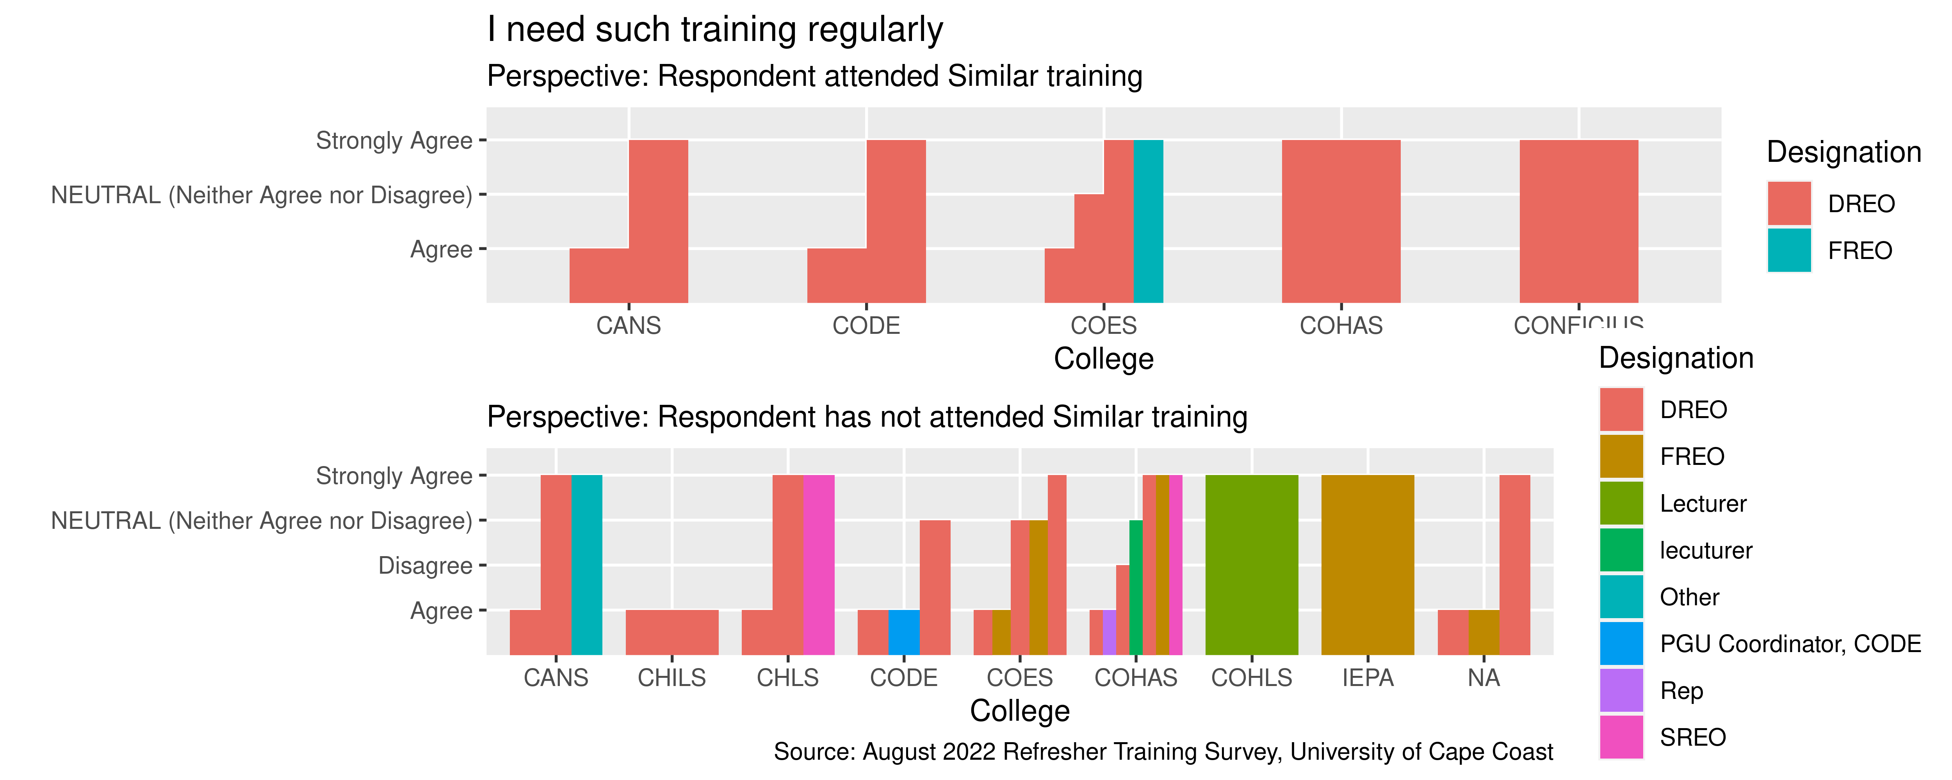
Comparison: I need such training regularly

Slide 15
Question : I have acquired the basic knowledge necessary to use the UCCOSIS

Slide 16
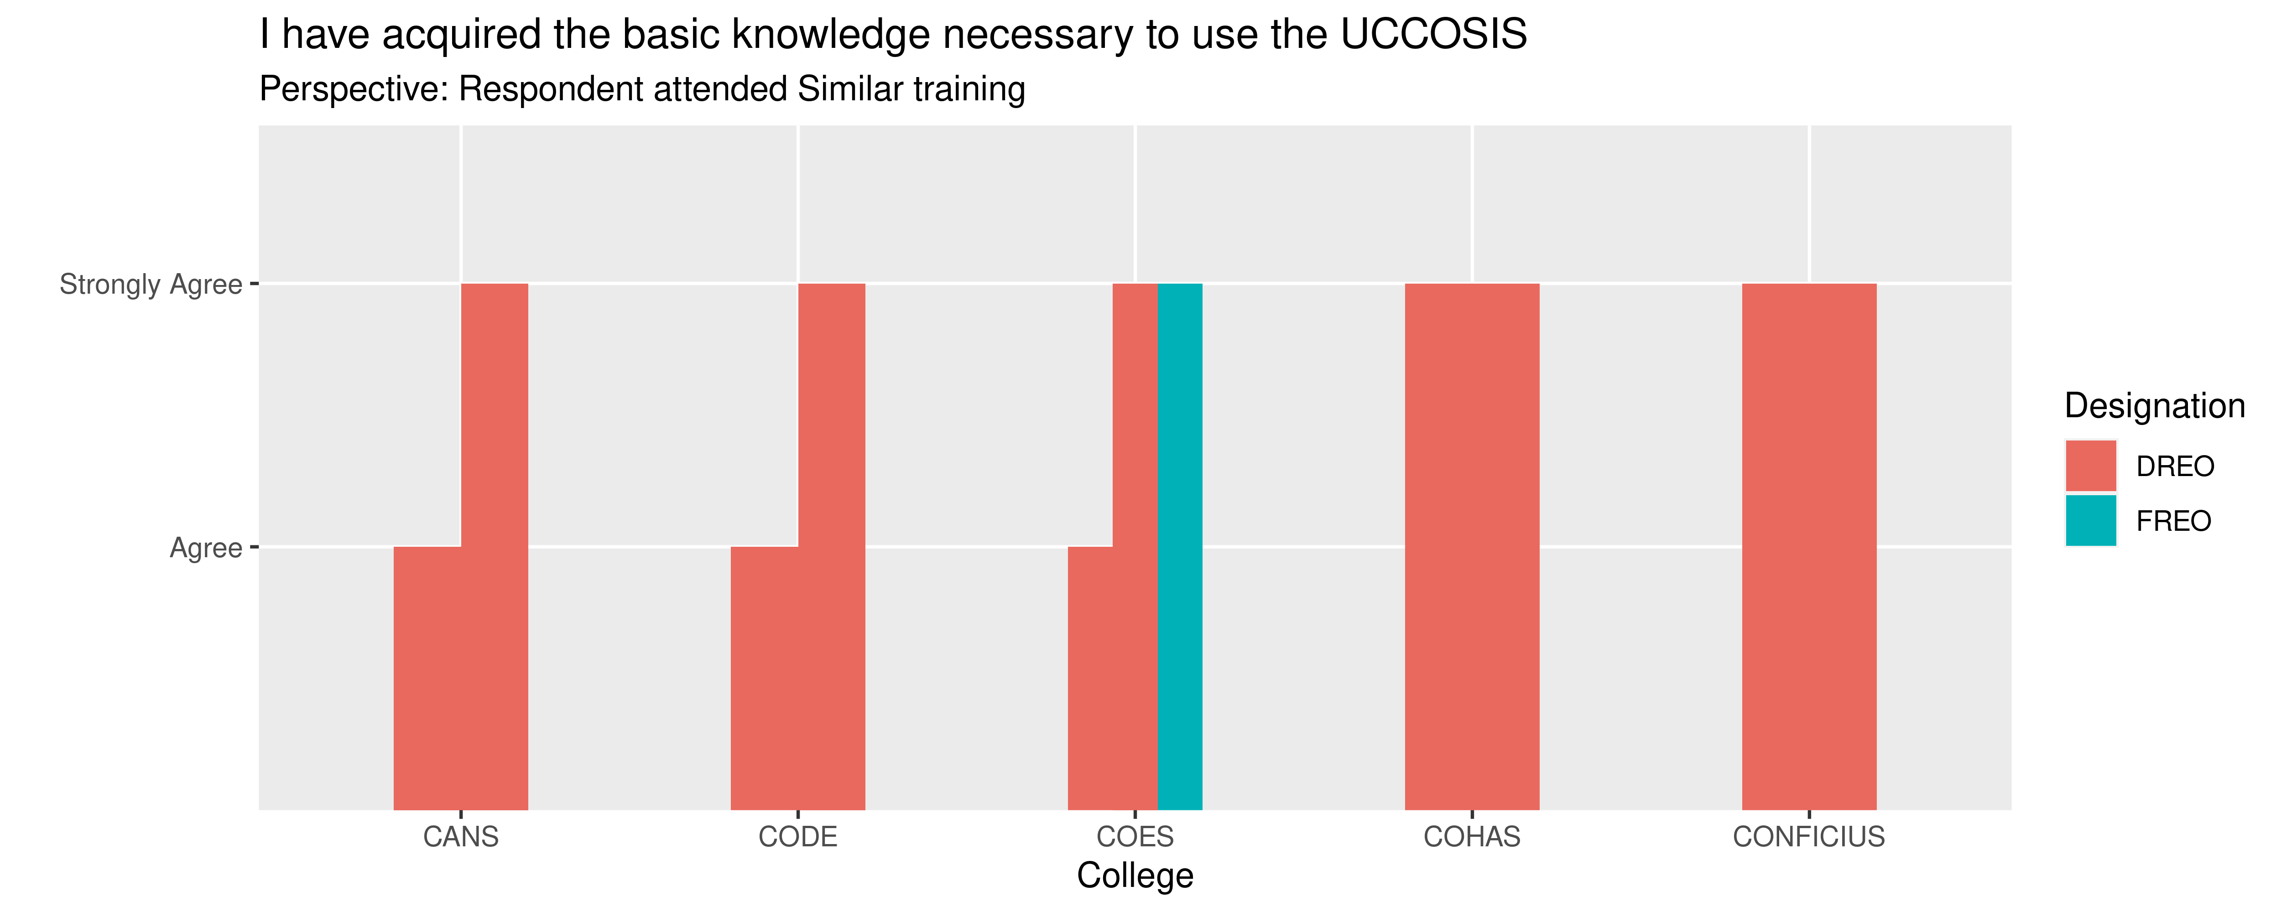
Acquired basic Knowledge on UCCOSIS usage

Slide 17
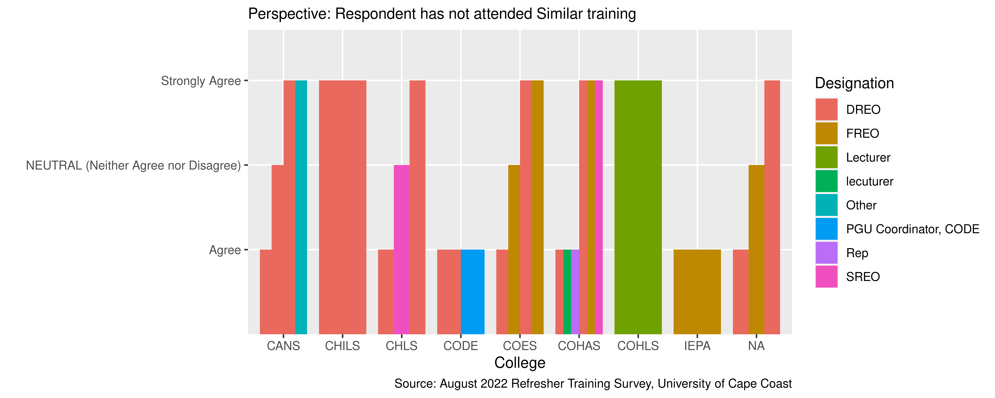
Acquired basic Knowledge on UCCOSIS usage

Slide 18
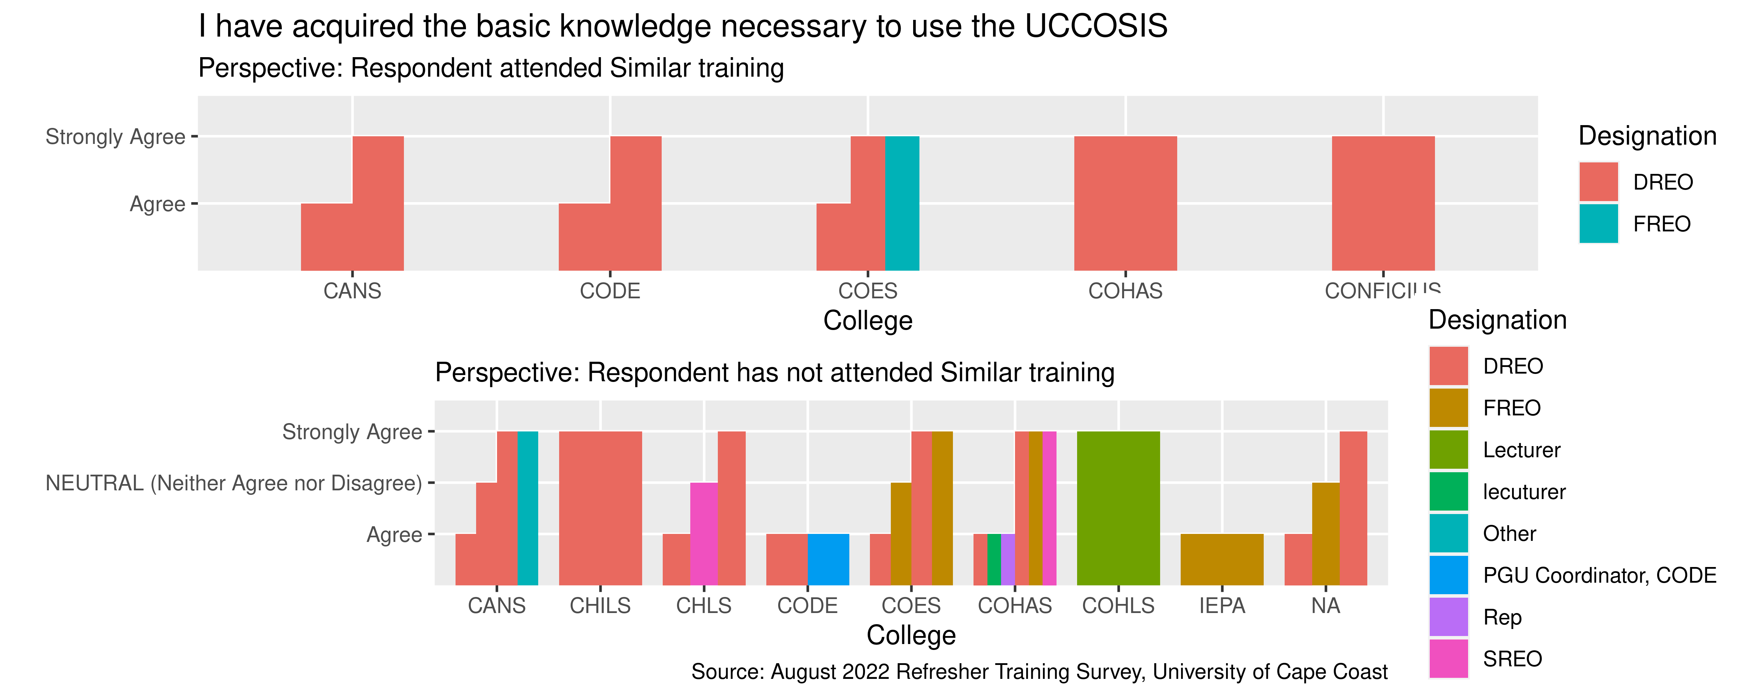
Comparison: I have acquired the basic knowledge necessary to use the UCCOSIS

Slide 19
Question: I need a user manual for the UCCOSIS

Slide 20
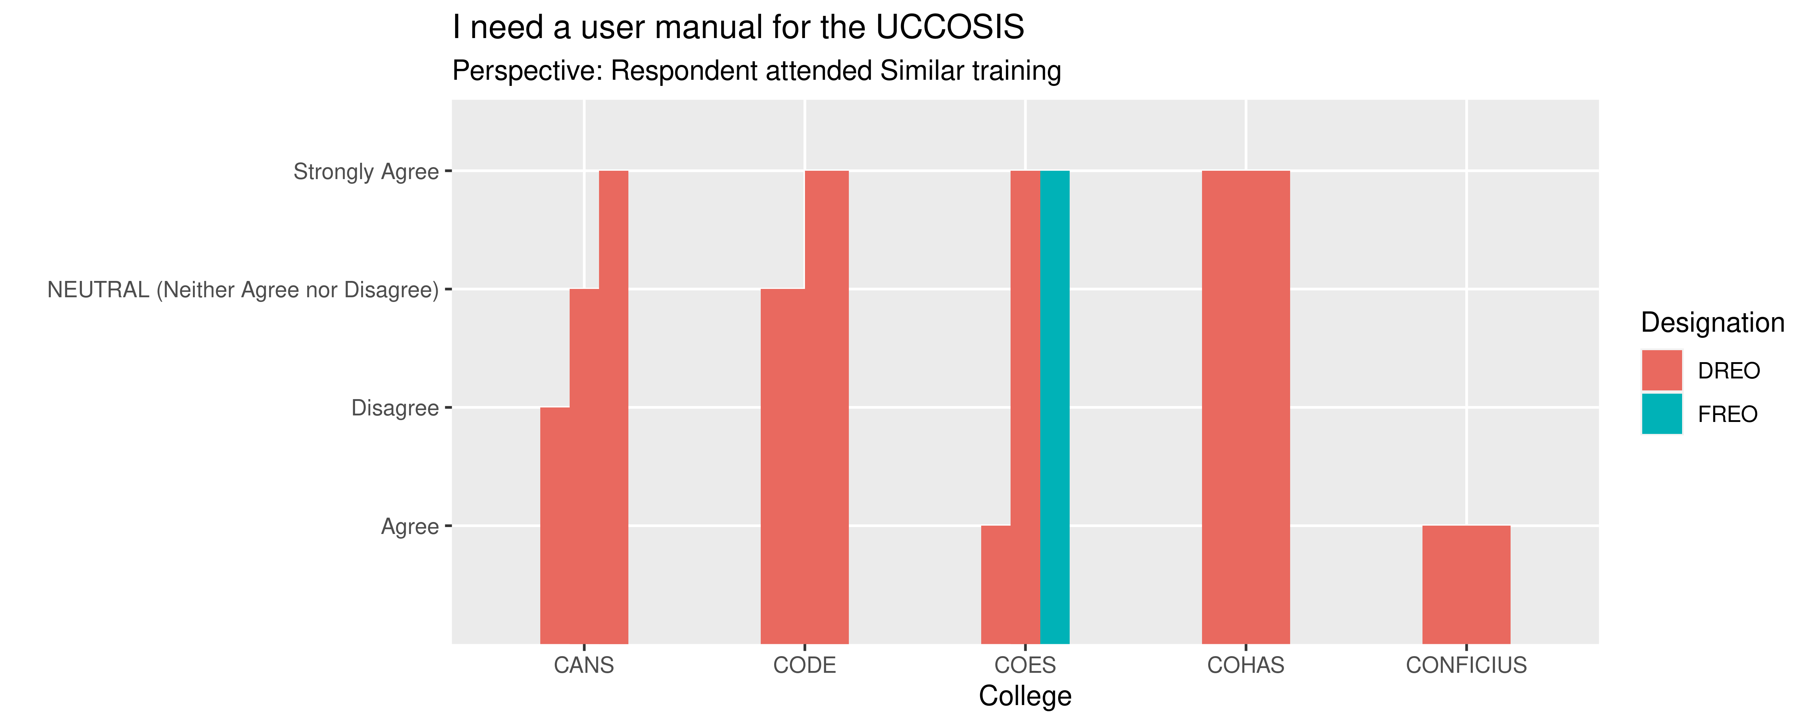
The Need For A User Manual

Slide 21
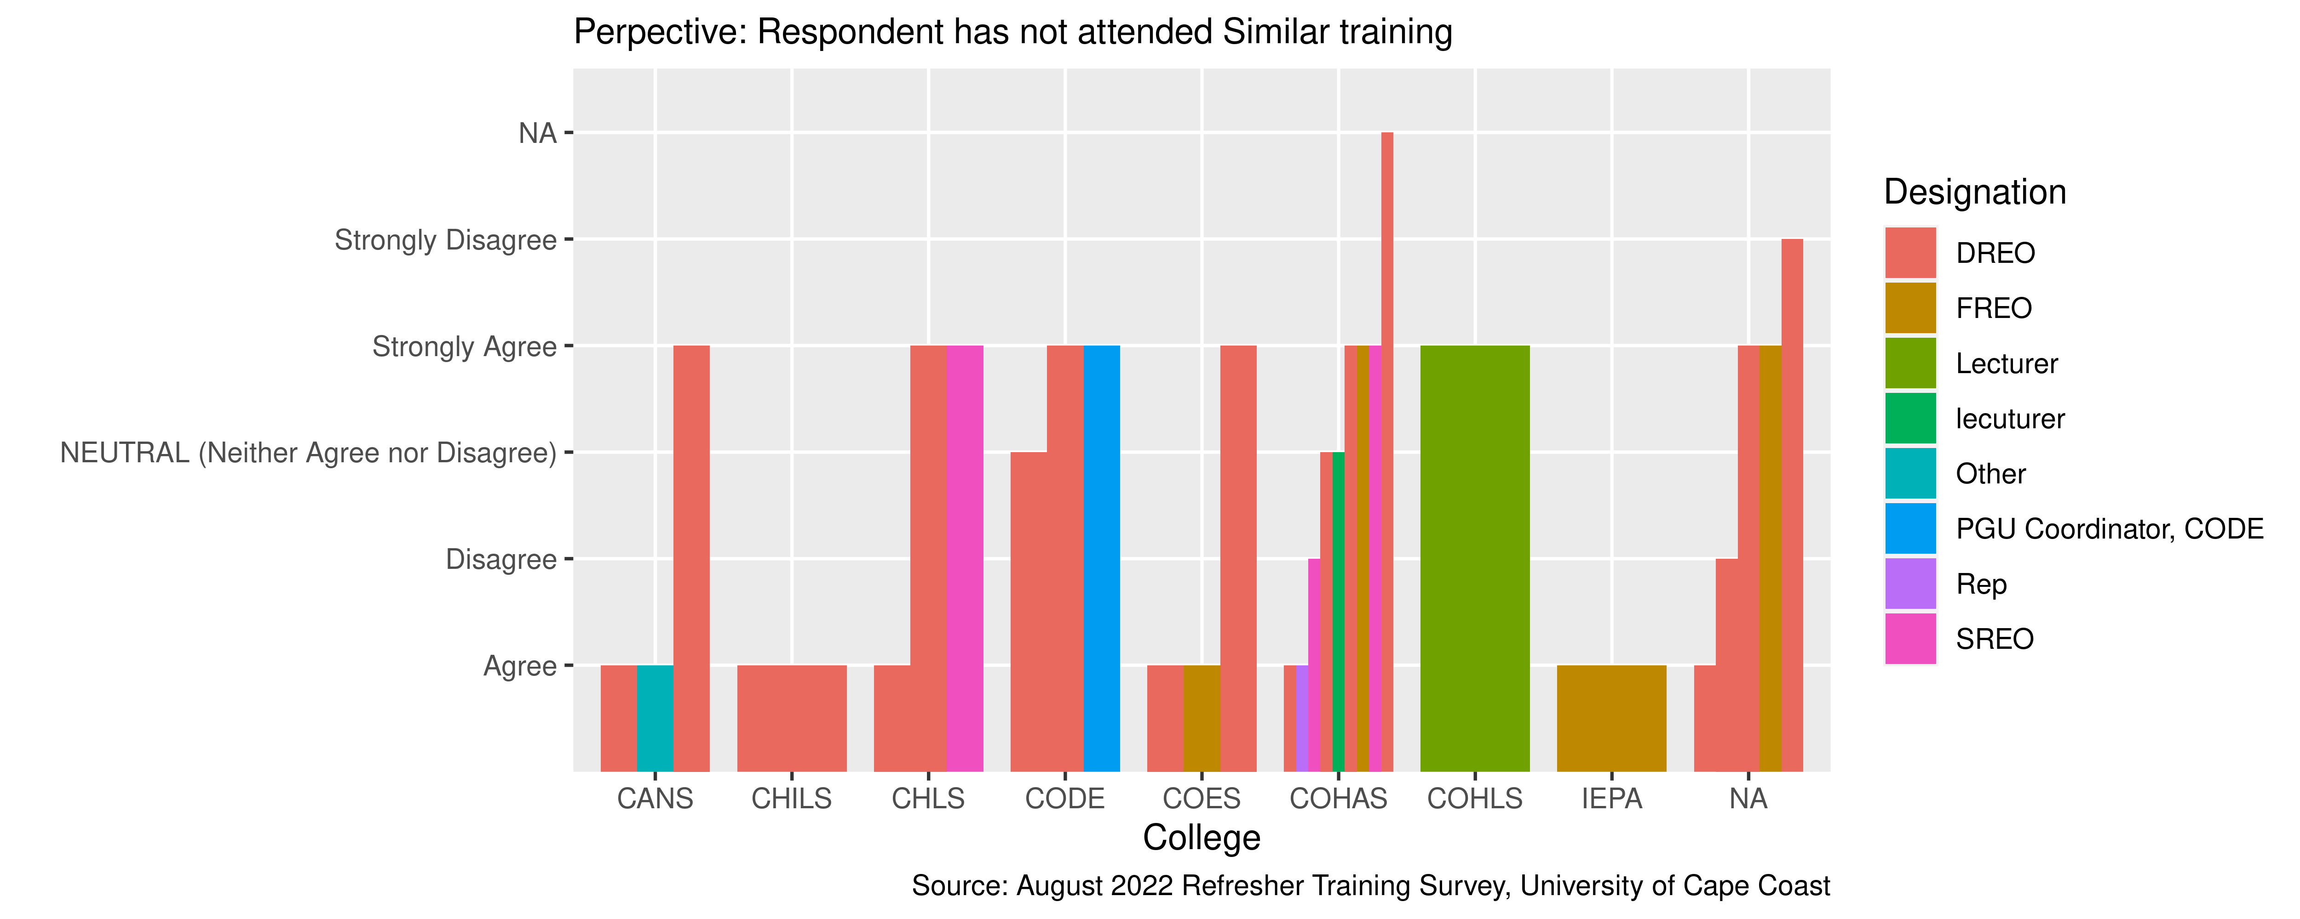
The Need For A User Manual

Slide 22
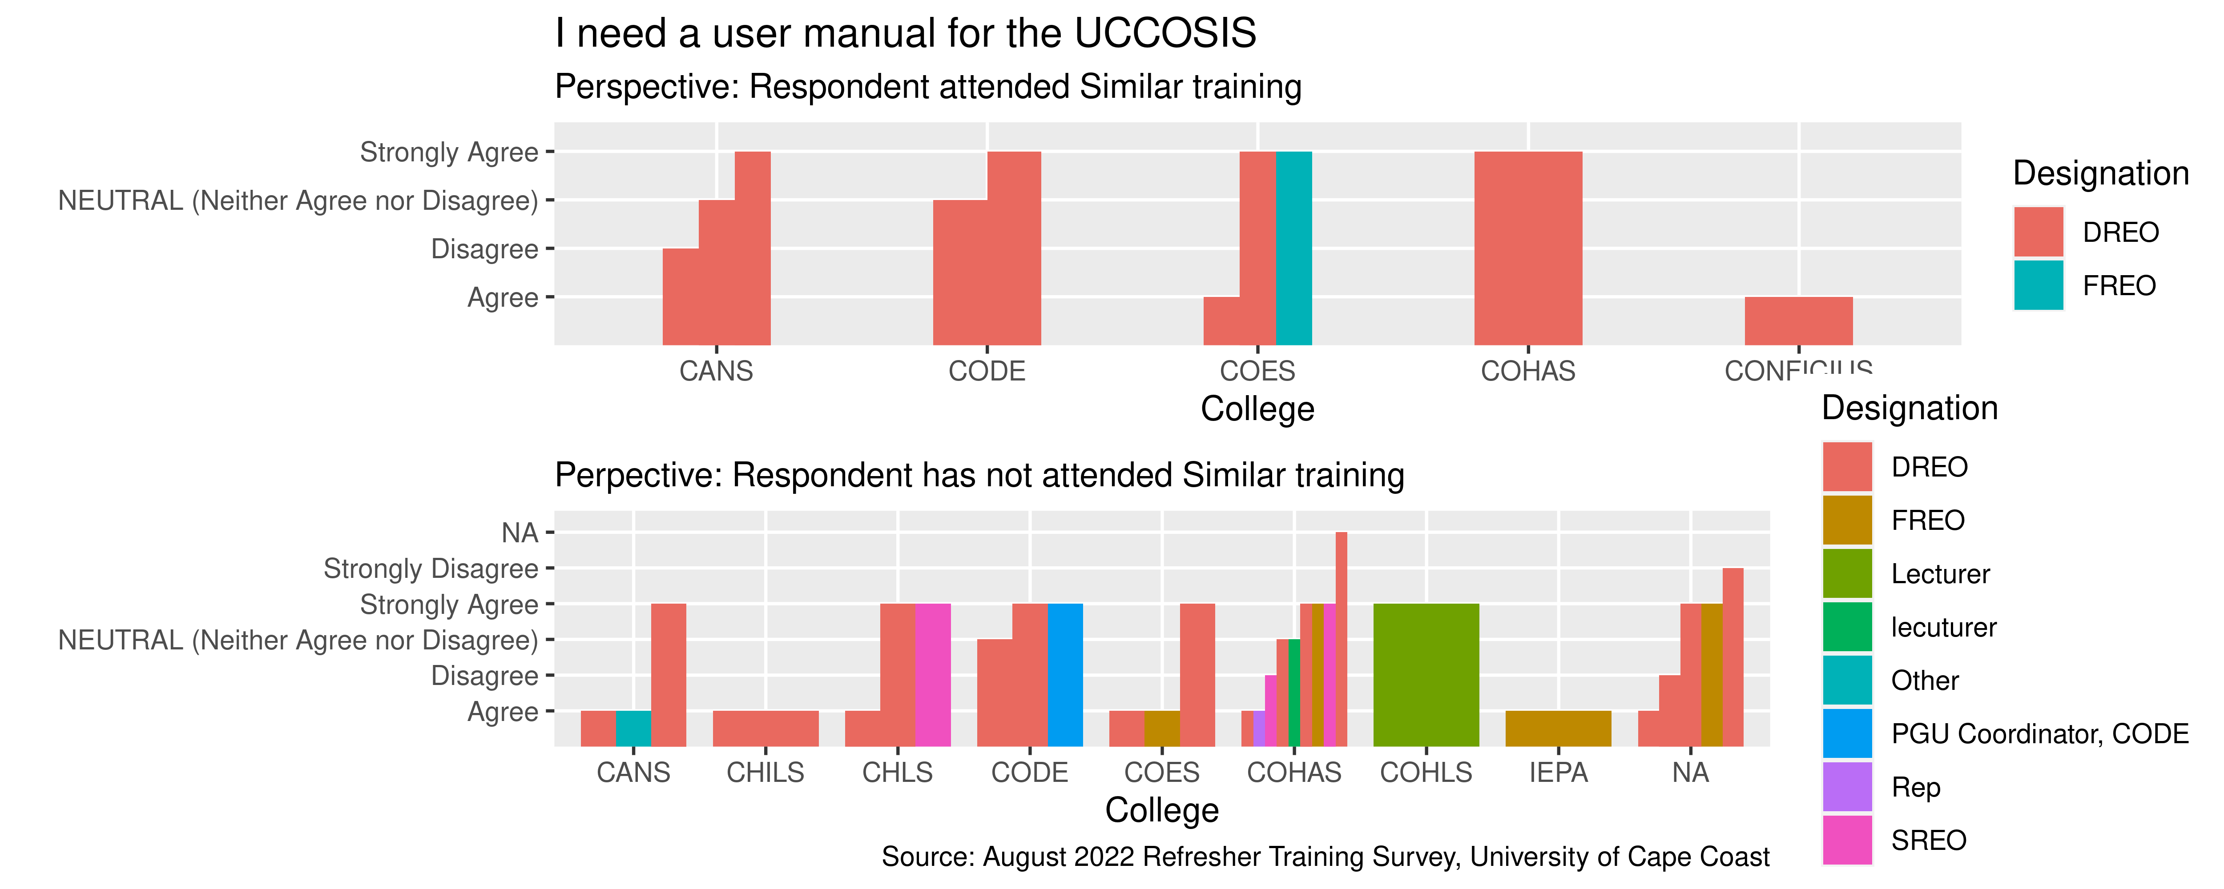
Comparison: I need a user manual for the UCCOSIS

Slide 23
Respondents on acquiring knowledge and capability of making data entries after training

Slide 24
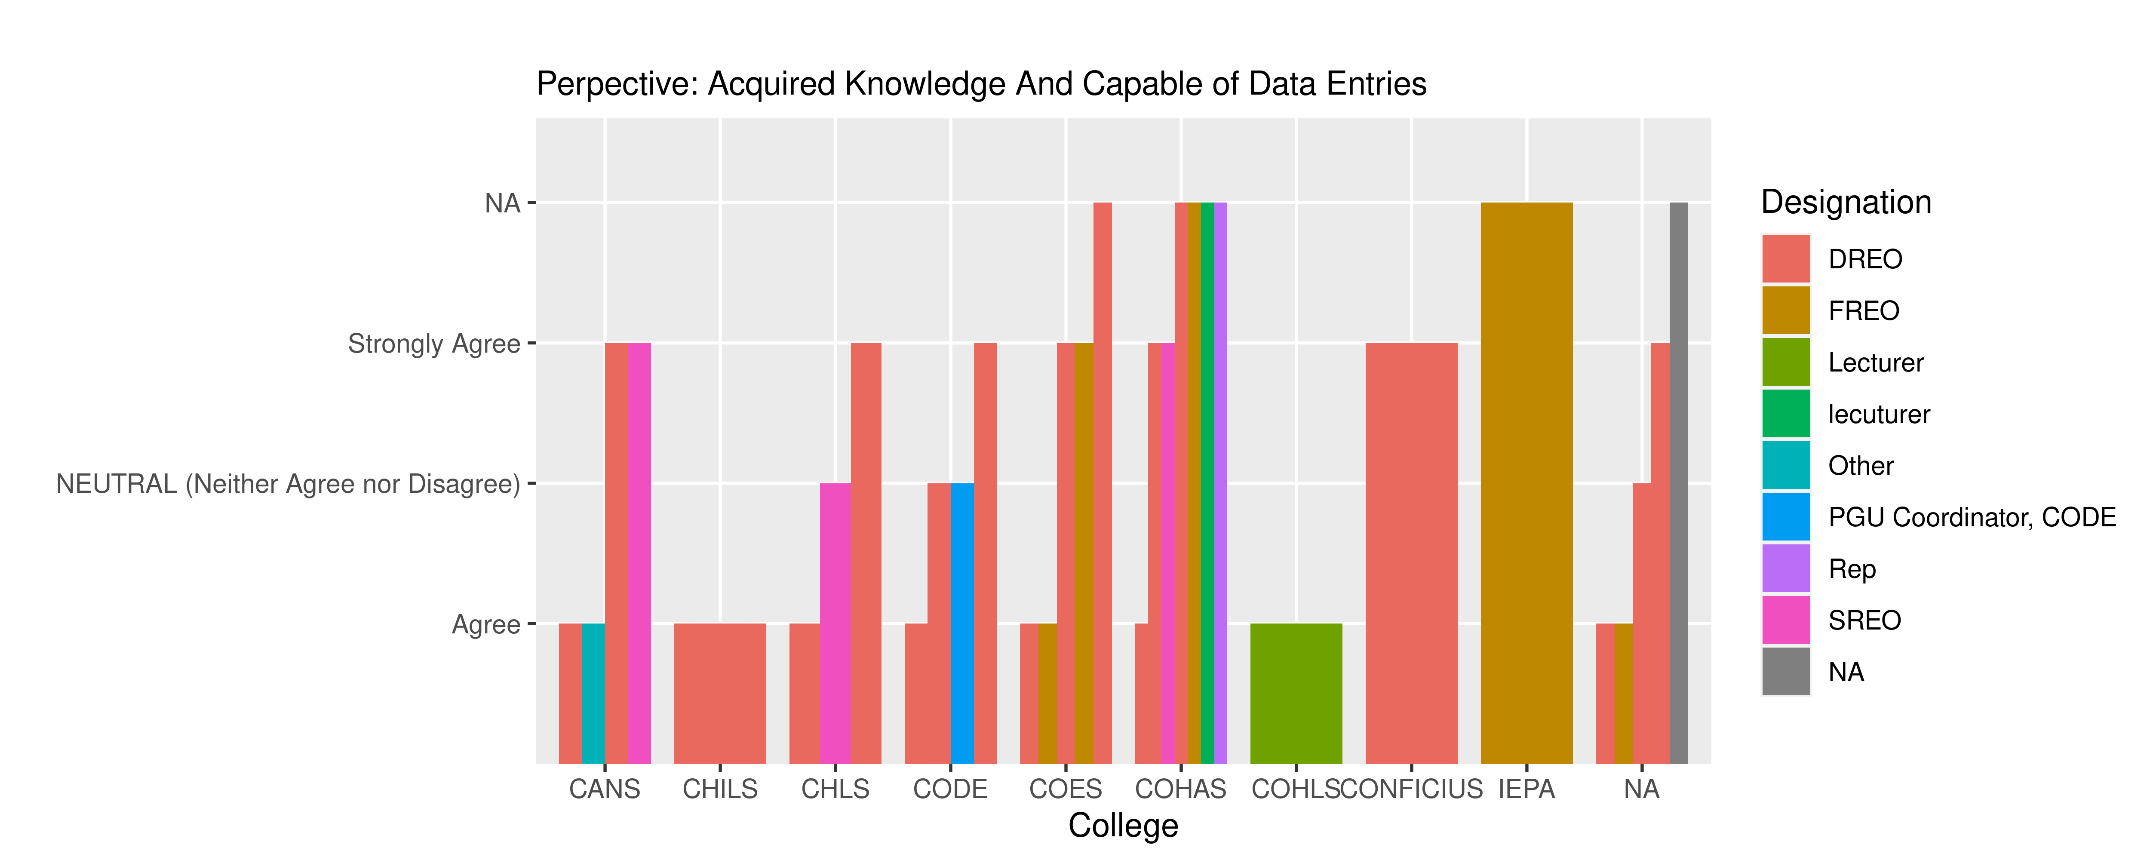
I have acquired the basic knowledge on UCCOSIS usuage & I can make data entry using the UCCOSIS software

Slide 25
Organisational Analysis And Other Relevant Questions

Slide 26
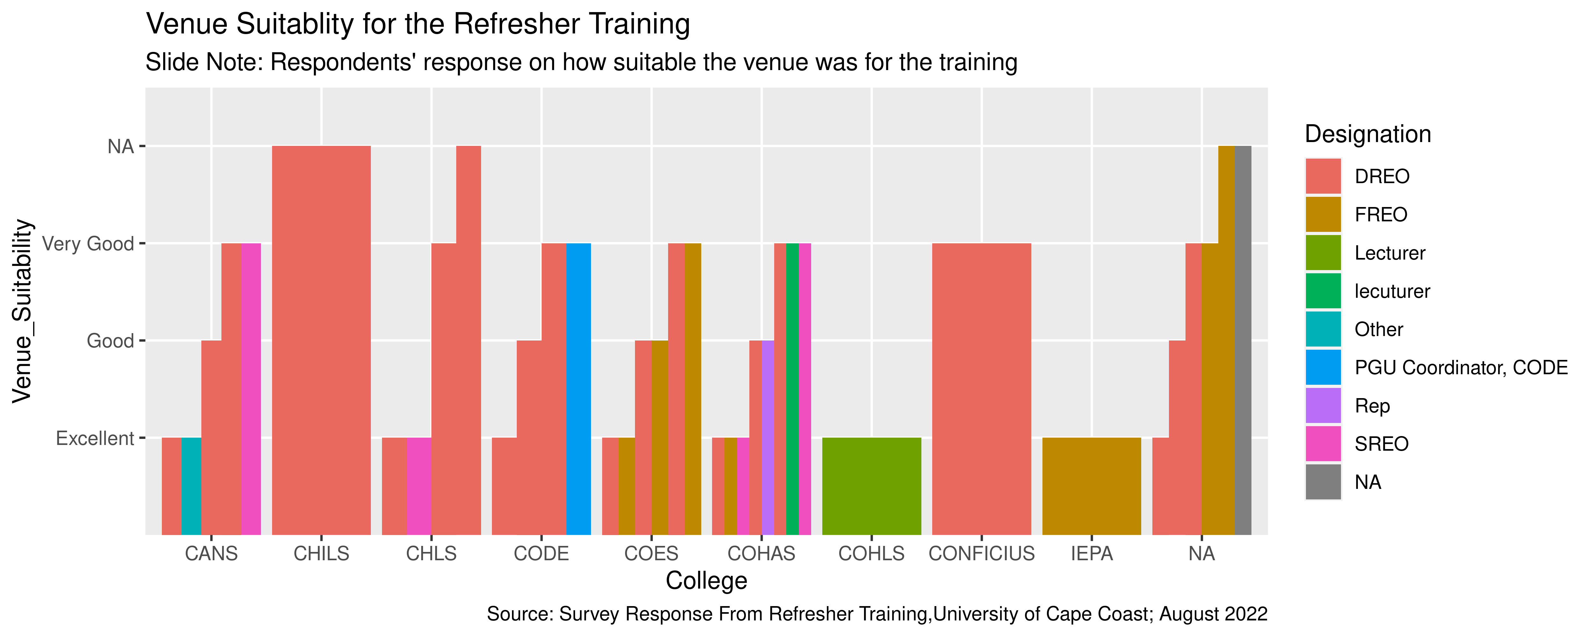
Was the venue suitable

Slide 27
Presentations

Slide 28
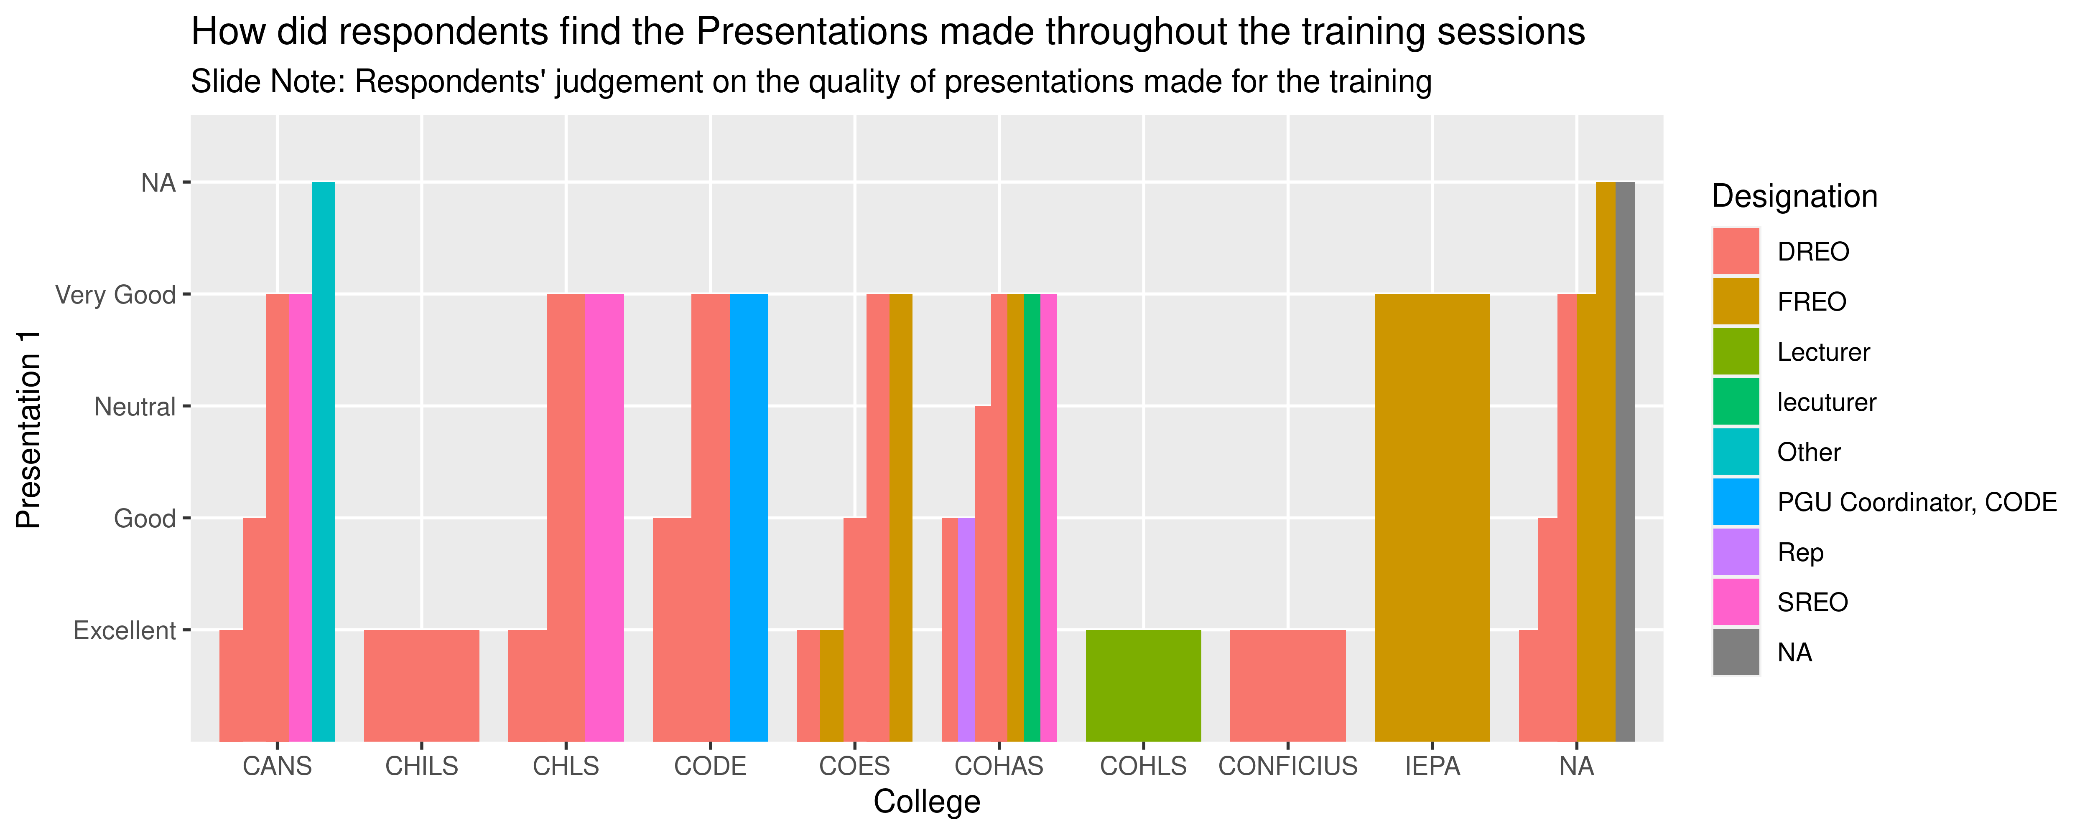
Presenation 1

Slide 29
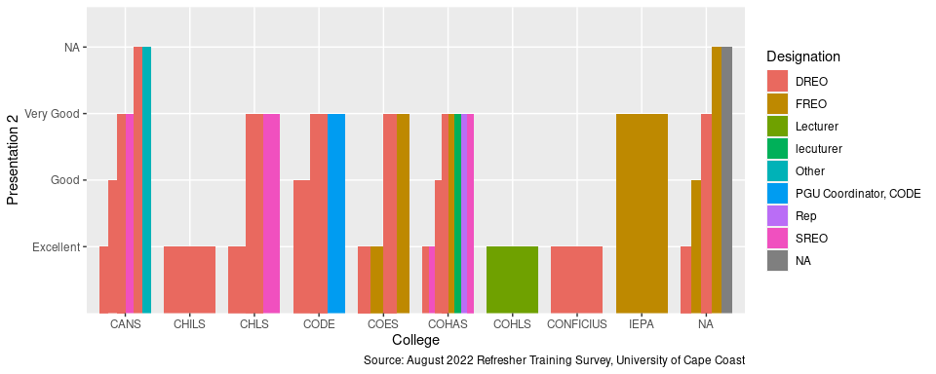
Presentation 2

Slide 30
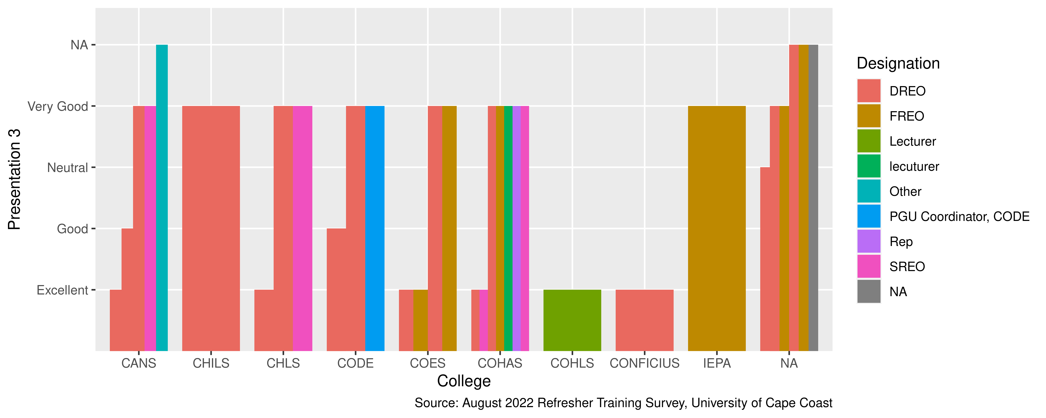
Presentation 3

Slide 31
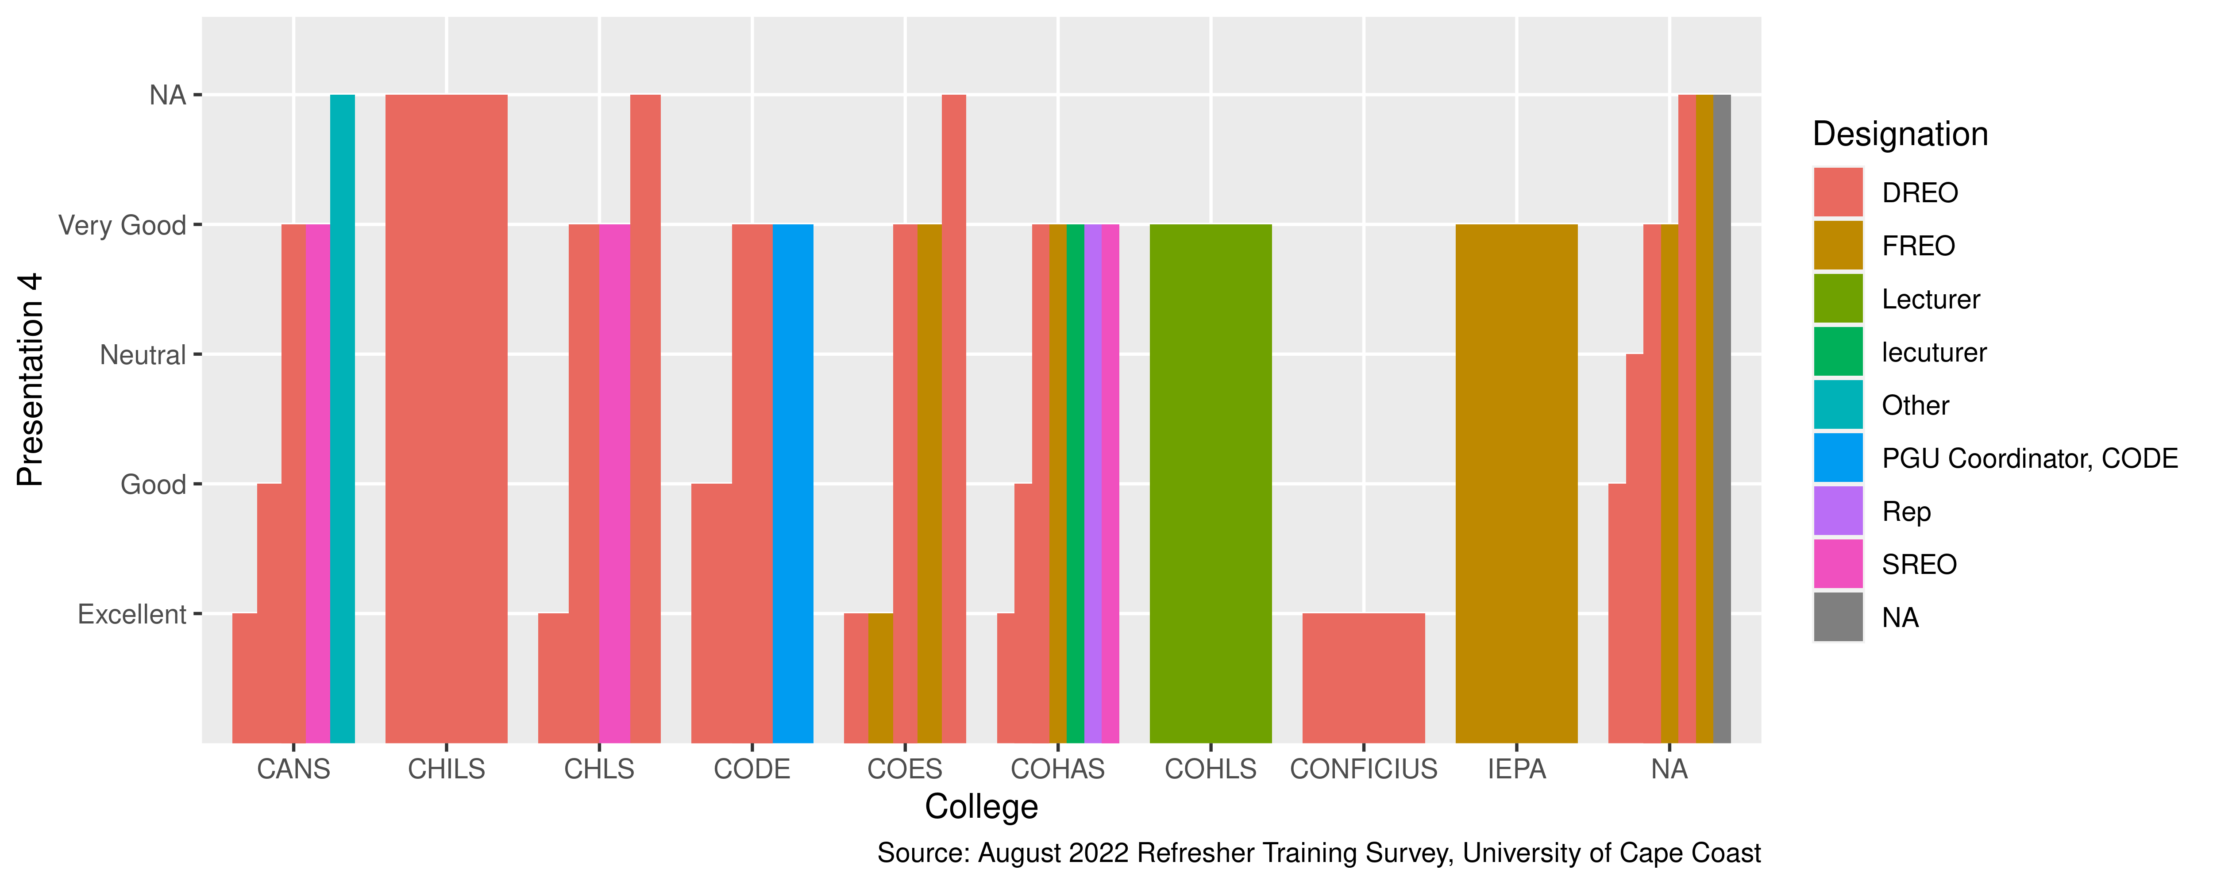
Presentation 4

Slide 32
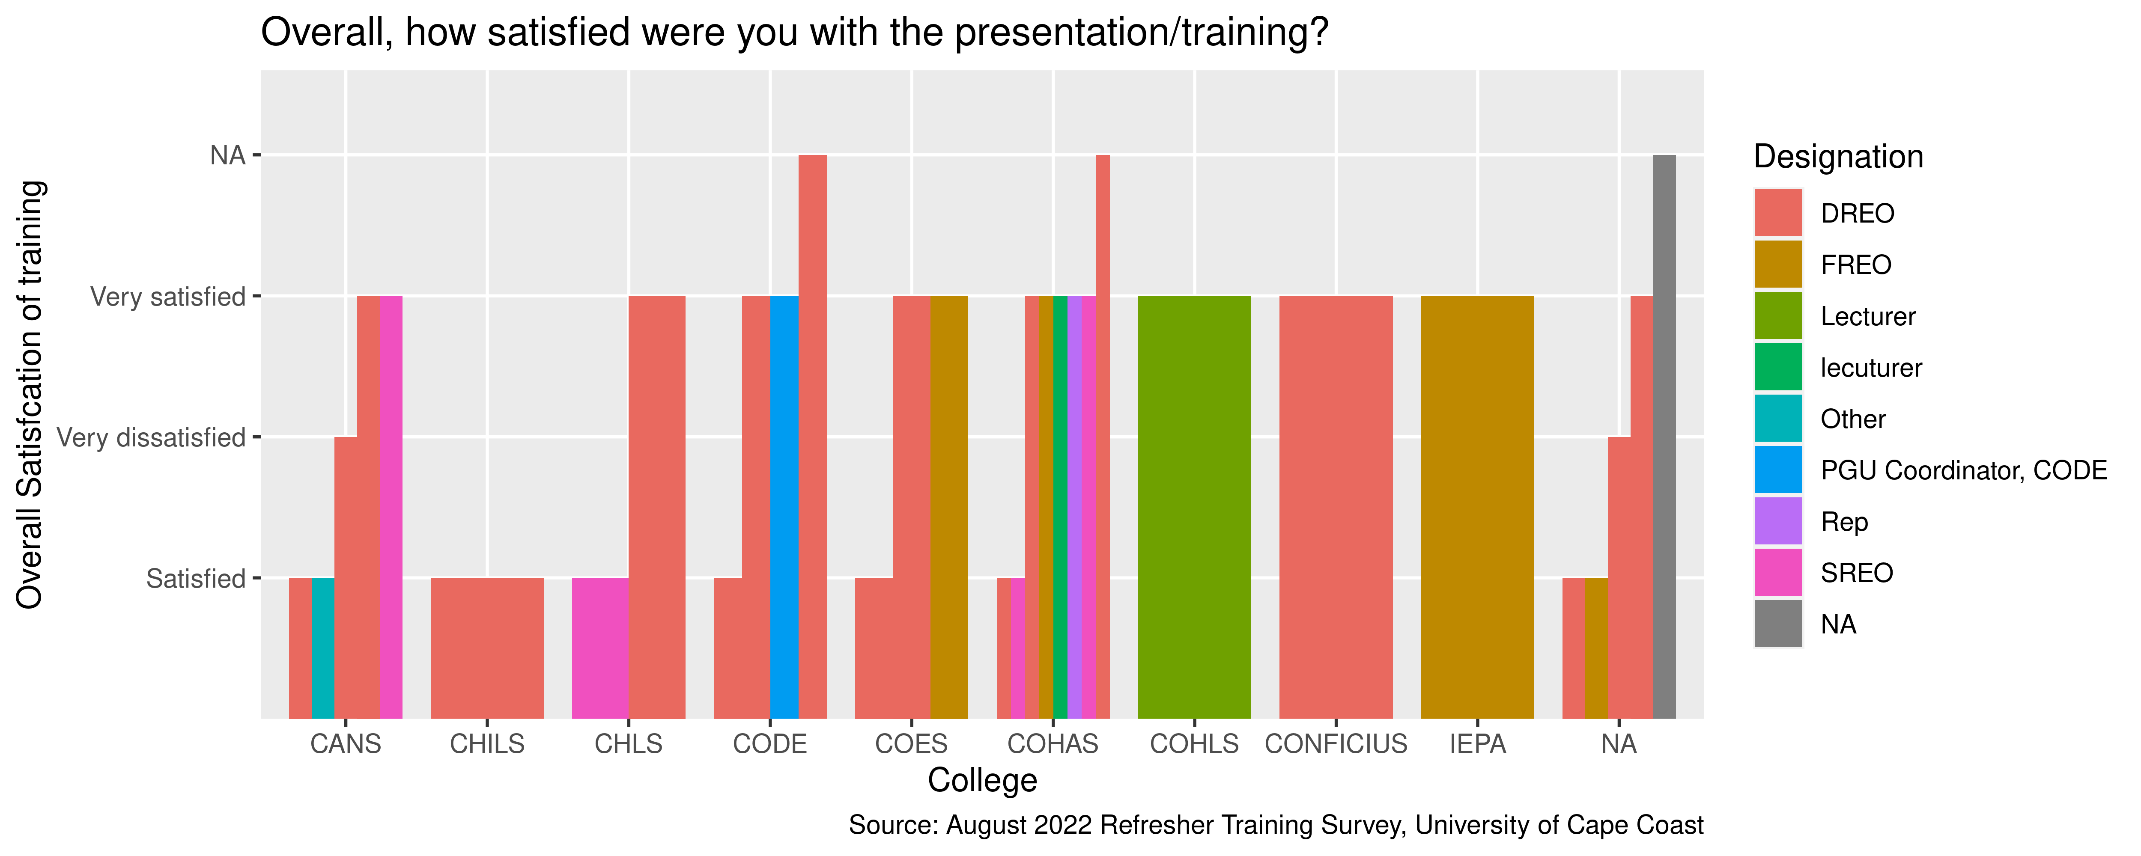
Overall, how satisfied were you with the presentation/training?

Slide 33
THANK YOU!!

