Slide 1
Data Report
JOSEPH HARRY MENSAH

Slide 2
Table of Contents
Have you attended any training of this sort before? Vs The training session was useful to my work
The training session was useful to my work
The training session was useful to my work
Conversely
The training will impact positively on my work
Positive Impact On Work
Positive Impact On Work
Comparison
Question: I need such training regularly
The need for such training regularly
The need for such training regularly
Comaparison
Question : I have acquired the basic knowledge necessary to use the UCCOSIS
Acquired basic Knowledge on UCCOSIS usage
Acquired basic Knowledge on UCCOSIS usage
Comparison

Slide 3
Have you attended any training of this sort before? Vs The training session was useful to my work

Slide 4
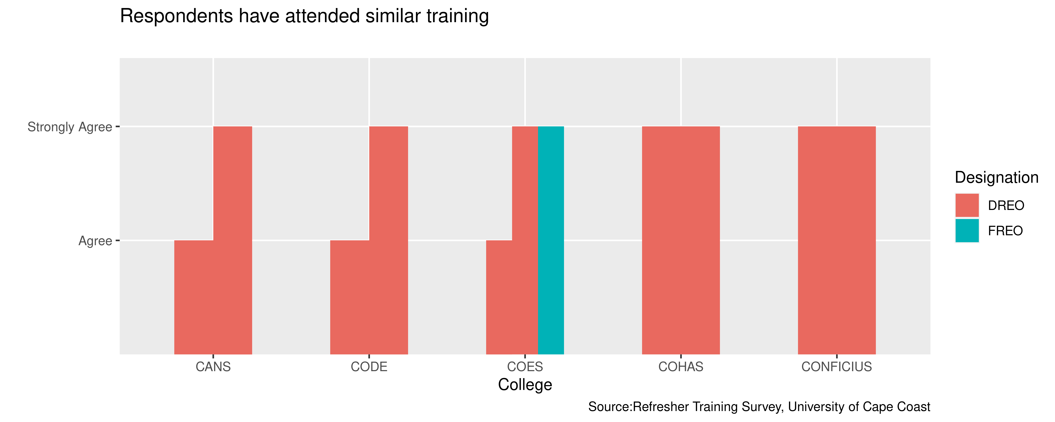
The training session was useful to my work

Slide 5
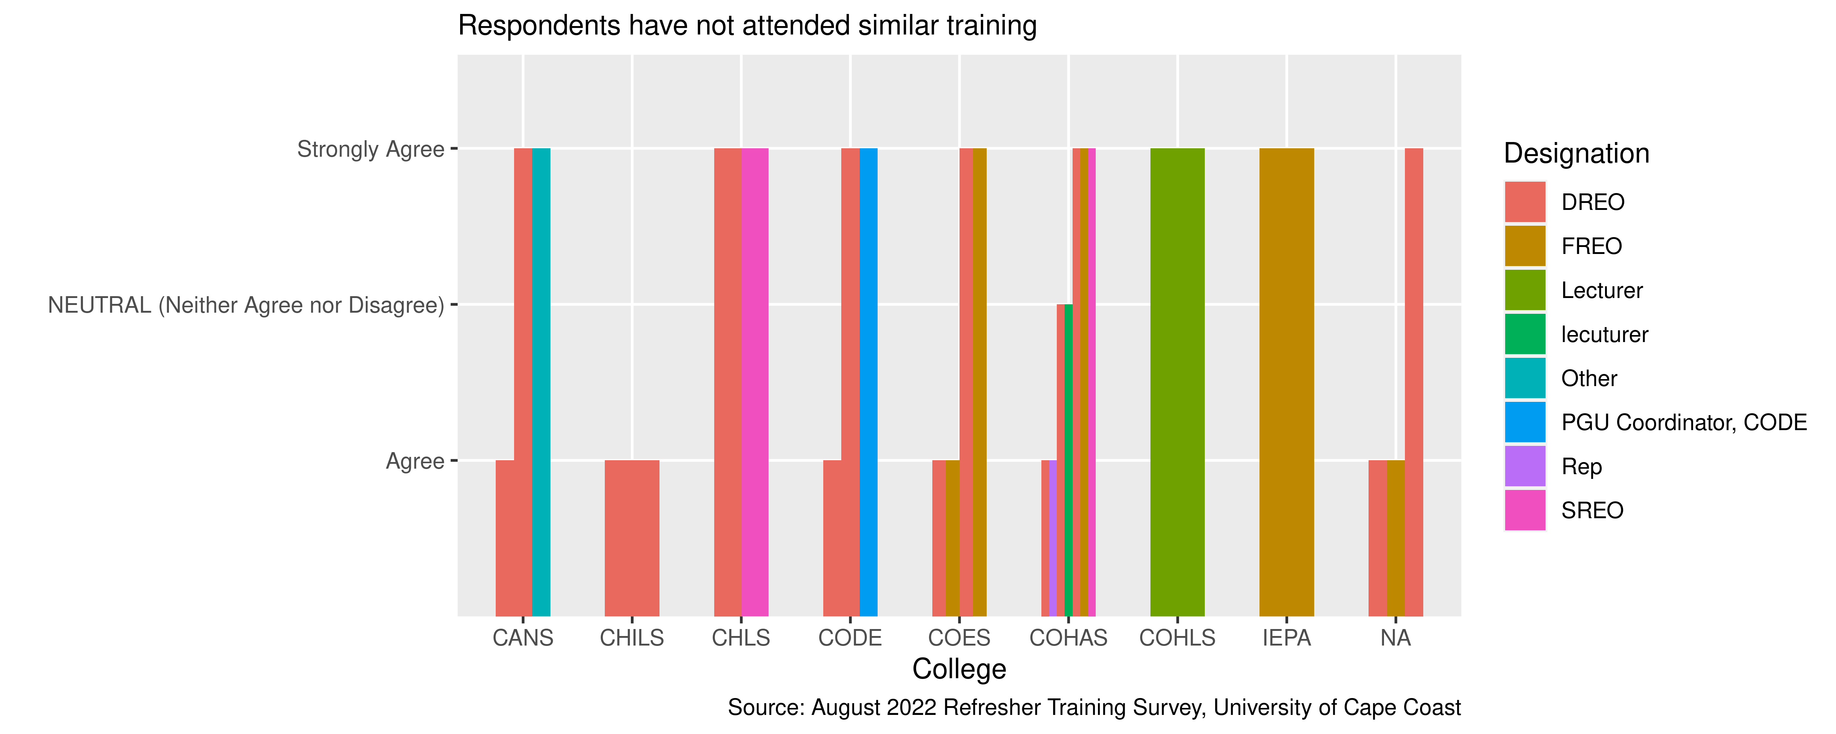
The training session was useful to my work

Slide 6
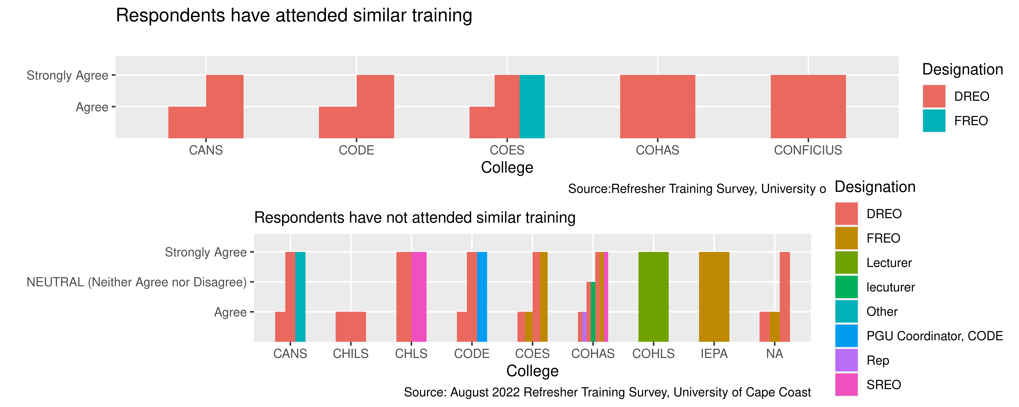
Conversely

Slide 7
The training will impact positively on my work

Slide 8
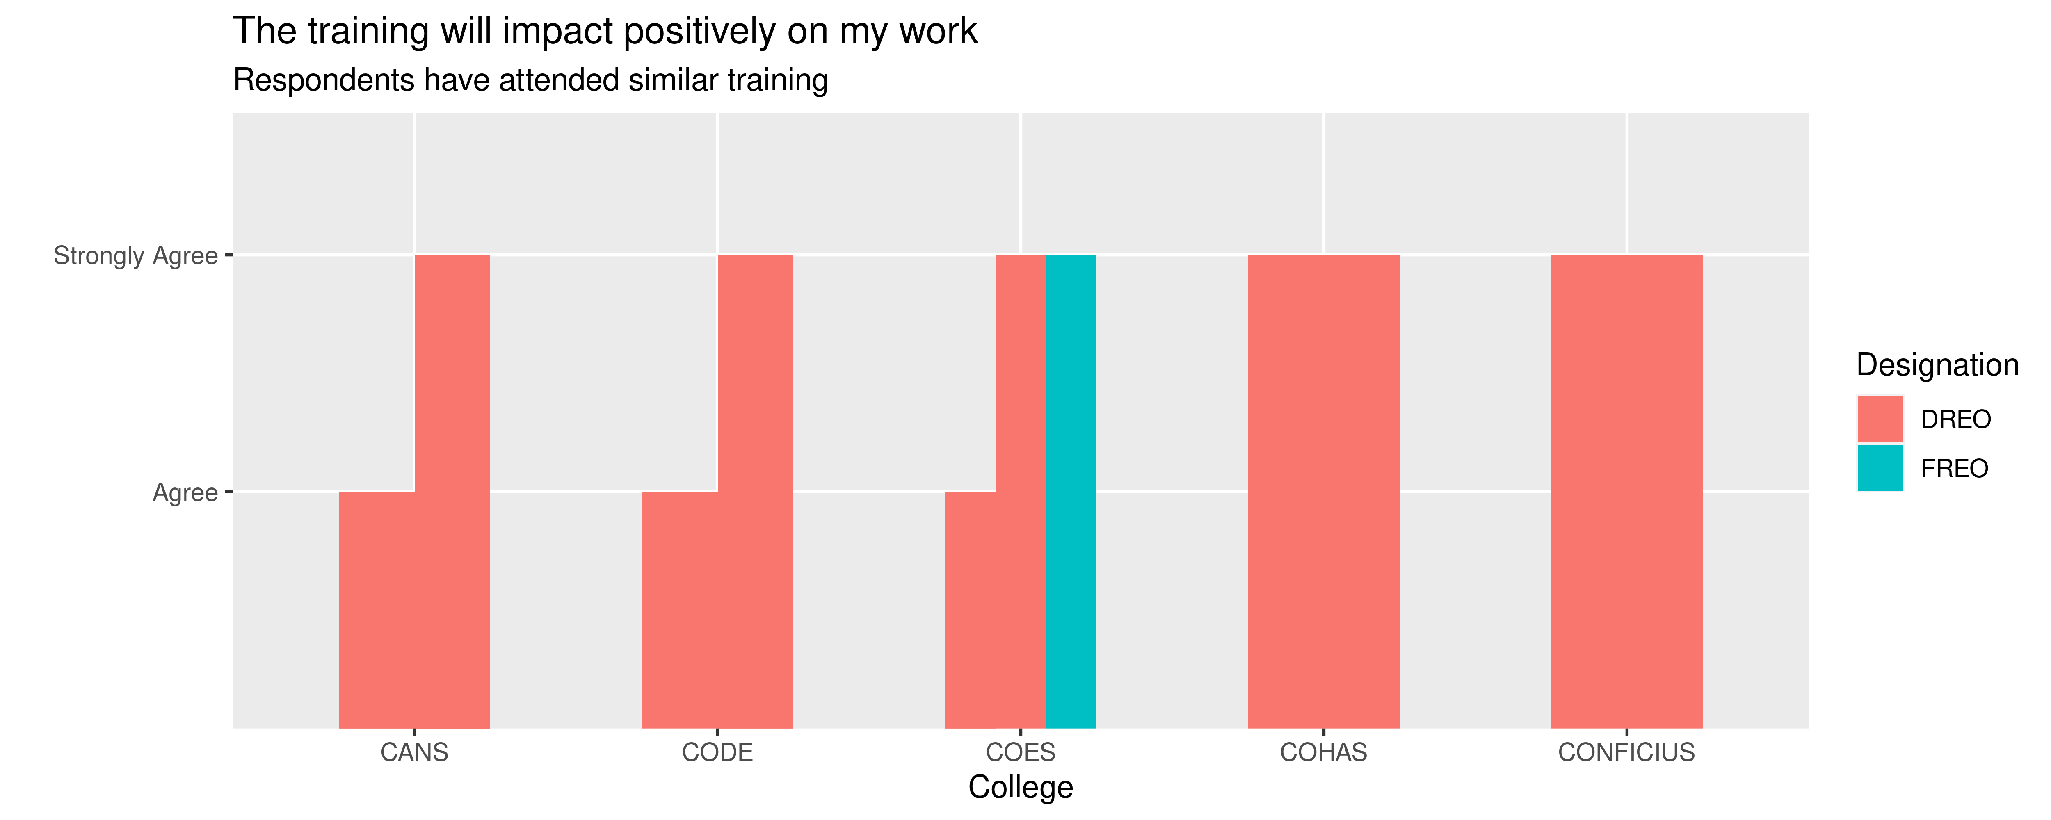
Positive Impact On Work

Slide 9
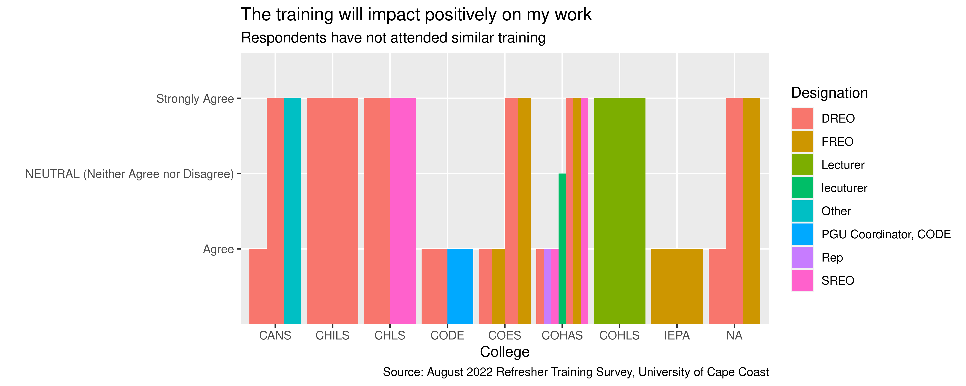
Positive Impact On Work

Slide 10
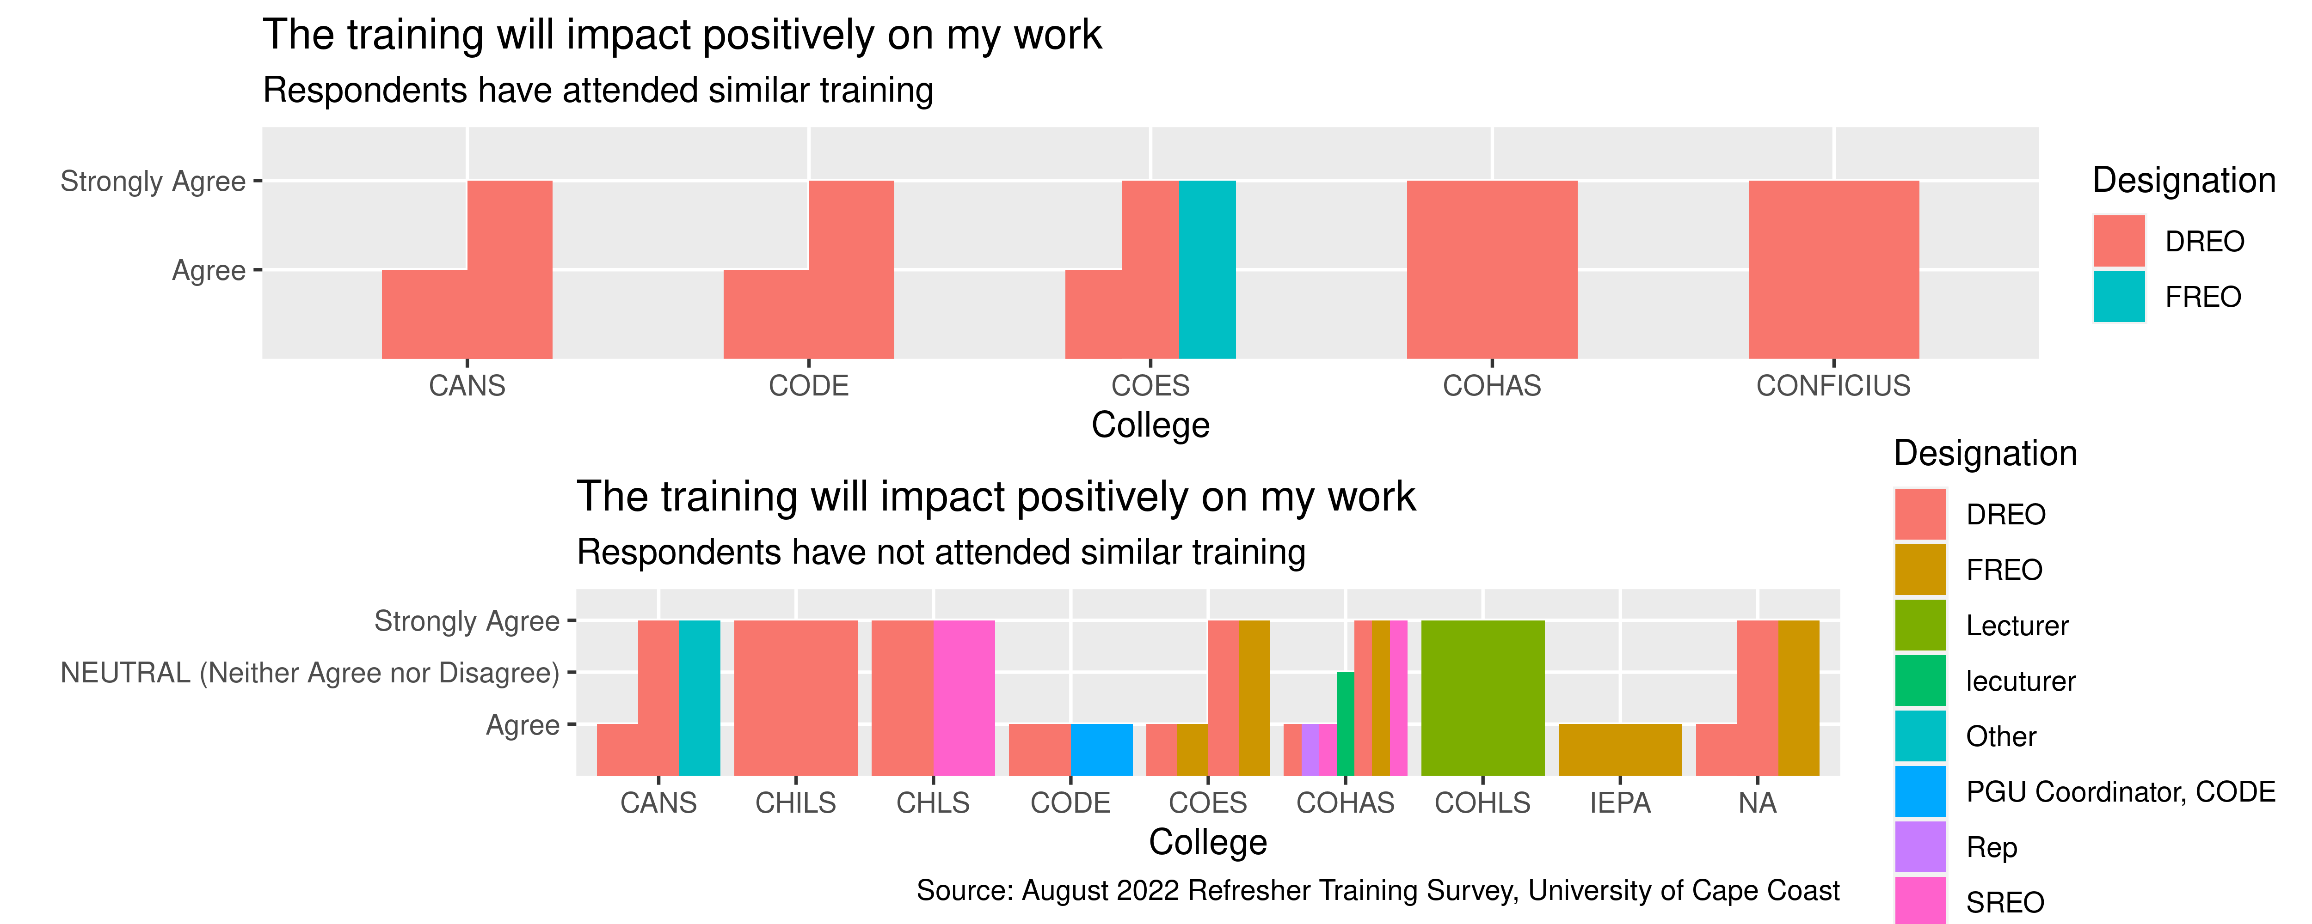
Comparison

Slide 11
Question: I need such training regularly

Slide 12
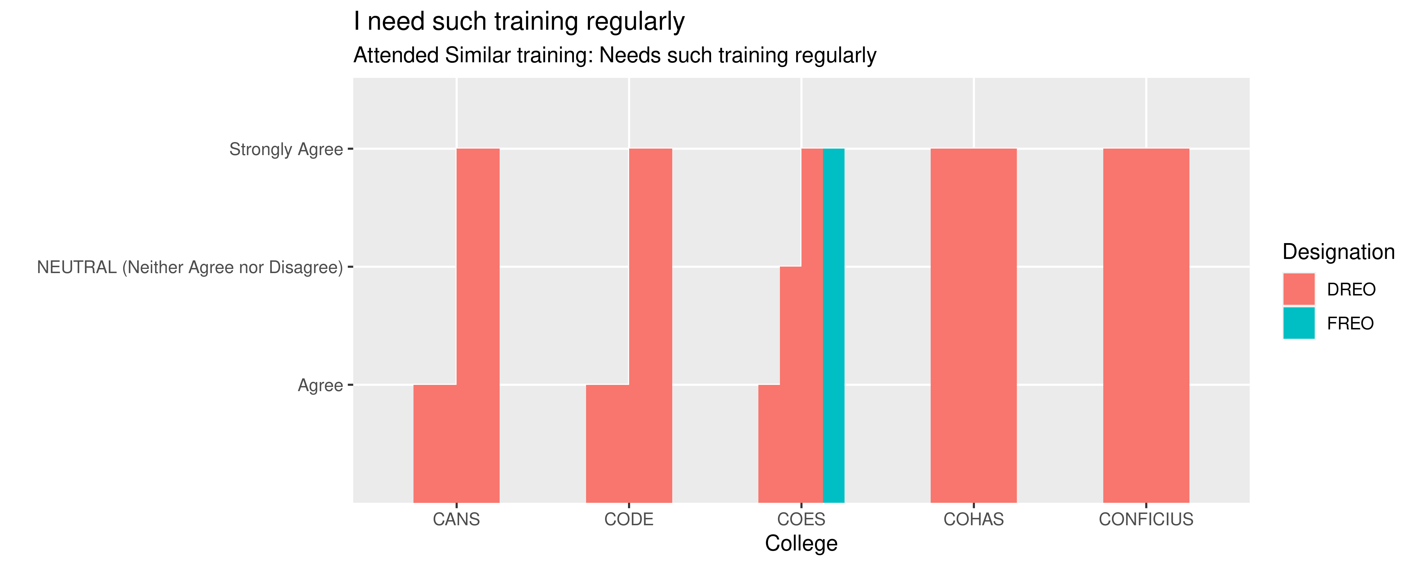
The need for such training regularly

Slide 13
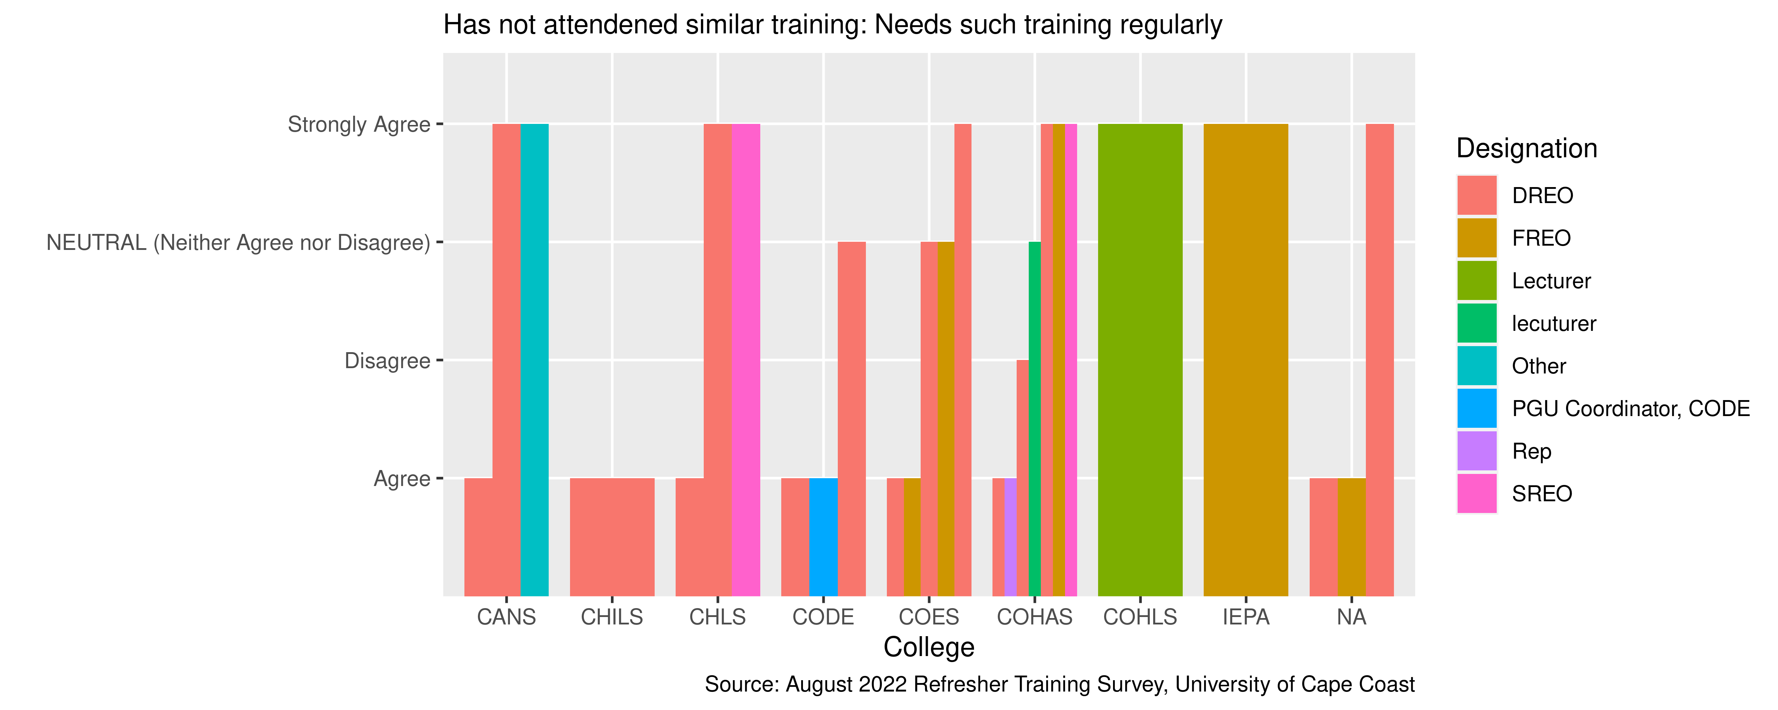
The need for such training regularly

Slide 14
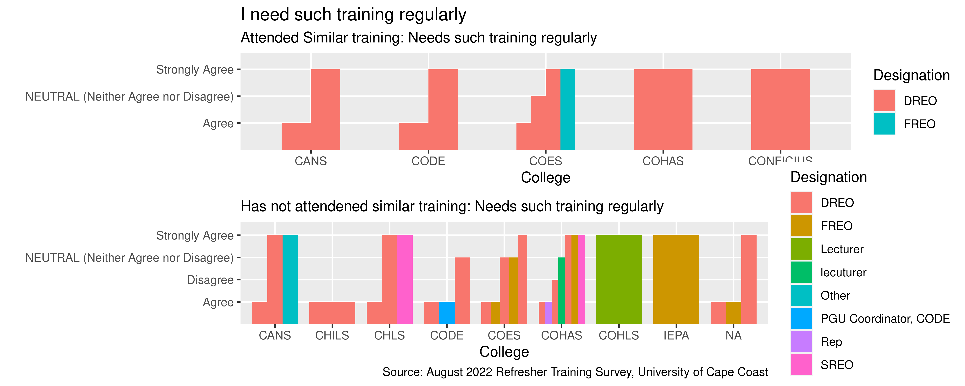
Comaparison

Slide 15
Question : I have acquired the basic knowledge necessary to use the UCCOSIS

Slide 16
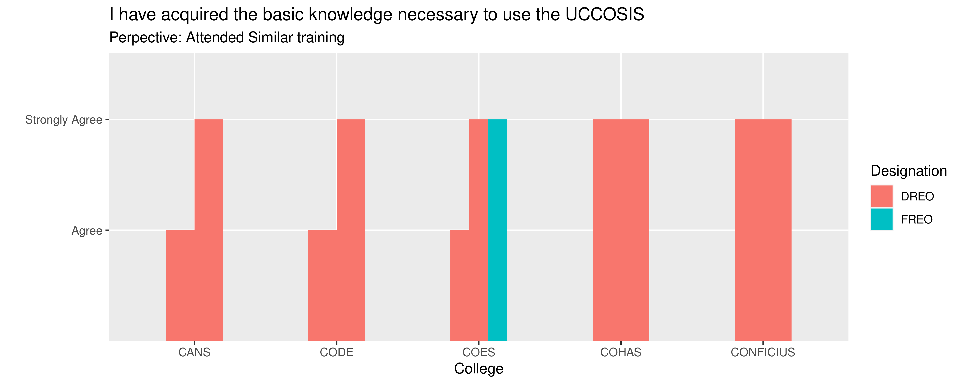
Acquired basic Knowledge on UCCOSIS usage

Slide 17
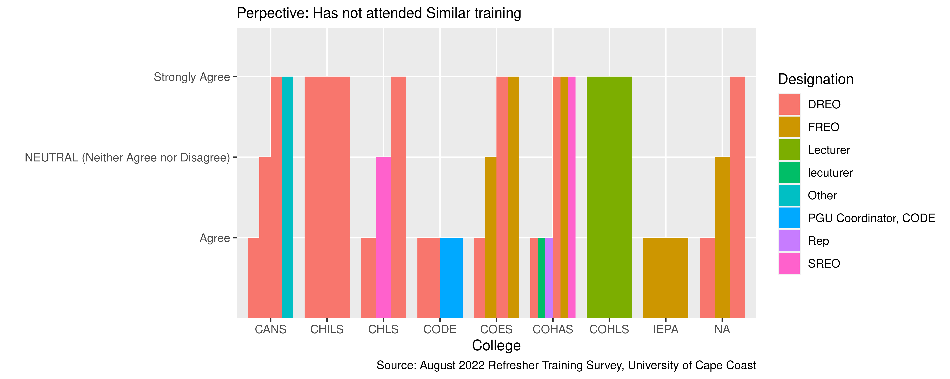
Acquired basic Knowledge on UCCOSIS usage

Slide 18
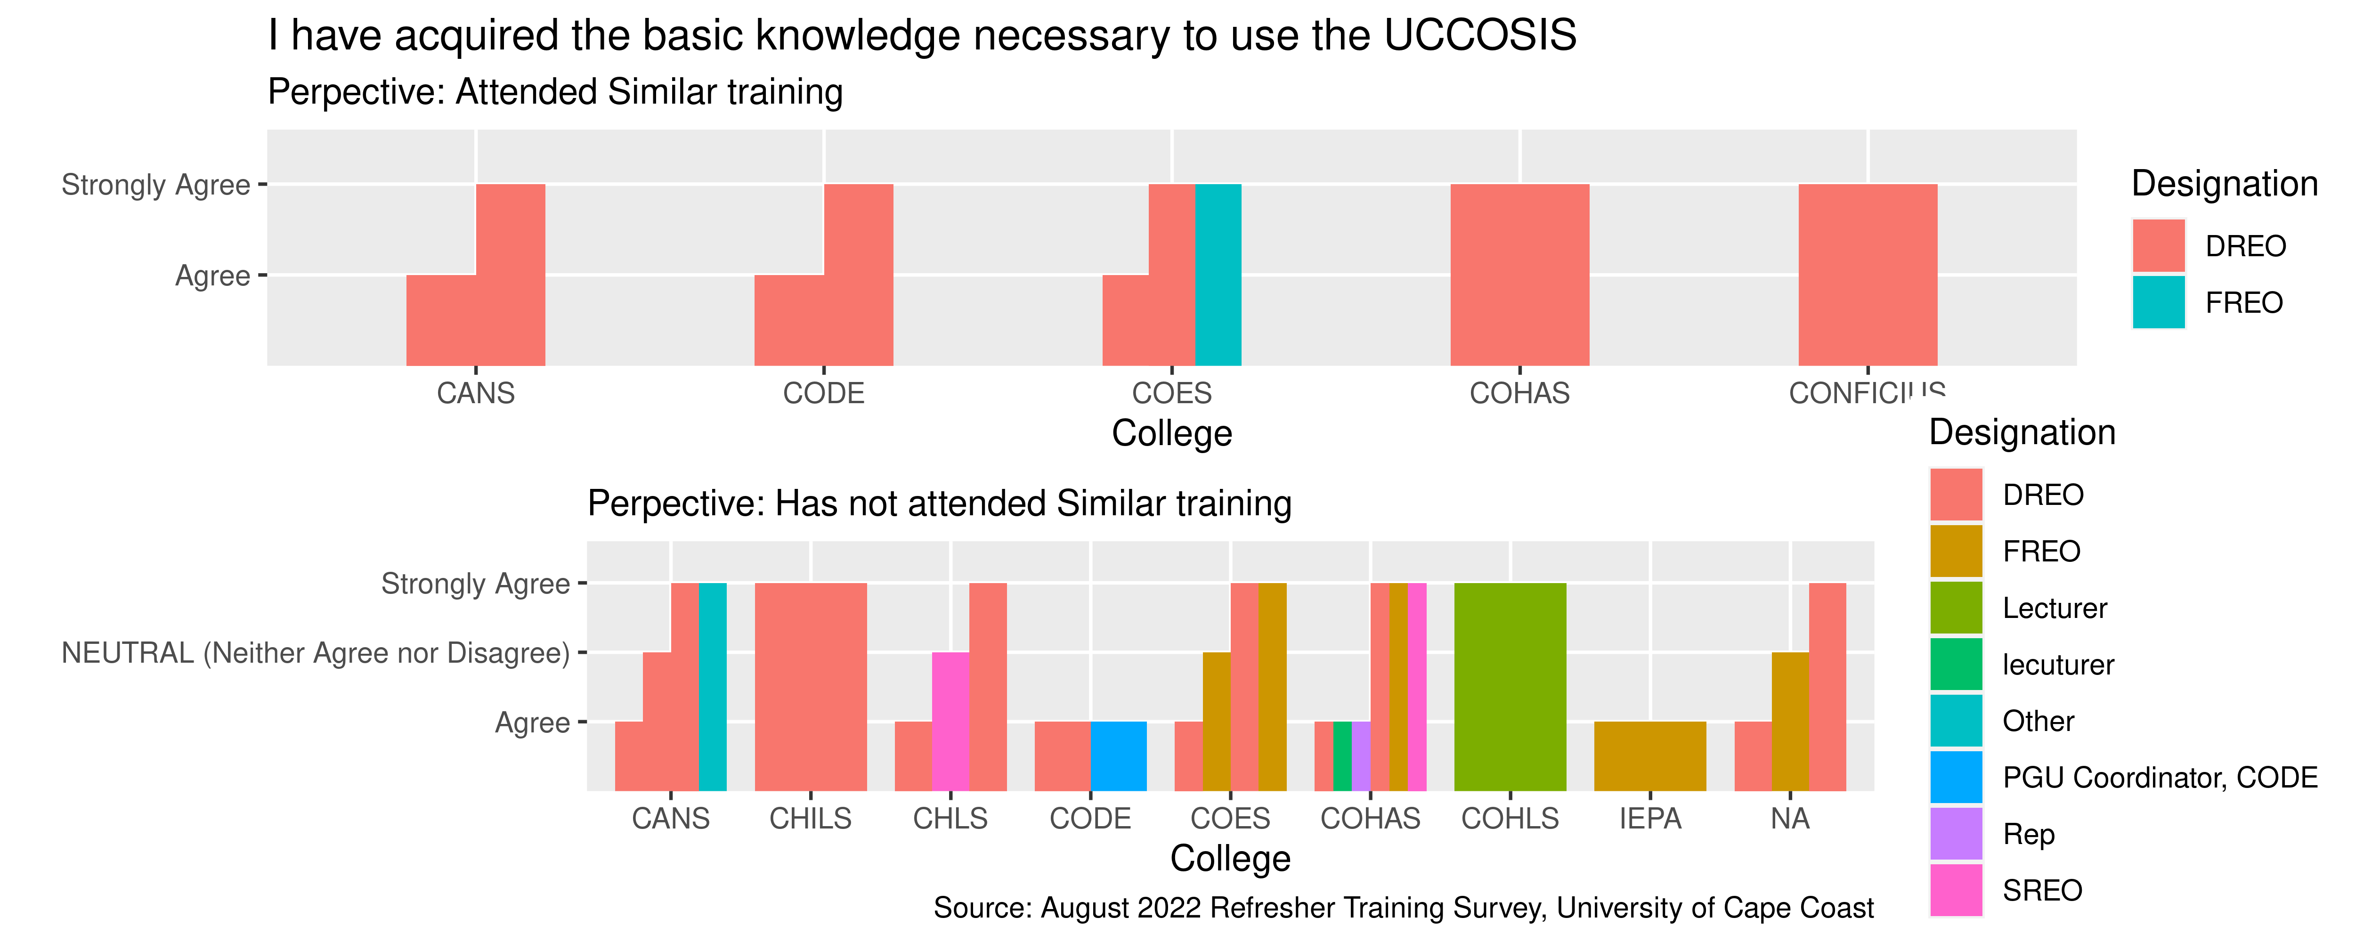
Comparison

