Slide 1

AI Behavior Tree
Zening Teng

Slide 2

AI Behavior Tree
AI Decision ？
An AI Decision Tree is a simple way to describe how an AI makes decisions
by asking a sequence of yes-or-no questions.
Instead of “thinking” freely, the AI follows a clear structure:
Check a condition
Based on the result, choose one action
Repeat this process continuously

Slide 3

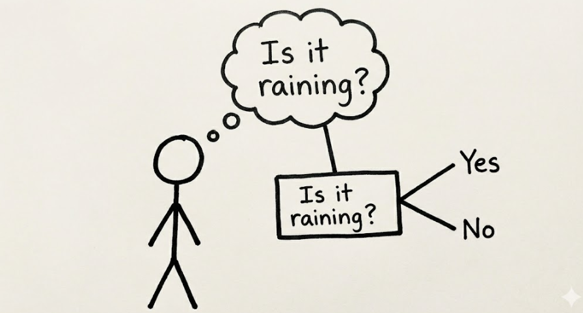
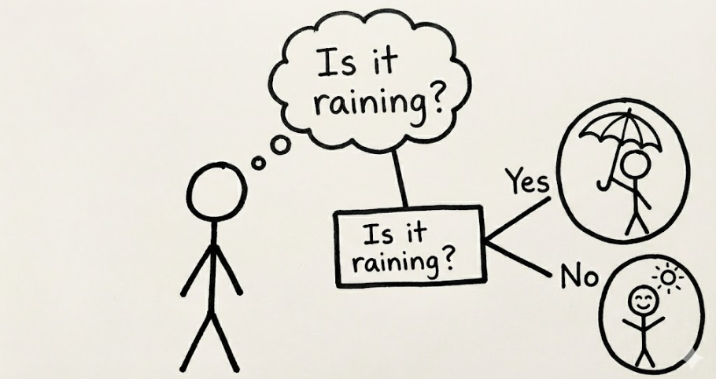

Slide 4
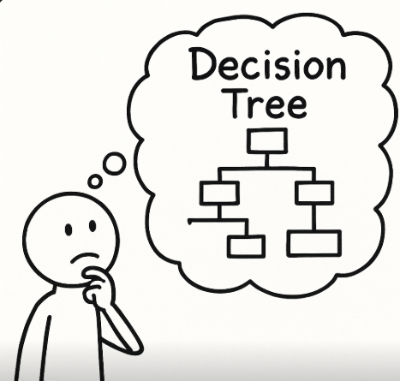

Slide 5
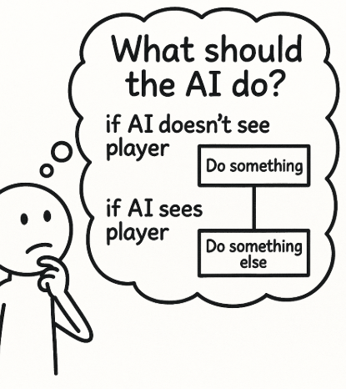
What is the AI thinking?
In games, AI does not “think” like humans.
Instead, it constantly asks simple questions about the current situation:
Can I see the player?
Is the player close or far?
Should I attack, or should I patrol?
Based on the answers to these questions, the AI chooses one action to execute.

Slide 6

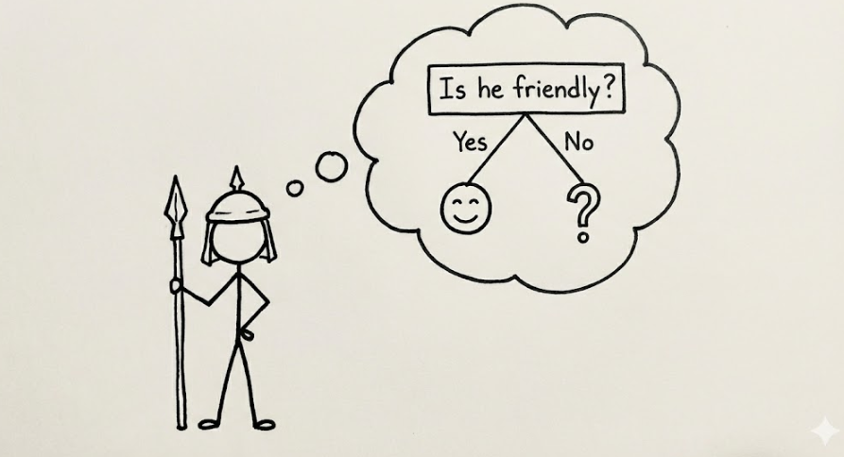
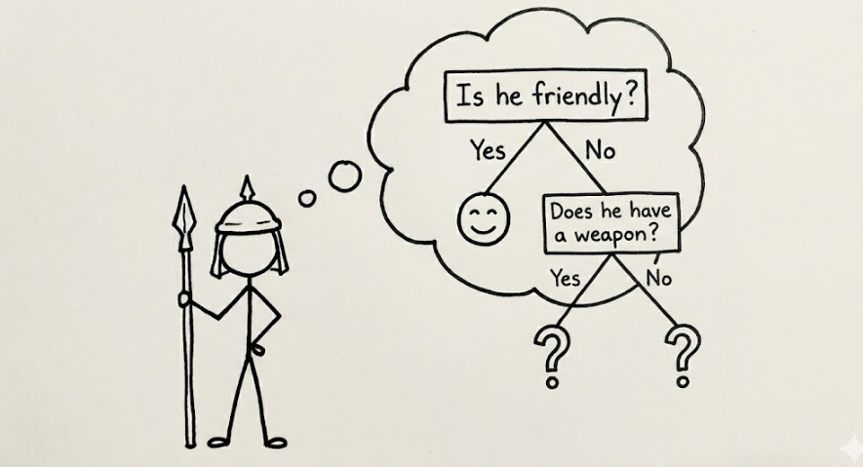
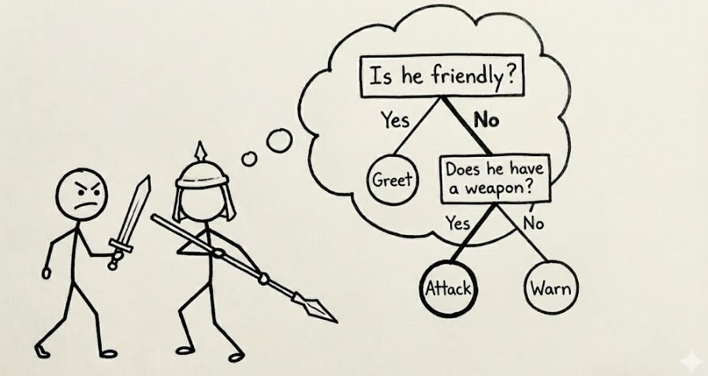

Slide 7
The Power of Scale: Infinite Possibilities
What starts as a simple "Yes/No" can expand into thousands of distinct branches.
Every subtle environmental change (weather, health, distance, reputation) can be a new node.
Capable of mapping millions of unique scenarios, transforming a simple "guard" into a complex, living character.
Conclusion: One structure, infinite outcomes.

Slide 8


Beyond Gaming: Behavior Trees in Robotics
The Challenge: Real-world environments are unpredictable (unlike static game maps).
The Solution: Behavior Trees provide Reactive Planning.
  They allow machines to switch tasks instantly when conditions change.
Use Case: Autonomous Warehouse Robots
  Task: "Retrieve Package."
  Interruption: "Obstacle Detected" or "Low Battery."
  Reaction: The tree switches branches from [Move] to [Wait] or [Recharge].
Industry Adoption: Now a standard in ROS (Robot Operating System) and used in NASA Mars Rover mission planning.

