Slide 1
Use of Fuzzing Via Random Julia Code Generation To Test Julia Compiler Optimizations
26 June 2020
Harrison Ashley Ankers
Project Supervisor: Dr John Wickerson
Second Marker.: Dr James J. Davis
CID: 01211208

Slide 2
Abstract
Julia Fuzzing To Test Julia Compiler Optimizations
26 June 2020
With growing reliance and trust in programming languages, it is fundamental that programs abide by their set rules to ensure user confidence. This report details the creation of a Julia-based Julia evaluating fuzzer. This fuzzer generates syntactically correct Julia code to expose flaws amongst different Julia optimisation levels. Through this, two issues with the language have been found: a strange for-loop variable behaviour that is scheduled to be fixed in the next release, and a precision issue with the standard function “muladd”.

Slide 3
Background
Julia Fuzzing To Test Julia Compiler Optimizations
26 June 2020

Slide 4
Compilers
Julia Fuzzing To Test Julia Compiler Optimizations
26 June 2020
High Level Code
Compiler
Low Level Code

Slide 5
LLVM Compiled C Code
Julia Fuzzing To Test Julia Compiler Optimizations
26 June 2020

Slide 6
Example Optimization: Loop Unrolling
Julia Fuzzing To Test Julia Compiler Optimizations
26 June 2020
Original | Unrolled | Further Optimised
int x; int a; for (x = 0; x < 5; x++) { a=x+1; } | int a; a=0+1; a=1+1; a=2+1; a=3+1; a=4+1; | int a = 15;

Slide 7
Fuzzing
Julia Fuzzing To Test Julia Compiler Optimizations
26 June 2020
Software Under Test
Unverified Output
Random Input

Slide 8
Differential Testing
Julia Fuzzing To Test Julia Compiler Optimizations
26 June 2020
Unverified Output
Compiler
Compiler
Compiler
Execution
Execution
Execution
0
0
1

Slide 9

Julia Fuzzing To Test Julia Compiler Optimizations
26 June 2020

Slide 10
Julia at a glance
Julia Fuzzing To Test Julia Compiler Optimizations
26 June 2020
Downloaded 13 million times
Uses
Data science
Machine learning
Scientific computing (e.g. Biology, Quantum Physics, Astronomy packages)
Parallel computing
High level syntax akin to Python
High performance [2]
First released in 2012 [3]
[1] MIT, https://docs.julialang.org/, Julia Homepage, December 2018.
[2] A. Medema, “Basic comparison of python, julia, matlab, idl and java (2019 edition).” https://modelingguru.nasa.gov/docs/DOC-2783, 07 2019. Accessed on 16/6/2020.
[3] MIT, https://julialang.org/blog/2012/02/why-we-created-julia/, Julia Release, December 2018.

Slide 11
Method
Julia Fuzzing To Test Julia Compiler Optimizations
26 June 2020

Slide 12
Design Goals
Julia Fuzzing To Test Julia Compiler Optimizations
26 June 2020
Maximising Julia language coverage
Reducing error alerts
Increasing efficiency

Slide 13
Project Structure
Julia Fuzzing To Test Julia Compiler Optimizations
26 June 2020
C++ Abstract Syntax Tree (Discontinued)
Julia Abstract Syntax Tree
AST:- “An abstract syntax tree (AST) is a way of representing the syntax of a programming language as a hierarchical tree-like structure.” [4]
Bash Testing environment
[2] Techopedia, “Abstract Syntax Tree (AST)” https://www.techopedia.com/definition/22431/abstract-syntax-tree-ast, 07 2018. Accessed on 17/6/2020

Slide 14
Statement Lists and Statements
Julia Fuzzing To Test Julia Compiler Optimizations
26 June 2020
Statement List
If Statement
Statement
Assign Statement
Statement List
Function Declaration
Statement
For Loop
Statement List

Slide 15
Bash Testing Environment
Julia Fuzzing To Test Julia Compiler Optimizations
26 June 2020
Manages the following
Flags
Creation and managing of directories
Looping
Initiates the file generation
Runs files
Compares outputs
Redirects errors and bugs

Slide 16
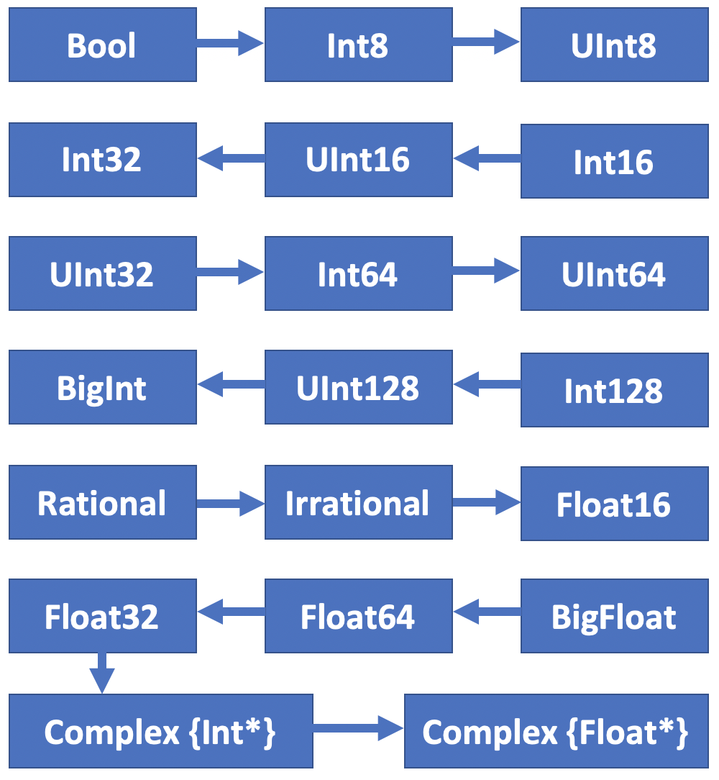
Type Handling
Julia Fuzzing To Test Julia Compiler Optimizations
26 June 2020
Typed arguments
Example: if expressions
Example: Bitwise arguments
Perform promotion between operators
Example 1: 1+2.1=3.1
Example 2: true/true=1.0

Slide 17
Variables
Julia Fuzzing To Test Julia Compiler Optimizations
26 June 2020
State contains:
Type (e.g. Integer)
Scope number
Id (e.g. var_23)

Slide 18
Control Flow
Julia Fuzzing To Test Julia Compiler Optimizations
26 June 2020
For loops
Exposed to optimizations
Range issues

Slide 19
Functions
Julia Fuzzing To Test Julia Compiler Optimizations
26 June 2020
Julia standard functions
Self declared functions
Function use in expressions
State stores:
Type (e.g. Integer)
Scope number
Id (e.g. var_23)
Argument types (e.g. [Integer, Float, Integer])

Slide 20
Results
Julia Fuzzing To Test Julia Compiler Optimizations
26 June 2020

Slide 21
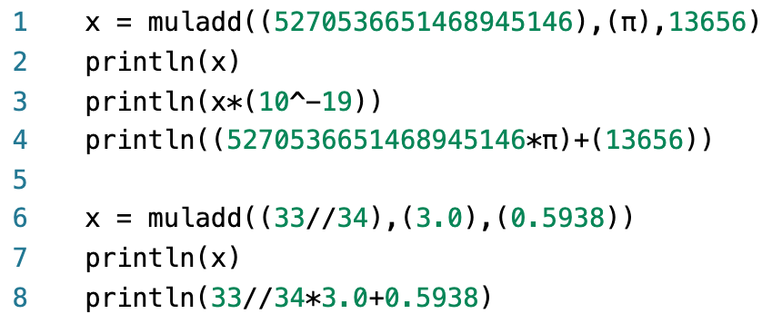
Muladd Precision
Julia Fuzzing To Test Julia Compiler Optimizations
26 June 2020
Optimization level 0 & 1
1.6557879224730601e19
1.6557879224730618
1.6557879224730601e19 (true)
3.5055647058823527
3.5055647058823527 (true)
Optimization level 2 & 3
1.6557879224730601e19
1.6557879224730616
1.6557879224730601e19 (true)
3.505564705882353
3.5055647058823527 (true)

Slide 22
For-loop Behaviour
Julia Fuzzing To Test Julia Compiler Optimizations
26 June 2020

Slide 23
Conclusion
Julia Fuzzing To Test Julia Compiler Optimizations
26 June 2020

Slide 24
Future Works
Julia Fuzzing To Test Julia Compiler Optimizations
26 June 2020

Slide 25
Future Works
Julia Fuzzing To Test Julia Compiler Optimizations
26 June 2020

Slide 26
Bibliography
Julia Fuzzing To Test Julia Compiler Optimizations
26 June 2020

Slide 27
Thank you
Julia Fuzzing To Test Julia Compiler Optimizations
26 June 2020

