Slide 1
IMS Project
Harry brown

Slide 2
Introduction
Use the knowledge and skills acquired during the modules covered during training to create a functioning program.
IMS-Starter repository.
Project management and documentation.

Slide 3
Consultant Journey
Project Management – Jira
Version Control – Git
Database System – SQL
Back-End Programming Language – Java
Build Tool – Maven
Testing – JUnit

Slide 4
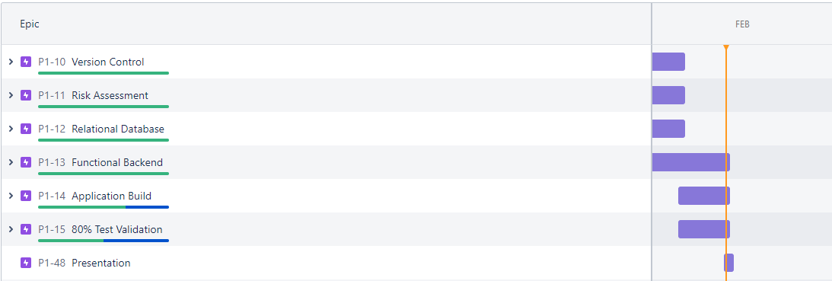
Jira

Slide 5
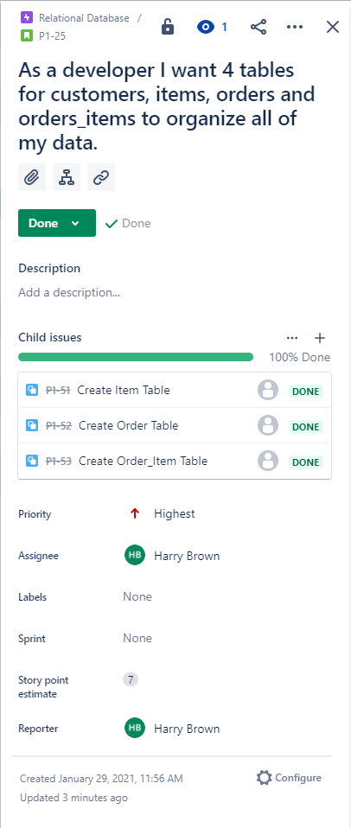
Jira

Slide 6
Git
Using GitHub I would commit and push whichever branch I was working on often.
If I had an error I could not resolve I would be able to revert or reset to a previous version.
Branches included
master
develop
item
order
test

Slide 7
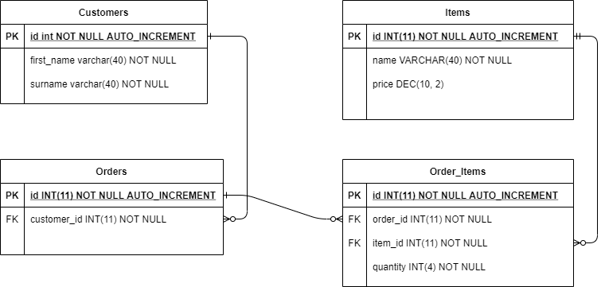
ERD

Slide 8
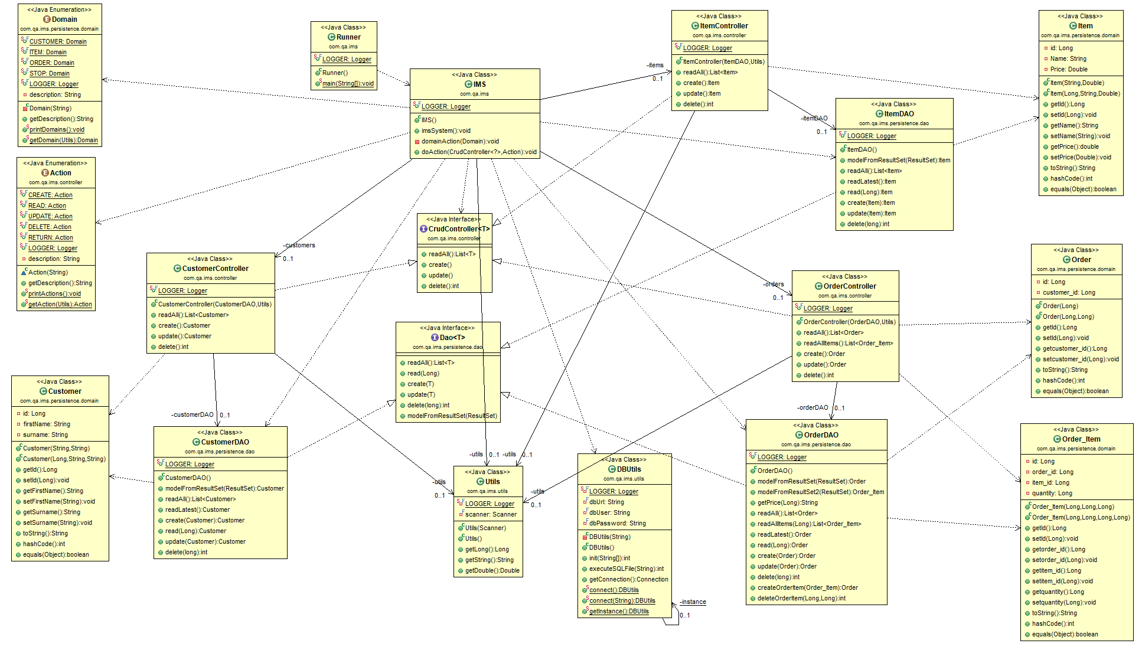
UML

Slide 9
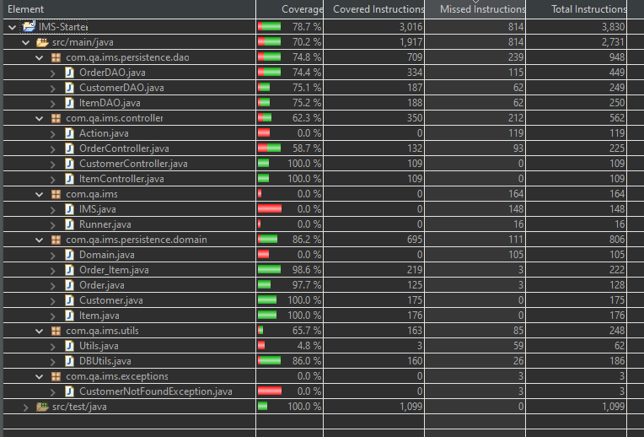
Testing

Slide 10
Demo

Slide 11
Sprint Review

Slide 12
Sprint Retrospective
I was able to complete all functionality requested.
What went well
Java programming
SQL
Project management
What went wrong
Documentation
Testing

Slide 13
Conclusion
I feel like the project went well, the program itself especially.
My pre existing time management skills helped with the sprint.
Improve on documentation and testing.

Slide 14
Questions?

