Slide 1
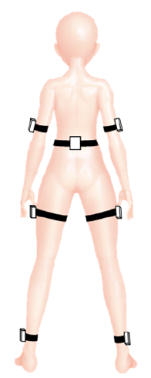
S2S
Source domain data
訓練
Train
Model
Test
驗證

Slide 2
S2T
Source domain data
Source
訓練
Train
Model
Target domain data
Target
Test
驗證

Slide 3
DABBS
Source
DA
Different
Same distribution
Target

Slide 4
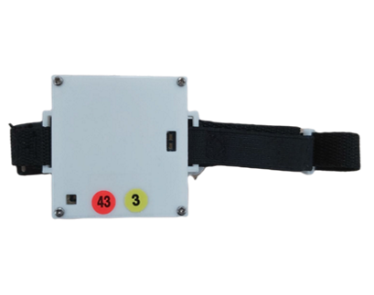
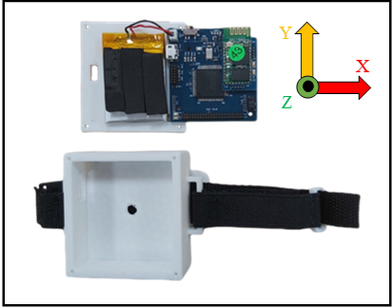

Slide 5
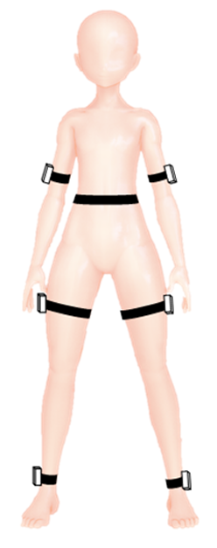
One IMU ,bad performance
Train Model
Model
Test Model
Poor
Performance

Slide 6
Many IMUs ,good performance
Model(5)
Model(1)
Model(2)
Model(6)
Model(3)
Model(7)
Model(4)

Slide 7
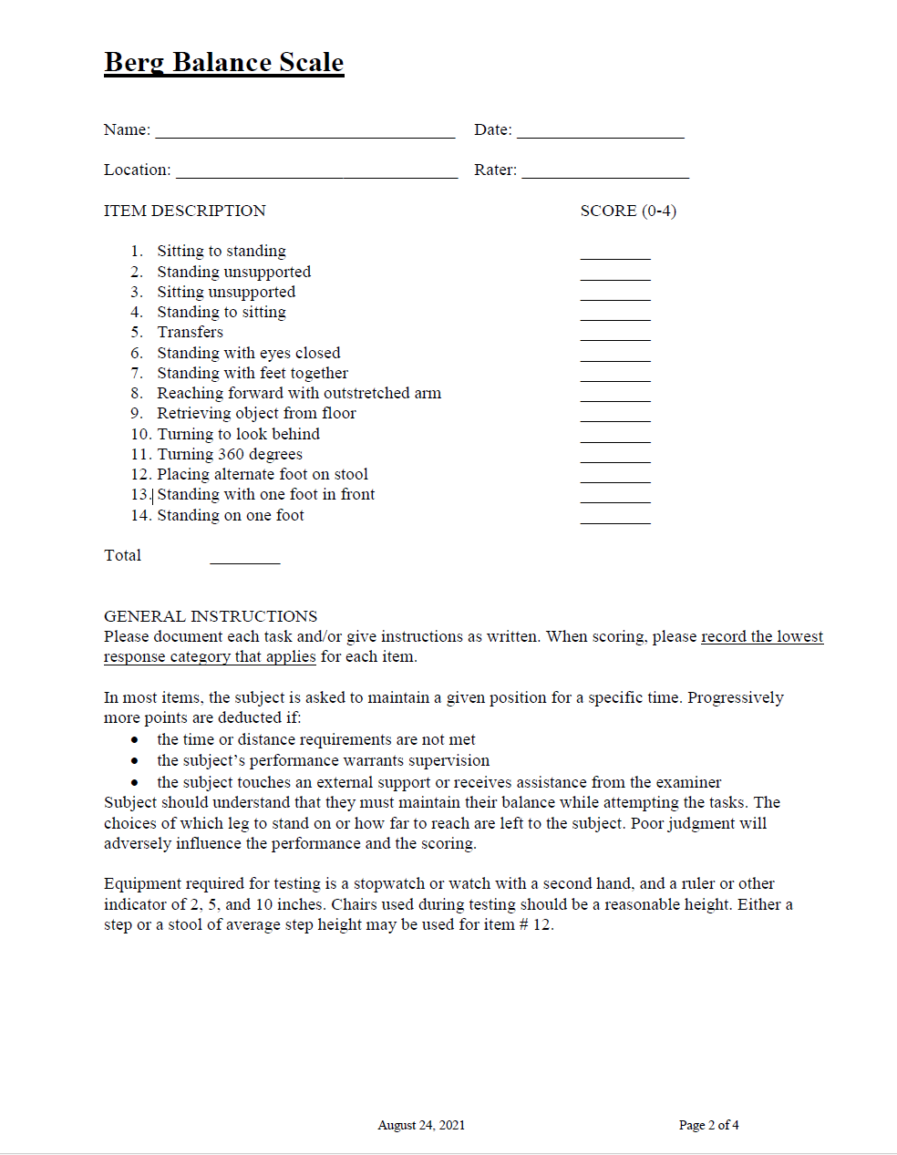
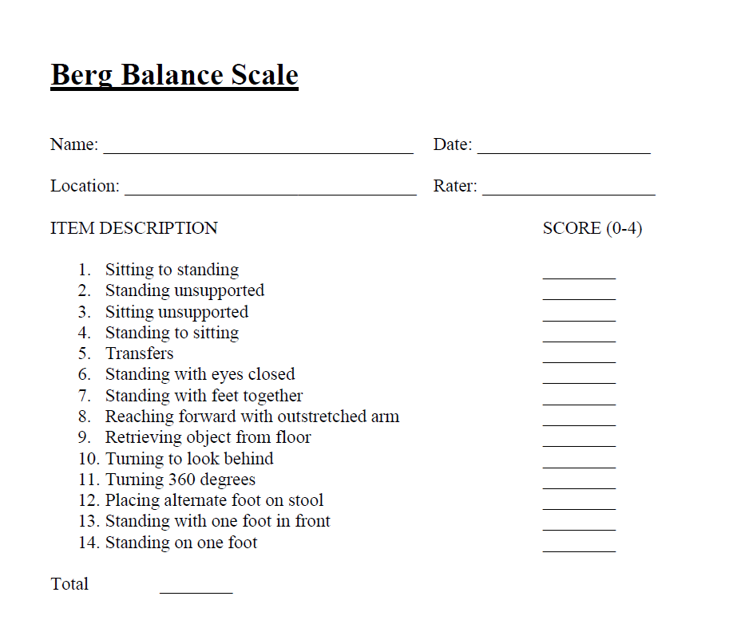

Slide 8
Source domain
source
Target domain
Source domain
Target
Target domain

Slide 9
S2S
Improved
By DA
S2T

Slide 10
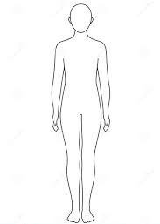
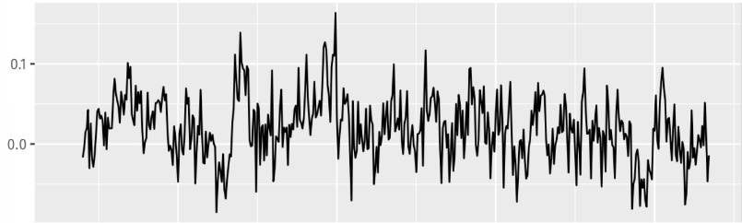
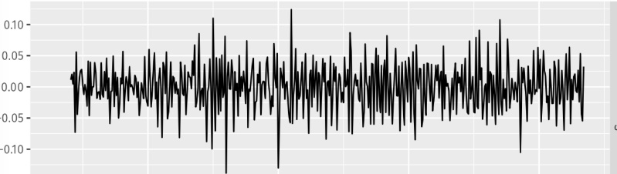
upper arm
waist

Slide 11
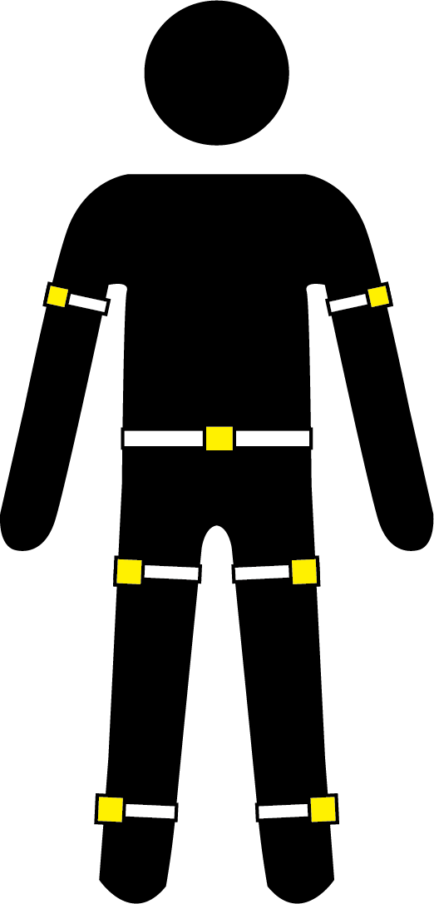
DeviceID:3
DeviceID:2
DeviceID:1
DeviceID:5
DeviceID:4
DeviceID:7
DeviceID:6

Slide 12
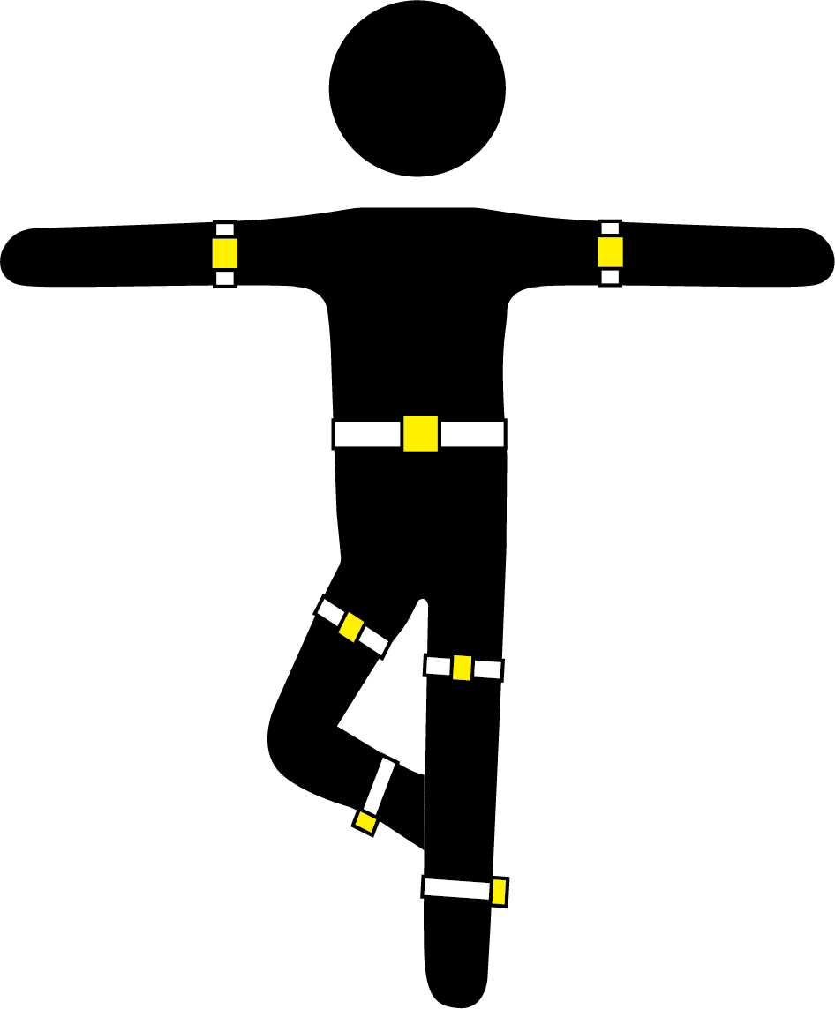
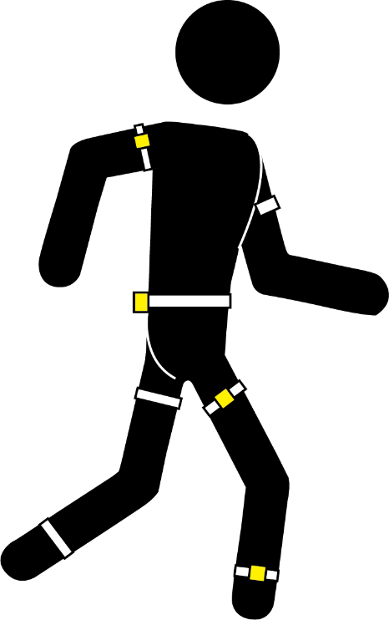
Data pre-processing
Normalization
Kinematic data
Data
segmentation
IMU 1
3-Axis
accelerometer
3-Axis
gyroscope
Source
Target
3-Axis
magnetometer
1 IMU
Data
6 IMU
Data
.
.
.
IMU 2
IMU 3
IMU 1
IMU 5
IMU 7
Domain adaptation/Prediction
IMU 4
Deep learning model
3-Axis
accelerometer
IMU 7
3-Axis
gyroscope
IMU 6
3-Axis
magnetometer
BBS score

