Slide 1
Car Price Prediction and Key Determinants in the U.S. Market

Slide 2
Content
Data Information
Explore Data Analysis
Model Selection
Evaluation and Result

Slide 3
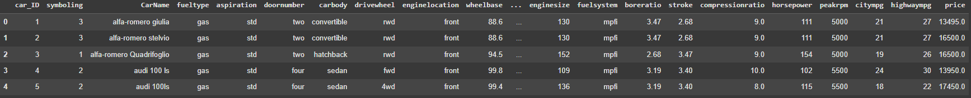
DATA INFORMATION
A Chinese automobile company, Geely Auto, plans to enter the U.S. market by establishing a local manufacturing unit to produce cars that can compete with American and European brands.
Specifically, the company wants to understand:
➔ What are the key factors that determine car pricing?
➔ Which technical specifications of a car have the most significant impact on its price?

Slide 4
1. Car price data dictionary
DATA INFORMATION
Column name | Description
Car_ID | Unique id of each observation (Integer)
Symboling | Its assigned insurance risk rating, A value of +3 indicates that the auto is risky, -3 that it is probably pretty safe.(Categorical)
carCompany | Name of car company (Categorical)
fueltype | Car fuel type i.e gas or diesel (Categorical)
aspiration | Aspiration used in a car (Categorical)
doornumber | Number of doors in a car (Categorical)
carbody | body of car (Categorical)
drivewheel | type of drive wheel (Categorical)
enginelocation | Location of car engine (Categorical)
wheelbase | Wheelbase of car (Numeric)
carlength | Length of car (Numeric)
carwidth | Width of car (Numeric)
Column name | Description
curbweight | The weight of a car without occupants or baggage. (Numeric)
enginetype | Type of engine. (Categorical)
cylindernumber | cylinder placed in the car (Categorical)
enginesize | Size of car (Numeric)
fuelsystem | Fuel system of car (Categorical)
boreratio | Bore Ratio of car (Numeric)
stroke | Stroke or volume inside the engine (Numeric)
compressionratio | compression ratio of car (Numeric)
horsepower | Horsepower (Numeric)
peakrpm | car peak rpm (Numeric)
citympg | Mileage in city (Numeric)
highwaympg | Mileage on highway (Numeric)
price(Dependent variable) | Price of car (Numeric)

Slide 5
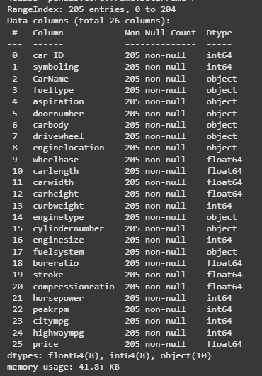
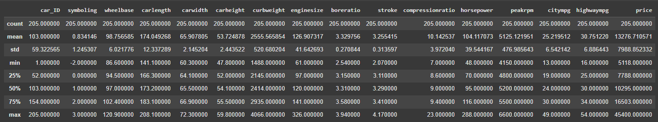
EXPLORE DATA ANALYSIS
Data Inspection
Identified and handled missing values
Checked for duplicated records
Detected outliers using the IQR
Fixed misspelled categorical values
Removed irrelevant or inappropriate
Findings
Dataset contains 205 records and 15 numerical columns.
Numerical features like carlength, curbweight, and enginesize show wide but reasonable ranges.
Average engine size is around 127 cc and horsepower around 104 HP, indicating diverse car types.
Average price is $13,276, with values ranging from $5,118 to $45,400, suggesting high variability.
Fuel efficiency averages 25 city MPG and 30 highway MPG, consistent with typical car performance.

Slide 6
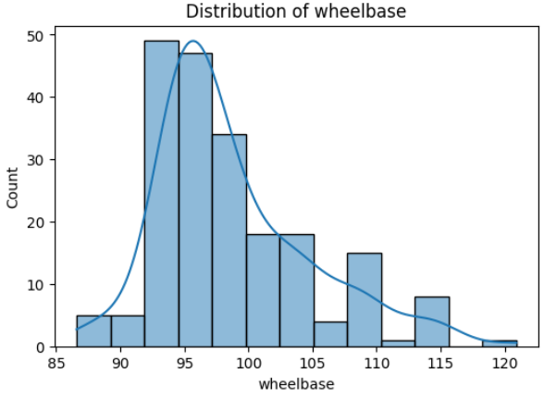
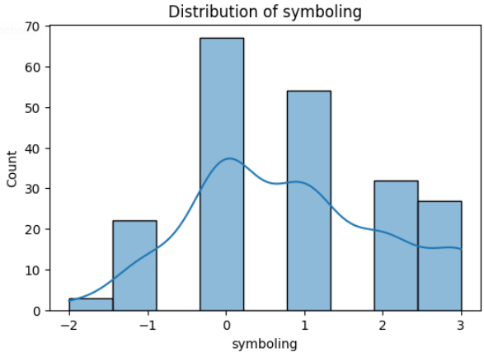
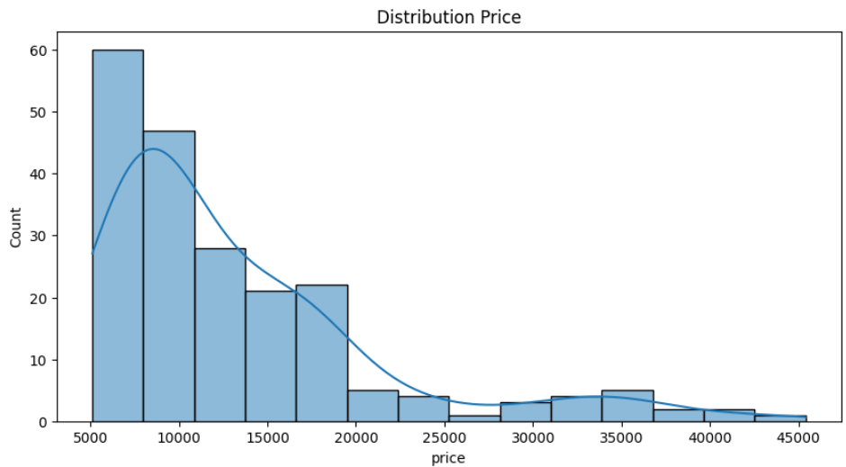
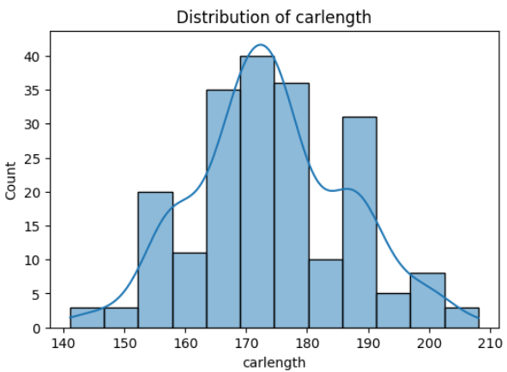
EXPLORE DATA ANALYSIS
Univariate Analysis
Numerical Features:
2. Wheelbase
Distribution: Slightly right-skewed.
Insight: Majority of vehicles have a wheelbase between 95–100 inches, with a few larger models beyond 110 inches.
3. Symboling
Distribution: Multi-modal and discrete.
Insight: Represents categorical insurance risk levels rather than a continuous variable.
4. Carlength
Distribution: Approximately normal.
Insight: Most car lengths range from 170–180 inches, with few long vehicles above 190 inches.
1. Price
Distribution: Right-skewed.
Insight: Most cars are priced below $15,000, while a few luxury cars exceed $30,000, indicating possible outliers.

Slide 7
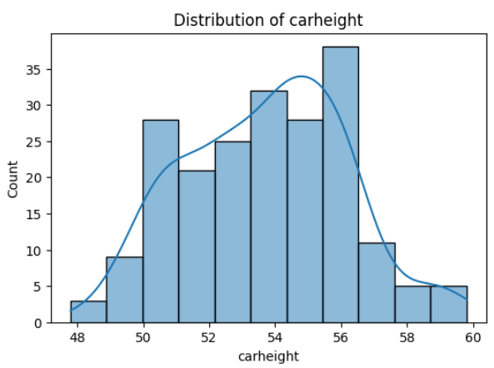
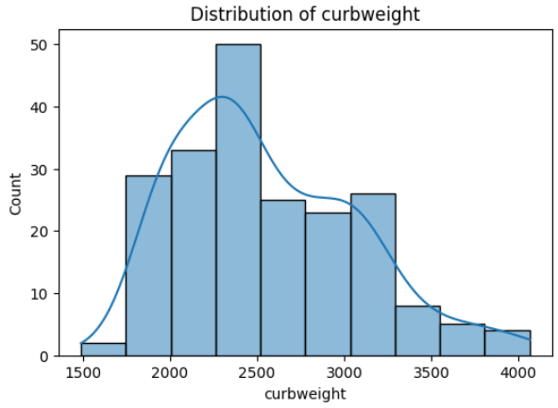
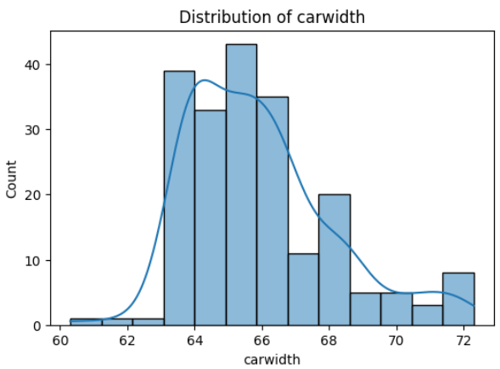
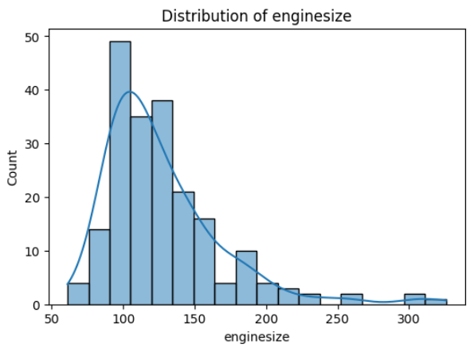
EXPLORE DATA ANALYSIS
Univariate Analysis
Numerical Features:
2. Carheight
Distribution: Approximately normal, slightly left-skewed.
Insight: Most vehicles have heights between 52–56 inches, with very few shorter or taller cars.
3. Curbweight
Distribution: Right-skewed.
Insight: Majority of vehicles weigh between 2,000–3,000 lbs, with heavier luxury cars reaching above 3,500 lbs.
4. Enginesize
Distribution: Strongly right-skewed.
Insight: Most cars have small to mid-size engines (under 150), while a few high-performance cars have engines over 250.
1. Carwidth
Distribution: Nearly normal with a slight right skew.
Insight: Most vehicles have widths between 64–67 inches, with a few wider models above 70 inches.

Slide 8
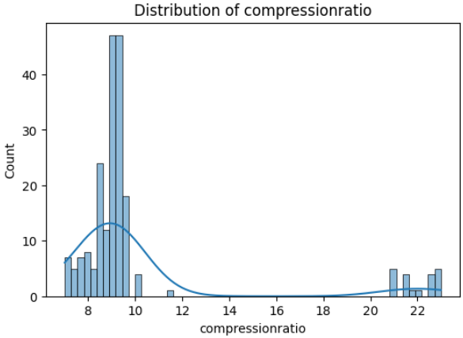
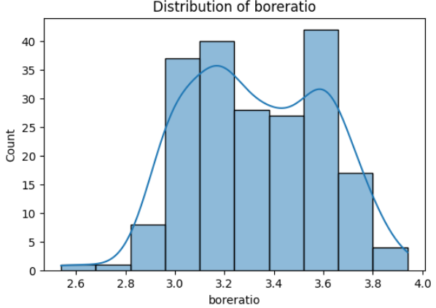
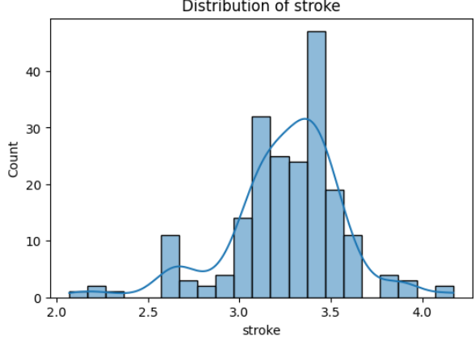
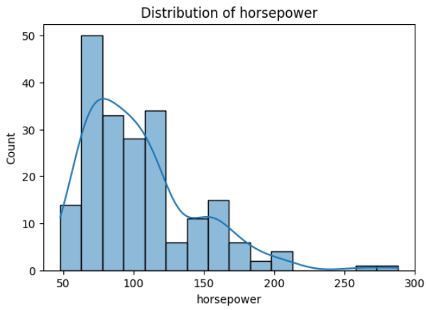
EXPLORE DATA ANALYSIS
Univariate Analysis
Numerical Features:
2. Compressionratio
Distribution: Highly right-skewed.
Insight: Most cars have a compression ratio around 8–10, but a few models have very high ratios (above 20).
3. Stroke
Distribution: Roughly normal with mild variation.
Insight: Majority of vehicles have stroke values between 3.0 and 3.5, indicating similar piston stroke design.
4. Horsepower
Distribution: Strongly right-skewed.
Insight: Most cars produce under 120 HP, while high-performance vehicles reach over 200 HP.
1. Boreratio
Distribution: Approximately normal.
Insight: Most values range between 3.0 and 3.6, suggesting consistent engine bore proportions across models.

Slide 9
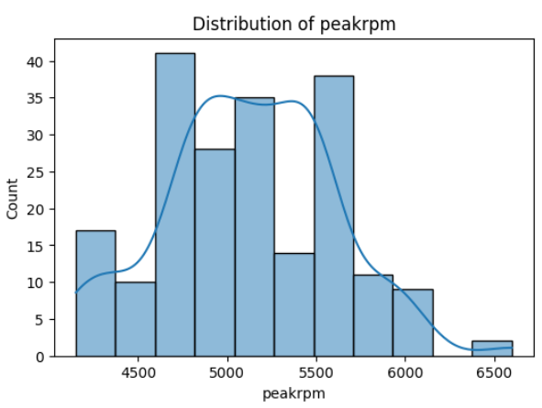
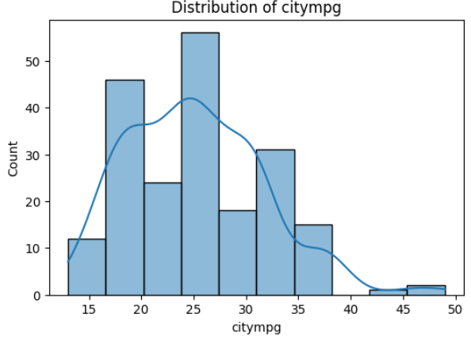
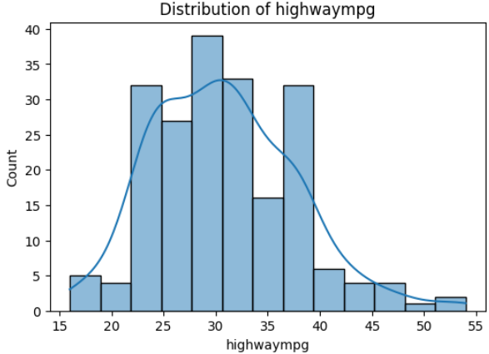
EXPLORE DATA ANALYSIS
Univariate Analysis
Numerical Features:
1. Peakrpm
Distribution: Approximately normal with slight right skew.
Insight: Most vehicles reach peak revolutions between 4,800 and 5,500 rpm, with only a few exceeding 6,000.
2. Citympg
Distribution: Right-skewed.
Insight: The majority of cars have city mileage between 20–30 mpg, while a few highly efficient models reach up to 45–50 mpg.
3. Highwaympg
Distribution: Nearly normal.
Insight: Most highway mileage values fall between 25–40 mpg, showing a balanced distribution across vehicle types.

Slide 10
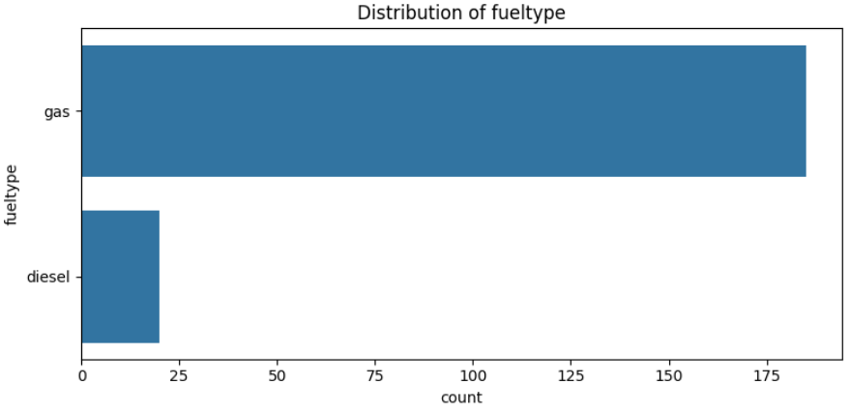
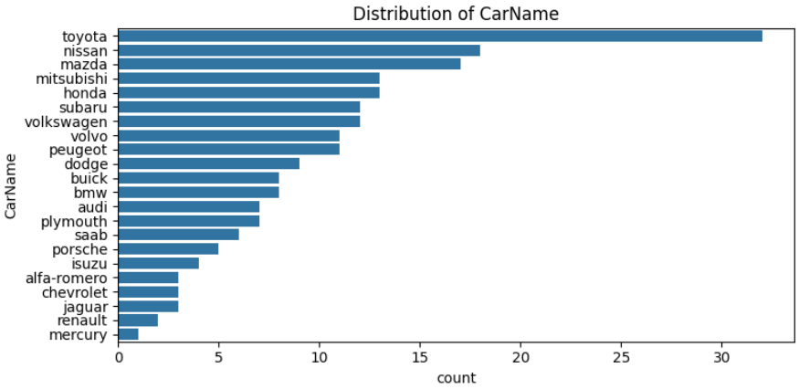
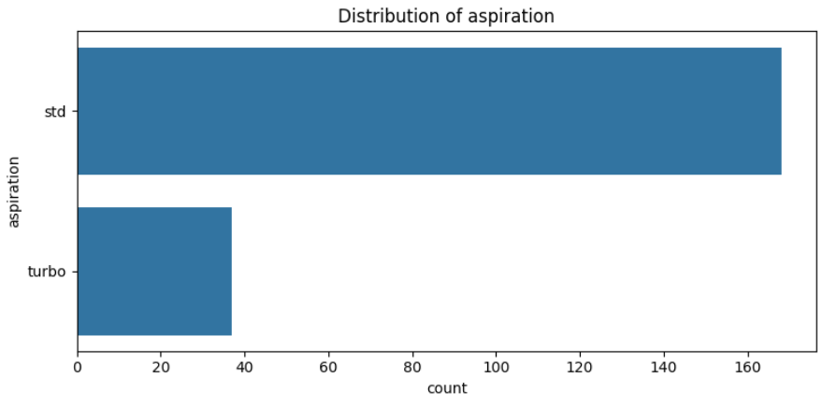
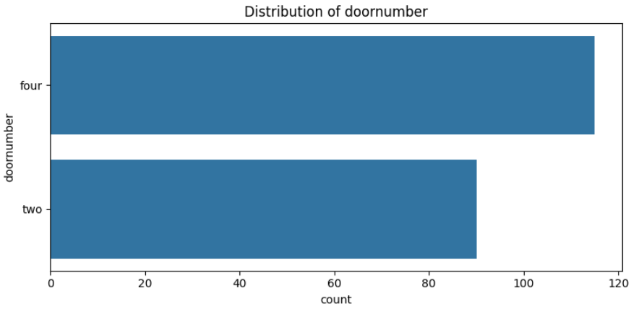
EXPLORE DATA ANALYSIS
Univariate Analysis
Categorical Features:
2. Fueltype
Insight:
The majority of cars use gasoline (gas), while only a small portion use diesel.
3. Aspiration
Insight:
Most vehicles have standard (std) aspiration systems, while a smaller proportion are turbocharged (turbo).
4. Doornumber
Insight:
Cars with four doors slightly outnumber those with two doors.
1. CarName
Insight:
Toyota is the most frequent brand in the dataset, followed by Nissan, Mazda, and Mitsubishi.
Brands such as Mercury, Renault, and Jaguar appear least frequently.

Slide 11
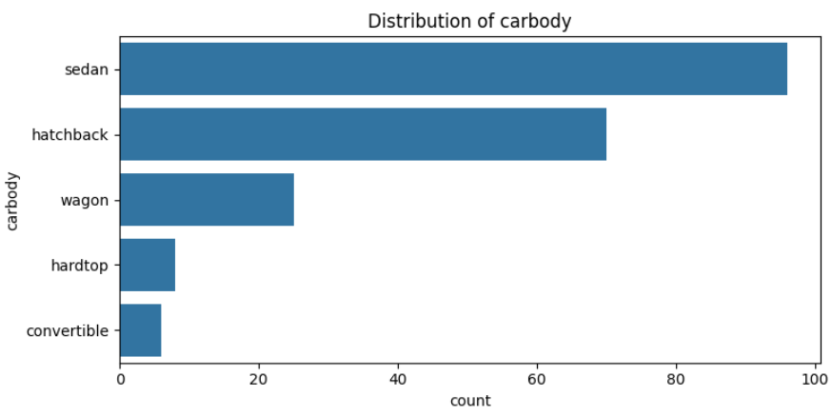
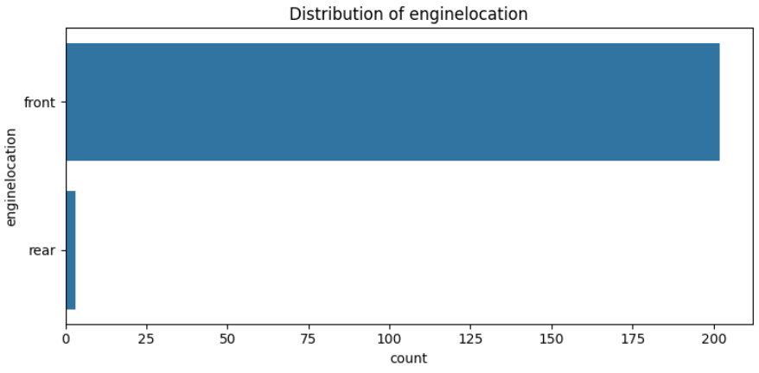
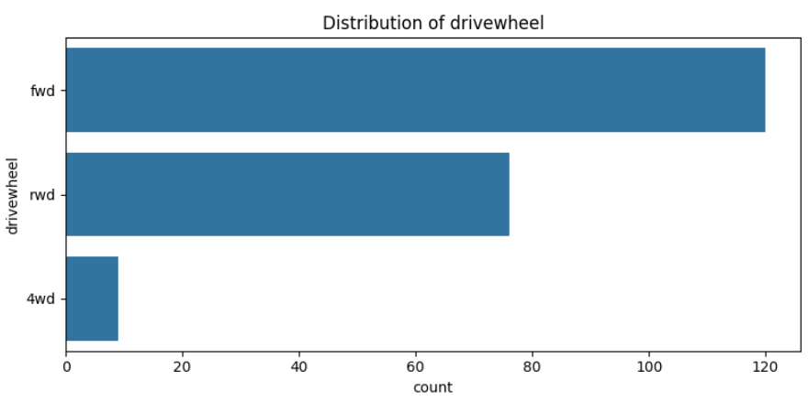
EXPLORE DATA ANALYSIS
Univariate Analysis
Categorical Features:
1. Carbody
Insight: The sedan body type is the most common in the dataset, followed by hatchback and wagon.
Hardtop and convertible models are relatively rare.
2. Enginelocation
Insight: Nearly all vehicles have their engine located in the front, with only a very small number having rear engines.
3. Drivewheel
Insight: Front-wheel drive (fwd) cars dominate, followed by rear-wheel drive (rwd).
Four-wheel drive (4wd) cars are very few in number.

Slide 12
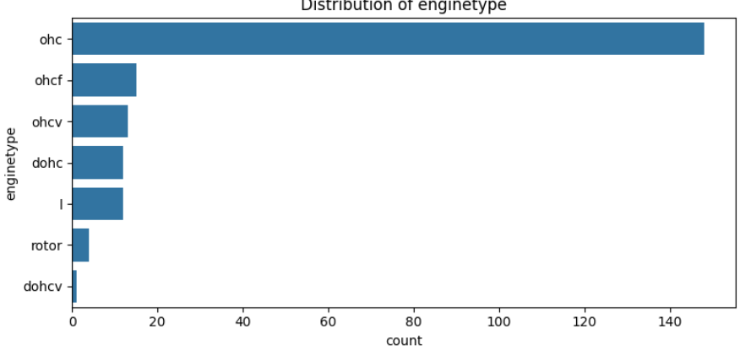
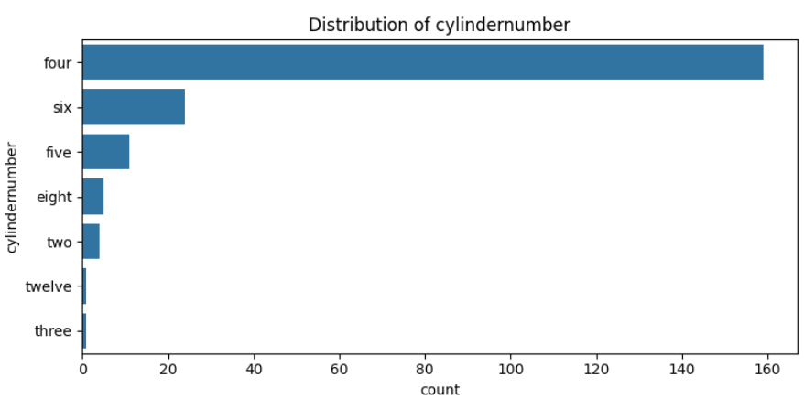
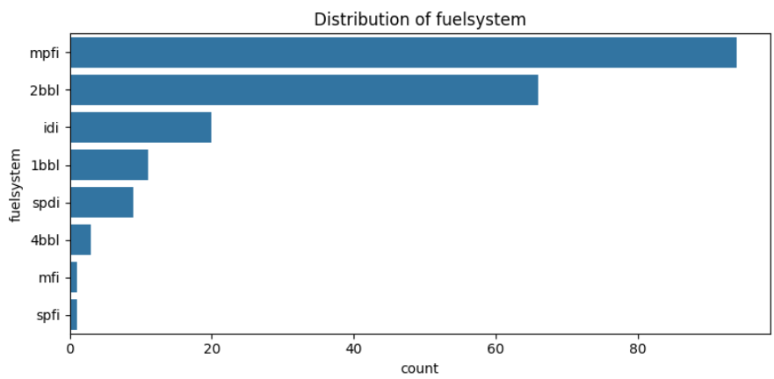
EXPLORE DATA ANALYSIS
Univariate Analysis
Categorical Features:
1. Enginetype
Insight: The OHC (Overhead Camshaft) engine type dominates the dataset, followed by OHCF, OHCV, and DOHC types.
Other types such as rotor, L, and DOHCV are very rare.
2. Cylindernumber
Insight: Cars with four cylinders are the most common, making up the majority of the dataset.
Other configurations like six, five, or eight cylinders appear much less frequently.
3. Fuelsystem
Insight: The MPFI (Multi-Point Fuel Injection) system is the most prevalent, followed by 2BBL and IDI.
Other systems like SPFI and MFI occur rarely.

Slide 13
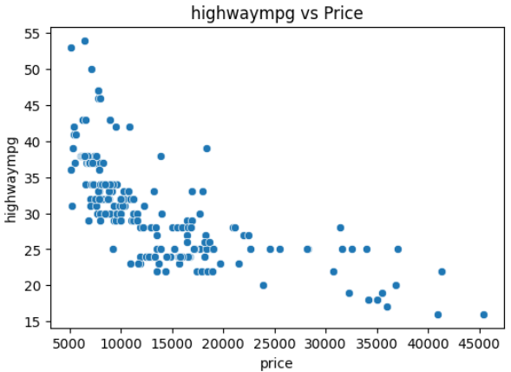
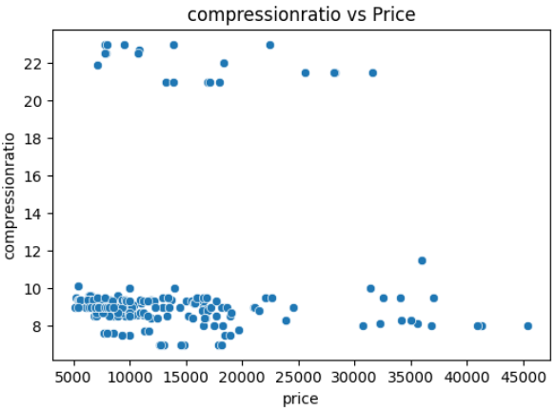
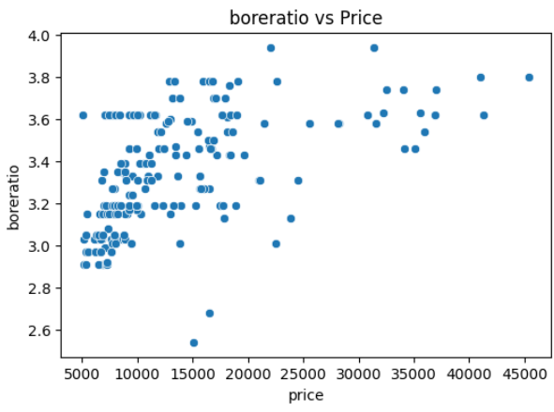
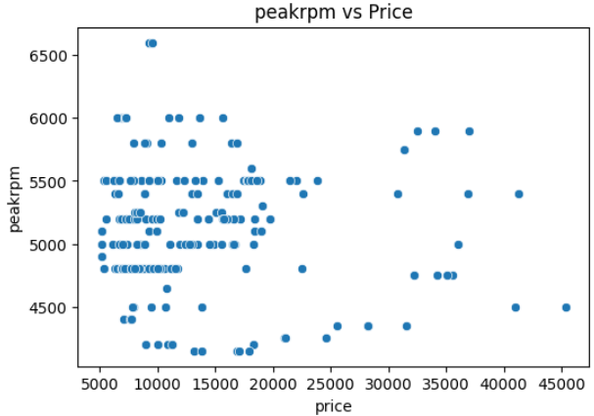
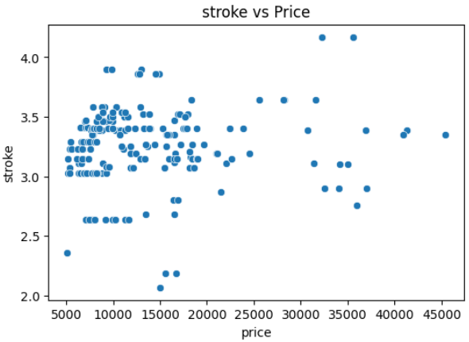
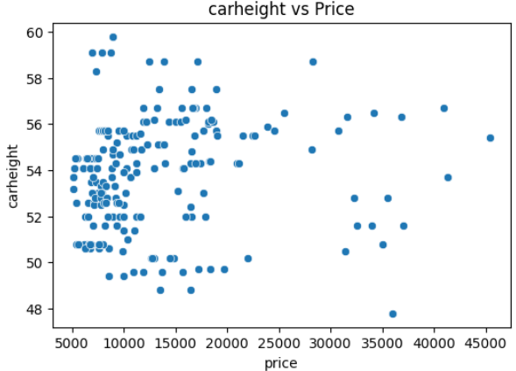
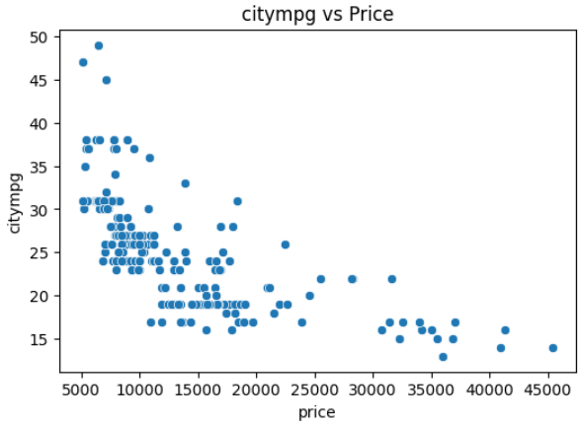
EXPLORE DATA ANALYSIS
Bivariate Analysis
Numerical Features:
Overall Conclusion:
There is no strong linear relationship between most numerical features and price.
However, a slight negative correlation can be observed between price and fuel efficiency variables such as citympg and highwaympg — indicating that more expensive cars tend to have lower fuel efficiency.
Other features like compressionratio, boreratio, peakrpm, stroke, and carheight show weak or no visible correlation with price.

Slide 14
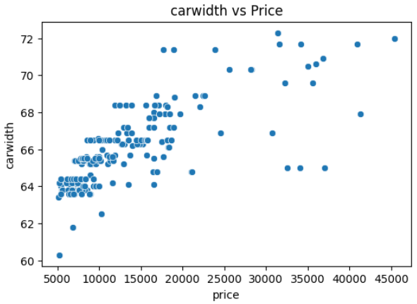
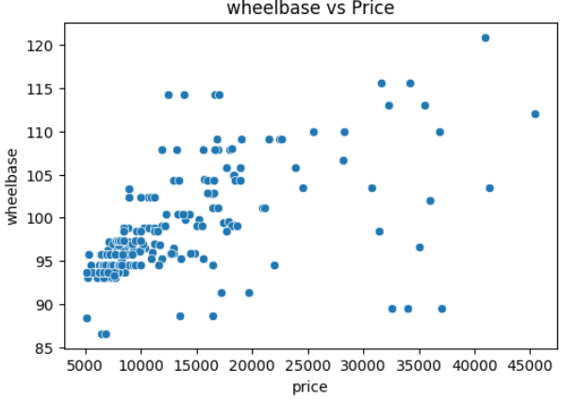
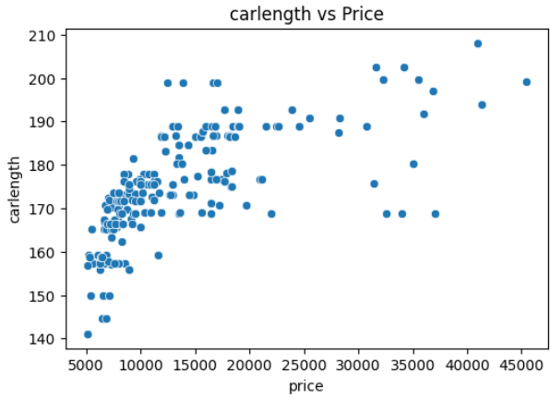
EXPLORE DATA ANALYSIS
Bivariate Analysis
Numerical Features:
1. Carwidth
Insight: There is a strong positive correlation between carwidth and price.
Wider cars tend to be more expensive, indicating that carwidth is a strong indicator of luxury and performance level.
2. Wheelbase
Insight: Wheelbase shows a positive relationship with price.
Cars with longer wheelbases generally have higher prices.
3. Carlength
Insight: Carlength demonstrates a moderate positive correlation with price.
Longer vehicles tend to cost more, though the correlation is not as strong as for carwidth or wheelbase.

Slide 15
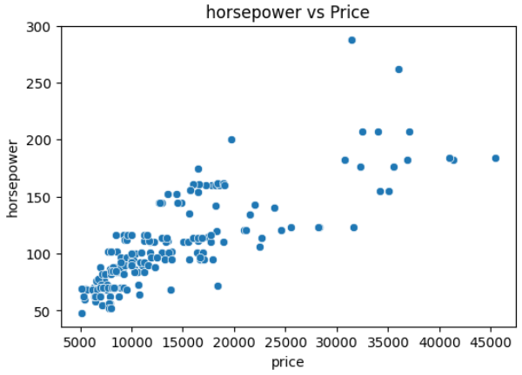
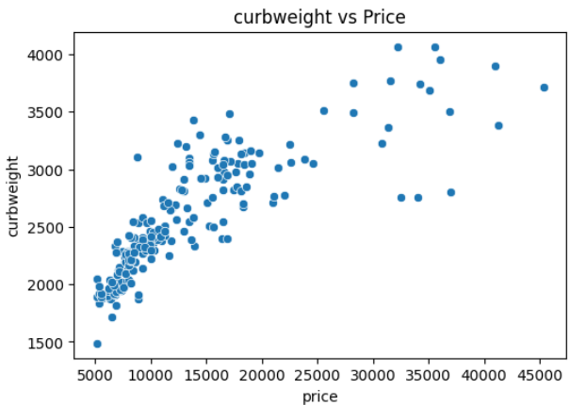
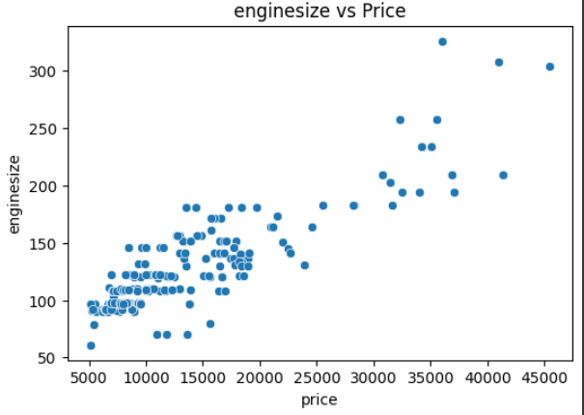
EXPLORE DATA ANALYSIS
Bivariate Analysis
Numerical Features:
4. Horsepower
Insight: There is a clear positive correlation between horsepower and price.
Cars with higher horsepower tend to have significantly higher prices.
5. Curbweight
Insight: Curbweight shows a strong positive relationship with price.
Heavier cars generally have higher prices.
6. Enginesize
Insight: Enginesize has one of the strongest correlations with price.
Cars with larger engine sizes are consistently more expensive.

Slide 16
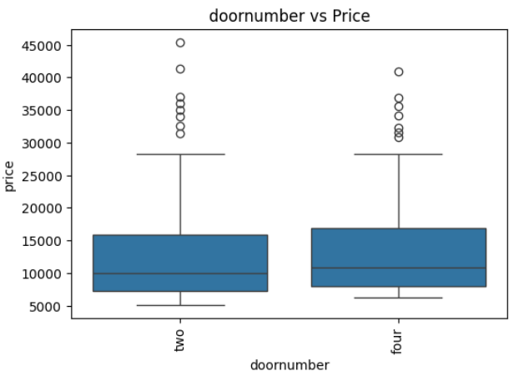
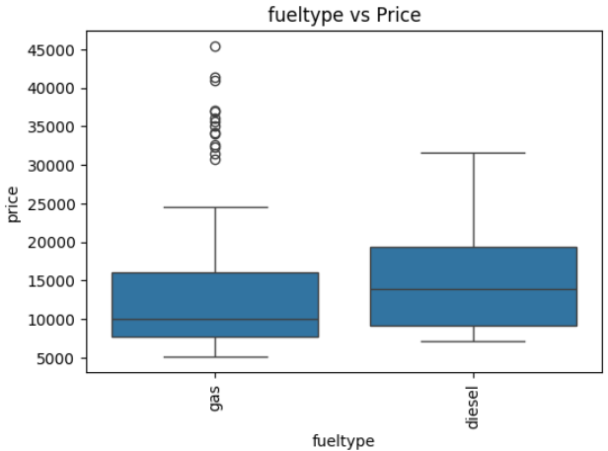
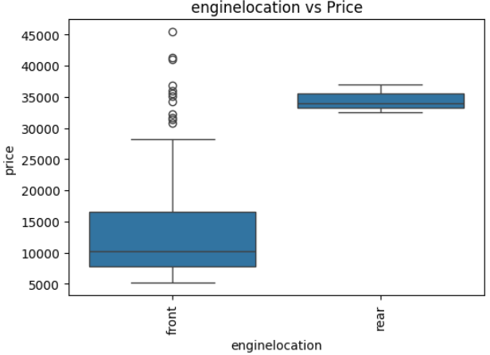
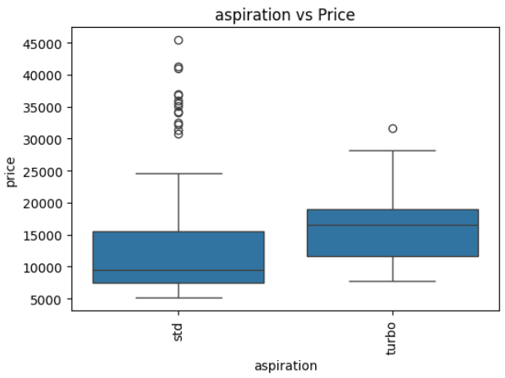
EXPLORE DATA ANALYSIS
Bivariate Analysis
Categorical Features:
1. Doornumber
Insight: There is little difference in price between cars with two and four doors.
2. Fueltype
Insight: Diesel cars generally have slightly higher prices than gas cars.
3. Enginelocation
Insight: Cars with rear engine placement are significantly more expensive than those with front engines.

Slide 17
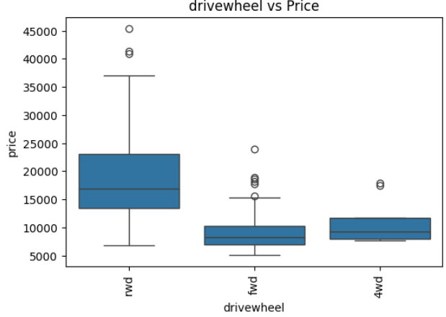
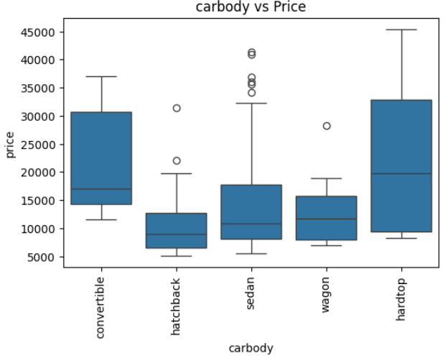
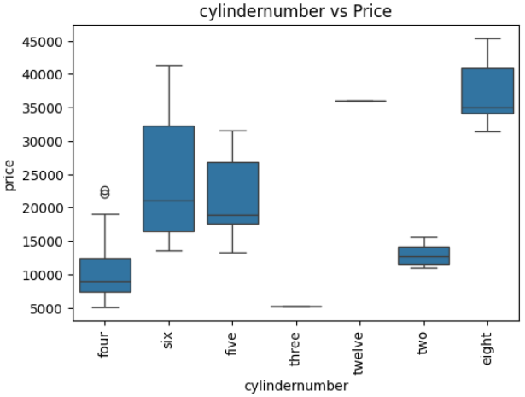
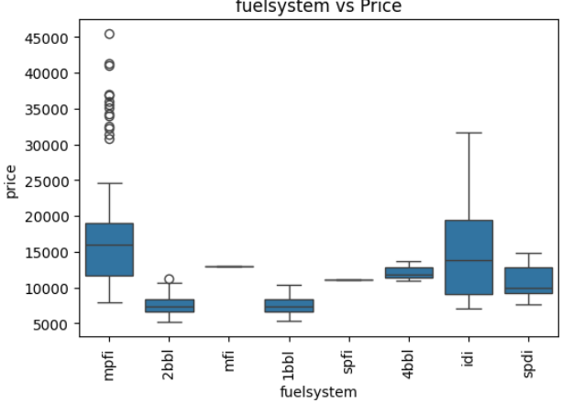
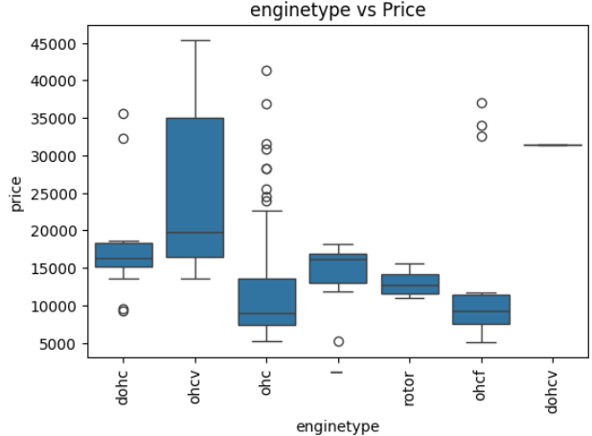
EXPLORE DATA ANALYSIS
Bivariate Analysis
Categorical Features:
1. Fuelsystem
Insight: The MPFI (Multi-Point Fuel Injection) system is associated with higher car prices, while systems like 2bbl, 1bbl, and mfi correspond to lower-priced models.
2. Carbody
Insight: Convertible and hardtop cars tend to have the highest prices, while hatchback and sedan models are more affordable.
3. Drivewheel
Insight: Cars with rwd (rear-wheel drive) generally show higher prices than fwd or 4wd vehicles.
4. Cylindernumber
Insight: Cars with eight or twelve cylinders are significantly more expensive, while four-cylinder engines dominate lower price ranges.
5. Enginetype
Insight: DOHC (Double Overhead Camshaft) and DOHCV engines correspond to higher-priced cars, while OHCF and rotor types are generally in the lower range.

Slide 18


MODEL SELECTION
Data Preprocessing
Before feeding the data into the model, all features were encoded and scaled to ensure consistent value ranges.
The features selected for model training include:
wheelbase, carlength, carwidth, curbweight, enginesize, and horsepower — all showing strong positive correlation with price, as seen in the heatmap.
Training Process
The dataset was divided into training (80%) and testing (20%) subsets.
All models were trained using their default hyperparameters as the initial setup.
Models Used
Random Forest Regressor
CatBoost Regressor
XGBoost Regressor
Gradient Boosting Regressor
Linear Regressor
LightGBM Regressor

Slide 19
EVALUATION AND RESULT
Model | MAE | MSE | RMSE | R2
Linear Regression | 2699 | 14248520.0 | 3774.0 | 0.820
Random Forest Regressor | 1308 | 3807549.0 | 1951.0 | 0.952
Gradient Boosting Regressor | 1620 | 7410204.0 | 2722.0 | 0.906
XGBRegressor | 1577 | 5458101.0 | 2336.0 | 0.931
LGBMRegressor | 2228 | 15193283.0 | 3897.0 | 0.808
CatBoostRegressor | 1266 | 5231102.0 | 2287.0 | 0.934
1. Model Comparison
From the table, several regression models were tested to predict car prices.
The performance metrics (MAE, MSE, RMSE, R²) indicate that:
Random Forest Regressor delivers the best performance among all models.
  MAE = 1308, RMSE = 1951.0, R² = 0.952
  It achieves the lowest prediction error and the highest R² score, meaning it fits the data very well.
CatBoost Regressor also performs strongly, with an R² of 0.934, but slightly below Random Forest.
Linear Regression performs the weakest, showing the highest error and lowest accuracy, suggesting the relationship between features and price is non-linear.
Conclusion
Random Forest Regressor is the most accurate and reliable model for predicting car prices in this dataset.

Slide 20




EVALUATION AND RESULT
Random Forest Regressor shows the closest alignment between predicted and actual values.
Most of its data points lie very near the diagonal line, indicating high prediction accuracy and strong model fit.
CatBoost and XGBoost also show good performance, with data points clustering close to the line, but with slightly more variance.
Gradient Boosting Regressor performs well but exhibits larger deviations for higher price values.
Conclusion
Random Forest Regressor is the best-performing model, offering the most reliable and consistent predictions for car price estimation.

Slide 21
EVALUATION AND RESULT
Hyperparameter Tunning Results:
Model | MAE | MSE | RMSE | R2
Random Forest Regressor | 1421 | 4314052 | 2077 | 0.945
Gradient Boosting Regressor | 1526 | 4874845 | 2207 | 0.938
XGBRegressor | 1705 | 5964858 | 2442 | 0.924
CatBoostRegressor | 1260 | 4655855 | 2157 | 0.94
After hyperparameter tuning:
Most models showed better balance between bias and variance.
Random Forest still achieved one of the best R² scores (0.945) and lowest RMSE, confirming its consistency and reliability.
CatBoost emerged as a strong competitor with a slightly higher R² than Gradient Boosting and XGB.
Conclusion
Random Forest Regressor remains the most robust and accurate model overall, even after tuning.
Gradient Boosting Regressor benefited the most from tuning and now performs comparably.
CatBoost Regressor also showed reliable improvement with strong generalization.

Slide 22

EVALUATION AND RESULT
Insight:
Enginesize is by far the most influential feature, contributing around 60% of the model’s predictive power.
Curbweight is the second most important feature, with about 30% importance.
Other features such as horsepower, carlength, wheelbase, and carwidth have minimal impact on predicting car prices.
Interpretation:
The results indicate that engine size and vehicle weight are the key determinants of car price — larger engines and heavier cars tend to correlate with higher prices.
Features like horsepower and car dimensions (length, width, wheelbase) have comparatively smaller effects, meaning price variations are less sensitive to these factors when other main attributes are known.
The Random Forest model effectively identifies these dominant factors, confirming that performance and structural size are critical price drivers in this dataset.

