Slide 1

AIRBNB Data Review
By Heryanto Jaya
Connect Me on LinkedIn
Notes:
Selamat malam Kak Riris dan rekan rekan semua, perkenalkan saya Heryanto Jaya dari tim data analyst Airbnb akan membawakan Airbnb Data review

Slide 2
1
2
3
4
5
Executive Summary
Business Overview
Problem Scope
Factors of Low Rated
Airbnb connects hosts with guests for short-term & long-term stays
Increasing trend of low rated reviews (under 90 of 100) from 2012 – 2017 in some cities on USA
Unit with bigger capacity & strict cancellation Policy tend to have lower Customer Rating Review Score
Pricing & Listings
Averagely $4.73 per night for 51.838 units
Recommendation
Compensation on factors that boost customer satisfaction for units which tend to have low rating
Notes:
Pada kesempatan ini berfokus pada listing yang memiliki rating (Tingkat kepuasan) rendah Dimana jumlahnya terus meningkat dari 2012 – 2017 pada 6 kota di USA dan berfokus untuk melakukan perbaikkan demi kepuasan tamu

Slide 3

Overview
Industry: Hospitality and Tourism
Founded on 2007 in San Francisco, California, United States of America
Business Model
Airbnb operates as a platform-based business that earns revenue mainly through service fees from guests and hosts. It follows a B2C model by connecting travelers with individual hosts, but also incorporates B2B elements through corporate travel partnerships and its Airbnb for Work offering
Notes:
Berikut penjelasan singkat dari Perusahaan aibnb, Dimana model bisinua menghubungkan pencari tempat tinggal dengan pemilik unit yang disewakan

Slide 4
Key Process
Platform Model
Fee Based Income
Diversity of Options
Customer Relationships
Airbnb operates as a digital platform connecting hosts and guests
Unique stays ranging from apartments to treehouses, accommodating various travelers' needs
Focus on building community through reviews, ratings, and continuous support for both hosts and guests
Charged to both Guest and Host
Notes:
Berikut utk poin” operasional Airbnb

Slide 5
Disclaimer
Data Source: Kaggle
Assumptions: 1. Data as per 31 October 2017 &
short-term stay
2. Objective Customer Review Rate
Notes:
Dataset diambil dari Kaggle, Dimana asumsi yang digunakan data terupdate saat 31 October 2017 dan smua penyewa adalah short-term stay, juga penilaian diberikan secara objektif

Slide 6

1
Business Problem

Slide 7



Project Scope & Analysis
This project analyze customer satisfaction for Airbnb services per accommodation based on what does the unit provides, host information, and policies implemented on unit
Problem
What causes customer review score rating less than 90 during 2012-2017?
Objectives
Aim to have overall review score rating is at least 90 on Q2 2018
Analysis Method
Using Python, create analysis customer satisfaction score and metrics
Notes:
Pada Analisa ini berfokus pada permasalaha, apa yang menyebabkan customer memberikan review dibawah 90 saat 2012-2017, lalu dengan itu management menargetkan nilai rating minimal 90 pada q2 2018. Dan Analisa metrics terkait menggunakan Python

Slide 8
1
2
3
4
5
6
Methodology
Business Undertanding
Data Collection
Data Cleaning
Undertand the business to effectively adress the problem
From listings in USA across 6 cities
Using phyton to clear noises in dataset
Data Analysis
Data Visualization
Recommendation
Insight generations from keystats generated using Phyton (Google Collab)
Using Tableau to deliver better insights
Advice to address regarding issue
Notes:
Berikut methodology dalam Analisa ini…pertama memahami bisnis, data collection dari Kaggle, lalu cleaning dan analysis memakai google collab, utk visualisasi menggunakan tablelau, dan terakhir memberikan rekomendasi

Slide 9
Focused Metrics
Click link below to access appendix for
Problem Tree (slide 33)
Problem Priority (slide 34)
Possible Root Cause | Hypothesis | Metrics | Rationale
Facilities from Accommodation | Customer Dissatisfaction with listing from: Less facilities and capacities Certain room type | Accommodates # of Amenities Room Type | Those metrics reflect accommodation’s value and facilities
Policies | Customer will be more satisfied if the accommodation impose less obligation | Cancellation Policy Cleaning Fee | Those two metrics are obligation for customer
Host’ Characteristic | Unclear information of Host verification and slow response rate will impair customer’s trust on the listing. Impairment of customer’s trust may drag the satisfaction rate. | Host’s Profile Pic & ID Verified % Host Response Rate | Fully Verified mean Host has profile photo and ID verified by Airbnb Will find the correlation of Response Rate with Cust Rating
Notes:
Kita akan berfokus pada 3 masalah yaitu fasilitas dari tmpt tinggal, peraturan, dan karakteristik pemilik Fully Verified Host yang dimaksud dalam Analisa ini adalah Host yang memiliki profile picture dan ID yang sdh diverifikasi oleh airbnb

Slide 10
Segregation of Duties
Click link below to access appendix for
Management Structure (slide 32)
ROLE | PIC - DUTIES
Decider | Chief Executive Officer (CEO) - Final approval for Business Initiatives
Accountable | Chief Business Officer (CBO) - Data Analyst guider in technical role
Responsible | Chief Technology Officer (CTO) - Ensures Data Analysts deliver accurate customer review tools and models Global Head of Operations (GHoO) - Gathers insights from ops/customer service and integrates customer feedback.
Consulted | Chief Financial Officer (CFO) - Considers cost impact of operational insights and actions Global Head of Marketing (GHoM) - Ensures alignment with branding and user perception Chief Strategy Officer (CSO) - Assesses long-term strategic impact of host or policy changes
Informed | Global Head Policy & Communication (GHPC) - Stays informed if insights need public communication or PR handling Chief Legal Officer (CLO) - Must be informed of changes affecting legal compliance or host-guest policies
Notes:
Dalam Analisa ini kita dipandu oleh CBO dalam hal” yang bersifat teknis di lapangan dan Keputusan akhir berada pada CEO

Slide 11
1
Data Cleaning & Analysis

Slide 12
DATASET
Steps
Before
After
Dropping Columns
36 Columns
19 Columns
Null & Duplicates
74097 Rows
52713 Rows
Data Formatting
Float
Datetime
Object
Data cleaning steps
Data dictionary on google sheet
Data formatting steps
Notes:
Untuk Analisa yang akurat, dilakukan pembersihan data set dan penyesuaian data format

Slide 13
EXPLORATORY DATA ANALYSIS
Factors - Host | Average Review Rate
Verified Host | 94.31
Unverified Host | 93.30
Factors - Room | Average Review Rate
Entire Room Type | 94.23
Private Room Type | 93.85
Shared Room Type | 92.10
Customers tend to be satisfied with the listing that has Verified Host (has verified Id & photos) and Entire Room Type
Responsive Host and decent Provided Amenities boost customer satisfaction rate
While more capacity (Accommodates)
in listing dragging satisfaction rate
Factors - Host | Correlation Review Rate
Host Resp. Rate | 0.07
Factors - Listing | Correlation Review Rate
No of Amenities | 0.13
Accommodates | -0.03
Notes:
Dari EDA disimpulkan bahwa konsumen merasa puas pada listing tipe Entire Room dan Host Terverifikasi, Responsig, memiliki fasilitas yang cukup. Tapi smakin banyaknya kapasitas listing, smakin rendah nilai kepuasan konsumen

Slide 14
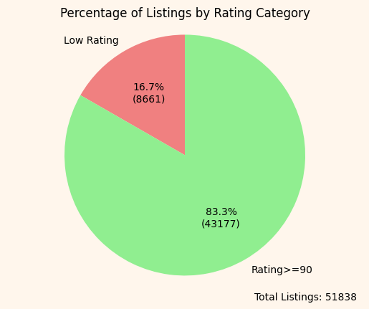
16.7% of listings across 6 cities in USA from 2012 – 2017 are low rated
Stats on customer review score please find on slide 35
Notes:
8600 atau 16.7% dari total listing memiliki rating dibawah 90 slama 2012-2017. Dimana nilai minimum adalah 20

Slide 15
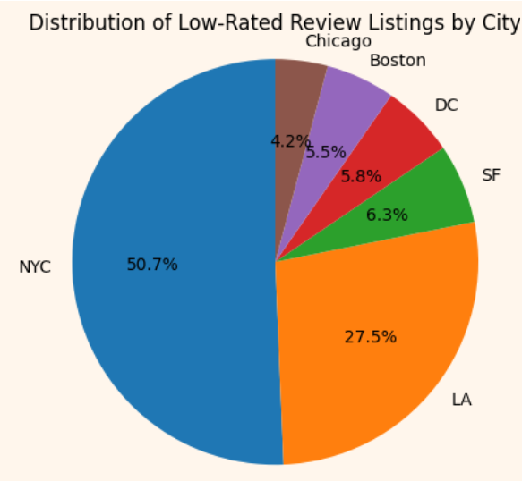
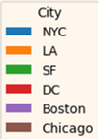
NYC has the most Low-Rated Listings, which has 50.7% contribution from 8661 low-rated listings
City | Average Resp Rate | Unverified Host Count | Average No Amenities | No Strict Policies | Total Listing
NYC | 74% | 7,171 | 17 | 11,403 | 22,824
LA | 86% | 3,739 | 18 | 7,416 | 15,454
SF | 77% | 1.094 | 19 | 2,033 | 4,490
DC | 83% | 873 | 19 | 1,421 | 3,638
Boston | 85% | 887 | 20 | 1,329 | 2,900
Chicago | 92% | 529 | 20 | 1,311 | 2,532
Total Listing from 6 Cities |  |  |  |  | 51,838
Strict Policies = strict + super_strict_30 + super_strict_60 (Source of Airbnb Policies)
Notes:
Dalam low rated listing, New York memiliki kontribusi terbesar dengan factor seperti low host response, banyaknya jumlah host yang belum terverifikasi & strict policies, tetapi jumlah fasilitas terendah dengan jumlah listing terbanyak diantara 6 kota tersebut Strict Policies di sini saya gabungkan dari strict, super strict 30 days, super strict 60 days, Dimana bersumber dari Airbnb policies

Slide 16
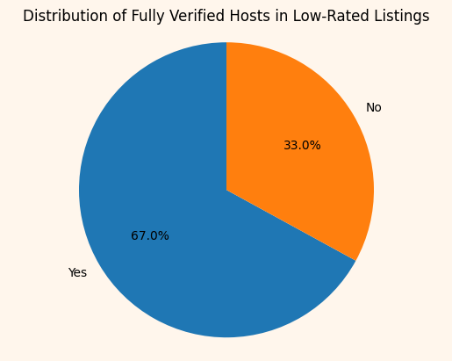
33% of low-rated listings have unverified hosts, suggesting host verification may impact customer satisfaction
Notes:
33 persen dalam listing yang rating rendah memiliki host yang belum terverifikasi, menunjukkan bahwa verifikasi pemilik unit mempengaruhi kepuasan konsumen

Slide 17
AVERAGE RESPONSE RATE ACROSS LISTING CATEGORIES
Listing Category | Average Host Response Rate
Low Rated | 74%
Overall | 79%
Rating >= 90 | 81%
Notes:
Response Rate pada rating yang rendah memiliki persentasi terkecil

Slide 18
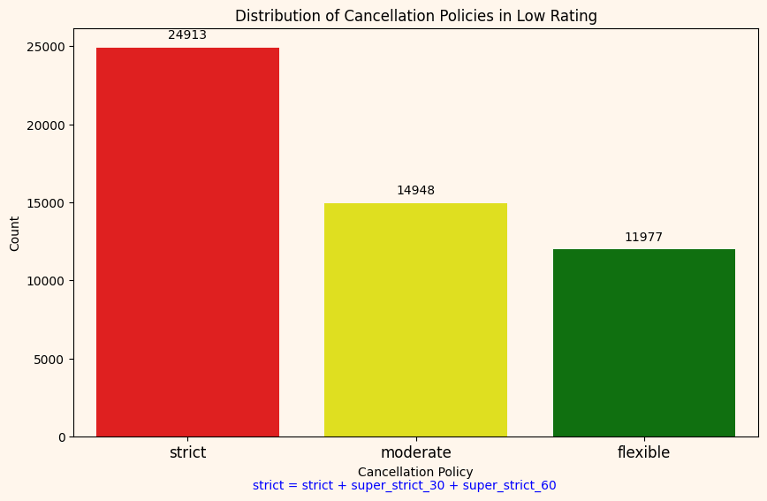


Strict cancellation policies are more common in low-rated listings, hinting at a link between inflexibility and poor customer experience
Notes:
Pada listing yg memiliki rating dibwah 90, jumlah implementasi strict policies terbanyak disbanding moderate dan flexible, menunjukkan hubungan antara peimplementasian strict policies and ketidak puasan konsumen

Slide 19



This statistics, support the correlation before, higher capacity, lower the average review rating
Average Capacity per Room Type
Entire Unit
Entire Room
Shared Room
4.25
Low Rated Listing
2.12
Low Rated Listing
2.35
Low Rated Listing
3.92
Rated >= 90
2.01
Rated >= 90
1.94
Rated >= 90
Notes:
Entire Unit, yang memiliki kapasitas terbesar, memiliki rata” kapasitas terbesar pada low rating, menunjukkan smakin besar kapasitas, smakin rendah Tingkat kepuasan konsumen

Slide 20
More amenities lead to higher customer satisfaction, support that both satisfaction review score and number of amenities are causative related
Listing Category | Average No of Amenities
Low Rated | 16
Overall | 18
Rating >= 90 | 19
Notes:
Smakin banyak Analisa, smakin puas customer. Menunjukkan Tingkat kepuasan dan jumlah fasilitas bersifat kausatif

Slide 21
1
Data Visulatization
Using tableau

Slide 22
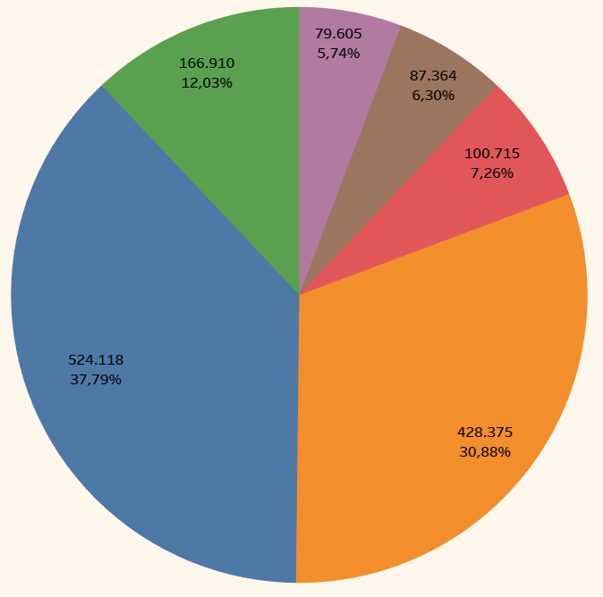
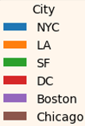
NYC has the most active guests who are giving customer review rate (524118 reviews)
Notes:
New York memiliki tamu yang paling aktif dalam memberikan Tingkat kepuasan

Slide 23
NYC has the most Airbnb listings across all room types, followed by LA
City | Entire Unit | Private Room | Shared Room
Boston | 1,567 | 932 | 33
Chicago | 1,744 | 1,091 | 65
DC | 2,446 | 1,112 | 80
LA | 9,433 | 5,569 | 452
NYC | 11,749 | 10,549 | 526
SF | 2,655 | 1,780 | 55
Notes:
New York memiliki jumlah listing terbanyak, diikuti oleh Los Angels

Slide 24
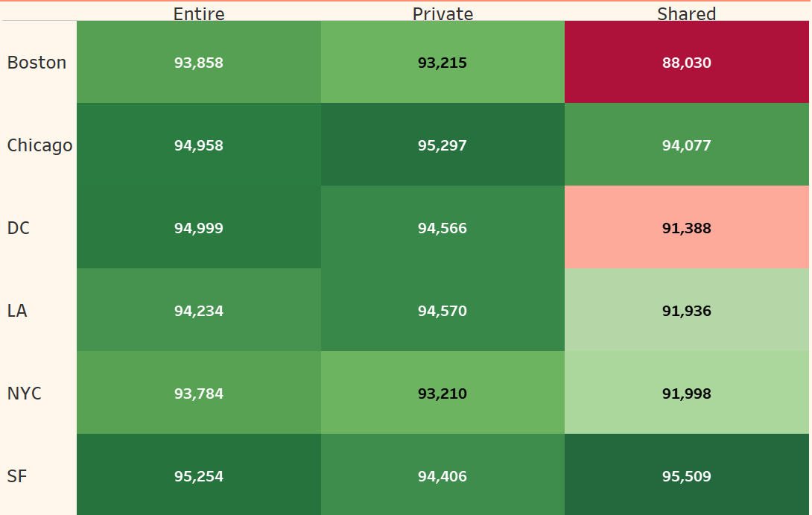
Boston's shared rooms have the lowest rating, while NYC shows generally lower ratings across all types despite high listings
Notes:
Rata” indeks kepuasan tamu terendah pada Shared Room Type kota Boston, tetapi NYC memiliki indeks kepuasan terendah pada tipe kamar Entire dan Private

Slide 25
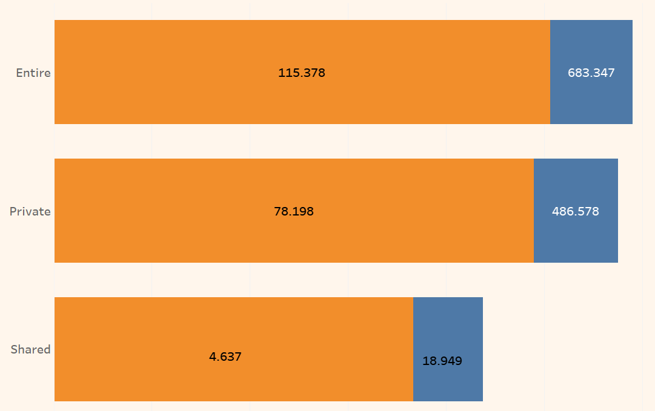

Entire Unit Type Has the biggest Number Listings with Low Rated Review Score
Notes:
Total listing yang memiliki review rate rendah terbanyak pada tipe Entire Room

Slide 26
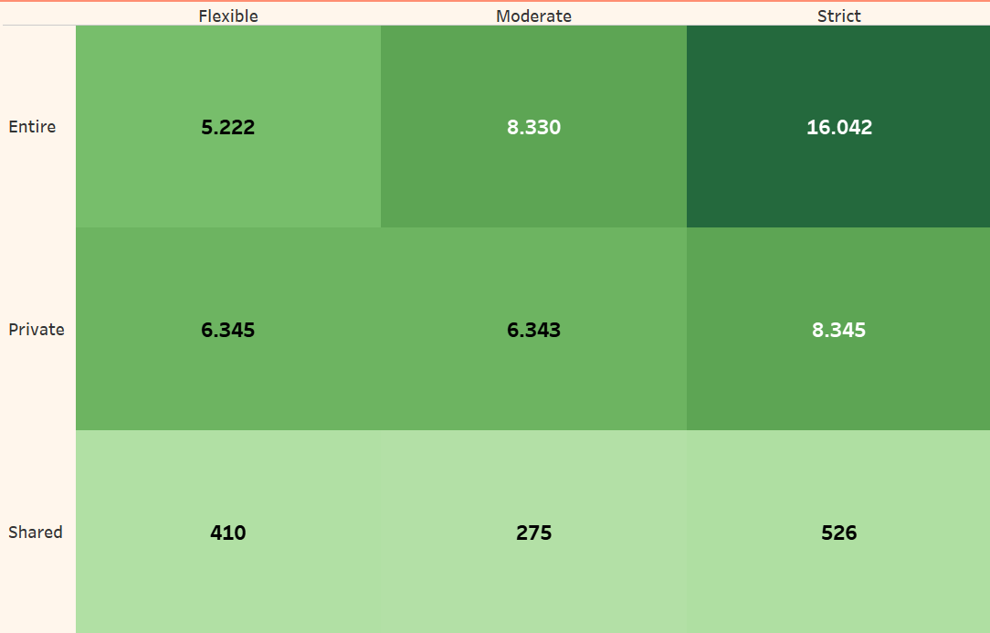
Entire Unit Type has the most Number of Strict Policy Implementations
Notes:
Juga entire room type memiliki unit terbanyak yang mengimplementasikan strict cancellation policies

Slide 27
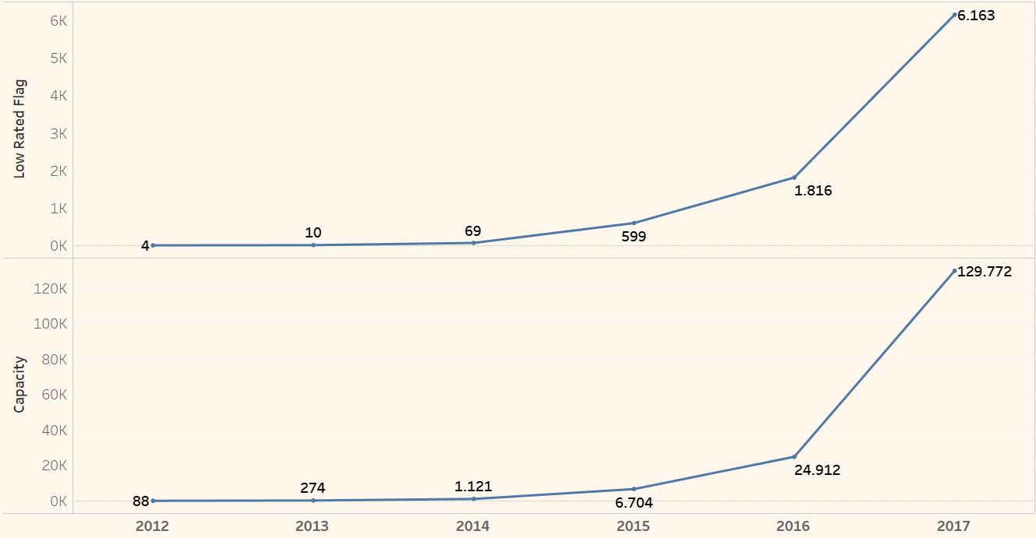
Increasing Trend of Low Rated Listing consistent with Increasing Accomodates
Notes:
Peningkatan trend Low Rated Listing dari 2012 ke 2017 sejalan dengan peningkatan jumlah kapasitas unit

Slide 28
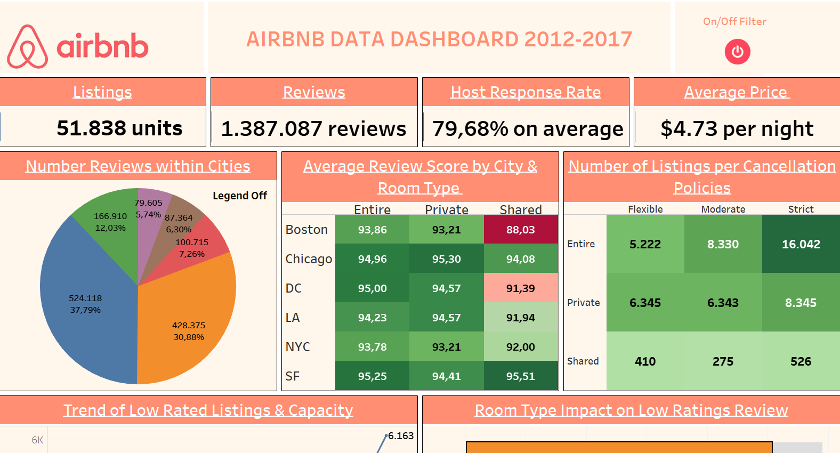
Full Dashboard on Tableau Public
Notes:
Dan berikut untuk dashboard, full dapat diakses pada Tableau Public pada link terlampir

Slide 29



Insight Summary
Host Verification & Responsiveness Drive Satisfaction Listings with verified hosts and responsive communication consistently receive higher customer ratings.
Strict Policies & High-Capacity Hurt Reviews Units with strict cancellation policies and higher guest capacity tend to get lower review scores, indicating these are potential pain points
More Amenities = Happier Guests A positive correlation exists between the number of amenities provided and customer satisfaction, suggesting added value leads to better experiences.
Notes:
Peningkatan trend Low Rated Listing dari 2012 ke 2017 sejalan dengan peningkatan jumlah kapasitas unit

Slide 30
Context | Recommendations
Cities | NYC Targeted host education and quality control for low-rated listings Incentives or support for highly rated hosts to maintain standards Boston Investigate shared quality room
Host | Strengthen Host Verification by implementing stricter verification measures on identity and property Improve Host Responsiveness by introducing incentives for quick responses, automated messaging tools, or host training
Policies | Adjust cancellation rules based on demand, listing type, and host reliability to balance flexibility and protection.
Room Type | Reassess strict cancellation policies in Entire Unit listings Targeted quality assurance such as Cleanliness & Enhanced Host Support
Capacities | Evaluate the impact of larger accommodations on guest experience Enhance service quality for high-capacity listings
Amenities | Promote key amenities like Wi-Fi and kitchen essentials Give hosts data-driven insights on amenities that improve ratings
Notes:
Dari keseluruhan Analisa tsb, Berikut beberapa rekomendasi, pertama dalam konteks City untuk Kota New York adakan edukasi untuk host dan quality control pada hunian low rated, jadi teridentifikasi Langkah apa yang harus dilakukan oleh pemilik tempat tinggal, lalu memberikat insentif khusus bagi pemilik yang sdh memiliki rating diatas 90, untuk kota Boston, perlu investigasi khusus pada shared room Dimana memiliki rata” rating yang rendah Kedua, Dalam rangka meningkatkan kepuasan dari konteks pemilik unit, dapat melakukan pengetatan agar mereka lebih aware untuk verifikasi property dan identitas, dan memberikan platform, insentif, atau training agar host lebih rensponsif dalam Ketika dihubungi oleh tamu Ketiga, sesuaikan aturan untuk pembatalan unit sesuai 3 kondisi permintaan, tipe listing, dan karakteristik pemilik Keempat, dibutuhkan juga evaluasi ulang pada strict cancellation policies pada Entire unit listings, dan menjaga kualitas dari segi kebersihan dan pemilik yang kooperatif dalam melayani tamu Dan dalam kapasitas, juga perlu evaluasi efek dari unit berkapasitas pesar pada kepuasan pelanggan, dimana perlunya meningkatkan pelayanan khususnya pada listing berkapasitas besar tersebut yang konteks terakhir pada fasilitas, perlunya focus pada penyediaan dan perhatian pada beberapa fasilitas seperti Wifi dan perlengkapan dapur, dan dikomunikasikan kepada pemilik unit agar mereka juga dapat memperhatikan penyediaan dan perawatan fasilitas yang tersedia

Slide 31
Thanks
Please keep this slide for attribution
Notes:
Terimakasih atas waktunya dan semoga Analisa bermanfaat untuk kemajuan dan peningkatan layanan Airbnb

Slide 32
1
Appendix

Slide 33
Airbnb Management Structure
As of April 6, 2025, Airbnb's executive management team is structured as follows:​
Brian Chesky: Co-founder and Chief Executive Officer (CEO).
Dave Stephenson: Chief Business Officer (CBO). ​
Ellie Mertz: Chief Financial Officer (CFO). ​
Ari Balogh: Chief Technology Officer (CTO). ​
Hiroki Asai: Global Head of Marketing. ​
Tara Bunch: Global Head of Operations. ​
Jay Carney: Global Head of Policy and Communications. ​
Ronald A. Klain: Chief Legal Officer
Source 1, 2
Back to slide 10

Slide 34
Possible Root Cause
Cleanliness
Accommodation
Facilities
Low Customer Rating
Policies
Host
Back to slide 9
Characteristic

Slide 35
Problem Prioritization
Possible Root Cause | Hypothesis | Priority
Cleanliness | Dirty accommodation obviously drive away customer’s satisfaction | Low (Relative Opinion)
Facilities from Accommodation | Less Facilities and capacities, certain room type, and high price per night will drive away customer satisfaction score. | High
Policies | Customer will be more satisfied if the accommodation impose flexible policies | High
Host’ Characteristic | Unclear information of Host verification and slow response rate will impair customer’s trust on the listing. Impairment of customer’s trust may drag the satisfaction rate. | High
Back to slide 9

Slide 36
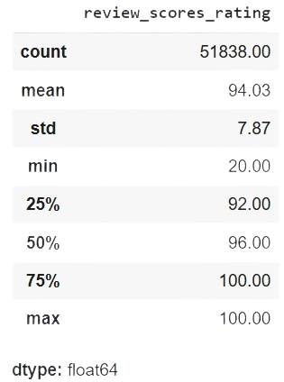
STATISTICAL ANALYSIS
This analysis focus on Customer Rating Score, which have the details below
Back to slide 14

Slide 37
DATA CLEANING – DROPPING COLUMN
The columns first_review, name, description, host_since, thumbnail_url, instant_bookable, latitude, longitude, zipcode, Neighbourhood and Unnamed: 29 to Unnamed: 35 were dropped from the dataset to focus on analysis
No Duplicated Data found in Listing ID, which must be unique
Null data in 'last_review', 'number_of_reviews’ are initially removed as Review Score will be invalid if both of them are 0, while null in 'bathrooms','bedrooms’ and 'beds’ are removed subsequently
However, null data in Host Verification dan Response Rate can be imputed by 0
Back to slide 12

Slide 38
DATA ADJUSTMENT
Adjusting data type for:
Host Response Rate (from Object to Float):
df['host_response_rate'] = df['host_response_rate'].str.rstrip('%').astype('float64') / 100
Last Review (from Object to Datetime):
df['host_response_rate'] = df['host_response_rate'].str.rstrip('%').astype('float64') / 100
Back

