Slide 1
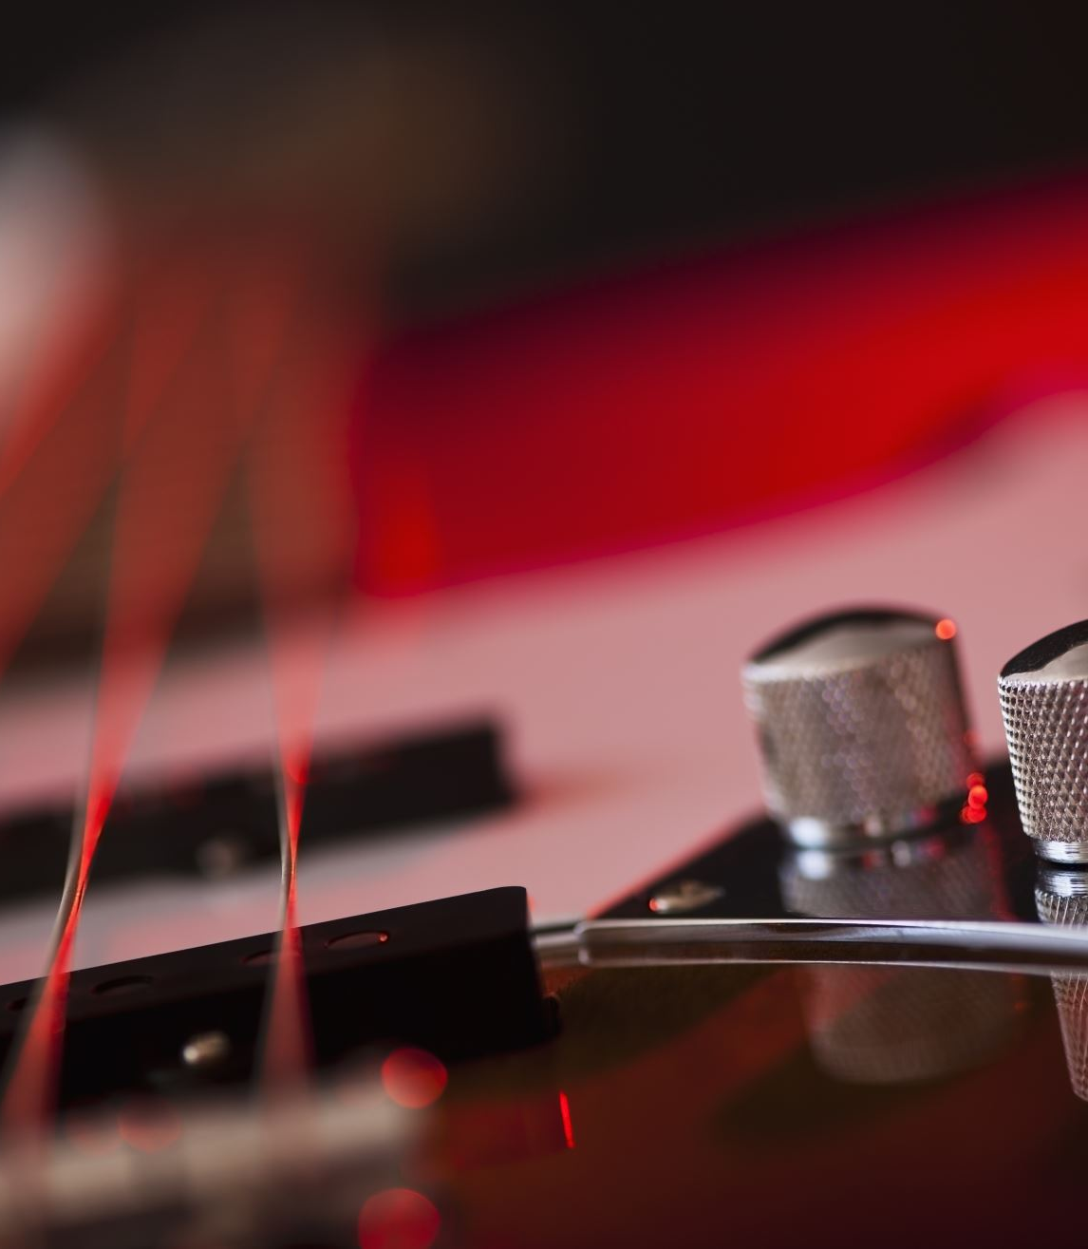
On-Board Multi-Effects Guitar Pedal
Presentation by Harry Moss

Slide 2
On-Board?
🤔

Slide 3
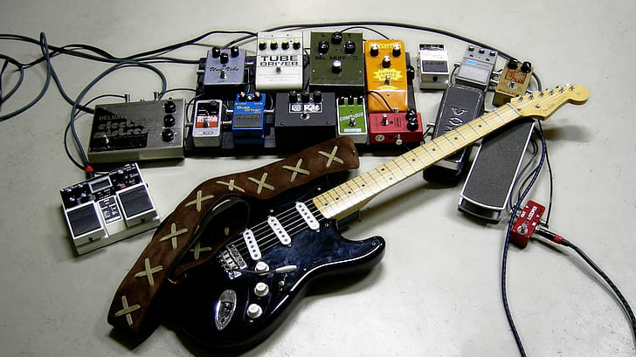
Guitar Pedals?
*public domain photo*

Slide 4
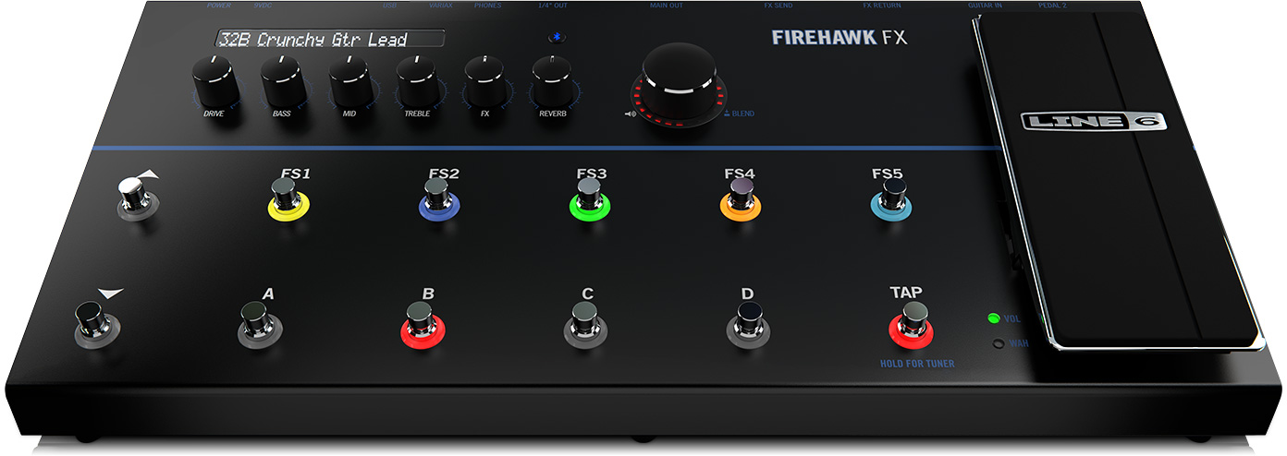
Multi-Effects Pedals ≠ New
25cm
50cm
6.4 kg (+ 1 kg)
£348!
[1][2]

Slide 5
Further Problems…
NEXT SONG!!
🧍🏻‍♂️
🧍🏻‍♂️
🎸
🎸
?
🧍🏻‍♂️
🎸
🙋‍♂️🙋‍♀️🙋‍♂️🙋‍♀️🙋‍♂️🙋‍♀️🙋‍♂️🙋‍♀️🙋‍♂️🙋‍♀️
🙋‍♀️🙋‍♂️🙋‍♀️🙋‍♂️🙋‍♀️🙋‍♂️🙋‍♀️🙋‍♂️🙋‍♀️🙋‍♂️
🙋‍♂️🙋‍♀️🙋‍♂️🙋‍♀️🙋‍♂️🙋‍♀️🙋‍♂️🙋‍♀️🙋‍♂️🙋‍♀️

Slide 6
What will this pedal help with?
PUTS THE GUITARIST BACK IN CONTROL
Small, lightweight package
Complete with 4 high-demand effects
Reasonably priced ~£100

Slide 7
LIVE DEMONSTRATION
https://drive.google.com/file/d/1bZtaHuSL4E7lbnmdPmNMsFeQU9mE2X98/view?usp=drivesdk

Slide 8
Key Selling Points
Fully compatible with any make/body of guitar (including bass!)
Can be powered via any simple powerbank
Sturdy housing
Connects to any speaker/headphone system
Light up LEDs!

Slide 9
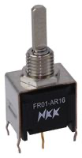
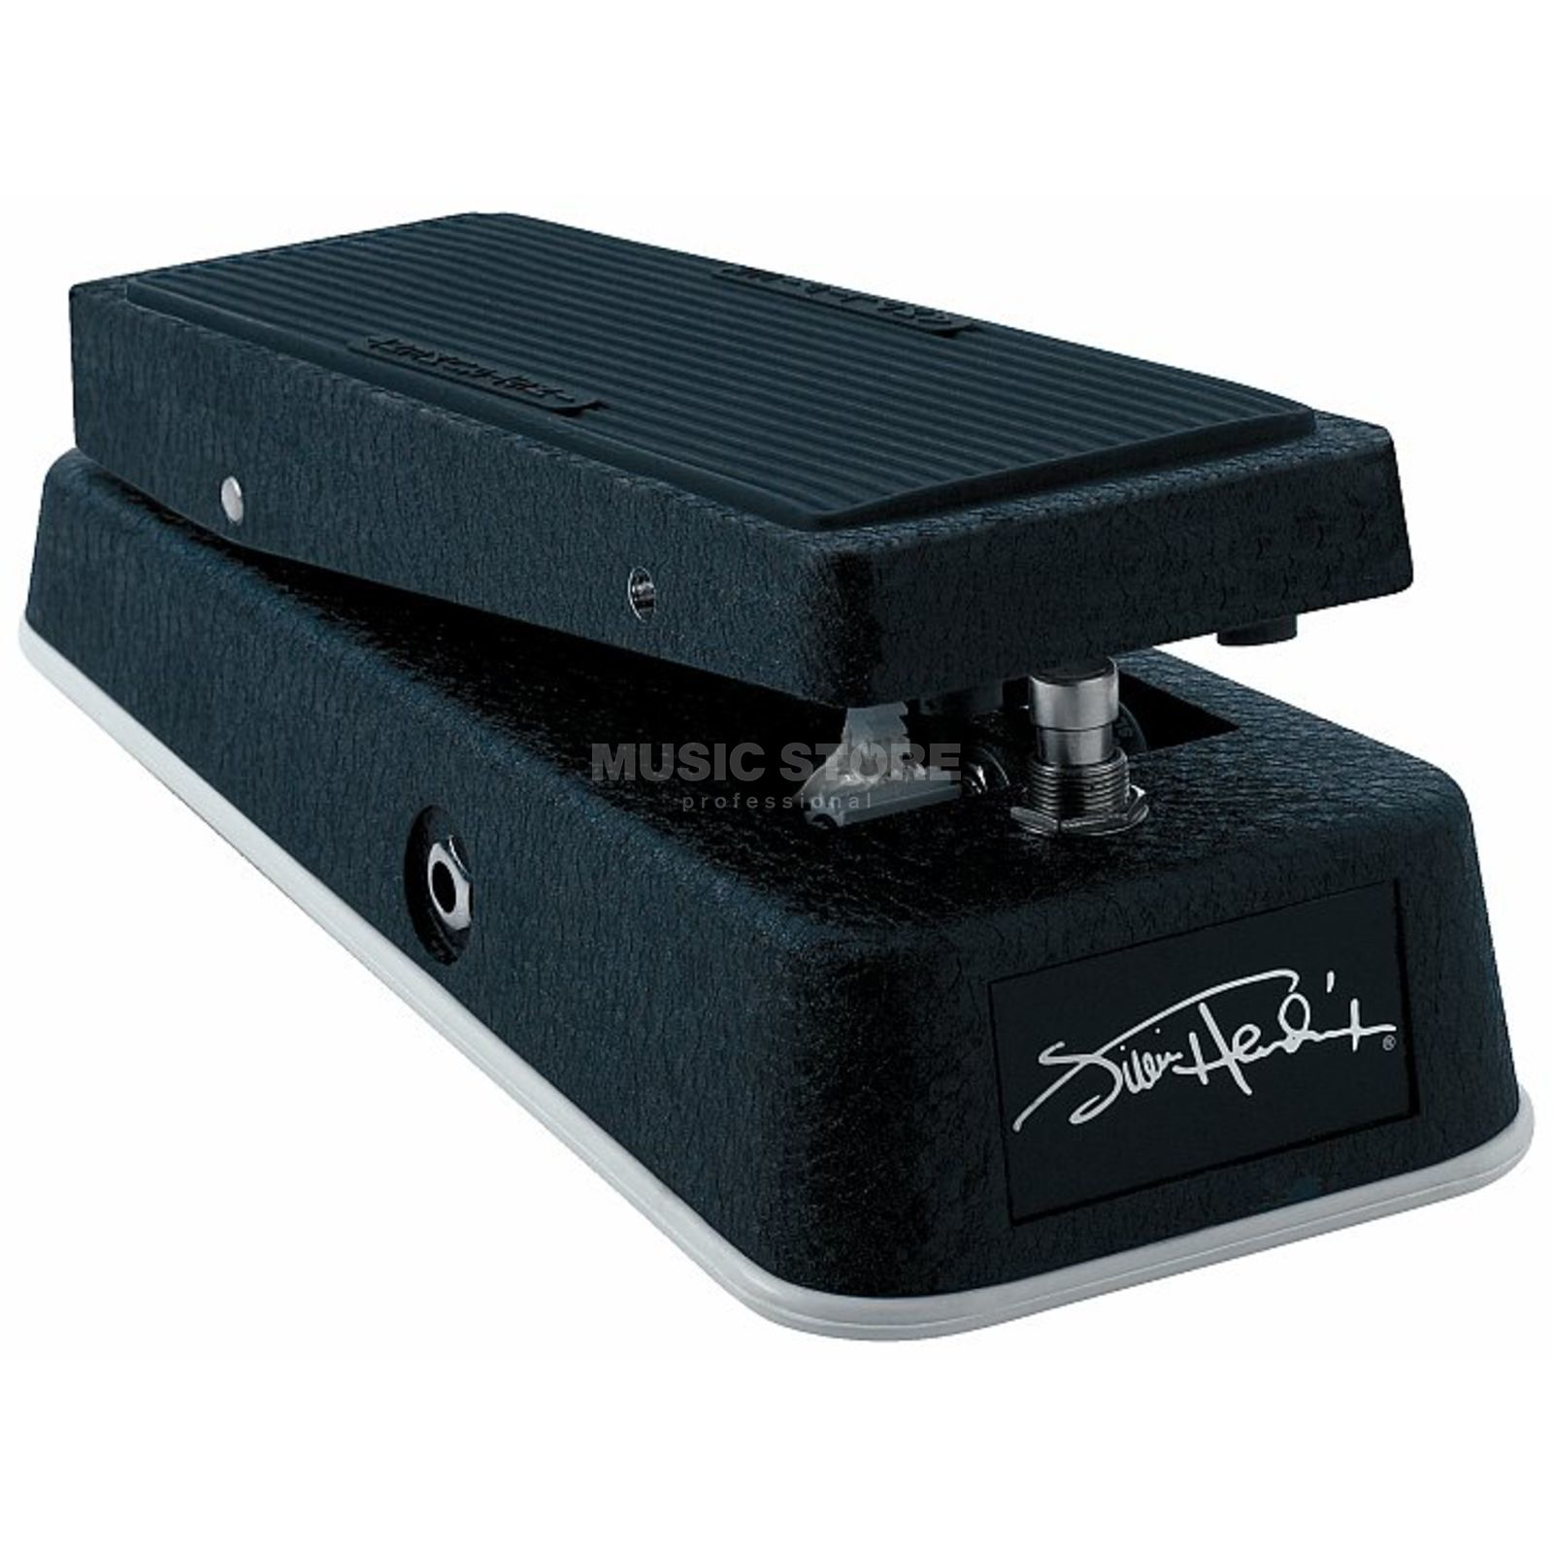
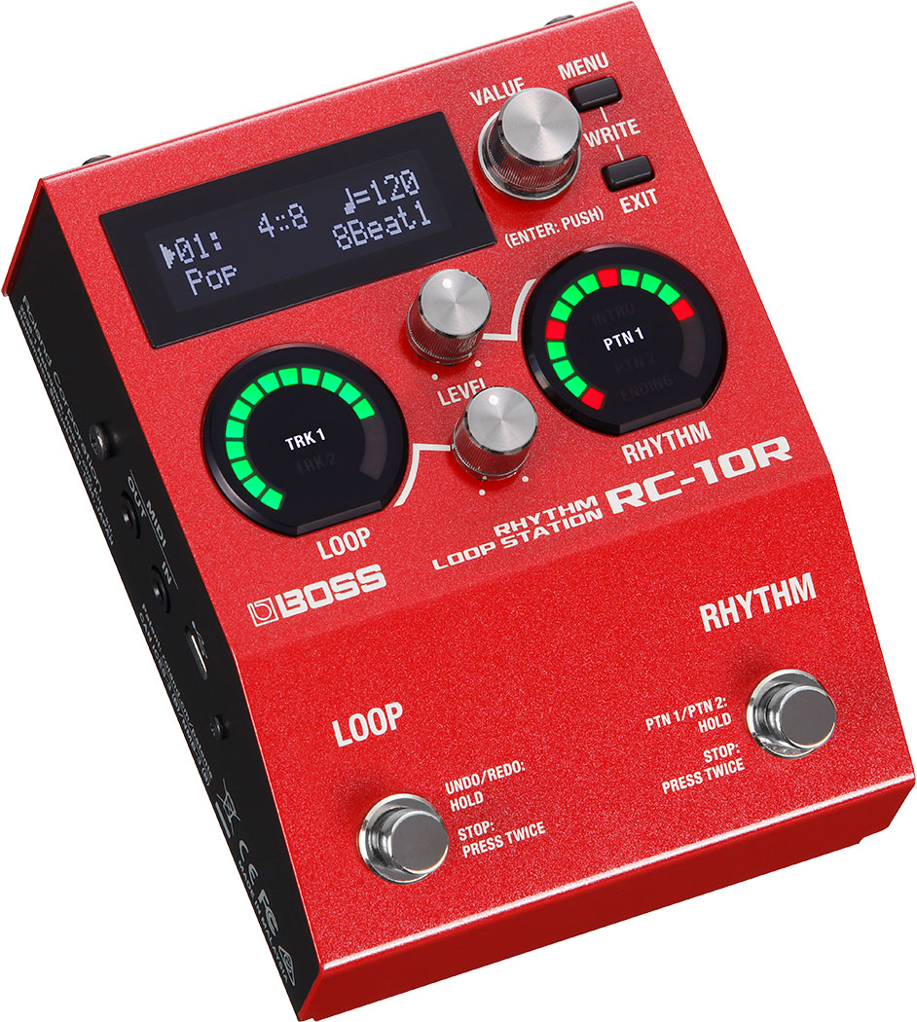
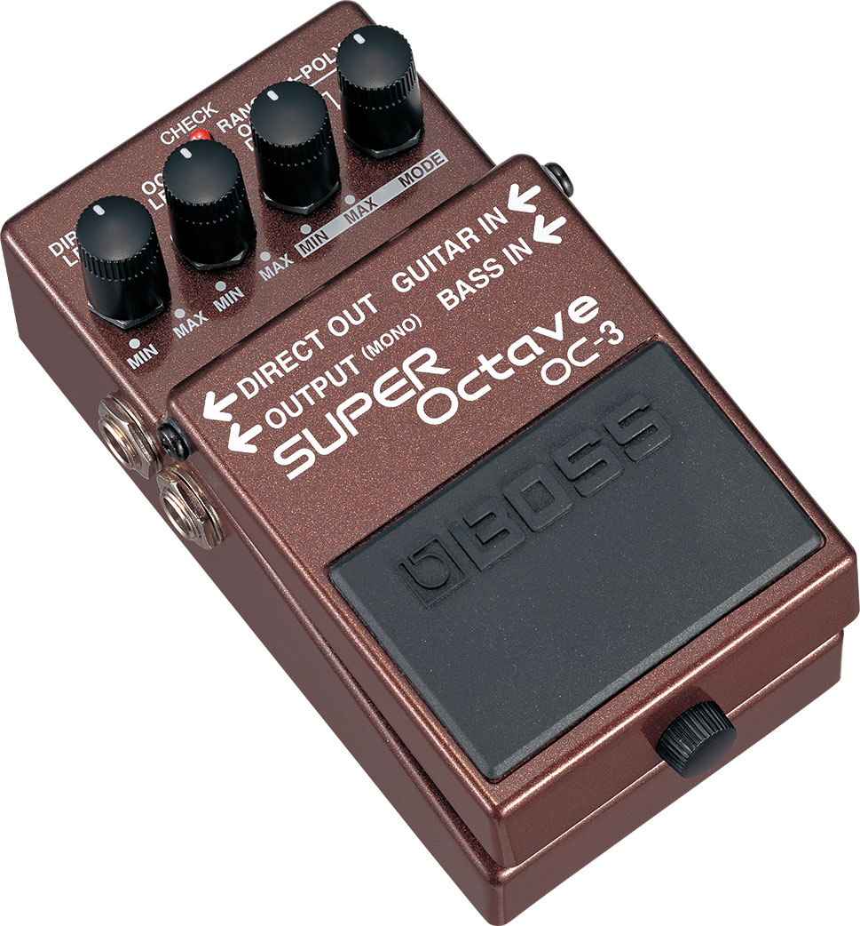
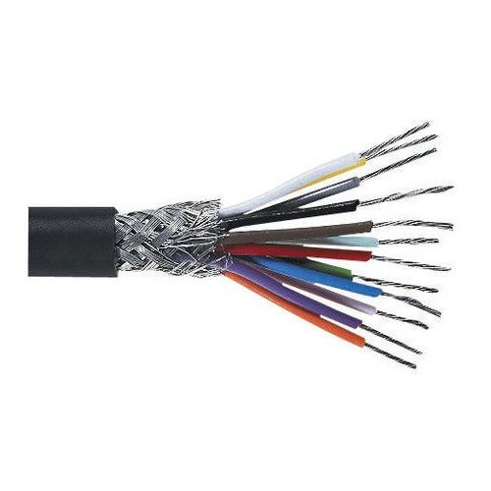
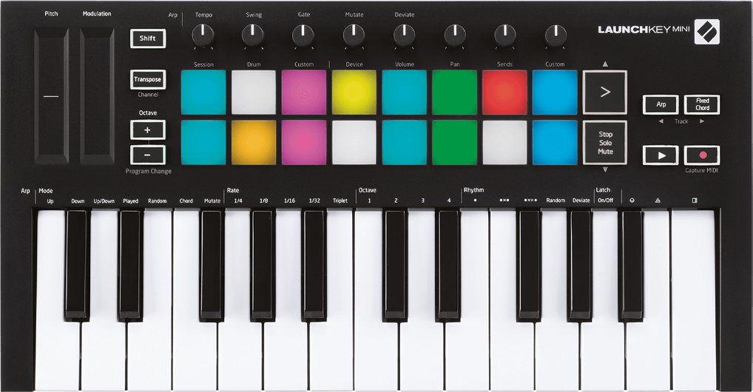
THE FUTURE
[8]
??
[3]
Enhanced Effect Control
[5]
[6]
[7]
[4]
Additional Effects…
Professional Housing
More Compact Button Layout

Slide 10
Bibliography
[1] audiofanzine, “Line 6 Firehawk FX”, (2022), [Online] Available: http://fr.audiofanzine.com/multieffet-guitare-electrique/line-6/firehawk-fx/ [accessed 11th May 2022]
[2] Curwen, T, “Line 6 Firehawk FX review”, musicradar., (2015), [Online] Available: https://www.musicradar.com/reviews/guitars/line-6-firehawk-fx-626489 [accessed 11th May 2022]
[3] Farnell, “FR01AR16PB-W-S”, (2022), [Online] Available: https://uk.farnell.com/nkk-switches/fr01ar16pb-w-s/switch-rotary-1pole-16-position/dp/2374802 [accessed 15th May 2022]
[4] Indiamart, “Multi Core Shielded Cable”, (2022), [Online] Available: https://www.indiamart.com/proddetail/multi-core-shielded-cable-12381205330.html [accessed 15th May 2022]
[5] Novation, “LAUNCHKEY MINI”, (2022), [Online] Available: https://novationmusic.com/en/keys/launchkey-mini [accessed 15th May 2022]
[6] Boss, “RC-10R Rhythm Loop Station”, (2022), [Online] Available: https://www.boss.info/uk/products/rc-10r/ [accessed 15th May 2022]
[7] Boss, “OC-3 Super Octave”, (2022), [Online] Available: https://www.boss.info/us/products/oc-3/ [accessed 15th May 2022]
[8] musicstore.com, ”Dunlop JH1D Jimi Hendrix Cry Baby Wah Pedal”, (2022), [Online] Available: https://www.musicstore.com/en_OE/EUR/Dunlop-JH1D-Jimi-Hendrix-Cry-Baby-Wah-Pedal/art-GIT0011432-000;pgid=EFWgg60ZfVdSRpMcmSew0U850000IxXeULgO [accessed 15th May 2022]

