Slide 1
CS-E4640 Big Data Plaforms Hands-on tutorial: Streaming Analytics with Apache Flink
Minh Tri Nguyen
PhD student at Department of Computer Science
Researcher at AaltoSEA

Slide 2
Purpose
First step experiencing with Apache Flink
Building the first application processing Stream data
Running/managing Flink jobs locally/remotely
Exploring Flink features and work around with a simple BTS analysis

Slide 3
Streaming Analytics using Apache Flink
BTS Application
Data Producer
Data Consumer 1
Kafka
Source
Transformations
Sink
Flink
Streamming
Processing
Rabbit MQ
Data Consumer 2

Slide 4
Streaming Analytics using Apache Flink
Running Flink app on local
Compile and run as a Java application (using Maven)
For example:
$ mvn compile
$ mvn clean package
$ java -cp <your_app>.jar <your_main_class>
Submit job using Flink CLI*:
For example:
$ flink run <your .jar file>
* : https://ci.apache.org/projects/flink/flink-docs-stable/deployment/cli.html

Slide 5
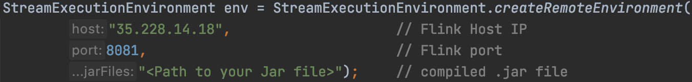
Streaming Analytics using Apache Flink
Running Flink app on remote server
Data Producer
Local
Google Cloud
Change the Execution Envirionment
Compile and run as a Java application
Kafka
Data Consumer 1
Flink
Rabbit MQ
Data Consumer 2

Slide 6


Streaming Analytics using Apache Flink
Processing in Flink
Process by Event
Stream Processing
3
2
1
6
5
4
3
2
1
BTS application:
Window size: 1 minute – Window slide 5s
Group by key: station_id
xxx : event 1 event 2
…
event n
next
4
3
2
…
process
station_id

Slide 7
Streaming Analytics using Apache Flink
Processing in Flink
BTS application:
Change the window slide to 1s
Change the window size to 5 minutes
Change the Key elements (e.g, alarm_id,…)
Change other papameters, perform futher analysis

Slide 8
Streaming Analytics using Apache Flink
Distributed Streaming Data Flow
Source
Data Stream Transformation Functions: map, flatMap, filter, keyBy, recude, … *
Transformation 1
Transformation N
Scalable components
E.g, DataStream.setParallelism(num);
Sink
* : https://ci.apache.org/projects/flink/flink-docs-stable/dev/stream/operators/

Slide 9
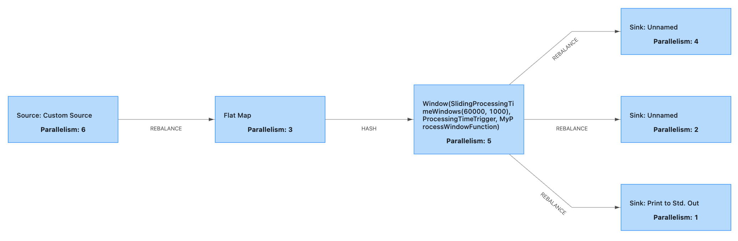
Streaming Analytics using Apache Flink
Processing in Flink
How can we deal with a huge amount of coming data?
Scaling data source component
How about other components? When they need to be scaled?

Slide 10
Contact and Further information
https://version.aalto.fi/gitlab/bigdataplatforms/cs-e4640
Apache Flink Documentation:
https://flink.apache.org/
https://ci.apache.org/projects/flink/flink-docs-stable/dev/stream/operators/

Slide 11
Thank you!
Any Question?
Notes:
Thank you and now is time for question

