Slide 1
CI328 - Internet game design and development
Game Presentation

Slide 2
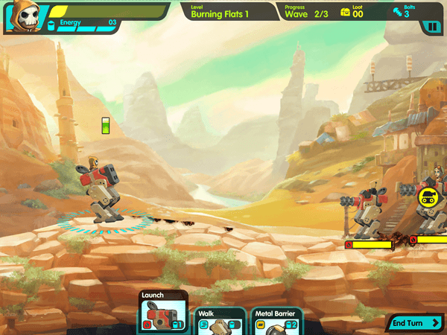
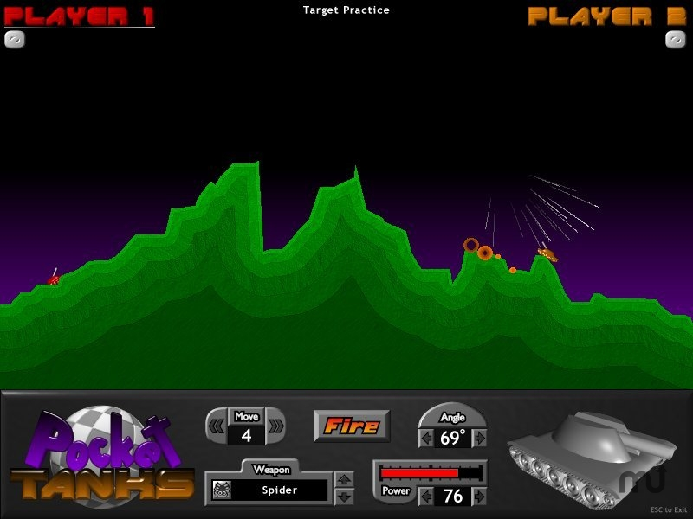
Similar Games
Tank Nation – Arcade Turned base tank vs
tank game with multiple characters.
Pocket Tanks – Use various weapons in an
arcade turn based environment to destroy
the enemy players tanks

Slide 3
Features to keep
Tank Nations
Multiple Character selection – In this game you can select from more than one driver with a different tank.
Multiple enemies incoming at a time – Each level has more than one enemy facing you at each time.
Different environments – The user should be able to choose from more than one arena/level.
Upgradeable tank (Not visually but statistically)
Both games
Arcade Physics – Projectile and tank should follow some physics laws
2D Arcade Map

Slide 4
New features
Instead of turn-based the game will be real time.
Power ups for both user and enemies for some ability boost (Homing missile, defence boost, speed boost, random crate).
Random disaster events - Such as rockets falling from the sky to damage the player.
Random environmental obstacles such as explosive barrels and mines.
Difficulty – Add more/less enemies and increase/decrease the AI accuracy

Slide 5
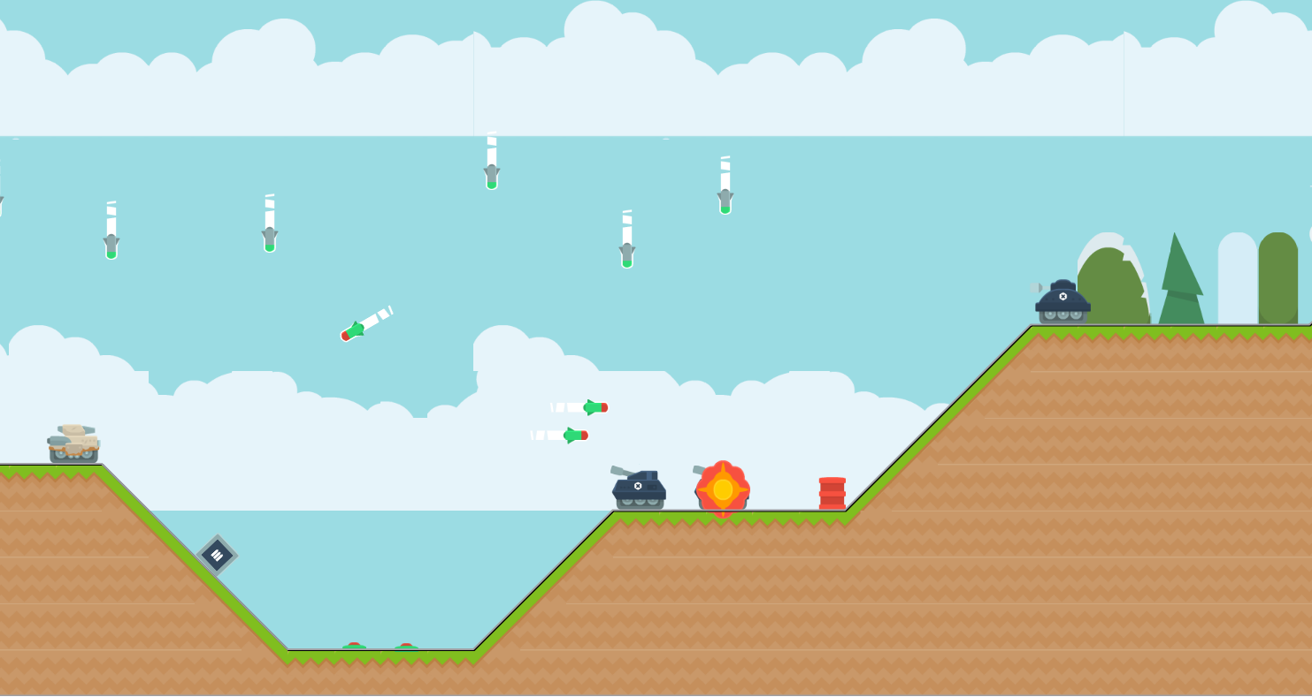
Game Preview
3
1
4
5
6
2
Notes:
1 – Player
2 – Weapon boost crate
3 – Random Disaster event missiles incoming!
4 – Enemy tank
5 – Enemy Tank being destroyed
6 – Explosive Barrel

Slide 6
Game Tech
Tiled map editor – A 2D Level editor for creating map and adding extra information used by the game.
Phaser P2 physics – It works well with Tiled as it enables you to convert Tiled objects into collision objects, this makes the tank ground movement look far more natural.

