Slide 1
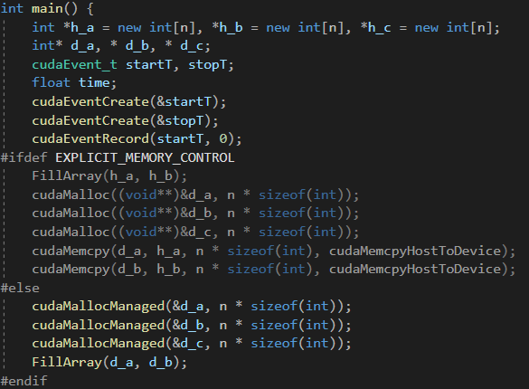
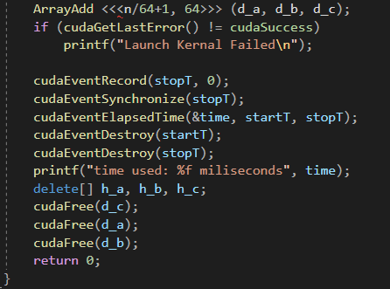
Implementation

Slide 2
Results

Slide 3
Discussion
Implicit Memory Control is extremely faster than Explicit Memory Control.
Time usage increases significantly while array length is greater than 1e5.

