Slide 1

Implementation
Store images in circular buffer on GPU (unsigned char**). The size of buffer should be equal to the width of decay function.
Iterate all frames to get the accumulated results
Pop and push one frame to buffer for each iteration.

Slide 2
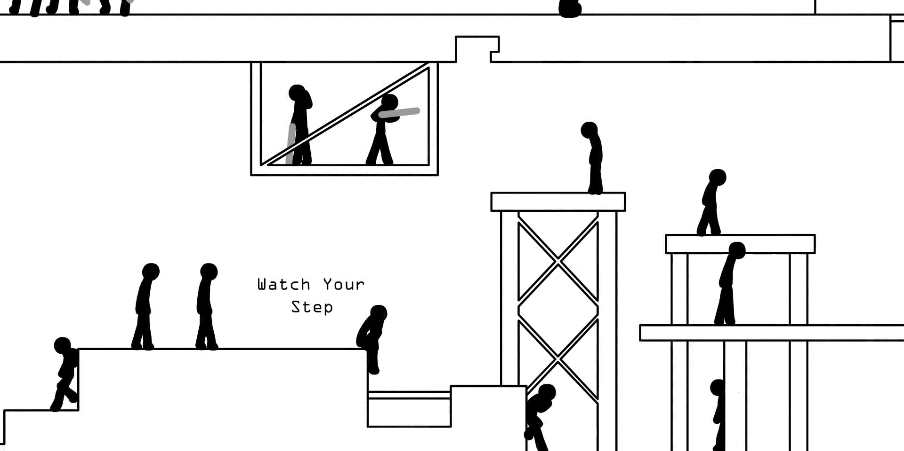
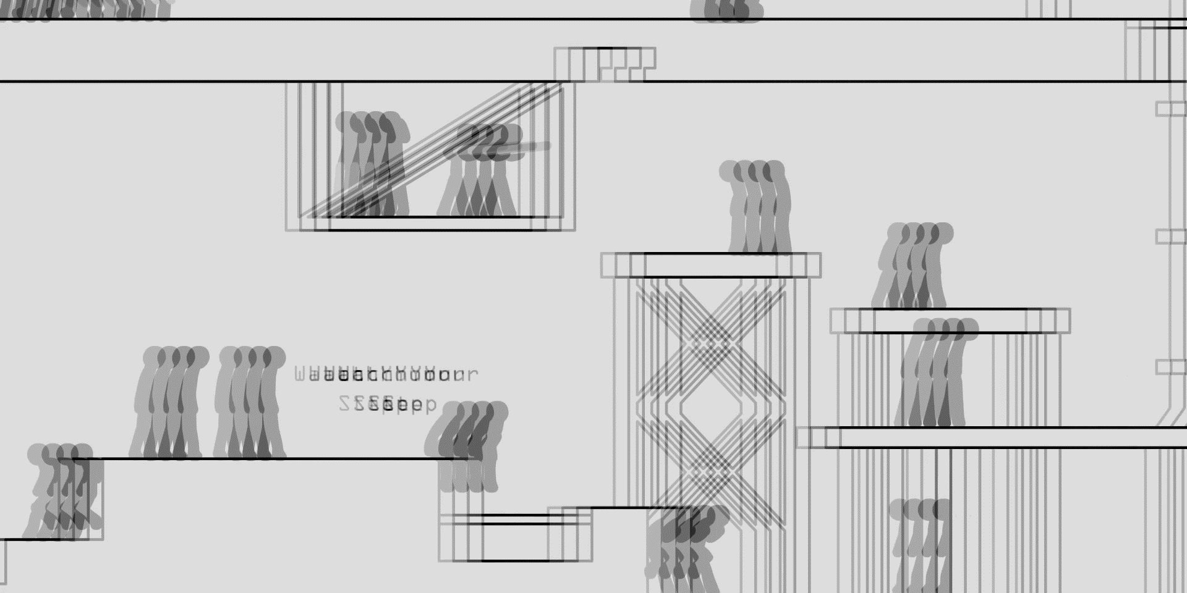
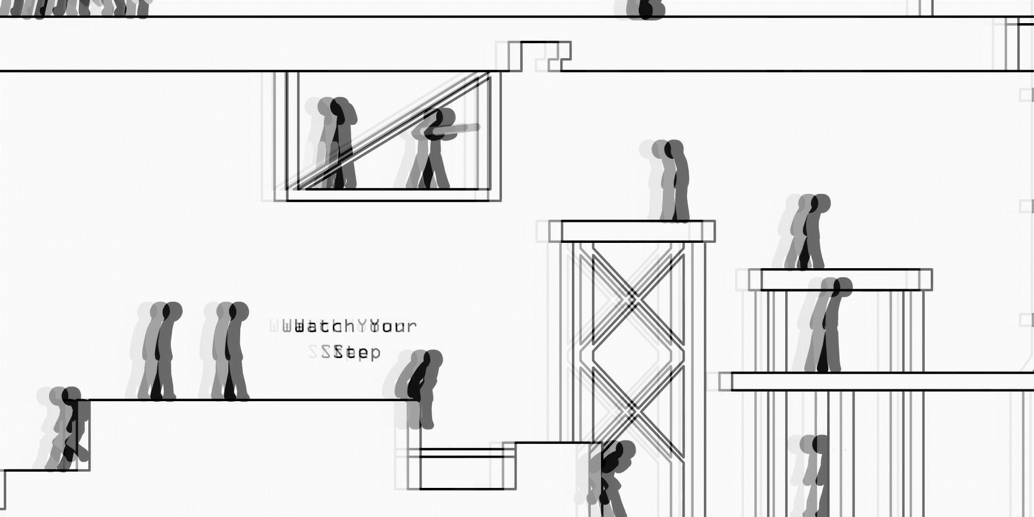
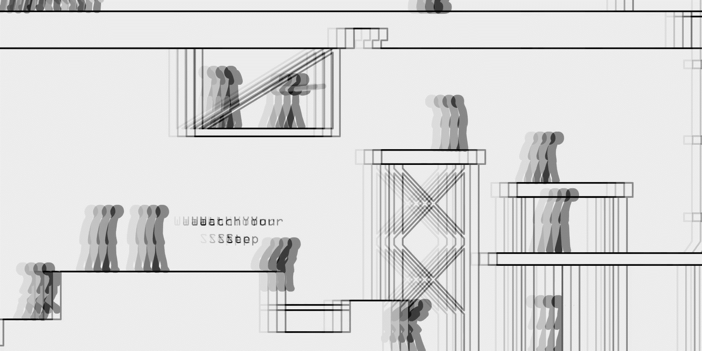
Different Decay Functions
Original
Rectangle
Gauss
Triangle

Slide 3
The bottleneck is my HDD. For example, if the window size is 4, the project processes around 6 frames per second. And each frame is around 5MB. Which means 30MB read & write per second. I tried to run this on my SDD, and it’s two times faster.

