Slide 1
Data Structure
Class: Point, Edge, Face, Cube, Surface
Input:
A string which indicate the shape of the tree.( L-system)
Float angle
Float width

Slide 2
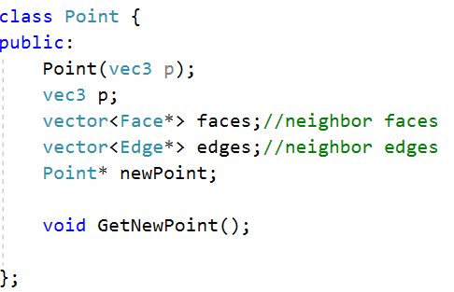
Point
A Point stores its location, and two vectors of pointers for neighbor edges and faces. And a pointer to the new point after subdivision.

Slide 3
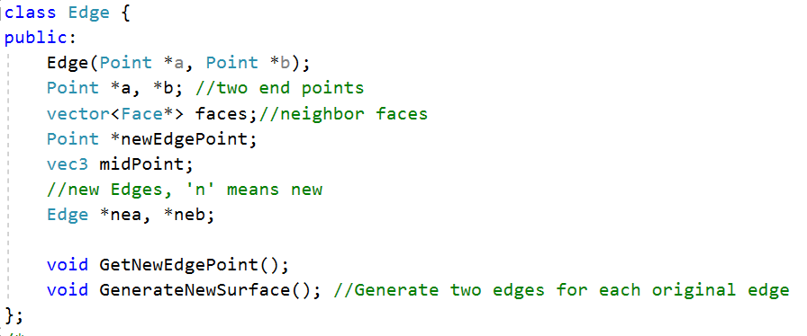
Edge
An Edge stores two pointers of its endpoints. A vector of pointers of its neighbor faces. And pointers for the new edge point and two new edges it generated after subdivision.

Slide 4
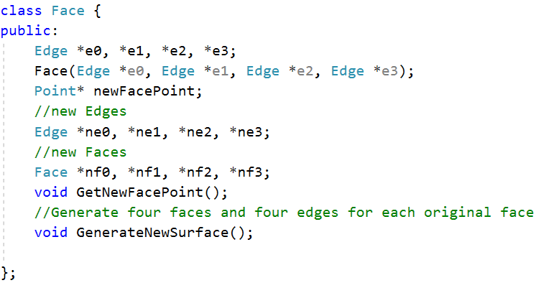
Face
Similarly, a Face contains four pointers of its four edges. And several pointers of the new face point, new edges and new faces.

Slide 5
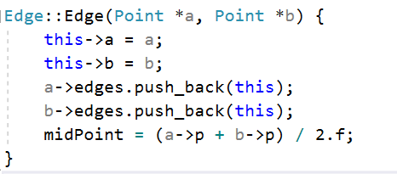
How to Get Neighbors?
In the constructor of Edge and Face, push it self to the primitives that form it. For instance:

Slide 6
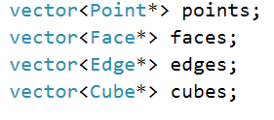
Cube & Surface
Class Cube is only used while creating the tree. It contains pointers of 12 edges, 8 points and 6 faces. It also have the function defining how to correctly connect all the cubes to for a tree.
Surface only has vectors of different kinds of pointers, which will store all the primitives in the calculation. It’s the class I used to draw the result.

Slide 7
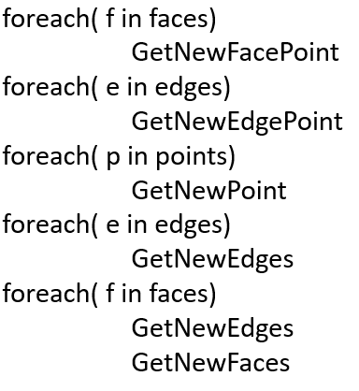
How to Subdivide?
Assuming we already have a tree formed by cubes. We can simply implement Catmull-Clark Subdivision by:
The time complexity of this method is O(n).

Slide 8
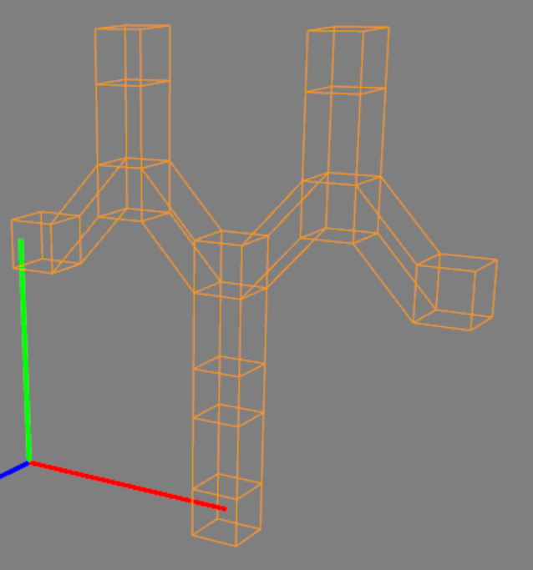
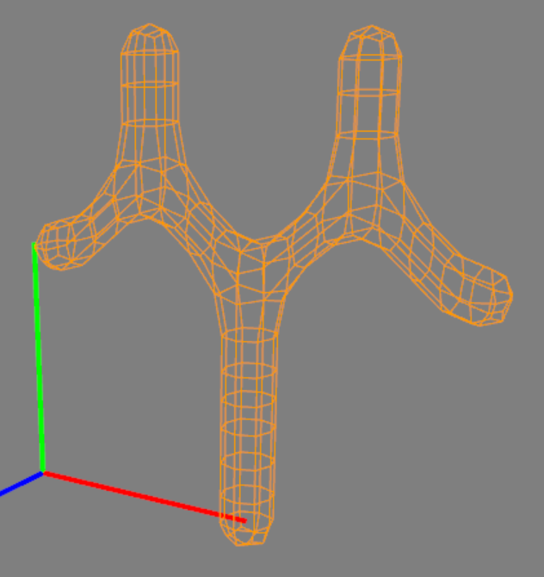
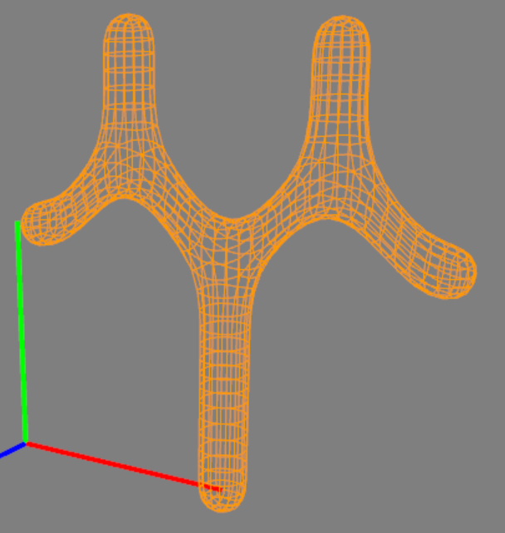
Result

Slide 9
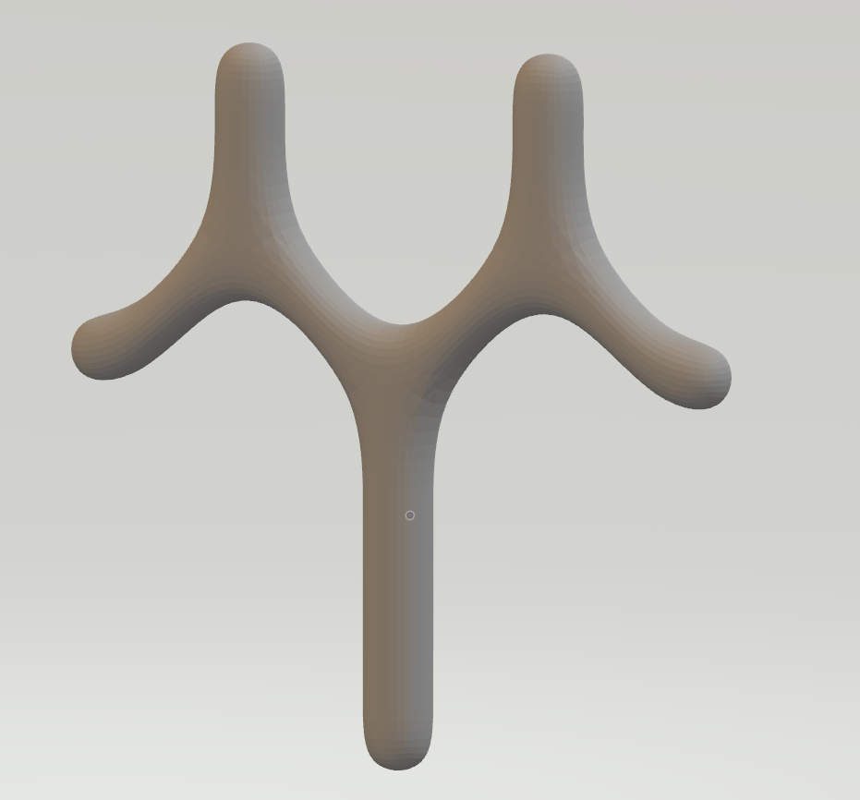
Thank you for watching!

