Slide 1
Real-time Procedural Terrain Generation
Course project of CS590 Procedural Modeling of Purdue University

Slide 2
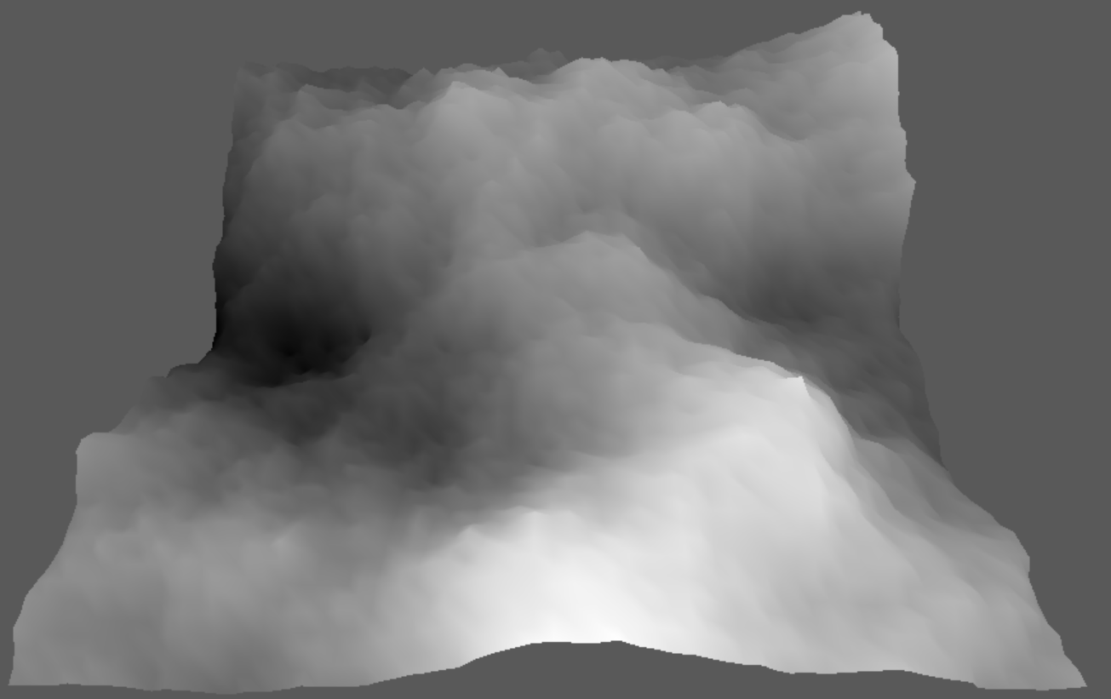
Approximation of 1/f Noise
Midpoint displacement method using diamond-square algorithm.

Slide 3
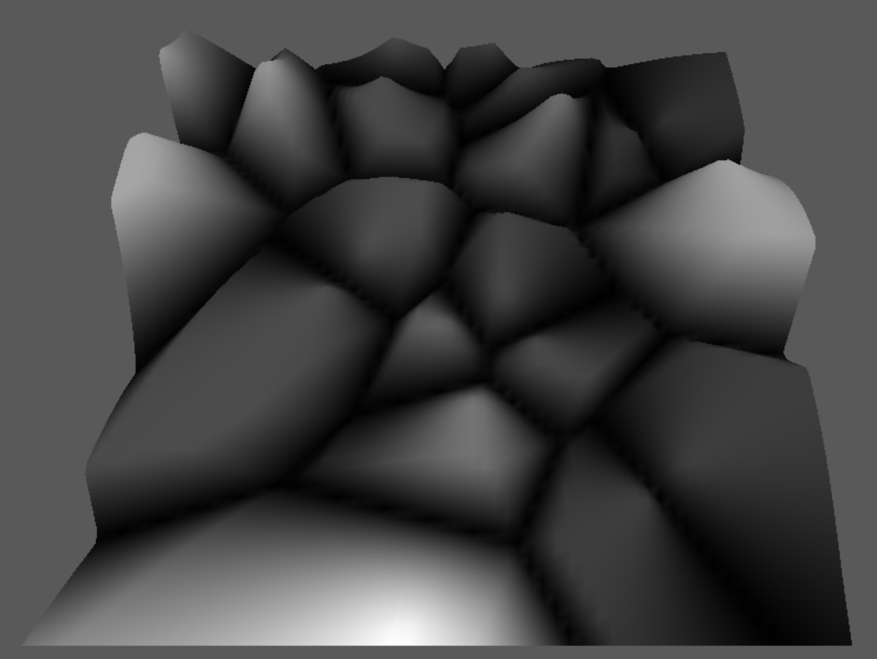

Voronoi Diagram
$h=c_{0}d_{0}+c_{1}d_{1}+c_{2}d_{2}+…+c_{n}d_{n}$, $d_{n}$ is the distance to a set of random points, starting from the closest to the farest.
Here $c_{0}=−1,c_{1}=1$

Slide 4
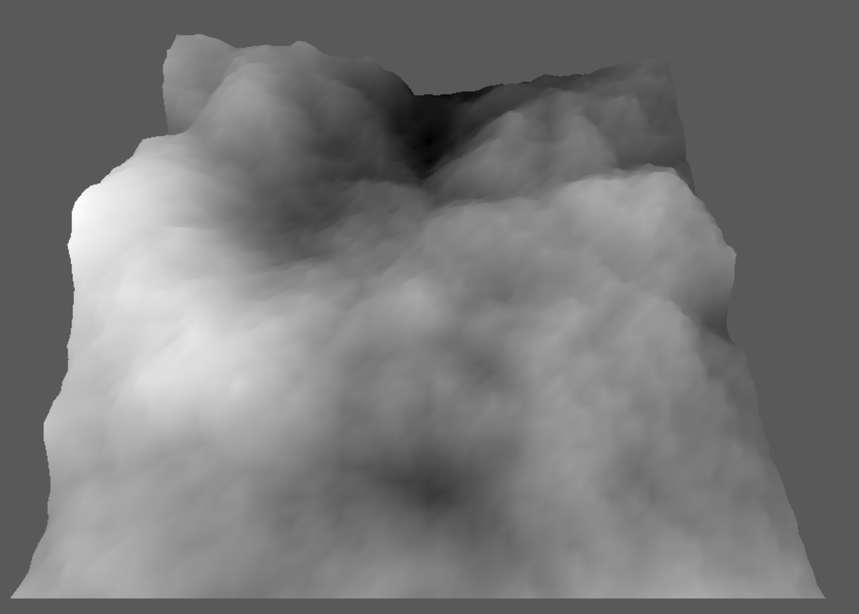
Generation of Base Terrain
Combination of 1/f noise and Voronoi diagram with a ratio of 2/3.

Slide 5
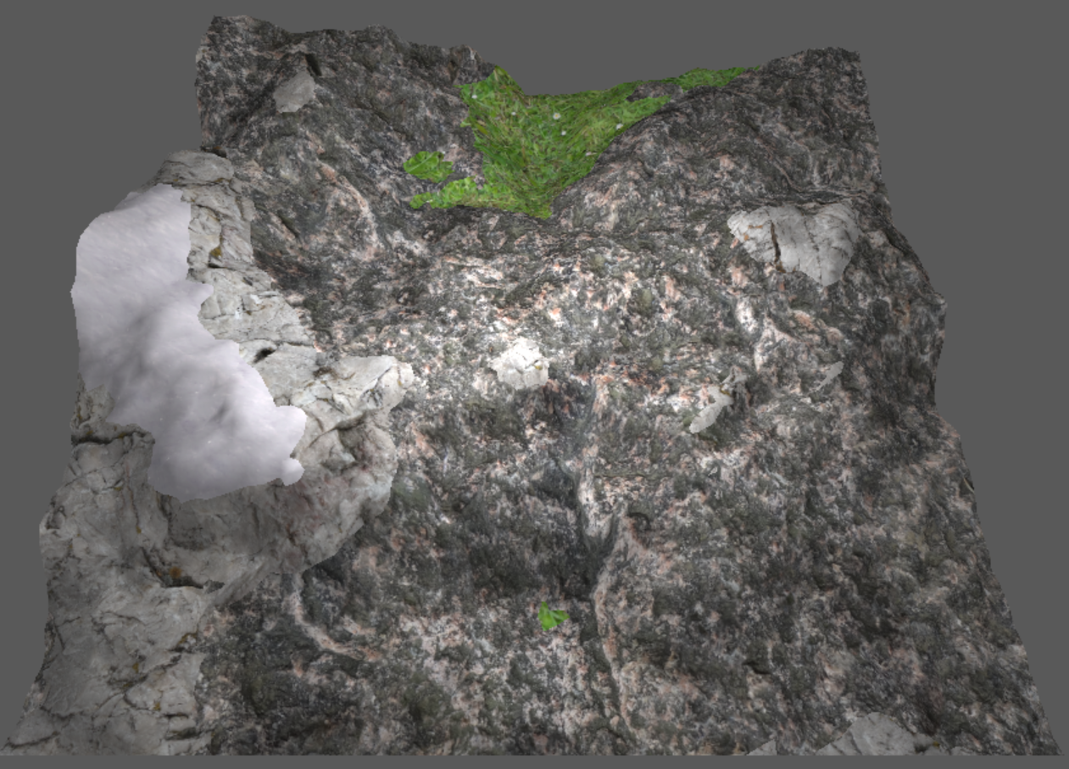
Texture Mapping

