Slide 1
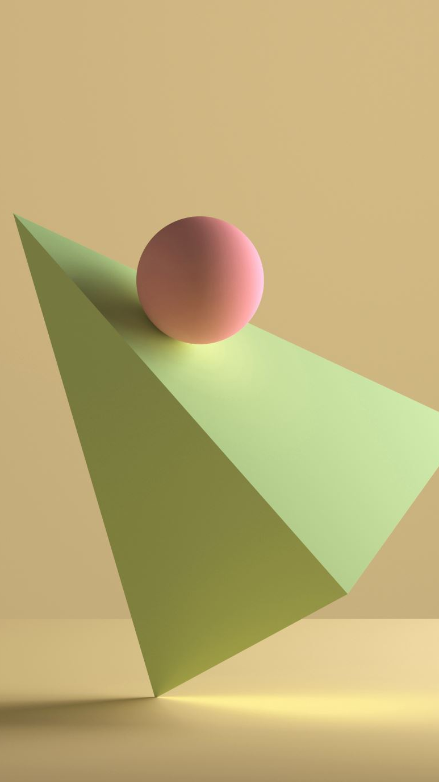
Check Point 1
Voxelization
Yucong Pan
Pan311@purdue.edu

Slide 2
Definition
Voxelization is the process of constructing voxels from mesh or volumetric data.
It’s basically 3D rasterization of triangle.
Conservative Surface Voxelization.
Triangle-AABB collision test is the key point.
Be careful of writing collision.

Slide 3
Triangle Per Thread VS Voxel Per Thread
Triangle Per Thread:
Time Complexity: Triangle Num * Voxels Per Triangle (could be very few)
Need lots of Atomic Operations (theoretically)
Voxel Per Thread:
Time Complexity: Triangle Num * Voxels Num
No Atomic operations

Slide 4
Triangle-AABB Collision Test
Test whether triangle’s plane overlaps AABB
If returns true
For each axis, test whether the projection of triangle and AABB overlaps.
If overlaps
3. Run AABB-AABB intersection test between triangle and AABB.
However, 3 is not necessary because we are testing voxels inside each triangle’s bounding box.

Slide 5

Atomic Operation
We need to compute the average color and normal if multiple writes are performing on the same voxel. However, since our voxels only has 6 bytes to store color and normal. We need to first fetch the data, compute the average, and then write. We’ll also need a counter n that occupies 1 byte in voxel.
$$new=\frac{old∗n+new}{n+1}$$
This is actually very difficult to conduct using atomic operation. I was planning to use 1 bit in voxel combining the atomicOr operation to avoid writing collisions. But my program got stuck.

Slide 6
Some ConClusions
Mesh | Triangle Count | AABB Size | Time (ms)
Cube | 12 | 3.4641 | 2270
Sphere | 320 | 3.24 | 393
Bunny | 4968 | 2.178 | 24
Bunny_High | 69451 | 1.443 | 4
Dragon | 871414 | 2.05 | 7
Because dot product is distributive, we can precompute data that could be used in triangle-AABB test. Potentially saves time of lots of dot and cross product. Instead data size per triangle increases from 12 bytes to 136 bytes.
Atomic operation will easily ruin this efficiency if is not done properly. In fact I don’t think we need it unless the mesh has sharp edges.
Voxelization’s time complexity is largely determined by how large each triangle is rather than triangle count.

Slide 7
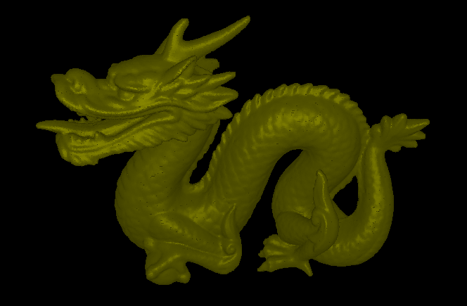
Result
Average Time used : 7 ms, Triangles: 870K, Voxels: ${512}^{3}$
Ray marching FPS : around 12

