Slide 1
Title

Slide 2
Aims
Analyse effects of putting absorbers on different floors and tuning to different modes.
Generally tuning absorbers to optimise them
Create code to automatically tune absorber given measureable characteristics of structure

Slide 3
Definition of terms
Absorber – the extra mass, spring, damper to reduce the max amplitude response of the system
Floor damping – the equivalent damping of the structure in the current situation.

Slide 4
Plan (same as method?)
Start from code to model 3dof system without damping from Moodle
Find modeshapes
Find equivalent masses
Find equivalent spring constants
Model the system as 2dof with the absorber and a given floor damping

Slide 5
Method
Calculate modeshapes
Calculate equivalent masses & stiffnesses
Analyse frequency response for range of absorber damping via solving for 2dof system (2d matrix with complex numbers)
Find the maximum peak at each absorber damping and plot graph
Repeat this for different values of the floor damping
Find the optimum absorber damping level
Find the reduction in maximum amplitude (efficiency of absorber)
Trial for each floor/mode

Slide 6
Assumptions / Modelling Approximations
Tested for a range of floor lambdas but over a small range of these values (0-10) the change in optimum absorber damping is small (~5%)
Assume that lambda is small
Modelling the frequency input as a single frequency
Assume perfect system
Assume masses and stiffnesses are identical between floors (could be implemented to allow differences though)
Modelling the maximum response as that of the maximum response for any frequency and ignoring number/width of those peaks

Slide 7
Notes about code
Neat
Easy to change variables – e.g the mass of each floor or stiffness etc.
Automates finding optimum values
Modular files – only need to re-run relevant code when changing variables.

Slide 8
Findings

Slide 9
Graphs for floor 1:
Varying absorber mass from 0.05kg to 0.2kg

Slide 10
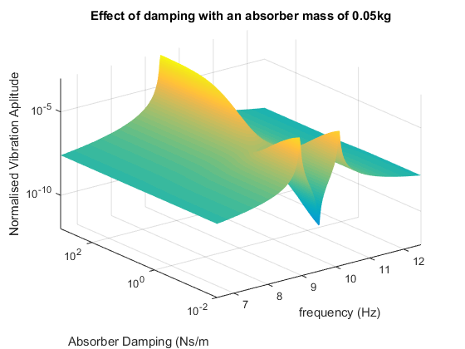

Slide 11
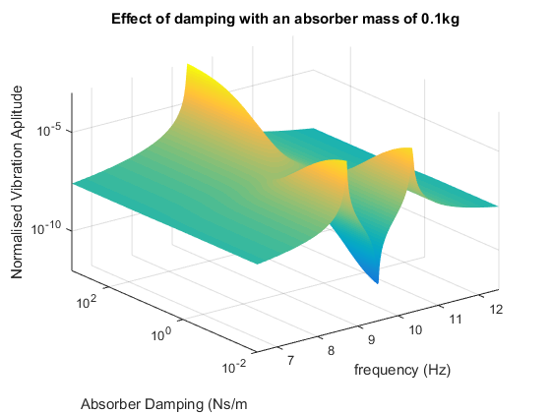

Slide 12
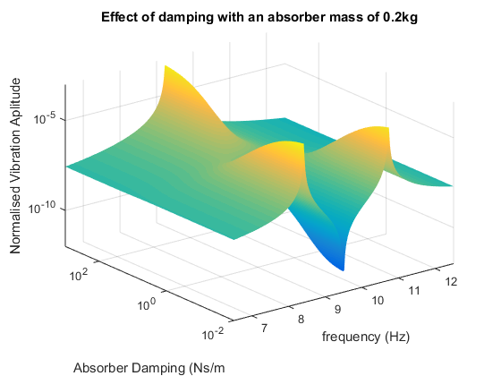

Slide 13
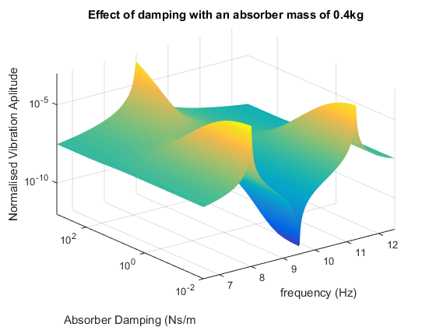

Slide 14
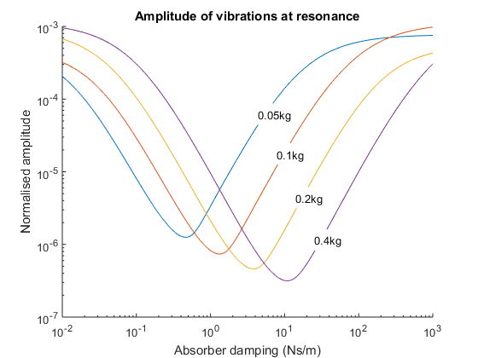

Slide 15
Graphs for floor 1:
Varying damping of building from 0 to 4Nms⁻¹

Slide 16
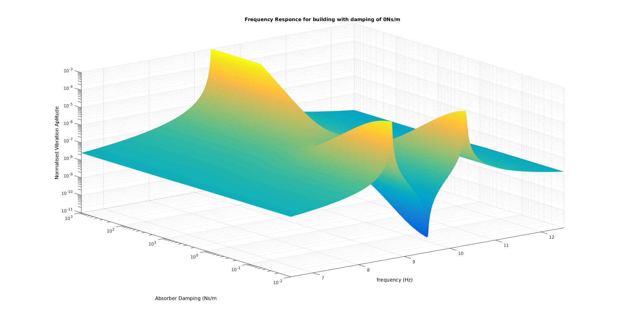

Slide 17
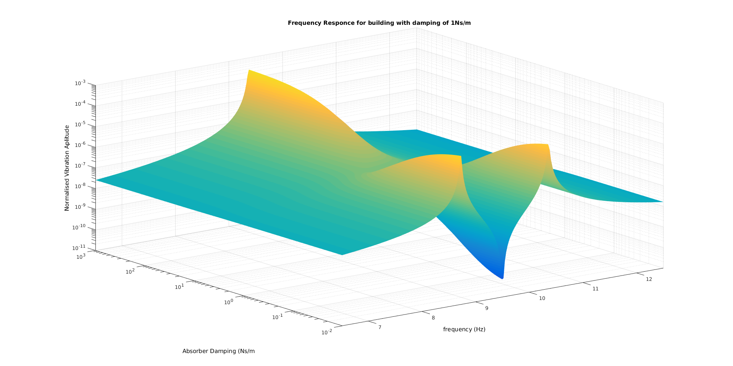

Slide 18
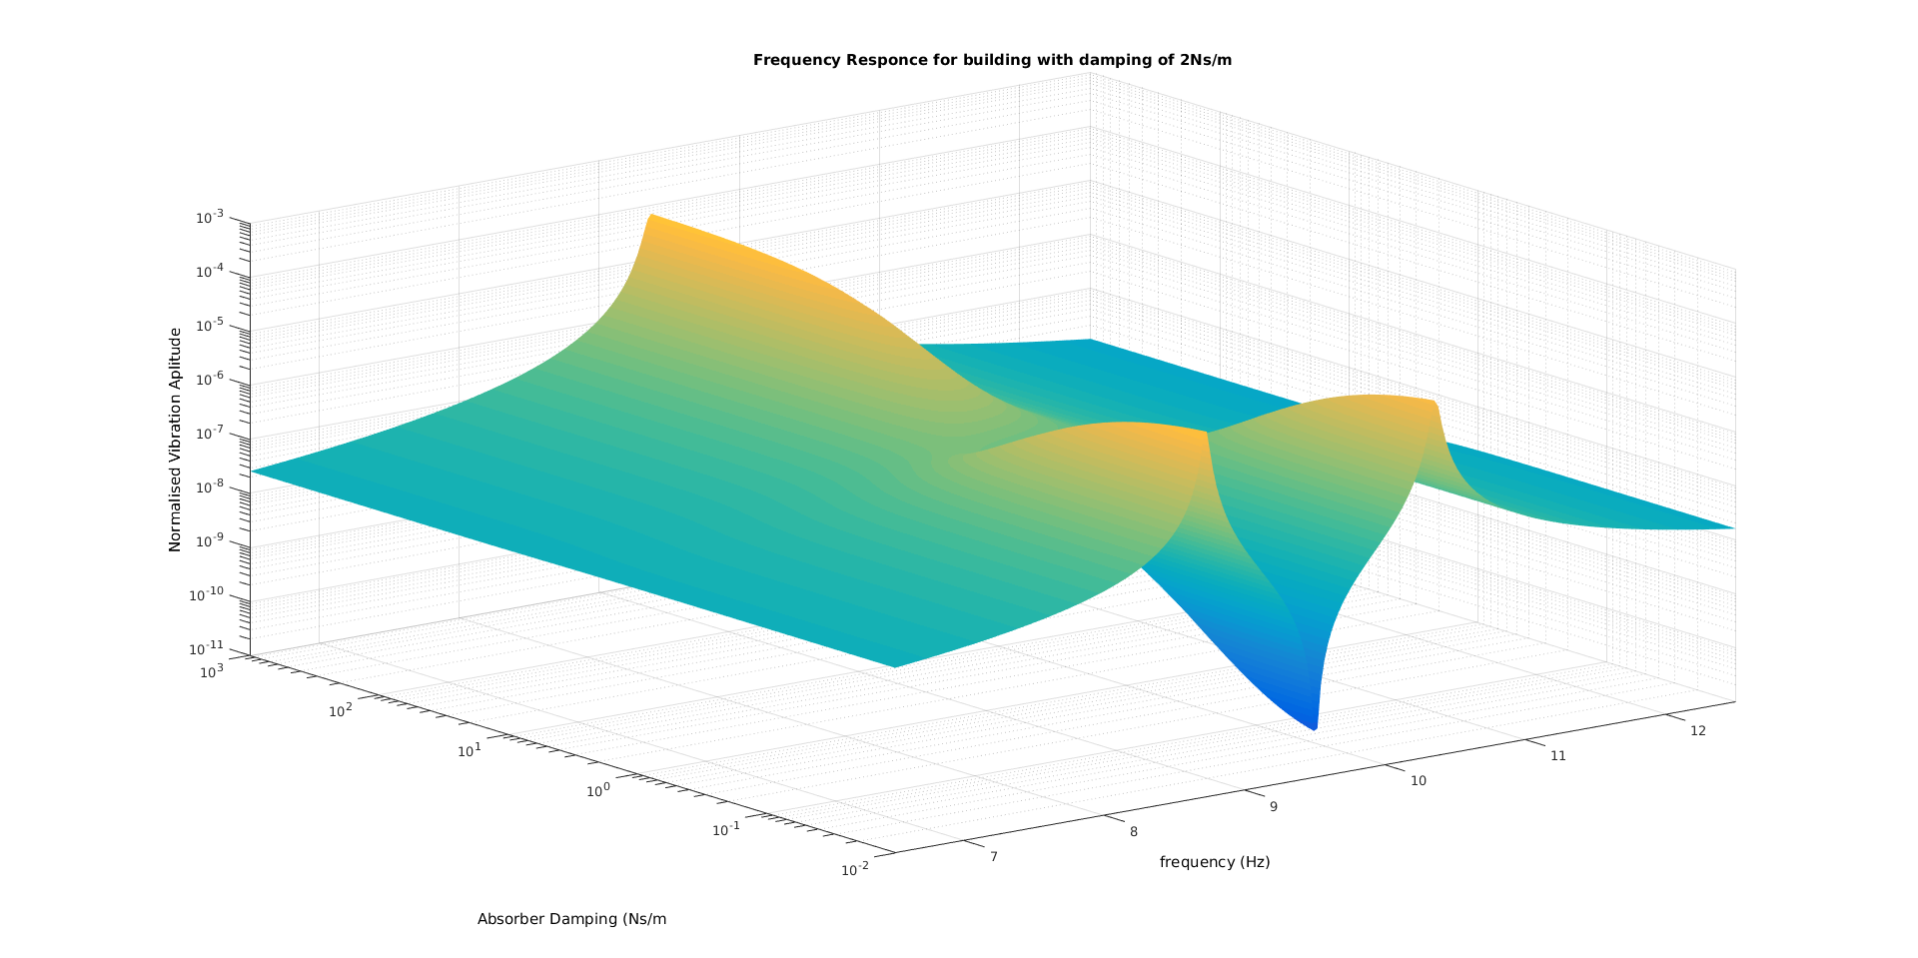

Slide 19
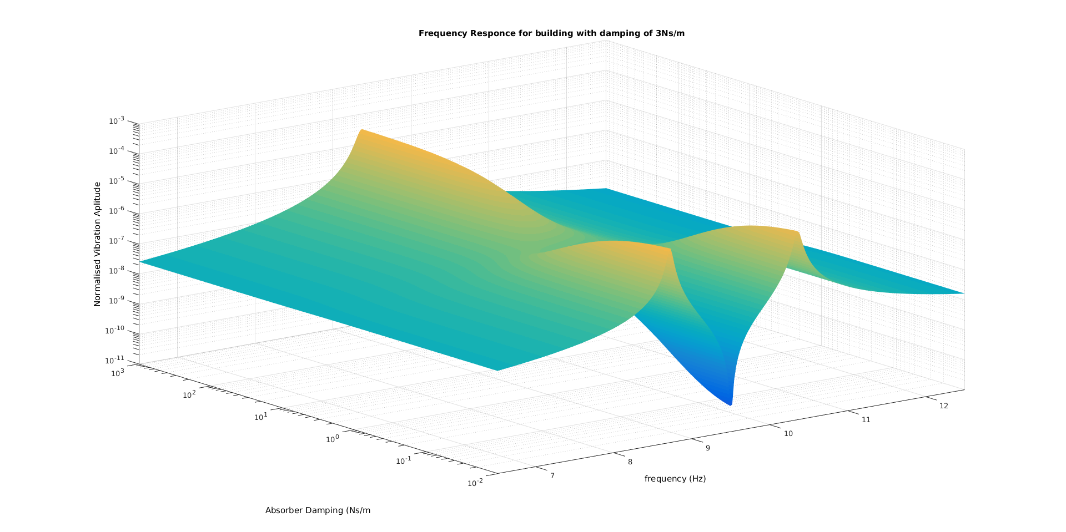

Slide 20
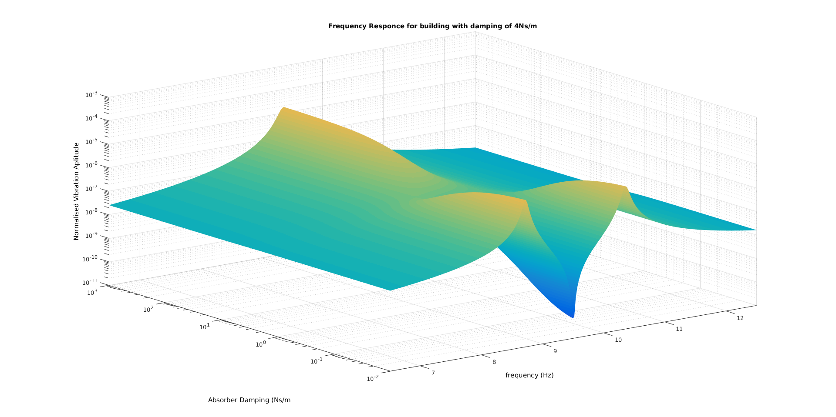

Slide 21
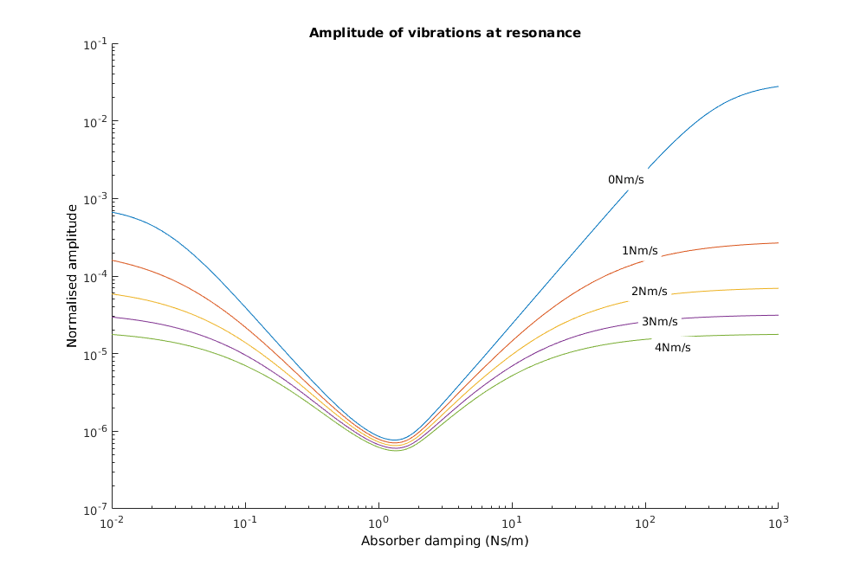

Slide 22
Note for absorber of mass = 0.4 this is becoming quite close to the equivalent mass of building (3.3kg) so the results produced may not be reliable as mass of absorber will have substantial affect on building

Slide 23
Variation in the amplitude of the vibration of different floors.

Slide 24
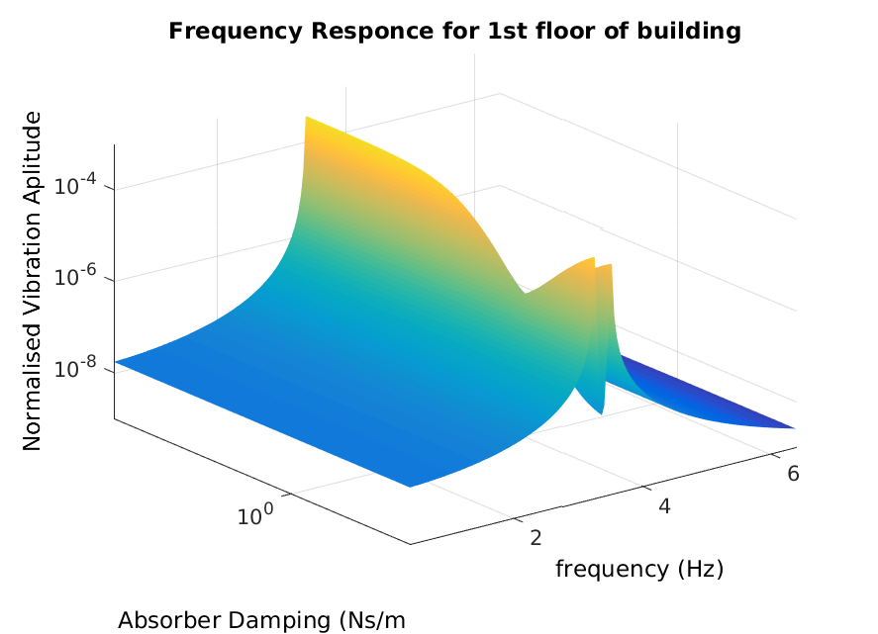

Slide 25
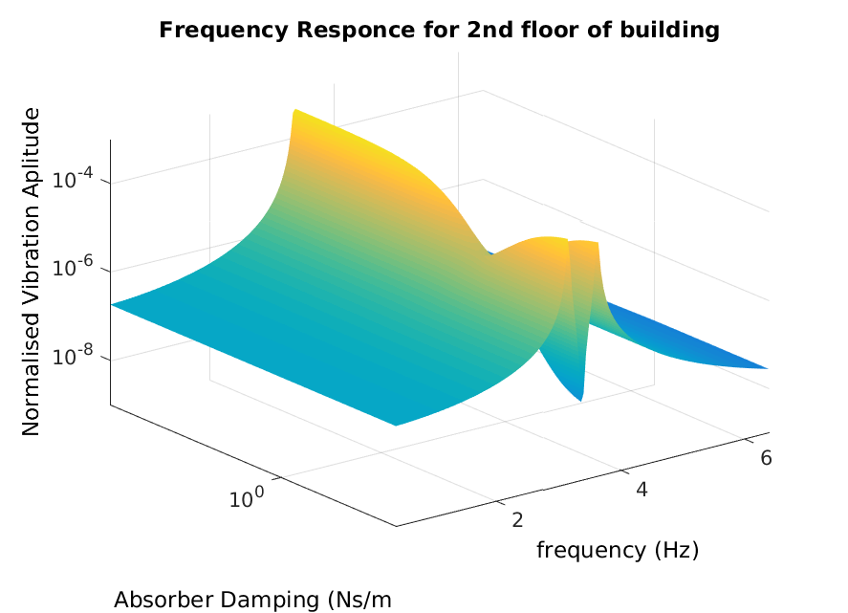

Slide 26
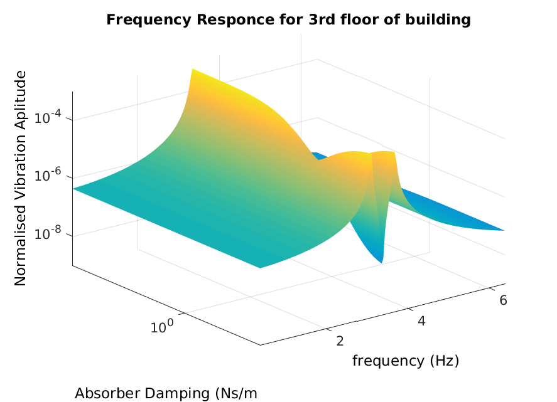

Slide 27
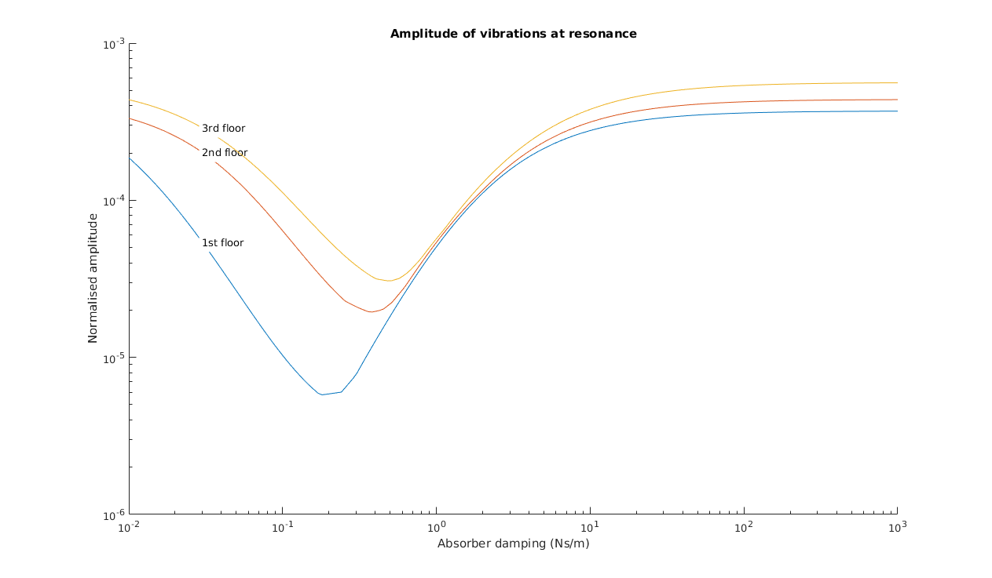

Slide 28
Conclusions

Slide 29
Further Developments
Check the impulse response for different floors/modes
Compare the efficiencies of putting absorber at different floors
Mass of absorber
Model unsimplified system – check the effects of having multiple absorbers
Numerical integration on system – 6 dof
Check relative amplitudes of peaks, are reduced peaks still greater than unreduced peaks of other modes/frequencies
Compare responses to range of frequencies – rather than having ‘impulse’ of single frequency, try step of all frequencies or some curve around natural frequency.
Given actual values of floor lambda for each floor and mode, put these in to give actual optimum values for the actual structure.

Slide 30






Equations

Slide 31
Tabulated Results
results
 | Mode 1 | Mode 2 | Mode 3
ω_{n} (Hz) | 3.3933 | 9.5078 | 13.7391
A₁ | -0.2425 | 0.5448 | -0.4369
A₂ | -0.4369 | 0.2425 | 0.5448
A₃ | -0.5448 | -0.4369 | -0.2425
m₁’ | 17.01 | 3.37 | 5.24
m₂’ | 5.24 | 17.01 | 3.37
m₃’ | 3.37 | 5.24 | 17.01
Optimum Damper | Mode 1 | Mode 2 | Mode 3
Floor 1 | 0.2009 | 1.341/1.394
Floor 2 | 0.3765 | 0.5705/0.5873 | 1.899/1.974
Floor 3 | 0.4642 |  | 0.8437

Slide 32
Interesting things noted
Equivalent mass matrix is symmetric about major diagonal (with top floor, first mode in top left)
Results of plotting 3d graph of frequency, absorber damping and amplitude not clear, plotting on log scales gives much clearer results and obvious saddle point, this is what we are aiming for with the optimum damper.

Slide 33
Sanity Checks
After modelling approximations, checked that the response with:
Absorber damping of 0 = two split peaks about resonant frequency
Absorber damping high = small dm to system so slight change in resonant frequency but single peak (effectively 1dof system)
Plot graph of maximum amplitude for each absorber damping to check expected result.

